Slide 1
Accountability Indicator Training: Graduation Rate
Christen Roseberry
Program Consultant
Office of Assessment and Accountability
Notes:
Hello and welcome to our accountability indicator training. I am Christen Roseberry, a program consultant in the Office of Assessment and Accountability.

Slide 2
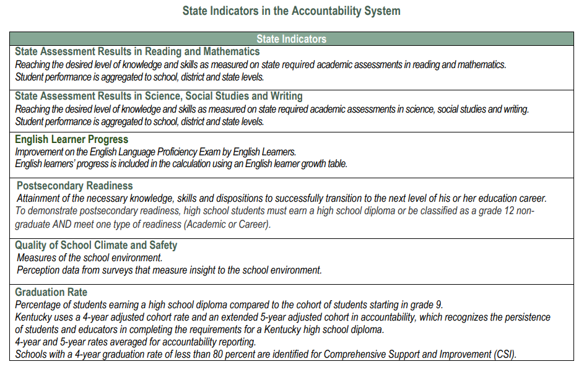
State Indicators in the Accountability System
Notes:
There are six indicators comprised in Kentucky’s Accountability System. These indicators are State Assessment Results in Reading and Mathematics, State Assessment Results in Science, Social Studies, and Writing, English Learner Progress, Postsecondary Readiness, Quality of School Climate and Safety, and Graduation Rate. In this session, we are going to focus on the Graduation Rate Indicator.

Slide 3
Agenda
Status
Accountability Weights
Accountability Calculations
Change
Change Score Calculations
Indicator Performance Ratings
Overall Score
Notes:
In this training I will provide you with an overview of the status component of the graduation rate indicator, including accountability weights and calculations. Then we will discuss information about the Change component, including change score calculations, indicator performance ratings, and overall score.

Slide 4
Status Scores
The Status Score represents the current year outcome for a given indicator.
Indicator | State Assessment Results in Reading and Mathematics | State Assessment Results in Science, Social Studies, and Writing | English Learner Progress | Quality of School Climate and Safety | Postsecondary Readiness (HS only) | Graduation Rate (HS only)
Metric | Weighted performance index based on student assessment performance levels | Weighted performance index based on student assessment performance levels | Points assigned based on student-level growth as measured by a value table | Average of student scores for applicable questions in the QSCS survey | Percent of 12th grade students demonstrating academic or career readiness | Average 4- and 5-year graduation rates
Notes:
Status is defined as current year performance on the metrics used for that indicator.
Later in this training, I will demonstrate how to configure the status for the Graduation Rate Indicator.

Slide 5
Key Points
The Graduation Rate Indicator Scores measures the percentage of students who enter high school and receive a diploma based on their adjusted cohort in 4 or 5 years.
Alternate Diploma students and students who do not graduate count against your graduation rate (both 4 and 5 year).
Schools below 80% on the 4 - year graduation rate will be identified as a Comprehensive Support and Improvement (CSI II). The next identification is in 2025.
Notes:
A few key points to begin the discussion about graduation rate. Graduation rate measures the percentage of students who enter high school and receive a diploma based on their adjusted cohort in four or five years. We will further discuss this in a moment, along with the definitions of each.
Federal regulations state that alternate diploma students and students who do not graduate count against your graduation rate and that goes for both four and five-year graduation rates.
Schools below 80 percent on the four-year graduation rate will be identified as comprehensive support and improvement schools and will be tagged for CSI II per federal regulations. The next year for identification is 2025.

Slide 6
Four Year Adjusted Cohort Graduation Rate Definition
The number of students who graduate in four years with a regular high school diploma divided by the number of students who entered high school four years earlier adjusting for transfers in and out, emigres and deceased students.
Notes:
A four-year adjusted cohort is the number of students who graduate in four years with a regular high school diploma divided by the number of students who entered high school four years earlier adjusting for transfers in and out, emigres, and deceased students.

Slide 7
Five Year Adjusted Cohort Graduation Rate Definition
The number of students who graduate in five years with a regular high school diploma divided by the number of students who entered high school five years earlier adjusting for transfers in and out, emigres and deceased students.
Notes:
A five-year adjusted cohort graduation rate is the number of students who graduate in five years with a regular high school diploma divided by the number of students who entered high school five years earlier adjusting once again for transfers in and out, emigres, and deceased students.

Slide 8
Four Year Adjusted Cohort Graduation Rate Calculation Formula
Number of cohort members who earned a regular high school diploma by the end of the current school year
----------------------------Divided By-----------------------------
Number of first-time 9th graders in the fall 3 years earlier (starting cohort) plus students who transferred in, minus students who transfer out, emigrate or have passed away during the past four years
Notes:
The four-year adjusted cohort graduation rate calculation formula is the number of cohort members who earn a regular high school diploma by the end of the current school year divided by the number of the first-time ninth graders in the fall three years earlier who started that cohort plus students who transferred in, minus students who transferred out, emigres, or have passed away during those last four years.
The five-year adjusted cohort graduation rate is calculated in the same way, the only change is you are dividing by the number of students from 4 years earlier.

Slide 9
Graduation Code (G-Code) Entry Dates
Regular graduates must have a completed Graduation Tab and a Graduation Code (G-code) entered in Infinite Campus (IC) by June 30.
Summer graduates must have a completed Graduation Tab and a G-code entered in IC by July 31.
Graduation Rate data will be pulled from Infinite Campus and used to determine four and five-year cohort data.
Notes:
A graduation code, also referred to as a G-code, has a couple different entry dates.
Regular graduates must have a completed graduation tab and a G-code entered in Infinite Campus by June 30th.
Summer graduates must have a completed graduation tab and a G-code entered in Infinite Campus by July 31st.
Graduation Rate data will be pulled from Infinite Campus and used to determine the four and five year cohort data.

Slide 10
Removal from Cohort
If the last enrollment end status is a
W20 (withdrawal to homeschool)
W21 (withdrawal to private school)
W29 (out of state school)
W07 (withdrawal due to medical issues)
W08 (deceased)
Then the student is removed from both the numerator and denominator parts of the Adjusted Cohort Graduation Rate formula. This student does not count positively or negatively for the school.
Notes:
Now we will talk about the removal from the cohort because that does happen from time to time. If the last enrollment status for a student is any of these; the W-20 which is withdrawal to homeschool, W-21 which is the withdrawal to private school, W-29 which is the withdrawal out of state, W-07 which is withdrawal due to medical reasons, or W-08 which is the student is deceased, the student is then removed form both the top and the bottom parts of the adjusted cohort graduation rate formula. This student does not count positively or negatively for the school.

Slide 11
Accountability
Based on last primary enrollment in both regular or virtual school
Accountability begins immediately upon enrollment (No 100 Day rule with Cohort)
KECSAC (Kentucky Educational Collaborative for State Agency Children) students will be accountable to state if valid during last primary enrollment
Graduation Rate for the 4-year and 5-year Adjusted Cohort will be averaged for the Graduation Rate Indicator Score
Public reporting will apply these rules to district and state reporting
Graduation Rate Indicator is 6% of overall score (High Schools Only)
Note: Schools with less than 80% graduation rate for Title I or non-Title I high schools based on 4- year cohort will be classified as CSI II (in years of identification) per federal guidelines.
Notes:
Now we will talk about how this all fits into accountability, basically it is based on the last primary enrollment in both regular or virtual school. Accountability begins immediately upon enrollment so there is no 100 day rule with cohort.
Kentucky Educational Collaborative for State Agency Children students will be accountable to the state if valid during last primary enrollment.
The graduation rate for the four-year and five-year adjusted cohort will be averaged for the graduation rate indicator.
Public reporting will apply these rules to district and state reporting and if you are a high school, graduation rate is 6 percent of your overall score.
Please note, schools will less than 80% graduation rate for Title I or non-Title I high schools based on 4-year cohort will be classified as CSI II in years of identification per federal guidelines.

Slide 12
Status Score
4-year adjusted cohort + 5-year adjusted cohort /
2 = Status Graduation Rate
(rounded to 1 decimal place)
4-year Adjusted Cohort
5-year Adjusted Cohort
Status Graduation Rate
Notes:
Here is an example of how we find the status score for graduation rate, it is the 4-year adjusted cohort plus the 5-year adjusted cohort divided by 2.

Slide 13
Status Levels
There are five Status Levels.
Status | Very Low | Low | Medium | High | Very High
Notes:
There are five status level ranging from very low to very high for the current year.

Slide 14
Change Score
Change Scores are a simple subtraction of Prior Year Status Scores from Current Year Status Scores.
They are calculated the same way for every Indicator.
Current Year Status Score – Prior Year Status Score = Change Score
Prior Year Scores are used to calculate Change Scores. They are not used to influence Indicator Performance Ratings.
Current Status Score
Prior Status Score
Change Score
Notes:
Read slide

Slide 15
Change Levels
There are five Change Levels:
Change | Declined Significantly | Declined | Maintained | Increased | Increased Significantly
Notes:
There are five change levels ranging from declined significantly to increased significantly.

Slide 16
Change Score Example
Current Year Status Score
Prior Year Status Score
Change Score
98 – 97 = 1
Notes:
Here is an example of how we find the change score, current year status of 98 subtract prior year status of 97 which gives a change score of 1.

Slide 17
Indicator Score
Indicator Scores are a simple combination of Status Scores and Change Scores.
They are calculated the same way for every Indicator.
Current Year Status Score + Change Score = Indicator Score
Indicator Scores are used to calculate Overall Scores. They do not influence Indicator Performance Ratings.
Current Year Status Score
Change Score
Indicator Score
Notes:
Read slide

Slide 18
Indicator Score Example: Graduation Rate
Current Year Status Score
Change Score
Indicator Score
98 + 1 = 99
Notes:
Here is an example of how we calculate the indicator score: current year status of 98 plus our change score of 1 equals our indicator score of 99.

Slide 19
Indicator Performance Ratings
Table: Indicator Performance Ratings based on combined Change and Status Levels*
 | Change Declined Significantly | Change Declined | Change Maintained | Change Increased | Change Increased Significantly
Very High Status in current year | Yellow | Green | Blue | Blue | Blue
High Status in current year | Yellow | Yellow | Green | Green | Blue
Medium Status in current year | Orange | Orange | Yellow | Green | Green
Low Status in current year | Red | Orange | Orange | Yellow | Yellow
Very Low Status in current year | Red | Red | Red | Orange | Yellow
Notes:
The table demonstrates how status and change are combined to get your indicator performance rating. On the left side is your status in the current year, with levels of very low to very high. Across the top of the table is change, with levels of declined significantly to increased significantly. Where your status and change intersect on the table will be your indicator performance rating.

Slide 20
Overall Accountability Weights
 | State Assessment Results - Reading and Math | Other State Assessment Results -Science (SC), Social Studies (SS) and Combined Writing (CW) | English Learner Progress | Quality of School Climate and Safety (QSCS) | Postsecondary Readiness | Graduation Rate
Elementary | 51 | 40 | 5 | 4
Middle | 46 | 45 | 5 | 4
High | 45 | 20 | 5 | 4 | 20 | 6
If any indicator is not available, weights will be redistributed proportionally to remaining indicators.
20
Notes:
This table shows the overall accountability weights set by the Kentucky Board of Education. Once indicator scores have been determined, this table will help us in determining overall score.

Slide 21
Overall Score – High School
State Assessment Results in Reading and Mathematics Indicator Score * .45
State Assessment Results in Sc, SS and Writing Indicator Score * .20
English Learner Progress Indicator Score *.05
QSCS Indicator Score
*.04
Postsecondary Readiness Indicator Score
*.20
Graduation Indicator Score *.06
Overall Score
Overall Scores represent the combined outcomes across all applicable Indicators, with appropriate weights applied.
High School Overall Score Calculation
Notes:
This slide is an example of how the overall score for a high school is calculated using the weights we saw on the previous slide. Overall scores represent the combined outcomes across all applicable indicators, with appropriate weights applied.

Slide 22
Overall Performance Rating
An overall performance score combines performance on the exclusive state indicators for elementary, middle and high schools.
The ratings will be reported using a color rating system to communicate performance of schools, with Red being the lowest rating and Blue being the highest rating.
Blue
Green
Yellow
Orange
Red
22
Notes:
Read slide

Slide 23
Resources
Cohort FAQs
Cohort Help
SDRR Help Button
Notes:
On this slide you will see some resources that are available to you.

Slide 24
State Accountability Trainings
Accountability Overview
State Assessment Results for Reading and Math/State Assessment Results for Science, Social Studies, and Writing
Quality of School Climate and Safety
Progress on English Language Proficiency
Postsecondary Readiness
Graduation Rate
Notes:
This concludes our training on Graduation Rate Indicator. Additional trainings are available for Kentucky’s Accountability System including the remainder of the indicators. Please visit each training to learn more about Kentucky’s Accountability System.

Slide 25
Division of Assessment and Accountability Support
Christen Roseberry, Program Consultant
christen.roseberry@education.ky.gov
OAA/DAAS (502) 564-4394 dacinfo@education.ky.gov
Notes:
If you have further questions, please contact us in the Division of Assessment and Accountability at dacinfo@education.ky.gov or call us at 502-564-4394. Thank you for joining me today.

Slide 26
Final Slide

