Slide 1
Accountability Indicator Training: State Assessment Results in Reading and Mathematics State Assessment Results in Science, Social Studies and Writing
Lisa Jett and Melissa Chandler
Program Consultants
Office of Assessment and Accountability
Notes:
Welcome to the Accountability Indicator Training for State Assessment Results in Reading and Mathematics and the State Assessment Results in Science, Social Studies, and Writing. This is one in a series of trainings for the Kentucky Accountability System.

Slide 2
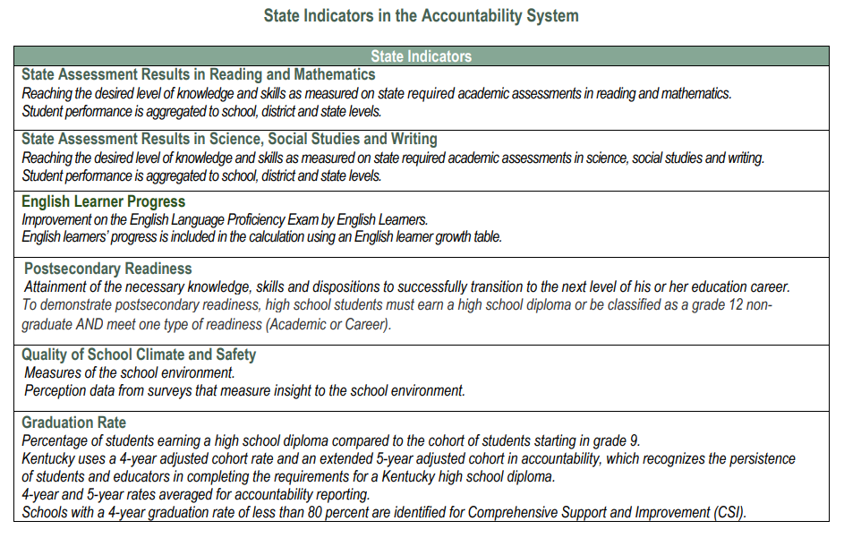
State Indicators in the Accountability System
Notes:
There are six indicators comprised in Kentucky’s Accountability System. These indicators are State Assessment Results in Reading and Mathematics, State Assessment Results in Science, Social Studies, and Writing, English Learner Progress, Postsecondary Readiness, Quality of School Climate and Safety, and Graduation Rate. In this session, we are going to focus on the State Assessment Results in Reading and Mathematics indicator as well as the State Assessment Results in Science, Social Studies, and Writing.

Slide 3
Glossary
Status Score: Numerical value based on student performance from each indicator
Status Level: Five levels ranging from Very Low to Very High for the current year
Change Score: The numerical value of the difference between the current year and the prior year Status Scores
Change Level: Five levels ranging from Declined Significantly to Increased Significantly
Indicator Score: Numerical value of Current Year Status Score + Change Score
Indicator Performance Rating: One of five color coded performance levels for each state indicator, the result of unique combination of Status Level and Change Level; not based on cut scores
Overall Score: Combination of Weighted Indicator Scores
Overall Performance Rating: one of five colors - red through blue
Weighted Indicator Score: Numerical value of indicator scores multiplied by the weight of each indicator
Notes:
The Office of Assessment and Accountability has created this resource of Accountability Terms to assist educators when discussing Kentucky’s Accountability system with fellow educators and stakeholders. With the addition of the Change Component this year, you will notice a few new terms from last year. The Change Score is the numerical value of the difference between the current year and the prior year Status Scores. Change level refers to the five levels ranging from Decline Significantly to Increased Significantly. When speaking of the Indicator Performances Rating we are referring to one of the five color coded performance levels for each state indicator, the result of unique combination of Status Level and Change Level; not based on cut scores.

Slide 4
Agenda
Status
Combined Writing
Accountability Calculations
Change
Change Score Calculations
Indicator Performance Ratings
Overall Score
Notes:
In this training I will provide you with an overview of the Status Component of Kentucky’s Accountability System, including Combined Writing and Accountability Calculations. Melissa Chandler will use the second half of this presentation to provide you with information on the Change Component, including Change Score Calculations, Indicator Performance Ratings, and the Overall Score.

Slide 5
Status State Assessment Results in Reading and Mathematics State Assessment Results in Science, Social Studies and Writing
Lisa Jett
Program Consultant
Office of Assessment and Accountability
Notes:
First, lets take a look at Status for State Assessment Results in Reading and Mathematics and State Assessment Results in Science, Social Studies, and Writing

Slide 6
Status Scores
The Status Score represents the current year outcome for a given indicator.
Indicator | State Assessment Results in Reading and Mathematics | State Assessment Results in Science, Social Studies, and Writing | English Learner Progress | Quality of School Climate and Safety | Postsecondary Readiness (HS only) | Graduation Rate (HS only)
Metric | Weighted performance index based on student assessment performance levels | Weighted performance index based on student assessment performance levels | Points assigned based on student-level growth as measured by a value table | Average of student scores for applicable questions in the QSCS survey | Percent of 12th grade students demonstrating academic or career readiness | Average 4- and 5-year graduation rates
Notes:
Status is defined as the overall performance for each district, school, and student demographic group determined by combining the state indicators to showcase the current year performance. Later in this training, I will demonstrate how to configure the status for the indicators of State Assessment Results in Reading and Mathematics and State Assessment Results in Science, Social Studies, and Writing.

Slide 7
State Assessment Results in Reading and Mathematics (E/M/H)
Reaching the desired level of knowledge and skills as measured on state required academic assessments in reading and mathematics.
Measures student achievement on Kentucky’s Academic Standards in reading and mathematics.
Notes:
Proficiency within the indicator of State Assessment Results in Reading and Mathematics is defined as reaching the desired level of knowledge and skills as measured on academic assessments in reading and mathematics. Scores are derived from the Kentucky State Assessment and the Alternate Kentucky State Assessment. Student performance is aggregated to school, district, and state levels. This indicator is reported in elementary, middle, and high school levels.

Slide 8
State Assessment Results in Science, Social Studies, and Writing (E/M/H)
Reaching the desired level of knowledge and skills as measured on state required academic assessments in science, social studies, and combined writing.
Measures student achievement on Kentucky’s Academic Standards in science, social studies, and writing.
Notes:
Proficiency within the indicator of State Assessment Results in Science, Social Studies, and Writing is defined as reaching the desired level of knowledge and skills as measured on academic assessments in the areas of science, social studies, and writing. When assessing the writing component of this indicator, students will be assessed in the areas of on-demand writing and editing/mechanics. Scores are derived from the Kentucky State Assessment and the Alternate Kentucky State Assessment. Student performance is aggregated to school, district, and state levels. This indicator is reported in elementary, middle, and high school levels.

Slide 9
Writing: How are the writing components factored?
On-demand writing and editing/mechanics will be combined to create the student performance for writing.
Students in grades 5, 8 and 11 will receive a scale score and performance level score for editing and mechanics and on-demand writing separately. Combined Writing will be reported by performance level only - Novice, Apprentice, Proficient, Distinguished (NAPD).

Slide 10
Combined Writing Decision Matrix
The combined writing performance levels are determined by the performance levels assigned for editing & mechanics and on-demand writing.
This table represents the general guidelines described by the panellists in determining the overall writing performance level that the influence of the on-demand writing performance level should be greater than the editing & mechanics performance level.
On Demand Writing
Performance Level | Novice | Apprentice | Proficient | Distinguished
Distinguished | Apprentice | Proficient | Proficient | Distinguished
Proficient | Apprentice | Apprentice | Proficient | Distinguished
Apprentice | Novice | Apprentice | Proficient | Proficient
Novice | Novice | Apprentice | Apprentice | Proficient
Editing and Mechanics
Notes:
The combined writing performance levels are determined by the performance levels assigned for editing and mechanics and on-demand writing. The Combined Writing Decision Matrix displays the general guidelines described by the panelists in determining the overall writing performance level. The on-demand writing performance level should be greater than the editing and mechanics performance level.
For example, if a student achieves a performance level of Apprentice in editing and mechanics and a proficient in On Demand Writing, their final performance level would be Proficient, with more influence being placed on their performance level in on demand writing.

Slide 11
Status Measures: Reading and Mathematics and Science, Social Studies, and Writing
Schools earn credit based on student performance levels on state summative assessments:
Novice 0
Apprentice .5
Proficient 1
Distinguished 1.25
Student performance aggregated to school, district and state levels.
Notes:
State assessment results for the indicators of reading and mathematics/science, social studies, and writing are all assigned points in the following manner: Novice will receive 0 points, Apprentice receives .5, proficient 1 point, and distinguished 1.25 points.
Student performance is aggregated to the school, district and state levels.

Slide 12
Status Levels
There are five Status Levels.
Status | Very Low | Low | Medium | High | Very High
Notes:
There are five status levels ranging from very low to very high for the current year.
Color ratings will include five performance levels from highest to lowest. Performance of schools will be reported by levels; elementary, middle, and high as applicable. The School Report Card will display the color ratings for each indicator to communicate performance of schools with red being the lowest and blue being the highest.

Slide 13
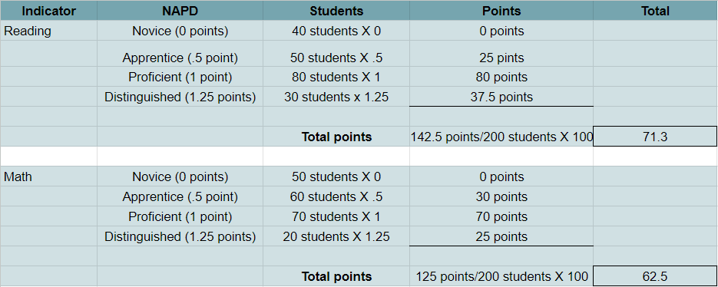
Status Calculation for Reading and Mathematics Example: Elementary School with 200 students
Notes:
This is an example for calculation of the State Assessment Indicator of Reading and Mathematics with an elementary school containing 200 students.
In Reading…(read chart) Adding all of the NAPD points together gives us 142.5 which we then divide by the number of students, 200. Multiplying this answer by 100 gives us the status score for reading.
In the area of Mathematics, we would complete the same process…(read chart) Adding all of the NAPD points together gives us 125 which we then divide by the number of students, 200. Multiplying this answer by 100 gives us the status score for mathematics.

Slide 14
Status Calculation for Reading and Mathematics Example: continued
71.3 + 62.5= 133.8 = 66.9
2
Notes:
Combining the scores for reading and mathematics, then dividing by 2 (once for reading and once for mathematics) gives us the score of 66.9 for the Indicator of State Assessment Results in Reading and Mathematics. The number 66.9 will contribute to an overall score using a proportional scale distribution or accountability weight.

Slide 15
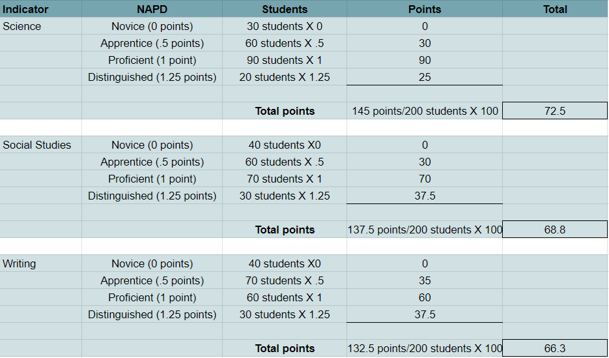
Status Calculation for Science, Social Studies, and Writing Example: Elementary School with 200 students
Notes:
The State Assessment Results in Science, Social Studies, and Writing will have a similar calculation. This is an example for calculation of the State Assessment Indicator of Science, Social Studies, and Writing with an elementary school containing 200 students.
After viewing the breakdown of the point configuration, you can see they earned a total of 72.5 points in science, 68.8 points in Social Studies, and 66.3 points in Writing.

Slide 16
Status Calculation for Science, Social Studies, and Writing Example: continued
72.5 + 68.8 + 66.3 = 207.6 = 69.2
3
Notes:
Combining the scores for Science, Social Studies, and Writing will give us a total of 207.6 which we will divide by 3 (once for science, social studies, and writing) earning this example a score of 69.2 for the indicator of Science, Social Studies, and Writing.
The numerical status scores for both indicators will then be compared to the Color Rating System to determine the color score for each indicator.

Slide 17
Change State Assessment Results in Reading and Mathematics State Assessment Results in Science, Social Studies and Writing
Melissa Chandler
Program Consultant
Office of Assessment and Accountability
Notes:
Thank you for joining me for the Status portion of this Accountability Indicator Training for State Assessment Results in Reading and Mathematics and State Assessment Results in Science, Social Studies, and Writing. Melissa Chandler will guide you through the Change component of these two indicators. Melissa.

Slide 18
Agenda Continued
Status
Combined Writing
Accountability Calculations
Change
Change Score Calculations
Indicator Performance Ratings
Overall Score

Slide 19
Change Levels
There are five Change Levels:
Change | Declined Significantly | Declined | Maintained | Increased | Increased Significantly

Slide 20
Change Score
Change Score is a simple subtraction of Prior Year Status Score from Current Year Status Score.
It is calculated the same way for every Indicator.
Current Year Status Score – Prior Year Status Score = Change Score
Prior Year Scores are used to calculate Change Scores. They are not used to influence Indicator Performance Ratings.
Current Year Status Score
Prior Year Status Score
Change Score

Slide 21
Change Score Example
Current Year Status Score
Prior Year Status Score
Change
66.9 – 65 = 1.9

Slide 22
Indicator Score
Indicator Score is a simple combination of Status Score and Change Score.
It is calculated the same way for every Indicator.
Current Year Status Score + Change Score = Indicator Score
Indicator Scores are used to calculate Overall Scores. They do not influence Indicator Performance Ratings.
Current Year Status Score
Change Score
Indicator Score

Slide 23
Indicator Score Example: Reading and Mathematics Indicator
Current Year Status Score
Change Score
Indicator Score
66.9 + 1.9 = 68.8

Slide 24
Indicator Performance Ratings
Table: Indicator Performance Ratings based on combined Change and Status Levels *
 | Change Declined Significantly | Change Declined | Change Maintained | Change Increased | Change Increased Significantly
Very High Status in current year | Yellow | Green | Blue | Blue | Blue
High Status in current year | Yellow | Yellow | Green | Green | Blue
Medium Status in current year | Orange | Orange | Yellow | Green | Green
Low Status in current year | Red | Orange | Orange | Yellow | Yellow
Very Low Status in current year | Red | Red | Red | Orange | Yellow

Slide 25
Overall Accountability Weights
 | State Assessment Results - Reading and Math | Other State Assessment Results -Science (SC), Social Studies (SS) and Combined Writing (CW) | English Learner Progress | Quality of School Climate and Safety (QSCS) | Postsecondary Readiness | Graduation Rate
Elementary | 51 | 40 | 5 | 4
Middle | 46 | 45 | 5 | 4
High | 45 | 20 | 5 | 4 | 20 | 6
If any indicator is not available, weights will be redistributed proportionally to remaining indicators.
25

Slide 26
Overall Score – Elementary
Overall Scores represent the combined outcomes across all applicable Indicators, with appropriate weights applied.
Elementary Overall Score Calculation
State Assessment Results in Reading and Mathematics Indicator Score * .51
State Assessment Results in SC, SS and CW Indicator Score * .40
Overall Score
English Learner Progress Indicator Score *.05
QSCS Indicator Score * .04

Slide 27
Overall Score – Middle
Overall Scores represent the combined outcomes across all applicable Indicators, with appropriate weights applied.
Middle School Overall Score Calculation
State Assessment Results in Reading and Mathematics Indicator Score * .46
State Assessment Results in SC, SS and CW Indicator Score * .45
Overall Score
English Learner Progress Indicator Score *.05
QSCS Indicator Score * .04

Slide 28
Overall Score – High School
State Assessment Results in Reading and Mathematics Indicator Score * .45
State Assessment Results in Sc, SS and Writing Indicator Score * .20
English Learner Progress Indicator Score *.05
QSCS Indicator Score * .04
Postsecondary Readiness Indicator Score
*.20
Graduation Indicator Score *.06
Overall Score
Overall Scores represent the combined outcomes across all applicable Indicators, with appropriate weights applied.
High School Overall Score Calculation

Slide 29
Overall Performance Rating
An overall performance score combines performance on the exclusive state indicators for elementary, middle and high schools.
The ratings will be reported using a color rating system to communicate performance of schools, with Red being the lowest rating and Blue being the highest rating.
Blue
Green
Yellow
Orange
Red
29

Slide 30
Where to find State Assessment Results Data
Data is released publicly in the School Report Card (SRC)
Search by school/district or explore Statewide Data
Once logged into the SRC, view individual school indicator performance by clicking on Overall Performance Rating: View Accountability Data then click on Indicator Performance Rating: Explore Data.

Slide 31
State Accountability Trainings
Accountability Overview
State Assessment Results for Reading and Mathematics/State Assessment Results for Science, Social Studies, and Writing
Quality of School Climate and Safety
Progress on English Language Proficiency
Postsecondary Readiness
Graduation Rate

Slide 32
Division of Assessment and Accountability Support
Lisa Jett, Program Consultant,
Lisa.Jett@education.ky.gov
Melissa Chandler, Program Consultant
Melissa.Chandler@education.ky.gov
OAA/DAAS (502) 564-4394 dacinfo@education.ky.gov

Slide 33
Closing Slide

