Slide 1
2023-2024 Back to School Trainings
ACCESS/Alternate ACCESS for ELLs
Chris Williams, Program Consultant
Office of Assessment and Accountability

Slide 2
Agenda
WIDA Screener for Kindergarten and WIDA Online Screener
ACCESS for ELLs
Alternate ACCESS for ELLs
Timelines and Resources

Slide 3
WIDA Screener for Kindergarten and
WIDA Online Screener

Slide 4
Beginning of School Year Guidance for the
WIDA Screener for Kindergarten and WIDA Online Screener
The WIDA screeners can be administered to students who are attending in-person schooling or to students who are enrolled in virtual learning. The schools will arrange a time with the parents for the screener to be administered in-person this school year.
The WIDA online screener and the WIDA Screener for Kindergarten cannot be administered remotely.

Slide 5
WIDA Screener for Kindergarten
This screener replaced the Kindergarten WIDA-ACCESS Placement Test (K W-APT)
Paper/Pencil screener
Two quizzes for Test Administrators (TAs) to complete prior to screening students
Testing Times:
  Up to 30 minutes - oral domains of listening and speaking- first semester
  Up to 45 minutes - listening, speaking, reading, and writing- second semester
Materials needed to administer:
  Storybook
  Test Administrator (TA) script
  Cards
  Score Sheet
  Response Booklet
Recorded Training for the Screener for Kindergarten is on the WIDA secure portal
Notes:
First semester kindergarten and first grade students take the oral domains of listening and speaking only. Second semester kindergarten students take all four domains of listening, speaking, reading, and writing.

Slide 6
Home-Language Survey, WIDA Screener for Kindergarten and WIDA Online Screener
Give each new student in the district the Home-Language Survey (HLS).
If the answer to any of the four required HLS questions is any language other than English, then administer the screener, WIDA Screener for Kindergarten or the WIDA Online Screener for grades 1-12.
The WIDA Screener Online is in WIDA Assessment Management System (AMS). The WIDA Screener for Kindergarten is downloadable free to districts from the website:
Contact the DAC if school or district staff need a screener password. Chris Williams will create the accounts
The results of the WIDA Screener for Kindergarten and the WIDA Online Screener must be shared with parents within the first 30 calendar days of enrollment or two weeks of enrollment during the school year and the scores entered Infinite Campus (IC).
https://wida.wisc.edu/
Notes:
The four required home-language survey questions are:
What is the language most frequently spoken at home?
Which language did your child learn when he/she first began to talk?
What language does your child most frequently speak at home?
What language do you most frequently speak to your child?
To print WIDA Screener for Kindergarten materials off the WIDA website, districts will need to use their WIDA Secure Portal username and password.
Trainings for the WIDA Online Screener are found on the ACCESS for ELLs page of the KDE website and WIDA Secure Portal.
http://education.ky.gov/AA/Assessments/Pages/EL-Testing.aspx
If districts need WIDA paper screener materials, then contact Chris Williams.

Slide 7
WIDA Screener for Kindergarten Scores
All kindergarteners regardless of their screener scores, must be administered ACCESS the following January.
Kindergarten students cannot exit an EL program until after taking the Kindergarten ACCESS for ELLs®.
Notes:
First semester first grade EL students also take the WIDA Screener for Kindergarten and listening and speaking domains only so they can’t exit from EL services until after Kindergarten ACCESS.
Parents can refuse EL services but still will have to take ACCESS for ELLs®.

Slide 8
WIDA Screener Online
Administered in Grade level clusters: 1, 2-3, 4-5, 6-8 and 9-12
Tested in in all four language domains: Listening, Reading, Speaking and Writing
Scored in the domains Speaking and Writing by the TA
Needed materials to administer: TA script, Student Test Tickets and Student Test Roster, Writing Test Booklets for Grade 1-3 only, Scratch Paper if needed
Notes:
Test tickets, and scratch paper should be destroyed securely after all screening is completed. All materials are to be kept in locked storage until screening is complete.
Reading Up to 15 minutes
Listening Up to 15 minutes
Speaking Up to 25 minutes
Writing Up to 25 minutes
TOTAL Up to 80 minutes

Slide 9
WIDA Screener Online in WIDA AMS
Watch the training video that provides brief overviews on common tasks in WIDA AMS
  Each one-two minute segment of the video will show how to complete tasks on creating a student, creating a registration and downloading test tickets
  Videos are available in the WIDA Secure Portal under Resources-Screener Online
Updated test demos, test practice and online sample items available in WIDA AMS and DRC INSIGHT
Review step-by-step directions on how to complete tasks in WIDA AMS through the WIDA AMS User Guide

Slide 10
WIDA Online Screener Scores – Grades 1-12
For Grades 1-12 if a student scores an overall composite proficiency level of less than a 4.5 on the WIDA Online Screener, the student is considered an EL and will be placed in an EL program. The student will take ACCESS for ELLs® in January.
For Grades 1-12 if a student scores an overall composite proficiency level of a 4.5 on the WIDA Online Screener, the student is considered Initially Fully English Proficient (IFEP). The student is not an EL and will not take ACCESS for ELLs® in January.

Slide 11
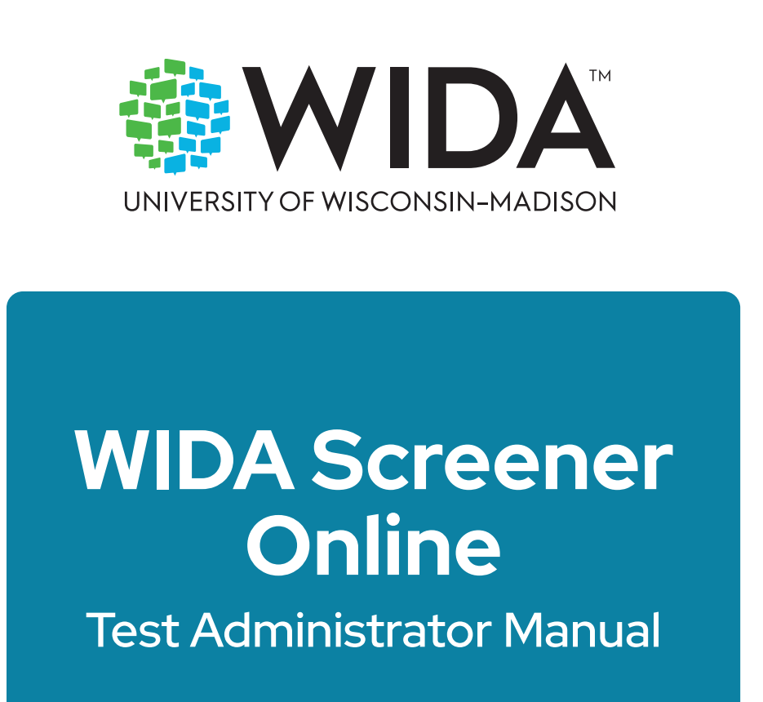
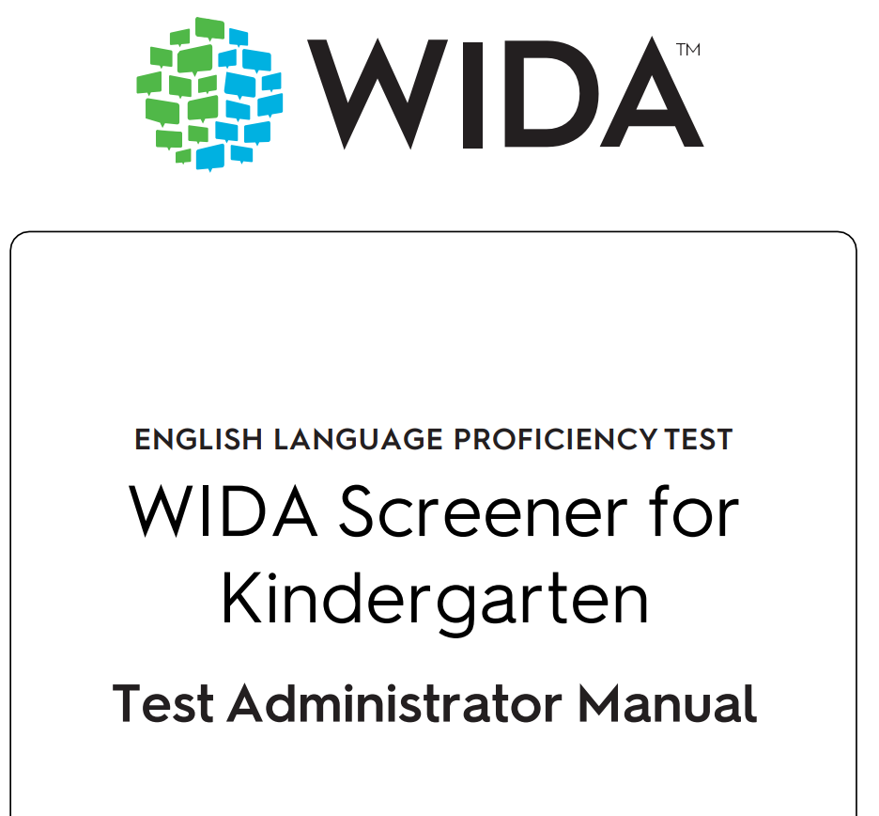
WIDA Screener Manuals

Slide 12
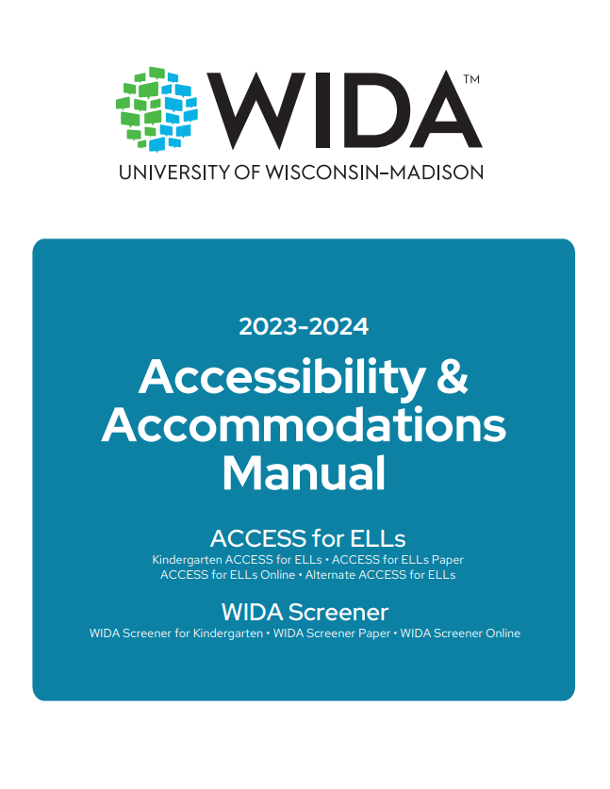
Accessibility and Accommodations Manual
Participation guidance
Framework
Types of supports
Alternate ACCESS for ELLs criteria
Keyboard shortcuts
Scribe and Transcription guidance
WIDA Screener for Kindergarten and Online
Accommodation checklists ACCESS online and paper, Kindergarten and Alternate ACCESS

Slide 13
Identified EL Students
A program services committee will design a Program Services Plan (PSP) for each identified EL student. The EL and regular educational teacher will provide services throughout the year, with appropriate instructional and assessment accommodations for each individual EL student.
The EL identification, assessments, services, and instructional and assessment accommodations must be entered into Infinite Campus (IC) under Program Participation. (English Learners-EL)
All identified EL students are required federally to be assessed annually with an English Language Proficiency test.
Notes:
PSP and EL Program Participation tabs in IC are to be completed within the first 30 calendar days of the school year or within 2 weeks of enrollment during the school year.
PSP committee includes the following: ELL Teacher/Specialist, Classroom Teacher(s), Principal, and Guidance Counselor and Special Education teacher if the EL student has an IEP. This is not the entire list of staff who are on the PSP committee.
Current PSP updated yearly with new ACCESS scores.
Everyone who works with an EL student needs to have a copy of the PSP.

Slide 14
Essential Elements of a PSP
Notes:
Contact Kaiman Triplett or Brandy Neal for a copy of a PSP.

Slide 15
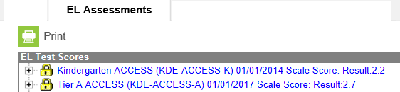
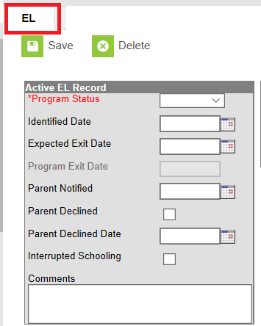
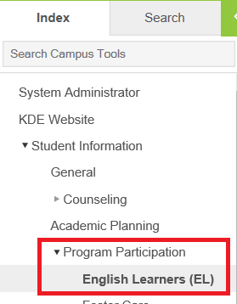
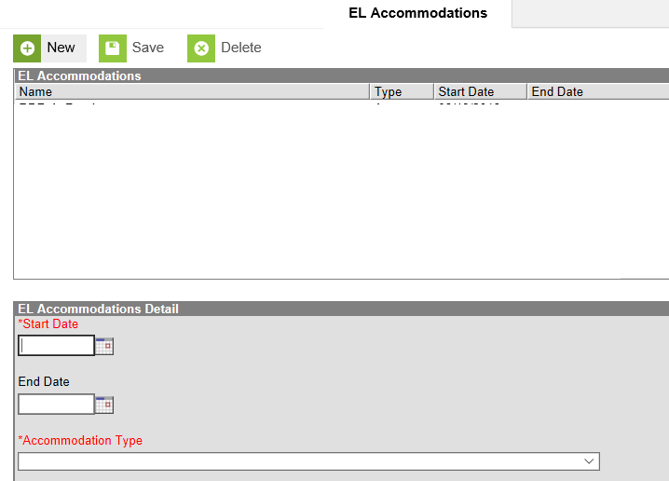
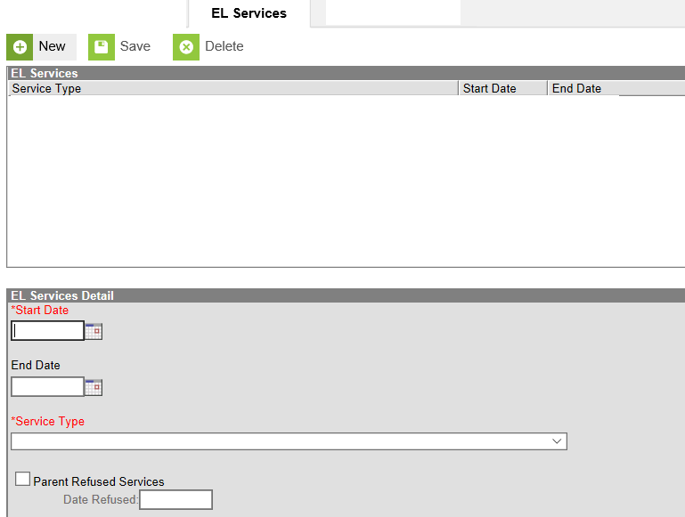
EL Data Standards for Entering EL Data in IC
Path to view/enter English Learner data (Student Information | Program Participation | English Learners (EL)
2
1
EL Program tab
EL Assessments tab
3
EL Services tab
4
EL Accommodations tab

Slide 16
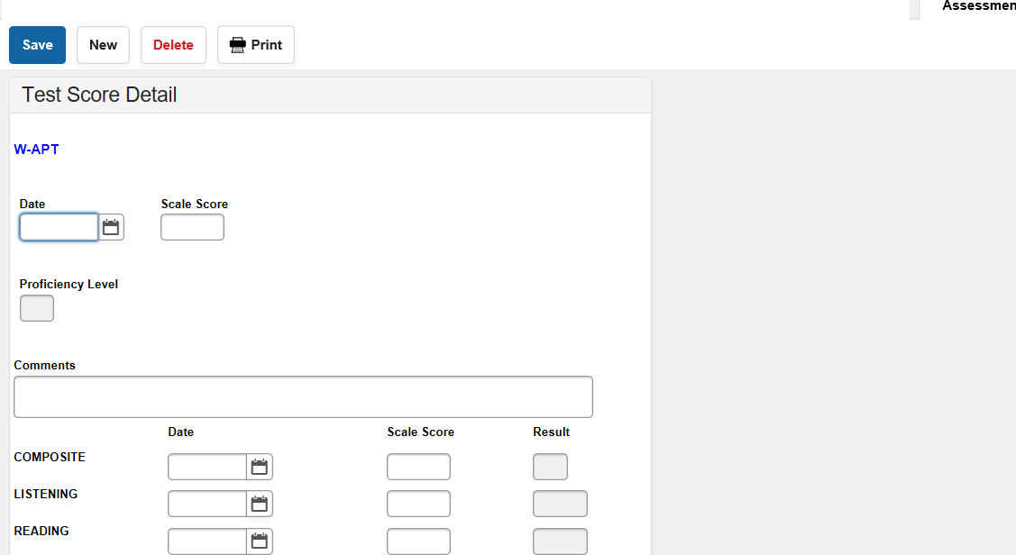
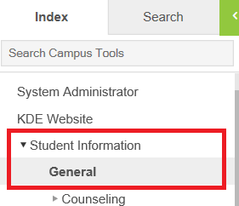
Entering EL Data in IC on the EL TABS (Continued)
Screener data entry
Path: Student Information | General | Assessment tab
Notes:
The WIDA Screener for Kindergarten screener scores can be entered into IC with date and proficiency levels and domain scores like the WIDA Screener scores are for grades 1-12.

Slide 17
Reports in IC for EL
There are two report types available in IC that will assist districts in preparation for the ACCESS testing window. The reports are available for selection within Infinite Campus under the existing QA English Learners report located via KY State Reporting/KDE Reports. The report titles and descriptions of each are outlined below:
Reach ACCESS Attainment Error Report: Excel format – provides a list of students who are indicated as EL but who have reached attainment on a prior ACCESS assessment
No Prior ACCESS Attainment Error Report: Excel format – provides a list of students who are not indicated as EL but have not previously reached attainment on a prior ACCESS assessment. Note: students who exited EL status from a state other than Kentucky will still appear on this report but will have the Program Exit State highlighted for reference, no action is required for these records.

Slide 18
Parent Refusal of EL Services
Parents can refuse EL services but the student:
  Is still EL until the exit criteria is met
  Will have a current PSP with EL accommodations in IC and be provided EL instruction in the regular classroom
  Will take ACCESS for ELLs® in January

Slide 19
ACCESS for ELLs

Slide 20

Test Vendor
  Data Recognition Corporation® (DRC) serves as the operational test vendor for ACCESS for ELLs®, both online and paper.
Notes:
Data Recognition Corporation serves as the operational test vendor for ACCESS for ELLs, both online and paper (including Kindergarten and Alternate ACCESS for ELLs).

Slide 21
2023-2024 ACCESS for ELLs (ACCESS and Alternate ACCESS) Testing Schedule in WIDA AMS (Tentative)
 | Start Date | End Date
Test Materials Ordering | 9/29/23 | 10/25/23
Online Test Setup for Registrations | 11/30/23 | 2/16/24
Districts Receive Test Material | 12/5/23 | 12/5/23
Additional Test Material Window | 12/5/23 | 2/9/24
Test Window | 1/04/23 | 2/16/23
All Test Material Received at DRC | 3/1/24 | 3/1/24
Pre-Reporting Data Validation Window | 3/20/24 | 4/3/24
Districts Receive Reports | 4/26/24 (online)-ACCESS | 5/8/24 (printed)-ACCESS
Score Correction Window | 5/7/24 | 5/21/24
Notes:
Data Recognition Corporation (DRC) prints, scores, houses the online system and ships the test materials and reports to the districts.
DRC opens a data validation window for districts to have one last look at the demographic data before the reports are printed and sent to the districts.
Kindergarten, Alternate ACCESS and Accommodated (Braille and Large print) are paper/pencil assessments.
Alternate ACCESS Reports will be available in the fall to districts after the WIDA Standard Setting of Alternate ACCESS conducted in summer of 2024.

Slide 22
ACCESS for ELLs Suite of Assessments
The following assessments are used to satisfy state and federal requirements for the annual assessment of the English language proficiency of English Language Learners (ELLs):
  ACCESS for ELLs, an online and paper-based assessment for Grades 1–12,
  Kindergarten ACCESS for ELLs, a paper-based assessment for Kindergarten,
  Alternate ACCESS for ELLs, a paper-based assessment for ELLs in Grades 1–12 who have significant cognitive disabilities.
Notes:
The ACCESS for ELLs assessments are a tool to measure English Language Learners proficiency in English. The ACCESS for ELLs suite of assessments includes:
ACCESS for ELLs, an online and paper-based assessment for students in Grades 1–12
Kindergarten ACCESS for ELLs, a paper-based assessment for Kindergarten students
Alternate ACCESS for ELLs, a paper-based assessment for students in Grades 1–12 who have significant cognitive disabilities
More information about Alternate ACCESS for ELLs and Kindergarten ACCESS for ELLs can be found in other presentations available on the WIDA website.

Slide 23
ACCESS for ELLs Trainings Update
District and school staff will begin ACCESS for ELLs trainings for ACCESS Online, Kindergarten and Alternate ACCESS beginning Sept. 1 in the WIDA Secure Portal
Additional Trainings on ACCESS for ELLs be released in the fall

Slide 24
WIDA AMS and DRC INSIGHT Updates
WIDA AMS: Student Management and Test Management:
Separation of Student Add/Edit functionality
Adding a new student to all sessions at once
Printing Test Tickets
  All test tickets for one student
  Printing tickets for multiple sessions
  All accommodations on test tickets
Exportable, sortable, Tier Placement Report
Easier School-to-School Transfers
Student Import history and error reports
  Extended error limit
  View who imported data and what date
Mass Test Monitoring Activation
Screener Regeneration by Domain
Naming Conventions (Test Sessions to Registrations)
Reporting Services:
Transition to newer Reporting Services menu
Increase of On Demand Exports
Customization of On Demand Exports
DRC INSIGHT:
Navigation Buttons for Accessibility
Enhanced Magnification
Color Preferences
Simpler Microphone Check
508c/WCAG compliance

Slide 25
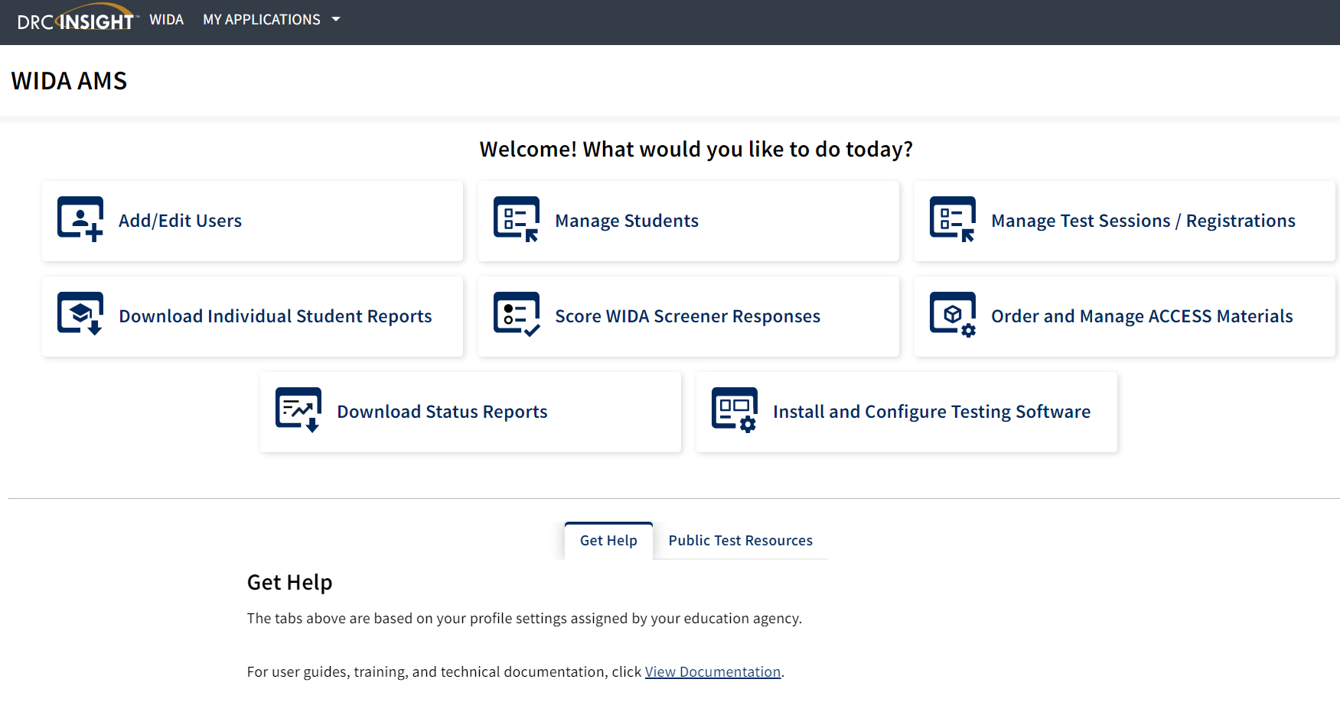
WIDA AMS

Slide 26
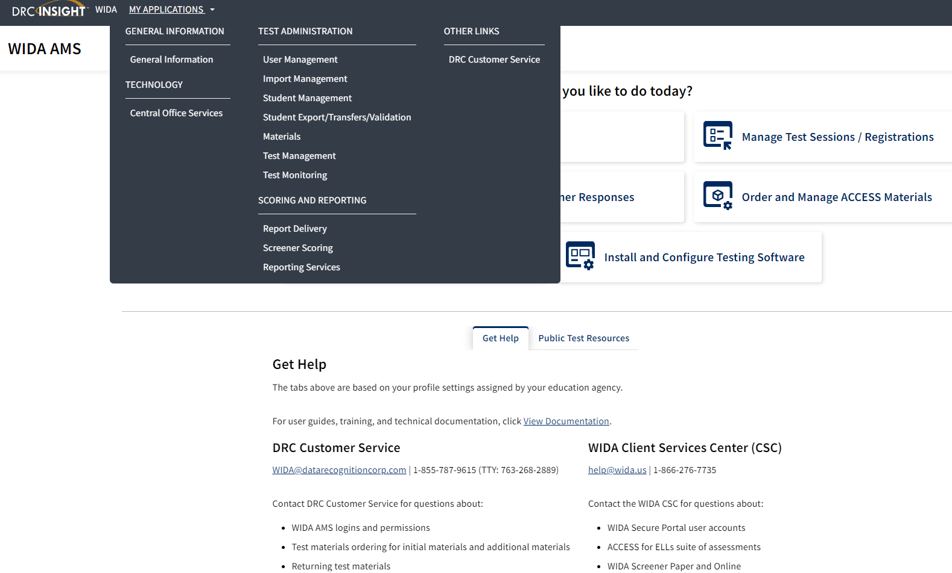
My Applications in WIDA AMS

Slide 27
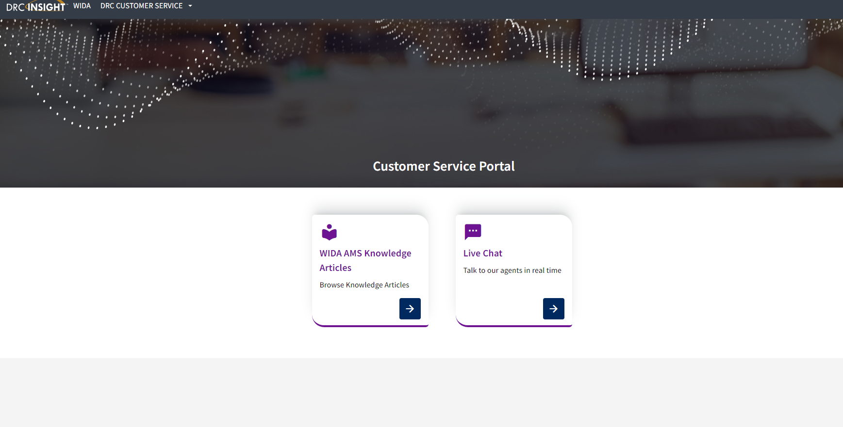
Customer Service-WIDA AMS Knowledge Articles

Slide 28
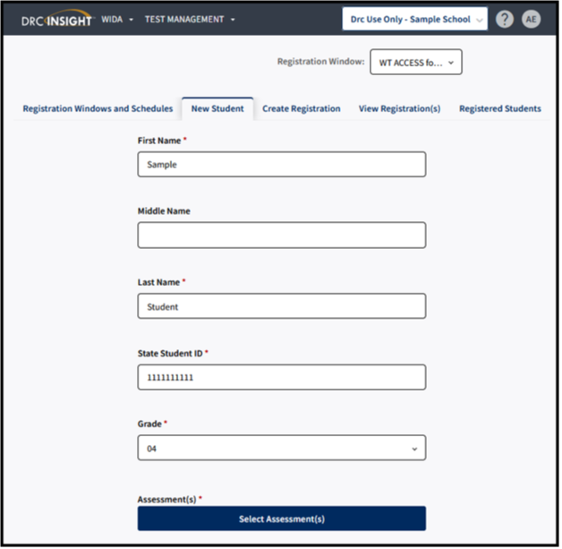
Adding a Registration
To add a registration, complete the following steps:
Click Test Management from the WIDA AMS My Applications menu bar
Confirm or enter your site criteria in the upper right corner. Click Save
Confirm or enter your Registration Window in the drop-down menu
Select the New Student tab
Complete First and Last Name, SSID, and Grade Filters. Button under Assessment(s) will activate
Click on Select Assessments
The Select Assessment(S) will appear. Select the assessments and domains applicable to the student
Click Add to add a student to the following registrations or click Close to cancel the process without saving the changes
Confirm or edit the Registration Name. The Registration Name will default to user's last name and date.
Complete other demographic fields as needed
Click Register to register the student to the selected assessment
Click View Registration(s) to see the newly created registration
Notes:
New Student Tab method simultaneously adds a student into Student Management and creates a registration for a single, new student.
Create Registration creates a registration for a single or group of students who already exist within WIDA AMS under Student Management.
To add a registration, complete the following steps:
Click Test Management from the WIDA AMS My Applications menu bar.
Confirm or enter your site criteria in the upper right corner. Click Save.
Confirm or enter your Registration Window in the drop-down menu.
Select the Create Registration tab.
Enter a Registration Name. The registration name should be descriptive. For example, a user might name the registration by the teacher name and classroom period.
Click Select Assessment(s). A Select Assessments window will appear. For ACCESS for ELLs, you will select an assessment for each domain. For WIDA Screener Online, you will select the assessment by grade cluster. Click Add.
Click Select Student(s) to add one or multiple students to the registration. To select multiple students, click the checkbox next to each student to add to the registration. A user can also filter by grade or last name. Click Add.
A user can choose to activate Test Monitoring and set to “Required.” This action will require all students in the registration to enter a Monitoring Code generated by the Test Administrator on initial login of the assessment.
Click Register.
You will receive a Registration Confirmation message showing the assessment(s) and the number of students added to the registration. If this is correct, select Close.
Click View Registration(s) to see the newly created registrations.
Note: A Registration Window, District and School will need to be selected for the Create Registration tab to activate. If the Create Registration tab does not appear, this will indicate that the user does not have the “Registration-Add/Edit” permission.
The registration name should be descriptive. For example, a user might name the registration by the teacher name and classroom period.
For WIDA Screener Online, you will select the assessment by grade cluster.
Note: If you do not see the student available to be placed into the registration, this will usually indicate that the student has not yet been added to WIDA AMS, or that the student is already enrolled in a registration of the same domain and grade cluster. Search for the student under the Registered Students tab to confirm the student’s enrollment in registrations for the given administration.
If creating a registration for Screener and are unsure which grade cluster registration to use for the student, refer to Knowledge Article “What grade cluster registration should I screen a student?”
For Screener testing, a student will only need to be enrolled in one registration. Screener Online is a single ticket login with one registration.
For more information on how to edit a registration, refer to Knowledge Article “How do I edit a registration?”

Slide 29
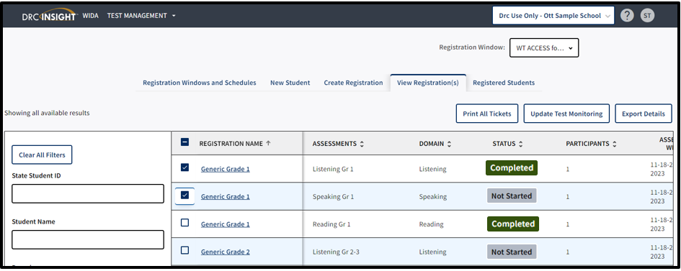
Printing Test Tickets
To print test tickets for students in a registration, complete the following steps:
Click Test Management from the WIDA AMS My Applications menu bar
Confirm or enter your site criteria in the upper right corner. Click Save
Confirm or enter your Registration Window in the drop-down menu
Select the View Registrations(s) tab
Apply one or more filter criteria such as SSID, Student Name, Domain, Registration Name, and/or Assessments to refine your search. Or, to print the test tickets for multiple registrations, leave the filters blank
Select the checkbox next to the registration(s) and click Print All Tickets
Notes:
District and school staff must keep test tickets secure before and after testing of the WIDA Online Screener. Must maintain test security through out the screening process-before, during and after.
Note: If the Print all Tickets button does not appear, please select a school in the site selector in the upper right corner.
If a PDF file does not appear, disable your browser’s pop-up blocker.
A test ticket includes the Student Name, Date of Birth, Accommodations, Domain, Registration Name, State Student ID, Username, and Password.
Prior to testing, Test Administrators should confirm the student’s identity when passing out the test tickets to the student to prevent the student from logging in under the incorrect profile.
Screener Online has one login and a single test ticket for all four domains.
How do I print test tickets for individual students?
To print test tickets for individual students in a registration, complete the following steps:
Click Test Management from the WIDA AMS My Applications menu bar.
Confirm or enter your site criteria in the upper right corner. Click Save.
Confirm or enter your Registration Window from the drop-down menu.
Select the Registered Student(s) tab and search for the student by name or state student ID. Any student with related search criteria will automatically filter on the screen with his or her current registrations.
If you need further assistance with WIDA AMS, please contact DRC Customer Service at 855-787-9615 or wida@datarecognitioncorp.com.

Slide 30
Exit Criteria for ACCESS for ELLs and Kindergarten ACCESS for ELLs
Overall Composite of a 4.5 on a Tier B/C is the exit criteria for ACCESS for ELLs.
Overall Composite of a 4.5 is the exit criteria for Kindergarten ACCESS for ELLs.

Slide 31
WIDA Alternate ACCESS®

Slide 32
WIDA Alternate ACCESS
A paper-pencil test for grades K-12
Individualized Education Program (IEP) team determines whether the student takes Alternate ACCESS or regular ACCESS with accommodations
To participate in Alternate ACCESS
    Must be classified as an English Learner (EL)
    Must have a significant cognitive disability
    Must participate or is expected to participate in the Alternate Assessment
    Must have a disability that precludes taking the ACCESS for ELLs® with accommodations
Notes:
Districts must give either the ACCESS for ELLs® or the WIDA Alternate ACCESS® to EL students each year.
State and federal laws require that all ELLs participate in annual English language proficiency assessments. The WIDA Accessibility/Accommodations Framework provides support for all ELLs, as well as targeted accommodations for students with Individual Education Plans (known as IEPs) or 504 plans. These supports will help all ELLs to better access the test. Some ELLs with significant cognitive disabilities will still be unable to take ACCESS for ELLs, even with supports and accommodations. These students may be eligible to participate in WIDA Alternate ACCESS, but only if they meet specific participation criteria. WIDA’s guidance for participation on Alt is found in Appendix A of the Manual and on the WIDA Website under WIDA Alternate ACCESS. Check with your state education agency for your state’s specific participation criteria for alternate assessment.
As the WIDA Alternate ACCESS Participation Criteria Decision Tree illustrates, there are several criteria that a student must meet to be eligible to participate in the WIDA Alternate ACCESS assessment. Again, it is recommended that the IEP Team makes this determination. Even if all of the criteria are met, it still may be more appropriate for an English language learner with significant cognitive disabilities to take the standard ACCESS for ELLs assessment based on their language proficiency.

Slide 33
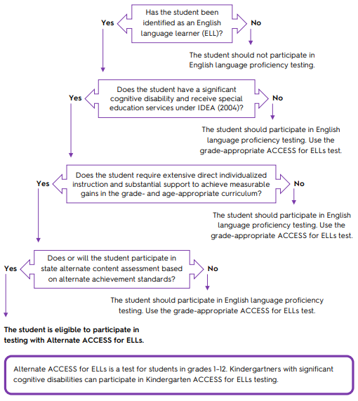
Participation Decision Tree

Slide 34
WIDA Alternate ACCESS-Operational
When school and districts test English learners with the most significant cognitive disabilities during the 2023–24 school year, the operational test will:
Incorporate the WIDA ELD Standards Framework, 2020 Edition
Cover kindergarten, which is part of the new K–2 grade-level cluster
Include brand-new test content and a new test item type
Contain an Individual Characteristics Questionnaire (ICQ), which prompts test administrators to answer questions about students (ICQ information will be reported on the individual student score report to help educators make reclassification decisions about students taking Alternate ACCESS)
Have a new look: Candoo, the Alternate ACCESS dog, adorns test materials and we carry over the field test color scheme
Have a redesigned training course, which has new content and a new look and feel
Have scores delayed after WIDA standard setting in late fall of 2024 and not in late April

Slide 35
Exit Criteria WIDA Alternate ACCESS
Overall Composite Proficiency Level (PL) 2 is the exit criteria for WIDA Alternate ACCESS.

Slide 36
Timelines and Resources

Slide 37
Timeline for WIDA Screener for Kindergarten and WIDA Online Screener (July/Aug./Sept.)
Within the first 30 calendar days of enrollment at the beginning of the school year:
  Give the Home Language Survey (HLS)
  Administer the WIDA Screener for Kindergarten and WIDA Online Screener
  Create a current PSP
  Enter IC under Program Participation (English Learners EL) the EL identification, assessments (screener scores), services and instructional and assessment accommodations
  Enter the screener scores in IC –WIDA Screener for Kindergarten and Online Screener for Grades 1-12 (date administered and scores)

Slide 38
WIDA Online Screener
Make sure all Test Administrators (TAs) for WIDA screener and WIDA Screener for Kindergarten have:
  Reviewed the screener training on the WIDA Secure Portal
  Taken the screener quiz on the WIDA Secure Portal starting July 1 and,
  Passed the quizzes with 80% or higher for this school year prior to administering to students
  Read the WIDA Online Screener and WIDA Screener for Kindergarten Manual
DACs will keep the quiz scores on file in the district office
DACs will assign the “Educator Scoring” permission in WIDA AMS after TA has passed WIDA online screener quiz
DACs/BACs provide Administration Code and Inclusion of Special Populations Training to TAs

Slide 39
WIDA Online Screener Continued
BACs/DACs set up test session in WIDA AMS
TA scores the student responses for Speaking and Writing domains. WIDA Screener Online will score the Listening and Reading domains automatically
Student Score Reports are available on-demand after scoring takes place
Most responses are available to score in WIDA AMS within 15 minutes but may take up to two hours
DACs must make sure that the scores are entered into IC correctly along with the other EL tabs at the beginning of school year and if EL student enrolls after within two weeks

Slide 40
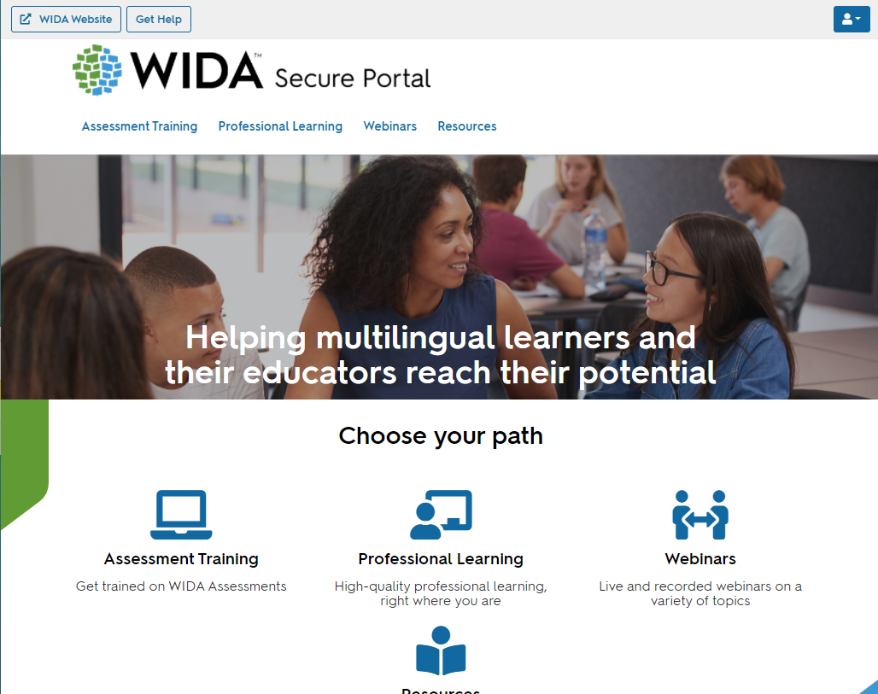
WIDA Secure Portal
Assessment Training
Professional Learning
Webinars
Resources
Users will continue to see courses, webinars, and resources based on permissions.
If a user has been given access to professional learning courses only, they will not see the assessment training category— nor any resources tagged solely to assessment training.
Users will be able to update their own personal information.

Slide 41
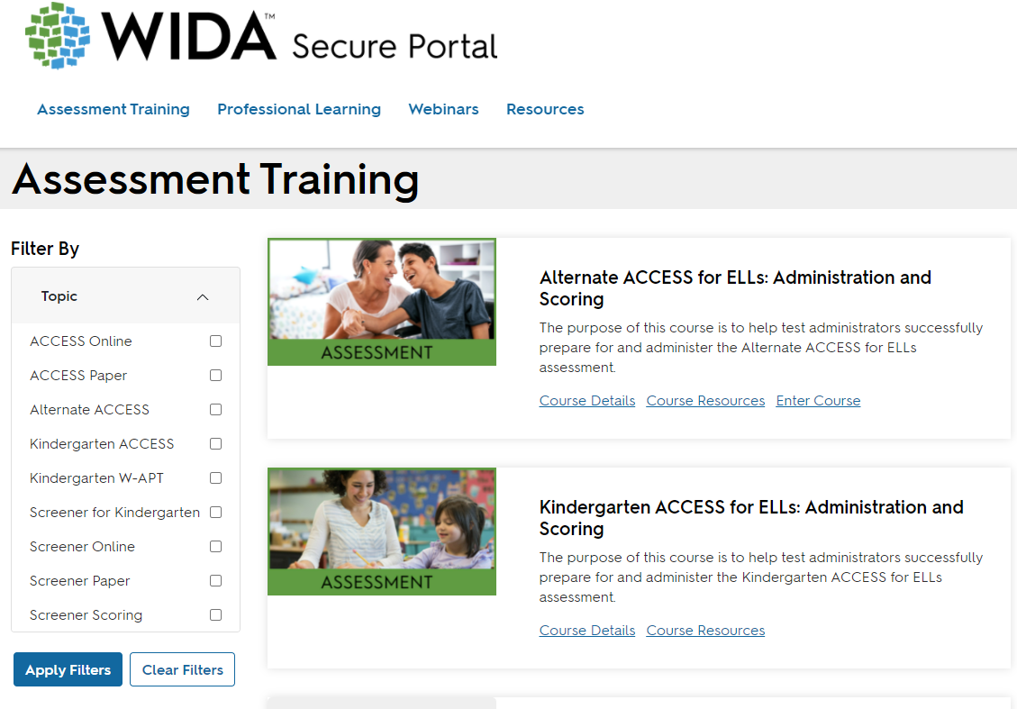
Assessment Training

Slide 42
Timeline for ACCESS Online (July/Aug.)
ACCESS Data Review of 2022-2023 information in the Student Data Review and Rosters (SDRR) application
Update test administrator spreadsheet for ACCESS/Alternate ACCESS/WIDA E-Learning Only
DACs update school and district permissions for ACCESS in WIDA Assessment Management System (AMS)
Prepare Technology Coordinator with up-to-date information on the upgrades to the Central Office Service (COS) Device on all computers for WIDA Online Screener and ACCESS for ELLs and reads the DRC INSIGHT Technology User Guide
Review timeline of district transition from AT&T to the new internet service with District Technology Coordinator for possible impact to online testing

Slide 43
WIDA Professional Learning
PD opportunity from WIDA
For EL and Content Teachers, some for Administrators
Self-paced e-Learning workshops in the WIDA Secure Portal
Available Sept. 1, 2023 -- new ones added, and some removed from last year and ends on Aug. 31, 2024
Send information through the WIDA Monday Mail and flyer on Kentucky’s member/state page on the WIDA website
Notes:
Must complete all e-Learning workshops by Aug. 31 of each year.

Slide 44
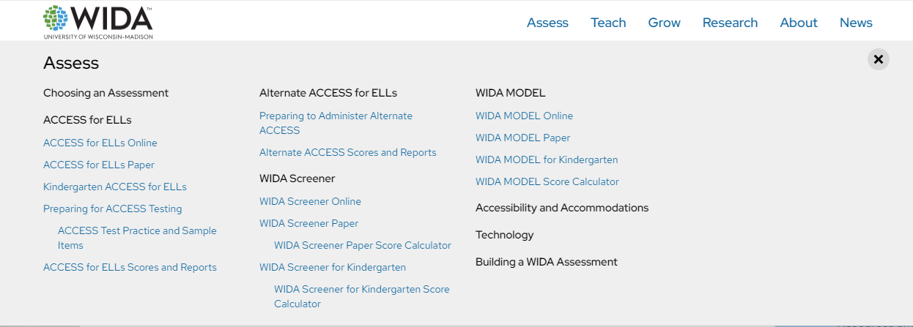
Assess Page (WIDA Website)

Slide 45
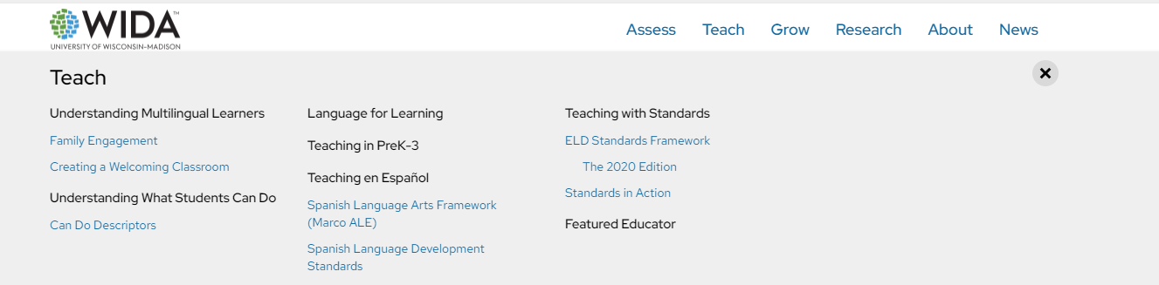
Teach Page (WIDA Website)

Slide 46
State-Specific Guidelines on WIDA Website
Visit Kentucky’s member state page for information related to:
Contacting State Educational Agency’s Representatives
Assessment Materials and Training
ACCESS for ELLs Testing Schedules
State-Specific guidance for ACCESS for ELLs
ACCESS for ELLs Online and Paper Checklist
Identification and Placement Guidance
Professional Development Opportunities
Notes:
Kentucky has its own specific guidance related to this information. Be sure to click on members/states and select Kentucky at wida.wisc.edu to see any specific guidelines and policies.
In 2023-2024, WIDA continues to offer the resource of state specific checklists. State checklists are available as a tool for you to assign and document the tasks that are required to administer ACCESS for ELLs. The state checklist indicates who typically handles each task in our state, along with any state-specific guidance. These are each customized for our state.

Slide 47
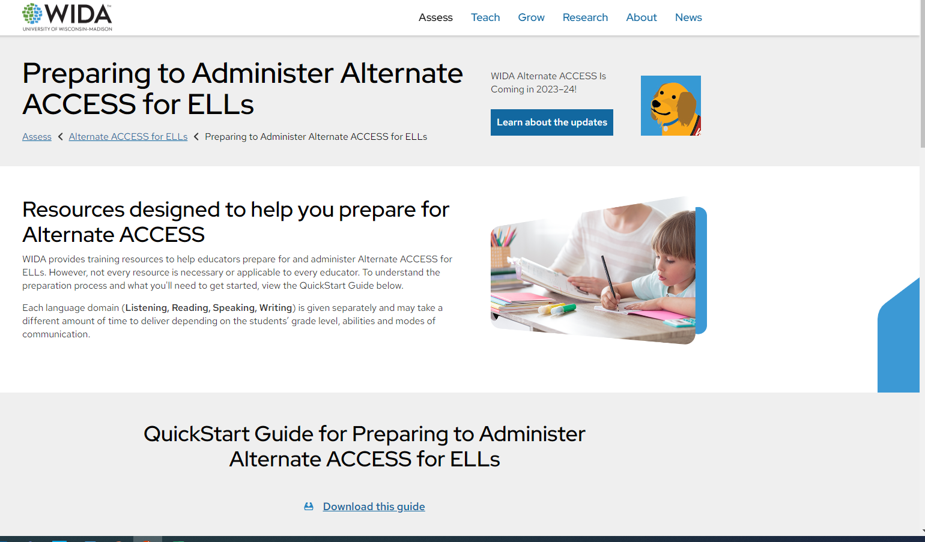
Alternate ACCESS (WIDA Website)

Slide 48
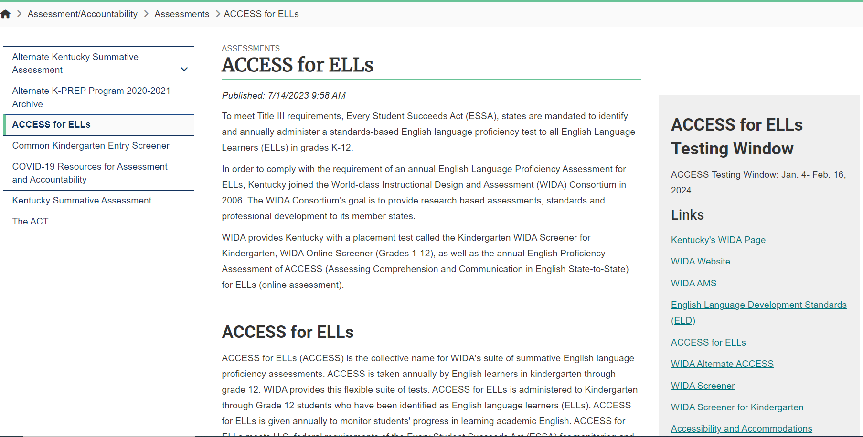
ACCESS for ELLs Webpage (KDE Website)

Slide 49
Contact Us
Ben Riley, Systems Consultant
Chris Williams, Program Consultant
Christen Roseberry, Program Consultant
Helen Jones, Academic Program Manager
Dr. Jennifer Stafford, Division Director
Krista Mullins, Program Consultant
Lisa Jett, Program Consultant
Melissa Chandler, Program Consultant
Shara Savage, Program Consultant

Slide 50
Other Back to School Trainings
Accountability Overview
ACCESS/WIDA Alternate ACCESS
AKSA (Attainment Tasks)
K Screen
ACT-Fall ACT Administration
Test Security

Slide 51
Division of Assessment and Accountability Support
  Chris Williams, Program Consultant,
  chris.williams@education.ky.gov
OAA/DAAS
(502) 564-4394
dacinfo@education.ky.gov

Slide 52

Thanks for Attending

