Slide 1
2024 February DAC Training
Student Data Review and Rosters (SDRR) Application
Ben Riley and Chris Williams
Systems IT Consultant and Program Consultant

Slide 2
Agenda
SDRR Spring Timeline
Training Sandbox in SDRR
SDRR and 100-Day Students
District Test Collection Windows
Rosters
Resources
SDRR “Hot Topic” Office Hours

Slide 3
SDRR Spring Timeline

Slide 4
Purpose of Data Quality
To get the student data correct prior to public reporting in the School Report Card (SRC).

Slide 5
SDRR Year at a Glance
Date/When | Event
January | Filing nonparticipations in SDRR if needed for ACCESS rosters.
February | Getting your graduate data correct in Infinite Campus (IC) for Cohort.
Mid-March | Enter the districts test windows for elementary, middle and high school in SDRR and updating district calendars in IC, so the students’ accountability will be pre-populated correctly in spring rosters starting mid/late April.
Mid/Late April | Spring rosters will open in SDRR for demographic data, adding students, deleting students, marking nonparticipations, change accountability if needed and marking accommodations for Individualized Education Program (IEP) and English Learner (EL) students
June | Look at Cohort Data in SDRR and fix the issues in IC
August | Data Review: this is the last time to make individual changes to the student data prior to public reporting.
Post Data Release-Fall | 10-Day Regulatory Review after public release to correct individual student data.

Slide 6
SDRR Spring Timeline
ALL DATES TENTATIVE
SDRR
ACCESS and Alternate ACCESS Rosters: Jan. 5 - March 7
District Test Window Collection: March 12 - 28
Spring Rosters: April 24 - June 12
Notes:
Let’s look at our schedule of events for this Spring. I’ll give you a moment to absorb this timeline. …
Notice that we begin with the ACCESS and Alternate ACCESS Rosters on Jan. 5. They will close on March 7 . During this time, there are no pre-loaded students in the roster.
Spring rosters are for the entry of Nonparticipations, such as Medical, First Year EL, making changes in IC if needed, reviewing student demographics, requesting 100-day accountability changes and marking accommodations . Each assessment roster may vary in the list of nonparticipations.
When we look above the timeline, we see the District Test Window Collection box running from March 12 through March 28 . It’s time to tell us when your last 14 instructional days will be. Remember, we check this against Campus, so get into IC and make certain it’s up-to-date!
Notice that our Spring Rosters don’t appear on our timeline until April . This gives us a few weeks to close the ACCESS rosters, populate them with students and re-open them with the rest of the rosters. The Spring rosters are KSA, Alternate, KSA, ACCESS, Alternate ACCESS and Postsecondary Readiness.
The announcements section in SDRR that appears upon login to the system will display reminders of when parts are opening and closing.

Slide 7
SDRR Highlights
The Sandbox for training staff in SDRR is available.
Rosters will open and accept tickets. The process remains the same.
Data Review will start in late summer/early fall.
Notes:
We’ve seen the changes in SDRR and rosters but what has remained the same from previous years? Almost everything!
There is a Sandbox area for staff training that opens a week or so ahead of each roster.
The big, red, I Need Help button is there containing tutorials for accountability, dropouts, etc. and information on how-to do most processes in SDRR.
Rosters will be open and accepting tickets on the tentative schedule we saw a few minutes ago. The rosters are once again connected to Infinite Campus for this phase.
And Data Review will continue to start in late summer or early fall.

Slide 8
Work in SDRR
2024 Spring Rosters
2024 Fall Data Review
Alternate Kentucky Summative Assessment (AKSA)
Kentucky Summative Assessment (KSA)
ACCESS (EL)
Alternate ACCESS
Postsecondary Readiness
Cohort (graduation rate)
Alternate KSA: Grades 3-8, 10 and 11
KSA: Grades 3-8, 10 and 11
ACCESS (EL): Grades K-12
Alternate ACCESS: Grades 1-12
Postsecondary Readiness and Scores: Grade 12 or current year graduate
Cohort (graduation rate): Grades 9-12(View Only)
Notes:
The work continues in SDRR with the two phases – Rosters and Data Review.
Let’s look at the Spring Rosters that you will be changing – Alternate KSA, KSA, ACCESS and Alternate ACCESS for ELLs, Postsecondary Readiness demographics. Postsecondary Readiness will also include information from TEDS on Career data. The Postsecondary Career Data will be through the Office of Career and Technical Education with Holly Tracy. The CTE Data will be reviewed in TEDS through the Office of Career and Technical Education with Claude Christian. The Cohort or graduation rate data will be visible during the spring, but it’s review closed earlier this year
The School Climate and Safety Survey (QSCS) no longer has a separate roster in the spring, since all students participating in the KSA or Alternate KSA assessment are expected to take the survey before they begin the rest of the content area tests.
Looking at Data Review, it will have the same rosters open this fall, but they will no longer be directly connected to IC. This is the time when you can “fix” things that slipped by during rosters. The Cohort or graduation rate is for review only with changes made in IC.

Slide 9
SDRR Features
Connection of SDRR to IC for rosters for demographics
Large buttons on the Home Page indicate which sections of SDRR are currently open
Home Page: Announcements, Student Listing, Ticket Listing, Transfer Listing, and Task List
“In Progress” will show for 100-Day Students and Nonparticipation changes before they are approved or denied
Edit tickets
Inactivity logout = 20 minutes
Notes:
Our features in SDRR continue from prior years.
Rosters are connected to IC for demographics
When you log into SDRR, there are large buttons on the Home Page denoting what is open
The Home Page continues to house announcements, student listing, ticket listing, transfer listing and the task list for each roster.
When accountability or 100-day student changes are requested, you will see “In Progress” on the student listing until the change is approved or denied.
The same applies to nonparticipation change requests.
You can still edit your tickets. Even though the edit ticket is locked, districts can still make edits by clicking on the edit button.
The big, red, I Need Help button remains on the screen to help answer your most common questions regarding features and the system in general, and to walk you thru the process of such things as determining if a student is 100 days and who should be accountable for this student.
If you haven’t done anything in SDRR for 20 minutes, it will log you out for inactivity. 20 minutes goes by very quickly, so it helps to have your information gathered before you begin.

Slide 10
SDRR Features (Continued)
Export button at the top of the student listing (EXCEL, PDF or CSV)
Filter menu displayed on screen
User controls how many students display at a time
Visible counts of students on screen, including filtered results
District/School codes included on all exports
Sandbox for staff training and practice without changing student information
Same login for SDRR as for Sandbox
Notes:
We like to remind you to keep a copy of each roster as you finish them this spring. You can export the roster into Excel, PDF or a CSV or comma separated values file. You will want a copy to refer to when you get to data review. The annotations are on the rosters, if your schools chose to use them, and usually contain valuable information. When you export, you will also get the 6-digit district and school codes, which is helpful for those students who had 100-days in another school or the district.
Some of the other features you can use are the filters to narrow the student listing, and you can control how many students are displayed on a page.
The Sandbox allows you to train staff without worrying about changing your student information. The login credentials for both SDRR and the Sandbox remain the same.
See I Need Help Button for details regarding features and using the system in general.
Even though the edit change request is in progress, districts can still make edits by clicking on the edit button.

Slide 11
Training Sandbox in SDRR

Slide 12
SDRR Sandbox
Available for districts to use for training purposes. The Sandbox will be populated with dummy data.
The Sandbox is open for spring rosters.
Notes:
You may choose to use the Sandbox to train staff in your district and schools.

Slide 13
Data Accuracy for Public Reporting
Starts NOW in Infinite Campus!
Student demographics, attendance status, accommodations, nonparticipations, testing.
Demographic changes made in IC during Spring Rosters won't be reflected in SDRR until the next school/business day.
One student can make a difference.
Notes:
Rosters are connected to Infinite Campus or IC. If the data is incorrect in IC for things like SSID, Student Name, enrollments, and more, then your roster will be incorrect. Get IC correct now.
We will expect the student to be assessed whether the student is in person or virtual. There is no remote testing of the state-required assessments.
One student can make a difference!

Slide 14
SDRR and 100 Day Students
Notes:
Let’s look closer at the Spring SDRR Activities.

Slide 15
100-Day Students
Test Name | Grade(s) | 100 Days as of …
KSA | 3-8, 10-11 | Spring 2024 KSA Window
Alternate KSA | 3-8, 10-11 | Spring 2024 KSA Window
ACCESS | K-12 | Spring 2024 KSA Window
Alternate ACCESS | K-12 | Spring 2024 KSA Window
Postsecondary Readiness | 12 or G-Code | Spring 2024 KSA Window
100 days as of the first day of the district (for all schools) 14-day testing window
Notes:
We are collecting the 100-day students as of the first day of your 14-day test Window for all schools.
https://goo.gl/Q05yvT - Anonymous accountability quiz if districts want to challenge/train the BACs or test own knowledge.

Slide 16
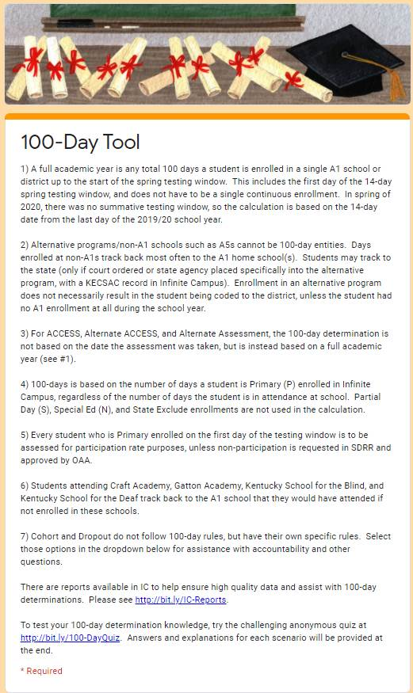
100-Day Tool
100 Day Tool
100 Day Quiz
Notes:
To help you determine 100-day accountability, we have developed the 100-day Tool. This is available under the I Need Help button or from the short URL displayed on the page. It is an anonymous accountability quiz you can use to test your knowledge and to challenge or train staff members.
https://goo.gl/Q05yvT - Anonymous accountability quiz if districts want to challenge/train the BACs or test own knowledge.
https://docs.google.com/forms/d/e/1FAIpQLSc9QQs4C44Z33vVpZ8fbzNVZfjjodgSzCPprPS2EPzty_TgyA/viewform -accountability tool.
https://docs.google.com/forms/d/e/1FAIpQLScEApZpVOwvb1MAEwXWAEvZ7FXkRCPLqLl-4mArGoaZOseyiA/viewform-
Anonymous accountability quiz if districts want to challenge/train the BACs or test own knowledge.

Slide 17
District Test Collection Windows
Notes:
We mentioned collecting the district test windows, earlier, but we are going into more detail here.

Slide 18
KSA Test Windows
KSA test windows for elementary, middle and high schools will be collected in SDRR.
District level users will be able to make changes to the KSA test windows.
School level users will have read-only access and cannot make changes to the KSA testing windows.
Collection window opens on March 12 and closes on March 28 (tentative).
OAA will pull from IC on the Friday before to populate the earliest start dates.
Notes:
Plan ahead - if you are going to be on Spring Break to put in your KSA test window for elementary, middle and high school before the SDRR closes.
Make sure your school calendars are up-to-date in IC a week prior to the KSA Test Window deadline closing on March 28.

Slide 19
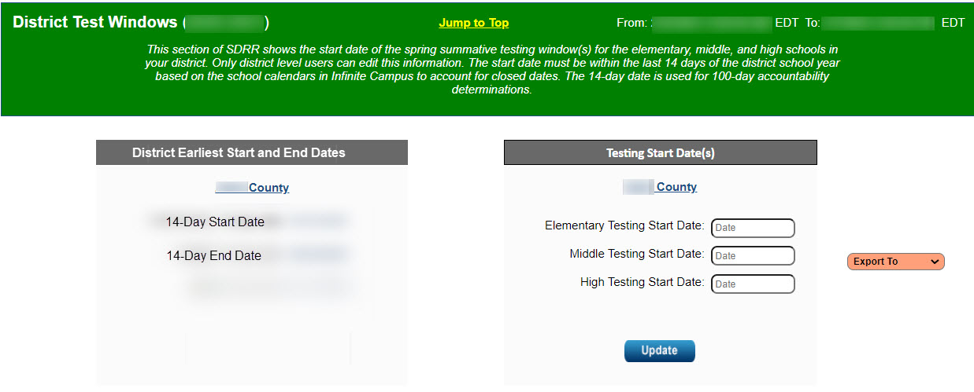
District Test Windows
Export to Excel
Downloads all test windows entered across the state.
Notes:
DACs can change the District Test Windows. BACs can only see the information. If the test windows are incorrect, please contact your DAC.
When you export the District Test Windows to EXCEL or PDF, you will be exporting all the test windows in Kentucky. This will assist you with determining accountability for your students.

Slide 20
Rosters
Notes:
SDRR URL
Applications - Login (ky.gov

Slide 21
KSA Rosters
Data is pre-populated from IC
Verify student enrollment in grades 3 - 8, 10 - 11.
Include all students enrolled as of the first day of the district 14-day testing window.
Change requests created for Nonparticipations:
Exemption: First Year EL, Medical
Roster Clean-up: Student Withdrew After Testing Window Began, Expelled Without Services
100-Day Students
Save an electronic version of all rosters in Excel or PDF format
Notes:
Verifying and updating student rosters for reporting purposes.
Students who are participating in the Alternate KSA should be included on the roster and designated as Alternate Assessment.
Students for whom a nonparticipation has been requested should be included on the roster.
If the student moved during the testing window, file a nonparticipation if the student withdrew after the testing window began.
If the student moved prior to the testing window, then annotate and delete the student off the roster.
Create a Change Request for:
Medical Nonparticipation
First Year EL
Change of Accountability
Student Withdrew After the Testing Window Began
Student Expelled Without Services
Save an electronic copy of each roster before the window closes. This will also capture any annotations added by the school for each student.

Slide 22
Updates for SDRR
Demographic data will be as the first day of the 14-day testing window based on the district calendar.
Districts will need to ensure that the school calendars are correct in IC.
OAA will pull data from IC as of the close of business on the Friday before all rosters open.
Notes:
Free and Reduced -Lunch, EL and IEP have a start and end date in IC and will be what OAA will be able to verify. Those fields will be based as of the 14-day testing window on the district calendar and not the end of the school year.

Slide 23
Medical Nonparticipation
Form allows the district to request the nonparticipation.
Required signatures on the form are District Assessment Coordinator (DAC) and a medical doctor, Superintendent or Designee.
Nonparticipations can be requested for individual contents or the entire test.
This request will encompass physical, mental, and emotional issues.
Keep a copy of this form on file in the district and upload the information into SDRR for approval.
Notes:
The Medical Nonparticipation will now see further use as some of the Extraordinary Circumstances reasons come over to it. The form includes all of the physical, mental, emotional and social issues that could necessitate a student being unable to participate in a state assessment.
Please enter the information into SDRR and wait for an approval, denial or request for additional information. You will continue to keep a copy of this form on-file in your district.
What did change with the Medical Nonparticipation form is that the Superintendent or Designee signature will be accepted in place of a doctor’s signature. The Designee could be the District Assessment Coordinator (DAC), if chosen by the Superintendent. This is a local decision.

Slide 24
IC Report Resources
District and school staff are strongly encouraged to utilize these tools to ensure accurate data in IC, which will then be reflected in SDRR.
IEP
IDEA Dec. 1 Count Extract
QA SPED report
Alternate Assessment
Alternate Assessment Tracking report
English Learners
English Learners Extract
Dropout
Dropout report
Cohort Graduation Rate
Enrollment End Status Validation report
G-Code Validation High School-Aggregate report
IC Reports to Assist in Data Quality document
Notes:
Links to these IC resources are in the I Need Help button in SDRR.
*The Dropout window was Jan. 10-22 and is not currently active.

Slide 25
Fields to Change on SDRR Roster in….
SDRR
Infinite Campus (IC)
Name
Grade
SSID
DOB
Gender
Race/Ethnicity
Lunch
IEP
EL
Annotations
Adding/Deleting Students
100-Day Entity Changes
Nonparticipation
Accommodations-IEP and EL
If IC change (except IEP) is not reflected in SDRR by the next day, contact kdedatarequest@education.ky.gov
Notes:
Most information during rostering is changed in IC rather than SDRR – including Name, SSID, Date of Birth, Gender, Race/Ethnicity, EL, Grade and Lunch Status. If information that has been updated in IC (except IEP) is not reflected in SDRR by the next day, please email the Enterprise Data–KSIS team at kdedatarequest@education.ky.gov, providing detailed information, and they will assist you.
*Contingent on the student being enrolled in infinite campus. If the student is not currently enrolled in Infinite Campus a ticket needs to be filled out in the SDRR.

Slide 26
IEP Field in SDRR (Helpful Hints)
IEP values in IC:
Verify the student has a current Individual Education Program (IEP) and is using the appropriate assessment accommodations.
IEP must be completed appropriately. Please contact program area for additional assistance.
Verify that the IEP is locked and current.
If IEP change is not reflected in SDRR by the next day, please contact Amy Patterson in the Office of Special Education and Early Learning
Notes:
Amy Patterson, Office of Special Education and Early Learning (OSEEL)
502 564-4970
Amy.Patterson@education.ky.gov

Slide 27
EL Field in SDRR (Helpful Hints)
Correcting the EL values in IC:
Mark the student as EL
Home language other than English:0400
Mark at least one instructional accommodation
Mark at least one program services type (cannot be just declined services)
If IC change (except IEP) is not reflected in SDRR by the next day, contact kdedatarequest@education.ky.gov
Notes:
Most information during rosters is changed in IC rather than SDRR – including Name, SSID, Date of Birth, Gender, Race/Ethnicity, IEP, EL, Grade and Lunch Status. If information that has been updated in IC (except IEP) is not reflected in SDRR by the next day, please email the Enterprise Data–KSIS team at kdedatarequest@education.ky.gov, providing detailed information, and they will assist you.
The program services type must be SEI- Sheltered English Immersion if parents decline services.

Slide 28
Roster Dates and Activities
Activity | Opens | Closes | Fields/Comments
District Test Window | March 12 | March 28
Spring Rosters | April 24 | June 12
AKSA KSA ACCESS Alternate ACCESS Postsecondary Readiness |  |  | Accommodations used on test collected (IEP, EL) with a yes/no option, Nonparticipation, 100-Day Students Spring Rosters as of the first day of the district 14-day test window and Annotations.
ALL DATES TENTATIVE
Districts will wait to mark the 100-day students during spring rosters.
Demographic changes are made in Infinite Campus (IC)
Notes:
Annotations are for district-use only. Everything is organized by test in SDRR. It is important that districts “Get the rosters right”.
The Quality of School Climate and Safety Survey is administered as a part of the KSA assessment and will not have a separate roster.
ACCESS and Alternate ACCESS rosters are open for nonparticipation entries from Jan. 5 thru March 7 . These rosters will close for a week and re-open with the rest of the Spring Rosters (populated) on April 24 .
The ACCESS and Alternate ACCESS rosters are not populated with student names. Please enter Medical Nonparticipations and other nonparticipation reasons for these assessments. Once the ACCESS rosters are closed and re-open for Spring Rostering, they will contain student names pulled from Infinite Campus and include any entered nonparticipation information.
The District Test Window Collection runs from March 12 through March 28. This is when you tell us when your test windows will be. Remember, we check this against Infinite Campus, so get into IC and make certain the calendar is up-to-date! There will be one refresh of data from IC into SDRR for the District Test Window. Please update your IC calendars a week in advance of the window to have the most accurate information.
The Postsecondary Readiness will show students marked as Grade 12 or Graduated during this school year in IC. This is the time to make certain all of your potential graduates are included. Questions concerning Career or TEDS data may be directed to Holly Tracy or Claude Christian in the Office of Career and Technical Education.

Slide 29
Resources

Slide 30
SDRR Resources
I Need Help
100-Day Tool
100-Day Quiz
Cohort Tool
Sandbox
Step-by-Step Instructions: Marking Accommodations, Change 100-Day Entity, Request Nonparticipation, etc.
Screencasts of the Step-by-Step Instructions.
Session for District and School Level Users on SDRR Functionality during Spring Rosters.

Slide 31
New for 2024 SDRR “Hot Topic” Office Hours

Slide 32
SDRR “Hot Topic” Office Hour- #1
Topic, Date, Participants and Login for each Office Hour in TEAMS:
SDRR Resources: Where to Get Assistance- April 16- 1-2 p.m. ET- All SDRR Users
Join on your computer, mobile app or room device
Click here to join the meeting
Meeting ID: 296 016 322 043 Passcode: jWXVYr
Download Teams | Join on the web
Or call in (audio only)
+1 502-694-1960,,275973152# United States, Louisville
Phone Conference ID: 275 973 152#

Slide 33
SDRR “Hot Topic” Office Hour- #2
Topic, Date, Participants and Login for each Office Hour in TEAMS:
Spring Rosters Task List and Ticketing Basics- April 23- 1-2 p.m. ET- New District Assessment Coordinators (DACs) and Building Assessment Coordinators (BACs)
Join on your computer, mobile app or room device
Click here to join the meeting
Meeting ID: 214 926 929 879 Passcode: L4kmWp
Download Teams | Join on the web
Or call in (audio only)
+1 502-694-1960,,686365063# United States, Louisville
Phone Conference ID: 686 365 063#

Slide 34
SDRR “Hot Topic” Office Hour- #3
Topic, Date, Participants and Login for each Office Hour in TEAMS:
Do’s and Don’ts of Requesting Nonparticipations - April 30- 1-2 p.m. ET- All SDRR Users
Join on your computer, mobile app or room device
Click here to join the meeting
Meeting ID: 246 861 607 752 Passcode: dX2xmt
Download Teams | Join on the web
Or call in (audio only)
+1 502-694-1960,,4493734# United States, Louisville
Phone Conference ID: 449 373 4#

Slide 35
SDRR “Hot Topic” Office Hour- #4
Topic, Date, Participants and Login for each Office Hour in TEAMS:
Determining 100-Day Accountability: Rules and Tools- May 7- 1-2 p.m. ET- All SDRR Users
Join on your computer, mobile app or room device
Click here to join the meeting
Meeting ID: 287 301 830 594 Passcode: pdMabC
Download Teams | Join on the web
Or call in (audio only)
+1 502-694-1960,,849476642# United States, Louisville
Phone Conference ID: 849 476 642#

Slide 36
SDRR “Hot Topic” Office Hour- #5
Topic, Date, Participants and Login for each Office Hour in TEAMS:
Digging into Demographics: Infinite Campus (IC) Values and SDRR- May 14- 1-2 p.m. ET- All SDRR Users
Join on your computer, mobile app or room device
Click here to join the meeting
Meeting ID: 226 018 488 394 Passcode: GBdqLk
Download Teams | Join on the web
Or call in (audio only)
+1 502-694-1960,,732429260# United States, Louisville
Phone Conference ID: 732 429 260#

Slide 37
2024 February DAC Hybrid Q&A Session Date/Locations
Feb. 5 – Frankfort – Sower Building
Feb. 15 – Ashland – Kentucky Education Development Corporation
Feb. 21 – Eddyville – West Kentucky Educational Cooperative
Please Note: Virtual Team Meetings are available for each date. If weather or other circumstances impact an in-person session, the Q&A session will be held online.
Notes:
.

Slide 38
Feb. DAC Recorded Trainings Available
Kentucky Summative Assessment (KSA)
KSA PearsonAccess^{next} (PAN)
TestNAV
Alternate Kentucky Summative Assessment (AKSA)
SDRR
Test Security
Accommodations
High School
Notes:
Since the live Q&A sessions will not include full presentations of content already covered in the video recordings, DACs and BACs should be prepared for the Q&A sessions. Before attending the Q&A Sessions, DACs and BACs can be prepared by watching all (or pertinent) training videos on the administration of Spring 2024 spring assessments.

Slide 39
2024 February DAC Hybrid Q&A Session
Time | Topic
9:00 | Welcome and Updates
 | Kentucky Summative Assessment (KSA) including PAN & TestNAV
10:15 - 10:30 | Break
 | Alternate Kentucky Summative Assessment (AKSA) & Accommodations
 | High School and Test Security
 | SDRR
 | Open Floor Questions
Noon | Conclusion
Please Note: The February DAC Q&A sessions will follow the same topics and timeframe at each location. The agenda and times on the slide will be followed; however, once an agenda item has no additional questions, staff will move on to the next topic. Participants planning to attend should plan for the entire meeting.
Notes:
The February DAC Q&A sessions will follow the same topics and timeframe at each location. The agenda and times on the slide will be followed; however, once an agenda item has no additional questions, staff will move on to the next topic. Participants planning to attend should plan for the entire meeting.

Slide 40
Division of Assessment and Accountability Support
OAA/DAAS Staff:
Jennifer Stafford, Director
Shara Savage, Branch Manager
Helen Jones, Program Manager
Ben Riley, Systems Consultant
Chris Williams, Program Consultant
Melissa Chandler, Program Consultant
Christen Roseberry, Program Consultant
Lisa Jett, Program Consultant
Krista Mullins, Program Consultant
Tammy Bradley, Division Administrator
OAA/DAAS (502) 564-4394
dacinfo@education.ky.gov

