Slide 1
Progress Update: 2030 Gap Goal
Aaron Butler
Hannah Poquette
Presentation for Kentucky Board of Education on December 6, 2017.

Slide 2
Summary
In order to close the proficiency gap in reading for grade 3 students, an additional 9,734 underserved students would have to move to proficiency.
There is considerable variation in the number of underserved students that schools and districts must move to proficient in order to reach the 2030 achievement gap goal.
Schools with similar populations of Free and/or Reduced Price Lunch (FRPL) eligible and minority students may differ in their achievement gap goal.
Given school demographics, several schools can be identified as showing promising potential in closing the achievement gap.

Slide 3
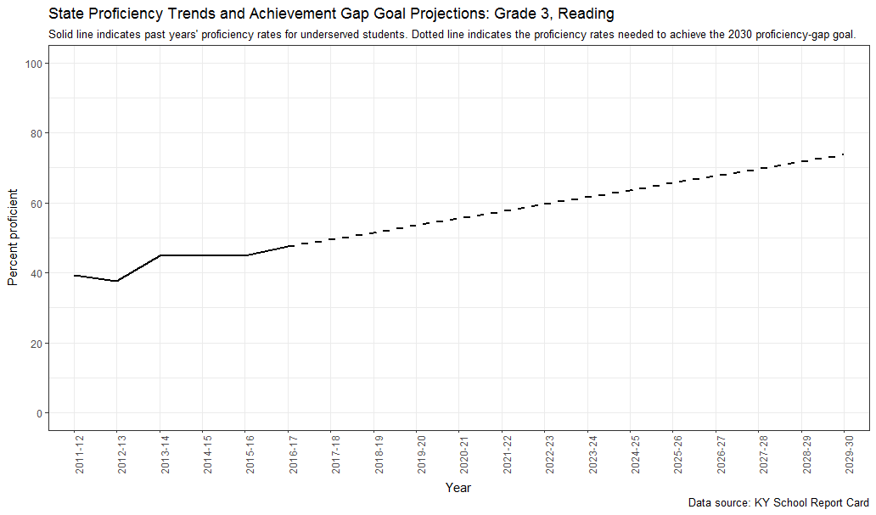

Slide 4
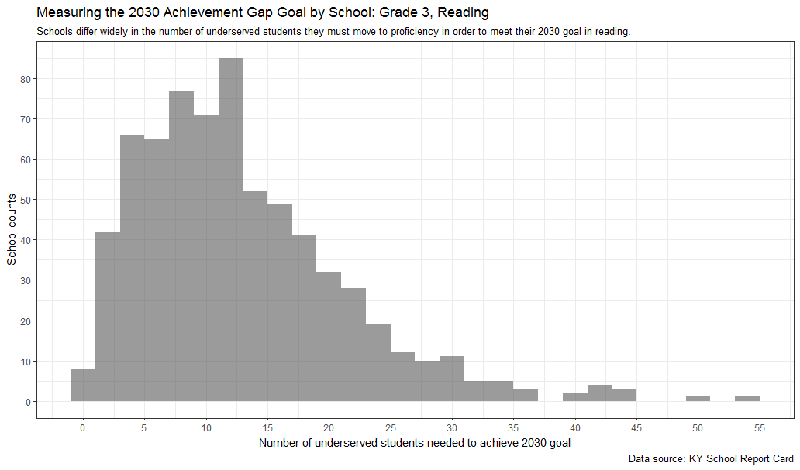

Slide 5
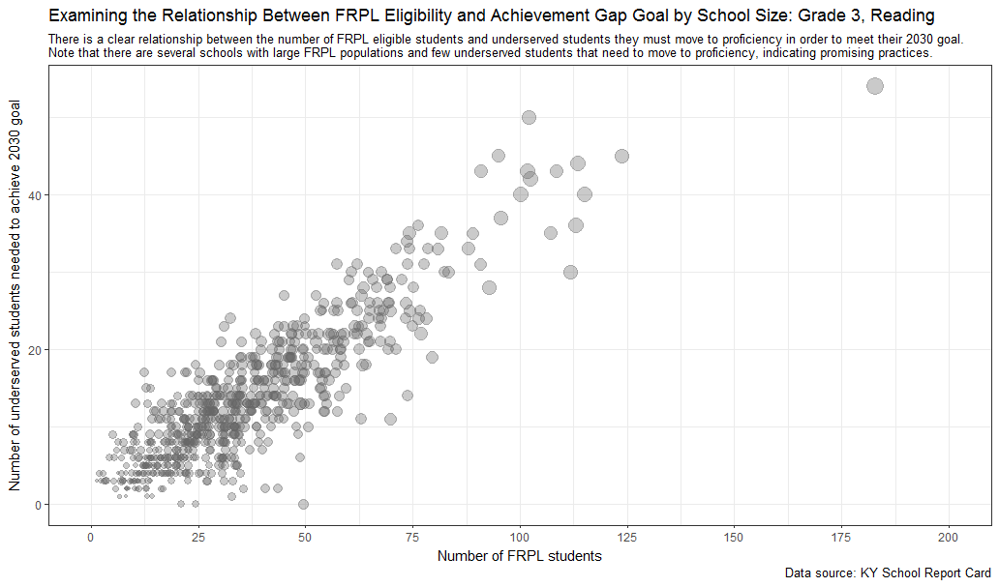

Slide 6
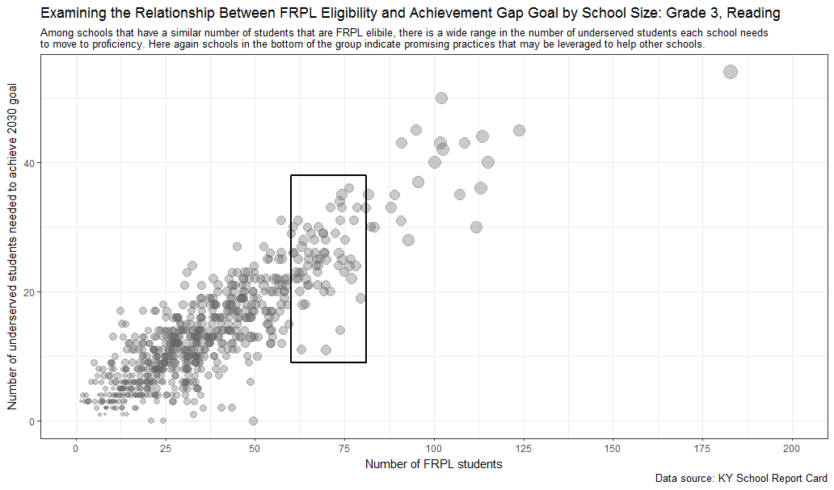

Slide 7
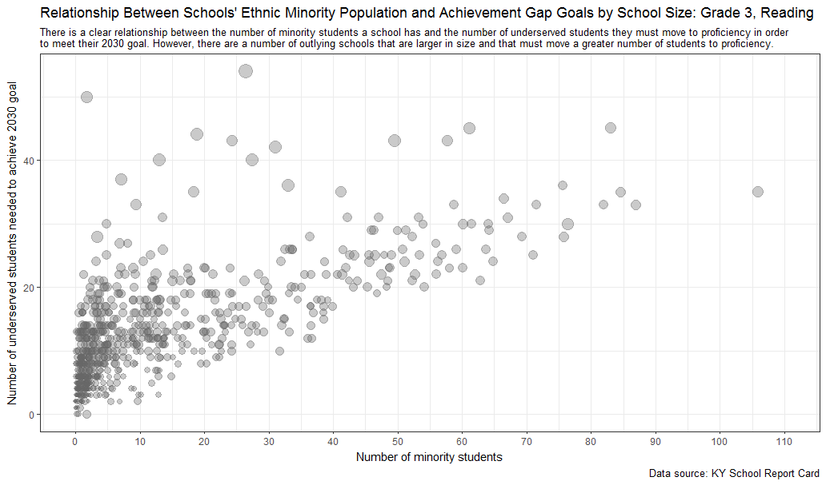

Slide 8
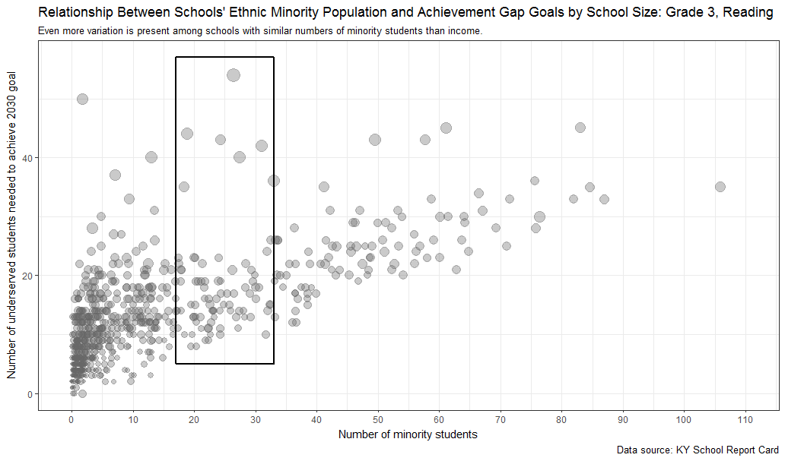

Slide 9
