Slide 1
Infinite Campus Health Overview
Angie McDonald, RN
Student Health Services/Division of District Support
Kentucky Department of Education

Slide 2
What is Infinite Campus?
Infinite Campus is a Web-based student information system (SIS) used by thousands of K-12 districts across the United States. Infinite Campus allows districts to streamline student administration of information on students including health, enrollment, food service/meal balances, and messaging students and parents.

Slide 3
Health
Since this is an educational based program, health, unfortunately was an afterthought and the core health product is minimal.
Districts have the ability to customize many areas of health. Setting up each district's health documentation choices can be very time consuming. However, it only has to be completed once and any person with health rights for that district has access.

Slide 4
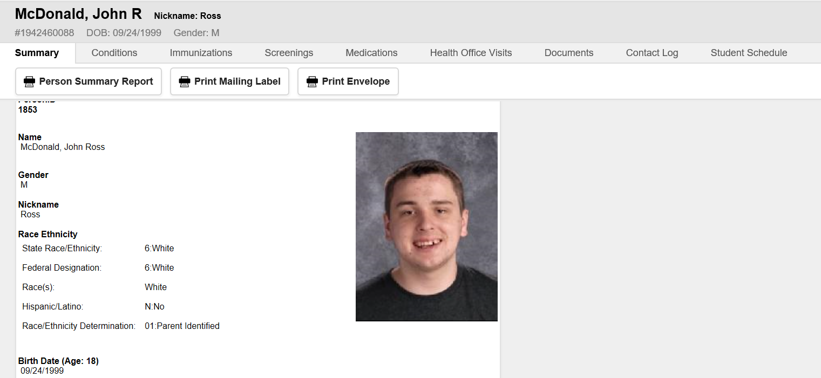
Photo here, when available
This is the health home screen, you will find the student photo (if available), and demographics.

Slide 5
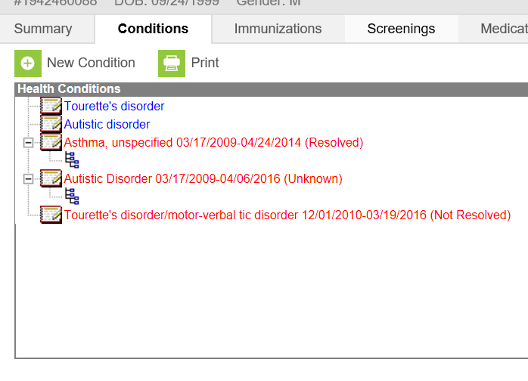
Health Conditions Tab
Health staff can add new student health conditions.
Current conditions are in blue, resolved conditions are in red.

Slide 6
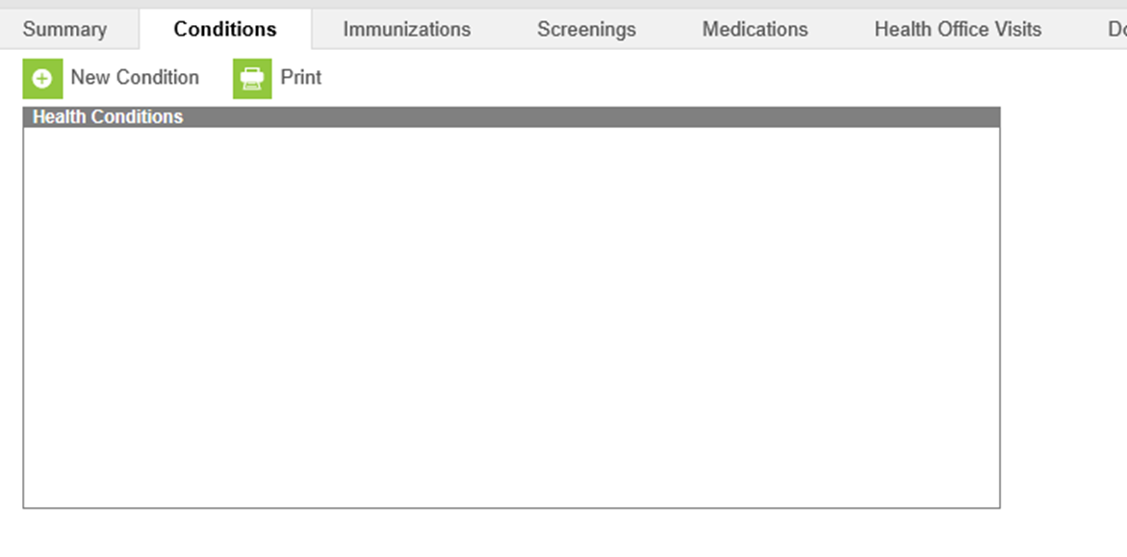
Blank10
Click on the conditions tab
Click on “New Condition”

Slide 7
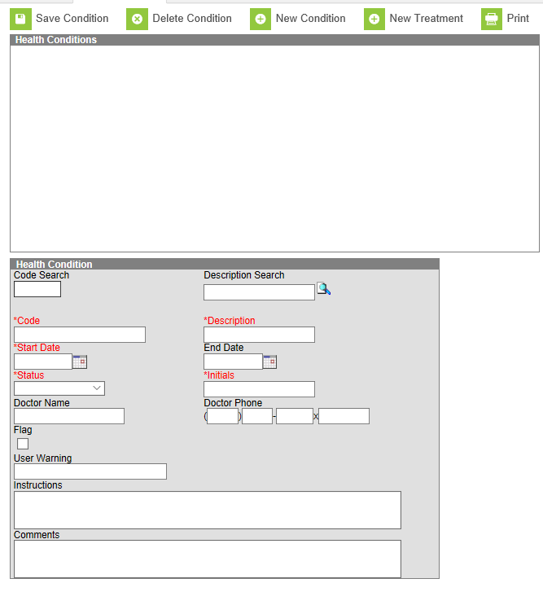
Conditions 1
Type in the name of the condition you are looking for. (Ex. Asthma)

Slide 8
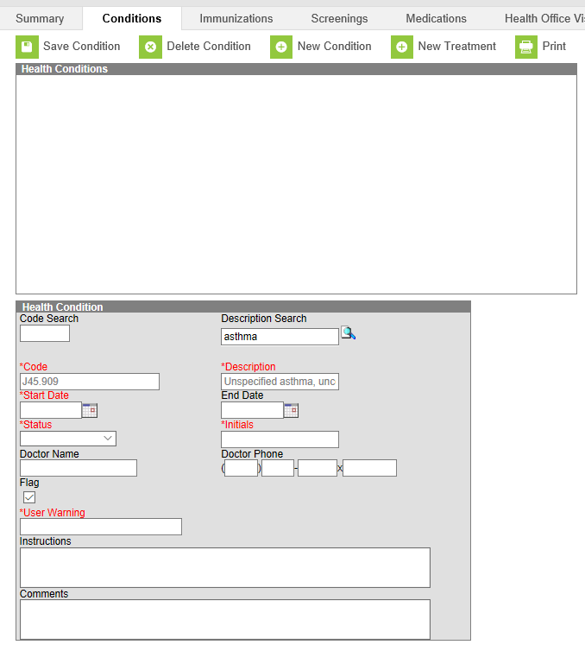
Conditions 3
Complete the red, required boxes.
User Warning box is what teachers will be able to see. Ex. “carries inhaler”
Also, check the flag box.
Finally, click the “Save Condition” button.

Slide 9
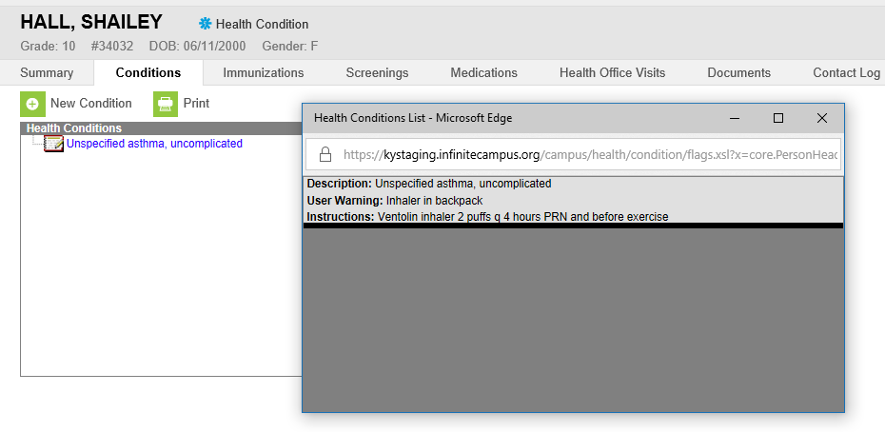
Conditions 4
Once the health condition has been saved, a symbol and health condition alert will appear next to the student’s name. If a teacher or other staff member hovers over the words “health condition” the user warning will appear. If they click on it, this box will open.
If, at any time you would like to review or change the health condition information, double click on the actual health condition and the box will open.

Slide 10
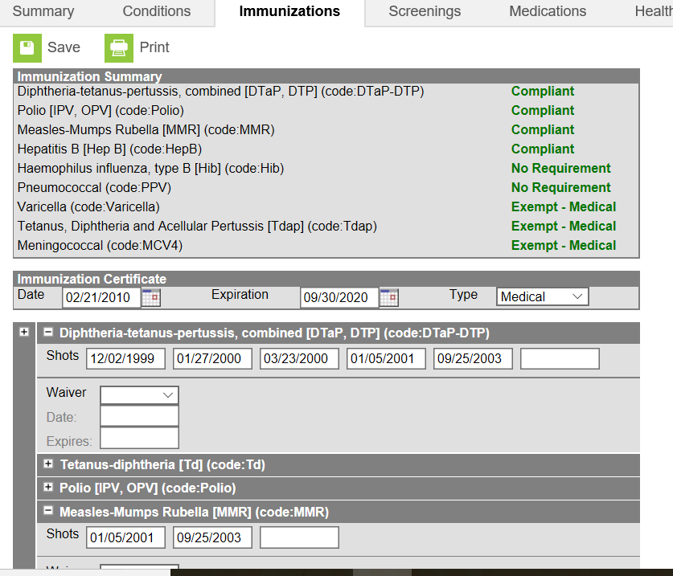
Immunization Tab
Immunization information is entered here. KDE only monitors that students have a current certificate (items in blue) but if the individual immunizations are entered, the data can be used for the yearly immunization survey.

Slide 11
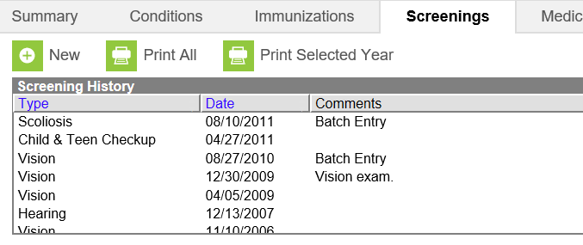
Screenings Tab
Student physical exams, dental and vision exams or screenings, as well as any other health screenings or exams are entered here.
There is a batch entry function to enter mass screenings in less than a minute.

Slide 12
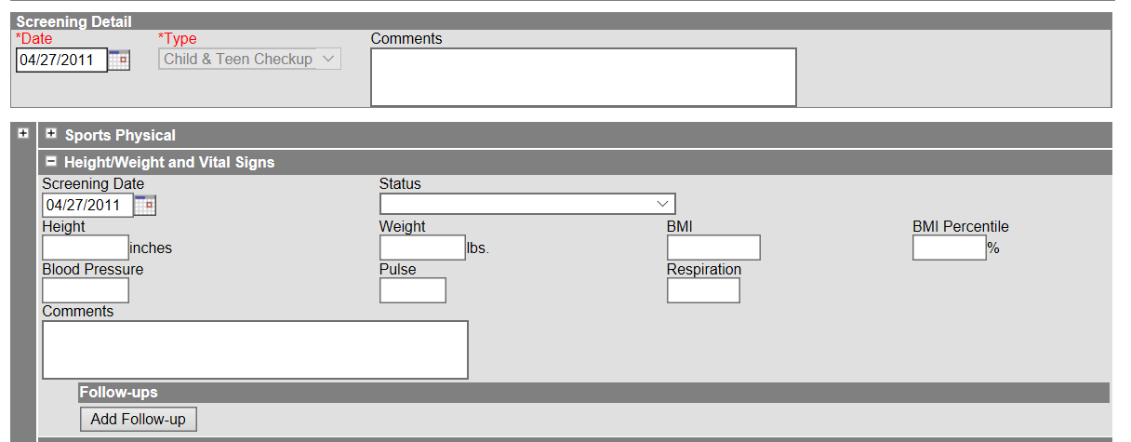
Entering screenings/exams
Data entry of screenings and exams take a minute or so and dropdown boxes allow users to choose the exam/screening type.
See how to enter exams and screenings PowerPoint on Student Health Services Infinite Campus webpage.

Slide 13
Medications Tab
One of the most used aspects of IC health.
Allows you to track student doses of medications.
Schedule medication doses as well as track prn medications
Allows staff to chart medication administration in a matter of a few clicks of the mouse.

Slide 14
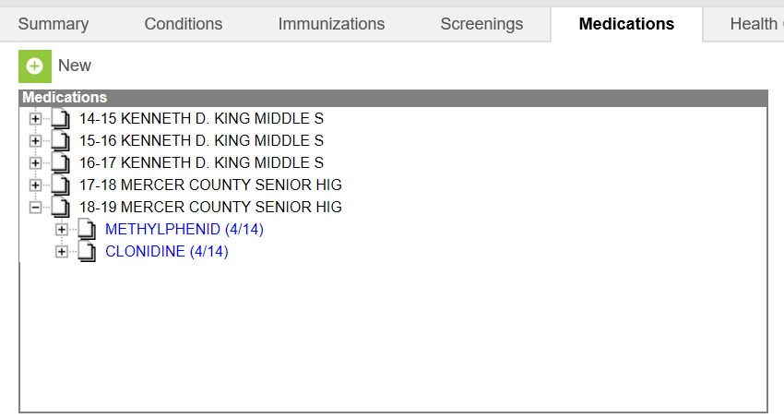
Medications
Medications are grouped by school year so medications can be viewed at a glance.
You can also track how many doses of medication is available.

Slide 15
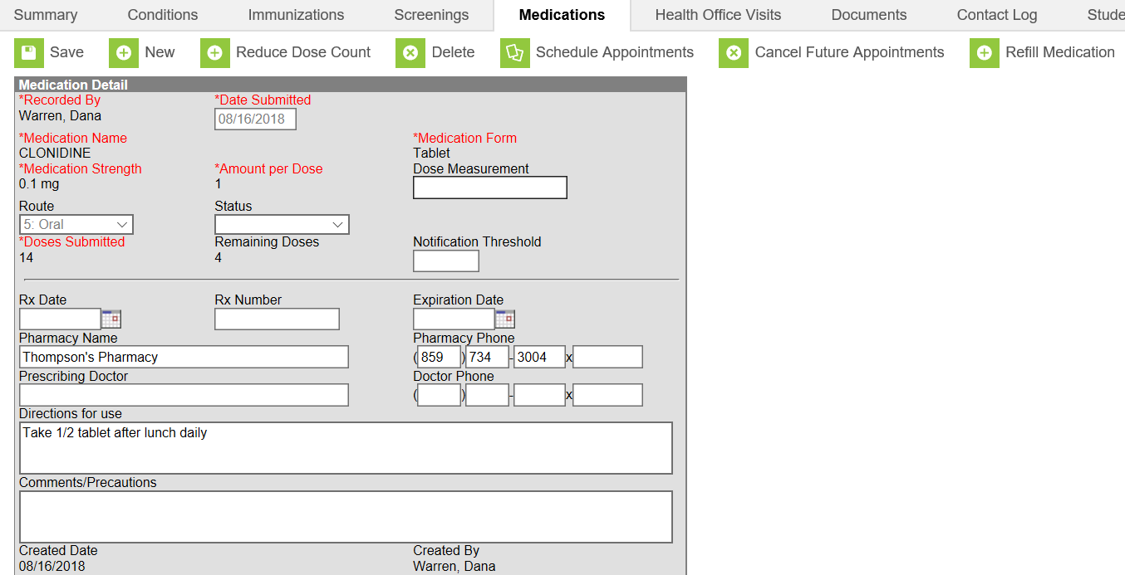
Blank
Medication dosage, pharmacy and MD information is entered here.
You can also schedule appointments, cancel appointments and change dose count.

Slide 16
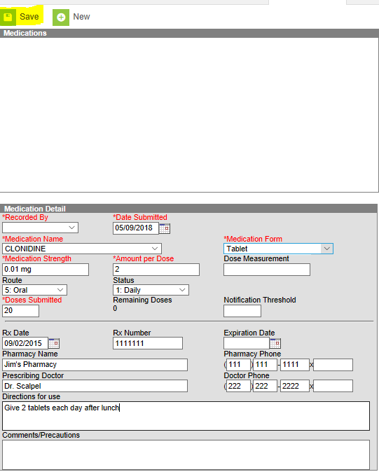
Continued 2
After you click, New, the Medication Detail box will appear. Enter the information requested in the boxes. Under Medication Name, many medications are already listed in the drop down box. If the medication is not listed, it can be added in the system administration tab, but for now, let’s choose a medication that is already listed.

Slide 17
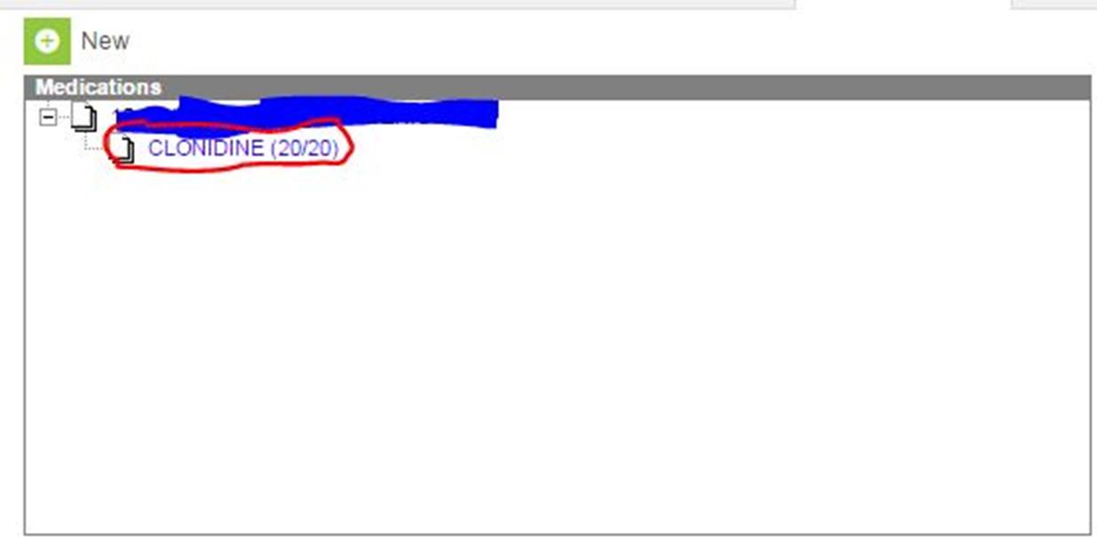
Continued4
After you save the medication, the box should look like this. The school name and school year should be listed in the area I have marked out with blue. Notice, the medication, and the number of doses you have are listed.

Slide 18
Continued 5
Now that you have entered your medication, all you need to do is schedule your medications!

Slide 19
Scheduling medications
To schedule a medication, click on the name of the medication and the following box should open.

Slide 20
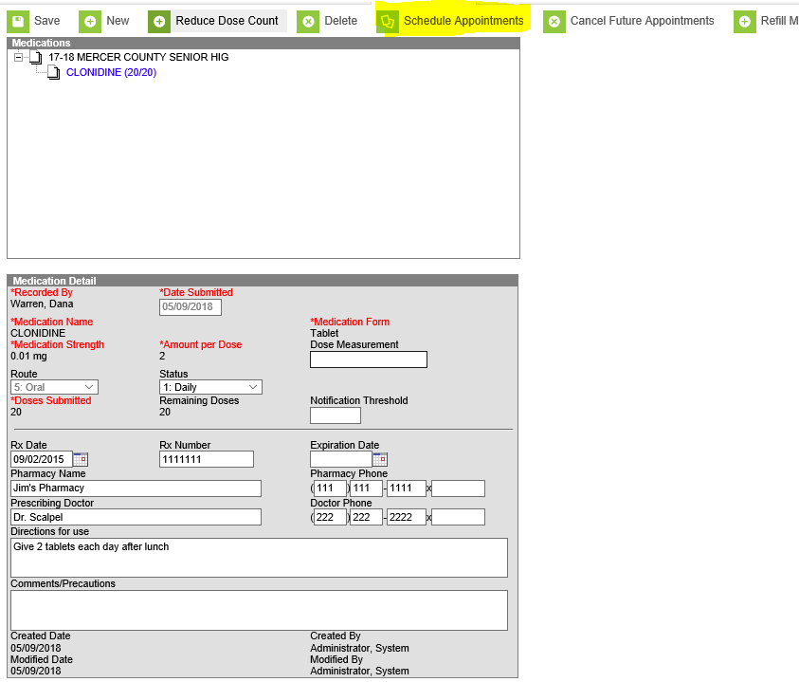
Appointments 2
Click on the Schedule Appointments tab above the boxes.

Slide 21
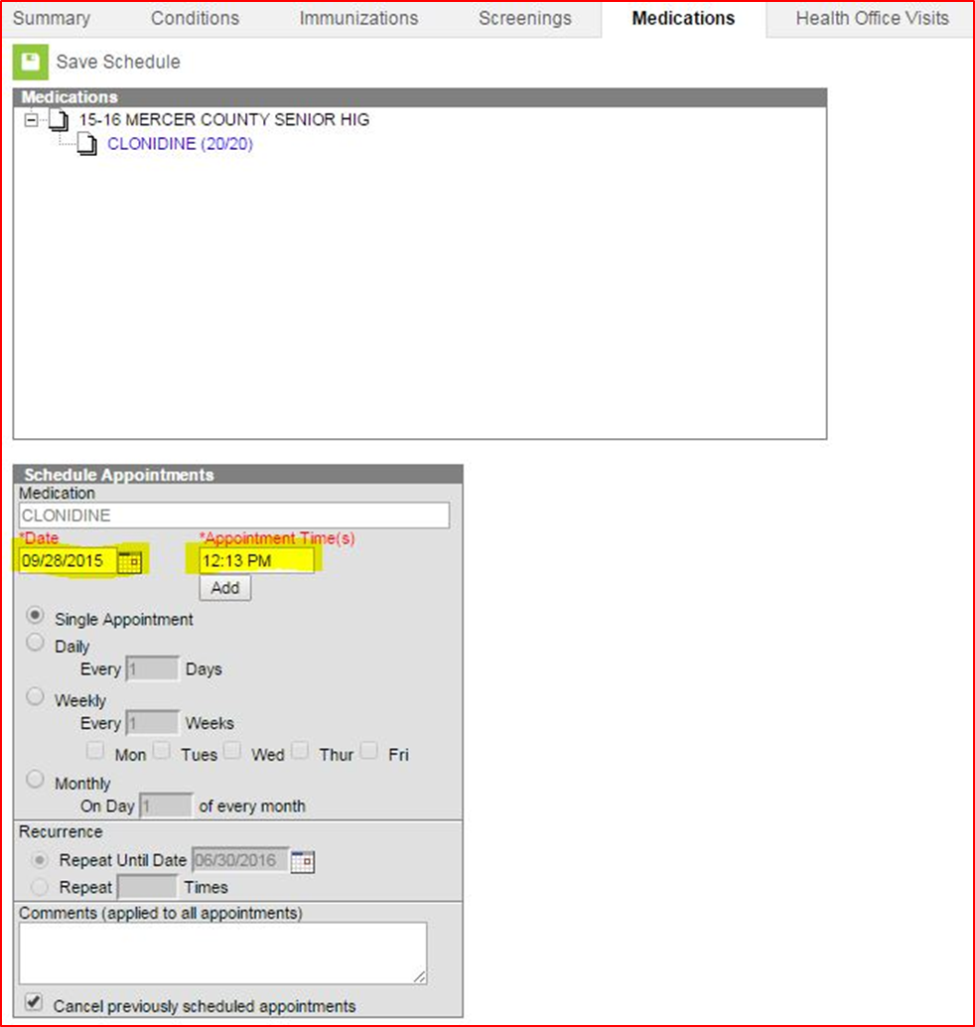
Appointment 3
In the Date box, enter the date that you will begin entering the medication. In the Appointment Time(s), enter what time you plan to administer the medication. If you will be giving the same medication and dosage, at multiple times of the day, click ADD under the appointment time box and you can enter an additional time.

Slide 22
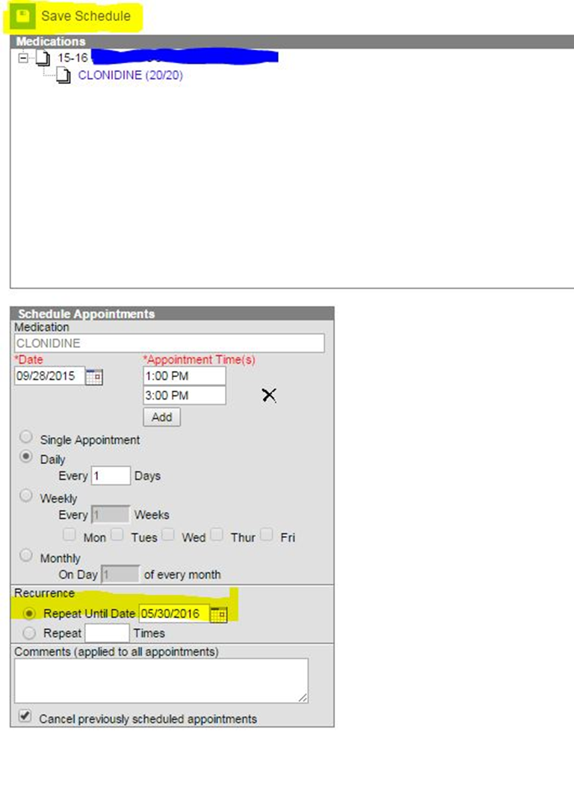
meds
In the Recurrence box, list the last day the medication is ordered for, usually the last day of the school year. Once you enter the frequency and recurrence, click on Save Schedule.

Slide 23
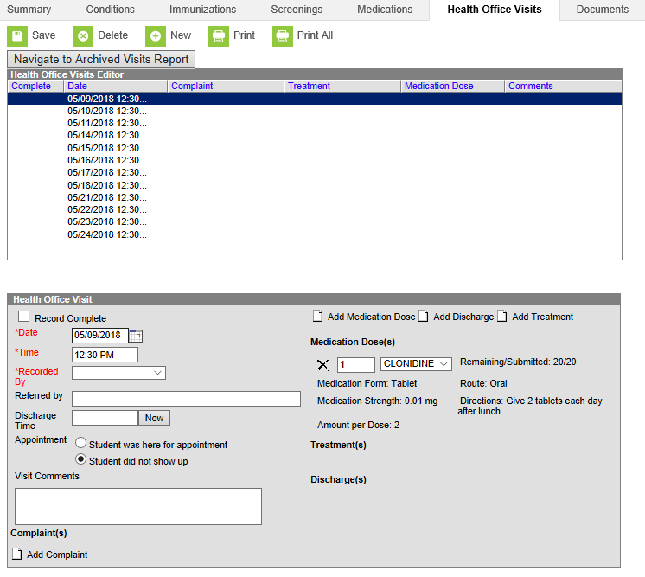
Meds continued
Now when you click on that student’s Health Office Visits Tab, you will see all the scheduled appointments listed in the upper box. When that student comes for his medication, you click on the correct date and time and the lower box appears.
Scheduled health office visits

Slide 24
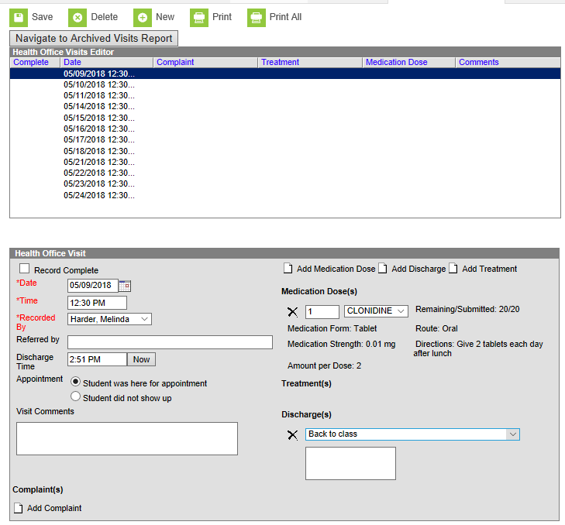
Appointments 4
After you administer the medication, check the Record Complete box, enter the time they were discharged and that they were here for appointment. Then, click Add Discharge, and choose from the drop down box the appropriate response.
After you have finished entering this, then click Save in the upper Left hand corner.

Slide 25
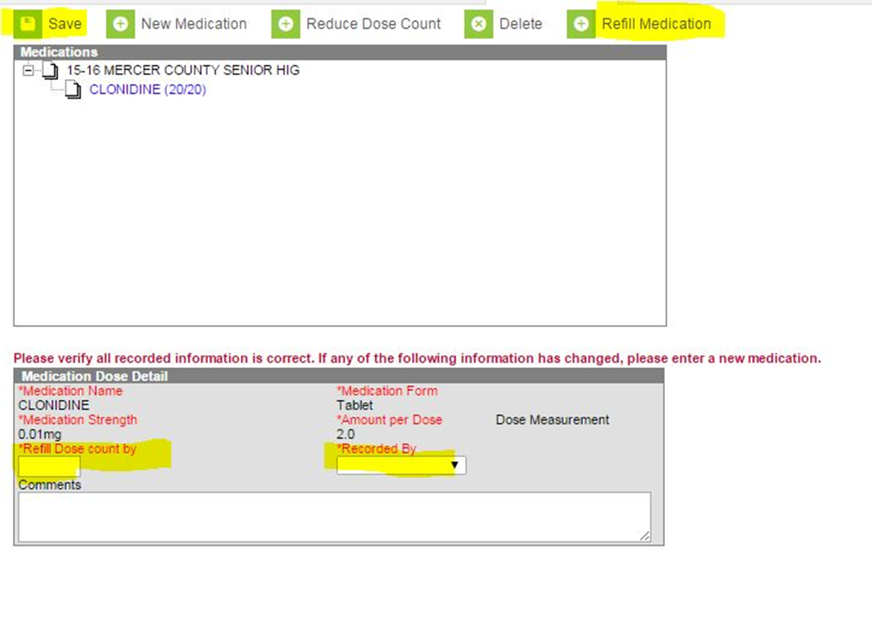
Med schedule
What do you do when you give all the medication and Mom brings in more? Simply click on the Refill medication tab and the bottom box will pop up. Enter the number of Doses sent in, not pills, Recorded by, and then Save. This will reset your pill count.
If you need to reduce the dose count for any reason, click on the “reduce dose count” button. This box will appear and you enter the correct number of pills in the reduce dose count by box, recorded by and finally save.
Notes:
Conversely, if you need to subtract pills, for instance the day before fall break begins and Mom comes to pick up pills to have enough medicine over break, you would click the “Reduce Dose Count” button. You would then complete the “Reduce Dose count by” and “Recorded by” buttons, then click “Save.”

Slide 26
Medications not listed in Campus
Now, lets show what we do if you have a medication that is ordered and isn’t listed in the drop down box of medication names.

Slide 27
Meds not in Campus2
On the left hand side, go to the Index tab, then scroll down toward the bottom of the page to:
System Administration
Health
Medication Name

Slide 28
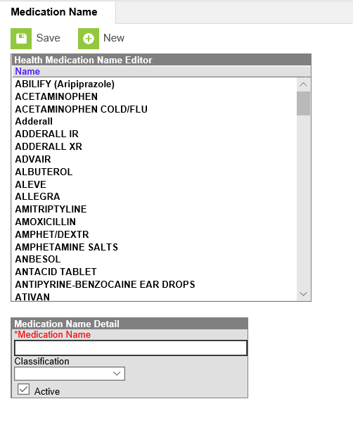
Adding new meds to Campus
Type in the name of the new medication that you would like to add. Choose the drug classification from the drop down box and click “Save”.

Slide 29
Documenting Medications
Now that the medication is entered and scheduled, how do I document it?
There are three ways to accomplish this, all are very simple.

Slide 30
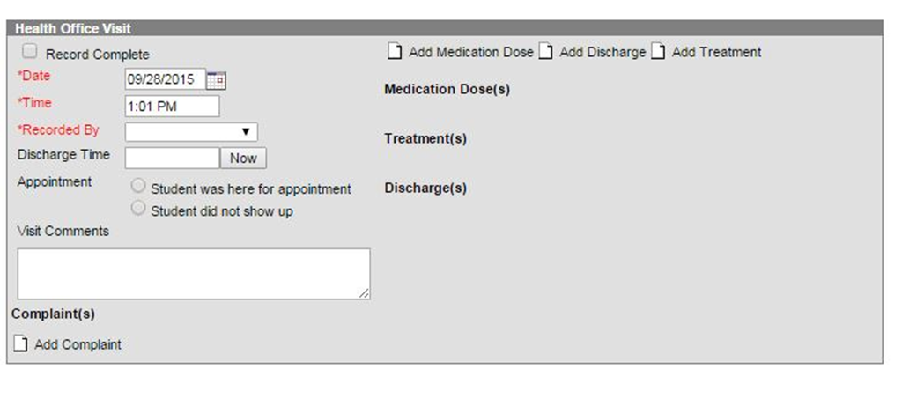
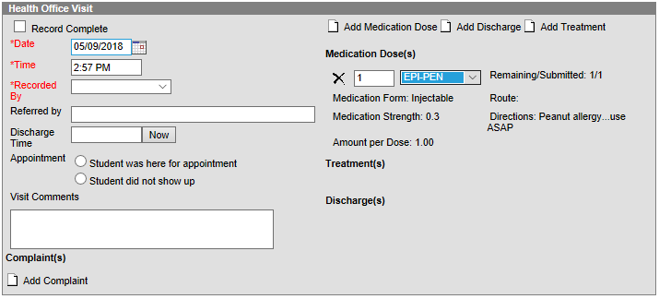
Charting medications
Option 1:
Open a new health office visit box and click, Add Medication Dose
A drop down box should appear, click on the drop down box and click on the medication name. The form, strength and amount per dose should appear. Complete the health office visit record as usual and save. Your medication has been documented!

Slide 31
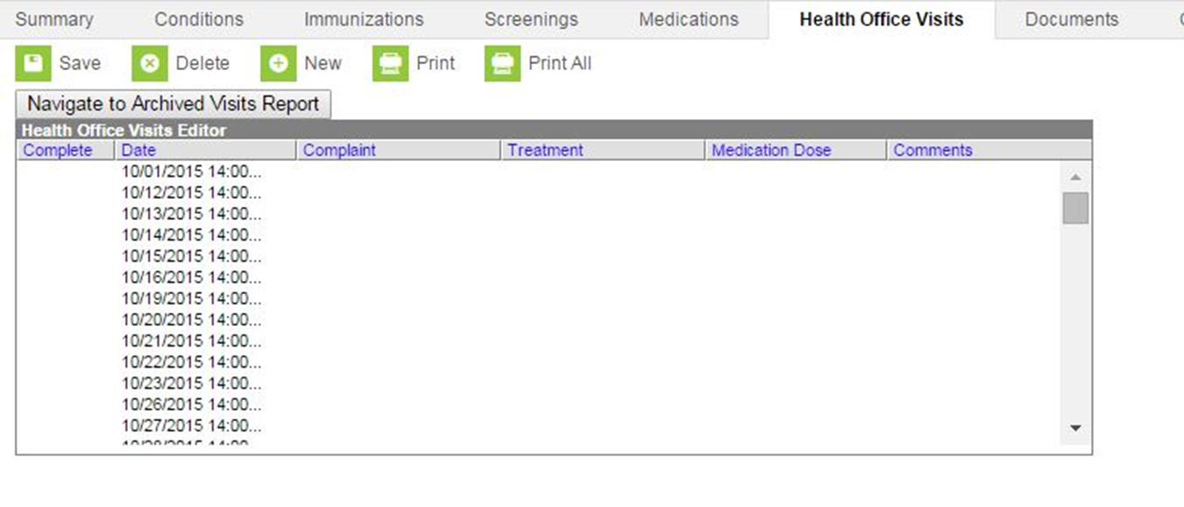
charting
Option 2:
As I previously mentioned, pull up the student and go to the health office visits tab, all the scheduled visits are listed. Choose the visit you would like to document and double click on it. The most recent health office visit will be listed at the top.

Slide 32
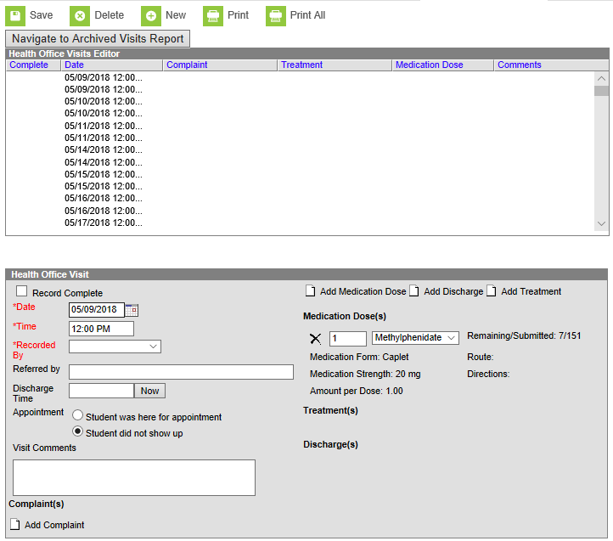
Medication health office visit
The health office visit box will open, complete the documentation and click the save button.

Slide 33
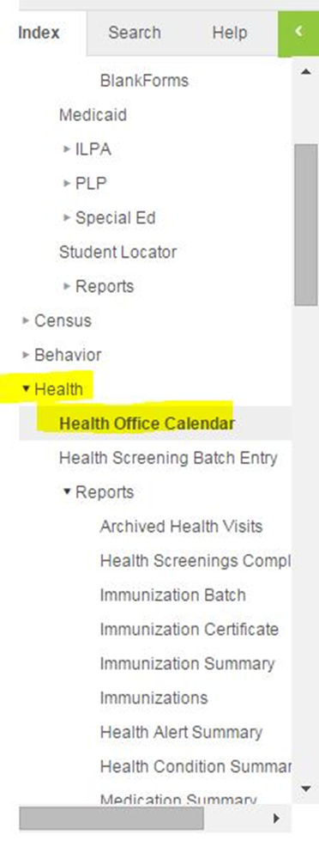
Health Office Calendar
The 3rd option is to use the Health Office Calendar. Go to the index tab, then go to the second health tab > Health Office Calendar

Slide 34
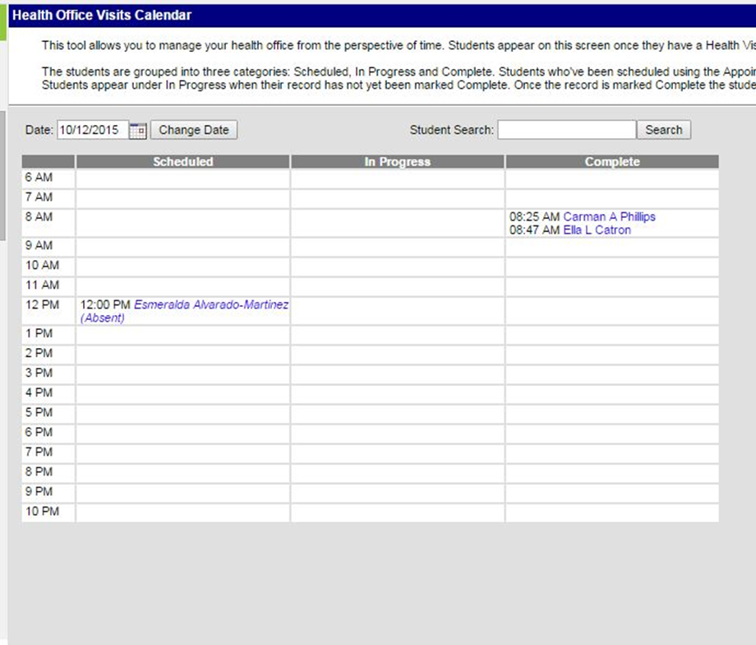
calendar
In the Health Office Visits Calendar, in the first column, named Scheduled, all students who have scheduled health office visits are listed. Choose the student you need and double click on the name. The correct health office visit will open and you can finish your documentation. Once you click save, the student’s name will move from the first column, Scheduled, to the last column listed Complete.

Slide 35
Health Office Visits (HOV)
At the HOV tab, you can see all student health office visits in a glance.
To start a new health office visit, click the “New” button.

Slide 36
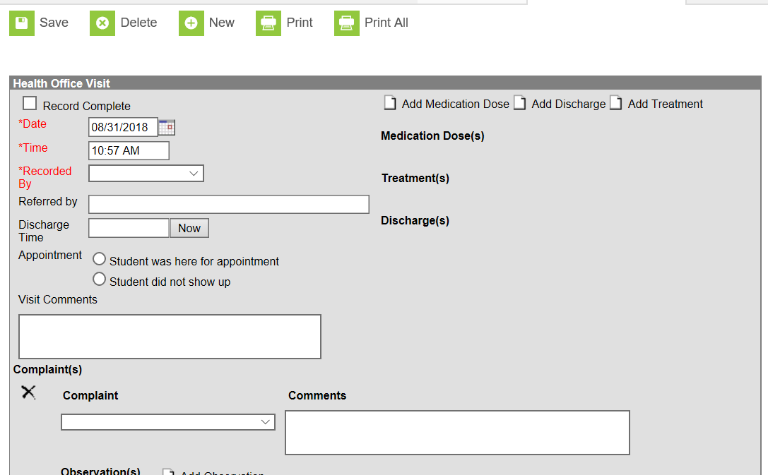
Office Visits
Notes:
When you click on the “New” button, this box will appear. The more information you enter in the drop down boxes, the more data you can extract in reports.

Slide 37
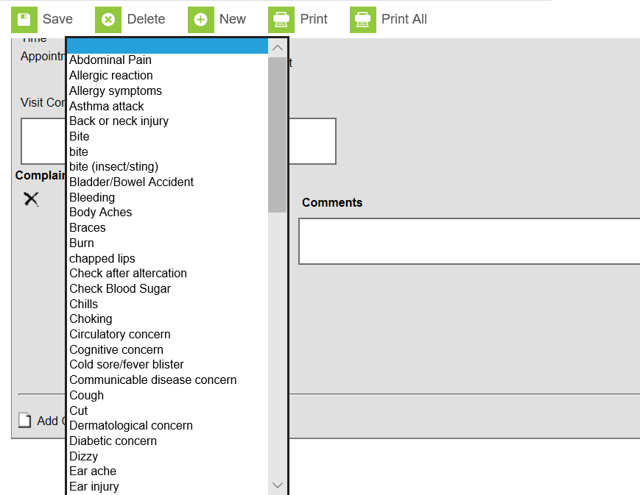
Blank2
After clicking “add complaint” a dropdown box will appear. IC will allow you to add any complaint as a choice.
Notes:
Districts can customize all items in the dropdown boxes to suit the needs of their district. See KDE student health services IC webpage

Slide 38
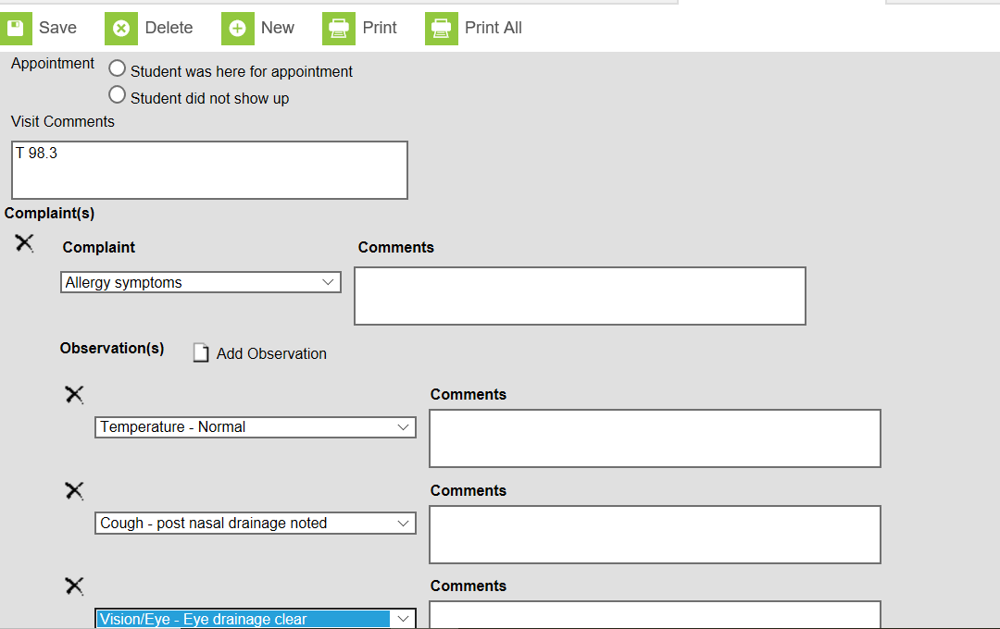
Blank3
Click the Observation button to add as many observations as needed
Anything that you can’t use a dropdown box for such as a temperature, blood sugar, wound measurement or other description, should go in the “visit comments” box.
Notes:
Avoid typing in the other “Comment” boxes as the data boxes as the data won’t pull in reports

Slide 39
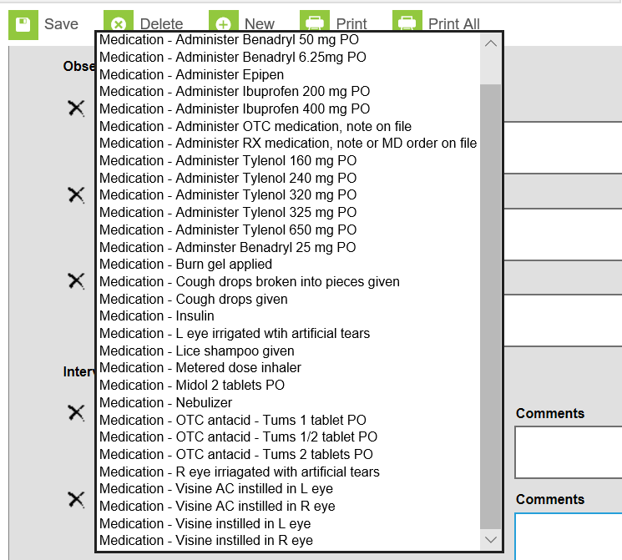
Blank 4
Next, click the Interventions button and then choose the correct choice from the dropdown box.

Slide 40
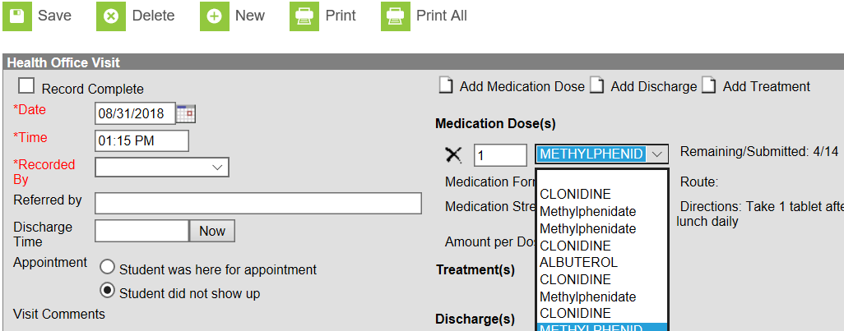
Medications During HOV
If scheduled or prn medications are administered, click the “add medication dose” button and a dropdown with all entered medications will appear and the dose and directions will appear.

Slide 41
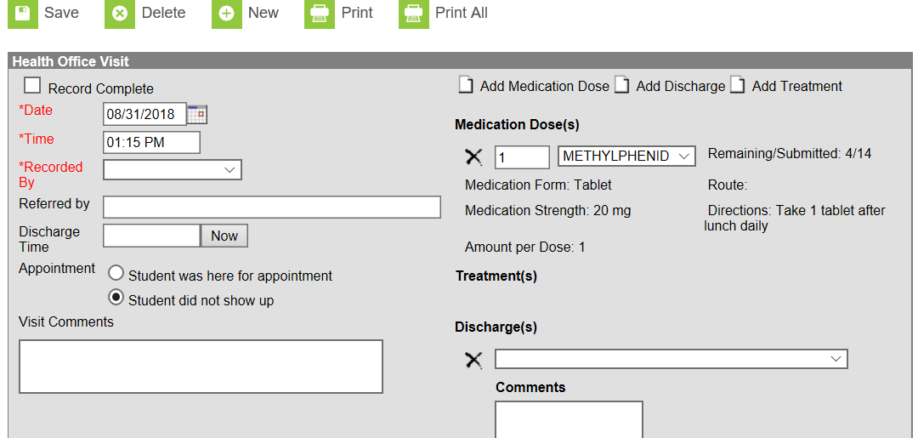
Blank4
When you have finished documenting, click the add discharge button and choose from the dropdown list

Slide 42
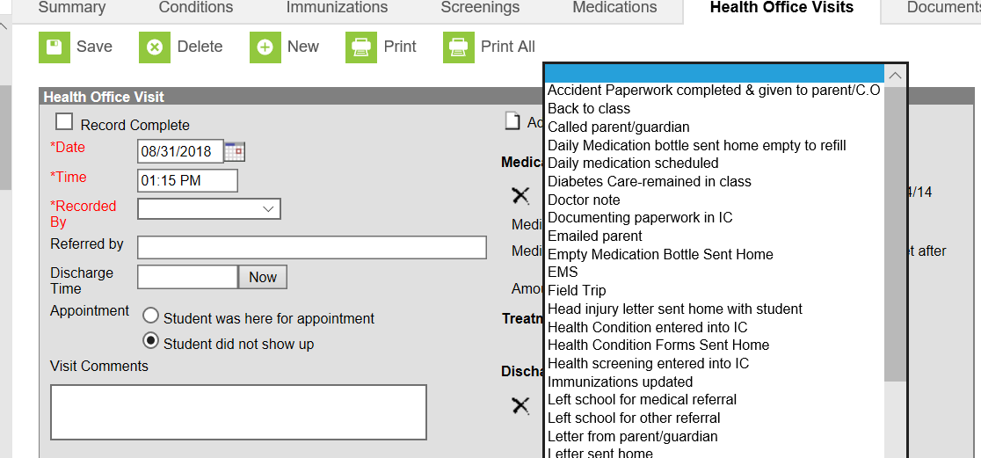
Adding Discharges
Note, you can add as many discharges as you need. Ex. Called parent, sent home

Slide 43
Documents Tab
Documents can be scanned and loaded into IC and are grouped by school year. To view the documents, click on the plus sign next to the year, then next to the uploaded documents and then a list of saved documents appear.
Double click on the name of the document and it will open to be read or printed.

Slide 44
Documents Tab Uses
Examples of documents include:
* MD orders
* Notes from parents
* Individualized health care plans
* Any other document that needs to be a
part of the student health record

Slide 45
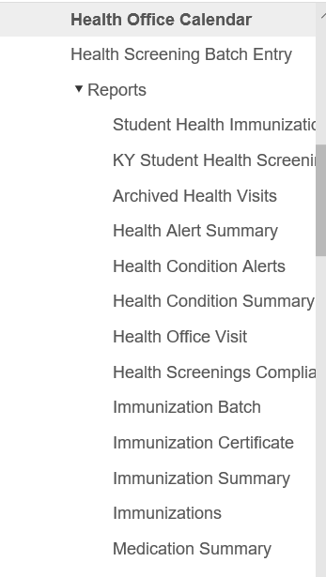
Health Reports
Several pre-built reports are already available in Campus health.

Slide 46
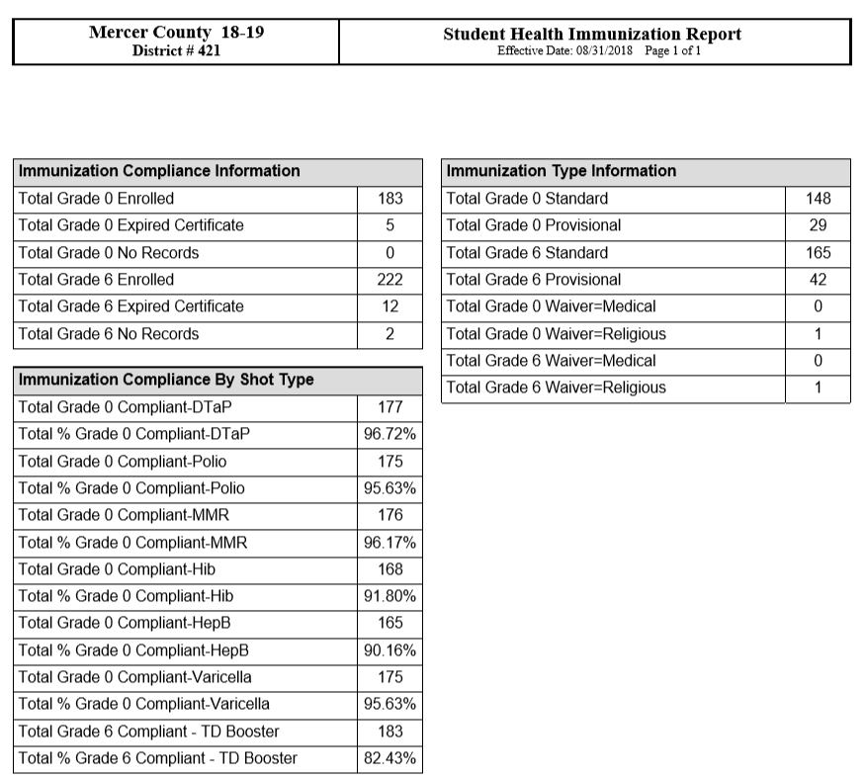
Student Health Immunization Report

Slide 47
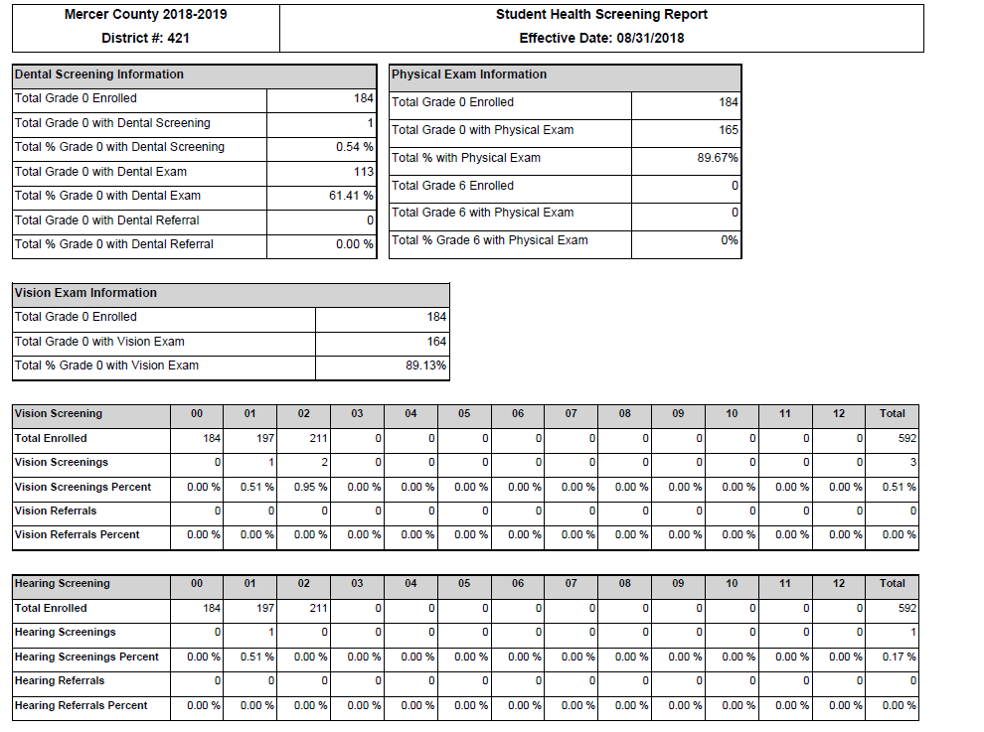
Student Health Screening Report

Slide 48
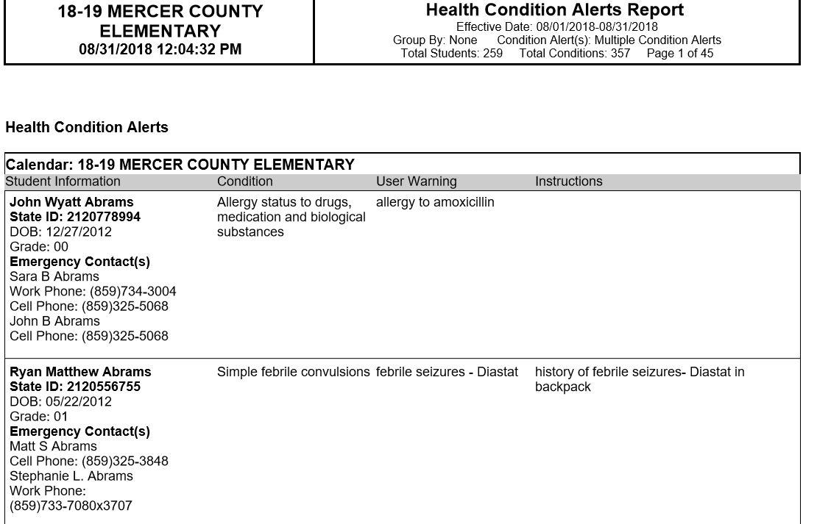
Health Conditions Alert Report

Slide 49
Health Office Visit Report
Gives a list of all student health office visits for a date or range of dates. Includes all information from the health office visits.

Slide 50
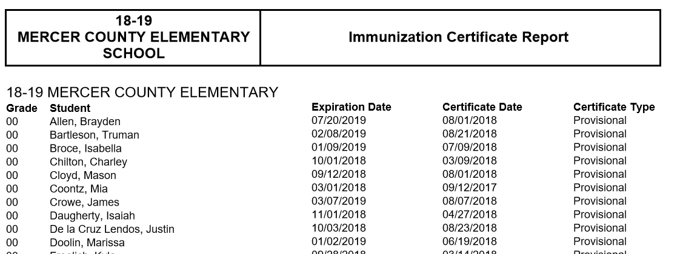
Immunization Certificate Report

Slide 51
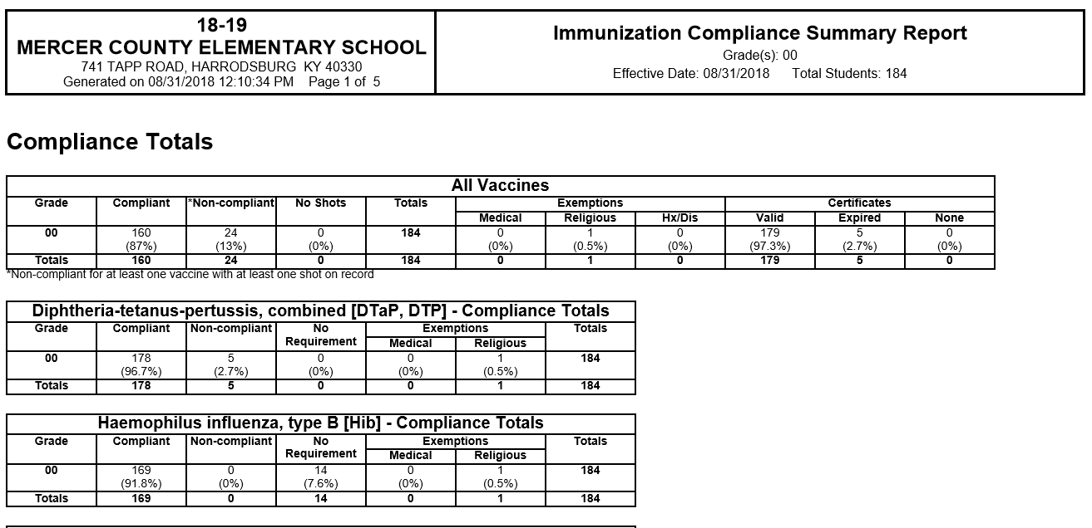
Immunization Summary
Notes:
This report allows nurses to quickly complete the annual immunization summary as it provides aggregate totals.

Slide 52
Ad Hoc Reporting
Ad hoc reporting is also an option to build custom reports for data in Campus.
Examples include:
* number of students sent back to class
* number of students with head injuries
* who is sending students to the nurse

Slide 53
For More Information
Visit KDE’s Student Health Services Infinite Campus Health webpage by clicking here.

Slide 54
Questions??
Email: angela.mcdonald@education.ky.gov
Phone: (502) 564-5279 Ext. 4430

