Slide 1
Growth Factor & New SAAR Application
Office of Finance and Operations – Division of District Support
Laura Loman

Slide 2
Growth Factor Basics
Due Date: The Growth Factor is due to KDE 10 days after the last day of the second month, but not later than November 1st of each school year.
Documentation: Please refer to the checklist here.
Purpose:
KRS 157.360 (8) states, "Program funding shall be increased when the average daily attendance in any district for the first two months of the current school year is greater than the average daily attendance of the first two months of the previous school year." The percent of growth is multiplied by the previous school year's end-of-year ADA to determine the additional ADA funding a district will receive.
Note - If a district does not incur any growth or shows a loss in ADA, there is no deduction of program funding to the district.
KRS 157.370 (3) provides an adjustment in transportation funding for current year increases in transported students. The number of transported students (T1s + T5s) for the first two months of the current year is compared to the number of transported students (T1s + T5s) reported on the previous school year's Growth Factor Report. The percent increase is multiplied by the tentative transportation calculation to determine the amount of transportation funding increase for a district. A district that shows a loss or no increase in T1s and T5s will not incur a reduction in funding.

Slide 3
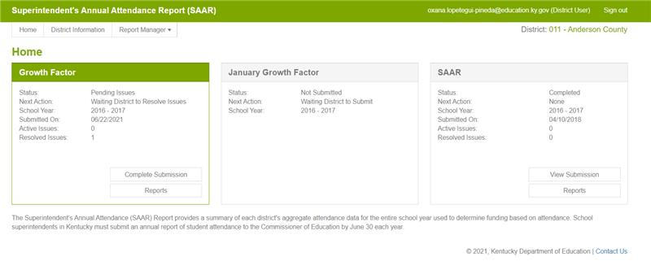
New SAAR Application
School district users will access the new SAAR system by using the following link: SAAR Application. You will then be asked to log in; this will be the same login credentials used to access your Microsoft Outlook. Once in the application, you will see your Home screen. Below is an example of your new Home screen.
Notes:
A couple of quick notes regarding what you see on the HOME tab:
in the top right corner, you will see your basic info: your login, your school district
KDE contact info in the bottom right corner
Home, District Info, and Report Manager's tabs (more in-depth later in a guidance document)
Main Function of Home screen
Tabs for the three cycles of SAAR – Growth Factor, January GF, and SAAR
The three cycles will reflect the current year
The tab that is highlighted in green is currently open
Status: the status that the Infinite Campus file is in. Below you will find the different status categories:
Not Submitted – the district has not submitted a file yet.
Waiting KDE Review – Infinite Campus file submitted by the district, waiting for KDE review
Waiting District Review – has already been reviewed by KDE, no errors, now awaiting verification by the Superintendent
Waiting KDE to Complete – has been verified by Superintendent, now simply waiting on KDE to finalize
Complete – submission final, approved by all parties
Denied – the submission can be denied by the district superintendent or KDE at any point during the submission.
Withdrawn – The district has withdrawn submission
Next Action – Next action to be taken in the submission process
School Year – Current / open school year
Submitted On – Date Infinite Campus file was submitted
Active Issues – Errors related to the current submission
Resolved issues – Displays any issues that have been resolved
Buttons - Within the highlighted, open window, there are two buttons. In the example above, the top one says Upload File (if a file has already been submitted, it would say View Submission). The second button takes you reports that are already complete.

Slide 4
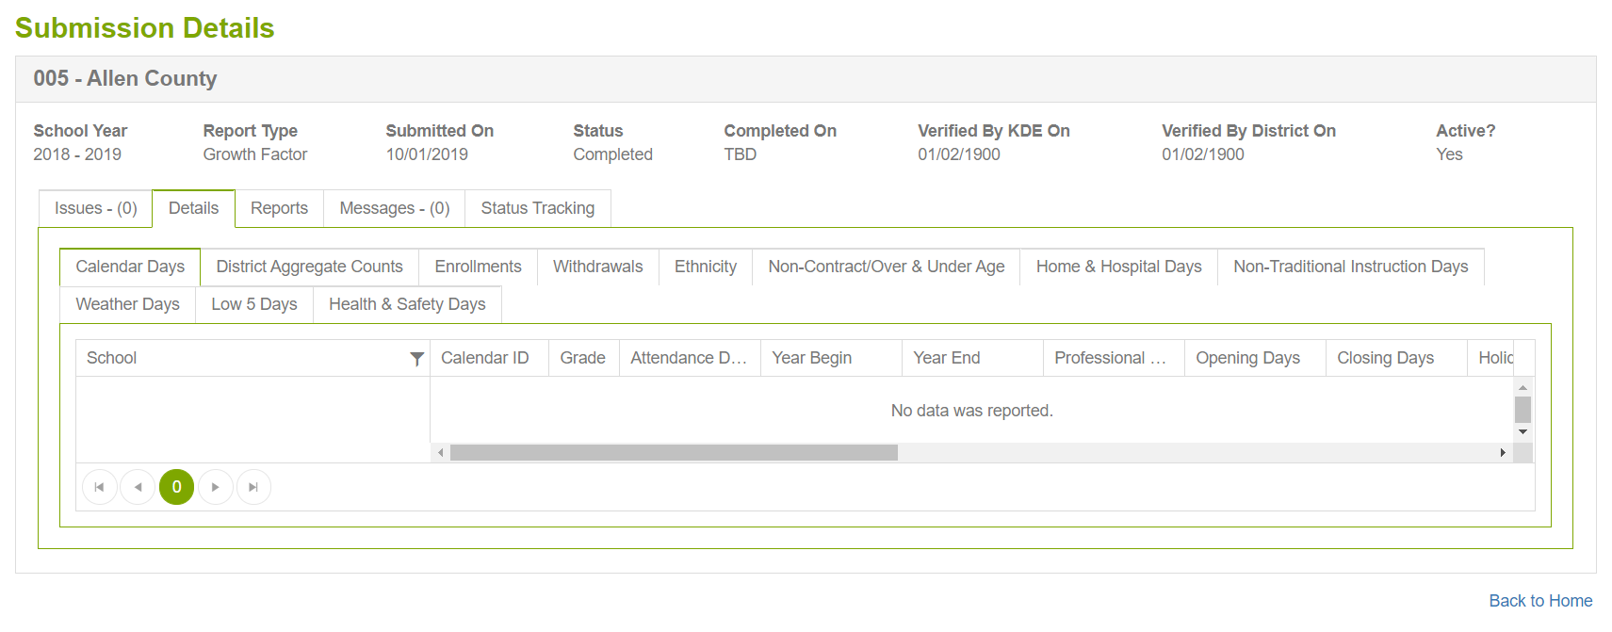
After a file is submitted
For reports already submitted, the View Submission button will be available.
Notes:
Issues – show any errors
Details – will show detailed reports for all records submitted
Note – not all records are submitted for each cycle
Reports – downloadable PDF copies of cycle reports. Always accessible, no longer sent via email
Messages – shows messages between KDE representative and district representative
Status Tracking – shows submission, any resubmissions, etc

Slide 5
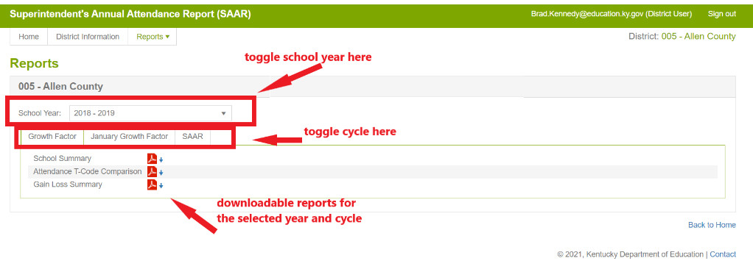
View Reports
The Report Manager's tab shows pdf reports. From here, it can also toggle into other cycles and years. This is also the same functionality as the Report Manager's tab at the top of the page.
Please note, district-level reports will have a "DRAFT" watermark until final approval is complete from KDE. If a cycle is denied after completion, the watermark will show again until Final Approval from KDE.

Slide 6
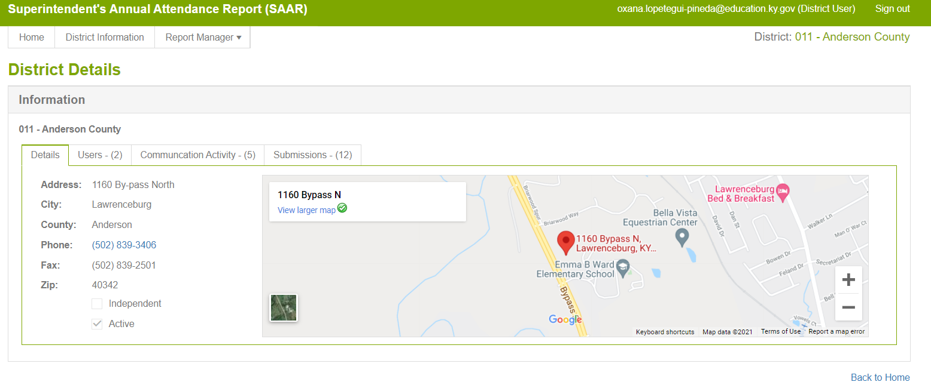
View District Information
The Details tab provides basic district information that is pulled in from SRIM.
The Users tab will be a list of all users and the roles these users fill.
Superintendent – needed to verify final reports
Finance Officer – can view only
District User – access to upload, edit files. This would include DPP and any other staff who needs access.
Notes:
The Communication Activity tab provides an account of messages sent through the SAAR application and KDE.
The Submissions tab provides information on previous SAAR application submissions.
There is also a Report Manager's tab at the top of the screen with the Home and District Information tabs. Using this tab will allow you to view all previously submitted reports for a given school year and cycle.
This information can also be accessed from the main Home screen dashboard by clicking View Reports, as noted on page 39.
More in-depth training at the KDPP training in Sept.
Guidance document can be found on our website

Slide 7
New System Training
Coming Soon – We will be doing a virtual training on the new SAAR system in September. (Official date coming soon)
The recorded training will be posted on the KDE website on the SAAR page after the virtual training.
We will also be presenting the same training at the KDPP conference Sept 21st-23rd.

Slide 8
KDE Support
Jessi Carlton – Jessica.carlton@education.ky.gov
(502) 564-5279, Ext. 2468
Ronda Devine – Ronda.Devine@education.ky.gov
(502) 564-5279, Ext. 4444
Josh Whitlow – Josh.Whitlow@education.ky.gov
(502) 564-5279, Ext. 4450
Samantha Engstrom– Samantha.Engstrom@education.ky.gov
(502) 564-5279, Ext. 4434
Laura Loman – Laura.loman@education.ky.gov
(502) 564-5279, Ext. 4485
Rodney Bennett – Rodney.bennett@education.ky.gov
(502) 564-5279, Ext. 4449
Sheila Harned – Sheila.Harned@education.ky.gov
(270) 705-9158
Ruth Wilkes – Ruth.Wilkes@education.ky.gov
(859) 516-1673
Sasha Reinhardt– Sasha.Reinhardt@education.ky.gov
(502) 226-0693

