Slide 1
District Facility Plan Part 3: Understanding your Orientation Packet Information
Kentucky Department of Education (KDE)
Office of Finance and Operations (OFO)
Division of District Support (DDS)
District Facilities Branch (DFB)
Presentation created September 29, 2022

Slide 2
Introductions

Slide 3
Office of Finance and Operations (OFO)
Associate Commissioner
Robin Fields Kinney
robin.kinney@education.ky.gov

Slide 4
Division of District Support (DDS)
Division Director
Chay Ritter
chay.ritter@education.ky.gov

Slide 5
District Facilities Branch (DFB)
Branch Manager
Greg Dunbar, AIA, MBA
greg.dunbar@education.ky.gov

Slide 6
District Facilities Branch Staff (DFB) Part 1
Project Management/District Liaison
Gary Leist, AIA, LEED AP
gary.leist@education.ky.gov
James A. Bauman, Architect
james.bauman@education.ky.gov
Marcus Highland, AIA
marcus.highland@education.ky.gov
John C. Gilbert, AIA, LEED AP
john.gilbert@education.ky.gov

Slide 7
District Facilities Branch Staff (DFB) Part 2
Resource Management Analyst II
Tanesha Keene
tanesha.keene@education.ky.gov

Slide 8
Presentation Summary
This presentation will focus primarily on Part 2 of the Orientation Packets sent for the Local Planning Committee (LPC) to review.
Orientation Part 1 – General Information
Orientation Part 2 – District-specific Information

Slide 9
Orientation Part 1
General Information

Slide 10
Part 1 Orientation – Overview of the Process
A video presentation reviewing:
Facilities Branch Mission Statement
Overview and History
Outcomes and Facilities Best Practices
Equity – Costs per square foot as replacement values (RS Means has changed – see next slide)
Adequacy of Model Programs
“Step by Step” DFP Process
A/E Evaluation of Facilities
Funding

Slide 11
Equity – Benchmark Costs Have Changed from RS Means to FRED
The ¾ national average cost of building construction benchmark historically provided in R.S. Means Construction Cost Data is no longer available due to changes made by the publisher. This benchmark which consists of the cost of materials, labor and contractor’s overhead and profit is referenced in the Kentucky School Facilities Planning Manual incorporated by reference in 702 KAR 4:180. KDE adjusts it to include “soft costs” such as A/E fees, CM fees, contingencies and equipment, site development and site acquisition to estimate total project costs related to planning and insurance replacement cost purposes.
KDE has used the costs included in the Planning Manual (2008) and applied the most recent inflation information reported by the Federal Reserve Economic Data (FRED) “Producer Price Index by Industry: New Building Construction” to determine the costs above.

Slide 12
Orientation Part 2
District-specific information
Lawrence County as an example

Slide 13
Lawrence County Local Planning Committee Orientation Part 2
Kentucky Board of Education (KBE)
Kentucky Department of Education (KDE)
Office of Finance and Operations (OFO)
Division of District Support (DDS)
District Facilities Branch (DFB)
Presentation created September 2, 2022

Slide 14
Presentation Summary – Welcome Back!
This presentation will focus on information specific to your district and will include:
An “Overview” of capacity calculations and existing buildings
Current District Facilities Plan (DFP)
Projects undertaken since 2018 DFP
District’s restricted funding stream
School center information and cost of delivery of services (each school)
Enrollment changes since 1990
Demographic projections based on 2020 US Census Data

Slide 15
Overview
Building capacity overview and existing building conditions in Lawrence County (Co), Kentucky (KY) schools

Slide 16
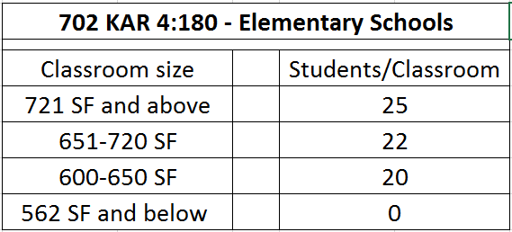
Overview – Capacity Calculations Elementary Schools
Per Kentucky Administrative Regulations (KAR), 702 KAR 4:180 incorporates by reference The Planning Manual which notes only standard classrooms are used when calculating student capacity.
Classrooms for special education, music, art, science, computer labs, etc. are not used in the capacity calculation.
Since only standard classrooms are used in this calculation, it is critical that the spaces and their use be accurately noted in KY Facilities Inventory and Classification System’s (KFICS) building inventories.
Number of students to be calculated per classroom is based on the room size in square feet (SF). See adjacent chart.

Slide 17
Overview – Capacity Calculations Middle and High Schools
Only the standard classrooms are used when calculating student capacity.
Classrooms for special education, music, art, science, computer labs, Career and Technical Education (CTE), etc. are not used in the capacity calculation.
The number of students to be calculated per classroom is based on the room size; note that since students are in non-standard classrooms about 25% of the time, the base capacity is adjusted by a divisor of .75.

Slide 18
Existing Conditions – Lawrence County Schools
Take a moment to have a representative from the district or your design professional to review existing building conditions as reported to the district and KDE from narratives and the KFICS data. Information may consider a broad range of topics including:
Renovation work (example: Need a new roof?),
Adding new systems (example: Is an HVAC system new to the building?),
Model program space comparisons (example: Do you have too many or not enough classroom space meeting KDE standards? Will an addition or renovations to existing space to serve a new purpose be considered?) or,
Any other improvements to meet KDE standards?

Slide 19
Current District Facilities Plan (DFP)
The information on your current DFP will give a good start to viewing your needs as determined by the last Local Planning Committee (LPC).

Slide 20
The first part of the DFP shows:
The date your last DFP was approved by KBE or KDE
Your current and proposed Plans of Organization
Then…
School Centers and their classification(s)
Each school’s status as a Permanent or Transitional Center
Grades served by the school center
*End-of-year enrollment / building capacity
*End-of-year enrollment is district provided information through the Students Annual Attendance Report (SAAR) from the previous year or Student Report Card (SRC) information if SAAR is not available.

Slide 21
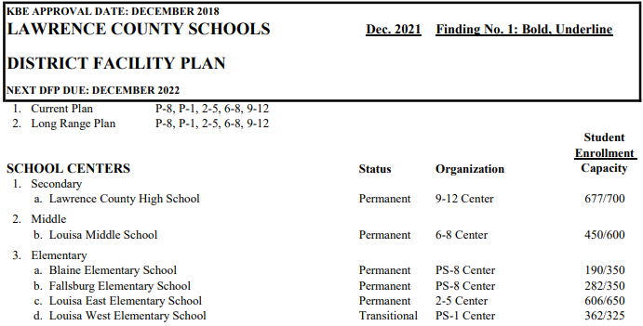
Lawrence County District Facility Plan

Slide 22
The main body of the DFP focuses on District Need (construction projects and property) identified by your LPC and shows work in one of four priorities. A fifth priority is listed for local needs not qualifying for restricted fund sources.

Slide 23
Priority 1 Projects
Work on educational facilities to be started or completed in the next biennium
1a,b: New construction justified by growth (a) or building replacement and consolidation (b)
1c: Major renovations (as defined in The Planning Manual) and additions
1d,e,f: KERA strands (d), life safety (& security) (e), ADA requirements (f)
All work in Priorities 1a through 1f are considered equal in terms of funding prioritization

Slide 24
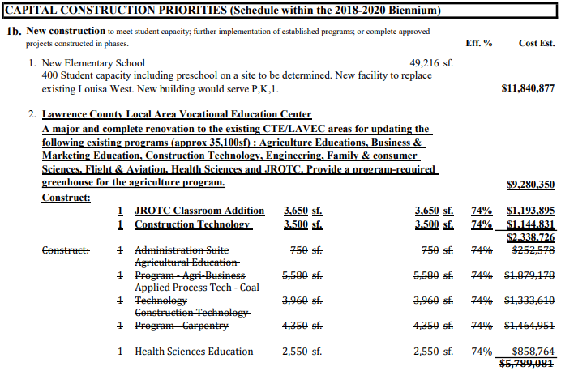
Priority 1b Projects
Commentary
Priority 1b.1 – New Elementary School (ES) replacing Louisa West ES.
Priority 1b.2 – Local Area Vocational Education Center – District reports an active project completing all or some of the listed needs (in review this should have been listed as a Priority 1c project). The strikethrough items were removed through a Finding approved December 2021.

Slide 25
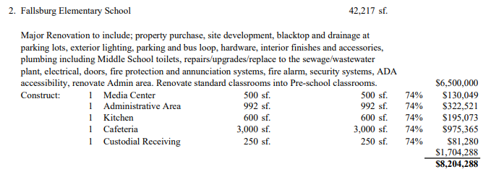
Priority 1c.1 and 1c.2 Projects
Commentary
Priority 1c.1 – Blaine ES
Priority 1c.2 – Fallsburg ES

Slide 26
Priority 1c.3, 1c.4 and 1d Projects
Commentary
Priority 1c.3 – Louisa Middle School (MS)
Priority 1c.4 – Louisa East ES
Priority 1d projects list district-wide work. Your new plan shall list these out by school. Comparable work for non-educational facilities (board office, bus garage, stand-alone auditoriums, storage, etc.) would be placed in other priorities.

Slide 27
Priority 2 Projects
Work on educational facilities to be started or completed after the next biennium
2a,b: New construction justified by growth (a) or building replacement and consolidation (b)
2c: Major renovations (as defined in The Planning Manual) and additions
2d,e,f: KERA strands (d), life safety (& security) (e), ADA requirements (f)
All work in Priorities 2a through 2f are considered equal in terms of funding prioritization
District reports no Priority 2 work in the current DFP.

Slide 28
Priority 3 Projects
Construction of non-educational additions or expansions (regardless of schedule) includes:
Educational support spaces related to schools such as media centers, district-wide kitchens, gymnasiums or schools/campuses that have no renovation needs or no direct instructional space needs (classrooms, resource rooms, etc.)
If a school has renovation or instructional space addition needs, you list educational support spaces under priorities 1 or 2 with that scope of work.
District reports one (1) DFP project in Priority 3 (high school auditorium).

Slide 29
Priority 4 Projects
Construction of Construction of management support areas (regardless of schedule)
Additions, renovation or new facilities for district support facilities that includes central offices, bus garages, storage buildings, etc.
District reports no Priority 4 work in the current DFP.

Slide 30
Priorities 1 – 4 establish District Need
District Need reported on your current DFP is reported at $47,472,903.

Slide 31
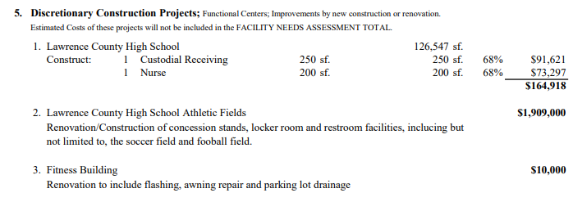
Priority 5 Projects
Building additions that are not justified or exceed allowable area by comparison to Model Program requirements
Extracurricular facilities
Buildings too new or too recently renovated to qualify for major renovation (30 years)
Minor projects
Priority 5 projects are not part of the District Need total.

Slide 32
HB 678 (2022) Impact to DFP
Districts may elect to place any qualifying extracurricular program under any DFP Priority if they choose.
If you place extracurricular under anything other than Priority 5, provide evidence the program is sanctioned by a governing body (example: Is the program you are providing a formal Kentucky High School Athletic Association program (KHSAA) (football, archery, e-sports, etc.)? Is the extracurricular affiliated with any other governing program considered by KDE? Community programs and unsanctioned programs shall not be considered.
HB 678 has a current deadline of June 24, 2024, so line items need to be separate from the long-term, project-related information with the language (HB-678-2022) listed by each item. You may include the costs on your total District Need in Priorities 1-4.
Any HB 678 item in Priorities 1 or 2, shall receive written approval from SFCC for use of their funds prior to project approval.

Slide 33
Projects undertaken since 2018 DFP
Building and Grounds (BG) projects reported to KDE with BG numbers.
The district’s administration may want to report on this section of the presentation.

Slide 34
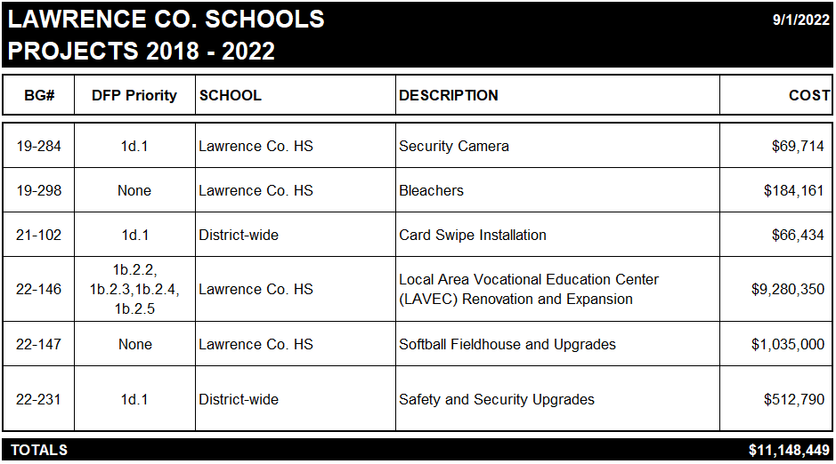
Lawrence County Schools
Projects 2018 - 2022

Slide 35
District’s restricted funding streams
All funding sources need to be considered during the DFP process. Include information from, or invite your fiscal agent and district finance officer to discuss this portion of the presentation.
Defining funding sources as provided through Kentucky Revised Statutes (KRS)
Reported restricted funding streams for Lawrence Co.

Slide 36
Types of Restricted Funding for School Construction
Monies used for capital construction or major renovation comes from multiple sources which include:
*Student Population Based Funds – KRS 157.420
Capital Outlay Funds
*Property Assessment Based Funds – KRS 157.440
Building Funds and Growth Levies
Facilities Support Program of KY (FSPK)
Qualified Needs Based Funds – KRS 157.611
KY School Facilities Construction Commission (SFCC)
Urgent-Needs Grants
* Funds through population and property assessment are considered through the Supporting Educational Excellence in Kentucky (SEEK) program.

Slide 37
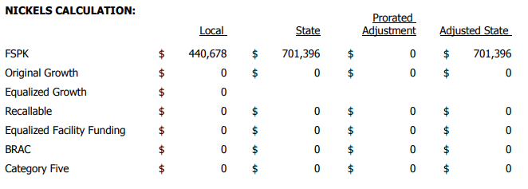
Lawrence County
SEEK Calculations 2022-2023 Forecast
Capital Outlay
FSPK

Slide 38
Lawrence County
Qualified Needs-Based Funding
SFCC funds – KRS 157.611
The unadjusted 2018 DFP calculated District Need (Priorities 1-4) totals $47,472,903 including projects that have been completed or underway since 2018. Discuss with your finance team adjustments to receive updated numbers.
This totals $19,432 per student, based on 2019 enrollment of 2,443 students.
Enrollment is still frozen for finance purposes through the 2022/23 school year.
Urgent-Needs Grants are provided as determined by the legislators during budget sessions. Your administration may further comment on these funds if available.

Slide 39
Consideration for DFP Process
All funding sources need to be considered during the DFP process.
Let’s see how they impact potential funding amounts.

Slide 40
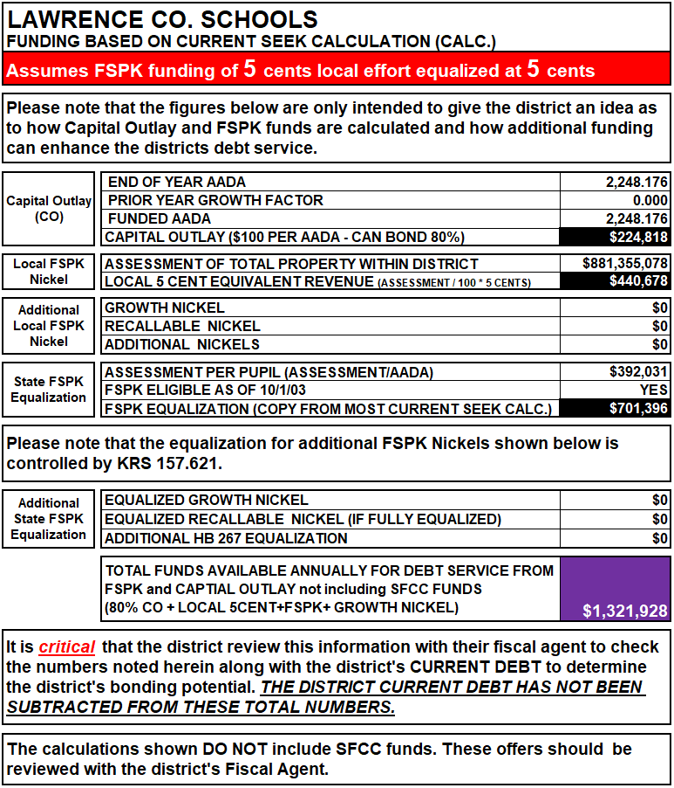
Current Funding Stream

Slide 41
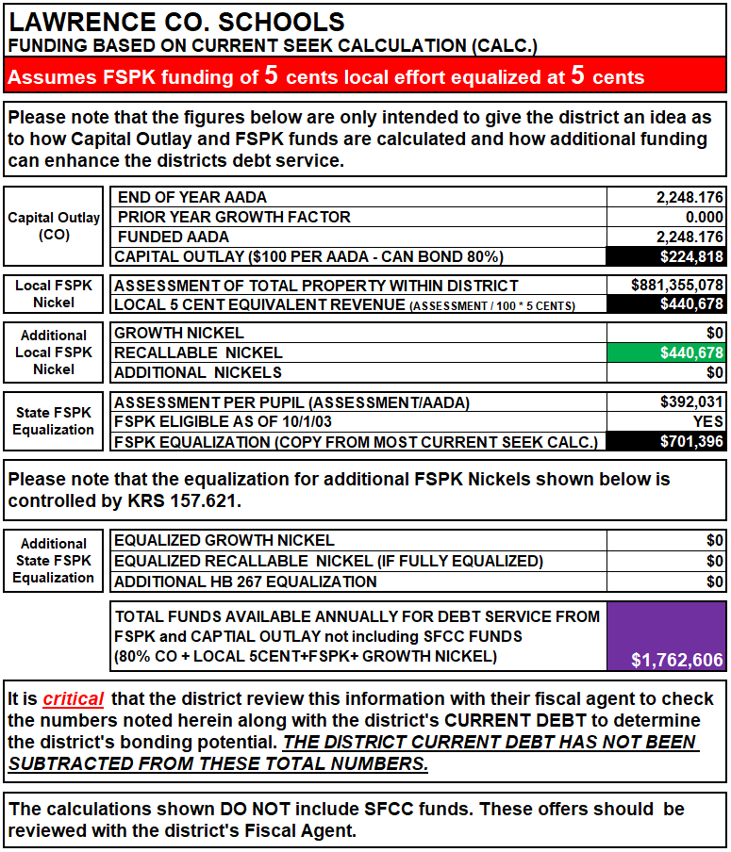
Adding a Recallable Nickel

Slide 42
School center information and cost of delivery of services
Framework for DFP reporting for each school center
Enrollment data from the Superintendent’s Annual Attendance Report (SAAR) which are end-of-year (EOY) numbers
Cost of delivery of services is from the Kentucky School Report Card (KY SRC) information

Slide 43
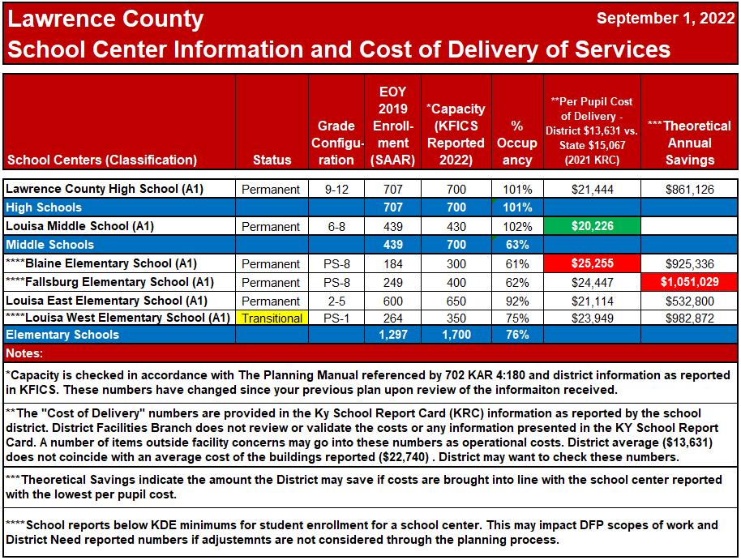
Cost of Delivery Services

Slide 44
Enrollment changes
1990 – 2022
Consider 2019 as a “freeze” year for funding allocations
2019/20 and 2020/21 school years are illustrated for information as provided in KY Student Report Card (KY SRC)

Slide 45
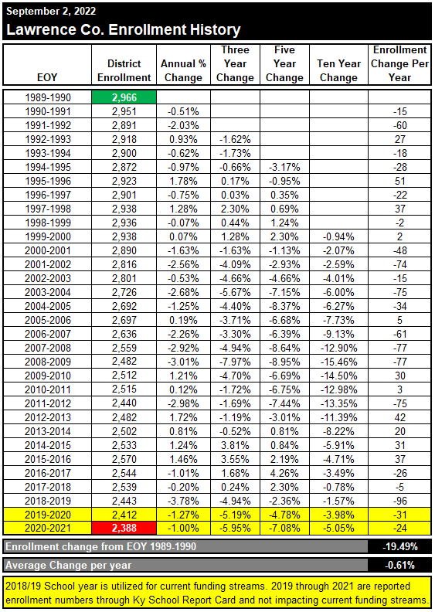
Enrollment History
Enrollment change from SAAR EOY 1989/90 shows a decline of 19.5%
Average change per year is a loss of 0.61%
2018/19 School year is utilized for current funding streams. 2019 through 2021 are reported enrollment numbers through KY SRC and not SAAR.

Slide 46
Demographic projections
U of L Data Center Information released August 2022 on the 2020 Census information.

Slide 47
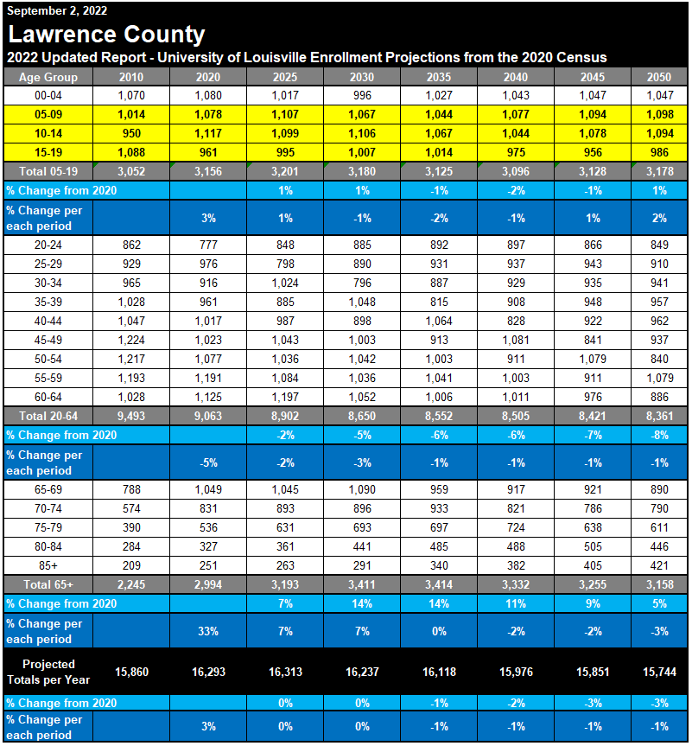
University of Louisville Enrollment Projections
Lawrence County population for ages 5-19 is projected to remain unchanged through 2050.

Slide 48
Projected Challenges for Lawrence County
Lawrence Co. school enrollment has declined 20% since 1990. From 2010 to 2019 there appears to be little change in enrollment.
A lot of school districts in the Commonwealth will experience a decline in enrollment through 2050 – Lawrence Co. is projected to remain steady during this time.
Through 2050, the Lawrence Co. population is projected to have an overall decrease of 3%; the FIVCO Area Development District is expected to decrease 17% while the Kentucky population projects an increase of 6%.
The Lawrence Co. student-aged (5-19) population is projected to increase only 1% from 2020 to 2050.
The Lawrence Co. over-65 population is projected to increase by 5% from 2020 to 2050.
The Lawrence Co. working age population (20-64) in Lawrence Co. is projected to decrease 8% from 2020 to 2050.
How will you wisely deal with the projected student population and the funding needed to run a school system?

Slide 49
Planning for the Future
The LPC working together as a team with design professionals, school board members, administrators, legislatures and the public is a worthwhile endeavor to provide a shared vision for quality environments to educate students that the community is proud to support.

Slide 50
Q & A
Questions
Thank you again for agreeing to be part of the Local Planning Committee for your district.
If you have any questions, you may call John C. Gilbert, AIA at (502) 564-4326 extension 4452; or email at john.gilbert@education.ky.gov.

Slide 51
Thank you for your interest and participation!
Kentucky Department of Education (KDE)
Office of Finance and Operations (OFO)
Division of District Support (DDS)
District Facilities Branch (DFB)
Presentation created September 23, 2022

