Slide 1
2022 Stilwell Awardees
Region 8
Notes:
2022 Stilwell Awardees – Region 8

Slide 2
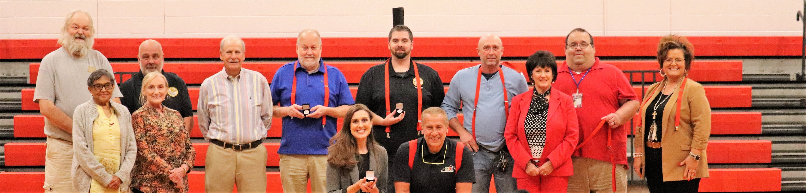
2022 Floyd County Stilwell Awardees with Courtney DeRossett and David Couch
Notes:
2022 Floyd County Stilwell Awardees with Courtney DeRossett and David Couch

Slide 3
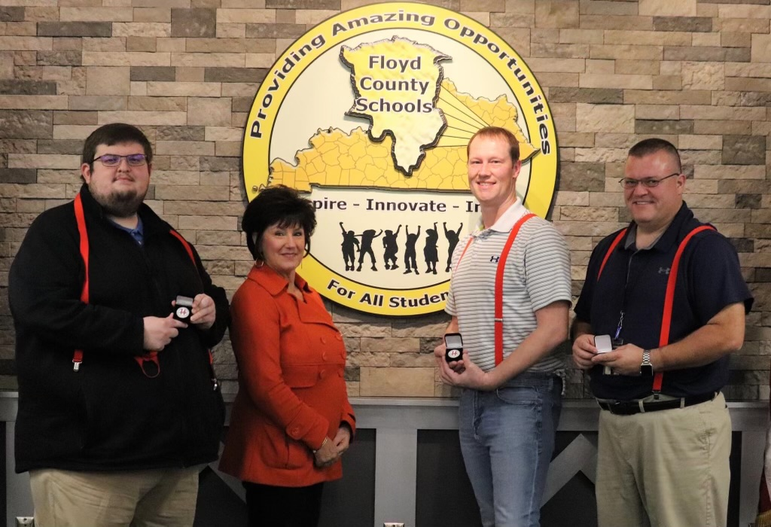
2022 Floyd County Stilwell Awardees pic 2
Notes:
2022 Floyd County Stilwell Awardees pic 2

Slide 4
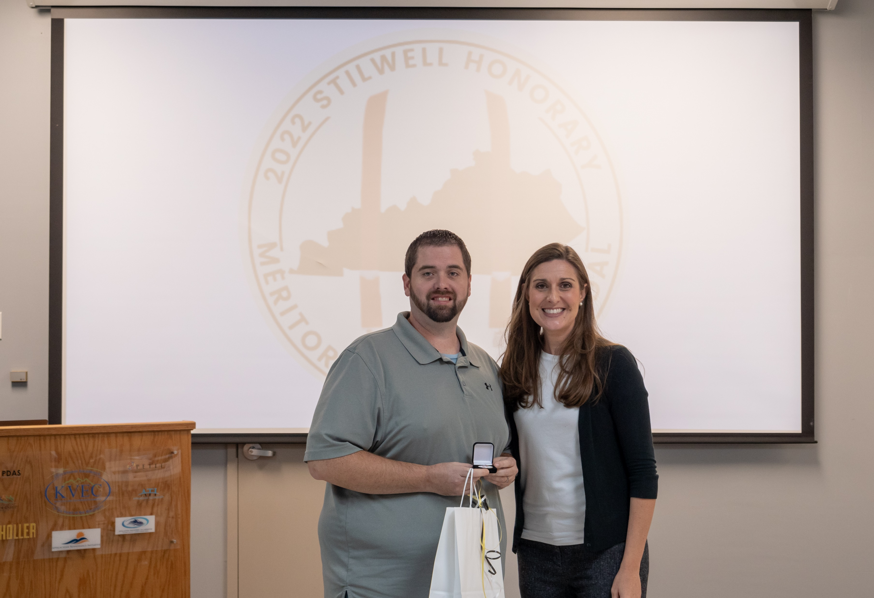
2022 Floyd County Stilwell Awardee pic 3 with Courtney DeRossett
Notes:
2022 Floyd County Stilwell Awardee pic 3 with Courtney DeRossett

Slide 5
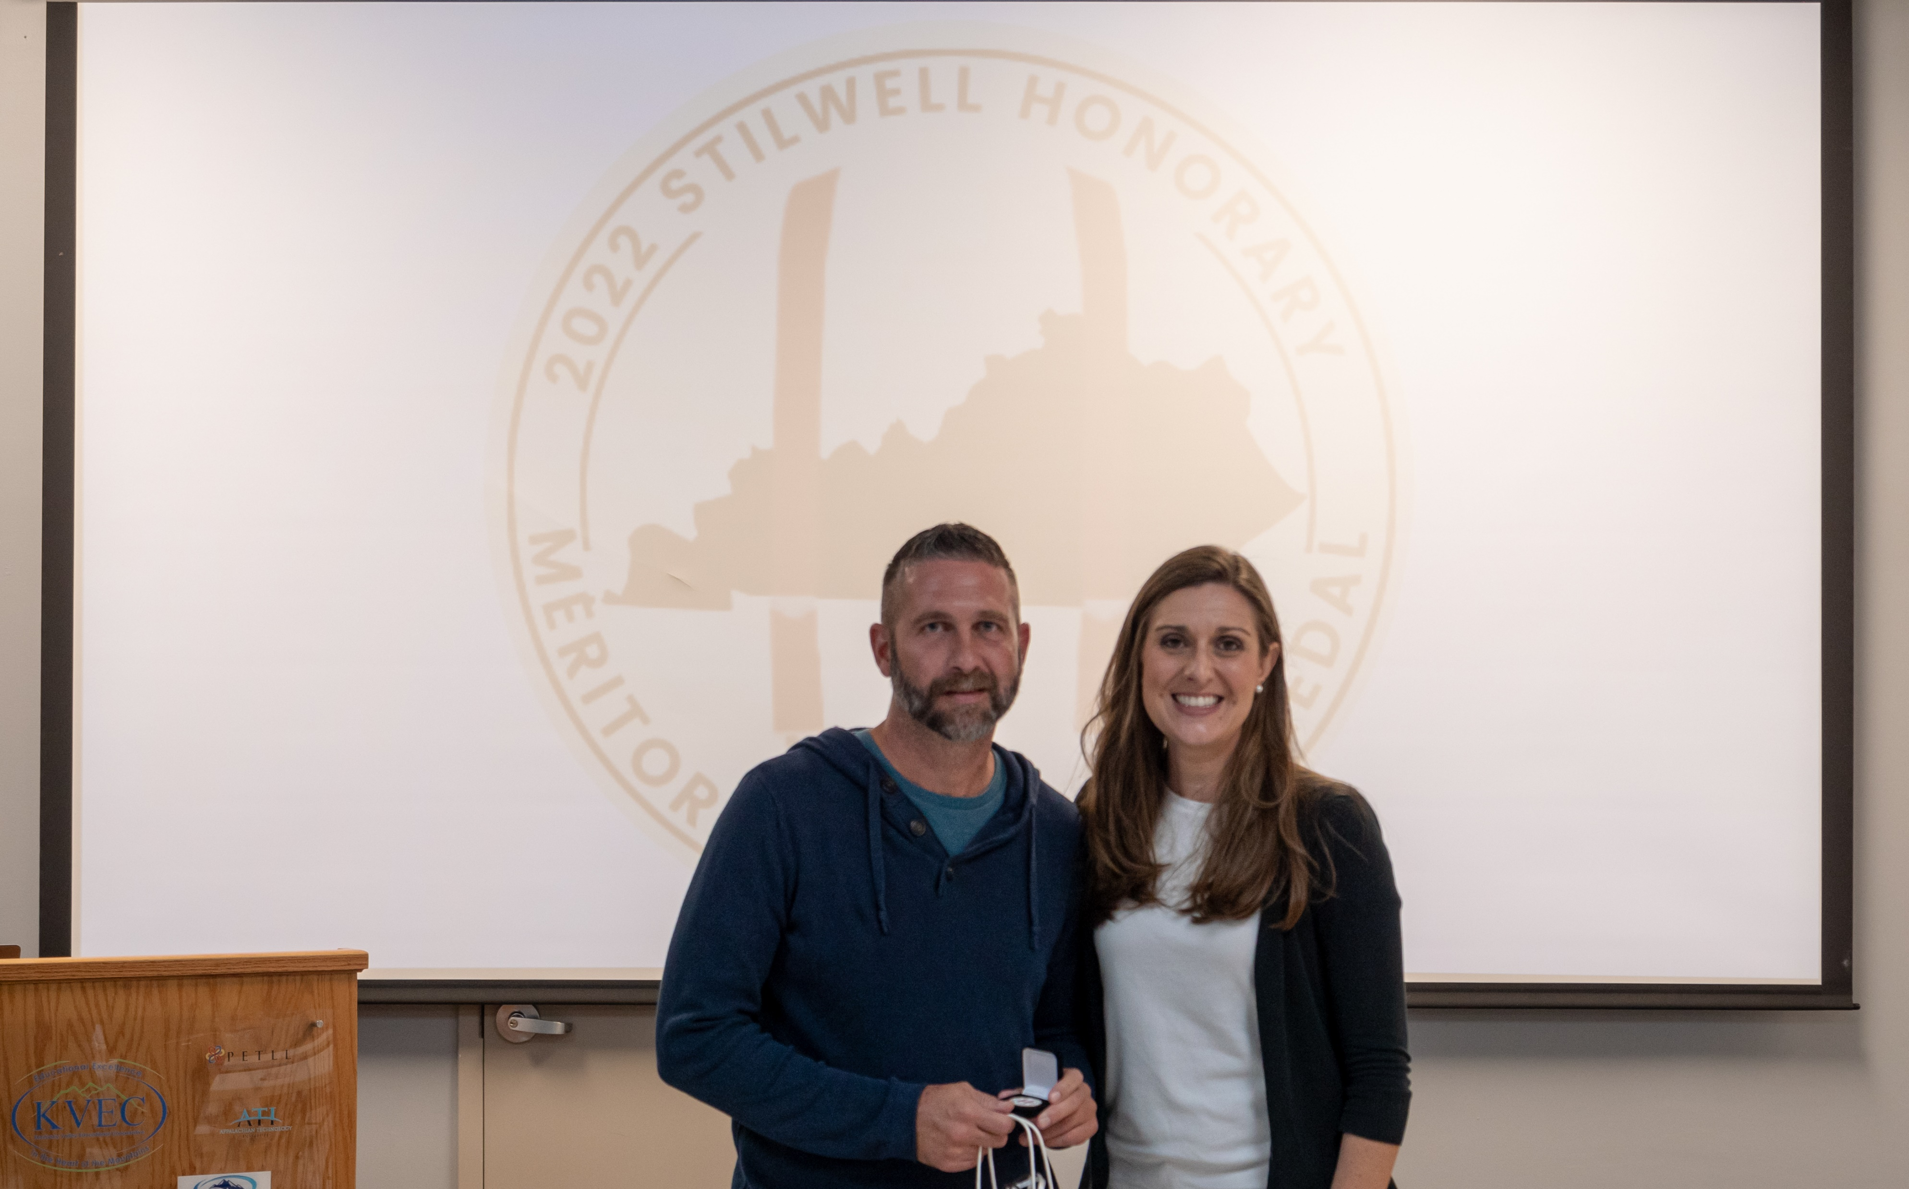
2022 Hazard Stilwell Awardee with Courtney DeRossett
Notes:
2022 Hazard Stilwell Awardee pic 3 with Courtney DeRossett

Slide 6
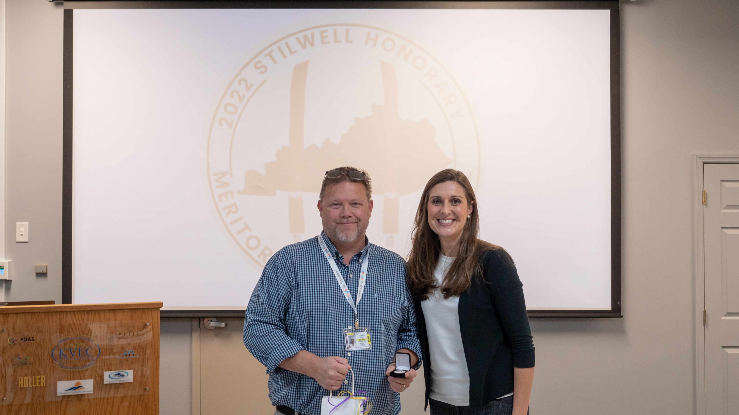
2022 Jackson Independent Stilwell Awardee with Courtney DeRossett
Notes:
2022 Jackson Independent Stilwell Awardee with Courtney DeRossett

Slide 7
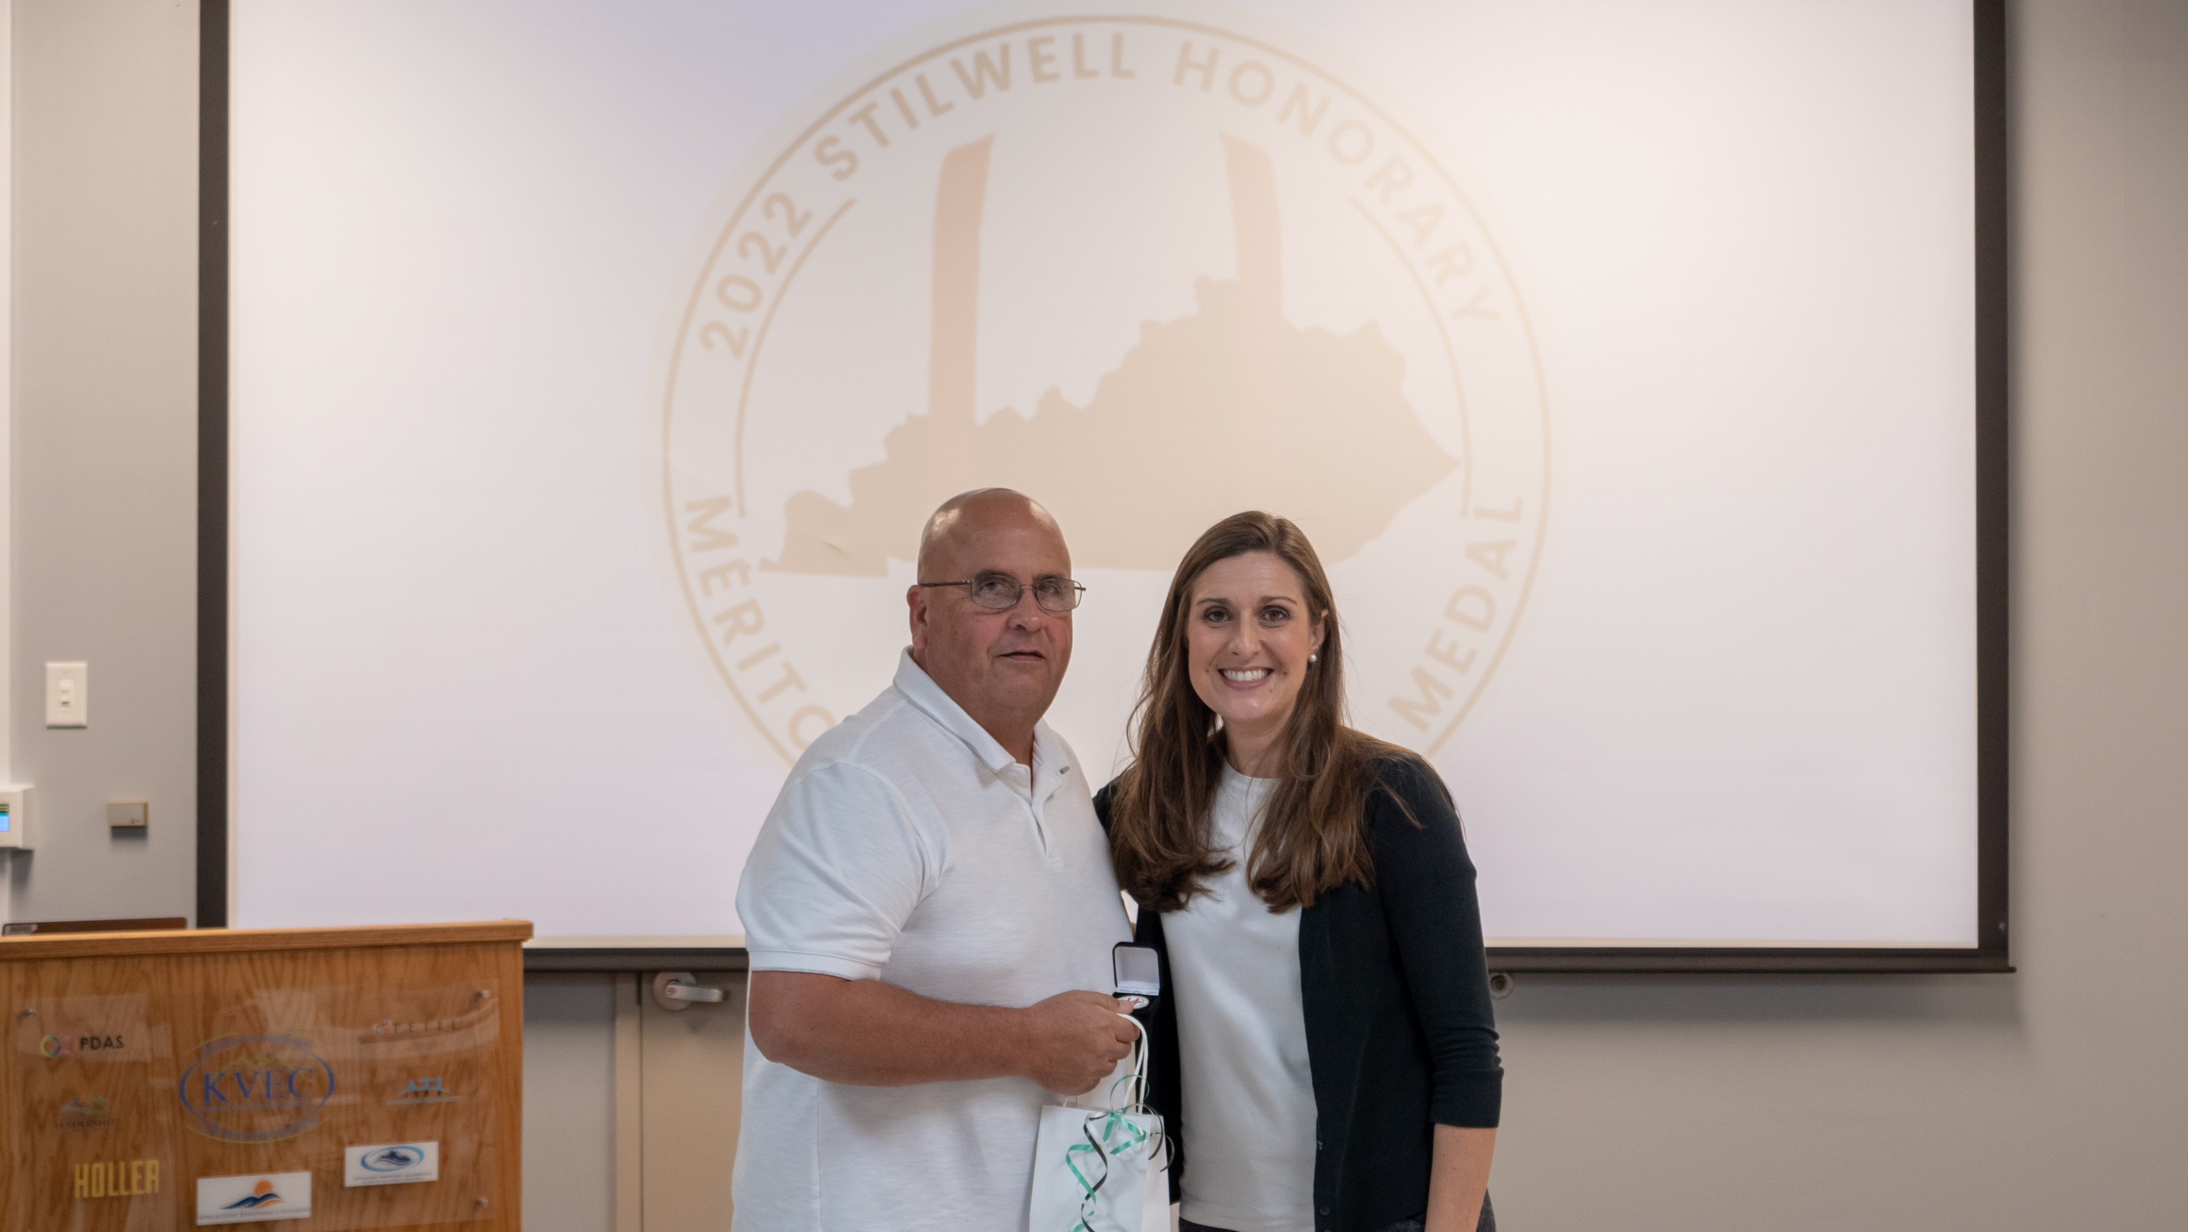
2022 Jenkins Co. Stilwell Awardee with Courtney DeRossett
Notes:
2022 Jenkins Independent Stilwell Awardee with Courtney DeRossett

Slide 8
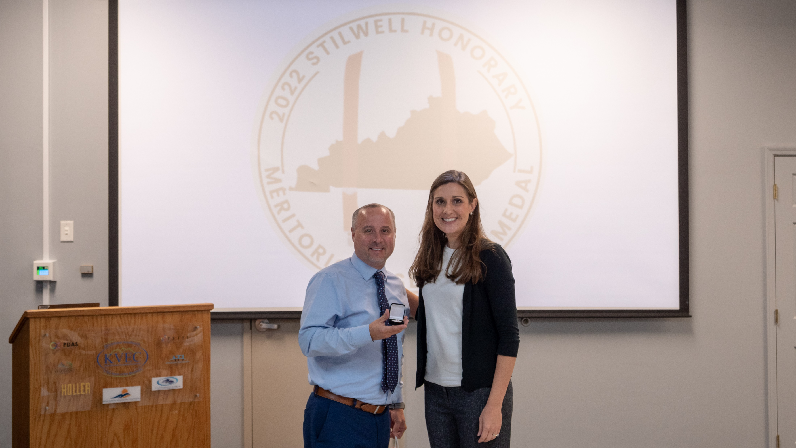
2022 Knott Co. Stilwell Awardee with Courtney DeRossett
Notes:
2022 Knott Co. Stilwell Awardee with Courtney DeRossett

Slide 9
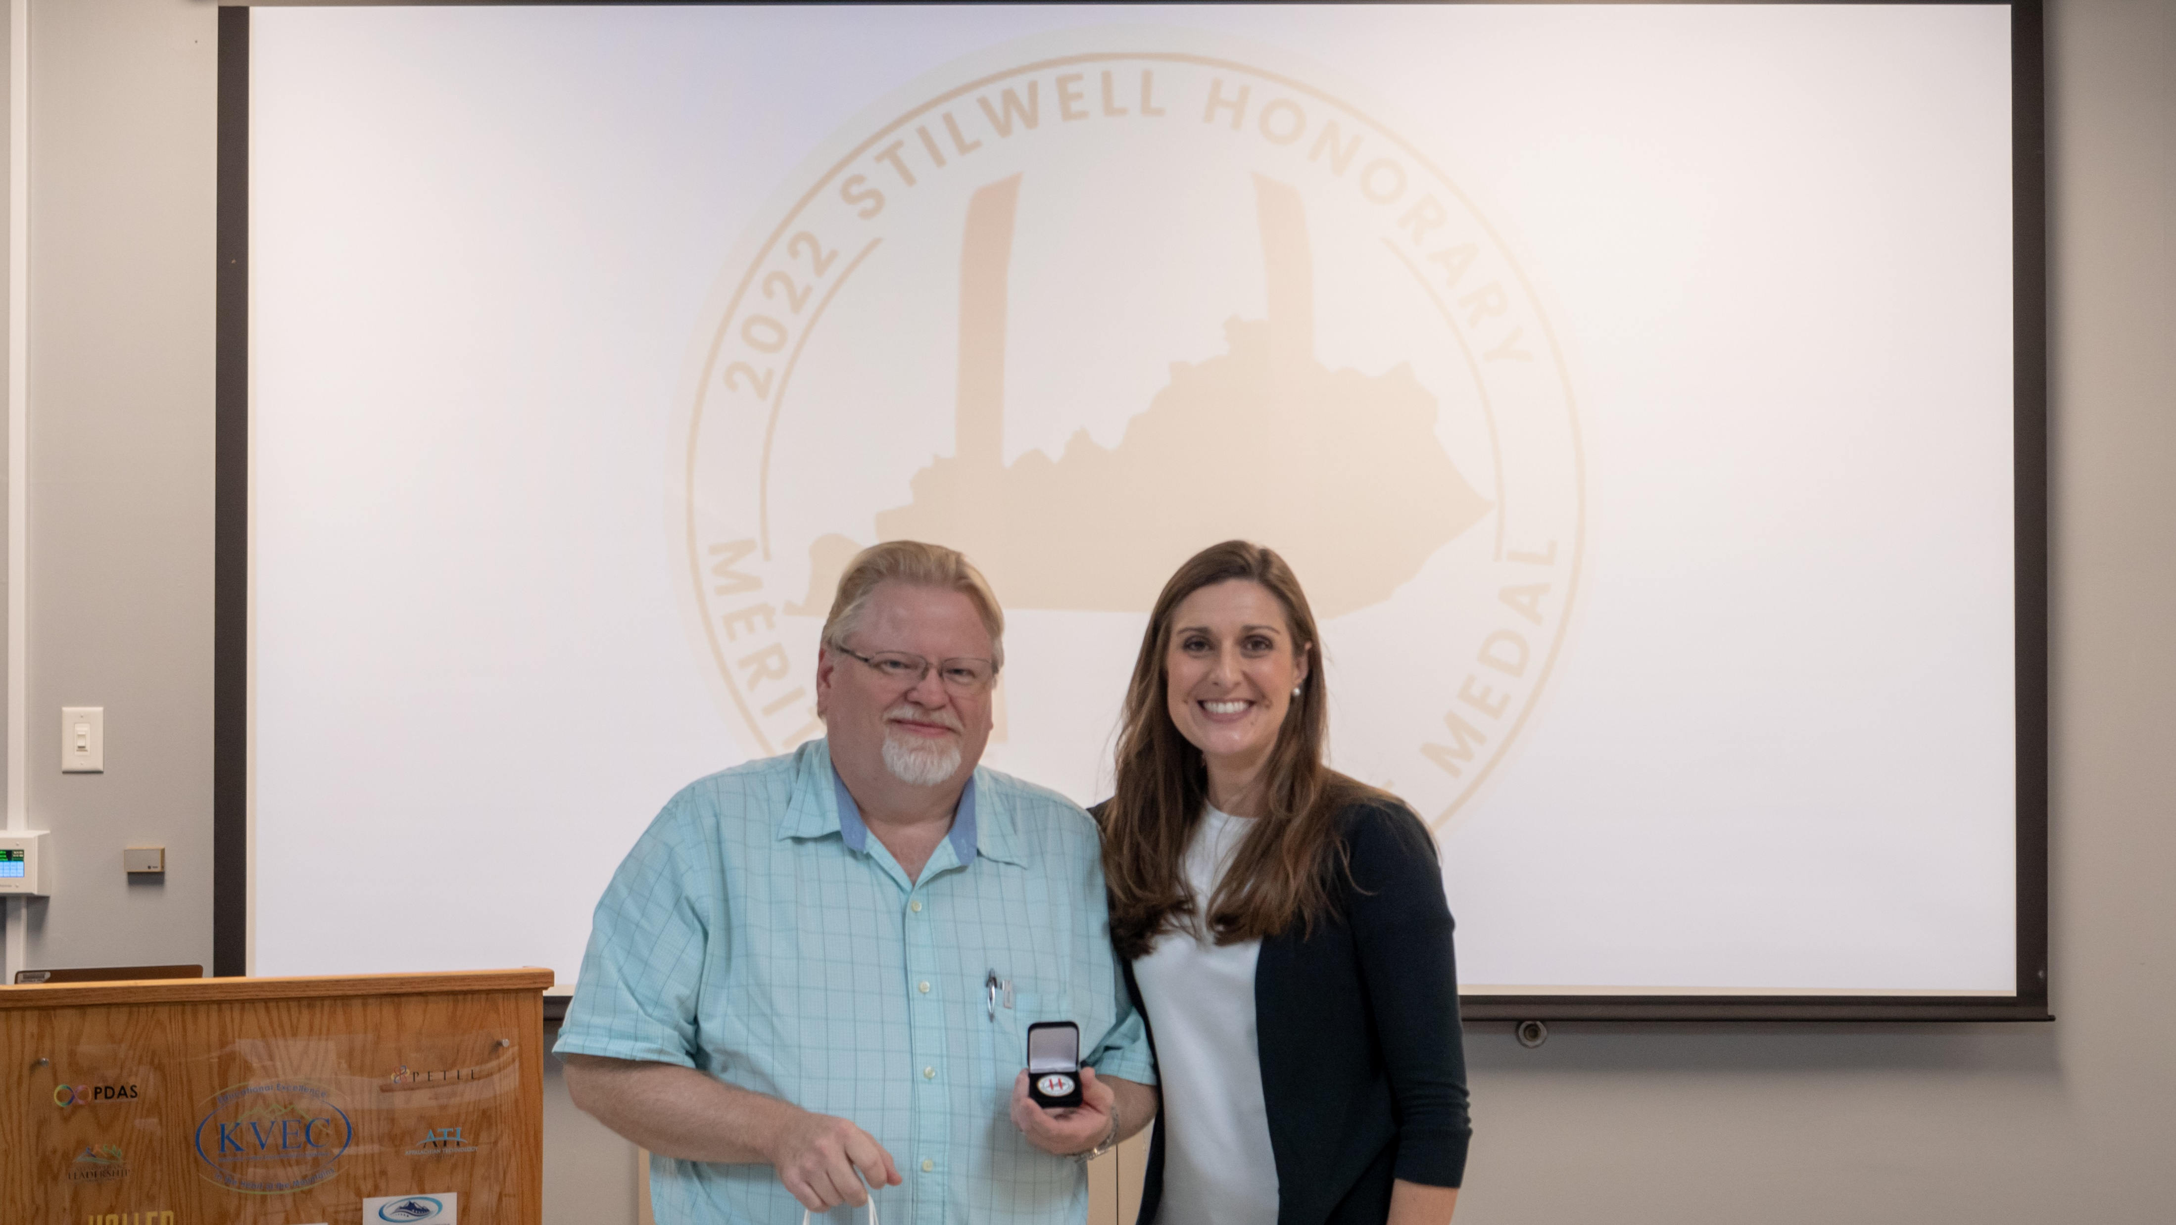
2022 Lee Co. Stilwell Awardee with Courtney DeRossett
Notes:
2022 Lee Co. Stilwell Awardee with Courtney DeRossett

Slide 10
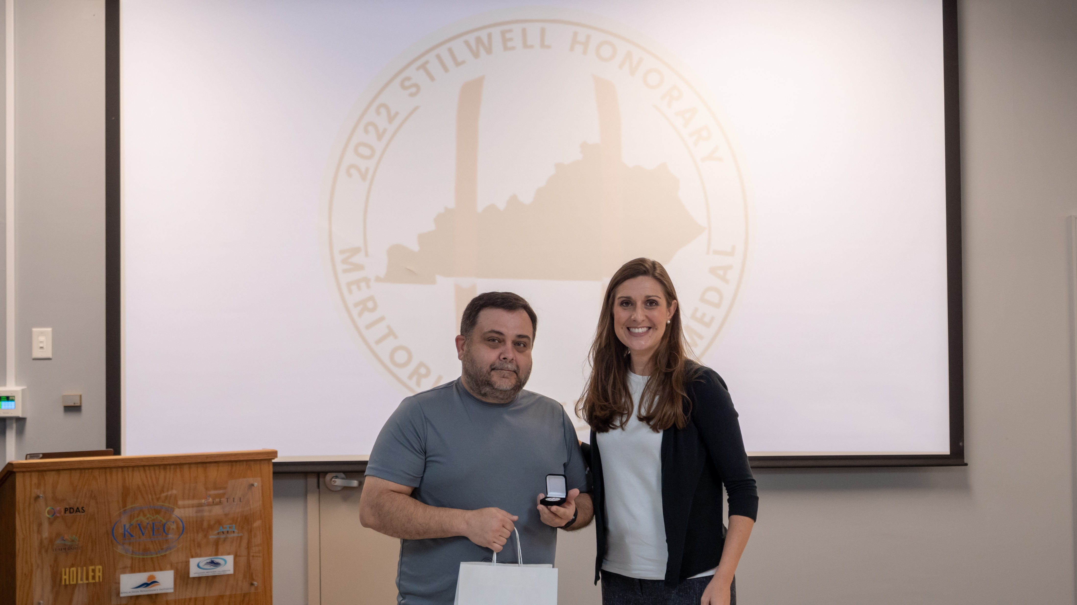
2022 Leslie Co. Stilwell Awardee with Courtney DeRossett
Notes:
2022 Leslie Co. Stilwell Awardee with Courtney DeRossett

Slide 11
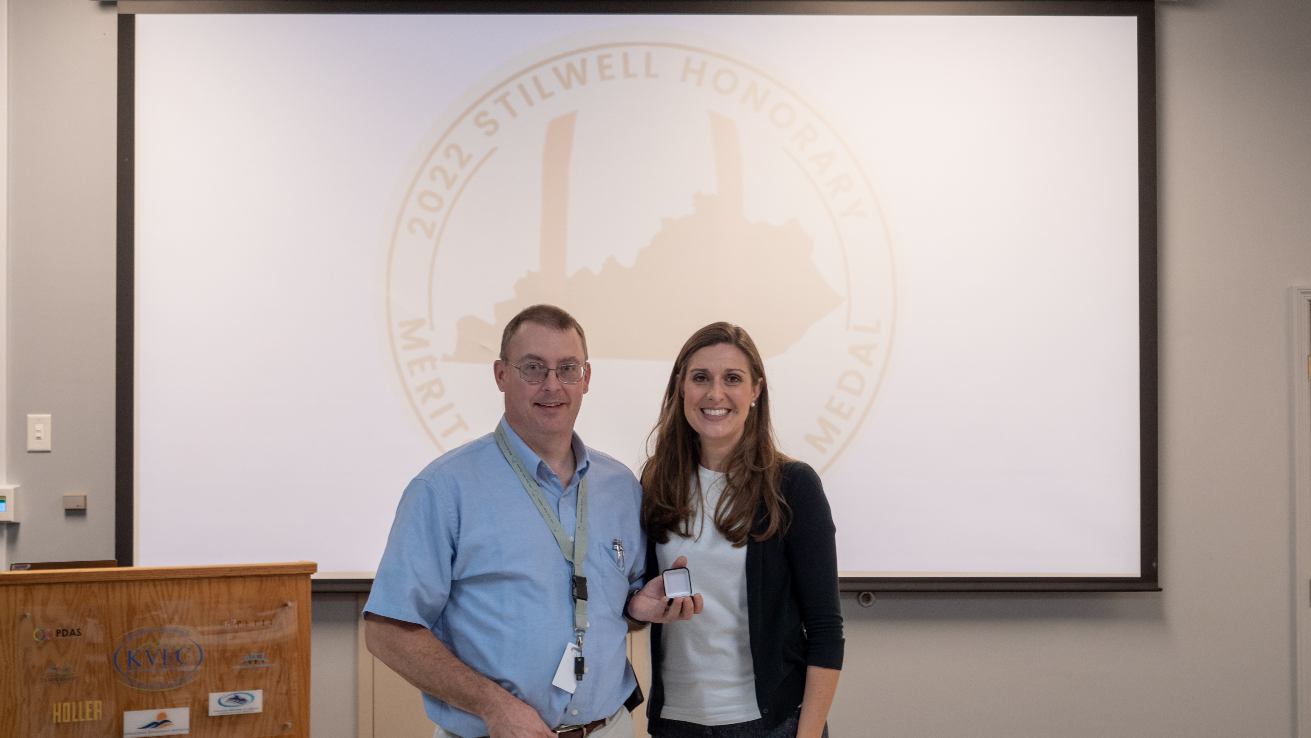
2022 Letcher Co. Stilwell Awardee with Courtney DeRossett
Notes:
2022 Letcher Co. Stilwell Awardee with Courtney DeRossett

Slide 12
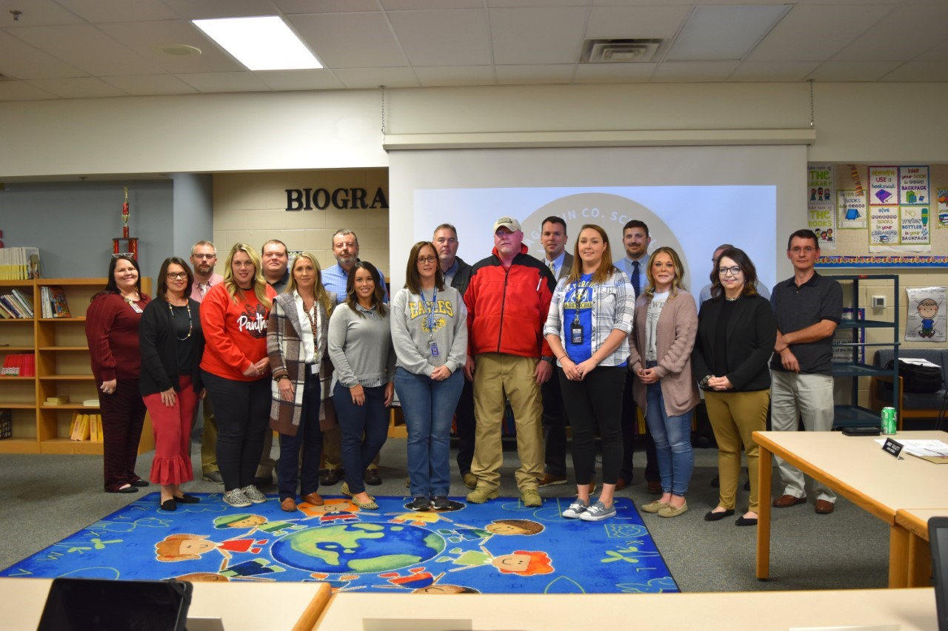
2022 Magoffin Co. BOE Stilwell Awardees
Notes:
2022 Magoffin Co. BOE Stilwell Awardees

Slide 13
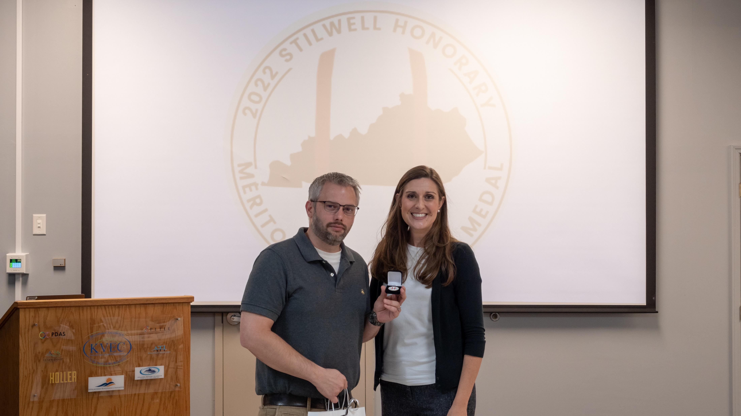
2022 Magoffin Co. Stilwell Awardee with Courtney DeRossett
Notes:
2022 Magoffin Co. Stilwell Awardee with Courtney DeRossett

Slide 14
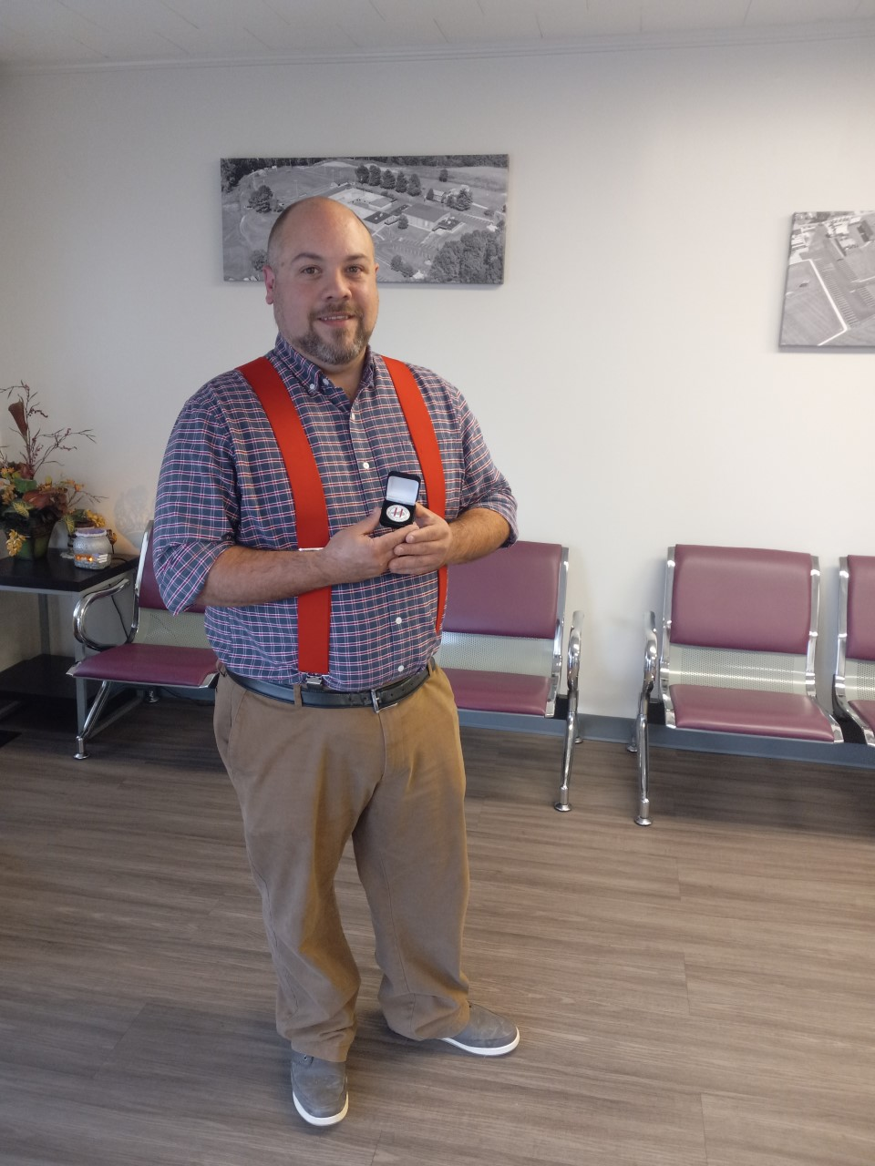
2022 Owsley Co. Stilwell Awardee No. 1
Notes:
2022 Owsley Co. Stilwell Awardee No. 1

Slide 15
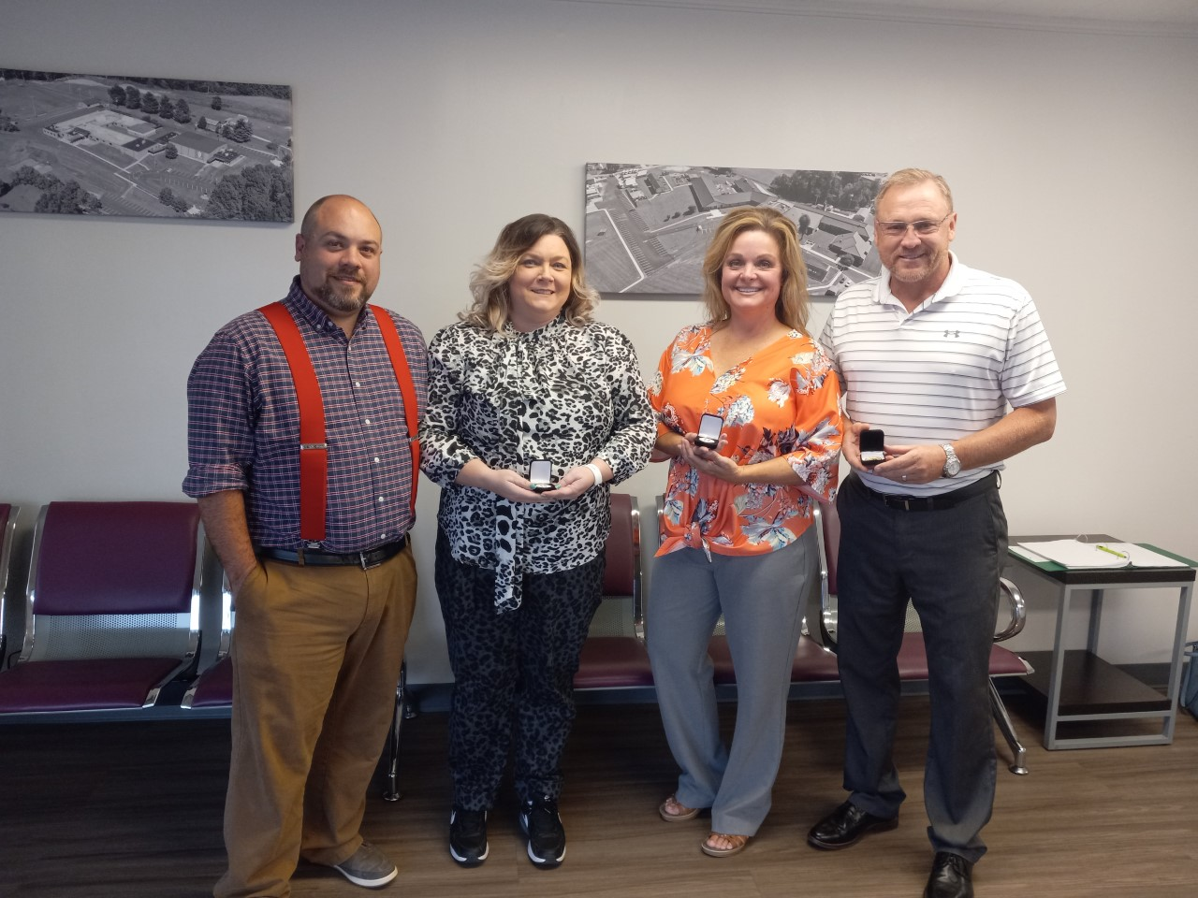
2022 Owsley Co. Stilwell Awardees No. 2
Notes:
2022 Owsley Co. Stilwell Awardees No. 2

Slide 16
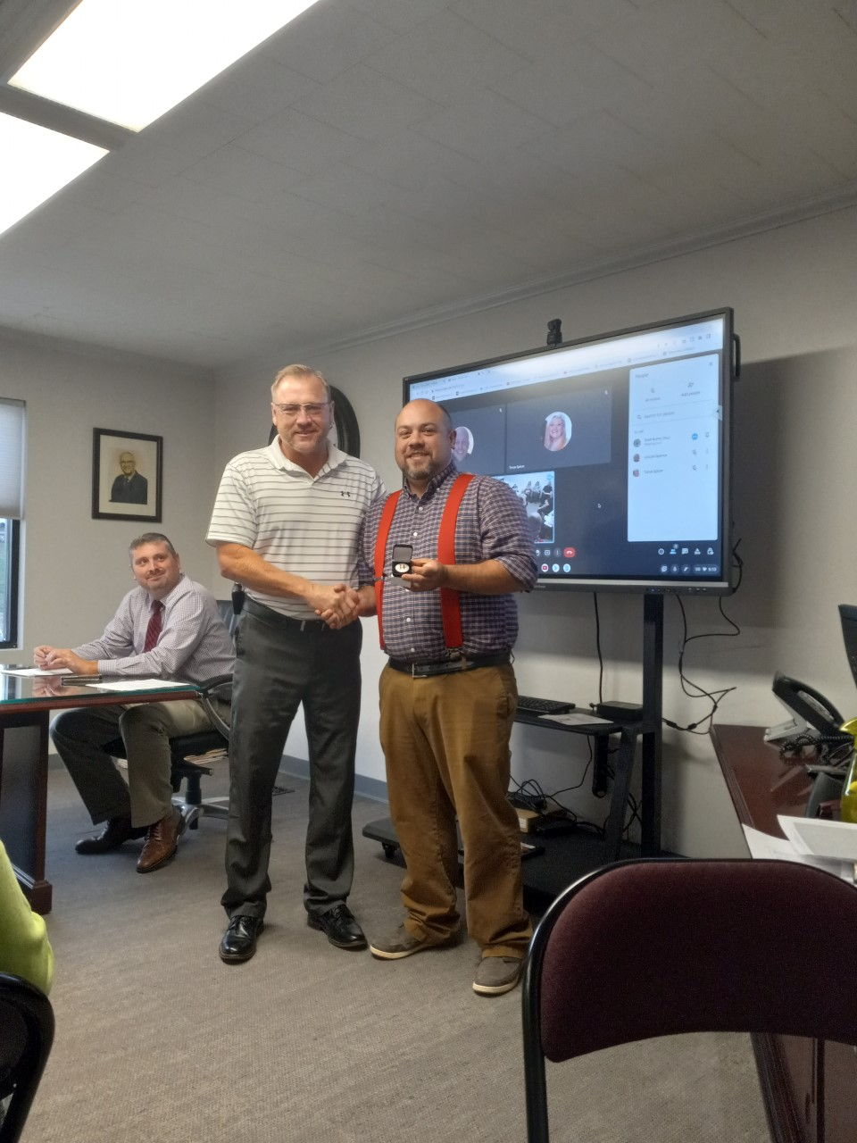
2022 Owsley Co. Stilwell Awardee No. 4
Notes:
2022 Owsley Co. Stilwell Awardee No. 4

Slide 17
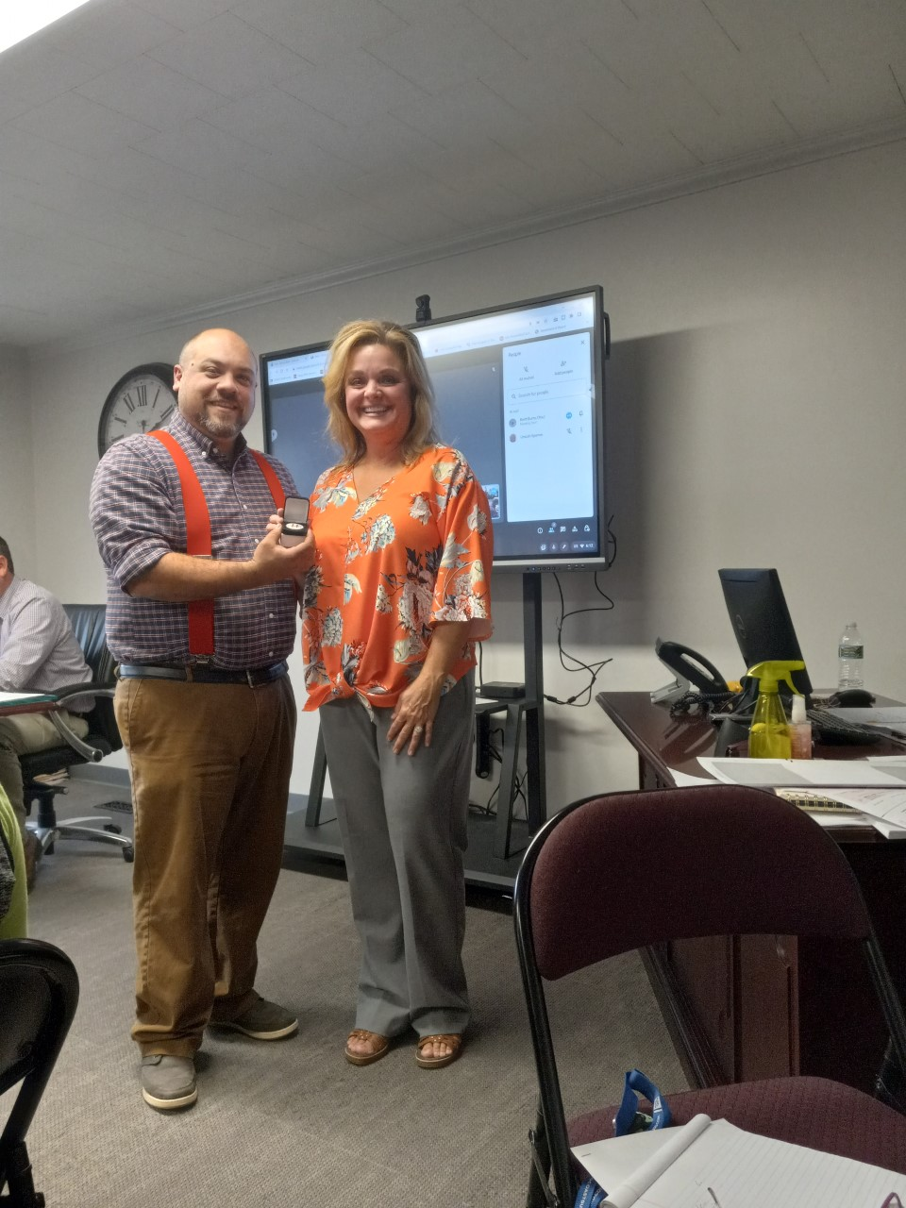
2022 Owsley Co. Stilwell Awardee No. 5
Notes:
2022 Owsley Co. Stilwell Awardee No. 5

Slide 18
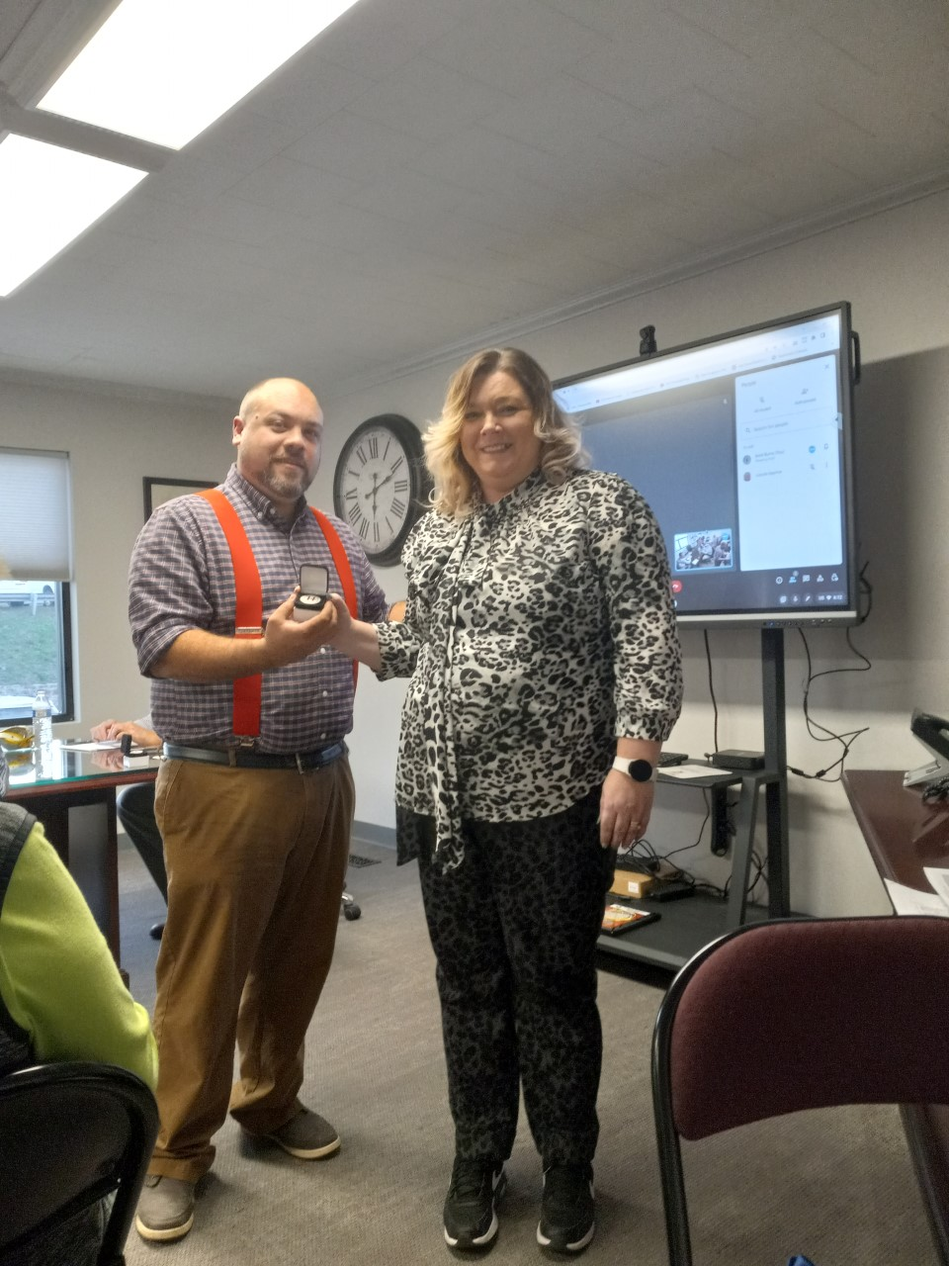
2022 Owsley Co. Stilwell Awardee pic 5
Notes:
2022 Owsley Co. BOE Stilwell Awardee pic 5

Slide 19
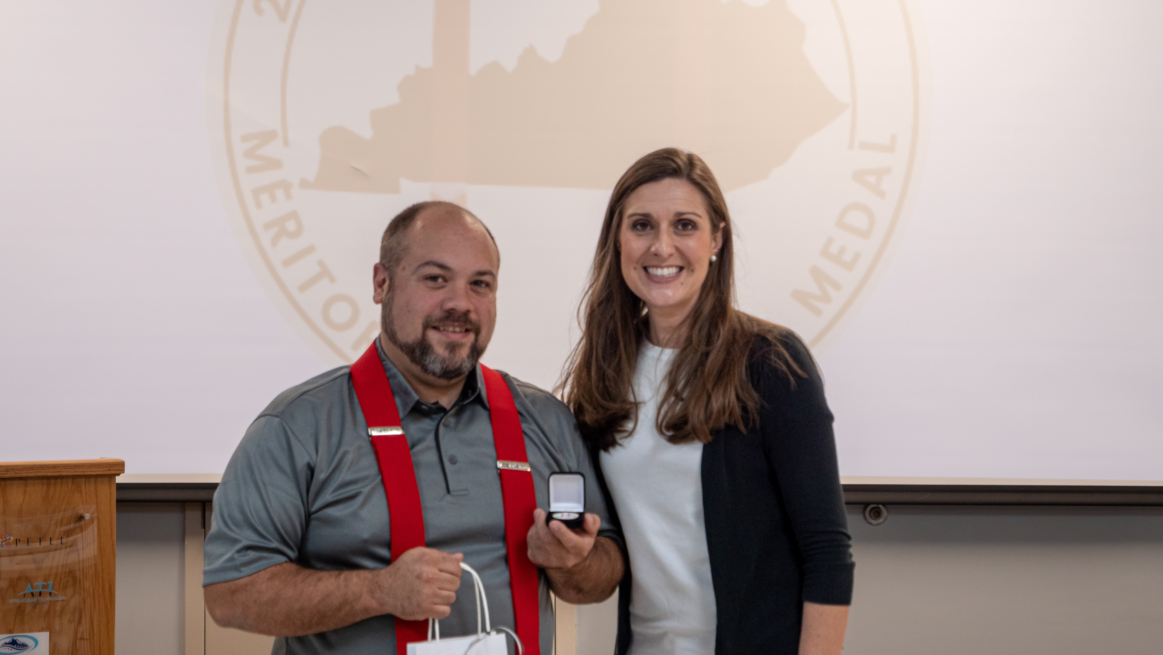
2022 Owsley Co. BOE Stilwell Awardee final pic with Courtney DeRossett
Notes:
2022 Owsley Co. BOE Stilwell Awardee final pic with Courtney DeRossett

Slide 20
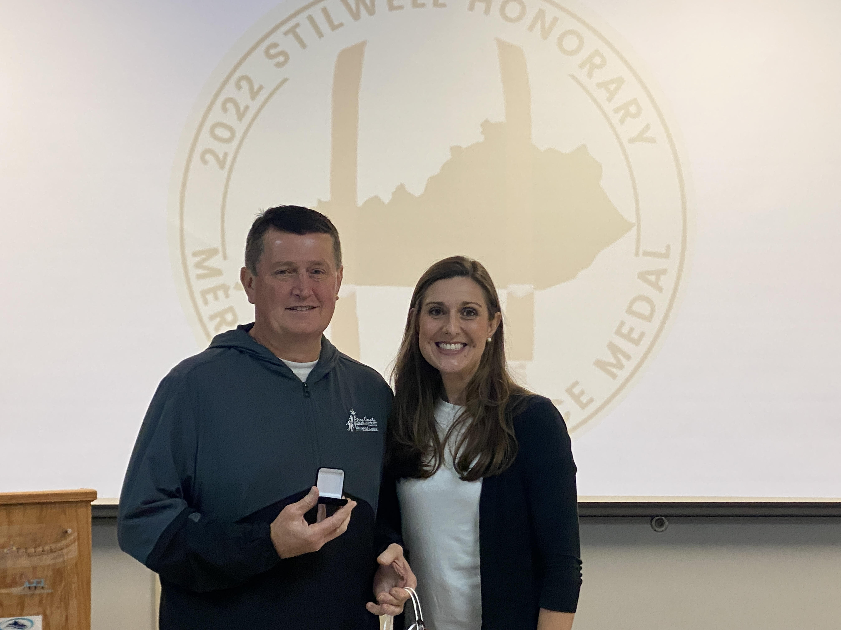
2022 Perry Co. Stilwell Awardee with Courtney DeRossett
Notes:
2022 Perry Co. Stilwell Awardee with Courtney DeRossett

Slide 21
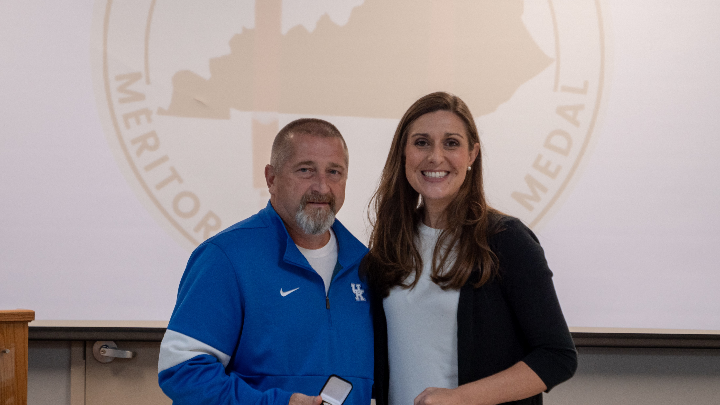
2022 Pike Co. Stilwell Awardee with Courtney DeRossett
Notes:
2022 Pike Co. Stilwell Awardee with Courtney DeRossett

Slide 22
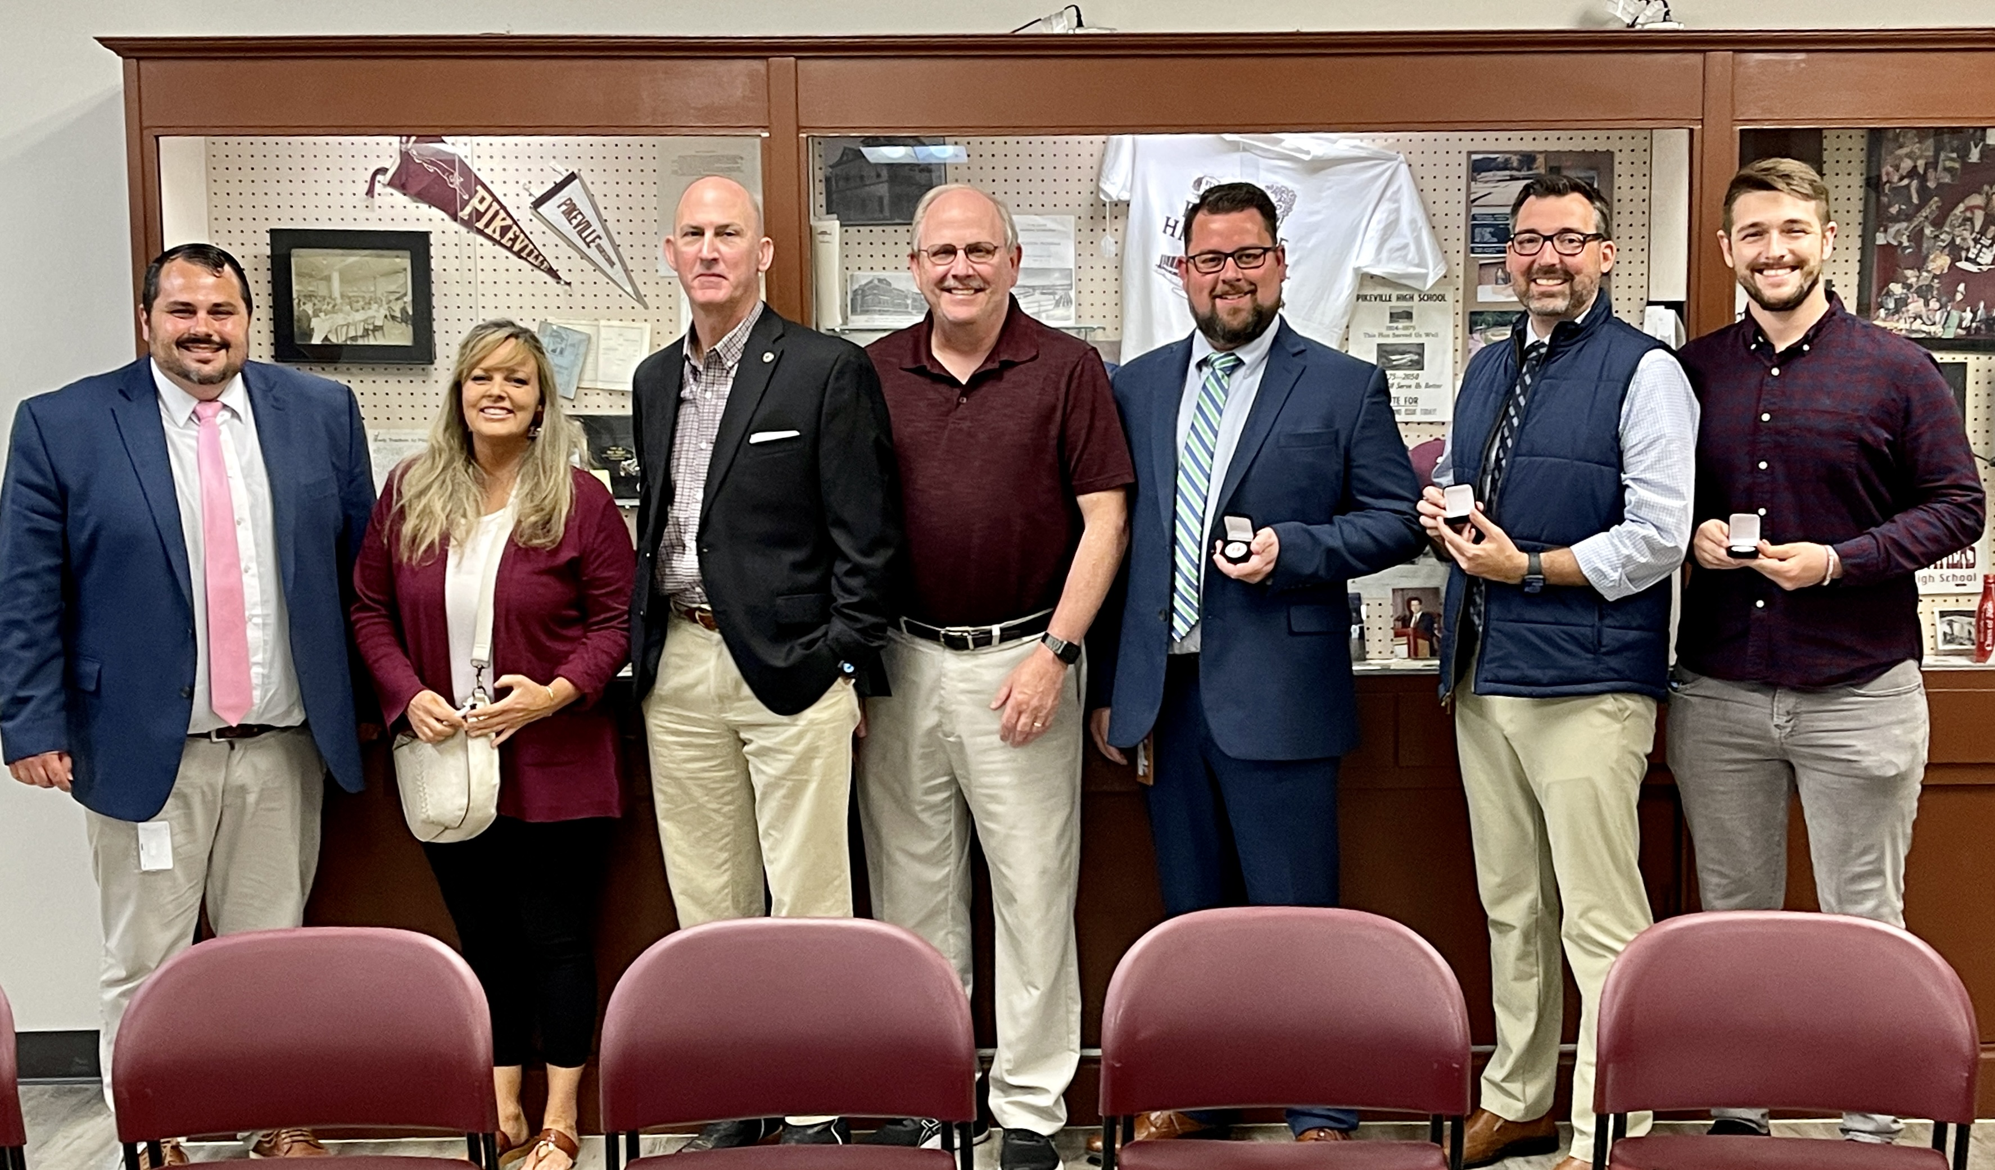
2022 Pikeville Stilwell Awardees
Notes:
2022 Pikeville Stilwell Awardees

Slide 23
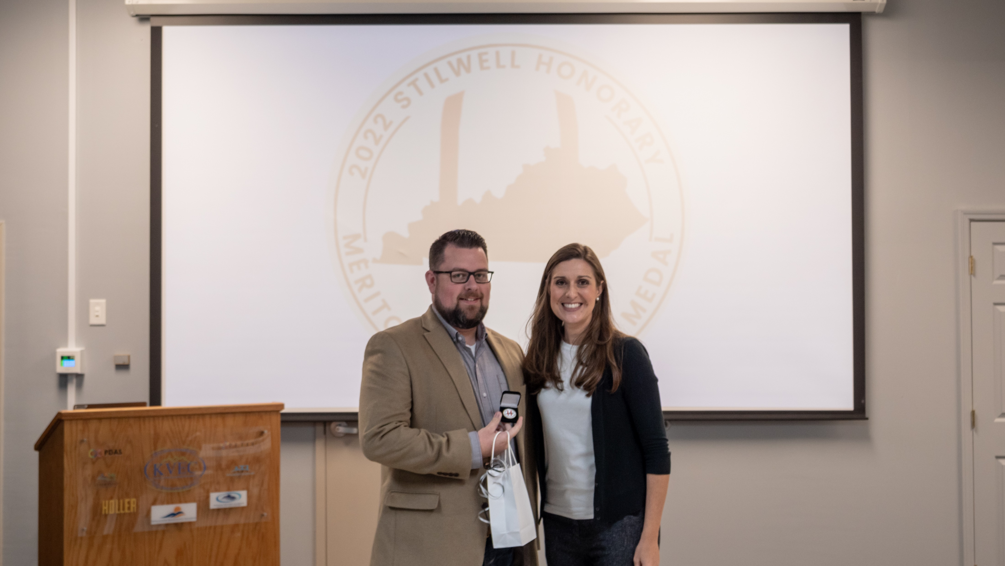
2022 Pikeville Independent Stilwell Awardee with Courtney DeRossett
Notes:
2022 Pikeville Independent Stilwell Awardee with Courtney DeRossett

Slide 24
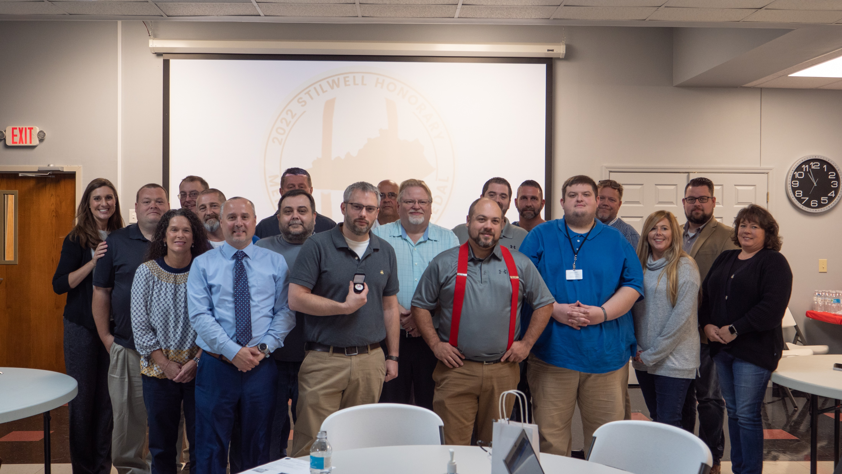
2022 Region 8 Stilwell Awardees Group Picture with Courtney DeRossett
Notes:
2022 Region 8 Stilwell Awardees Group

Slide 25
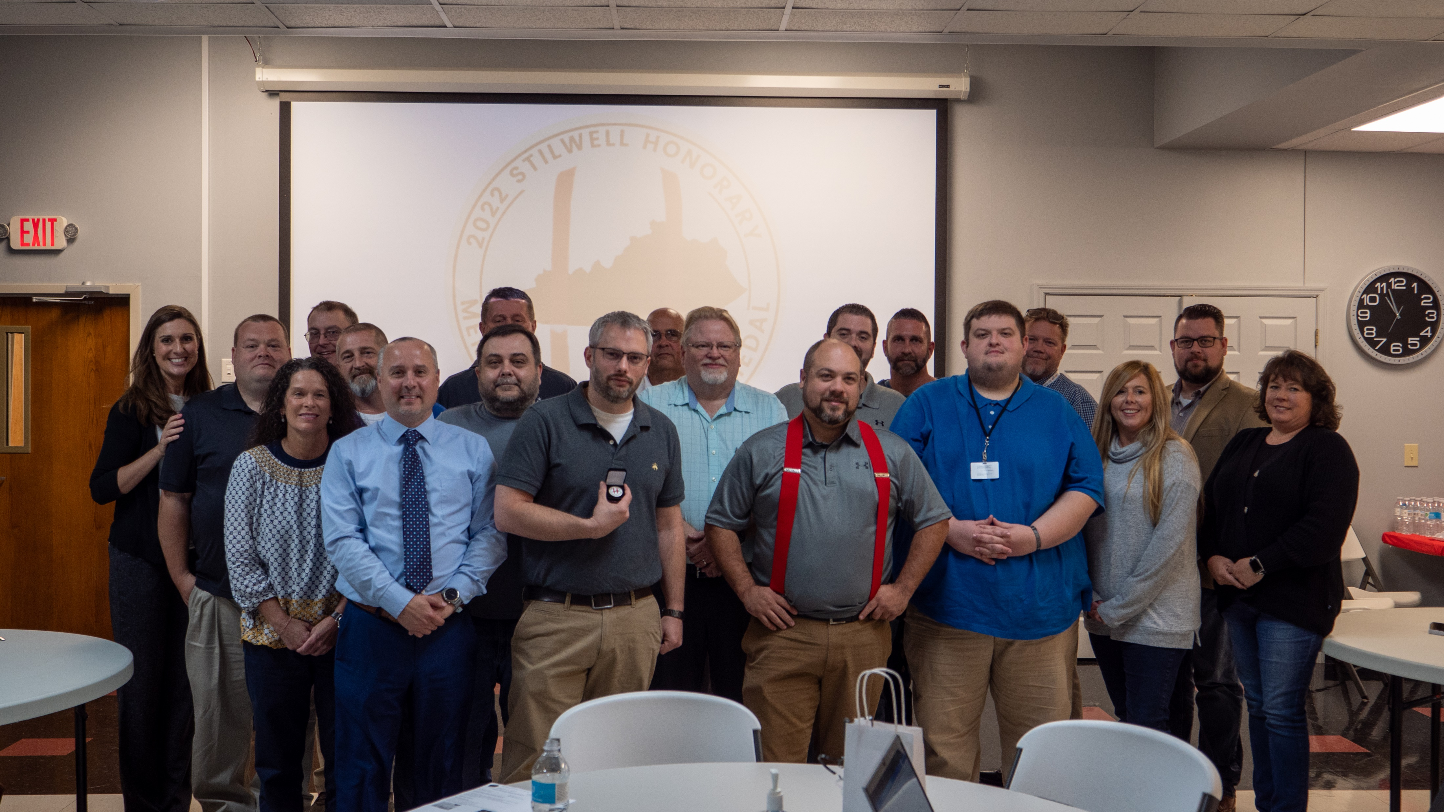
2022 Region 8 Stilwell Awardees Group Picture 2 with Courtney DeRossett
Notes:
2022 Region 8 Stilwell Awardees Group Picture 2 with Courtney DeRossett

Slide 26
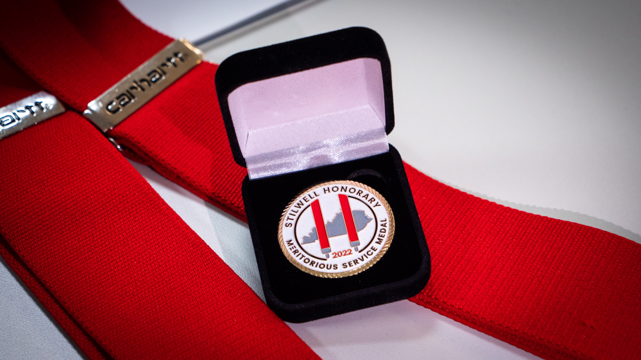
2022 Region 8 Stilwell Front Side Picture
Notes:
2022 Region 8 Stilwell Picture

Slide 27
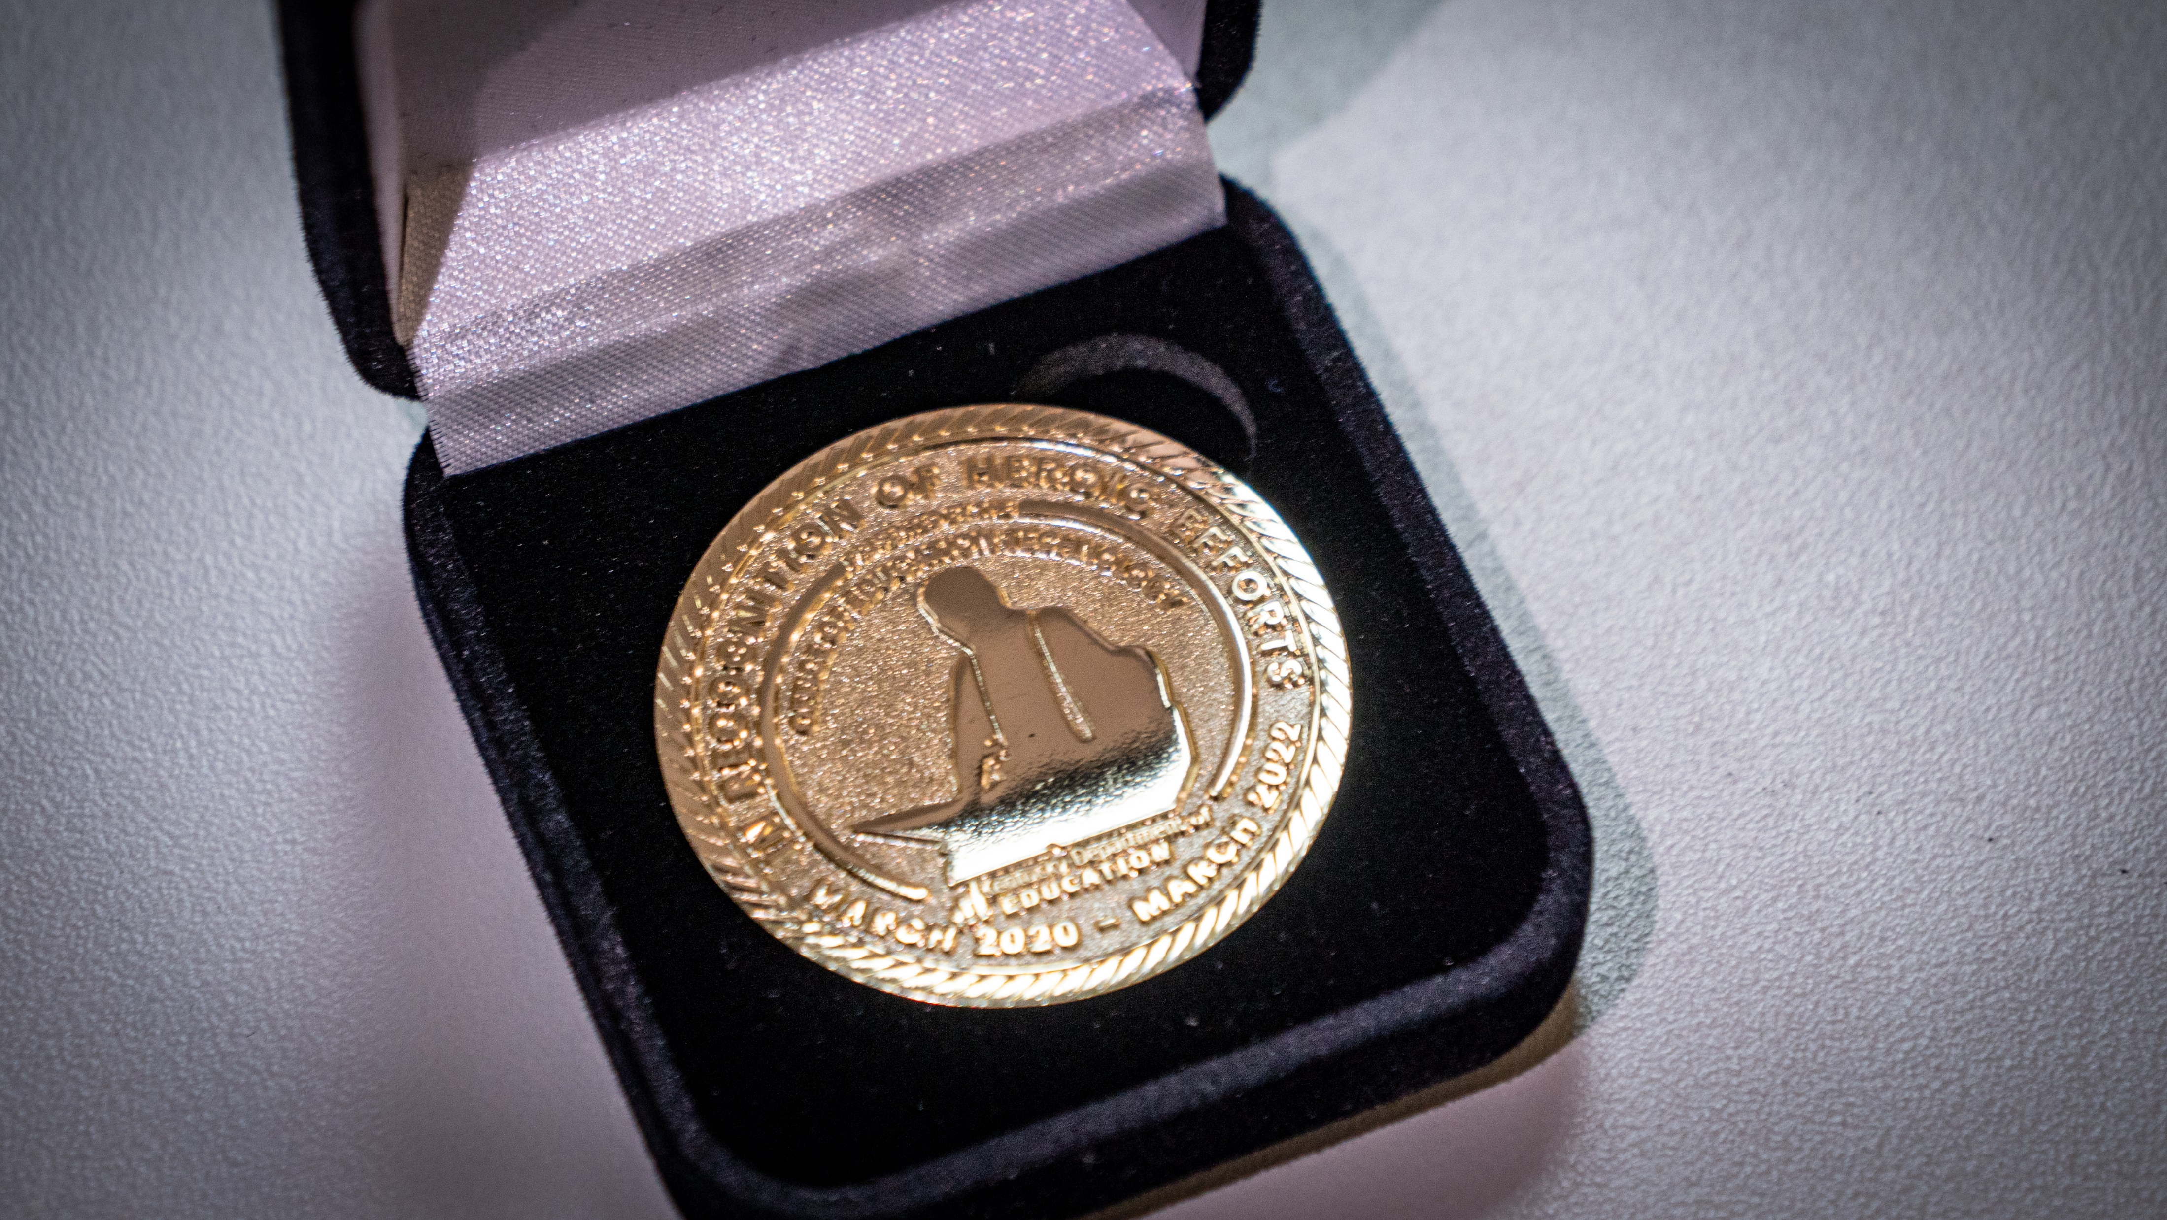
2022 Region 8 Stilwell Award Back Side Picture
Notes:
2022 Region 8 Stilwell Award Back Side Picture

Slide 28
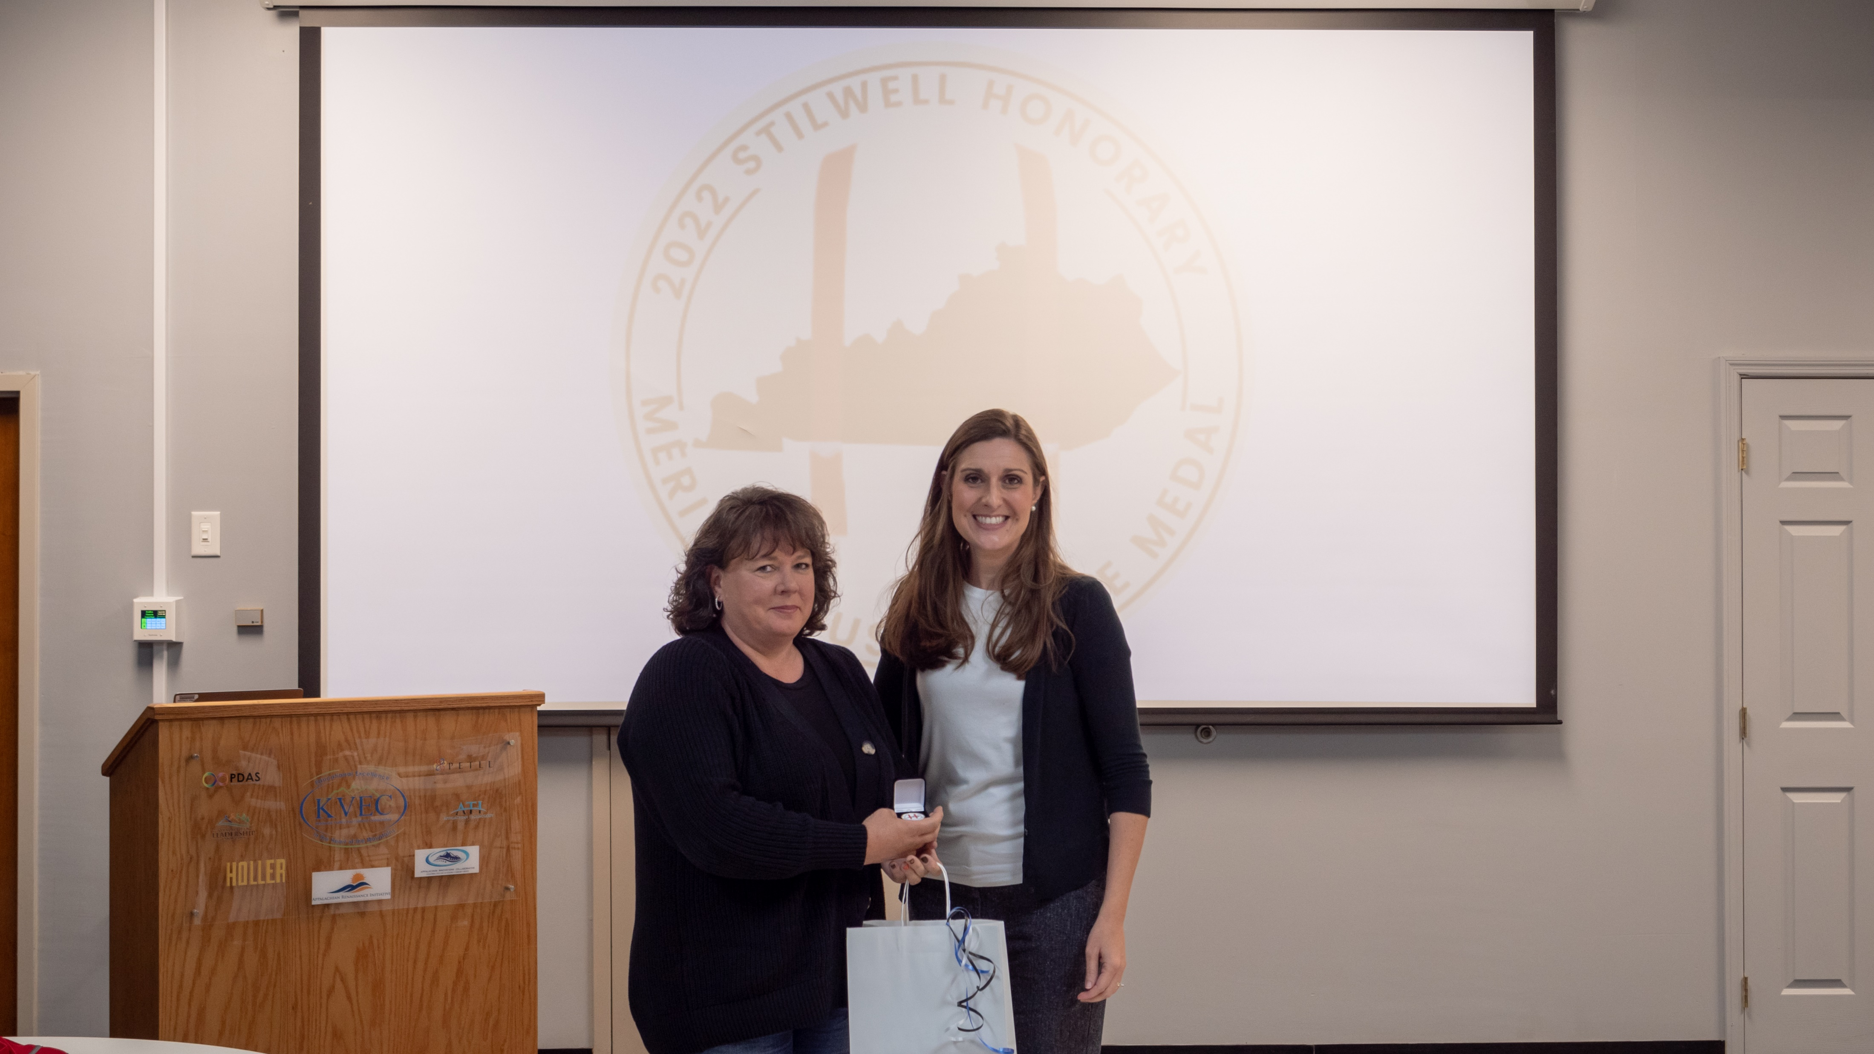
2022 Wolfe Co. Stilwell Awardee
Notes:
2022 Wolfe Co. Stilwell Awardee with Courtney DeRossett

