Slide 1
DAC Webcast
April 11, 2024
Jennifer Stafford, Ed.D, Director
Division of Assessment and Accountability Support
Office of Assessment and Accountability

Slide 2
Agenda
  ACT Reporting and Updates
  Alternate Kentucky Summative Assessment (AKSA) Update
  Student Data Review and Rosters (SDRR) Updates
  ACCESS/WIDA Alternate ACCESS Updates
  K Screen Training
  Kentucky Summative Assessment (KSA)/AKSA Site Visits

Slide 3
ACT Reporting and Updates
Christen Roseberry, Program Consultant
Office of Assessment and Accountability

Slide 4
ACT Spring 2024 Junior Administration Reporting
Scores will be available 3-8 weeks after answer documents are received by ACT.
Reporting Resources
2024 Score Report Schedule
ACT Success Site
ACT Contact Webform

Slide 5
AKSA Update
Christen Roseberry, Program Consultant
Office of Assessment and Accountability

Slide 6
AKSA Timeline Reminders
Window 2 runs from April 15-May 24.
Note: Districts may choose to end the window earlier than May 24.
Student Registration Database (SRD) opens for score entry April 15.
Transition Attainment Record (TAR) administration ends May 24.
Last day to enter scores in SRD for Window 2 and TAR is May 31.
Last day to delete students from SRD is May 31.
Notes:
Window 2 for AKSA runs from April 15 through May 24th. Districts may choose to end the Window earlier than May 24th. The Student Registration Database (SRD) will open for score entry on Monday, April 15th. The Transition Attainment Record (TAR) administration ends on May 24th. The last day to enter scores into the SRD for both the TAR and Window 2 is May 31st. Any scores from Window 1 makeups will also need to be entered by May 31st as well. The last day to delete students from SRD is May 31st. Deleting students is for those students who no longer meet eligibility criteria after an Admissions and Release Committee (ARC) has met and determined the student no longer qualifies for AKSA. A form requesting a student deletion will be sent out in a future Monday DAC email and Special Alternate email.

Slide 7

New Teachers or Students
If a new student has moved into the district from out of state, the student must take Window 1 and Window 2 during the second Window (April 15-May 24).
  The DAC will need to add the student in SRD and complete the AKSA Window 1 Makeup during Window 2 Form (sent in Monday DAC email on March 18 and April 1) for score entry.
  If the new student has transferred from another District in Kentucky, email dacinfo@education.ky.gov with the SSID number, district, and school the student now attends, so KDE can transfer the student in SRD.
If there is a new teacher, the teacher will need to complete Admin Code, Inclusion of Special Populations, and both Attainment Task trainings.
  The new teacher will need to register in the online training system (OTS), and the DAC will need to email KDE to have the AT quiz opened.
Notes:
If a new student has moved into the district from out of state, you will need to add the student into the SRD. The new student will need to complete both Window 1 and Window 2 assessments. The DAC can request for Window 1 to be opened for score entry into the SRD by completing the AKSA Window 1 Makeup during Window 2 Form that was sent in the Monday DAC email on March 18th and April 1st. It is also linked on this slide. If a new student has transferred into your district from another district in Kentucky, please email dacinfo@education.ky.gov with the student's SSID number, district, and the school the student attends and KDE will transfer the student in SRD. Please do NOT delete a student from SRD who has moved out of the district and has scores entered for Window 1.
If a district has a new teacher or a teacher who will be administering Window 2 who was not previously trained, the teacher will need to complete the Admin Code, Inclusion of Special Populations, and both Attainment Task Trainings. In order for the teacher to complete the AT quiz, the teacher will need to register in the Online Training system in the Members Area as seen on this slide. It is important that the teacher completes all portions of the registration as the videos will become available based on the grades taught. DACs will need to email KDE to request the quiz be opened for the teacher. As a reminder, teachers must give a copy of their quiz certificates to DACs upon successful completion of the quiz.

Slide 8
Newly Eligible Students
If a student is newly eligible for AKSA, the student must complete both Window 1 and Window 2.
If an Admissions and Release Committee (ARC) meeting takes place and determines a student is no longer eligible for AKSA, the student will take the Kentucky Summative Assessment (KSA) in the Spring. The student’s record in SRD will need to be deleted.
Notes:
If an Admissions and Release Committee (ARC) has met and determined a student is eligible for the AKSA, the student will need to take both Window 1 and Window 2.
If a student is determined to no longer be eligible for the AKSA based on the eligibility criteria during an ARC meeting, even if the student completed Window 1 during Fall testing, the student will take the Kentucky Summative Assessment (KSA) in the Spring. The student's record will need to be deleted in SRD. A form requesting student deletion in SRD will be sent in a future Monday DAC email and Special Alternate email.

Slide 9

Entering Scores in SRD
Entering scores in Window 2 will be similar to Window 1 score entry in the SRD.
Prior to entering scores, a Form number will need to be chosen.
For Window 2, the Quality of School Climate and Safety (QSCS) scores will also be entered.
Notes:
Entering scores for Window 2 will be very similar to Window 1 score entry as you can see on this screen. Prior to entering scores, teachers will be prompted to choose a Form number. Once a form number is selected, teachers will be able to enter scores. As a reminder, all content areas except for science have a field test. For Window 2, the Quality of School Climate and Safety (QSCS) survey will be administered. These scores will be entered on the main student screen as seen on the slide. All scores must be entered into SRD by the close of business on May 31st.

Slide 10
SDRR Updates
Chris Williams, Program Consultant
Office of Assessment and Accountability

Slide 11
SDRR
Spring rosters open in SDRR on April 24 and will close on June 12.
  Alternate Kentucky Summative Assessment (AKSA)
  Kentucky Summative Assessment (KSA)
  ACCESS (EL)
  Alternate ACCESS
  Postsecondary Readiness
  Cohort (graduation rate)
There are several reports available in Infinite Campus (IC) to assist in making sure that students are correctly identified in the student information system, so that they will then show correctly in SDRR by April 19 before the spring rosters open.
Notes:
In IC- you will change name, grade, SSID, DOB, gender, race/ethnicity, lunch, IEP and EL information.
In SDRR- you can make annotations, add or delete students, make changes to 100-Day entity, mark nonparticipations and mark accommodations for IEP and EL students.

Slide 12
IC Report Resources
District and school staff are strongly encouraged to utilize these tools to ensure accurate data in IC, which will then be reflected in SDRR.
  IEP
    IDEA Dec. 1 Count Extract
    QA SPED report
  Alternate Assessment
    Alternate Assessment Tracking report
  English Learners
    English Learners Extract
  Dropout
    Dropout report
  Cohort Graduation Rate
    Enrollment End Status Validation report
    G-Code Validation High School-Aggregate report
  IC Reports to Assist in Data Quality document
Notes:
Links to these IC resources are in the I Need Help button in SDRR.
*The Dropout window was Jan. 10-22 and is not currently active.

Slide 13

SDRR Resources
I Need Help
100-Day Tool
100-Day Quiz
Cohort Tool
Sandbox
Step-by-Step Instructions: Marking Accommodations, Change 100-Day Entity, Request Nonparticipation, etc.
Screencasts of the Step-by-Step Instructions.
Session for District and School Level Users on SDRR Functionality during Spring Rosters.

Slide 14
SDRR “Hot Topic” Office Hours
Topic, Date, and Participants for each Office Hour in TEAMS:
SDRR Resources: Where to Get Assistance- April 16- 1-2 p.m. ET- All SDRR Users
Spring Rosters Task List and Ticketing Basics- April 23- 1-2 p.m. ET- New District Assessment Coordinators (DACs) and Building Assessment Coordinators (BACs)
Do’s and Don’ts of Requesting Nonparticipations- April 30- 1-2 p.m. ET- All SDRR Users
Determining 100-Day Accountability: Rules and Tools- May 7- 1-2 p.m. ET- All SDRR Users
Digging into Demographics: Infinite Campus (IC) Values and SDRR- May 14- 1-2 p.m. ET- All SDRR Users
Note: See the SDRR February DAC Training ppt. for each office hour login information

Slide 15
ACCESS/WIDA Alternate ACCESS Updates
Chris Williams, Program Consultant
Office of Assessment and Accountability

Slide 16
ACCESS for ELLs Report Reminders
ACCESS Online Reports available in WIDA Assessment Management System (AMS) on April 26
ACCESS Printed Reports shipped to districts on May 8
Resources for Score Report
  ACCESS for ELLs Score and Reports webpage
  Interpretive Guide for Score Reports
  WIDA Secure Portal- Under Resources-ACCESS For ELLs Parent Letters translated in 47 languages to accompany the score report, ACCESS for ELLs Parent Score Report Guides-explains the score reports, Under Webinars-webinar on March 12-Post Testing: Interpreting Score Reports

Slide 17
WIDA Alternate ACCESS Report Reminders
WIDA Alternate ACCESS Online Reports available in WIDA Assessment Management System (AMS) on Sept. 11
WIDA Alternate ACCESS Printed Reports shipped to districts on Sept. 26
Resources will be available in the fall

Slide 18
K Screen Training
Lisa Jett, Program Consultant
Office of Assessment and Accountability

Slide 19
Train the Trainers
Virtual training presented by Curriculum Associates and the Kentucky Department of Education on April 24
Required for anyone who will train others in the district to implement the K Screen
Participants can register using this link
Registration will remain open until April 19
Training information will be sent out via email on April 22

Slide 20
K Screen Refresh Office Hour
The Office of Assessment and Accountability (OAA) and Curriculum Associates (CA) will host an Office Hour on April 15 starting at 1:00 p.m. ET.
OAA and CA will be available to answer all questions concerning the Implementation Guide and the screening process.
Please use this Microsoft Teams Link to join.

Slide 21
KSA/AKSA Site Visits
Melissa Chandler, Program Consultant
Office of Assessment and Accountability

Slide 22
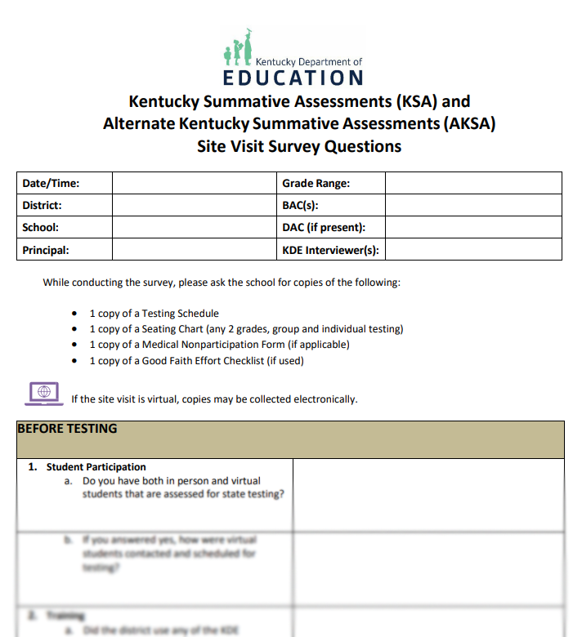
2024 KSA/AKSA Site Visits
In-person and virtual monitoring is planned for spring 2024.
Sites will be selected both purposefully and at random.
Site visit questions are located on Assessment Support Forms webpage.

Slide 23
KSA/AKSA Site Visits: What to Expect
In-person Site Visits
  Approximately 30-minute advance notice phone call to DAC
Virtual Site Visits
  DAAS will contact DAC/BAC to schedule time in advance
  Will be conducted via Microsoft Teams
For both in-person and virtual visits, school staff will be interviewed and asked to provide testing documentation (i.e., testing schedule, seating charts, good faith effort checklists, etc. )
Information collected from site visits will be compiled and added to a Google Form for reporting and auditing purposes

Slide 24
Questions and Answers
Please send questions or comments to dacinfo@education.ky.gov .
May DAC Webcast is CANCELED.
The next monthly DAC Webcast is scheduled for June 13 at 11 a.m. ET.
Thank you for your participation!

Slide 25
Division of Assessment and Accountability Support
Contact Information
KDE DAC Information
dacinfo@education.ky.gov
(502) 564-4394

