Slide 1
ACCESS for ELLs® Chris Williams, Program Consultant Division of Assessment and Accountability Support Office of Assessment and Accountability
Ordering Materials: ACCESS for ELLs® Online, Large Print, Braille, Kindergarten ACCESS for ELLs® and WIDA Alternate ACCESS

Slide 2
Ordering Materials
The ordering window for ACCESS for ELLs® is Sept. 29–Oct. 25.
Data Recognition Corporation (DRC) sent every District Assessment Coordinator (DAC) an email on Sept. 22 with instructions for ordering ACCESS materials in the WIDA Assessment Management System (AMS).
DACs will need to log in to WIDA AMS with the password or the password will expire. Contact DRC if it has expired or click forgot username or password and it will be re-sent.
DACs must go to the WIDA AMS site to order ACCESS materials. If the DAC has set up the Building Assessment Coordinators (BACs) in the WIDA AMS system, then the BACs can order for their school only.
2

Slide 3
Policy for Ordering and Testing
English Learner (EL) students in Kindergarten who need to take the WIDA Alternate ACCESS will take it this year since it is operational.
Districts who have Kindergarten English Learner (EL) students participating in the WIDA Alternate ACCESS this year will need to order Kindergarten WIDA Alternate ACCESS materials in the new K-2 cluster.
There will not be any nonparticipations for Kindergarten Alternate students unless the student is medically not able to test during the entire window.
Students are screened for EL identification prior to testing the students with WIDA Alternate ACCESS. The IEP team determines whether the EL student will take the regular ACCESS with accommodations or will take the WIDA Alternate ACCESS with accommodations.
3

Slide 4
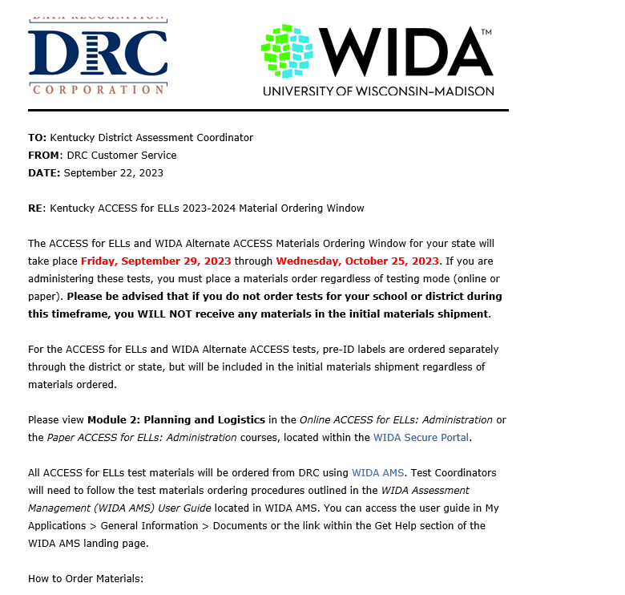
ACCESS Ordering Email
DACs received this email from DRC as the District Testing Coordinator on Tuesday, Sept. 22. If DACs did not receive the email, contact DRC Customer Service.
4

Slide 5
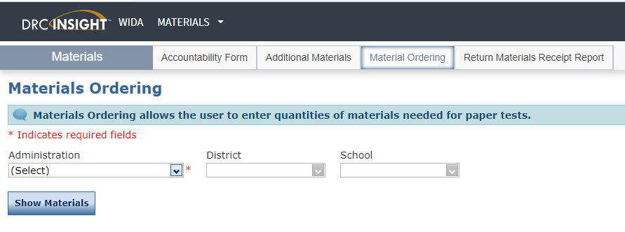
Materials Ordering
After logging into WIDA AMS, click the Order and Manage ACCESS Materials tile on the landing page, and click on Materials Ordering tab.
Choose the Administration-KY ACCESS for ELLs 2023-2024.
On the top of the Order Materials page to the right of the district name, choose the first school in which to place an order and click Show Materials.
Do not order at the District-Level Additional Orders Only Site when ordering.
5

Slide 6
Ordering Materials Reminders
For best results use Google Chrome, Mozilla Firefox, Microsoft Edge or Apple Safari as the most current production release version of the browsers when ordering materials.
Districts will receive a 15% (7.5% for school and 7.5% for the district) overage of ACCESS for ELLs® materials from DRC.
Do not over order; only order what the district needs. Make sure Infinite Campus (IC) reflects the number of EL students that districts order in WIDA AMS.
Districts can order additional materials starting on Dec. 5 in WIDA AMS for students that have enrolled after the initial ordering window closes.
Do not order pre-id labels; Office of Assessment and Accountability (OAA) will supply DRC with that information after the ordering window closes on Oct. 25.
6
Notes:
OAA will be verifying your ACCESS for ELLs order this year with DRC and verifying your EL enrollment in IC to eliminate over ordering of ACCESS for ELLs materials.

Slide 7
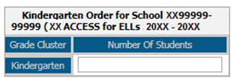
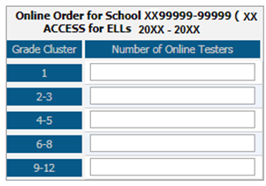
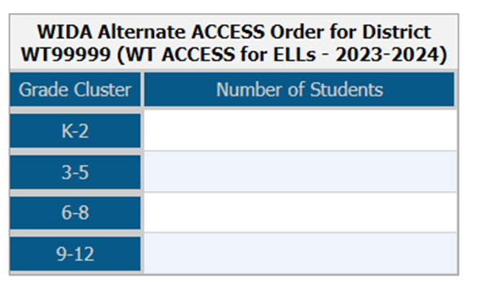
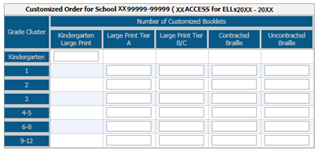
Ordering Materials in WIDA AMS
Enter student counts at each grade level as applicable. Enter counts only for the grades that have students testing.
Enter a 0 or leave blank for the grade levels with students not enrolled.
Districts just enter the online counts for writing within the grade level clusters for grades 1-3 and DRC sends tier levels automatically.
7
Notes:
Districts just enter the online counts for writing within the grade level clusters for grades 1-3 and DRC sends them automatically. If the districts finds they need more of a particular tier those can be ordered during the Additional Material Window.

Slide 8
ACCESS For ELLs Ordering Materials DACs or designee will order the following by selecting the specific school:
Online Order
Kindergarten, WIDA Alternate ACCESS, Braille and Large Print Order
ACCESS for ELLs® Online--Enter counts by grade level cluster (1, 2-3, 4-5, 6-8 and 9-12).
ACCESS for ELLs® Writing--Grades 1-3. Enter the online counts by grade level clusters; paper materials for tier levels A, B/C will be sent by DRC for the writing domain based on the online counts. Do not order paper writing test booklets for Grades 1-3 students.
ACCESS for ELLs®--Grades 4-12 will all be online; no paper/pencil testing for the writing, speaking, reading or listening domains. Do not order paper materials for Grades 4-12.
Enter counts for the following on each separate grid--Kindergarten, WIDA Alternate ACCESS, Braille (UEB Contracted, UEB Uncontracted and UEB with Nemeth Contracted), and Large Print (Kindergarten, Tier levels A, and B/C) will be given paper/pencil.
8
Notes:
ACCESS for ELLs Paper may be needed for English Learners (ELs) if:
• student’s IEP accommodations for WIDA testing require the paper ACCESS for ELLs, or
• student doesn’t have formal education with the use of technology prior to entering the U.S.

Slide 9
Ordering Window
DACs can view the school’s order for the entire district by selecting all schools on the Summary tab. BACs can only view their school.
DACs can see which schools have not completed the orders on the Status Report tab by selecting all schools.
Click on Save at the bottom of the screen in WIDA AMS to continue the ordering process. The order will show In Progress.
9

Slide 10
Ordering Window Completion
Click on Complete at the bottom of the screen in WIDA AMS when all school orders have been completed. Continue to edit until the materials ordering window closes. ACCESS for ELLs orders will be read-only after the ordering window closes.
Kentucky is shipping test materials to the district and not to individual schools, so the shipping address will not be visible for BACs but will be for DACs in WIDA AMS. Please verify the shipping address.
ACCESS ordering window closes at 11:59 p.m. ET on Oct. 25.
10

Slide 11
Electronic Materials Available
DRC will provide the following materials electronically; the test materials will be shipped:
DRC Return Labels
UPS Return Shipping Labels
Test Administrator Manual
District and School Test Coordinator Manual
Grade 4-12 Test Administrator Online Script
State-Specific Directions (Goldenrod Sheet-electronic only)
11
Notes:
If more return labels are needed, those can be emailed. The manuals and scripts can be accessed on wida.wisc.edu.
Only the AMS guide and Technology documents will be on WIDA AMS.

Slide 12
DACs
Ensure that initial orders are:
Placed during the statewide Materials Ordering window-Sept. 29- Oct. 25. If delayed, districts will only receive Pre-ID labels.
Reflect actual anticipated student counts, as overage charges may apply if orders are “padded.”
Ensure schools are aware of available materials overage.
Encourage schools to return unused materials to district as soon as possible to increase district materials overage inventory.
Encourage schools to return completed testing materials to the district office as soon as possible, so materials can be shipped to DRC in a timely fashion.
Coordinate and submit one district-wide additional materials order, only after the district and school overage inventories have been depleted.
Retain overage until the end of the testing window so there is available inventory for any new students who enroll.
12

Slide 13
BACs
Send unused overage to district office to increase overage inventory.
If additional materials are needed, contact DAC, who will pull materials from district overage or will put in an additional order.
Return testing materials to district office promptly upon completion of testing to initiate the return of materials to DRC.
13

Slide 14
Ordering Materials Demonstration and Q&A Session
To demonstrate and assist district and school staff with ordering materials in WIDA AMS
Kindergarten ACCESS for ELLs
ACCESS for ELLs Online
WIDA Alternate ACCESS
Accommodated Materials: Large Print and Braille
Date: Sept. 29
Time: 2-3 p.m. ET
Demonstration and Q&A Session Login Link
14

Slide 15
Contact Information:
KDE:
Chris Williams
502-564-4394 ext. 4750
DRC:
WIDA DRC Customer Service
Data Recognition Corporation
855-787-9615
15

