Slide 1
Manage Users and Test Setup/Registration WIDA Assessment Management System (AMS)
Chris Williams, Program Consultant
Division of Assessment and Accountability Support

Slide 2
New For WIDA AMS
View all student demographic details in one tab, and quickly move to the next to add or remove accommodations in the new student management application.
Review, edit and create new registrations (the new name for “test sessions”) on a refreshed test management interface.
Easily navigate in and between applications with clearly identifiable buttons, and quickly locate options to print test tickets and run tier placement reports.
The new import management application allows district and school staff to upload a file with the students’ information and add those students to automatically generated registrations at the same time. The new application also identifies any errors in the import file for correction.
2

Slide 3
WIDA AMS Enhanced Landing Page
3

Slide 4
Test Monitoring in WIDA AMS
Test Monitoring - the application uses a Monitoring Code to assign a student’s test session to a Test Monitor. The test monitor will open the test monitoring menu under My Application on the home screen where a random unique Monitoring Code will be assigned to that user. The test monitor will share the code with the students whom they are monitoring. After logging in to a test, students will enter the monitoring code and then they will show up on the Test Monitoring Dashboard. Test monitors can view a student’s test status, navigation and test progress in real time.
4

Slide 5
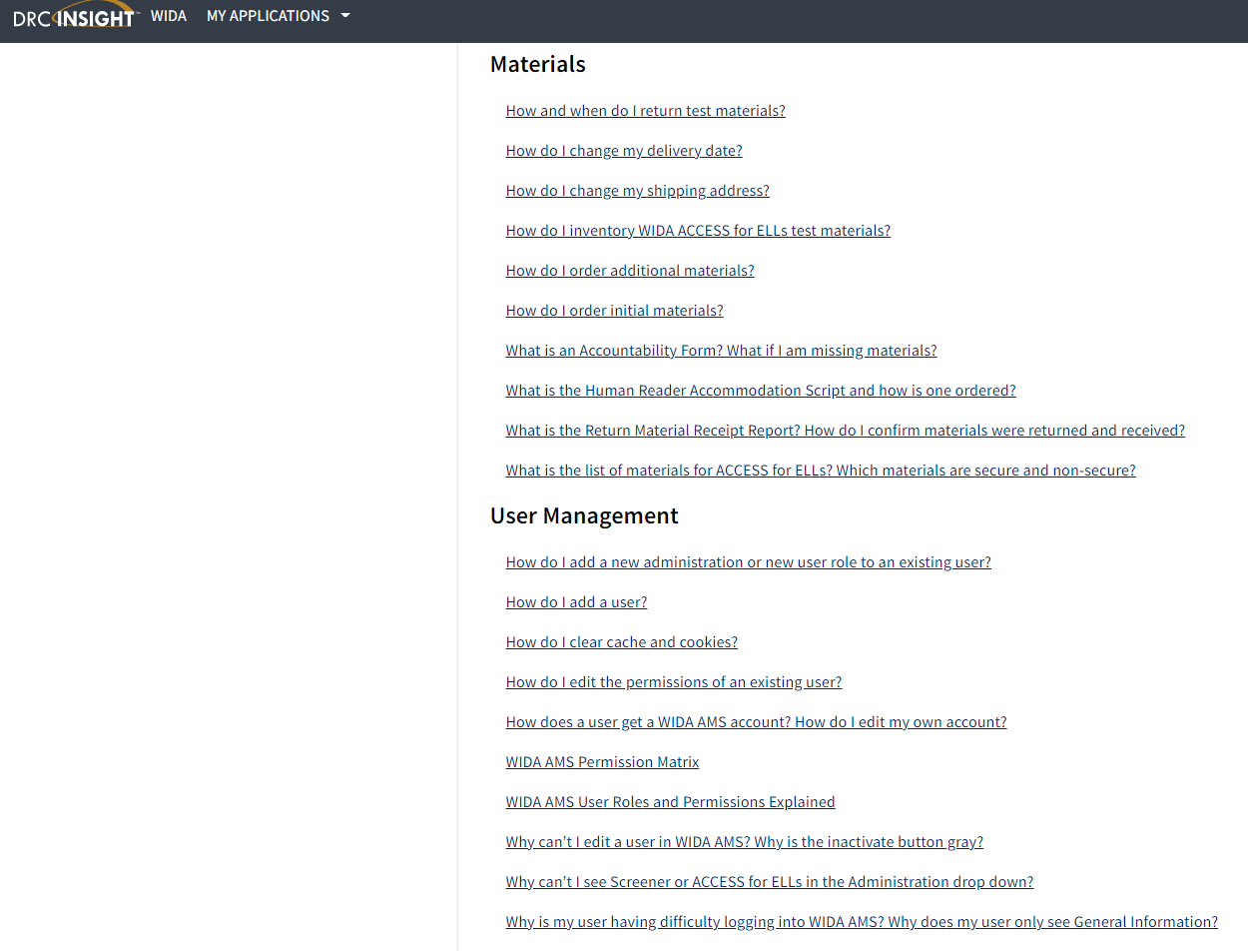
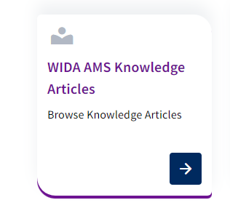
WIDA AMS Knowledge Articles
Under My Application-DRC Customer Service- to find the WIDA AMS Knowledge Articles to assist with questions around WIDA AMS
5

Slide 6
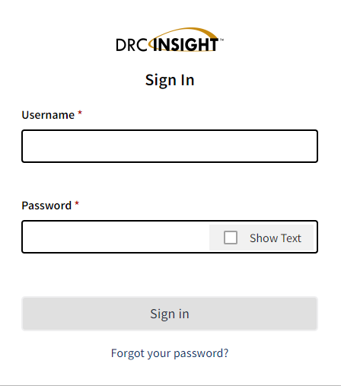
Login to WIDA AMS
WIDA AMS
If District Assessment Coordinators (DACs) and District Technology Coordinators (DTCs) need an account, contact Chris Williams.
If school personnel need an account, contact the DAC.
6

Slide 7
WIDA AMS
Welcome to the WIDA Assessment Management System (AMS)
WIDA AMS supports the administration of the ACCESS for ELLs suite of assessments and WIDA Screener Online.
Find technical and test administration materials in the WIDA AMS Library (login not required).
Logging in to WIDA AMS
To access WIDA AMS, log in using your username (email address) and password.
If you do not have a WIDA AMS login, go to the 'Logging in' section of your WIDA member/state page. Find your member/state page by going to the WIDA website and using the drop down in the upper right corner. If you can't find what you're looking for, contact the WIDA Client Services Center.
Check the DRC System Status Indicator to see if all systems are operating normally or if there is an outage that could be affecting your work.
Public Test Resources
View the Test Demo to demonstrate test features to students. The Test Demo is a series of videos that explain to students how they will take the online test and interact with the test platform.
Use the Test Practice items to help students understand how to respond to ACCESS for ELLs Online and WIDA Screener Online items on the test platform. While using the test practice items, students can familiarize themselves with the features available to them during the actual assessment. To access and view the Test Practice Items on Windows, macOS, ChromeOS, or Linux devices, you must use the Chrome browser. If you are on an iPad, you must use the Safari Browser.
Use the Sample Items to help students, educators, and families get a better understanding of ACCESS for ELLs Online. None of the sample items appear on the operational test; however, they are similar to items that students will see on the test. To access and view the Sample Items on Windows, macOS, ChromeOS, or Linux devices, you must use the Chrome browser. If you are on an iPad, you must use the Safari Browser.
ACCESS for ELLs and WIDA are trademarks of Board of Regents of the University of Wisconsin System.
Notes:
Need to use Chrome for the test practice and the test demo. For everything else in WIDA AMS, you can use any browser.

Slide 8
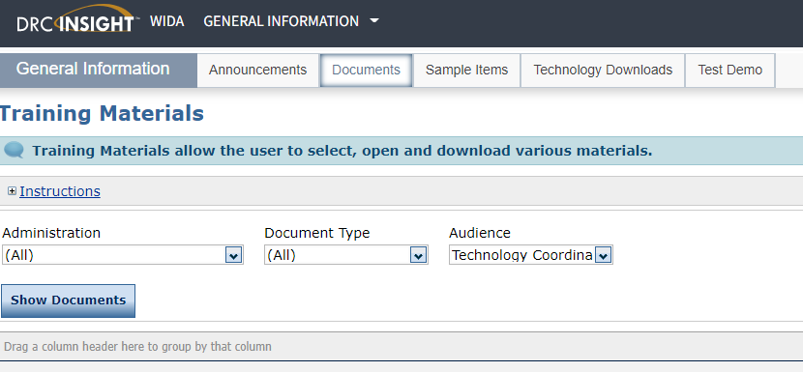
Install and Configure Testing Software Tab
Technology Downloads and Documents for the DTC will be on the General Information

Slide 9
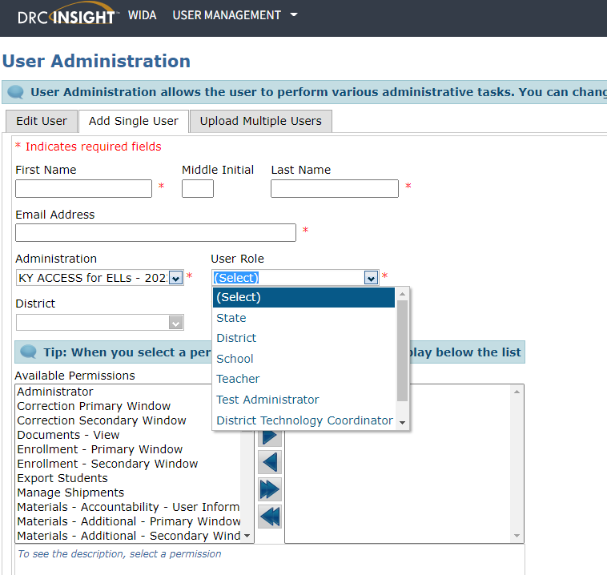
Add/Edit Users-Adding a Single User
After logging into WIDA AMS, click on Add/Edit Users
Add a single user by filling in the following:
First Name, Middle Initial and Last Name
Email Address
Administration: (Select KY ACCESS for ELLs- 2023-2024)
District
School
User Role: Test Administrator (DACs and DTCs already have access to WIDA AMS)
Available Permissions vs. Assigned Permissions

Slide 10
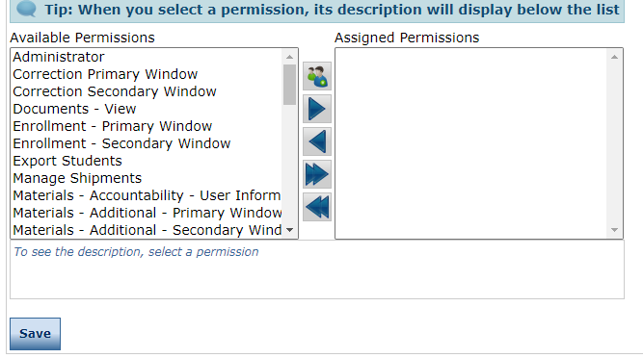
Add/Edit User Tab Continued
Once the user role has been selected for Test Administrator, select the corresponding permission set and the available permissions will highlight on the screen. (See WIDA AMS Guide pp. 35-41 for assistance.)
DACs must use the right arrow to move available permissions to the assigned permissions box.
Once permissions are assigned then hit the save button at the bottom of the screen.
If staff have left or retired from the district, please inactivate the accounts in WIDA AMS. Only current staff should have access to WIDA AMS depending on the role.

Slide 11
Add/Edit User Tab-Adding Multiple Users
Click on Upload Multiple Users at the top.
Download the File Layout and Sample File to enter the users.
Once the users are in the format, then do the following:
Select ACCESS for ELLs -2023-2024-Kentucky under administration
Click on Browse to find your CSV file
Click on Upload
Upload complete; confirmation will appear if successful
Assign permissions

Slide 12
WIDA AMS Test Administration
Materials, Student Management, Test Management and Getting Ready for Testing

Slide 13
Order and Manage ACCESS Materials Tab
Accountability Form is for the district to enter the quantity of paper materials to be returned or could not be returned to DRC when testing is complete. It is prepopulated with the initial shipment order in Oct.
Additional Materials is for the DACs to order additional paper materials needed for testing after Oct. and prior to the last week of testing.
Materials Ordering is the initial materials order that DACs completed during the materials ordering window in Oct.
Return Materials Receipt Report is the electronic inventory of all materials shipped to the district and schools.

Slide 14
Student Management Tab
Student Management allows the district to add new students that were not pre-populated in WIDA AMS from the original pre-id data file sent to DRC in Oct. from the Office of Assessment and Accountability (OAA).
Update Accommodations allows the district or school staff to update the accommodations for students who have an Individual Education Program (IEP) or 504 Plan
Transfer Students allows the student to be transferred from one school to another within the district in WIDA AMS.
Export Student allows school or district staff to export up to eight thousand students with all the demographics from WIDA AMS.

Slide 15
Student Export/Transfer/Validation
Student Status Dashboard allows the user to view the online testing status of each student within a school.
Student Transfer Form allows the student to be transferred from one district to another district within WIDA AMS.
Data Validation allows the district/school to correct demographics, etc. after testing is completed.

Slide 16
Manage Test Sessions/Registrations Tab
Manage Test Sessions/Registrations allows the district/school to search or view existing testing sessions/registrations for a specific district or school.
Create or edit test sessions/registrations.
Assign or remove students for each test session/registrations.
Export session details, print test tickets or view the status of the test session/registrations.

Slide 17
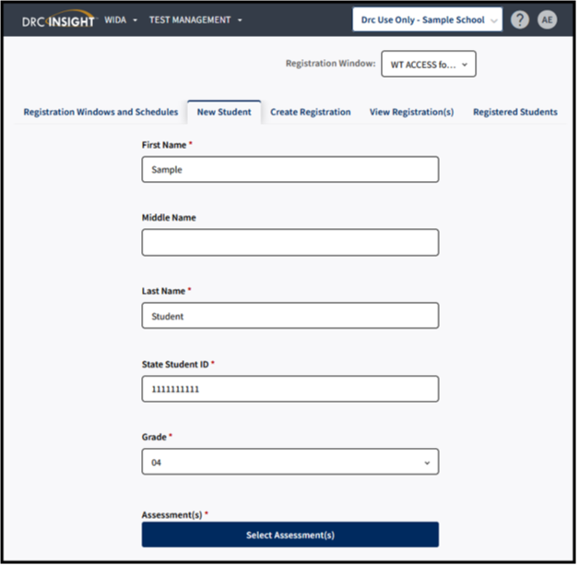
Adding a Registration
To add a registration, complete the following steps:
Click Test Management from the WIDA AMS My Applications menu bar.
Confirm or enter your site criteria in the upper right corner. Click Save.
Confirm or enter your Registration Window in the drop-down menu.
Select the New Student tab.
Complete First and Last Name, SSID, and Grade Filters. Button under Assessment(s) will activate.
Click on Select Assessments.
The Select Assessment(S) will appear. Select the assessments and domains applicable to the student.
Click Add to add a student to the following registrations or click Close to cancel the process without saving the changes.
Confirm or edit the Registration Name. The Registration Name will default to user's last name and date.
Complete other demographic fields as needed.
Click Register to register the student to the selected assessment.
Click View Registration(s) to see the newly created registration.
17
Notes:
New Student Tab method simultaneously adds a student into Student Management and creates a registration for a single, new student.
Create Registration creates a registration for a single or group of students who already exist within WIDA AMS under Student Management.
To add a registration, complete the following steps:
Click Test Management from the WIDA AMS My Applications menu bar.
Confirm or enter your site criteria in the upper right corner. Click Save.
Confirm or enter your Registration Window in the drop-down menu.
Select the Create Registration tab.
Enter a Registration Name. The registration name should be descriptive. For example, a user might name the registration by the teacher name and classroom period.
Click Select Assessment(s). A Select Assessments window will appear. For ACCESS for ELLs, you will select an assessment for each domain. For WIDA Screener Online, you will select the assessment by grade cluster. Click Add.
Click Select Student(s) to add one or multiple students to the registration. To select multiple students, click the checkbox next to each student to add to the registration. A user can also filter by grade or last name. Click Add.
A user can choose to activate Test Monitoring and set to “Required.” This action will require all students in the registration to enter a Monitoring Code generated by the Test Administrator on initial login of the assessment.
Click Register.
You will receive a Registration Confirmation message showing the assessment(s) and the number of students added to the registration. If this is correct, select Close.
Click View Registration(s) to see the newly created registrations.
Note: A Registration Window, District and School will need to be selected for the Create Registration tab to activate. If the Create Registration tab does not appear, this will indicate that the user does not have the “Registration-Add/Edit” permission.
The registration name should be descriptive. For example, a user might name the registration by the teacher name and classroom period.
For WIDA Screener Online, you will select the assessment by grade cluster.
Note: If you do not see the student available to be placed into the registration, this will usually indicate that the student has not yet been added to WIDA AMS, or that the student is already enrolled in a registration of the same domain and grade cluster. Search for the student under the Registered Students tab to confirm the student’s enrollment in registrations for the given administration.
If creating a registration for Screener and are unsure which grade cluster registration to use for the student, refer to Knowledge Article “What grade cluster registration should I screen a student?”
For Screener testing, a student will only need to be enrolled in one registration. Screener Online is a single ticket login with one registration.
For more information on how to edit a registration, refer to Knowledge Article “How do I edit a registration?”

Slide 18
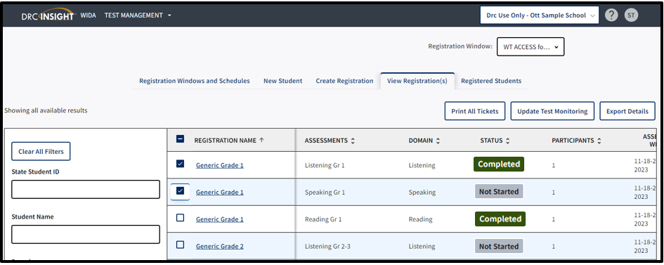
Printing Test Tickets
To print test tickets for students in a registration, complete the following steps:
Click Test Management from the WIDA AMS My Applications menu bar.
Confirm or enter your site criteria in the upper right corner. Click Save.
Confirm or enter your Registration Window in the drop-down menu.
Select the View Registrations(s) tab.
Apply one or more filter criteria such as SSID, Student Name, Domain, Registration Name, and/or Assessments to refine your search. Or, to print the test tickets for multiple registrations, leave the filters blank
Select the checkbox next to the registration(s) and click Print All Tickets.
18
Notes:
District and school staff must keep test tickets secure before and after testing of the WIDA Online Screener. Must maintain test security through out the screening process-before, during and after.
Note: If the Print all Tickets button does not appear, please select a school in the site selector in the upper right corner.
If a PDF file does not appear, disable your browser’s pop-up blocker.
A test ticket includes the Student Name, Date of Birth, Accommodations, Domain, Registration Name, State Student ID, Username, and Password.
Prior to testing, Test Administrators should confirm the student’s identity when passing out the test tickets to the student to prevent the student from logging in under the incorrect profile.
Screener Online has one login and a single test ticket for all four domains.
How do I print test tickets for individual students?
To print test tickets for individual students in a registration, complete the following steps:
Click Test Management from the WIDA AMS My Applications menu bar.
Confirm or enter your site criteria in the upper right corner. Click Save.
Confirm or enter your Registration Window from the drop-down menu.
Select the Registered Student(s) tab and search for the student by name or state student ID. Any student with related search criteria will automatically filter on the screen with his or her current registrations.
If you need further assistance with WIDA AMS, please contact DRC Customer Service at 855-787-9615 or wida@datarecognitioncorp.com.

Slide 19
Getting Ready for Testing
A week prior to testing, districts will need to have the students do a practice test to become familiar with the online testing format.
The day before testing in the district, print out the tickets online for the students in grades 1-12. Kindergarten, Alternate, Braille and Large print take the paper-pencil ACCESS.
Online Test Setup Window is Nov. 30, 2023- Feb. 16, 2024
Testing Window is Jan. 4- Feb. 16, 2024

Slide 20
Resources in WIDA AMS
WIDA AMS User Guide
WIDA AMS Knowledge Articles
Technology Resources- Documents and Downloads
Technology Memos and Webinars-recorded and upcoming webinars
20

Slide 21
Kentucky ACCESS Trainings on KDE Website
User Accounts
Materials Ordering
Test Setup
Writing Tier Placement
Overview
ACCESS Roster Training in SDRR (coming soon)
Notes:
Each of the Kentucky ACCESS trainings are required along with the WIDA online training and quizzes.

Slide 22
Contact Information:
KDE:
Chris Williams
502-564-4394 ext. 4750
DRC:
WIDA DRC Customer Service
Data Recognition Corporation
855-787-9615 TTY: 763-268-2889

