Slide 1
Student Registration Database
Fall 2024

Slide 2
Agenda
Overview of Student Registration Database (SRD)
Test Administrator or Teacher Access and Use
Attainment Task (AT) data entry
Transition Attainment Record (TAR)
Quality School Climate and Safety (QSCS) Survey
District Assessment Coordinator (DAC) Access and Use
Teacher Certification
Student Registration
Nonparticipation
Reports

Slide 3
SRD General Information
The SRD is the forward-facing interface for student data entry of the students participating in the Kentucky Alternate Assessment Program (KAAP) academic components.
The Alternate Kentucky Summative Assessment (AKSA) is comprised of Attainment Tasks (AT). ATs are multiple choice assessments in Reading, Mathematics, Science, Social Studies and Writing (Windows 1 and 2).
The Transition Attainment Record (TAR) is a rating scale for post-secondary readiness (open Nov. 12 – May 23, 2025).
The Quality School Climate and Safety (QSCS) Survey (Window 2 only).

Slide 4
Login Credentials
Log in credentials are synced between the Online Training System (OTS) and the Student Registration Database (SRD).
Teachers or test administrators profile information will be transferred from the OTS to the SRD.
The same username and password is used to access both systems.

Slide 5
Login
Login to the SRD
Enter the username and password

Slide 6
Teacher Use and Access
Users must be registered in the Kentucky Alternate Assessment Program (KAAP) Online Training System (OTS) to be granted access to the SRD.
Users who are having difficulty registering in the OTS should contact Darrell Mattingly at darrell.mattingly@uky.edu for access to the OTS.
Prior to gaining access to the SRD, users must successfully complete the Overview and AT quiz and TAR quiz, if applicable.
DACs can certify test administrators upon successful completion of required quizzes.

Slide 7
SRD Tool Menu
Teacher Tools are found in the menu along the left side of the system interface (screen).
Dashboard
Student Information
Reports

Slide 8
Teacher Reports

Slide 9
Report Format

Slide 10
Student Roster Interface
The following links are listed beside the student’s name (see example on slide 11):
Survey - active link to access the student’s Quality of School Climate and Safety (QSCS) survey.
TAR - active link to access the student’s Transition Attainment Record (TAR) Data entry interface.
AT - active link to access the student’s Attainment Task (AT) data entry interface.

Slide 11
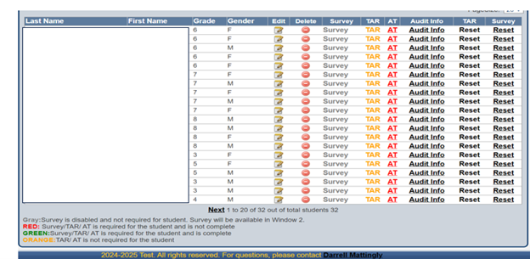
Student Rosters and Color Coding

Slide 12
Attainment Task (AT) Data Entry
The AT link is red when the student is required to complete an AT, and the AT data has not been saved and submitted.
The user can access the AT data entry portal by clicking on the red link.
Select the Field Test Form that was administered to the student.

Slide 13
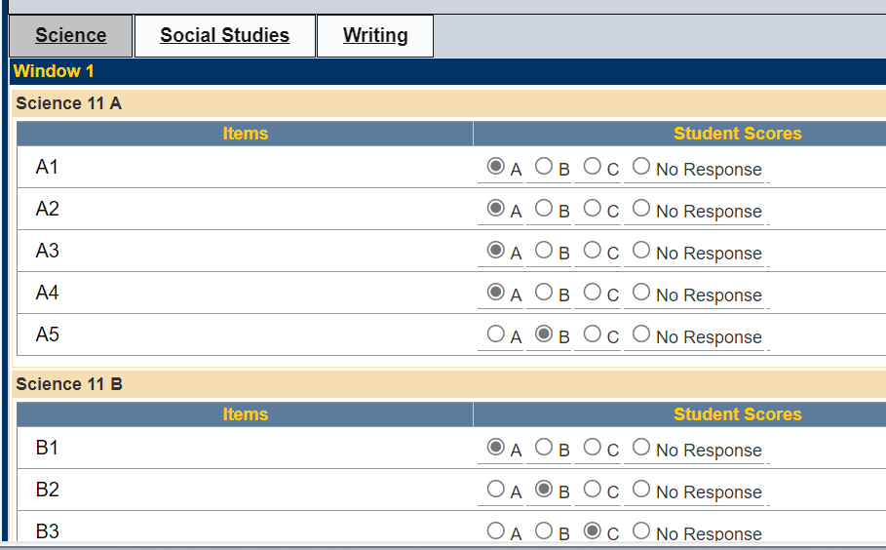
AT Response Entry Interface
The active page will be highlighted.

Slide 14
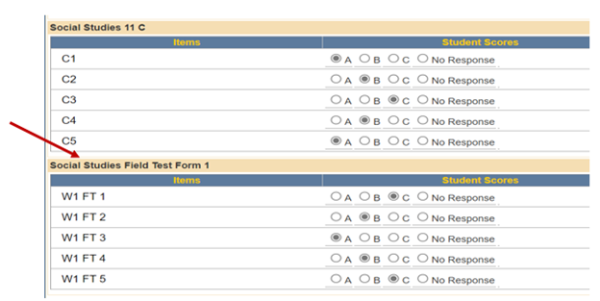
Field Test

Slide 15
Saving Data
Test administrators must select A, B, C or NR (no response). Do not leave any item blank.
At the bottom of each content area page there is a Save and Submit button.
For data to be saved, it must be saved prior to leaving the content area page.
Each content area can be submitted individually.

Slide 16
Navigating the Categories
Reminder: it is possible to navigate from one page (content area) to another.
Use the linked content title (boxes across the top of the score entry field) to move to the next page or content area.
Data that is not saved and submitted prior to leaving the page will be lost.

Slide 17
AT Save and Submit
If users save and submit:
Responses will be saved in the SRD and submitted to KDE.
All items must have a response or NR selected or users will receive an alert.

Slide 18
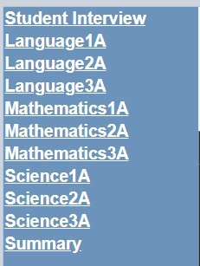
TAR – Response Entry, Red Link
Initial score entry:
Access the red TAR link for initial rating entry
Takes you to the Student Interview
Links to the TAR data entry pages are provided along the left-side of the interface

Slide 19
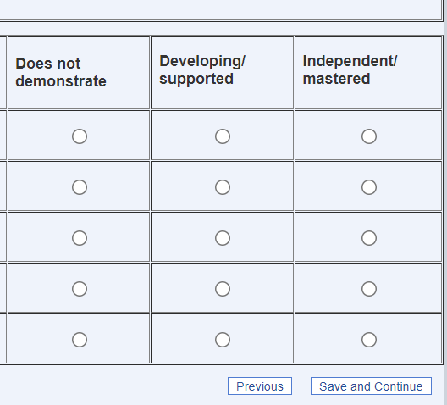
Response Entry Interface
Rating entry fields for all TAR items

Slide 20
TAR – Data Submission
To ensure responses are submitted, users must go to the Summary Page and click on the check box. Once that is checked, click Save and Submit.

Slide 21
TAR – Save and Submit
If you select the Save and Submit button:
Responses will be saved in the SRD and submitted to KDE.
Any item that does not have a selection (no response selected) will default to 0.
TAR data entry can be reset and re-entered if an error is noted by selecting Reset under TAR on the student’s link line.
If the TAR reset function is selected, it will not reset the AT.

Slide 22
Final TAR Response Submission
When data has been saved and submitted for all items (across all categories or pages), the system will alert the user that data has been finalized and provide support contact information.
The TAR link in the student’s links will appear in green.
Reminder, TAR data can be reset and re-entered if an error is noted by selecting Reset under TAR on the student’s link line.

Slide 23
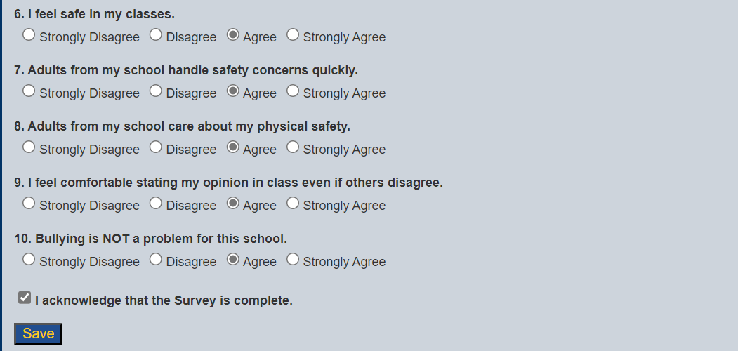
Quality of School Climate and Safety (QSCS) Survey Window 2 Only

Slide 24
DAC Access and Use

Slide 25
Teacher Certification (DAC Only)
DACs must activate all teachers or test administrators that should have access to enter data in the SRD.
Test Administrators (teachers) must successfully complete the corresponding quizzes (AT and Overview and/or TAR if applicable) prior to being granted access to the SRD.
DACs are provided the number of teachers that need to be certified within their district.

Slide 26
Teacher Certification

Slide 27
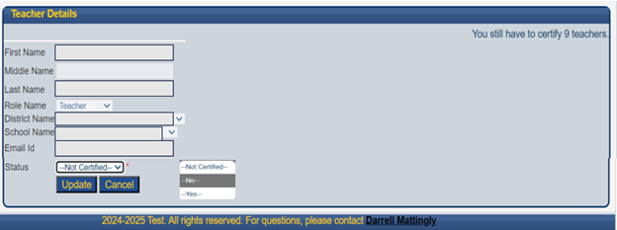
Teacher Status - Certification

Slide 28
Student Rosters
Student rosters (lists) can be located by selecting the Student Information link.
As a DAC or by having DAC Level Access, all school rosters for the district will be available, searchable by grade, school or state student identifiers (SSID) number.

Slide 29
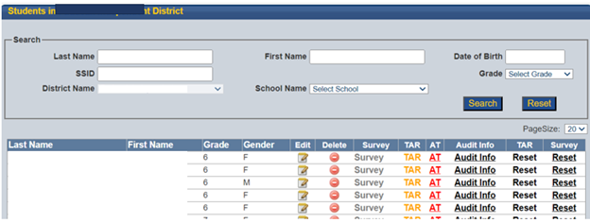
District Student List

Slide 30
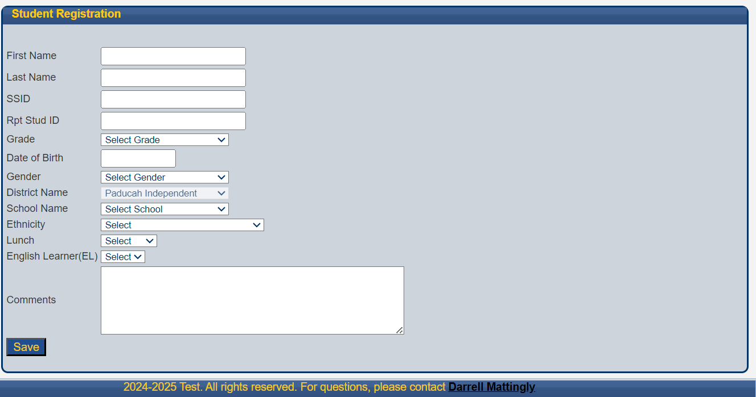
Student Registration (DAC Only)

Slide 31
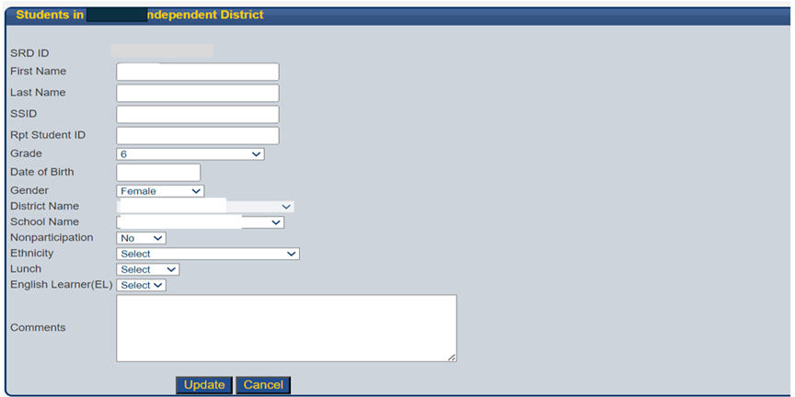
Edit Student Information (DAC Only)

Slide 32
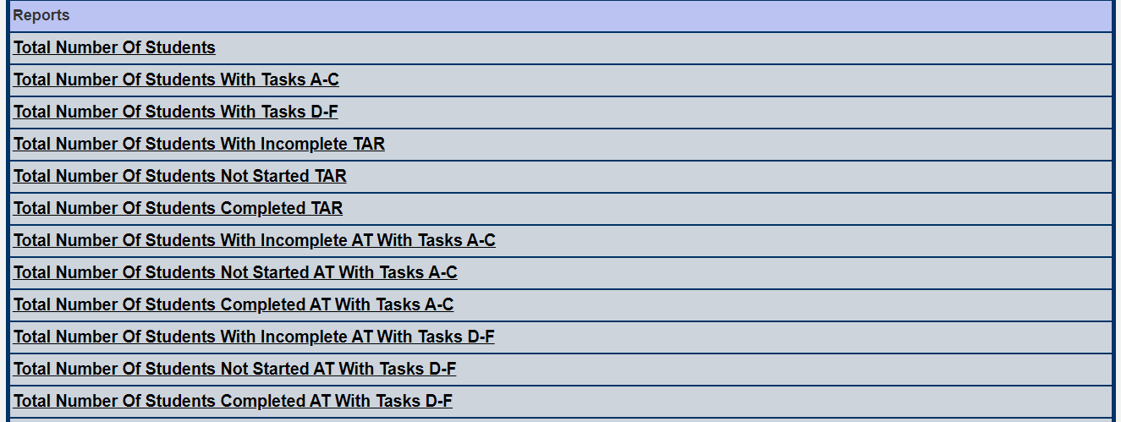
DAC Reports

Slide 33
DAC Report Format

Slide 34
Division of Assessment and Accountability Support
Krista Mullins, Program Consultant
Krista.mullins@education.ky.gov
For SRD Support:
Darrell Mattingly, Computer Specialist II
University of Kentucky, HDI, Darrell.Mattingly@uky.edu
OAA/DAAS (502) 564-4394 dacinfo@education.ky.gov

