Slide 1
NAEP 2017 Mathematics and Reading Results
Mark DeCandia
Kentucky NAEP State Coordinator

Slide 2
What is NAEP?
The only assessment that measures what U.S. students know and can do in various subjects across the nation, states, and in some cases, urban districts.
NAEP results are released as “The Nation’s Report Card”
www.nationsreportcard.gov
Notes:
NAEP is the National Assessment of Educational Progress.

Slide 3
NAEP Subjects
Civics
Economics
Geography
U.S. History
Mathematics
Music
Reading
Science
Technology &
Engineering Literacy
Visual Arts
Writing
Notes:
Mathematics and reading results are released every two years for the nation, states, and urban districts.

Slide 4
What does NAEP measure?
Overall student performance for key demographic groups
Change over time
Differences between the nation, states, and urban districts
Notes:
NAEP is a survey designed to produce national, state, and select urban district level results.
NAEP results are for populations of students, not for individual students nor schools.
Measures student performance nationally and reports changes over time.
Allows comparisons between states, urban districts, and the nation.

Slide 5
NAEP School and Student Selection
1. Identify all eligible schools
3. Sample students
2. Sample schools
Notes:
NAEP uses a carefully designed sampling procedure for the assessment to be representative of the geographical, racial, ethnic, and socio-economic diversity of schools and students in the state.
An initial list of all public schools in the nation is compiled using the U.S. Department of Education’s most current public education system database.
The sample of schools is drawn for NAEP participation with a systematic sampling procedure. The procedure ensures that each school has the correct selection probability, and that schools of different sizes and varying demographics are selected.
In each sampled school, a list is compiled of all students within the grade to be assessed. From this list, a sample of students is randomly selected by NCES for participation in the assessment. Every student in a sampled school has an equal probability of being selected.

Slide 6
Sample Sizes (National Public)
Representative samples of schools and students
Mathematics
Reading
 | Schools | Students | Schools | Students
Grade 4 | 7,440 | 144,000 | 7,440 | 143,400
Grade 8 | 6,150 | 140,200 | 6,150 | 137,200
NOTE: Student sample sizes rounded to the nearest hundred. School sample sizes rounded to the nearest ten.
Notes:
The results from the 2017 assessments are based on representative samples, approximate figures are used in the tables.

Slide 7
NAEP Administration
Six week period
Each student assessed in one subject
Students take a small portion of the assessment
Accommodations provided as necessary for
students with disabilities
English language learners

Slide 8
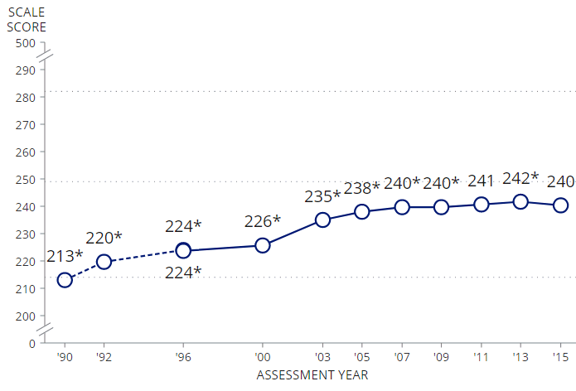
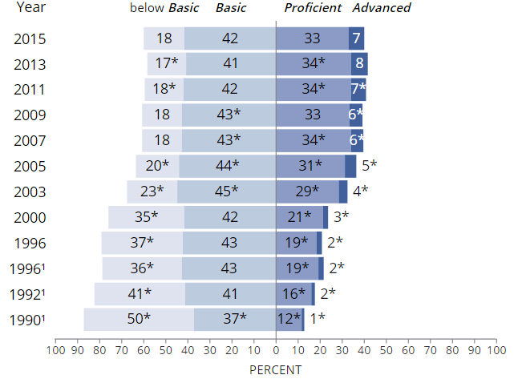
NAEP Results
Scale Scores
Numeric scale
0 − 500 on mathematics and reading assessments
Cannot be compared across grade levels or content areas
Achievement Levels
Categorical scale
Below Basic, Basic, Proficient, Advanced
Notes:
NAEP uses the metrics of scale scores and achievement levels and reports statistics of averages, percentiles and percentages.
The pictured examples are from the 2015 4th grade mathematics assessment. Statistically significant differences are noted with asterisks.

Slide 9
Student, School/District Characteristics for Kentucky Public Schools
Student Characteristics | Racial/Ethnic Background | School/District Characteristics
Number enrolled: 686,598 | White: 78.24 % | Number of school districts: 173*
Percent in Title I schools: 84.8% | Black: 10.59% | Number of schools: 1,541
With Individualized Education Programs (IEP): 14.46% | Hispanic: 5.97% | Number of charter schools: N/A
Percent in limited-English proficiency programs: 3.21% | Asian/Pacific Islander: 1.6% | Per-pupil expenditures: $9,560
Percent eligible for free/reduced lunch: 59.43% | American Indian/Alaskan Native: 0.12% | Pupil/teacher ratio: 16.39
 | Two or more races: 3.39% | Number of FTE teachers: 41,860
Notes:
* Local school districts only (type 1, 2). SOURCE: Common Core of Data, State Profiles Demographics, 2015-16 school year (non-adjudicated)
† Not applicable.
NOTE: The percentages of students by race/ethnicity, students eligible for the National School Lunch Program (NSLP), students with individualized education programs, and students with limited-English proficiency programs were calculated by using original number of students from Common Core of Data (CCD).
SOURCE: U.S. Department of Education, National Center for Education Statistics, Common Core of Data (CCD), "Local Education Agency (School District) Universe Survey LEP Data", 2015-16 v.1a; "Local Education Agency (School District) Universe Survey Membership Data", 2015-16 v.1a; "Local Education Agency (School District) Universe Survey Special ED Data", 2015-16 v.1a; "Public Elementary/Secondary School Universe Survey Free Lunch Data", 2015-16 v.1a; "State Nonfiscal Public Elementary/Secondary Education Survey Directory Data", 2014-15 v.1a; "State Nonfiscal Public Elementary/Secondary Education Survey Membership Data", 2015-16 v.1a. "National Public Education Financial Survey (NPEFS)," fiscal year 2015, Provisional Version 1a and "Nonfiscal Survey of Public Elementary/Secondary Education," school year 2014-15, Provisional Version 1a.

Slide 10
2017 NAEP Participation School and Student Counts
Total Kentucky NAEP Districts – 111
Total number of schools that participated:
Grade 4 - 168
Grade 8 - 137
305 (Includes 94 Jefferson County TUDA Schools)
Total number of students assessed:
Math Reading
Grade 4 – 3,200 3,100
Grade 8 – 3,100 3,000
6,300 6,100
Notes:
2017 NAEP School Control Center (SCS)

Slide 11
Grade 4 Mathematics Results

Slide 12
Average Scale Scores
Grade 4
Proficient
Basic
*Significantly different (p < .05) from 2017.
Notes:
Proficient (249)
Fourth-grade students performing at the Proficient level should consistently apply integrated procedural knowledge and conceptual understanding to problem solving in the five NAEP content areas. Students reaching this level have demonstrated competency over challenging subject matter, including subject-matter knowledge, application of such knowledge to real-world situations, and analytical skills appropriate to the subject matter.

Slide 13
Achievement Level Percentages
Grade 4
Below Basic Basic Proficient Advanced
Kentucky
National Public
*Significantly different (p < .05) from 2017.
NOTE: Detail may not sum to totals because of rounding.

Slide 14
Student Group Score Differences
Grade 4 – Differences since 2007
 | All Students | Male | Female | Eligible for NSLP | Students with Disabilities | English language learners
Kentucky | ↑ | ↑ | ↑ | ↑ | ↓7 | ◆
National Public | ◆ | ◆ | ◆ | ◆ | ↓7 | ◆
↑ Higher ↓ Lower  No significant change — Not available
 | White | Black | Hispanic | Asian/ Pacific Islander | American Indian/ Alaska Native | Two or more races
Kentucky | ↑ | ◆ | ◆ | — | — | ◆
National Public | ◆ | ◆ | ↑3 | ↑4 | ◆ | ↑4
Notes:
2011 guidelines for race/ethnicity were revised.

Slide 15
Math Grade 4 – Ranked 29 (KY 239 – NP 239)

Slide 16
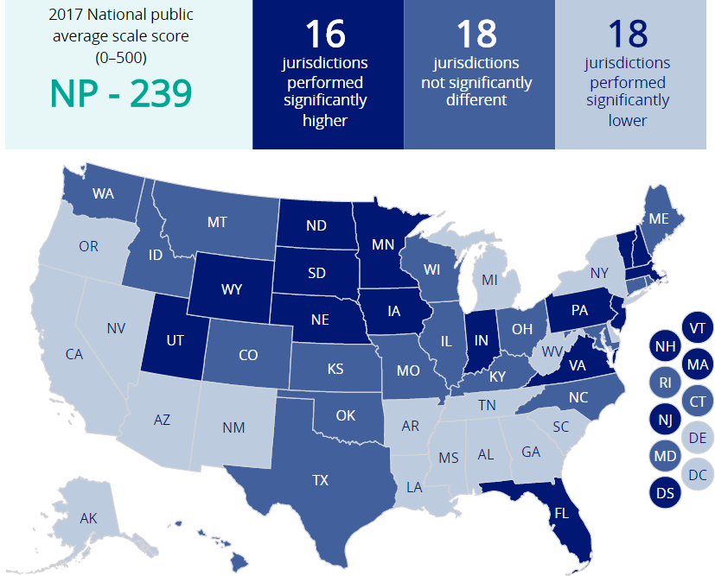
State Comparisons
Grade 4

Slide 17
2011 – 2017 Exclusion Rates* of SD/ELL – MATH Grade 4
Kentucky Exclusion Rate
Nation Exclusion Rate
 | ‘11 | ‘13 | ‘15 | ‘17 | ‘11 | ‘13 | ‘15 | ‘17
% | 3 | 1 | 2 | 2 | 2 | 2 | 2 | 2
* Rates are rounded to nearest percentage
Notes:
OK

Slide 18
Grade 8 Mathematics Results

Slide 19
Average Scale Scores – Grade 8
Grade 8
Proficient
Basic
*Significantly different (p < .05) from 2017.
Notes:
Proficient (299)
Eighth-grade students performing at the Proficient level should apply mathematical concepts and procedures consistently to complex problems in the five NAEP content areas. Students reaching this level have demonstrated competency over challenging subject matter, including subject-matter knowledge, application of such knowledge to real-world situations, and analytical skills appropriate to the subject matter.

Slide 20
Achievement Level Percentages – Grade 8
Grade 8
Below Basic Basic Proficient Advanced
Kentucky
National Public
*Significantly different (p < .05) from 2017.
NOTE: Detail may not sum to totals because of rounding.

Slide 21
Student Group Score Differences – Grade 8
Grade 8 – Differences since 2007
 | All Students | Male | Female | Eligible for NSLP | Students with Disabilities | English language learners
Kentucky | ◆ | ◆ | ◆ | ◆ | ◆ | —
National Public | ↑2 | ↑1 | ↑2 | ↑2 | ◆ | ◆
↑ Higher ↓ Lower  No significant change — Not available
 | White | Black | Hispanic | Asian/ Pacific Islander | American Indian/ Alaska Native | Two or more races
Kentucky | ◆ | ◆ | — | — | — | —
National Public | ↑2 | ◆ | ↑4 | ↑13 | ◆ | ◆
Notes:
Student with disabilities include 504 plans due to 2007 reporting.

Slide 22
Math Grade 8 - Ranked 37 (KY 278 – NP 282)

Slide 23
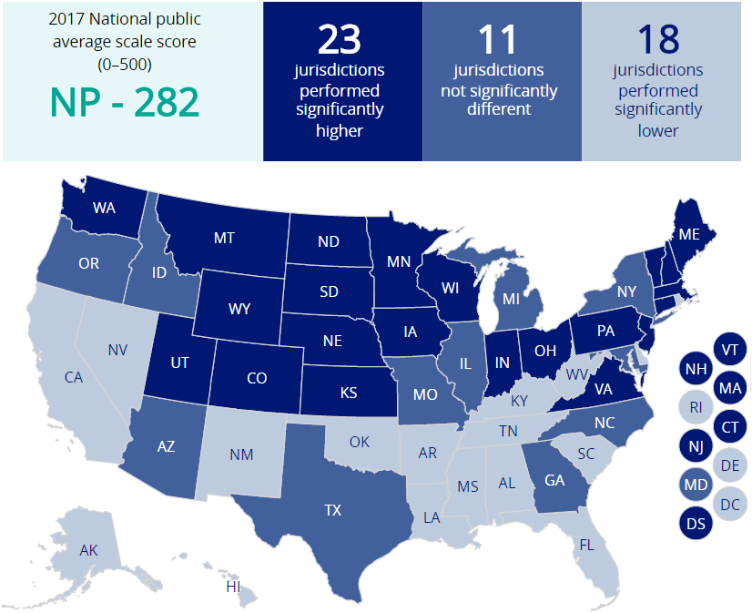
State Comparisons – Grade 8
Grade 8

Slide 24
2011 – 2017 Exclusion Rates* of SD/ELL – MATH Grade 8
Kentucky Exclusion Rate
Nation Exclusion Rate
 | ‘11 | ‘13 | ‘15 | ‘17 | ‘11 | ‘13 | ‘15 | ‘17
% | 3 | 2 | 1 | 1 | 3 | 2 | 2 | 2
* Rates are rounded to nearest percentage

Slide 25
Grade 4 Reading Results

Slide 26
Average Scale Scores – Grade 4
Grade 4
Proficient
Basic
*Significantly different (p < .05) from 2017.
Notes:
Proficient (238)
Fourth-grade students performing at the Proficient level should be able to integrate and interpret texts and apply their understanding of the text to draw conclusions and make evaluations. Students reaching this level have demonstrated competency over challenging subject matter, including subject-matter knowledge, application of such knowledge to real-world situations, and analytical skills appropriate to the subject matter.

Slide 27
Achievement Level Percentages – Grade 4
Grade 4
Below Basic Basic Proficient Advanced
Kentucky
National Public
*Significantly different (p < .05) from 2017.
NOTE: Detail may not sum to totals because of rounding.

Slide 28
Student Group Score Differences – Grade 4
Grade 4 – Differences since 2007
 | All Students | Male | Female | Eligible for NSLP | Students with Disabilities | English language learners
Kentucky | ◆ | ◆ | ◆ | ◆ | ◆ | —
National Public | ↑1 | ↑2 | ◆ | ↑3 | ↓4 | ◆
↑ Higher ↓ Lower  No significant change — Not available
 | White | Black | Hispanic | Asian/ Pacific Islander | American Indian/ Alaska Native | Two or more races
Kentucky | ◆ | ◆ | — | — | — | ◆
National Public | ↑1 | ↑2 | ↑4 | ↑7 | ◆ | ↑3

Slide 29
Reading Grade 4 – Ranked 17 (KY 224 – NP 221)

Slide 30
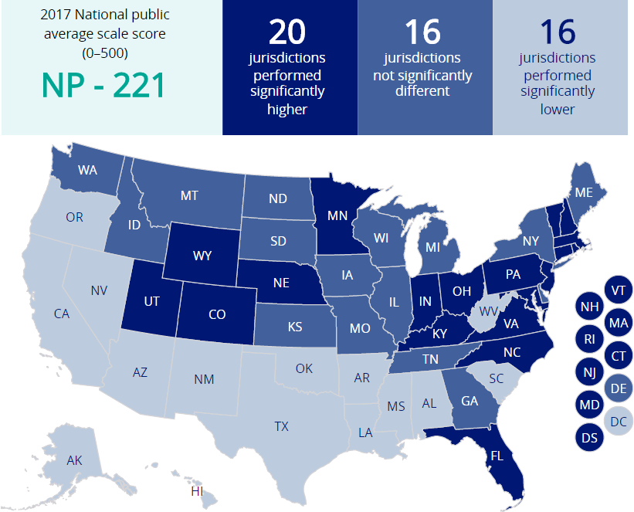
State Comparisons – Grade 4
Grade 4

Slide 31
2011 – 2017 Exclusion Rates* of SD/ELL – Reading Grade 4
Kentucky Exclusion Rate
Nation Exclusion Rate
 | ‘11 | ‘13 | ‘15 | ‘17 | ‘11 | ‘13 | ‘15 | ‘17
% | 9 | 3 | 5 | 3 | 4 | 3 | 2 | 2
* Rates are rounded to nearest percentage
Notes:
OK

Slide 32
Grade 8 Reading Results

Slide 33
Average Scale Scores – Grade 8 Reading
Grade 8
Proficient
Basic
*Significantly different (p < .05) from 2017.
Notes:
Proficient (281)
Eighth-grade students performing at the Proficient level should be able to provide relevant information and summarize main ideas and themes. They should be able to make and support inferences about a text, connect parts of a text, and analyze text features. Students performing at this level should also be able to fully substantiate judgments about content and presentation of content. Students reaching this level have demonstrated competency over challenging subject matter, including subject-matter knowledge, application of such knowledge to real-world situations, and analytical skills appropriate to the subject matter.

Slide 34
Achievement Level Percentages – Grade 8 Reading
Grade 8
Below Basic Basic Proficient Advanced
Kentucky
National Public
*Significantly different (p < .05) from 2017.
NOTE: Detail may not sum to totals because of rounding.

Slide 35
Student Group Score Differences – Grade 8 Reading
Grade 8 – Differences since 2007
 | All Students | Male | Female | Eligible for NSLP | Students with Disabilities | English language learners
Kentucky | ↑3 | ◆ | ↑6 | ↑4 | ◆ | —
National Public | ↑4 | ↑4 | ↑4 | ↑6 | ↑5 | ↑4
↑ Higher ↓ Lower  No significant change — Not available
 | White | Black | Hispanic | Asian/ Pacific Islander | American Indian/ Alaska Native | Two or more races
Kentucky | ↑3 | ◆ | — | — | — | —
National Public | ↑3 | ↑5 | ↑9 | ↑12 | ↑4 | ↑8

Slide 36
Reading Grade 8 – Ranked 31 (KY 265 – NP 265)

Slide 37
2011 – 2017 Exclusion Rates* of SD/ELL – Reading Grade 8
Kentucky Exclusion Rate
Nation Exclusion Rate
 | ‘11 | ‘13 | ‘15 | ‘17 | ‘11 | ’13 | ‘15 | ‘17
% | 7 | 3 | 3 | 2 | 3 | 2 | 2 | 2
* Rates are rounded to nearest percentage

Slide 38
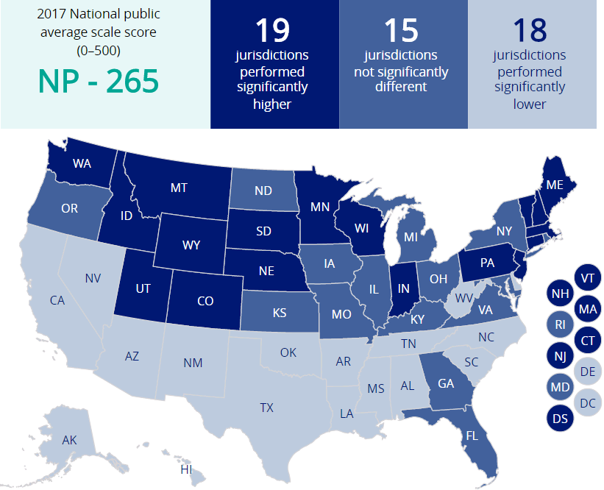
State Comparisons – Grade 8 Reading
Grade 8

Slide 39
JCPS and Kentucky Average Scale Score Gains 2015 - 2017
Kentucky had a significant decrease in Grade 4 Reading, while both JCPS and Kentucky are either ticking down or remaining steady.
 |  | JCPS |  |  | Kentucky
 | JCPS 2015 | JCPS 2017 | JCPS Gains | KY 2015 | KY 2017 | KY Gains
Grade 4 Reading | 222 | 221 | -1 | 228 | 224 | -4
Grade 8 Reading | 261 | 261 | 0 | 268 | 265 | -3
Grade 4 Mathematics | 236 | 233 | -2 | 242 | 239 | -3
Grade 8 Mathematics | 272 | 271 | -1 | 278 | 278 | 0
Significant Increase
Not Significant
Significant Decrease

Slide 40
SUMMARY HIGHLIGHTS
KY 4th grade reading (224) is still higher than the Nation (221) despite the decrease in reading grade 4.
KY 8th grade reading (265) is now same as Nation (265) despite the decrease in reading grade 8.
KY 4th grade math (239) scored the same as the Nation (239)
KY 8th Grade Math (278) no change since 2015 and still below the Nation (282)

Slide 41
SUMMARY HIGHLIGHTS
NAEP Administered a First Time Digital Based Assessment (DBA) for Grades 4 and 8
This is a Major Transition when compared to NAEP Paper and Pencil Assessment from the past.
NAEP Trend Line was all Paper and Pencil Based Assessment except for the 2017 NAEP Results
DBA included a Tutorial using a Surface Pro device
State Assessment, at this time, is still a paper and pencil assessment.

Slide 42
Summary Highlights: Exclusions for Reading Grade 4
KY Reading Grade 4 exclusion rates dropped by 2 points:
KY 2015 Reading 4th grade exclusion rate was 5
KY 2017 Reading 4th grade exclusion rate was 3
TUDA 2017 Reading Grade 4 exclusion rate was 5

Slide 43
Areas of Concern
KY state assessment is still paper and pencil format.
Digital Based Assessment for Kentucky will be considered for the future.
NAEP is considered the gold standard for assessment and is a valid “second opinion” when comparing to ourselves and other states. NAEP will assess using digital format in all future tests.
2017 NAEP KY results show a need to also assess in a digital format.

Slide 44
NAEP LINKS
2017 NAEP Mathematics & Reading Assessments: https://www.nationsreportcard.gov/reading_math_2017_highlights/​
Key findings for the nation, states, and participating urban districts. Score changes are compared to the previous assessment years.
NCES NAEP website (http://nces.ed.gov/nationsreportcard
National Center for Education Statistics and National Assessment of Educational Progress Resources
Governing Board website (http://www.nagb.org)
The National Assessment Governing Board was created by Congress in 1988 as an independent, nonpartisan board to set policy for the National Assessment of Educational Progress (NAEP), also known as The Nation’s Report Card.

