Slide 1
2022 Fall Reporting-Data Review
Chris Williams, Program Consultant
Division of Assessment and Accountability Support
Office of Assessment and Accountability

Slide 2
Agenda
Need for Data Review
Understanding the Process
Tentative Timeline for Reporting
Data Review Priorities
SDRR Features and Steps
Cohort
Postsecondary Readiness Scores
SDRR Resources

Slide 3
Need for Data Review
Data review is the final opportunity to review and verify data before it is publicly released in the School Report Card (SRC).
Short and focused review of
ACCESS and Alternate ACCESS for ELLs
Kentucky Summative Assessment (KSA) and Alternate Kentucky Summative Assessment (AKSA)
Postsecondary Readiness and Scores
Cohort data (4- and 5-year )
Limited effort so school and district staff can concentrate on reopening schools.

Slide 4
Understanding the Process
Getting the Rosters Right
SDRR rosters for ACCESS/Alternate ACCESS (Jan.-Mar. roster window)
Data Review and Cleanup
Make changes to individual student level data
Accurate Reporting
School Report Card (SRC)
Request nonparticipations if needed
Spring Rosters (Apr.-June)
Cohort (Feb.-July)
Request accountability changes
Ten-Day Regulatory Data Review follows Public Release

Slide 5
Tentative Timeline for Fall Reporting
Data Review in SDRR
Aug. 11-19
Closes 12 noon
(New Tickets) Demographics, Accountability and Participation for Individual Students will be the focus
Quality Control (QC) Review Sept. 22 (Tentative)
Spreadsheets –KDE applications login and
Google form
Systemic issues
Media Release
(Late Sept./Early Oct.-exact dates-TBD)
Data is Embargoed until Public Release
Public Release
(Early Oct.-exact dates-TBD)
Ten-Day Regulatory Data Review after Public Release

Slide 6
Data Review Priorities
Step 1 Demographics/Accountability
Step 2 Participation
(Priority Two) KDE applications login
Check students' participation status using the spreadsheet.
(Priority One) SDRR
All demographics are based on the first day of the 14-day testing window.
Check lunch status and students with disability status (IEP), since these have potential to change over time.
Confirm ethnicity and race categories.
Tested school and grade cannot be changed, except by request to KDE.
Mark Accommodations for students with an IEP or a PSP.
Indicate the correct accountability for student that contribute to the school or district accountability and those who do not.
Resolve nonparticipation status of students without test results.
Notes:
All demographic changes made in IC at the end of the 2021/2022 school year and most in SDRR can be edited during Data Review.
School and districts may review all available student information.

Slide 7
Data Review Process
SDRR
Spreadsheets will be available in KDE applications login
TEDS
Notes:
Spreadsheets are only available to the DAC for download once . The DAC will distribute the appropriate spreadsheet(s) to staff assisting with Data Review.

Slide 8
Data Available in SDRR
Roster information has been loaded and matched with test vendor data.
For example, if a response book was submitted for a student to the vendor or the student tested online and the student was not on your roster, then the student was added to your roster by KDE.
Rosters must match vendor information.
Changes made during the roster window last spring are reflected in data review.
Data review is your opportunity to review and verify student data before QC Day.
No scores are in SDRR, except academic readiness for Postsecondary Readiness.

Slide 9
Suggested Steps
SDRR
Make demographic and 100-day changes
Request nonparticipations, if needed
Make changes in SDRR for Academic Readiness data for Postsecondary Readiness and Cohort if needed
KDE Applications Login
Download spreadsheet from applications site
Filter to identify students who need resolution
TEDS
Contact Office of Career and Technical Education for Career Data changes

Slide 10
Student Participation Rates - Assessment Data
Students who didn’t attempt the test or have an approved nonparticipation in SDRR will be reflected in a lower participation rate in the summary spreadsheet regardless of the instruction type (in-person or virtual).
To meet federal participation rates, the lowest score is applied to school reports for students who did not test. Therefore, aggregate performance for schools, districts and the state is based on scores of only students who attempted to test and did not have an approved nonparticipation. School/district performance is based on the students who tested or attempted to test at their location (not 100-day students).
Reminder for KSA and Alternate KSA are participation rates by content area. Participation rates are reported by each content area (reading, mathematics, science, and writing) for the school as a whole and student demographic groups.
First-year EL students must have this nonparticipation and have participated in mathematics and science for the grade levels assessed for KSA.

Slide 11
Student NAPD Inclusion - Assessment Data and Accountability Data Comparison
Assessment (Tested Location)
Accountability (100-Day Entity)
All students that test and attempted to test without an approved nonparticipation at the school are reported at the testing location.
All students that do not have an approved nonparticipation.
This includes students that did not attempt the test, they are assigned the lowest score of Novice.

Slide 12
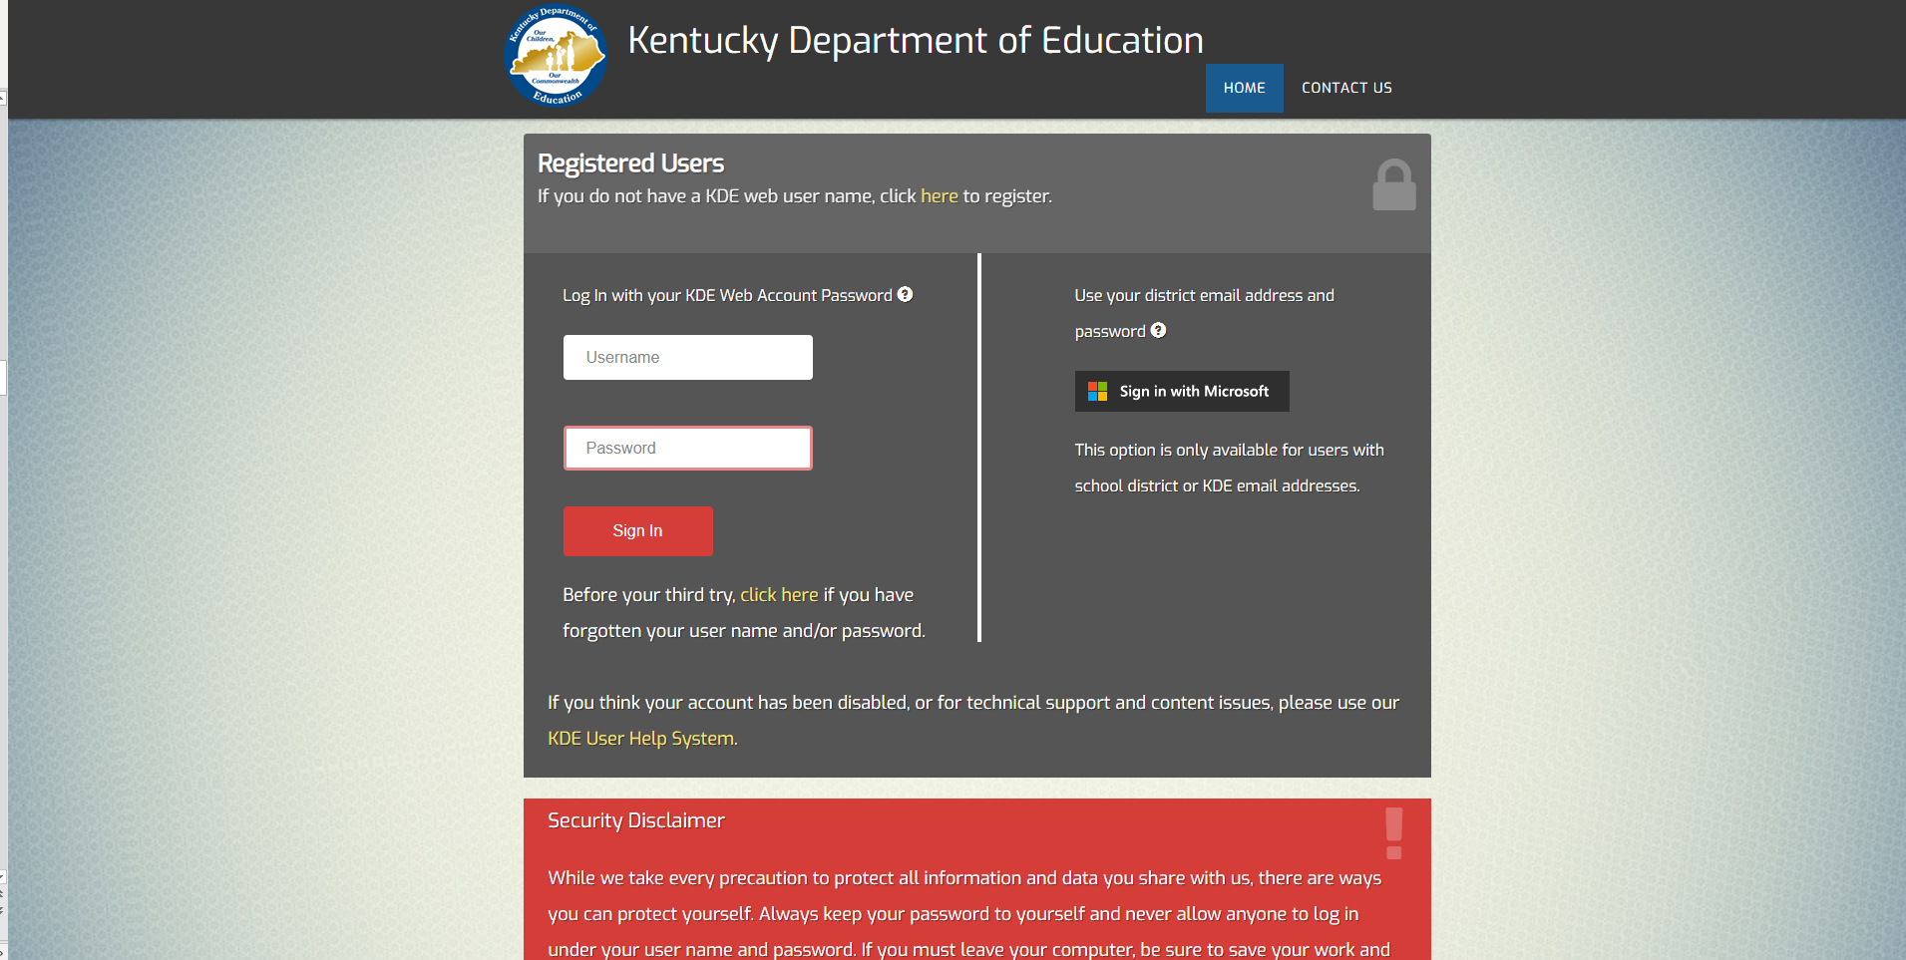
Login Page
https://applications.education.ky.gov/login/default.aspx

Slide 13
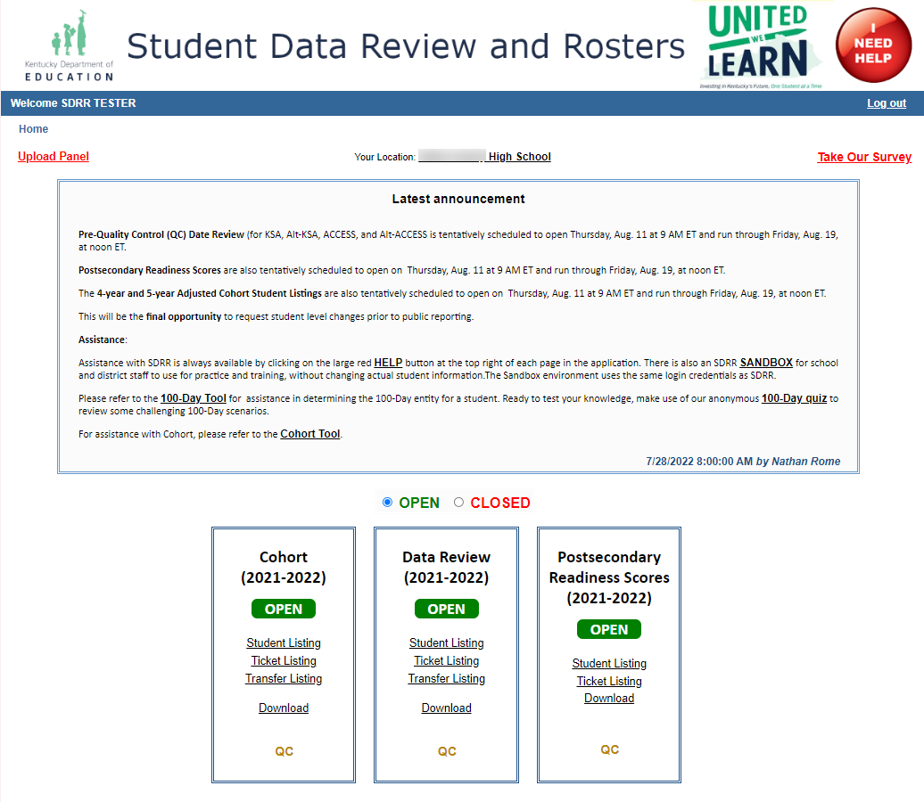
Welcome/Home

Slide 14
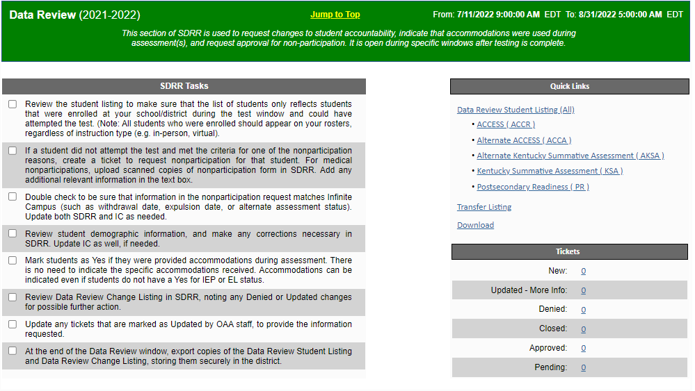
Home Page
Notes:
On the Home page, there is easily visible information that indicates the number and the status of tickets.
Read the Announcement box each time to be apprised of maintenance times for help or resources and other changes.
Tests Available:
KSA
Alternate KSA
ACCESS
Alternate ACCESS
Postsecondary Readiness

Slide 15
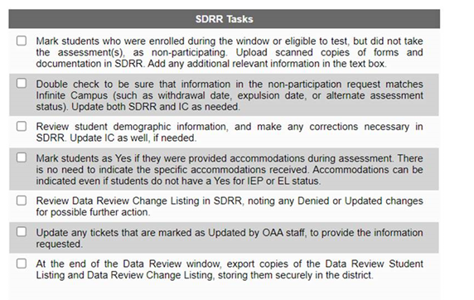
SDRR Tasks Checklist
Blank checkboxes = To be completed

Slide 16
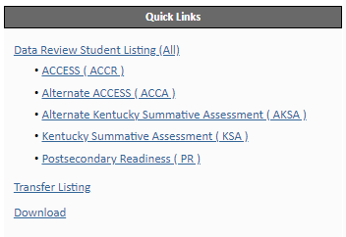
Quick Links

Slide 17
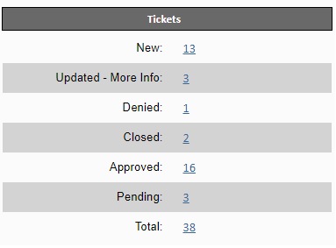
Tickets
Notes:
Total: the entire number of tickets that have been entered into SDRR by the district.
New: the new tickets that have been entered by the district but not yet approved or denied by OAA.
Updated-More Info.: OAA needs additional information from the district to approve or deny.
Denied: the changes that were denied by OAA. OAA will let districts know what other change is needed, if any, on the denied tickets. Districts cannot change the denied but can open a new ticket. Denied tickets do not go away.
Closed: Tickets that were closed/cancelled before being approved or denied. On the ticket it will list who closed it and when, at the top.
Approved: these are the tickets that have been approved in SDRR, either automatically or after review by OAA staff.
Pending OAA Approval: the ticket has been updated and is now waiting on OAA to review and approve/deny.

Slide 18
Features of SDRR
Integrated search and filters
Ticket history link for each student
Edit most demographic fields during Data Review
Hyperlinks to the student listing, tickets, transfer listing, and download
Upload form documentation for Medical non-participations
Notes:
Ticket history will be three years: 2019-2020, 2020-2021, 2021-2022 school year.

Slide 19
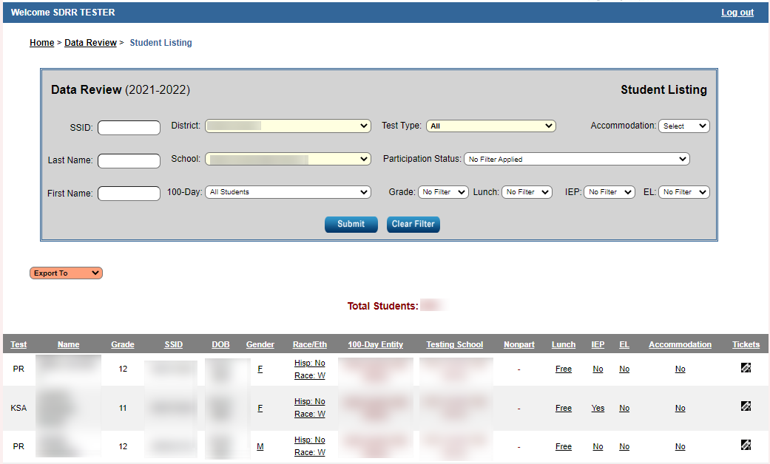
Data Review Student Listing
Notes:
On the student listing:
Ability to change nonparticipation status
Grade cannot be changed in SDRR during Data Review. If there is an issue with any of this field for a particular student, please send an e-mail to KDEAssessment@education.ky.gov with the relevant information.
Tested school can be changed during Data Review.
Changes to demographics can be done in SDRR during data review.
Request approval for nonparticipation by double-clicking on that column in the student’s row and selecting the appropriate reason, providing details if needed. Districts will need to upload the medical nonparticipation.
Remove an approved nonparticipation (NP) by double clicking on it and selecting [Remove nonparticipation] in the drop-down list. Only remove the NP if the student was able to test.
Focus should be on tested school and not on 100 Day entity because of the reporting data in the SRC.
Return to the Home Page by clicking on Home at the top of the screen on the left-hand side.
Priority One: Check Accountability and Demographics
Priority Two: Check Participation

Slide 20
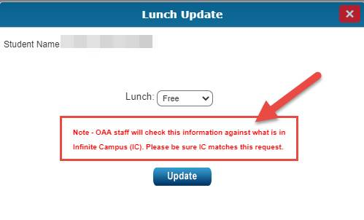
Changes to Demographics in SDRR
Notes:
For another example, when filing a nonparticipation for Cohort in SDRR, IC must match the nonparticipation you are requesting for it to be approved in SDRR. It must be in both places.

Slide 21
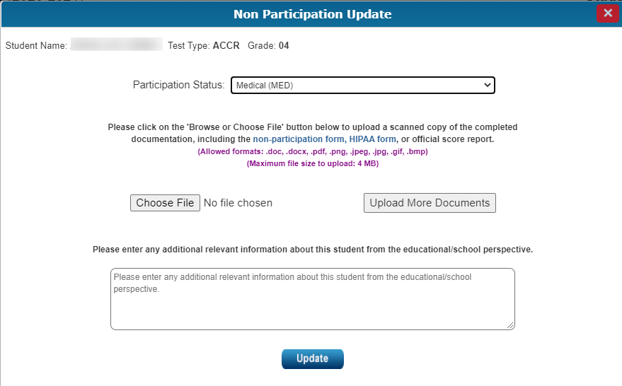
Uploading Medical Nonparticipation in SDRR
Notes:
Participation Status: Medical (MED)
For what content area(s) are you requesting the nonparticipation for this student? Select / Unselect All Editing Mechanics (EM) Science (SC) Social Studies (SS) Writing (WR)
Note - Only grades 3-8, 10, and 11 participate in KSA and AKSA assessments and the content areas are based on the grade of the student. For First Year EL nonparticipation requests: All content areas are selected by default. If a First Year EL nonparticipation is granted for this student, it only excludes this student's score from the accountability measures. First Year EL students are still expected to participate in the mathematics and science sections of the KSA tests (at the grade levels these content areas are assessed).
Please click on the 'Browse or Choose File' button below to upload a scanned copy of the completed documentation, including the nonparticipation form, HIPAA form, or official score report. (Allowed formats: .doc, .docx, .pdf, .png, .jpeg, .jpg, .gif, .bmp) (Maximum file size to upload: 4 MB)
Please enter any additional relevant information about this student from the educational/school perspective in the box.

Slide 22
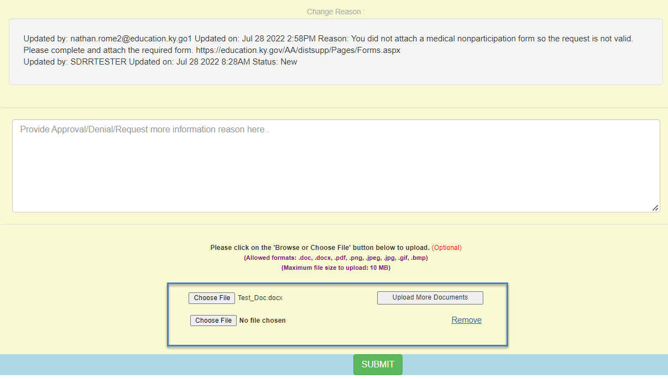
Medical Nonparticipation Update
Notes:
If the wrong form was submitted for a medical nonparticipation. Schools and districts can upload the correct medical nonparticipation form into SDRR by scanning it to the computer and uploading it again into the same test ticket without creating a new one by choosing file button. If there are more than one form to upload, then the school or district staff then click on the upload more documents and choose file button.

Slide 23
Nonparticipation in SDRR
Roster Cleanup
Addresses situations where the student appears on the student listing in error
Please explain why the student was not deleted from the spring roster or why the student appears on the student listing in error in the text box

Slide 24
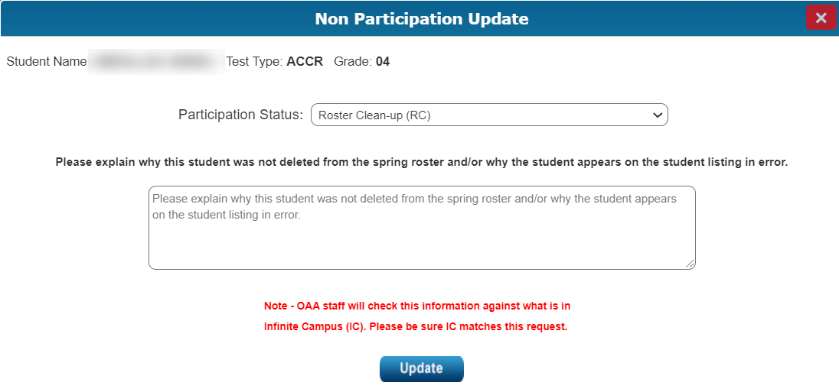
Roster Cleanup
Notes:
Please explain why this student was not deleted from the spring roster and/or why the student appears on the student listing in error in the box below this wording.
Note - OAA staff will check this information against what is in Infinite Campus (IC). Please be sure IC matches this request.

Slide 25
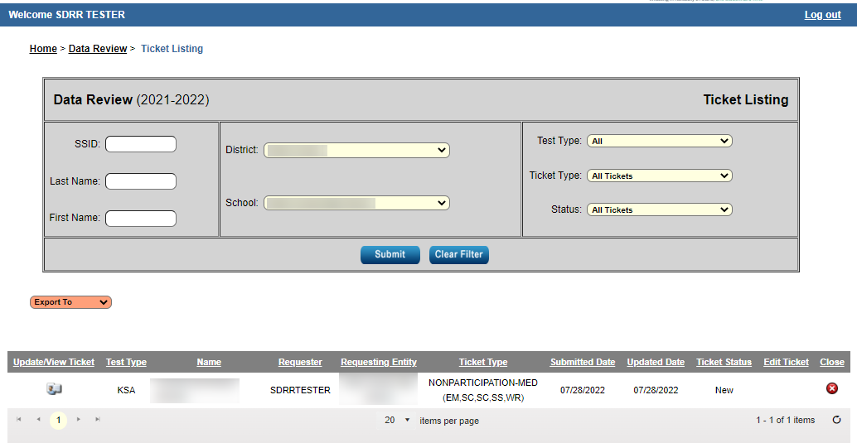
Ticket Listing

Slide 26
Nonparticipations by Test Type

Slide 27
Cohort
The Adjusted Cohort Graduation Rate data provides an accurate graduation model that follows students from their first year in high school through their expected cohort graduation school year.
The “4-year adjusted cohort graduation rate” is defined as the number of students who graduate in four years with a regular high school diploma divided by the number of students who entered high school four years earlier adjusting for transfers in and out, émigrés, and deceased students.
The “5-year adjusted cohort graduation rate” is defined as the number of students who graduate in five years with a regular high school diploma divided by the number of students who entered high school five years earlier adjusting for transfers in and out, émigrés, and deceased.

Slide 28
Cohort Student Listing
Enrollment changes (ex. G-code) should have been made in Infinite Campus (IC).
Demographic changes should be made in SDRR.
Cohort does not follow the 100-day rule.
Tickets to change reporting location for public reporting and non-participation requests in SDRR will require matching IC enrollment records for approval.
Data last updated from IC is reflected in SDRR as of August 5.

Slide 29
Cohort Student Listing-Continued
Students track to the A1, A5 or A6, etc. school where the student was last Primarily enrolled (for in-person and virtual students), unless the student was a Verified Transfer or Kentucky Educational Collaborative for State Agency Children (KECSAC).
Notes:
(KECSAC)- Kentucky Educational Collaborative for State Agency Children.

Slide 30
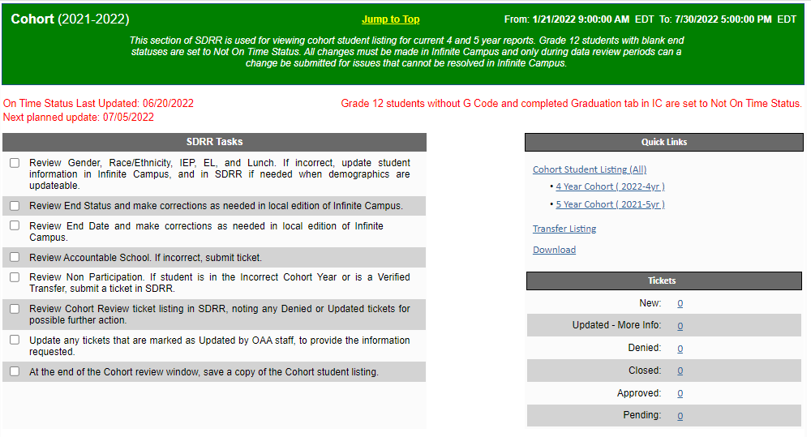
Welcome/Home Page
Notes:
Districts can see the date the Cohort data was last updated and the next planned update in the Cohort section of SDRR.
Here are the tasks:
Review Gender, Race/Ethnicity, IEP, EL, and Lunch. If incorrect, update student information in Infinite Campus, and in SDRR if needed when demographics are updateable.
Review End Status and make corrections as needed in local edition of Infinite Campus.
Review End Date and make corrections as needed in local edition of Infinite Campus.
Review Accountable School. If incorrect, submit ticket
Review Nonparticipation. If student is in the Incorrect Cohort Year or is a Verified Transfer, submit a ticket in SDRR.
Review Cohort Review ticket listing in SDRR, noting any Denied or Updated tickets for possible further action.
Update any tickets that are marked as Updated by OAA staff, to provide the information requested.
At the end of the Cohort review window, save a copy of the Cohort student listing.

Slide 31
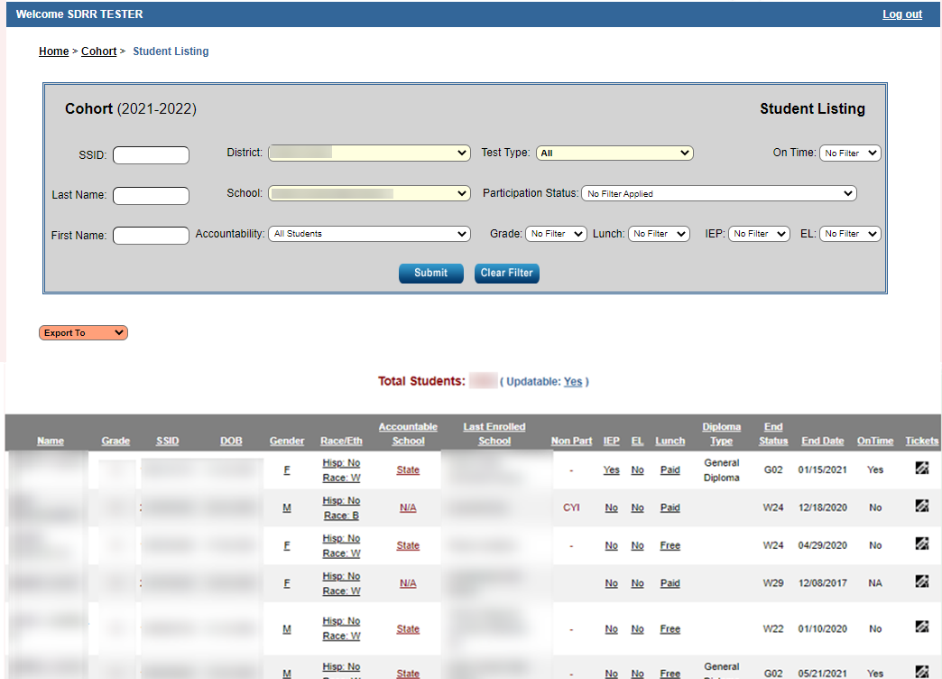
Cohort Student Listing in SDRR
Notes:
District and school staff can change accountable school and file nonparticipations in SDRR during Data Review. All the other demographic fields must be changed in IC.

Slide 32
Cohort Reminders
Review the last update of Cohort in SDRR from IC
Make changes in IC
Request verified transfers if necessary

Slide 33
Postsecondary Readiness-Academic Readiness
These are tests to show academic readiness for high school:
The ACT-college admissions exam
KYOTE-college placement exam
KDE-approved dual credit courses- updated in TEDS
SAT
ALEKS
GED College Readiness
Transition Attainment Record (Alternate KSA)
Advanced Placement (AP) Examinations
International Baccalaureate (IB) Examinations
Cambridge Advanced International Examinations
Notes:
All of the Academic Readiness for Postsecondary Readiness is updated in SDRR except the KDE–approved dual credit courses that is updated only in TEDS.

Slide 34
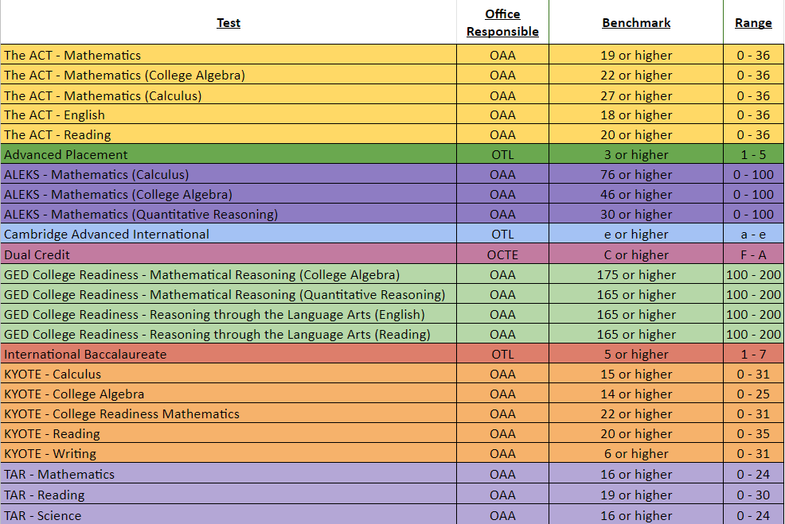
Academic Readiness for Postsecondary Readiness Resource
Notes:
The benchmark scores for academic readiness in postsecondary readiness can be found in the I need help button in SDRR.

Slide 35
Postsecondary Readiness Scores
If the student met the benchmarks
Shows in SDRR: met benchmark and the test
If the student did not meet the benchmarks
Shows in SDRR: click on update score, upload a scanned official copy of the score report from the vendor and if approved will locate in the tickets
NOTE: Demographics may be reviewed and accountability changes for Postsecondary Readiness may be requested in the Data Review Section of SDRR.
Notes:
No non-participation for Postsecondary Readiness. All students who received a G Code in Infinite Campus are included.

Slide 36
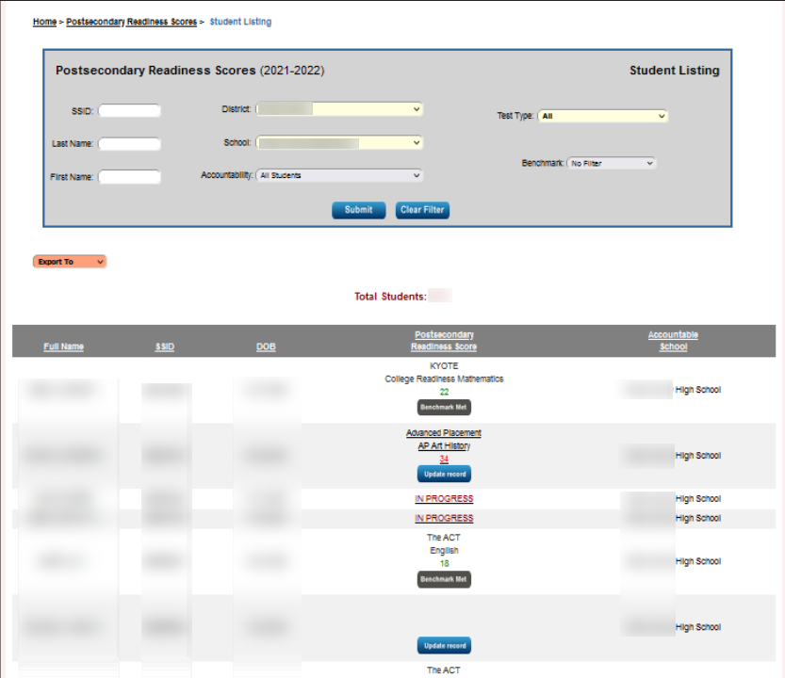
Postsecondary Readiness Scores in SDRR
Notes:
There will be only one column now to show the Post Secondary Readiness Scores instead of having the two buckets for academic part of Postsecondary Readiness.

Slide 37
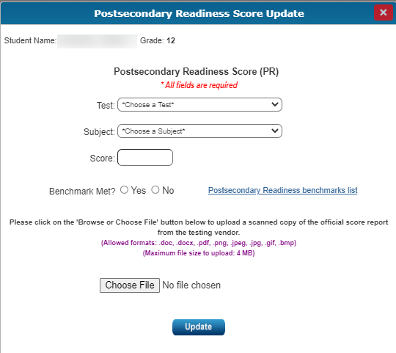
Postsecondary Readiness Score Update
Notes:
The score report must be a scanned copy of the official score report. It cannot be a copy from a transcript or from IC.

Slide 38
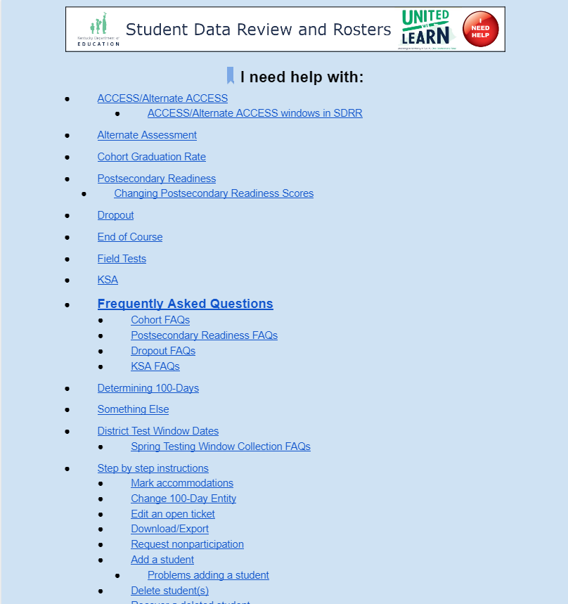
Resources for Data Review: (Online Help Button)

Slide 39
Resources to Assist with Data Review
See WAAPOC for permissions to SDRR
Review the SDRR Page- Data Review PPT. and Video
Download the student listings from Spring Rosters in SDRR
Download the spreadsheets from the web applications login
Take the 100-day anonymous quiz to test accountability knowledge
Use the 100-day tool to look at different scenarios for accountability

Slide 40
Resources Continued- Step by Step Instructions
Review step by step instructions under the “I Need Help” button in SDRR to:
Mark Accommodations
Change the 100-Day entity
Edit an open ticket
Download/export
Request nonparticipation

Slide 41
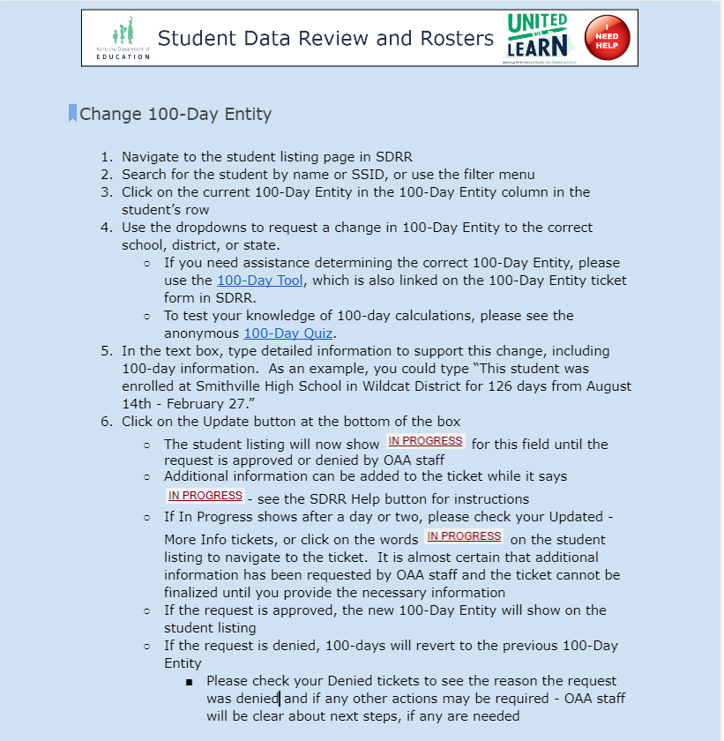
Step by Step Instructions Example- Change 100–Day Entity

Slide 42
Cohort Resources
Cohort information, withdrawal codes, calculations, etc. under the “I Need Help” button in SDRR
Data Review ppt. and video
Cohort Tool

Slide 43
SDRR Resources
Local WAAPOC for access to SDRR
Help Button
Recorded Trainings
Cohort Tool
Accountability Quiz/Scenarios and Accountability Tool

Slide 44
Questions and Answer Session for Data Review
TEAMS
August 15 at 3-4 p.m. ET
Click here to join the meeting
Join by Phone +1 502-694-1960,592769620#
Phone Conference ID: 592 769 620#
Ask questions about the functionality of SDRR
Not for specific student information

Slide 45
Contact Information for Questions
OAA/DAAS (502) 564-4394 dacinfo@education.ky.gov
Other Data Issues and Cohort
kdeassessment@education.ky.gov
Notes:
This concludes the Fall Reporting-Data Review Training. If you have any questions, please feel free to contact us. Thank you for your time.

