Slide 1
Accountability Indicator Training: Postsecondary Readiness
Christen Roseberry, Program Consultant
Office of Assessment and Accountability
Sarah Robbins, Assistant Data Manager
Office of Career and Technical Education
Notes:
Welcome to the Postsecondary Readiness Indicator Training. My name is Christen Roseberry. I am a Program Consultant in the Office of Assessment and Accountability. I am joined by my Sarah Robbins from the Office of Career and Technical Education.

Slide 2
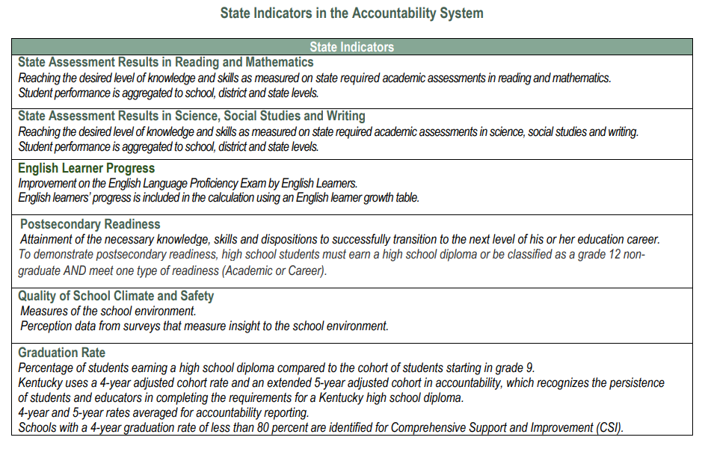
State Indicators in the Accountability System
Notes:
The accountability system performance for each district, school, and student demographic group determined by the state indicators will be based on a combination of annual performance called “status” and the difference between the prior year and current year, called “change .” For each state indicator, there will be five status levels ranging from very high to very low and five change levels ranging from increased significantly to declined significantly. Postsecondary readiness is one of six indicators in the overall accountability system.

Slide 3
Glossary
Status Score: Numerical value based on student performance from each indicator
Status Level: Five levels ranging from Very Low to Very High for the current year
Change Score: The numerical value of the difference between the current year and the prior year Status Scores
Change Level: Five levels ranging from Declined Significantly to Increased Significantly
Indicator Score: Numerical value of Current Year Status Score + Change Score
Indicator Performance Rating: One of five color coded performance levels for each state indicator, the result of unique combination of Status Level and Change Level; not based on cut scores
Overall Score: Combination of Weighted Indicator Scores
Overall Performance Rating: one of five colors - red through blue
Weighted Indicator Score: Numerical value of indicator scores multiplied by the weight of each indicator

Slide 4
Agenda
Postsecondary Readiness Overview
Academic Readiness
Career Readiness
Alternate Career Readiness
Notes:
In this training, we will review all parts of the post-secondary readiness state indicator.

Slide 5
Postsecondary Readiness Defined
Postsecondary Readiness is the attainment of the necessary knowledge, skills, and dispositions for a student to successfully transition to the next level of his or her educational career.​
All students with a Graduation Code (G-Code) in Infinite Campus (IC) and grade 12 non-graduates are included in Postsecondary Readiness and are accountable based on the 100-day rule.
To demonstrate postsecondary readiness, the student must meet one type of readiness (Academic or Career).​
Notes:
Postsecondary Readiness is the attainment of the necessary knowledge, skills, and dispositions for a student to successfully transition to the next level of his or her educational career.​ In order to demonstrate postsecondary readiness, high school students must earn a regular or alternative high school diploma or be classified as a grade 12 non-graduate AND meet one type of readiness (Academic or Career).​ This includes all students with a G-code in Infinite Campus (IC). Grade 12 non-graduates are included in Postsecondary Readiness and are accountable based on the 100-day rule.

Slide 6
Postsecondary Readiness Overview
Christen Roseberry, Program Consultant
Office of Assessment and Accountability
Notes:
First, let’s review the overall postsecondary readiness.

Slide 7
Postsecondary Readiness Regulation
KRS 158.6455 requires that postsecondary readiness for each high school student be measured by one of the following:
Meeting or exceeding a college readiness benchmark score on the college admissions examination or a college placement examination approved by the Council on Postsecondary Education (CPE);
Achieving 3 hours of dual-credit or postsecondary articulated credit by completing a course approved by the Kentucky Board of Education (KBE);
Achieving a benchmark score on an AP, IB, CAI, or other nationally recognized exam approved by the KBE that generally qualifies the student for 3 or more hours of college credit;
Completing a required number of hours or achieving a benchmark within an apprenticeship, cooperative, or internship that is aligned with a credential or associate degree and approved by the KBE after receiving input from the Local Superintendents Advisory Council (LSAC); or
Achieving any industry-recognized certifications, licensures, or credentials, with more weight in accountability for industry-recognized certifications, licensures, or credentials identified as high demand.
Notes:
The Kentucky Department of Education (KDE) will report measures from KRS 158.6455 that are available, such as meeting a college readiness benchmark score on a college admissions examination or college placement examination, earning a “C” or higher in 3 hours of KDE approved dual credit, meeting approved benchmarks on an AP, IB, or CAI examination, earning an approved industry certification, scoring at or above the benchmark on the CTE End-of-Program (EOP) assessment for articulated credit, or completing a KDE/Cabinet approved apprenticeship program.

Slide 8
Postsecondary Readiness Status Calculation
Based on the students who graduate and grade 12 nongraduates
(Number of students ready in high-demand areas*1.25) OR
(Number of students ready*1.0)
___________________divided by______________________
total number of graduates plus grade 12 non-graduates
Credit for students obtaining an industry-recognized certification, licensure, or credential in specialized career pathways in state and regional high-demand sectors as approved by Kentucky's Workforce Innovation Board is one and one-quarter (1.25) points. Credit for students obtaining all other readiness indicators is one (1.0) point.
Notes:
The postsecondary readiness is calculated based on the students who graduate, and non-graduates are calculated by adding the number of high school graduates plus grade 12 non-graduates who have met measures of postsecondary readiness divided by the total number of graduates plus grade 12 non-graduates.
For example, a school had 50 grade 12 non-graduates and graduates with 6 industry certification students in high-demand sectors and 40 students to meet readiness. The calculation would be ((6*1.25)+(40*1.0))/50 =.95*100=95.
Early grad students are included in this indicator the year they receive a G-Code.

Slide 9
Status Score
The Status Score represents the current year outcome for a given indicator.
Indicator | State Assessment Results in Reading and Mathematics | State Assessment Results in Science, Social Studies, and Writing | English Learner Progress | Quality of School Climate and Safety | Postsecondary Readiness (HS only) | Graduation Rate (HS only)
Metric | Weighted performance index based on student assessment performance levels | Weighted performance index based on student assessment performance levels | Points assigned based on student-level growth as measured by a value table | Average of student scores for applicable questions in the QSCS survey | Percent of 12th grade students demonstrating academic or career readiness | Average 4- and 5-year graduation rates
Notes:
The Status Score represents the current year outcome for a given indicator. It is calculated according to the metric described in the table displayed.

Slide 10
Status Levels
There are five Status Levels.
Status | Very Low | Low | Medium | High | Very High
Notes:
There are five status levels ranging from very low to very high for the current year.
Color ratings will include five performance levels from highest to lowest. Performance of schools will be reported by levels; elementary, middle, and high as applicable. Color ratings for each indicator will be used to communicate performance of schools with red being the lowest and blue being the highest.

Slide 11
Status Cut Scores for High Schools
School Level | Indicators | Very Low | Low | Medium | High | Very High
High | State Assessment Results in Reading/Mathematics | 0-38.9 | 39.0-52.9 | 53.0-64.9 | 65.0-76.9 | 77.0-125
 | State Assessment Results in Science/ Social Studies/Writing | 0-31.9 | 32.0-46.9 | 47.0-54.9 | 55.0-62.9 | 63.0-125
 | English Learner Progress | 0-9.9 | 10.0-23.9 | 24.0-30.9 | 31.0-44.9 | 45.0-140
 | Quality of School Climate and Safety | 0-53.9 | 54.0-58.9 | 59.0-63.9 | 64.0-67.9 | 68.0-100
 | Postsecondary Readiness | 0-58.9 | 59.0-75.9 | 76.0-87.9 | 88.0-94.9 | 95.0-125
 | Graduation | 0-85.9 | 86.0-91.9 | 92.0-94.9 | 95.0-97.9 | 98.0-100

Slide 12
Change Score
Change Scores are a simple subtraction of Prior Year Status Scores from Current Year Status Scores.
They are calculated the same way for every Indicator.
Current Year Status Score – Prior Year Status Score = Change Score
Prior Year Scores are used to calculate Change Scores. They are not used to influence Indicator Performance Ratings.
Current Year Status Score
Prior Year Status Score
Change
There are five Change Levels:
Change | Declined Significantly | Declined | Maintained | Increased | Increased Significantly
Notes:
Change Scores are a simple subtraction of Prior Year Status Scores from Current Year Status Scores.
They are calculated the same way for every Indicator.
Current Year Status Score – Prior Year Status Score = Change Score
For example, if your 2023 status score is 75 and your 2022 status score is 70, the change score would be 5.
Prior Year Scores are used to calculate Change Scores. They are not used to influence Indicator Performance Ratings.

Slide 13
Change Levels
There are five Change Levels:
Change | Declined Significantly | Declined | Maintained | Increased | Increased Significantly

Slide 14
Change Cut Scores for High Schools
School Level | Indicators | Declined Significantly | Declined | Maintained | Increased | Increased Significantly
High | State Assessment Results in Reading/Mathematics | -11.9 or less | -12.0 to -4.9 | -5.0 to 0.0 | 0.1 to 6.2 | 6.3 or more
 | State Assessment Results in Science/ Social Studies/Writing | -10.9 or less | -11.0 to -3.4 | -3.5 to 0.0 | 0.1 to 6.9 | 7.0 or more
 | English Learner Progress | -12.9 or less | -13.0 to -3.9 | -4.0 to 0.0 | 0.1 to 9.5 | 9.6 or more
 | Quality of School Climate and Safety | -3.9 or less | -4.0 to -1.9 | -2.0 to 0.0 | 0.1 to 3.9 | 4.0 or more
 | Postsecondary Readiness | -4.9 or less | -5.0 to -1.9 | -2.0 to 0.0 | 0.1 to 6.9 | 12.0 or more
 | Graduation | -4.9 or less | -5.0 to -1.9 | -2.0 to 0.0 | 0.1 to 2.9 | 3.0 or more
Notes:
Your change score will give you a change level.

Slide 15
Indicator Scores
Indicator Scores are a simple combination of Status Scores and Change Scores.
They are calculated the same way for every Indicator.
Current Year Status Score + Change Score = Indicator Score
Indicator Scores are used to calculate Overall Scores. They do not influence Indicator Performance Ratings.
Current Year Status Score
Change Score
Indicator Score
Notes:
Indicator Scores are a simple combination of Status Scores and Change Scores.
They are calculated the same way for every Indicator.
Current Year Status Score + Change Score = Indicator Score
Using the previous example, the 2023 status score of 75 +2023 change score of 5 gives you the 2023 Postsecondary Readiness Indicator Score of 80.
Indicator Scores are used to calculate Overall Scores. They do not influence Indicator Performance Ratings.

Slide 16
Indicator Performance Ratings
Table: Indicator Performance Ratings based on combined Change and Status Levels
 | Change Declined Significantly | Change Declined | Change Maintained | Change Increased | Change Increased Significantly
Very High Status in current year | Yellow | Green | Blue | Blue | Blue
High Status in current year | Yellow | Yellow | Green | Green | Blue
Medium Status in current year | Orange | Orange | Yellow | Green | Green
Low Status in current year | Red | Orange | Orange | Yellow | Yellow
Very Low Status in current year | Red | Red | Red | Orange | Yellow
Notes:
You saw on the cut score tables how your score will determine your status and change levels. On the left side of the table is the status in the current year, with levels of very low to very high. Across the top of the table is change, with levels of declined significantly to increased significantly. Your indicator performance rating will be where status and change intersect on the table.

Slide 17
Overall Accountability Weights
 | State Assessment Results - Reading and Math | Other State Assessment Results -Science (SC), Social Studies (SS) and Combined Writing (CW) | English Learner Progress | Quality of School Climate and Safety (QSCS) | Postsecondary Readiness | Graduation Rate
Elementary | 51 | 40 | 5 | 4
Middle | 46 | 45 | 5 | 4
High | 45 | 20 | 5 | 4 | 20 | 6
If any indicator is not available, weights will be redistributed proportionally to remaining indicators.
Notes:
An overall accountability score is generated by multiplying the indicator scores by their percentage of weight. The postsecondary readiness indicator is weighted at 20 percent of the overall score for high schools.

Slide 18
Overall Score – High School
Overall Scores represent the combined outcomes across all applicable Indicators, with appropriate weights applied.
High School Overall Score Calculation
State Assessment Results in Reading and Mathematics Indicator Score * .45
State Assessment Results in Sc, SS and Writing Indicator Score * .20
English Learner Progress Indicator Score *.05
Quality of QSCS Indicator * .04
Postsecondary Readiness Indicator
*.20
Graduation Indicator *.06
Overall Score
Notes:
For the High School Overall Score Calculation, we will add all 6 indicators scores together to find the overall score.

Slide 19
Overall and Indicator Performance Ratings
Overall Performance ratings are reported as one of five colors - red through blue based on cut scores.
Indicator Performance ratings are the result of unique combination of Status Level and Change Level; not based on cut scores.
Color ratings include five performance levels from highest to lowest, Blue, Green, Yellow, Orange and Red.
Note: School Report Card will be released later this calendar year.
Blue
Green
Yellow
Orange
Red
Notes:
The Overall Performance Rating combines performance on the state indicators for elementary, middle, and high schools. These ratings will be communicated using a color rating system, where blue represents the highest rating, and red represents the lowest rating. The five performance levels, from highest to lowest, are Blue, Green, Yellow, Orange, and Red. Indicator Performance ratings are also reported as colors the result of unique combination of Status Level and Change Level; not based on cut scores.
Please note that the public School Report Card will be released later this year. The initial public release of assessment and accountability data will be in Open House.

Slide 20
Overall Performance Rating Cut Scores
School Level | Red | Orange | Yellow | Green | Blue
Elementary Schools | 0-37.9 | 38.0-54.9 | 55.0-69.9 | 70.0-82.9 | 83.0 or more
Middle Schools | 0-35.9 | 36.0-50.9 | 51.0-63.9 | 64.0-76.9 | 77.0 or more
High Schools | 0-48.9 | 49.0-59.9 | 60.0-70.9 | 71.0-80.9 | 81.0 or more

Slide 21
Academic Readiness
Christen Roseberry, Program Consultant
Office of Assessment and Accountability
Notes:
Now, let’s take a look at academic readiness.

Slide 22
Postsecondary Readiness College Admissions Exam or Placement Examination
KRS 158.6455 requires that postsecondary readiness for each high school student be measured by one benchmark:
Meeting or exceeding a college readiness benchmark score on the college admissions examination or a college placement examination approved by the Council on Postsecondary Education (CPE)
Notes:
KRS 158.6455 requires that postsecondary readiness for each high school student be measured by one benchmark:
Therefore, a student meeting or exceeding a college readiness benchmark score on the college admissions examination or a college placement examination approved by the Council on Postsecondary Education (CPE) would have met the indicator.

Slide 23
Postsecondary Readiness – Dual Credit
Achieving 3 hours of dual-credit or postsecondary articulated credit by completing a course approved by the Kentucky Board of Education (KBE)
KDE-Approved Dual Credit
Pursuant to KRS 164.002, dual credit is defined as “a college-level course of study developed in accordance with KRS 164.098 in which a high school student receives credit from both the high school and postsecondary institution in which the student is enrolled upon completion of a single class or designated program of study”. Eligible dual credit courses for “academic readiness” are approved annually by the KDE. Students must complete one (1) of the approved dual credit courses with a letter grade of “C” or higher in order to meet this indicator.
Notes:
Another way for a student to meet academic readiness is by Achieving 3 hours of dual-credit or postsecondary articulated credit by completing a course approved by the Kentucky Board of Education (KBE)
Pursuant to KRS 164.002, dual credit is defined as “a college-level course of study developed in accordance with KRS 164.098 in which a high school student receives credit from both the high school and postsecondary institution in which the student is enrolled upon completion of a single class or designated program of study”. Eligible dual credit courses for “academic readiness” are approved annually by the KDE. Students must complete one (1) of the approved dual credit courses with a letter grade of “C” or higher in order to meet this indicator.

Slide 24
Postsecondary Readiness – AP, IB, CAI
Achieving a benchmark score on an AP, IB, CAI, or other nationally recognized exam approved by the KBE that generally qualifies the student for 3 or more hours of college credit.
Advanced Placement (AP)
Advanced Placement or "AP" means a college-level course that incorporates all topics and instructional strategies specified by the College Board on its standard syllabus for a given subject area and is licensed by the College Board. Students enrolled in Advanced Placement (AP) coursework may take the corresponding AP assessments. Those who earn a score of “3” or higher on at one (1) approved AP exam are considered “academic ready”.
International Baccalaureate (IB)
International Baccalaureate or "IB" means the International Baccalaureate Organization's Diploma Programme, a comprehensive two (2) year program designed for highly motivated students. Students must earn a score of “5+” on one (1) approved IB exam.
Cambridge Advanced International (CAI)
The Cambridge Advanced International Certificate of Education Diploma program is an international pre-university curriculum and examination system offered by Cambridge International Examinations at the University of Cambridge. Students must earn a score of “e” or higher on one (1) approved Cambridge exam.
Notes:
Achieving a benchmark score on an AP, IB, CAI, or other nationally recognized exam approved by the KBE that generally qualifies the student for 3 or more hours of college credit is another path for students to meet this indicator.
Advanced Placement or "AP" means a college-level course that incorporates all topics and instructional strategies specified by the College Board on its standard syllabus for a given subject area and is licensed by the College Board. Students enrolled in Advanced Placement (AP) coursework may take the corresponding AP assessments. Those who earn a score of “3” or higher on at one (1) approved AP exam are considered “academic ready”.
International Baccalaureate or "IB" means the International Baccalaureate Organization's Diploma Programme, a comprehensive two (2) year program designed for highly motivated students. Students must earn a score of “5+” on one (1) approved IB exam.
Cambridge Advanced International (CAI)
The Cambridge Advanced International Certificate of Education Diploma program is an international pre-university curriculum and examination system offered by Cambridge International Examinations at the University of Cambridge. Students must earn a score of “e” or higher on one (1) approved Cambridge exam.

Slide 25
CPE College Indicator (2022-2025)
Area | ACT | SAT | KYOTE | GED College Readiness | Accuplacer | ALEKS | EdReady Diagnostic
English (Writing) | 18 | 22 | 6 | 165 | 250 |  | 70
Reading | 20 | 24 | 20 | 165 | 250 |  | 70
Math (Quant Reasoning) | 19 | 510 | 22 | 165 | 250 | 30 | 55
Math (College Algebra) | 22 | 540 | 14 | 175 | * | 46 | 65
Math (Calculus) | 27 | 640 | 15 | N/A | * | 76 | *
Notes:
For the 2024 fall reporting and students entering the 2024-2025 school year, OAA will accept the Accuplacer and EdReady assessments for the 2024-2025 Post Secondary Readiness Indicator. However, as a reminder, OAA only receives scores from the ACT and KYOTE exams. If a school uses the SAT, GED College Readiness, Accuplacer, EdReady Diagnostic or the ALEKS exams, the school will need to ensure OAA receives the scores by submitting an official score report in SDRR.

Slide 26
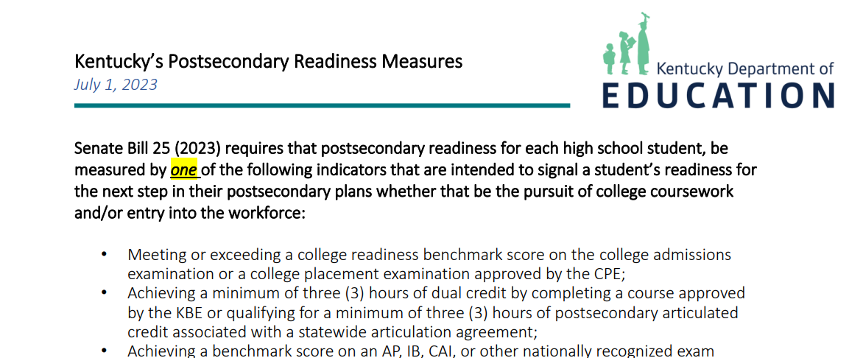
Postsecondary Readiness Overview Resource Snapshot
The Postsecondary Readiness Overview resource can be found on the KDE website.
Notes:
READ SLIDE. I will now turn the presentation over to Sarah.

Slide 27
Career Readiness
Sarah Robbins, Assistant Data Manager
Office of Career and Technical Education

Slide 28
5 Options for Career Readiness
Industry Certification(s)
End-of-Program Assessment (for articulated credit)
CTE Dual Credit (a minimum of 3 hours and a grade of “C” or higher)
CTE Co-op or Internship, or unique approval by the KBE (a minimum of 300 on-the-job hours with a passing grade)
TRACK: Tech Ready Apprentices for Careers in Kentucky Certificate

Slide 29
Career Readiness -- Industry Certifications
To meet this indicator, a student must pass a certification (or stack of certifications, if applicable) on the Kentucky Workforce Innovation Board’s (KWIB) valid industry certification list published by the KDE and approved by the KWIB.
Industry certifications identified as high demand by the KWIB will receive 1.25 points in the state accountability model under Postsecondary Readiness versus 1.00 point for all other certifications
Notes:
We will start off with Industry Certifications first. There is a valid list of industry certifications on the KDE career and technical education webpage. Depending on the program area and pathway, a Student must pass a single certification, or a stack of certifications in order to qualify for this career indicator.
Industry certifications count as 1 point in the accountability model and high demand certifications count as 1.25 points. Regular and high demand certifications are clarified in the certification list.

Slide 30
Career Readiness – CTE End-of-Program (EOP) Assessments for Articulated Credit
CTE EOP Assessments are based upon standards identified by Kentucky employers, aligned with CTE career pathways, and associated with statewide articulation agreements with a variety of postsecondary institutions. These assessments measure foundational academic, technical, and employability skills and are taken by eligible students to measure the knowledge, skills, and competencies attained through their career pathway coursework.
A student must be a concentrator in their career pathway to sit for an EOP.
Notes:
Next, we have CTE End of Program Assessments. EOPs are based on employer standards, CTE pathways and are associated with an articulation agreement with a variety of postsecondary institutions. So, if a student completes an EOP that has an articulation agreement with the college they are attending after high school, that student will receive credit from that institution.
In order for a student to take an EOP, they must be a concentrator in their career pathway.

Slide 31
Career Readiness – CTE Dual Credit
Eligible dual credit courses aligned to CTE career pathways are approved annually by the KDE. To meet this indicator, students must complete one (1) of the approved CTE dual credit courses with a “C” or higher letter grade.
See eligible KDE-approved CTE dual credit courses/course codes for the 2024-2025 school year see the Career Readiness tab in Infinite Campus.
Notes:
For CTE Dual Credit, there is a list of approved dual credit course codes to use for students enrolled in a CTE dual credit course published on the Accountability and Postsecondary Readiness CTE webpage. It is up to the district to decide which course code best aligns with the postsecondary course.
For CTE dual credit to count towards career readiness, the student must pass the course with a C or higher along with an approved CTE dual credit course code.

Slide 32
Career Readiness – Cooperative Education and Internships
Successfully completing a Kentucky Board of Education (KBE)- approved cooperative or internship that is aligned with a credential or associate degree and which provides a minimum of 300 hours of on-the-job work experience.
The KBE has given approval for any student who passed an internship or co-op course and who worked directly with an employer partner for 300 or more hours of on-the-job work experience to qualify for this indicator.
If a student has completed 300 on-the-job hours with an employer partner and the school or district aided with the student’s work experience, the school or district may apply to the KBE to earn accountability for school-sanctioned individual work experience that was not associated with a course code.
All co-ops and internships should adhere to the information in Kentucky's Work-Based Learning Manual and to 705 KAR 4:041, work-based learning program standards.
Notes:
For work-based learning, the student must complete a co-op or internship. There must be a minimum of 300 hours of on-the-job work experience. The student must successfully complete that experience, which means they passed, and it must align with an approved WBL course code. Otherwise, if a student has completed 300 on-the-job hours with an employer partner and the school or district aided with the student’s work experience, the school or district may apply to the KBE to earn accountability for school-sanctioned individual work experience that was not associated with a course code.
All co-ops and internships should adhere to the work-based learning manual and to Kentucky regulation linked in the presentation and on the career and technical education webpage.

Slide 33
Available Guidance for Cooperative Education and Internships for State Accountability
Frequently Asked Questions (FAQ)
Co-ops and Internships for State Accountability
Notes:
There is a new WBL FAQ document that has been published to the CTE webpage- here you will find frequently asked questions along with the answer. It also provides links to regulation, the WBL manual and a list of approved WBL course codes.

Slide 34
Career Readiness – Registered Apprenticeship
The KDE’s Tech Ready Apprentices for Careers in Kentucky (TRACK) youth/pre-apprenticeship program, regulated by the United States Department of Labor (USDOL) and the Kentucky Cabinet for Education and Workforce Development, is nationally recognized as a best practice youth apprenticeship model. The program affords CTE students career pathway opportunities aligned with Registered Apprenticeship programs.
Notes:
Last but not least, we have our TRACK apprenticeship. TRACK stands for Tech Ready Apprentices for Careers in Kentucky. Students may complete a youth apprenticeship or pre-apprenticeship. This program affords CTE students career pathway opportunities that are aligned with registered apprenticeship programs. Further information and guidance are available in the link in the presentation and on the CTE webpage.
That concludes my presentation on Career Readiness indicators for Postsecondary Readiness- if you have any questions, please feel free to reach out. My email is sarah.robbins@education.ky.gov. Christen, I will hand it back over to you!

Slide 35
Alternate Career Readiness
Christen Roseberry, Program Consultant
Office of Assessment and Accountability
Notes:
Thank you, Sarah! Now we will talk about Alternate Career Readiness.

Slide 36
Alternate Career Readiness Options
Options for career readiness for alternative high school diploma course of study or alternate assessment students include successfully completing ONE of the following:
Career Work Experience Completion (CWEC) and meeting benchmark on the Employability Skills Attainment Record (ESAR), or
300 or more hours of a KBE-approved cooperative education or internship associated with a course code (CWEC course codes for alternate), or
KBE-approved application for work experiences not associated with a co-op internship course code and have completed 300 on-the-job hours with an employer partner and the school or district aided with the student’s work experience
Refer to the following resources for more information.
Working with Exceptional Children in CTE
Accountability and Postsecondary Readiness in CTE
Frequently Asked Questions (FAQ): Co-ops and Internships for State Accountability Document
Notes:
Refer to slide

Slide 37
Career Readiness Record and Career Ready Database
The CWEC courses are available in Infinite Campus (IC) to track co-op and internship hours associated with a course. Schools and districts should identify a staff member to be responsible for reporting student co-op and internship data in the “Career Readiness Record” tab in Infinite Campus (IC). Instructions on how to enter Work Based Learning (WBL) records for students is available on the KDE KSIS Data Standards webpage and can be found in the Career Readiness – Work Based Learning Data Standard document.
The Career Ready Database (CRD) is utilized to enter the CWEC status and ESAR score to KDE.
September 6: CWEC Qualification Quiz Opens
October 11: ESAR Qualification Quiz Opens
For questions regarding CWEC and ESAR, please reach out to Sherri Craig in the Office of Career and Technical Education.
For Career Readiness Record questions, please contact Sarah Robbins in the Office of Career and Technical Education.
Notes:
Refer to slide

Slide 38
State Accountability Trainings
Accountability Overview
State Assessment Results for Reading and Math/State Assessment Results for Science, Social Studies, and Writing
Quality of School Climate and Safety
Progress on English Language Proficiency
Postsecondary Readiness
Graduation Rate
Notes:
This concludes our training on the Postsecondary Readiness Indicator. Additional trainings are available for the remainder of the indicators of Kentucky’s Accountability System. Please visit each training to learn more about Kentucky’s Accountability System.

Slide 39
Contact Us
Jennifer Stafford, Division Director
Helen Jones, Academic Program Manager
Shara Savage, Education Administration Program Manager
Ben Riley, Systems Consultant
Devon Avery, Program Consultant
Chris Williams, Program Consultant
Christen Roseberry, Program Consultant
Krista Mullins, Program Consultant
Melissa Chandler, Program Consultant

Slide 40
Division of Assessment and Accountability Support
Christen Roseberry, Program Consultant
Office of Assessment and Accountability, christen.roseberry@education.ky.gov
Sarah Robbins, Assistant Data Manager
Office of Career and Technical Education, sarah.robbins@education.ky.gov
OAA/DAAS (502) 564-4394 dacinfo@education.ky.gov

Slide 41
Ending Slide

