Slide 1
Accountability Indicator Training:
Reading, Math, Science, Social Studies, Writing
Melissa Chandler
Program Consultant
Office of Assessment and Accountability

Slide 2
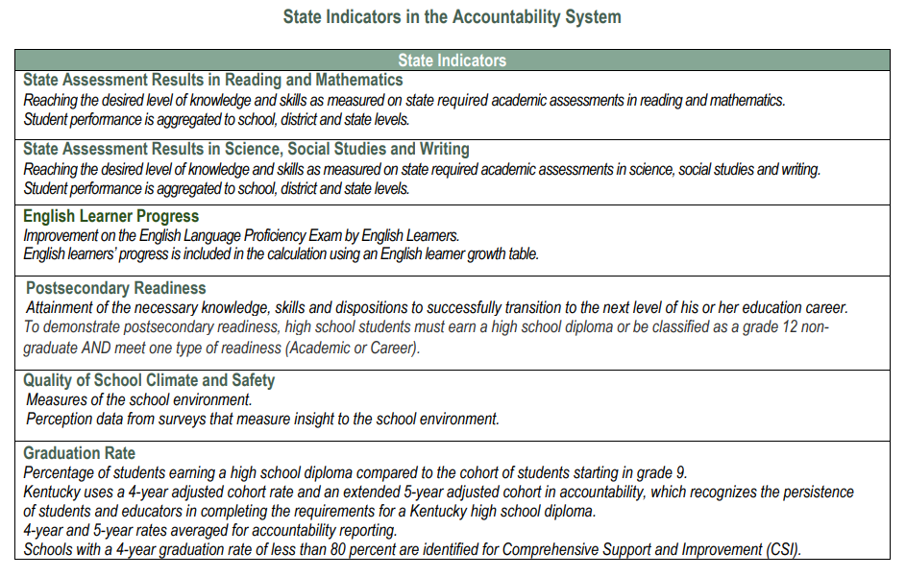
State Indicators in the Accountability System

Slide 3
Glossary
Status Score: Numerical value based on student performance from each indicator
Status Level: Five levels ranging from Very Low to Very High for the current year
Change Score: The numerical value of the difference between the current year and the prior year Status Scores
Change Level: Five levels ranging from Declined Significantly to Increased Significantly
Indicator Score: Numerical value of Current Year Status Score + Change Score
Indicator Performance Rating: One of five color coded performance levels for each state indicator, the result of unique combination of Status Level and Change Level; not based on cut scores
Overall Score: Combination of Weighted Indicator Scores
Overall Performance Rating: one of five colors - red through blue
Weighted Indicator Score: Numerical value of indicator scores multiplied by the weight of each indicator

Slide 4
Agenda
Status
Combined Writing
Accountability Calculations
Change
Change Score Calculations
Indicator Performance Ratings
Overall Score

Slide 5
Status
State Assessment Results in Reading and Mathematics State Assessment Results in Science, Social Studies and Writing

Slide 6
Status Score
The Status Score represents the current year outcome for a given indicator.
Indicator | State Assessment Results in Reading and Mathematics | State Assessment Results in Science, Social Studies, and Writing | English Learner Progress | Quality of School Climate and Safety | Postsecondary Readiness (HS only) | Graduation Rate (HS only)
Metric | Weighted performance index based on student assessment performance levels | Weighted performance index based on student assessment performance levels | Points assigned based on student-level growth as measured by a value table | Average of student scores for applicable questions in the QSCS survey | Percent of 12th grade students demonstrating academic or career readiness | Average 4- and 5-year graduation rates

Slide 7
State Assessment Results in Reading and Mathematics (Elementary/Middle/High)
Reaching the desired level of knowledge and skills as measured on state required academic assessments in reading and mathematics.
Measures student achievement on Kentucky’s Academic Standards in reading and mathematics.

Slide 8
State Assessment Results in Science, Social Studies, and Writing (Elementary/Middle/High)
Reaching the desired level of knowledge and skills as measured on state required academic assessments in science, social studies, and combined writing.
Measures student achievement on Kentucky’s Academic Standards in science, social studies, and writing.

Slide 9
Writing: How are the writing components factored?
On-demand writing and editing/mechanics will be combined to create the student performance for writing.
Students in grades 5, 8 and 11 will receive a scale score and performance level for editing and mechanics and on-demand writing separately.
Combined Writing will be reported by performance level only - Novice, Apprentice, Proficient, Distinguished (NAPD).

Slide 10
Combined Writing Decision Matrix
The combined writing performance levels are determined by the performance levels assigned for editing and mechanics and on-demand writing.
On Demand Writing
Performance Level | Novice | Apprentice | Proficient | Distinguished
Distinguished | Apprentice | Proficient | Proficient | Distinguished
Proficient | Apprentice | Apprentice | Proficient | Distinguished
Apprentice | Novice | Apprentice | Proficient | Proficient
Novice | Novice | Apprentice | Apprentice | Proficient
Editing and Mechanics

Slide 11
Status Measures: Reading and Mathematics and Science, Social Studies, and Writing
Schools earn credit based on student performance levels on state summative assessments:
Novice 0
Apprentice .5
Proficient 1
Distinguished 1.25
Student performance aggregated to school, district and state levels.

Slide 12
Status Calculation for Reading and Mathematics
Example: Elementary School with 200 students
Indicator | NAPD | Students | Points | Total
Reading | Novice (0 points) | 40 students X 0 | 0 points
 | Apprentice (0.5 point) | 50 students X 0.5 | 25 points
 | Proficient (1 point) | 80 students X 1 | 80 points
 | Distinguished (1.25 points) | 30 students X 1.25 | 37.5 points
 |  | Total points: | 142.5 points/200 students X 100 | 71.3
Math | Novice (0 points) | 50 students X 0 | 0 points
 | Apprentice (0.5 point) | 60 students X 0.5 | 30 points
 | Proficient (1 point) | 70 students X 1 | 70 points
 | Distinguished (1.25 points) | 20 students X 1.25 | 25 points
 |  | Total points: | 125 points/200 students X 100 | 62.5

Slide 13
Status Calculation for Reading and Mathematics (2)
Example Continued:
71.3 + 62.5= 133.8 = 66.9
2

Slide 14
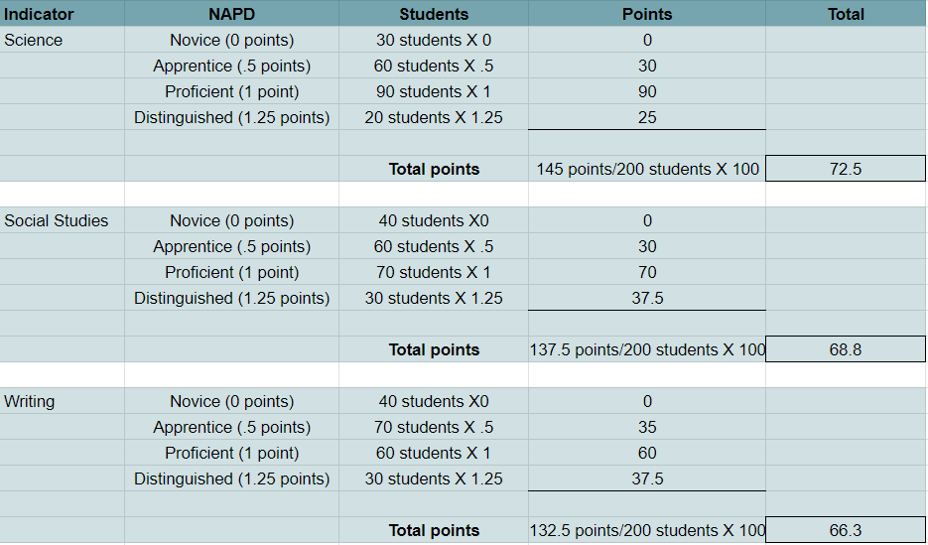
Status Calculation for Science, Social Studies, and Writing
Example: Elementary School with 200 students

Slide 15
Status Calculation for Science, Social Studies, and Writing (2)
Example Continued:
72.5 + 68.8 + 66.3 = 207.6 = 69.2
3

Slide 16
Status Levels
There are five Status Levels.
Status | Very Low | Low | Medium | High | Very High
Notes:
There are five status levels ranging from very low to very high for the current year.
Color ratings will include five performance levels from highest to lowest. Performance of schools will be reported by levels; elementary, middle, and high as applicable. The School Report Card will display the color ratings for each indicator to communicate performance of schools with red being the lowest and blue being the highest.

Slide 17
Status Cut Scores for Elementary Schools
School Level | Indicators | Very Low | Low | Medium | High | Very High
Elementary School Status | State Assessment Results in Reading/Mathematics | 0-31.9 | 32.0-53.9 | 54.0-69.9 | 70.0-80.9 | 81.0-125
 | State Assessment Results in Science/ Social Studies/Writing | 0-33.9 | 34.0-49.9 | 50.0-66.9 | 67.0-75.9 | 76.0-125
 | English Learner Progress | 0-33.9 | 34.0-47.9 | 48.0-57.9 | 58.0-64.9 | 65.0-140
 | Quality of School Climate and Safety | 0-66.9 | 67.0-73.9 | 74.0-76.9 | 77.0-81.9 | 82.0-100

Slide 18
Status Cut Scores for Middle Schools
School Level | Indicators | Very Low | Low | Medium | High | Very High
Middle School Status | State Assessment Results in Reading/Mathematics | 0-35.9 | 36.0-54.9 | 55.0-64.9 | 65.0-72.9 | 73.0-125
 | State Assessment Results in Science/ Social Studies/Writing | 0-32.9 | 33.0-47.9 | 48.0-58.9 | 59.0-68.9 | 69.0-125
 | English Learner Progress | 0-15.9 | 16.0-23.9 | 24.0-30.9 | 31.0-44.9 | 45.0-140
 | Quality of School Climate and Safety | 0-58.9 | 59.0-63.9 | 64.0-67.9 | 68.0-74.9 | 75.0-100

Slide 19
Status Cut Scores for High Schools
School Level | Indicators | Very Low | Low | Medium | High | Very High
High School Status | State Assessment Results in Reading/Mathematics | 0-38.9 | 39.0-52.9 | 53.0-64.9 | 65.0-76.9 | 77.0-125
 | State Assessment Results in Science/ Social Studies/Writing | 0-31.9 | 32.0-46.9 | 47.0-54.9 | 55.0-62.9 | 63.0-125
 | English Learner Progress | 0-9.9 | 10.0-23.9 | 24.0-30.9 | 31.0-44.9 | 45.0-140
 | Quality of School Climate and Safety | 0-53.9 | 54.0-58.9 | 59.0-63.9 | 64.0-67.9 | 68.0-100
 | Postsecondary Readiness | 0-58.9 | 59.0-75.9 | 76.0-87.9 | 88.0-94.9 | 95.0-125
 | Graduation | 0-85.9 | 86.0-91.9 | 92.0-94.9 | 95.0-97.9 | 98.0-100

Slide 20
Change
State Assessment Results in Reading and Mathematics State Assessment Results in Science, Social Studies and Writing

Slide 21
Agenda Continued
Status
Combined Writing
Accountability Calculations
Change
Change Score Calculations
Indicator Performance Ratings
Overall Score

Slide 22
Change Score
Change Score is a simple subtraction of Prior Year Status Score from Current Year Status Score.
It is calculated the same way for every Indicator.
Current Year Status Score – Prior Year Status Score = Change Score
Prior Year Scores are used to calculate Change Scores. They are not used to influence Indicator Performance Ratings.
Current Year Status Score
Prior Year Status Score
Change Score

Slide 23
Change Score Example
Current Year Status Score
Prior Year Status Score
Change
66.9 – 65 = 1.9

Slide 24
Change Levels
There are five Change Levels:
Change | Declined Significantly | Declined | Maintained | Increased | Increased Significantly

Slide 25
Change Cut Scores for Elementary Schools
School Level | Indicators | Declined Significantly | Declined | Maintained | Increased | Increased Significantly
Elementary School Change | State Assessment Results in Reading/Mathematics | -6.1 or less | -6.0 to –2.1 | -2.0 to 0.0 | 0.1 to 6.9 | 7.0 or more
 | State Assessment Results in Science/ Social Studies/Writing | -7.1 or less | -7.0 to –2.1 | -2.0 to 0.0 | 0.1 to 8.9 | 9.0 or more
 | English Learner Progress | -7.1 or less | -7.0 to –1.1 | -1.0 to 0.0 | 0.1 to 22.9 | 23.0 or more
 | Quality of School Climate and Safety | -5.1 or less | -5.0 to –2.1 | -2.0 to 0.0 | 0.1 to 3.7 | 3.8 or more

Slide 26
Change Cut Scores for Middle Schools
School Level | Indicators | Declined Significantly | Declined | Maintained | Increased | Increased Significantly
Middle School Change | State Assessment Results in Reading/Mathematics | -7.1 or less | -7.0 to –2.1 | -2.0 to 0.0 | 0.1 to 6.2 | 6.3 or more
 | State Assessment Results in Science/ Social Studies/Writing | -7.1 or less | -7.0 to –2.1 | -2.0 to 0.0 | 0.1 to 5.9 | 6.0 or more
 | English Learner Progress | -15.1 or less | -15.0 to -5.1 | -5.0 to 0.0 | 0.1 to 7.9 | 8.0 or more
 | Quality of School Climate and Safety | -5.1 or less | -5.0 to –2.1 | -2.0 to 0.0 | 0.1 to 3.9 | 4.0 or more

Slide 27
Change Cut Scores for High Schools
School Level | Indicators | Declined Significantly | Declined | Maintained | Increased | Increased Significantly
High School Change | State Assessment Results in Reading/Mathematics | -12.1 or less | -12.0 to –5.1 | -5.0 to 0.0 | 0.1 to 6.2 | 6.3 or more
 | State Assessment Results in Science/ Social Studies/Writing | -11.1 or less | -11.0 to –3.6 | -3.5 to 0.0 | 0.1 to 6.9 | 7.0 or more
 | English Learner Progress | -13.1 or less | -13.0 to –4.1 | -4.0 to 0.0 | 0.1 to 9.5 | 9.6 or more
 | Quality of School Climate and Safety | -4.1 or less | -4.0 to –2.1 | -2.0 to 0.0 | 0.1 to 3.9 | 4.0 or more
 | Postsecondary Readiness | -5.1 or less | -5.0 to –2.1 | -2.0 to 0.0 | 0.1 to 11.9 | 12.0 or more
 | Graduation | -5.1 or less | -5.0 to –2.1 | -2.0 to 0.0 | 0.1 to 2.9 | 3.0 or more

Slide 28
Indicator Score
Indicator Score is a simple combination of Status Score and Change Score.
It is calculated the same way for every Indicator.
Current Year Status Score + Change Score = Indicator Score
Indicator Scores are used to calculate Overall Scores. They do not influence Indicator Performance Ratings.
Current Year Status Score
Change Score
Indicator Score

Slide 29
Indicator Score Example: Reading and Mathematics Indicator
Current Year Status Score
Change Score
Indicator Score
66.9 + 1.9 = 68.8

Slide 30
Indicator Performance Ratings
Table: Indicator Performance Ratings based on combined Change and Status Levels *
 | Change Declined Significantly | Change Declined | Change Maintained | Change Increased | Change Increased Significantly
Very High Status in current year | Yellow | Green | Blue | Blue | Blue
High Status in current year | Yellow | Yellow | Green | Green | Blue
Medium Status in current year | Orange | Orange | Yellow | Green | Green
Low Status in current year | Red | Orange | Orange | Yellow | Yellow
Very Low Status in current year | Red | Red | Red | Orange | Yellow

Slide 31
Overall Accountability Weights
 | State Assessment Results - Reading and Math | Other State Assessment Results -Science (SC), Social Studies (SS) and Combined Writing (CW) | English Learner Progress | Quality of School Climate and Safety (QSCS) | Postsecondary Readiness | Graduation Rate
Elementary | 51 | 40 | 5 | 4
Middle | 46 | 45 | 5 | 4
High | 45 | 20 | 5 | 4 | 20 | 6
If any indicator is not available, weights will be redistributed proportionally to remaining indicators.

Slide 32
Overall Score – Elementary
Overall Scores represent the combined outcomes across all applicable Indicators, with appropriate weights applied.
Elementary Overall Score Calculation
State Assessment Results in Reading and Mathematics Indicator Score * .51
State Assessment Results in SC, SS and CW Indicator Score * .40
Overall Score
English Learner Progress Indicator Score *.05
QSCS Indicator Score * .04

Slide 33
Overall Score – Middle
Overall Scores represent the combined outcomes across all applicable Indicators, with appropriate weights applied.
Middle School Overall Score Calculation
State Assessment Results in Reading and Mathematics Indicator Score * .46
State Assessment Results in SC, SS and CW Indicator Score * .45
Overall Score
English Learner Progress Indicator Score *.05
QSCS Indicator Score * .04

Slide 34
Overall Score – High School
State Assessment Results in Reading and Mathematics Indicator Score * .45
State Assessment Results in Sc, SS and Writing Indicator Score * .20
English Learner Progress Indicator Score *.05
QSCS Indicator Score * .04
Postsecondary Readiness Indicator Score
*.20
Graduation Indicator Score *.06
Overall Score
Overall Scores represent the combined outcomes across all applicable Indicators, with appropriate weights applied.
High School Overall Score Calculation

Slide 35
Overall and Indicator Performance Ratings
Overall Performance ratings are reported as one of five colors - red through blue based on cut scores.
Indicator Performance ratings are the result of unique combination of Status Level and Change Level; not based on cut scores.
Color ratings include five performance levels from highest to lowest, Blue, Green, Yellow, Orange and Red.
Note: School Report Card will be released later this calendar year.
Blue
Green
Yellow
Orange
Red
Notes:
The Overall Performance Rating combines performance on the state indicators for elementary, middle, and high schools. These ratings will be communicated using a color rating system, where blue represents the highest rating, and red represents the lowest rating. The five performance levels, from highest to lowest, are Blue, Green, Yellow, Orange, and Red. Indicator Performance ratings are also reported as colors the result of unique combination of Status Level and Change Level; not based on cut scores.
Please note that the public School Report Card will be released later this year. The initial public release of assessment and accountability data will be in Open House.

Slide 36
Overall Performance Rating Cut Scores
School Level | Red | Orange | Yellow | Green | Blue
Elementary Schools | 0-37.9 | 38.0-54.9 | 55.0-69.9 | 70.0-82.9 | 83.0 or more
Middle Schools | 0-35.9 | 36.0-50.9 | 51.0-63.9 | 64.0-76.9 | 77.0 or more
High Schools | 0-48.9 | 49.0-59.9 | 60.0-70.9 | 71.0-80.9 | 81.0 or more

Slide 37
State Accountability Trainings
Accountability Overview
State Assessment Results for Reading and Mathematics/State Assessment Results for Science, Social Studies, and Writing
Quality of School Climate and Safety
Progress on English Language Proficiency
Postsecondary Readiness
Graduation Rate

Slide 38
Contact Us
Jennifer Stafford, Division Director
Helen Jones, Academic Program Manager
Shara Savage, Education Administration Program Manager
Ben Riley, Systems Consultant
Devon Avery, Program Consultant
Chris Williams, Program Consultant
Christen Roseberry, Program Consultant
Krista Mullins, Program Consultant
Melissa Chandler, Program Consultant

Slide 39
Division of Assessment and Accountability Support
Division of Assessment and Accountability Support
OAA/DAAS (502) 564-4394 dacinfo@education.ky.gov

Slide 40
End Slide

