Slide 1
2024-2025 Back to School Trainings- Module 4- WIDA AMS
ACCESS for ELLs/WIDA Alternate ACCESS
Chris Williams, Program Consultant
Office of Assessment and Accountability

Slide 2
Module Trainings
Module 1-WIDA Screener for Kindergarten and WIDA Screener Online
Module 2-Identified EL Students
Module 3-WIDA Secure Portal
Module 4-WIDA AMS
Module 5-ACCESS/Alternate ACCESS

Slide 3
Module 4-WIDA Assessment Management System (AMS)
Assigning permissions, manage students, manage test session/registrations, scoring screener results, downloading individual student Online Screener reports, practice tests, knowledge articles

Slide 4
WIDA AMS Resources
Watch the WIDA AMS and DRC Technical Enhancements for 2024-2025 webinar recording, located on the Webinars page in the WIDA Secure Portal.
Import students correctly in WIDA AMS: Make sure to use the correct WIDA Student Import sample file and file layout for 2024-2025. This year’s layout includes a new column A to indicate whether the import is for ACCESS or WIDA Screener. Find the file layout and instructions in WIDA AMS in the online help feature of Import Management.
Know where to go for more support: Select the Knowledge Articles button on the WIDA AMS landing page to access a library of in-depth information on a variety of topics.
Access DRC’s Online Help feature from within an application for step-by-step instructions on how to complete tasks in Import, Student or Test Management, the Test Monitoring Application, or Reporting Services. Select the question mark icon in the upper right corner of the application to get started.

Slide 5
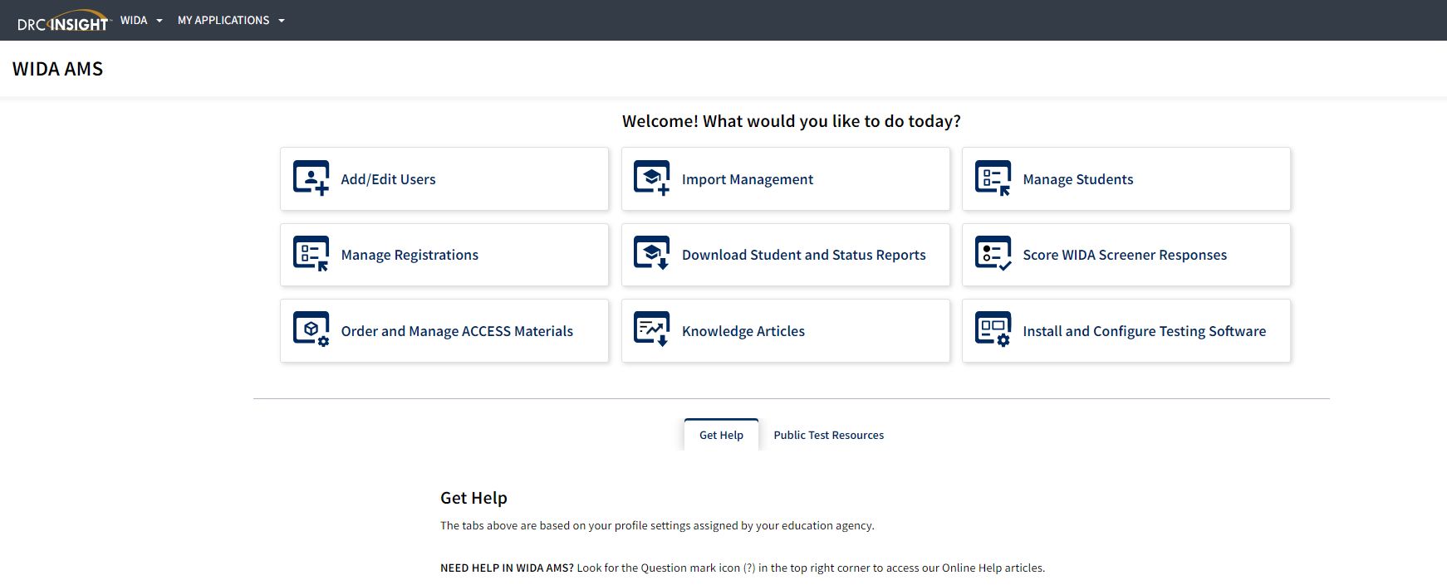
WIDA AMS
WIDA AMS Login

Slide 6
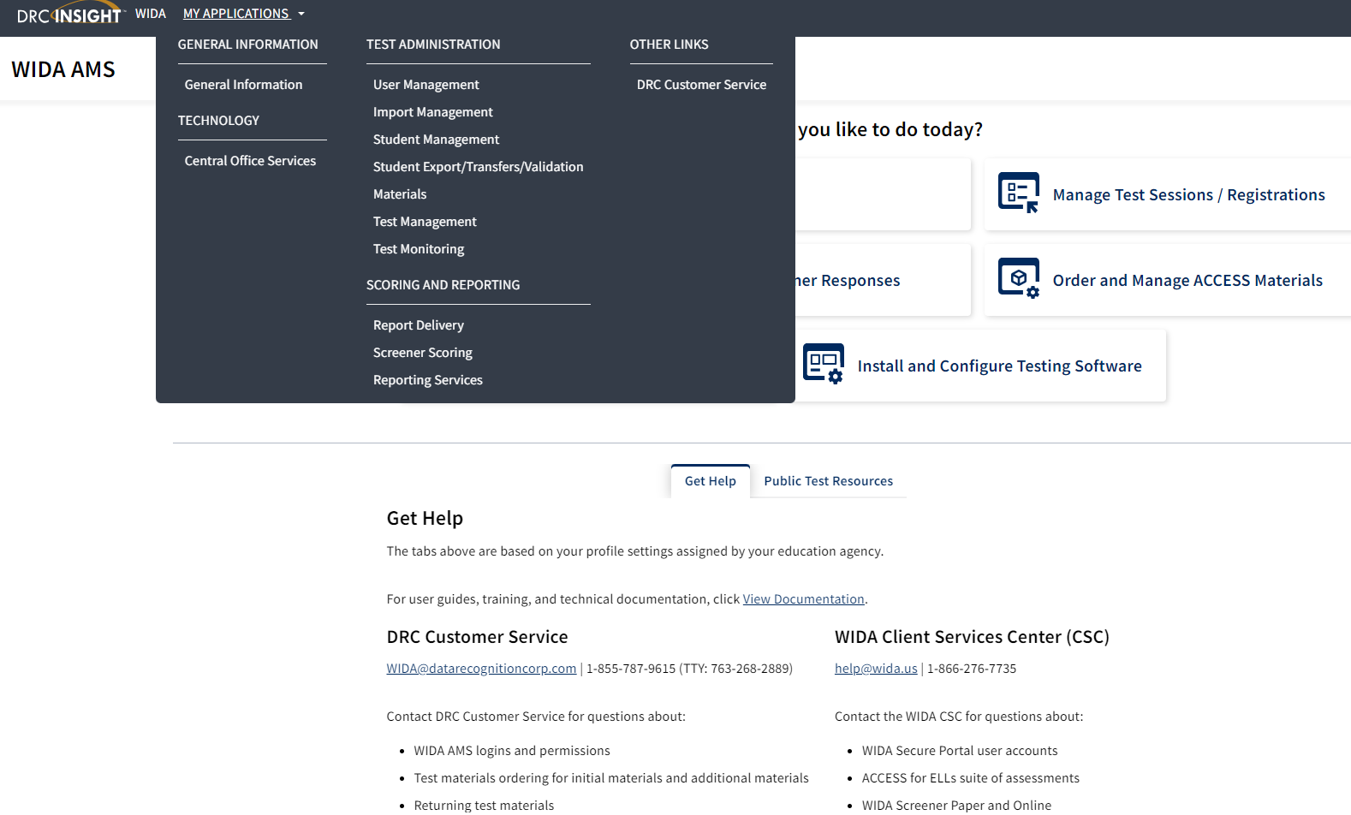
My Applications in WIDA AMS

Slide 7
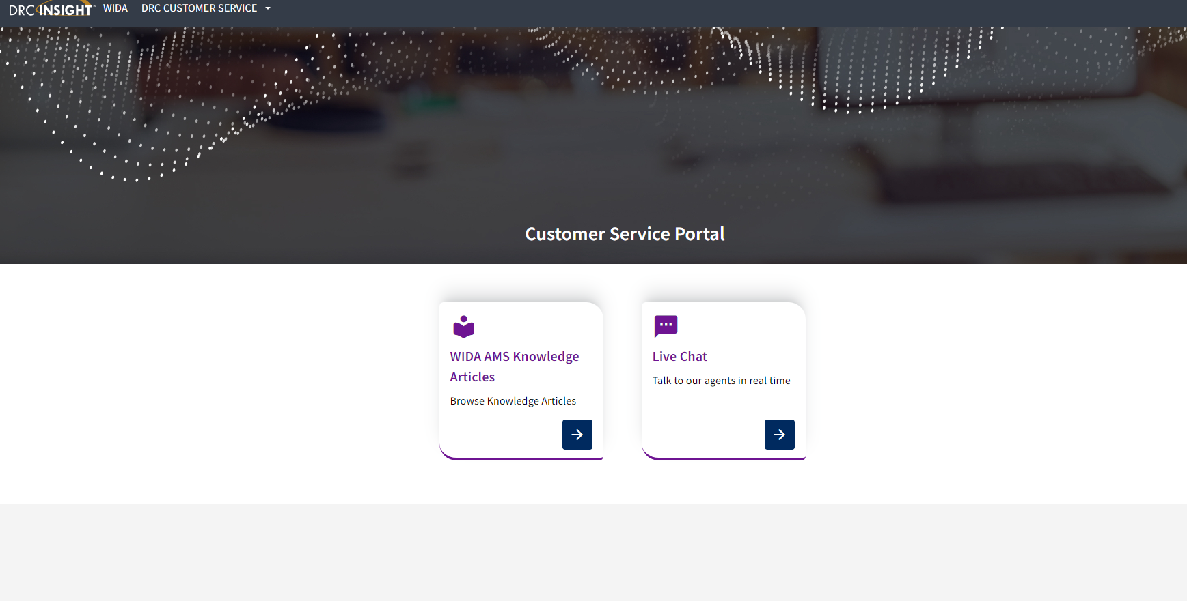
Customer Service-WIDA AMS Knowledge Articles

Slide 8
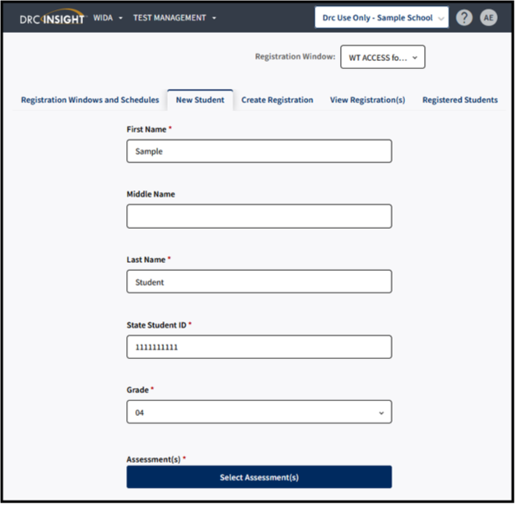
Adding a Registration
To add a registration, complete the following steps:
Click Test Management from the WIDA AMS My Applications menu bar
Confirm or enter your site criteria in the upper right corner. Click Save
Confirm or enter your Registration Window in the drop-down menu
Select the New Student tab
Complete First and Last Name, SSID, and Grade Filters. Button under Assessment(s) will activate
Click on Select Assessments
The Select Assessment(S) will appear. Select the assessments and domains applicable to the student
Click Add to add a student to the following registrations or click Close to cancel the process without saving the changes
Confirm or edit the Registration Name. The Registration Name will default to user's last name and date.
Complete other demographic fields as needed
Click Register to register the student to the selected assessment
Click View Registration(s) to see the newly created registration
Notes:
New Student Tab method simultaneously adds a student into Student Management and creates a registration for a single, new student.
Create Registration creates a registration for a single or group of students who already exist within WIDA AMS under Student Management.
To add a registration, complete the following steps:
Click Test Management from the WIDA AMS My Applications menu bar.
Confirm or enter your site criteria in the upper right corner. Click Save.
Confirm or enter your Registration Window in the drop-down menu.
Select the Create Registration tab.
Enter a Registration Name. The registration name should be descriptive. For example, a user might name the registration by the teacher name and classroom period.
Click Select Assessment(s). A Select Assessments window will appear. For ACCESS for ELLs, you will select an assessment for each domain. For WIDA Screener Online, you will select the assessment by grade cluster. Click Add.
Click Select Student(s) to add one or multiple students to the registration. To select multiple students, click the checkbox next to each student to add to the registration. A user can also filter by grade or last name. Click Add.
A user can choose to activate Test Monitoring and set to “Required.” This action will require all students in the registration to enter a Monitoring Code generated by the Test Administrator on initial login of the assessment.
Click Register.
You will receive a Registration Confirmation message showing the assessment(s) and the number of students added to the registration. If this is correct, select Close.
Click View Registration(s) to see the newly created registrations.
Note: A Registration Window, District and School will need to be selected for the Create Registration tab to activate. If the Create Registration tab does not appear, this will indicate that the user does not have the “Registration-Add/Edit” permission.
The registration name should be descriptive. For example, a user might name the registration by the teacher name and classroom period.
For WIDA Screener Online, you will select the assessment by grade cluster.
Note: If you do not see the student available to be placed into the registration, this will usually indicate that the student has not yet been added to WIDA AMS, or that the student is already enrolled in a registration of the same domain and grade cluster. Search for the student under the Registered Students tab to confirm the student’s enrollment in registrations for the given administration.
If creating a registration for Screener and are unsure which grade cluster registration to use for the student, refer to Knowledge Article “What grade cluster registration should I screen a student?”
For Screener testing, a student will only need to be enrolled in one registration. Screener Online is a single ticket login with one registration.
For more information on how to edit a registration, refer to Knowledge Article “How do I edit a registration?”

Slide 9
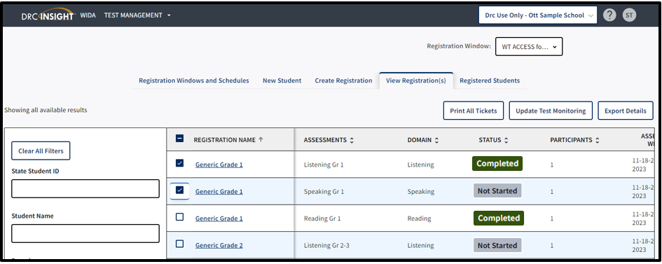
Printing Test Tickets
To print test tickets for students in a registration, complete the following steps:
Click Test Management from the WIDA AMS My Applications menu bar
Confirm or enter your site criteria in the upper right corner. Click Save
Confirm or enter your Registration Window in the drop-down menu
Select the View Registrations(s) tab
Apply one or more filter criteria such as SSID, Student Name, Domain, Registration Name, and/or Assessments to refine your search. Or, to print the test tickets for multiple registrations, leave the filters blank
Select the checkbox next to the registration(s) and click Print All Tickets
Notes:
District and school staff must keep test tickets secure before and after testing of the WIDA Online Screener. Must maintain test security through out the screening process-before, during and after.
Note: If the Print all Tickets button does not appear, please select a school in the site selector in the upper right corner.
If a PDF file does not appear, disable your browser’s pop-up blocker.
A test ticket includes the Student Name, Date of Birth, Accommodations, Domain, Registration Name, State Student ID, Username, and Password.
Prior to testing, Test Administrators should confirm the student’s identity when passing out the test tickets to the student to prevent the student from logging in under the incorrect profile.
Screener Online has one login and a single test ticket for all four domains.
How do I print test tickets for individual students?
To print test tickets for individual students in a registration, complete the following steps:
Click Test Management from the WIDA AMS My Applications menu bar.
Confirm or enter your site criteria in the upper right corner. Click Save.
Confirm or enter your Registration Window from the drop-down menu.
Select the Registered Student(s) tab and search for the student by name or state student ID. Any student with related search criteria will automatically filter on the screen with his or her current registrations.
If you need further assistance with WIDA AMS, please contact DRC Customer Service at 855-787-9615 or wida@datarecognitioncorp.com.

Slide 10
Contact Us
Jennifer Stafford, Division Director
Helen Jones, Academic Program Manager
Shara Savage, Education Administration Program Manager
Ben Riley, Systems Consultant
Devon Avery, Program Consultant
Chris Williams, Program Consultant
Christen Roseberry, Program Consultant
Krista Mullins, Program Consultant
Melissa Chandler, Program Consultant

Slide 11
Other Back to School Trainings
Accountability Overview
ACCESS/Alternate ACCESS
AKSA (Attainment Tasks)
K Screen
Test Security

Slide 12
Division of Assessment and Accountability Support
OAA/DAAS (502) 564-4394 dacinfo@education.ky.gov
Chris Williams, Program Consultant,
chris.williams@education.ky.gov

Slide 13
Thanks for Attending

