Slide 1
DAC Webcast September 12, 2024
Jennifer Stafford, Director
Division of Assessment and Accountability Support
Office of Assessment and Accountability

Slide 2
Agenda
Fall 2024 Optional Senior ACT Administration Reminders
Alternate Kentucky Summative Assessment (AKSA) Updates
WIDA Alternate ACCESS Reporting
K Screen Updates
House Bill (HB) 6 (2024) Website Requirements
Quality Control Day (Tentative)
Reimagining Assessment and Accountability Prototype 4.0

Slide 3
Fall 2024 Optional Senior ACT State Administration Reminders
Christen Roseberry, Program Consultant
Office of Assessment and Accountability

Slide 4
Fall 2024 Optional Senior ACT State Administration: Test Window 1
Test Window 1
Administration | Dates
The ACT Online Standard & ACT- Authorized Accommodations Testing Window (Online only) The ACT-Authorized Accommodations Testing Window (Paper) | October 1-4 & October 7-11

Slide 5
Fall 2024 Optional Senior ACT State Administration: Test Window 2
Test Window 2
Administration | Dates
The ACT Online Standard & ACT- Authorized Accommodations Testing Window (Online only) The ACT-Authorized Accommodations Testing Window (Paper) | October 15-18 & October 21-25
Please Note: ACT and OAA have secured an Emergency Test Window 3. OAA will work with districts should a statewide emergency arise.

Slide 6
Fall 2024 Optional Senior ACT State Administration: Schedule of Events
The Fall ACT Schedule of Events outlines the various tasks that must be completed during the testing cycle. Tasks will vary depending on which type of administration is being managed (standard time or accommodated online/paper).
In addition to the fall 2024 schedule of events, please download and utilize the ACT Test Coordinator Checklist. It is a valuable tool to assist DACs and BACs in navigating through the testing cycle.

Slide 7
Fall 2024 Optional Senior ACT State Administration: Office Hours
ACT and OAA have partnered to offer office hours through the fall 2024 administration.
ACT Office Hours (all times listed below are easter standard time):
Thursday, Sept. 12, 2024, 1:00-2:00 PM
Tuesday, Sept. 24, 2024, 11:00 AM-12:00 PM
Wednesday, Oct. 9, 2024, 11:00 AM-12:00 PM

Slide 8
AKSA Updates
Krista Mullins, Program Consultant
Office of Assessment and Accountability

Slide 9
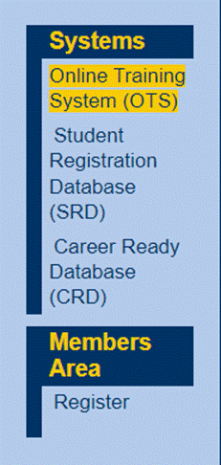
Online Training System (OTS)
DACs will register in the OTS and indicate they are the DAC. KDE will approve the registration for DACs
Teachers need to register if they do not have an account.
Complete or update profiles

Slide 10
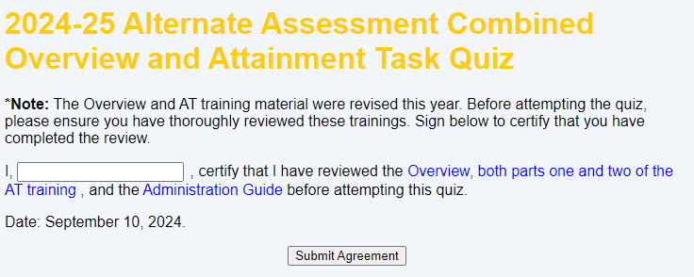
Overview Attainment Task Trainings Quiz
Teachers complete the certification statement prior to being able to access the quiz.
There have been some changes to the administration procedures and several quiz questions are different to address these changes.

Slide 11
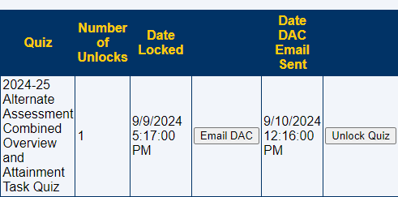
Overview Attainment Task Trainings Quiz Continued
If a teacher has attempted the quiz three times and been unsuccessful, the teacher will be locked out of the quiz.
The quiz will be unlocked 24 hours after the date and time the teacher is locked out.
An email will be sent to the teacher when the quiz is unlocked.
If a teacher has six unsuccessful attempts of the quiz, an email is sent to the teacher and DAC. The quiz will not be unlocked until the DAC emails KDE.

Slide 12
New Alternate Assessment Targets for the Science Kentucky Academic Standards
The new science alternate assessment targets will be used during the field test portion of the AKSA this year.
The attainment tasks will use the previous science alternate assessment targets.
Both the previous and the new science alternate assessment targets can be found on the Kentucky Academic Standards – Alternate KSA webpage.
Teachers should use both in their instruction.

Slide 13
WIDA Alternate ACCESS Reporting
Chris Williams, Program Consultant
Office of Assessment and Accountability

Slide 14
WIDA Alternate ACCESS Reports and Resources
Districts have received the WIDA Alternate ACCESS Reports and Data File Online in WIDA Assessment Management System (AMS).
District will receive the printed WIDA Alternate ACCESS Reports on Sept. 26.
Resources to assist with WIDA Alternate ACCESS:
WIDA Alternate ACCESS Interpretive Guide for Score Reports
Understanding 2023-2024 WIDA Alternate ACCESS Reports Recorded Webinar
WIDA Alternate ACCESS: Understanding your Child's Scores flyer
Alternate Proficiency Level Descriptors (PLDs)
Applying the Framework: A Matrix for Educators to Address Students' Language and Disability Needs
Conversations with Candoo: WIDA Alternate ACCESS standard setting

Slide 15
K Screen Updates
Tiffany Christopher, Program Consultant
Office of Assessment and Accountability

Slide 16
K Screen Office Hours
The Office of Assessment and Accountability and Curriculum Associates will hold virtual office hours on Sept. 13 and Sept. 30 to support the K Screen process.
Sept. 13, 2 – 3 p.m. ET, Join the Zoom Meeting
Sept. 30, 2 – 3 p.m. ET, Join the Zoom Meeting
These sessions provide an opportunity to ask questions, receive guidance, and ensure readiness for upcoming tasks.
Participation is encouraged for all, whether experienced or new to the role.
Contact Ben Riley with questions.

Slide 17
House Bill 6 (2024) Website Requirements
Shara Savage, Academic Program Manager
Office of Assessment and Accountability

Slide 18
HB 6 (2024) Website Requirements
Each local board of education and each school must prominently display on its internet landing page:
In not less than 16-point type,
The district’s/school’s percentage of students scoring:
Proficient in Reading
Distinguished in Reading
Proficient in Mathematics
Distinguished in Mathematics
A web link to the detailed results of the district’s/schools’ performance*
The district’s/school’s reading and mathematics performance percentages must also be displayed at the top of each webpage on districts’/schools’ websites in a banner format.

Slide 19
Key Reminders
Spot checks have revealed a few areas that need attention:
Some schools/districts have not yet posted the required information.
Some links lead to incorrect SRC pages.
Some districts have averaged their elementary/middle/high data.
Districts should post the data by level, as provided by KDE.
Be Proactive—schools/districts should correct any issues prior to the release of 2023-2024 data.

Slide 20
HB 6 Timeline for 2024 Public Release
Public release is tentatively scheduled for Oct. 3
With the assessment and accountability data files, District Assessment Coordinators will receive a spreadsheet containing student reading and mathematics Proficient and Distinguished percentages for the district and each school.
Districts will have 14 days to update percentages on websites (tentatively due Oct. 17).
With each release of updated spreadsheets, districts will need to update websites within 14 days if data has changed.

Slide 21
Quality Control Day
(Tentative)
Jennifer Stafford, Director
Office of Assessment and Accountability

Slide 22
Quality Control Day Still Tentative
QC Day still tentative for Sept. 19 from 9 a.m.- 4 p.m. ET.
The purpose of the QC Day is for District Assessment Coordinators (DACs) to identify systemic issues in accountability data prior to any public release.

Slide 23
QC Day Purpose
Purpose​
Ensure accurate public reporting​
Identify statewide systemic data issues that potentially impact multiple schools and districts ​
Review Data​
Changes to individual student data were requested in the Student Data Review and Rosters (SDRR) application during QC Data Review (August 7-14). ​
QC Day Activities will focus on reviewing accountability data
Review accountability data including color ratings, indicator data, and federal classifications.
Conduct a final review of data to ensure data quality for schools and districts.​
Carefully review individual student groups for federal classification (TSI).

Slide 24
Timeline for 2024 Public Reporting
TENTATIVE
Oct. 1
Oct. 3
Oct. 3–
Oct. 14
District Embargo Opens at 8:00 a.m. ET
10-day Regulatory Data Review for new individual student change requests in SDRR begins at 9:00 a.m. ET and closes for new tickets at 5:00 p.m. ET
Oct. 1
Media Embargo Opens -Districts may begin discussing data under embargo privately with media at 1:00 p.m. ET
Embargo ends
Public Release of School Accountability and test results at 12:01 a.m. ET

Slide 25
Open House
The Kentucky Department of Education will release 2023-2024 assessment and accountability data in a phased approach this fall. The data will be released in datasets before the new School Report Card (SRC) dashboard is available.
The data will be released in datasets in Open House. This platform provides comprehensive information on school performance, enabling stakeholders to review and analyze educational outcomes. Please visit Open House to access the latest data and insights.
Please note: Due to a vendor change, a new SRC dashboard will be available later this year. The current SRC dashboard will sunset and be replaced.

Slide 26
Reimagining Assessment and Accountability Prototype 4.0
Jennifer Stafford, Director
Office of Assessment and Accountability

Slide 27
Kentucky United We Learn Council’s Journey to the Moon

Slide 28
Released Today
Input Sought | Next Steps
Version 4.0 Version 4.0 Stakeholder Survey Prototype 4.0 Resource Webpage | Advisory Meetings Kentucky Board of Education, Oct. 7-8 Kentucky United We Learn Council Convening, Oct. 21-22

Slide 29
Questions and Answers
Please send questions or comments to dacinfo@education.ky.gov .
The next monthly DAC Webcast is scheduled for Oct. 10 at 11 a.m. ET.
Thank you for your participation!

Slide 30
Division of Assessment and Accountability Support
Contact Information
KDE DAC Information
dacinfo@education.ky.gov
(502) 564-4394

