Slide 1
DAC Webcast December 12, 2024
Jennifer Stafford, Director
Division of Assessment and Accountability Support
Office of Assessment and Accountability

Slide 2
Agenda
ACCESS for ELLs Reminders
Alternate Kentucky Summative Assessment (AKSA) Updates
ACT Reminders
Career and Technical Education (CTE) Reminders
K Screen Updates
Town Hall Schedule and Agenda

Slide 3
ACCESS for ELLs Reminders
Chris Williams, Program Consultant
Office of Assessment and Accountability

Slide 4
Before Testing-ACCESS for ELLs
WIDA Secure Portal Account
Training Course/Quizzes
Resources-Manuals, Non-Disclosure User Agreement (NDUA)
Webinars
Individual Education Program (IEP) and 504 Plan Accommodations in the WIDA Accessibility and Accommodations Manual
Forms- ACCESS Online, Alternate ACCESS, Kindergarten
Testing-Online/Test Booklet
Test Setup in WIDA Assessment Management System (AMS)- Nov. 27-Feb. 14
Run English Learner (EL) Extract Report in Infinite Campus (IC)
Inventory Test Materials-record discrepancies on the Accountability Form in WIDA AMS

Slide 5
Before Testing ACCESS for ELLs
Order Additional Materials in WIDA AMS- Dec. 3- Feb. 7
Technology Coordinator –Completes Checklist and Setup of Testing Devices
Testing Schedule-Print or Electronic
Test Security
Print Test Tickets in WIDA AMS
Test Booklets
Check-In and Check-Out Process
Trainings
Administration Code Training
Inclusion of Special Populations Training
ACCESS Trainings
Review Kentucky's Member Page-Testing Schedule and WIDA Online Checklist
Practice Test and Review Test Security Procedures with Students

Slide 6
During Testing-ACCESS for ELLs
Testing Window- Jan. 6- Feb. 14
No Opt-out of Testing
In-Person Testing-No Remote Testing
Off-site Testing- home/hospital, etc.
Test Security
Test Materials-Test Tickets, Test Booklets, Scratch Paper with Check-In and Check-Out Process
Monitoring Students
Tier Level Report in WIDA AMS- Grade 1-3 Writing
Ordering Additional Materials in WIDA AMS
Test Set Up in WIDA AMS
Run EL Extract Report in IC
Seating Charts
ACCESS Rosters in Student Data Review and Reporting (SDRR) Application- Jan. 6-Mar. 10 at 5 p.m. for new –nonparticipations tickets only
Site Visits

Slide 7
ACCESS Testing Scripts
WIDA is providing translated test instructions in ACCESS Online Test Administrator Scripts.
ACCESS Online Grades 4–12 Test Administrator Script (all domains)
Listening, Reading, and Speaking domains in the ACCESS Online Test Administrator Scripts for Grades 1–3
Guidelines for Using the Translated Instructions:
Only the instruction text will be translated for the student. All other text that is read aloud to the student must be read in English.
Test administrators should remind students to provide their responses in English. (This reminder will also appear in the scripts.)
These translations are not secure materials. At the completion of testing, please recycle any translated scripts printed. Do not return them to Data Recognition Corporation (DRC).
You will only use the translated scripts for any EL students who need the directions only translated in their native language and the EL student must have Oral Native Language Support (ONLS) marked in the plan.

Slide 8
Kindergarten ACCESS Student Response Booklet Update
Printing Issue Identified
The Kindergarten ACCESS Student Response Booklets have a printing error:
Page numbers begin with "5" instead of "1".
The printing error also affects the large print format of the booklet.
Action Required
Please do not distribute or use the incorrect booklets currently in DAC’s or testing staff's possession.
Additional material orders for Kindergarten ACCESS Student Response Booklets are on hold until replacements are available.
Next Steps
DRC is reprinting all Kindergarten ACCESS Student Response Booklets.
Corrected booklets will be delivered in early January.
Further communication will provide:
Delivery date.
How to identify corrected booklets.
Returning Misprinted Materials
Return unused, misprinted booklets with other secure materials after testing.

Slide 9
Resources
WIDA Secure Portal-Training Course, Webinars, Resources, Professional Development (PD), etc.
WIDA AMS- Test Setup, Accounts, Test Tickets, Testing, Technology Coordinator Resources, etc.
WIDA Accessibility and Accommodations Manual
Forms page on the Kentucky Department of Education (KDE) website- Seating Charts, No Opt-Out Testing Policy, Medical Nonparticipation, Site Visit etc.
Administration Code and Inclusion of Special Populations Trainings and Regulations
ACCESS Trainings on the KDE website
Kentucky's Member page on the WIDA website-Testing Schedule, Checklist, PD

Slide 10
AKSA Updates
Krista Mullins, Administration Program Consultant
Office of Assessment and Accountability

Slide 11
AKSA Window 1 Closing
Window 1 closes on Wednesday, Dec. 18.
All tasks must be administered and completed.
Scores may continue to be entered into the Student Registration Database (SRD) through the close of business Friday, Dec. 20.

Slide 12
SRD Score Entry
Prior to entering test scores, the user will be prompted to select the field test form number (option 1, 2, or 3).
The correct number can be found on the binder cover sheet and in the top right-hand corner of the field test.
Use the tabs to enter the scores for the correct content area.
Each item must have a score entered.
If a student did not respond, the test administrator must choose “no response.”
Click “Save and Submit” to save any entered data.
Data may be edited until all content areas have been completed. Once all content area scores have been entered and the “Save and Submit” button has been pressed, the student record cannot be edited unless the whole record is reset, which will erase all data.
The last day to enter scores for Window 1 is Dec. 20.

Slide 13
Medical Situations/Nonparticipation
Medical nonparticipations are completed and filed in the spring.
Students who are unable to test during Window 1 may test during the makeup window (Jan. 6-Mar. 21).
If the student is unable to complete testing during the makeup window, (s)he may complete both Windows (1 and 2) in the Spring during Window 2 (April 14-May 23).

Slide 14
Window 1 Makeup
Window 1 makeups must be requested from KDE.
A form must be submitted with the request.
Includes SSID, district, reason, name of test administrator, and date of expected completion.
A copy of the completed form will be emailed to the person completing the request.
Allow 1 to 2 business days for KDE to review the request and make a determination.
Please allow 1 to 2 business days after approval for the SRD and Online Training System (OTS) to update.
The makeup window is Jan. 6-Mar. 21.

Slide 15
Test Materials
Delete any materials that were downloaded onto a computer or device
Destroy any materials that were copied or made for administration
Return student answer sheets to the Building Assessment Coordinator (BAC) or District Assessment Coordinator (DAC) to be kept in a secure location
Return binders and any original copies to BAC or DAC to be kept in a secure location
Retain math counters for Window 2 (elementary only)

Slide 16
ACT Reminders
Christen Roseberry, Program Consultant
Office of Assessment and Accountability

Slide 17
Accommodations Request Window: Nov. 11, 2024 – Jan. 24, 2025
ACT and OAA strongly encourage schools/districts to submit requests in the Test Accessibility and Accommodations (TAA) system prior to winter break. This will help ensure that testing staff has ample time to provide ACT with any additional information and documentation needed to secure the authorized accommodations and supports.
Students may not be approved for accommodations if a school waits until the deadline. If a school misses the deadline, the student will be denied accommodations.
Important note: If a school fails to request accommodations for a student, this is considered a potential allegation. The DAC should enter the allegation into the online KDE/CAVEON Core reporting system.

Slide 18
Spring 2025 Junior ACT State Administration: Verify Enrollment Task
PAN Activity | Dates
Student Data Upload (SDU) File Loaded from KDE into PAN | Jan. 14
Verify Enrollment | Jan. 14 – Jan. 31
Barcode Label (paper testing only) & Non-Test Instructions Deadline | Jan. 31
The deadline to complete the Verify Enrollment task is Jan. 31.
All students will be loaded in the ACT. PearsonAccess^{next} (PAN) system as testing online.

Slide 19
Career and Technical Education
Sherri Craig
Systems Consultant
Office of Career and Technical Education

Slide 20
2024-25 CTE End-of-Program (EOP), TRACK Pre-Apprenticeship Assessments and E-SESS Updates

Slide 21
2024-25 CTE End-of-Program (EOP) Assessment
2024-25 CTE EOP Assessment Coordinator and Administrator Manual is now available Refer to the CTE EOP Assessment web page for more information related to testing CTE EOP Online IT Requirements
CTE EOP Assessment is administered using the online system, E-SESS, provided by Pitso Education. Please review the technical specifications in the CTE EOP Online IT Requirements to ensure a smooth testing experience. Technical support is provided by E-SESS and the Career and Technical Education Consortium of States (CTECS).
DACs, BACs, and Principals should communicate with Building and District Technology Coordinators to confirm all guidelines in the CTE EOP Online IT Requirements document, including the updated E-SESS Focus Lock Technical Preparations, are addressed prior to local administration of the test.

Slide 22
2024-25 Testing Critical Deadlines: CTE Assessments (EOP, TRACK) Testing
Reminders:
2025 CTE EOP and TRACK Pre-Apprenticeship testing windows are Feb. 24 – Mar. 28
All CTE EOP and TRACK Pre-Apprenticeship testing must be completed by Mar. 28
Feb. 1 Critical Deadline:
Feb. 1 Student testing registration deadline CTE EOP / TRACK Pre-Apprenticeship. Refer to the Critical Deadlines link for more details.
Students must be properly identified as a concentrator and have the required number of credits in the career pathway(s) in the Technical Education Database System (TEDS) by Feb. 1 of the current school year to receive a test ticket. Refer to the links TEDS Monthly Notes and TEDS website for more information regarding TEDS data.

Slide 23
2024-25 E-SESS Update
E-SESS - Focus Lock activated in E-SESS and has been updated for the 2025 testing window to automatically load in full screen mode.
Proctors must continue to actively monitor students during testing.
Focus Lock will monitor loss of browser focus during testing. Students are not permitted to leave or navigate away from the testing screen in E-SESS once the test has begun. If a student attempts to open another browser window or program during testing, the student will be warned and may become locked out of their assessment.
The CTE EOP Online Sample Test allows students to practice using the online testing environment and become familiar with the test format. Prior to testing, the online sample test should be run on every device that will be used for live testing to ensure local system performance.

Slide 24
Training and Contact Information
All individuals participating in test administration must complete the required Assessment Regulations Training prior to the test administration at the school level.
Contact Sherri Craig, Office of Career and Technical Education (OCTE), or KDE EOP Support at 502-564-4286 for assistance with CTE EOP Assessment or TRACK Pre-Apprenticeship Assessment.

Slide 25
Reminders: Additional CTE Deadlines
Career Readiness WBL – July 31 deadline for entering the WBL data in Infinite Campus (IC) for the 300+ hours
For assistance with IC data entry, contact Amy Tracy, OCTE
For assistance with WBL related questions, contact Tina Brogli, OCTE
Perkins Deadlines
1/1/25 - Deadline for 24-25 CLNA review to satisfy Perkins compliance for 25-26
3/1/25 - Deadline for 75% of 24-25 Perkins funding to be encumbered/spent
3/1/25 - 25-26 Perkins applications open in GMAP (associated training TBD in February)
4/30/25 - Last day to amend 24-25 Perkins application
5/1/25 - deadline for 25-26 Perkins application
For assistance with Perkins, contact Lori Looney, OCTE

Slide 26
Questions?
KDE Office of Career and Technical Education
Beth Engle–Director, Division of Technical Schools and Continuous Improvement
Tom Thompson–Director, Division of Student Transition and Career Readiness
^{New} Lori Looney–Branch Manager, Data and Investment Branch, Perkins
Lea Lewis – Administrative Branch Manager, KY TECH
^{New} Amy Tracy – OCTE Data Manager
^{New} Esti Stith – OCTE Asst. Data Manager
Claude Christian –TEDS Coordinator
Mary Taylor – Industry Training and Development Specialist, TRACK Program
Tina Brogli – Work-Based Learning Coordinator
Sherri Craig – End-of-Program (EOP) Assessment, TRACK Pre-Apprenticeship Assessment and Alternate Assessment Career Readiness

Slide 27
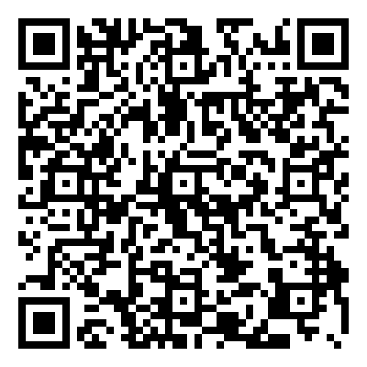
Stay Connected…
@KY_CTE​
KY Office of Career and Technical Education​
https://bit.ly/41iOiXz

Slide 28
2024-25 Alternate Career Readiness Career Work Experience Certification (CWEC) and Employability Skill Attainment Record (ESAR)

Slide 29
Alternate Career Readiness
Options for career readiness for alternative high school diploma course of study or alternate assessment students include successfully completing ONE of the following:
Career Work Experience Completion (CWEC) and meeting benchmark on the Employability Skills Attainment Record (ESAR), or
300 or more hours of a KBE-approved cooperative education or internship associated with a course code (CWEC course codes for alternate), or
KBE-approved application for work experiences not associated with a co-op internship course code and have completed 300 on-the-job hours with an employer partner and the school or district aided with the student’s work experience
Refer to the following resources for more information.
Working with Exceptional Children in CTE
Accountability and Postsecondary Readiness in CTE
Frequently Asked Questions (FAQ): Co-ops and Internships for State Accountability Document

Slide 30
2024-25 Alternate Career Readiness
Kentucky Alternate Assessment Program Calendar
CWEC and ESAR
Reminders:
Dec. 20 – CWEC and ESAR Qualification Quizzes Close
May 23 – Last day to administer the ESAR
May 30 – Last day to enter CWEC Completion Status and ESAR Evaluation Scores in the Career Readiness Database (CRD)

Slide 31
2024-25 Alternate Career Readiness Contacts
Contact Sherri Craig, Office of Career and Technical Education (OCTE), at 502-564-4286 for assistance with CWEC and ESAR administration related questions
Contact Bill Bates, Exceptional Child Education Consultant for Career and Technical Education, in the Office of Special Education and Early Learning (OSEEL), at 502-564-2106

Slide 32
K Screen Updates
Tiffany Christopher, Program Consultant
Office of Assessment and Accountability

Slide 33
Accessing Published K Screen Data
K Screen Data was posted on Dec. 9.
This data can be viewed by logging in to the Student Data Detail on the KDE Secure Web Application and clicking 'Other Documents'.
Download the zip files to your computer for further review.

Slide 34
Town Hall Schedule and Agenda
Jennifer Stafford, Director
Division of Assessment and Accountability Support
Office of Assessment and Accountability

Slide 35
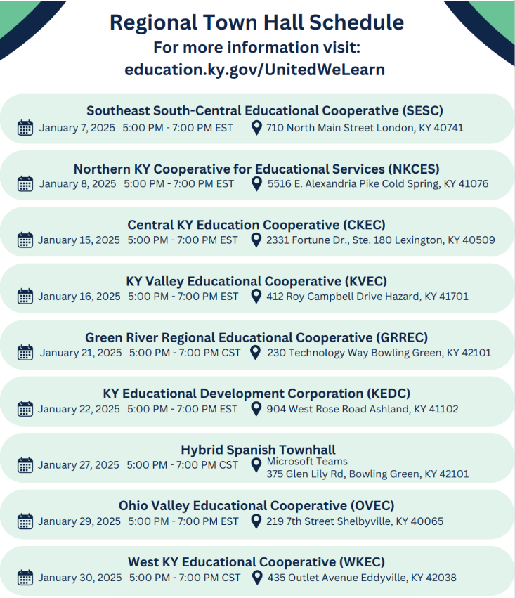
Regional Town Hall Schedule

Slide 36
Town Hall Agenda

Slide 37
Questions and Answers
Please send questions or comments to dacinfo@education.ky.gov .
The next monthly DAC Webcast is scheduled for Jan. 9 at 11 a.m. ET.
Thank you for your participation!

Slide 38
Division of Assessment and Accountability Support
Contact Information
KDE DAC Information
dacinfo@education.ky.gov
(502) 564-4394

