Slide 1
DAC Webcast March 12, 2020
Jennifer Stafford, Director
Division of Assessment and Accountability Support
Notes:
March 12, 2020

Slide 2
Agenda
Welcome
Online Field Test Update
Coronavirus (COVID-19) and State Required Testing
2020 Legislative Update
Sample Items
K-Screen
ACCESS For ELLs: Pre-Reporting Validation
Questions and Answers

Slide 3
Online Field Test Update

Slide 4
Online Field Test
More than 772,880 tests and surveys are completed.
On the largest day of testing, almost 175,000 tests and surveys were taken.
At one point, more than 68,000 students were online at once!
Additional analysis showed that all districts have completed some or all test sessions and surveys.
The window for online field testing opened Feb. 24 and ran through March 6.

Slide 5
Online Field Test (continued)
Online testing has been successful statewide in Kentucky.
Last spring, high school students began taking state required tests online.
Kentucky is transitioning elementary and middle schools to online testing.
Beginning in spring 2021, state summative operational assessments will be administered online at elementary, middle and high schools.

Slide 6
Social Studies Fall 2020 Field Test/Operational
Current social studies standards will be field tested in Fall 2020 at grades 6, 9 and 12.
Social studies operational assessments (beginning spring 2021) will remain at grades 5, 8 and 11 for accountability.

Slide 7
Online Quality of School Climate and Safety Survey
Online student survey was administered as part of Field Test at every tested grade prior to testing the content.
There are two constructs and will receive two separate scores:
Quality
Safety
Administration time – found that survey took less than 20 minutes.
Combined score will be included in 2019-2020 accountability.
Roster will be available in the spring to mark participation.
Notes:
Quality of School Climate and Safety survey starting in Spring 2021 will be part of the summative assessment window. This is the only year that the survey will be part of the field test.

Slide 8
Coronavirus (COVID-19) and State Required Testing
ACT
K-PREP
Alternate K-PREP

Slide 9
COVID-19 and ACT Testing
For districts who tested on March 10 and are in session on the Make Up Test Day (March 24)
March 10 was the Initial Test date
March 24 remains the Make Up Test date (paper)
Option to move to online make up testing March 10, 11, 12, 17, 18, 19
For districts who were not in session on the Initial ACT Test Day (March 10)
March 24 becomes the Initial Test date
April 14 becomes the Make Up Test date (paper)
Accommodations Make Up: March 24-April 3
Option to move to online testing March 24, 25, 26,March 31, and April 1, 2

Slide 10
COVID-19 and ACT Testing (2 of 3)
For districts who tested on March 10 but are not in session on the Make Up Test Day (March 24)
March 10 was the Initial Test date
April 14 becomes the Make Up Test date
Accommodations Make Up testing April 14-24
Option to move to online testing April 14, 15, 16, 21, 22, 23

Slide 11
COVID-19 and ACT Testing (3 of 3)
ACT Accommodations window is March 24- April 3
OAA recommends completing accommodated testing by March 13 if possible.
If accommodated students cannot complete ACT testing during the accommodations window, please contact Shara Savage.
KDE and ACT representatives are in discussion of additional options if schools are not in session during any of these test date options.

Slide 12
COVID-19 and K-PREP/Alt K-PREP
Health and Safety of students, faculty and staff are the foremost priority.
Possible closure of school districts, the increase to the number of NTI days, and waiver of NTI days for more districts to participate could impact state testing.
OAA is actively preparing for all possible scenarios that impact K-PREP and Alternate K-PREP.
State testing vendors have been notified of the Governor’s guidance to superintendents.
KDE is in contact with state and national partners.

Slide 13
2020 Legislative Update

Slide 14
Filed Legislation
SB 158 – Original Version
Amends KRS 158.6455 in multiple areas to create an accountability system that includes an annual meaningful differentiation of all public schools in the state using multiple measures that describe the overall performance of each district, school, and student subgroup. Performance shall be based on a combination of academic and school quality indicators and measures known as “state indicators.”
SB 158 Senate Committee Substitute - Updated Version
Retains original provisions, except amend KRS 158.6455 to clarify implementation dates of the accountability system provisions; clarify that three years of performance shall be used when determining the lowest-performing five percent of schools; delete the minimum subgroup provisions; and clarify that a superintendent, principal, or school district can appeal a performance judgment.
Notes:
Amend KRS 158.6455, Section 1 to create an accountability system that shall include an annual meaningful differentiation of all public schools in the state using multiple measures that describe the overall performance of each district, school, and student subgroup. Performance shall be based on a combination of academic and school quality indicators and measures known as “state indicators.”
The original bill removes specific language that an overall summative performance evaluation of each school and district compared to goals established by the KDE and that the evaluation of each school and district does not consist of a single summative numerical score that ranks schools against each other. In addition, the evaluation should be based on a combination of academic and school quality indicators and measures, with greater weight assigned to the academic measures.
In Section 3, the bill removes achieving a minimum score on a statewide assessment from the high school graduation requirements. In addition, it states that the minimum requirements for high school graduation shall not include achieving any postsecondary readiness indicator.
In Section 6, the bill changes the score of 5 on IB exams to a 4.

Slide 15
Filed Legislation (2 of 3)
HB 278 - Amend KRS 158.6455 to require inclusion of the Armed Services Vocational Aptitude Battery (ASVAB) test as a measurement of postsecondary readiness for the state accountability system. The state board shall determine the benchmark score.
HJR 82 - HJR 82 is a JOINT RESOLUTION relating to school accountability. The resolution directs the commissioner of education to convene a strategic assessment and accountability committee; establish minimum requirements for the composition of the committee; establish the duties of the committee; require the commissioner to report the findings of the committee to the Interim Joint Committee on Education by December 1, 2020, and December 1, 2021.

Slide 16
Filed Legislation (3 of 3)
HB 429 – Amends KRS 158.6453 to require a pre-college admissions exam to be administered in the fall of grade 10 instead of a college admissions exam; allows a student to retake the college admissions exam in the fall of grade 12.
HB 514 - Each local district shall determine a high score required for a student to be exempted from the college admissions examination. If a student attains the high score on a college admissions examination, the parent or guardian of the student, or the student if he or she is at least eighteen (18) years old or legally emancipated, may request exemption from any college admissions examination the student has not taken.
HB 87 Floor Amendment 2 - Amends KRS 156.160 to prohibit high school graduation requirements from including a postsecondary readiness indicator used in the state accountability system or a minimum score on a statewide assessment; amend KRS 158.140 to prohibit a local board from requiring achievement of a minimum score on a statewide assessment as a high school graduation requirement.

Slide 17
K-PREP Sample Test Items

Slide 18
Sample Test Items
For the Operational Tests:
Sample K-PREP Test Items are available for the current reading, math and writing standards from this google drive. Items in the link do not contain items for the new standards or for science or social studies.
Science: The recommended process for administering the tasks and the TCT bank may be accessed on KDE’s website. For questions, contact Rae McEntyre, Science Consultant, at 502-564-2106, ext. 4104.
For the Field Tests:
Tutorials and practice tests are available from the PearsonAccess^{next} landing page by clicking on the Practice Test link in the lower right-hand corner. The tutorials are split into two levels – Grades 3-5 and Grades 6-12.
Current Kentucky Standards and resources are available through the kystandards.org site for each content area.
Notes:
Sample K-PREP Items were released in 2012 and are in the google drive link.

Slide 19
K Screen Information
Jennifer Akin
Program Consultant

Slide 20
Ordering K Screen Materials
New Ordering Process
Materials now ordered directly through Curriculum Associates. The downloadable order form and directions are located on the Curriculum Associates Kentucky webpage.
Place orders by March 27. Email spreadsheet directly to FulfillmentOps@cainc.com. Materials will be delivered mid-May.
Spanish directions should be provided for translator.
Notes:
Add information about consolidating and closing schools

Slide 21
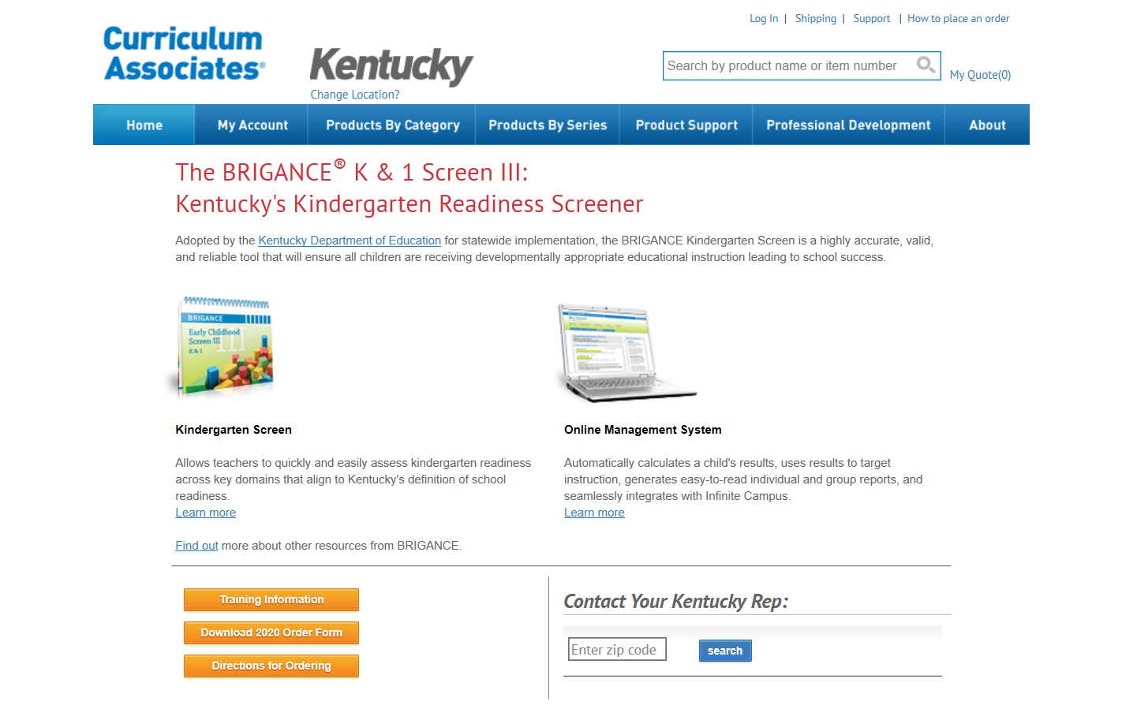
Order Form

Slide 22
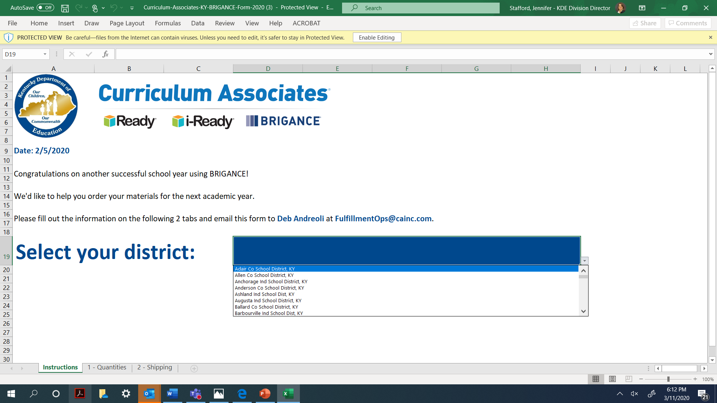
K Screen Order Form: Instructions

Slide 23
K Screen Order Form: Quantities

Slide 24
K Screen Order Form: Shipping

Slide 25
K Screen Training Requirements
NEW district Training the Trainer (TOT) administrators must attend a 6-hour TOT module presented by Curriculum Associates and KDE.
NEW teachers administering the screen must attend a 3-hour session provided by the district TOT.
EXPERIENCED district TOT trainers must register for a webcast refresher.
EXPERIENCED teachers administering the screen must receive a one-hour refresher provided by the district TOT.
NEW and EXPERIENCED data entry staff annually review training materials hosted on the Common Kindergarten Entry Screener website.
Notes:
Be sure to note the REQUIREMENTS listed above.

Slide 26
K Screen Training Opportunities (Face-to-Face)
New Training of Trainer (TOT)
March 26 – Bob Kirby Library, Bowling Green
March 27 – Lexington Public Library, Central Library Branch, Lexington
July 22 – KDE, Frankfort
Registration information located on Common Kindergarten Entry Screen webpage.
Notes:
Be sure to note the REQUIREMENTS listed above.

Slide 27
K Screen Training Opportunities
Experienced Training of Trainer (TOT)
March 25 – Refresher Webcast, KDE Media Portal
Recorded webcast available through July
Data Entry Staff
Training Videos, Implementation Guide and Infinite Campus Resource
Additional Staff
To be determined by district TOT
Notes:
Be sure to note the REQUIREMENTS listed above.

Slide 28
K Screen Tasks
Plan for screen
Screening window
Screening method
Student Data Sheets
iPads
Plan for staff training
Review Implementation Guide
Reference K Screen Updates
Notes:
Be sure to note the REQUIREMENTS listed above. Checklist for the District Kindergarten Coordinator

Slide 29
K Screen Resources
K Screen Updates
Implementation Guide
K Screen Webcasts
Refresher TOT Webcast
Prior Settings video
Curriculum Associates Kentucky Brigance series
Common Kindergarten Entry Screen website

Slide 30
ACCESS For ELLs: Pre-Reporting Validation
ACCESS and Alternate ACCESS

Slide 31
ACCESS for ELLs Data Validation
ACCESS Data validation window for English Learners (ELs) is March 6 – 20
Located in WIDA Assessment Management System (AMS)
Tasks:
Verify that all student demographics are correct
Fix all duplicate student records
Student records needing invalidated (do not score code) contact Chris Williams
Save all your changes

Slide 32
Duplicate Students in WIDA AMS
To fix duplicate student records all the following must be the same and no blanks for both records:
First Name
Last Name
Birthdate
SSID
Grade
District
School
Notes:
It does not matter about the case size (All CAPS or not) but it does matter if there are hyphens or spaces n the duplicate records.

Slide 33
Questions and Answers
Please send questions or comments to dacinfo@education.ky.gov
Next scheduled DAC Webcast is April 16. Note: this is one week later than our normal scheduled date.
Thank you for your participation!

Slide 34
Division of Assessment and Accountability Support
Contact Information
KDE DAC Information dacinfo@education.ky.gov (502) 564-4394

