Slide 1
Online Data Quality Control (QC) Day
Preparation
Shara Savage, Director
Division of Assessment and Accountability Support
Office of Assessment and Accountability
Notes:
Hello and welcome to the Online Data Quality Control Day preparation presentation. My name is Shara Savage, Director of the Division of Assessment Accountability Support. I will guide you through the preparation process for this year's QC Day. Let's get started!

Slide 2
Quality Control Day Agenda
Quality Control (QC) Day Overview
Accountability Cut Scores
State and Federal Calculations
Reporting Timeline
Preliminary Data Cautions and Embargo Status
QC Day Spreadsheets
QC Day Materials and Processes
Notes:
Today, we will be covering several key topics to prepare you for Quality Control Day. I will start with an overview of what to expect on QC Day. Next, I will discuss the accountability cut scores, the reporting timeline, and some preliminary data cautions and embargo status. Finally, I will review the materials and processes you'll need to be familiar with to ensure a smooth QC Day.

Slide 3
Quality Control Day Overview

Slide 4
Quality Control Day Scheduled
QC Day will occur on Sept. 23 from 9 a.m. to 4 p.m. ET.
The purpose of the QC Day is for District Assessment Coordinators (DACs) to identify systemic issues in accountability data prior to any public release.
Notes:
Let’s begin with an overview of Quality Control Day. QC Day is confirmed for Sept. 23, from 9:00 a.m. to 4:00 p.m. Eastern Time. The primary objective is for District Assessment Coordinators to identify any systemic issues in accountability data before the public release. This improves accuracy and addresses potential data concerns in advance.

Slide 5
QC Day Purpose
Purpose​
  Ensure accurate public reporting​.
  Identify statewide systemic data issues that potentially impact multiple schools and districts.
Review Data​
  Changes to individual student data were requested in the Student Data Review and Rosters (SDRR) application during QC Data Review.
  Review accountability data, including color ratings, indicator data and federal classifications.
  Conduct a final review of data to ensure data quality for schools and districts.​
  Carefully review individual student groups for federal classification (TSI).
Notes:
On Quality Control Day, the focus is on reviewing accountability data, particularly color ratings, indicator data, and federal classifications. This is the final step in the quality control process before public reporting.
The purpose of Quality Control Day is to review school and district data prior to public release. District assessment coordinators will first look at their school and district's accountability data to find any systemic issues. On Quality Control Day, information from other schools, districts, and the state will not be visible. However, DACs will review their school and their own district data for big issues that could impact multiple schools.
Now is not the time to make individual student changes. Those changes occurred in August during the fall data review. Once the data is released publicly, schools and districts will have another opportunity to make individual student changes.
Again, the purpose of Quality Control Day is to improve public reporting and identify big issues that could potentially impact multiple schools or districts. An example from a previous Quality Control Day: there was an error in the programming that excluded all students who participated in the alternate assessment program.
Quality Control Day focuses on accountability data. This will be the first time DACs will get to see their color ratings and federal classifications.

Slide 6
Accountability Indicators
Indicator ratings will be reported as red, orange, yellow, green and blue.
Status is defined as the annual school-level summary based on student performance. Change is the difference in Status between student performance from one year to the next in the following state indicators:
  State Assessment Results in Reading and Mathematics (E/M/H)
  State Assessment Results in Writing, Science and Social Studies (E/M/H)
  Progress on English Language Proficiency (E/M/H)
  Quality of School Climate and Safety Survey (E/M/H)
  Postsecondary Readiness (H)
  Graduation Rate (H)
For more details on the accountability indicators, please review the 2026 Accountability Indicator Trainings
PowerPoint and the training video,
Notes:
As in years past, accountability indicators will be reported using a color-coded system: red, orange, yellow, green, and blue.
These colors represent performance at the school level.
Each indicator includes status and change. Status refers to the current year’s performance on each of the indicators and is reported in levels of very high to very low. Change is the difference between the current and previous year status in all state indicators and is reported in levels of increased significantly to decreased significantly.
QC Day will be the first time we see indicator data, which we've discussed in previous trainings on the levels, ratings, colors, and federal classifications. During the quality control day, we'll want to pay particular attention to individual student groups with a federal classification of targeted support and improvement. OAA has released the indicator trainings and the Accountability Overview training for your review. It is important to review the 2026 Accountability Indicator Trainings, especially the Accountability Overview Training. In the Accountability Overview Training, I go into detail about the State and Federal calculations.

Slide 7
State and Federal Accountability Overview

Slide 8
State and Federal Accountability
State Accountability
Colors
KRS 158.6455
Status and change shall receive equal weight in determining overall performance. For all students as a group and separately for individual groups, status shall be determined by using the current year performance, and change shall be determined by using the difference in performance from the prior to the current year.
Except that change shall be based on the difference in performance for the prior three (3) years for the purpose of determining the lowest-performing five percent (5%) of schools under subsections (2) and (3) of Section 2 of this Act.
Federal Accountability
Classifications
Notes:
As a reminder, last year introduced two distinct calculations for 'change' in performance, as outlined in KRS 158.6455. There are two distinct methods for determining "change" in performance, depending on the context.
Let’s look closely at the wording of the statute. Status and change shall receive equal weight in determining overall performance. For all students as a group and separately for individual groups, status shall be determined by using the current year’s performance, and change shall be determined by using the difference in performance from the prior year to the current year.
Our accountability system balances two components equally: Status, which reflects current year performance, and Change, which measures improvement over time.
Senate Bill 158 requires that, to identify these lowest-performing schools, three years of prior data be used to calculate Change.
To identify the lowest-performing five percent of schools, the change calculation will be based on a three-year trend, comparing the current year to performance over the prior three years. For CSI, TSI, and ATSI identification, Change is based on a three-year average difference in performance, ensuring a more stable, long-term view of progress.
A couple of additional reminders:
It is essential to remember that if no Change data is available for an indicator, the Federal Indicator Score will be based on Status. In other words, a school may not necessarily have a Federal Change Score for each indicator.
Although schools will receive different Federal and State Change Scores, Indicator Scores, and Overall Scores, the only unique calculation method is the computation of the Federal Change Score.
Applying two distinct calculations may yield a very different set of State and Federal scores. For example, a school with a very high Change Score in a previous year and a very low Change Score in the current year could have a low State Indicator Score, yet a high Federal Indicator Score. On the other hand, a school with several Indicator Performance Ratings of Green in State reporting could fall into the lowest-performing bottom 5% of schools in Federal reporting, depending on Change Scores in prior years.

Slide 9
Federal Classification
Targeted Support and Improvement (TSI) identification is required annually. Beginning in Fall 2025, Comprehensive Support and Improvement (CSI I and CSI II) schools will be identified annually.
Notes:
As a reminder, federal classifications are a critical component of our state accountability system and is required under the Every Student Succeeds Act, or ESSA.
TSI identification must occur annually to ensure schools are receiving appropriate support.
CSI I and CSI II are identified on an annual basis.

Slide 10
Public Reporting

Slide 11
Timeline for 2026 Public Reporting
TENTATIVE
Oct. 13
Oct. 13
Oct. 15
Oct. 15 - 26
  District Embargo Opens at 8:00 a.m. ET
  Media Embargo Opens -Districts may begin discussing data under embargo privately with media at 1:00 p.m. ET
  Embargo ends
  Public Release of School Accountability and test results at 12:01 a.m. ET
  10-day Regulatory Data Review for new individual student change requests in SDRR begins at 9:00 a.m. ET and closes for new tickets at 5:00 p.m. ET

Slide 12
Preliminary Data Cautions and Embargo Status

Slide 13
Preliminary Data Security Cautions
Quality Control data are preliminary and may change.
At QC Day, appropriate district and school level leadership staff will be able to see their school and district data. It is critical to maintain security of preliminary data.
  Reports may change even if the district does not identify a data issue.
  Avoid print and digital copies; they live forever.
Data are not final and ready for public reporting until the embargo phase when school and district staff may discuss the data internally and with media; however, data cannot be shared in public meetings or by the media.

Slide 14
Embargoed Data Sharing
  Scores provided by vendor, not likely to change
  Individual student level data are appropriate for sharing with school/district leaders and teachers who could use it to make instructional decisions. A teacher would only need to see data for students who were or are on his/her own class roster(s).
  Implement confidentiality rules used locally for students.
Individual Student Level Data
(Fall Data Review)
  Preliminary data that can change, provided in secure KDE Applications site
  Data should only be shared at the school/district leadership level (superintendent, DAC, district level staff with a vested interest, principals, BACs, etc.) until after public release.
  Nondisclosure form must be completed by all viewers and maintained by DAC.
School/District Data
(QC Day)
  Aggregate data are confidential until specific date/time
  School and district staff may discuss the data internally and with media; however, data cannot be shared in public meetings or by the media until embargo is lifted.
  Publicly released data does not include individual student level information.
  Nondisclosure form must be completed by all viewers and maintained by DAC.
Pre-Release Data
(post-QC Day/pre-Public Release)
Notes:
The second category is school- and district-level data available during QC Day. These results are preliminary and may still change. Because of that, they should only be shared with appropriate school and district leadership, such as superintendents, DACs, principals, BACs and other staff members who have a direct need to review the information. Everyone who views these data must complete a nondisclosure form, and the DAC must maintain those forms. As a reminder, DACs are required to submit an NDA to OAA before you receive your QC Data.
The third category is pre-release data, which becomes available after QC Day but before the public release. These aggregate results remain confidential until the specified release date and time. School and district staff may discuss the data internally and with members of the media who agree to honor the embargo, but the results may not be presented during public meetings or published by the media before the embargo is lifted. A nondisclosure form is also required for everyone who has access to these results.
The key point is that access expands as we move through the reporting process, but the data remain protected until the official public release. Even after public release, individual student-level information remains confidential and is never included in publicly reported data.

Slide 15
Data Details
  Minimum N of 30
  Data Suppression
  Alternative School Track Back
  Participation Rate
  Feeder Schools

Slide 16

Limits to Change
Example: State Assessment Results on Reading and Mathematics (0-125)
Current Year Status: 120
Prior Year Status: 110
Current Year Status Score + Change Score = Indicator Score
Change Difference: 10 (used in determining Indicator Rating on 5X5 Colored Table)
Applied Change: 5 Used to calculate Indicator Score (which is used to calculate Overall Score)
Notes:
Let’s look at an example of when a change score would cause the indicator to fall above the score range and how it would be reflected in the spreadsheets.
Subtracting the Prior Year’s Status Score from the Current Year’s Status Score produces a Change Score. In the example on the slide of State Assessment Results in Reading and Math, the Current year status is 120, and the prior year status is 110 to produce a change score of 10. The Change Score is referred to as the Change Difference in the data spreadsheets.
The Change Score is added to the Current Year Status Score to produce an Indicator Score. In the example, the change score of 10 would be added to the current year status of 120. 10 plus 120 equals 130, which is above the score range (0-125).
If the Change Score would cause the Indicator Score to fall below or above the range for that indicator, the Change Score will be adjusted to keep the Indicator Score within the range. That adjustment will be reflected in a different Applied Change number.
In most cases, the Change Difference and Applied Change will be the same number. In the example, the change difference could not be used because it would exceed 125, so the applied change could be no more than 5 based on the current year status.
The Applied Change value is used in calculating the Indicator Score.

Slide 17
Minimum N-Count of 30 for Schools and Each Student Group​
For all accountable students and each accountable student demographic group, there must be 30 students per school level (elementary, middle, high) per indicator (not per grade level and content area) to be included in school calculations.
Kentucky reports by level (elementary, middle and high).
Continue to report in the School Report Card (SRC) at 10 per grade​.
Public reporting will follow US Department of Education (USED) and the Family Educational Rights and Privacy Act (FERPA) guidelines and Best Practices for Reporting.
Notes:
For accountability data to be included in school calculations, the student group must have a minimum of 30 accountable students at the school level, elementary, middle, and high. This includes data for all demographic groups and ensures that the data is statistically reliable and FERPA-compliant.
Student groups will continue to report at 10 per grade.
In Kentucky, we follow the US Department of Education's guidance and the FERPA laws, guidelines and best practices for reporting. Therefore, data that does not meet the minimum N-Count will not be made public.

Slide 18
Suppressed Data Definitions
PL Count <3 A performance level (NAPD) has few than 3. In this case, all the performance levels will be suppressed for that grade/level and subject.
NAPD Count <10 There are no FERPA issues, but there are fewer than 10 students in the tested population.
Suppressed data are indicated in red font in the spreadsheets. Suppressed data are available to schools/districts but will not be displayed in the School Report Card and should not be shared in public meetings.
Notes:
Data suppression helps protect student privacy. For instance, if fewer than three students fall into a particular performance level, the data for that level is suppressed and will not appear in the public report. Schools and districts can view these suppressed data internally for leadership purposes, but the data must remain confidential and is never displayed in public reports.
Now, let's look at a couple of examples of what will be suppressed in the School Report Card. The first example is if a performance level count is less than three. In this case, all the performance levels will be suppressed at that grade level.
In the school and district spreadsheets, the suppressed data will be displayed in red font, indicating that all data will be available to schools and districts but not publicly available, so the public cannot see or determine students' test scores.

Slide 19
Alternative Program/School Track Back
All 100-day rules remain in place.
Direct placements in alternative programs, with over 100 days of enrollment, code to the district rather than school unless court ordered or state agency placed, which code to the state, provided the student has no A1 enrollment during the year (excludes students with secondary enrollment in Gatton Academy, Craft Academy, Kentucky School for the Blind [KSB] and Kentucky School for the Deaf [KSD], which track to the A1 home school).
Use the 100-Day Tool to assist with determining accountability.
KDE will monitor placement practices.
Notes:
Students who are placed in alternative programs for more than 100 days will have their accountability data coded to the district unless they were placed there by court order or a state agency.
If district placements in alternative schools occur, the student's scores would be coded to the district rather than the school unless the student was court-ordered or a state agency placed the student there. In that instance, the student's scores would then be coded to the state, given that the student has no other A1 enrollment.
Now, this doesn't exclude the students in Gatton, Craft, KSD and KSB, which track back to their A1 home school.
To assist districts with the 100-day rule, we have a wonderful hundred-day tool. This will assist districts when trying to determine where the students' accountability would ultimately fall.
KDE does look at placement practices when looking in Infinite Campus to see where the students have been to determine that hundred-day accountability.

Slide 20
Participation Rate
Students with approved medical nonparticipations are exempt from accountability and participation rate.
First-year English Learner (EL) students are exempt from accountability but remain in the denominator of the participation rate calculation.
Participation Rate does not affect accountability. It’s only required for federal reporting.
Participation Rate = Number of Students Who Attempted Tests ÷ Number of Students Enrolled
Please note: For participation rate purposes, first-year EL students are credited as attempting the reading, social studies, editing and mechanics and writing assessments. First-year EL students who do not attempt mathematics and science tests in grades 4 and 7 will negatively impact the participation rate.
Notes:
Participation rates are an important measure, calculated by dividing the number of students who attempted the assessments by the total number of students enrolled. Although the participation rate does not impact accountability, we do have to report it for federal purposes. So, the participation rate includes the students that are in the school, and the calculation is the number of students who attempted the test divided by the number of students enrolled.
First-year English Learners are exempt from accountability, though they remain in the denominator of the participation rate. For participation rate purposes, first-year El students are credited with attempting the reading, social studies, ending mechanics, and writing assessments. First-year El students who do not attempt math and science will negatively impact the participation rate, so you want to make sure that you are having your EL students attempt those required assessments.
The US Department of Education, through the Every Student Succeeds Act, requires that all public schools, even those without tested grades, are included in accountability. The participation rate affects federal reporting, even though it does not directly impact accountability scores.

Slide 21
Inclusion of Feeder Schools
Every Student Succeeds Acts (ESSA) requires an accountability system of annual meaningful differentiation of ALL public schools, even those without tested grades.
Feeder Schools are regular schools that do not have KSA/AKSA Assessment data (e.g., K through 2 that feeds an elementary, etc.).
A feeder school will receive the classification of the school that it feeds.
Notes:
Feeder schools are terms we use for those schools that do not have tested grades, have students in either kindergarten, first or second grade, and that feed to an elementary school. Those feeder schools would then receive the same classification as the schools they feed.
For example, a kindergarten, first and second-grade school has only those grades and feeds to an elementary school, which would receive the classification of the school it feeds to. If the elementary school, let's say, 3-5 school, received a green color rating, then the K2 school would receive the green rating as well.
Even schools that do not have tested grades must be included in the accountability system. Feeder schools are assigned the classification of the school they feed into, which ensures they are not overlooked in accountability ratings.

Slide 22
QC Day Spreadsheets

Slide 23
QC Day Spreadsheet Folders
Folder | Spreadsheets for Validation of Accountability
Accountability | NAPD Level Summary
Student Data (used to validate summary data) | Graduates Postsecondary Readiness (PSR) Tests
Focus of QC Day Review
Folder | Informational Spreadsheets
Accountability | NAPD Grade QSCS
Assessed | NAPD Grade NAPD Level
Calculator | Accountability Calculator
English Language Proficiency (EL) | ACCESS for ELLs EL Attainment
Graduation Rate | Graduation Rate
Additional folders provided for informational purposes
Notes:
I'm going to walk you through the data that you will have access to on QC Day, and then I will discuss some very important preparations for you for that particular day.
I will also talk you through some activities that you may want to ensure are completed prior to QC Day and provide some contact information so that you will know you will be there to support you as you go through your data on QC Day.
The focus on QC Day will be reviewing the contents of these spreadsheets. We have two key folders: ‘Accountability’ for validation purposes and ‘Student Data,’ which includes graduate lists, postsecondary readiness data, and test scores. This is where you want to begin the validation process and spend the bulk of your time.

Slide 24


Accountability
Summary
Accountability Summary
This Workbook includes aggregate summary data in eight worksheets (tabs):
Profile
Federal Groups
Scores and Labels for each state indicator
  State Assessment Results in Reading and Mathematics (RDMA)
  State Assessment Results in Science, Social Studies and Writing (SCSSWR)
  English Learner Progress (ELP)
  Quality of School Climate and Safety (QSCS)
  Postsecondary Readiness (PSR)
  Graduation
.
Notes:
The Accountability Summary workbook contains aggregate data across several tabs. This workbook allows districts to see summary data related to state indicators like reading, mathematics, and more. The tabs in this workbook include Profile, TSI Groups, and others that break down scores and performance levels.

Slide 25
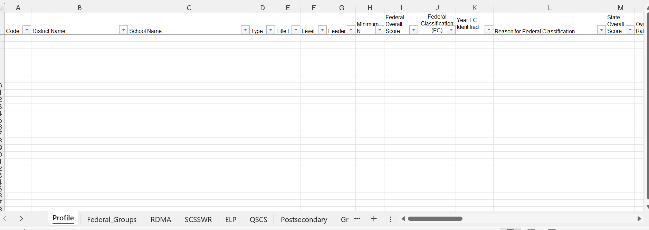
Accountability Summary Worksheets
Notes:
In the following slides, I will cover the accountability summary Excel worksheets. These spreadsheets have been updated this year to include the federal calculations and classifications.
It is important to remember that state calculations result in the color rating. The federal calculations result in the classifications.

Slide 26

Accountability Indicator Tabs – Federal Section - Change Current Status
Current Year (2026) State Status Score
Prior Year (2025) State Status Score
Prior Year (2024) State Status Score
Change Current Status
Number of Years Available
Please note: The federal section above is included in each accountability indicator tab.

Slide 27
Accountability Indicator Tabs – Federal Section - Change Prior Status
Prior Year (2025) State Status Score
Prior Year (2024) State Status Score
Prior Year (2023) State Status Score
Change Prior Status
Number of Years Available
Please note: The federal section above is included in each accountability indicator tab.

Slide 28
Accountability Indicator Tabs – Federal Section – Federal Change Score
Change Prior Status
Change Current Status
Federal
Change
Score
Please note: The federal section above is included in each accountability indicator tab.

Slide 29
Accountability Indicator Tabs – Federal Section – Federal Indicator Score
Federal Change Score
Current Status
Federal
Indicator
Score
Please note: The federal section above is included in each accountability indicator tab.
Notes:
Once you have your Federal Change Score, you’ll add column J-current year status to column P to calculate the Federal Indicator Score.
As a reminder, the change scores are constrained by the range of each indicator, meaning that the applied change is limited to the minimum and maximum values defined for that specific indicator. The applied change scores are used in the federal accountability calculation. This ensures that the scores remain valid and comparable across schools.
Then, each of the indicator scores is multiplied by its respective weight. Then, they’re all added together to create the Overall Federal Performance Score.

Slide 30
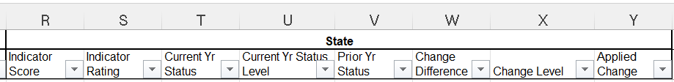
Accountability Indicator Tab – State Section
Please note: The state section above is included in each accountability indicator tab.
Notes:
As a reminder, the state change score is calculated by subtracting the Current Year Status Score from the Prior Year Status Score, equaling the Change Score. Once you have the State change score, the Current Year Status Score is added to the State Change Score, giving you the State Indicator Score.
Then, each of the indicator scores is multiplied by its respective weight. Then, they’re all added together to create the Overall State Performance Score.

Slide 31
Accountability Summary Profile Tab
Profile Tab
Federal indicators include:
    Reading & Mathematics
    Science, Social Studies & Writing
    English Learner Progress
    Quality of School Climate and Safety
    Postsecondary Readiness
    Graduation
State indicators include:
    Reading & Mathematics
    Science, Social Studies & Writing
    English Learner Progress
    Quality of School Climate and Safety
    Postsecondary Readiness
    Graduation
The Profile tab includes a high-level view of each school or district’s overall accountability score and ratings for the various indicators. This tab provides a key overview of overall performance in state ratings and federal classifications.
Notes:
On this slide, we’re looking at the Profile Tab within the Accountability Summary spreadsheet. This worksheet is an overview that pulls together the key measures you’ll need at a glance, including the Overall Accountability Score, the Overall Rating, Indicator Scores, and federal classification.
This tab really functions as a summary sheet as it is a one-stop view where you can see both state and federal accountability outcomes side by side, making it easier to interpret the data and communicate results at the district and school level

Slide 32
Accountability Summary TSI Groups Tab
Federal Groups Tab
Federal Groups Worksheet includes:
  Year Identified
  Minimum N (minimum number of students)
  Overall Score
Displays federal indicator scores for the following indicator:
  Reading & Mathematics
  Science, Social Studies & Writing
  English Learners Progress
  Quality of School Climate and Safety
  Postsecondary Readiness
  Graduation
Notes:
On this slide, we’re looking at the Federal Groups Tab in the Accountability Summary. This worksheet provides information on student demographic groups that have been identified for federal classification of TSI across each indicator.
As you’ll see, the fields capture essential details, including district and school name, school type and level, demographic group, and the year of federal classification identification. There are also columns for Minimum N, which helps determine whether the group meets the reporting threshold, and the overall federal classification assigned.
This tab highlights the federal indicator scores, including Reading and Mathematics, Science, Social Studies, Writing, English Learner Progress, School Climate and Safety, Postsecondary Readiness, and Graduation.

Slide 33
Accountability Summary
RDMA Tab
RDMA Tab
Reading and Mathematics Indicator Worksheet includes :
  Federal Classification
  Federal Minimum N
  Current and Prior Year Status Scores
  State and Federal Change Score
  State Indicator Rating
  The spreadsheet includes performance breakdown by Novice, Apprentice, Proficient and Distinguished levels. It also presents an Index value for each subject to summarize performance strength.
Notes:
On this slide, we’re looking at the RDMA Tab, which stands for Reading and Mathematics Indicator. This worksheet provides detailed accountability data at both the state and federal levels.
On the state side, it includes the Indicator Score, the rating, current and prior year status scores, and the level assigned. It also tracks the change difference whether performance improved or declined, and the applied change level.
You’ll also notice detailed breakdowns of student performance in Reading and Mathematics. These are separated into performance categories: Novice, Apprentice, Proficient, and Distinguished, along with the index values that are calculated for each.

Slide 34
Accountability Summary
SCSSWR Tab
SCSSWR Indicator Worksheet includes:
  Federal Classification
  Federal Minimum N
  Current and Prior Year Status Scores
  State and Federal Change Score
  State Indicator Rating
  Includes performance breakdown by Novice, Apprentice, Proficient and Distinguished levels
Please note: Student-level scores and performance levels will be provided for Editing and Mechanics and On-Demand Writing in the Assessed NAPD spreadsheets. There are no aggregations of Editing and Mechanics and On-Demand Writing scores for the school. The Writing component of the State Assessment Results for Science, Social Studies and Writing indicator uses the Combined Writing.
Notes:
On this slide, you will want to reference the Science, Social Studies, and Writing (SCSSWR) Tab within the accountability summary.
This tab includes key information such as the Indicator Score, Rating, Current and Prior Year Status Scores, and levels for both status and change. It also provides student performance data, or NAPD, for state assessment results in science, social studies, and writing. In addition, if applicable, it will display any federal classifications.
One important note for writing: student-level scores are provided separately for Editing and Mechanics and for On-Demand Writing. However, at the school level, those components are combined. The Writing component of the state indicator relies on the Combined Writing Performance Levels to determine scores.

Slide 35
Accountability Summary ELP Tab
ELP Tab
The ELP Indicator Worksheet includes:
  Federal Classification
  Federal Minimum N
  Current and Prior Year Status Scores
  State and Federal Change Score
  State Indicator Rating
Shows percentage of students achieving specific growth point thresholds:
  0 points
  60 points
  80 points
  100 points
  140 points
Please note: The ELP growth value tables are on the English Language Progress indicator page on the KDE website.
Notes:
The English Language Progress indicator (ELP) worksheet tab includes the Indicator Score, Rating, and both Current and Prior Year Status Scores. You’ll also find levels for status and change, along with the percentages of points drawn from the ELP growth value tables.
The data here also captures federal classifications.
It is important to note that the full ELP growth value tables are available online. You can find them on the English Language Progress indicator page on KDE’s website. That resource will give you even more detail about how the growth tables are constructed and how points are assigned.”

Slide 36
Accountability Summary
QSCS Tab
QSCS Indicator Worksheet includes:
  Federal Classification
  Federal Minimum N
  Current and Prior Year Status Scores
  State and Federal Change Score
  State Indicator Rating
  School climate and school safety constructs
Please note: The Quality of School Climate and Safety indicator uses results from the Quality of School Climate and Safety survey. The survey measures students’ perceptions of the school experience in two constructs: school climate and school safety. Results are provided for each construct.
Notes:
Here we’re looking at the Quality of School Climate and Safety (QSCS) tab within the accountability summary.
This worksheet provides the indicator score, rating, and both current- and prior-year status scores. It also includes levels for both status and change, and any federal classifications if applicable.
The QSCS indicator is based on results from the Quality of School Climate and Safety survey. This survey captures students’ perceptions of their school experiences in two key constructs: school climate and school safety.

Slide 37
Accountability Summary (2)
Accountability Summary
Postsecondary Tab
Postsecondary Tab Indicator Worksheet includes:
  Federal Classification
  Federal Minimum N
  Current and Prior Year Status Scores
  State and Federal Change Score
  State Indicator Rating
Postsecondary Tab Indicator Worksheet additionally includes:
Population – Total number of students included in the readiness measure
Academic – Number or percentage of students meeting academic readiness benchmarks
Career – Number or percentage of students meeting career readiness benchmarks
Readiness Count – Combined total of students demonstrating academic and/or career readiness
Rate Without Bonus – Readiness rate prior to any bonus calculation applied
Bonus Count – Additional count applied to students earning bonus points toward readiness
Notes:
This slide highlights the Postsecondary Tab (PR) section of the Accountability Summary.
This worksheet tab provides details about the Postsecondary Readiness Indicator. It includes the Indicator Score and Rating, along with both current and prior year status scores. You’ll also see how levels for status and change are tracked.
For questions related to career readiness, please contact kdectedataservices@education.ky.gov.

Slide 38
Accountability Summary (4)
Accountability Summary
Graduation Tab
Graduation Tab Indicator Worksheet includes:
  Federal Classification
  Federal Minimum N
  Current and Prior Year Status Scores
  State and Federal Change Score
  State Indicator Rating
Graduation Data Fields
4-Year Cohort Graduation
  Numerator
  Denominator
  Rate
5-Year Cohort Graduation
  Numerator
  Denominator
  Rate
Notes:
On this slide, we are looking at the Graduation Tab within the Accountability Summary, which covers the federal scores.

Slide 39

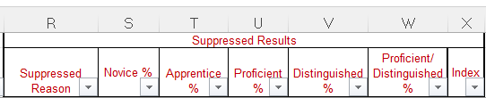
Accountability NAPD
NAPD Level
Accountable NAPD
This spreadsheet contains aggregated data for NAPD performance percentages of 100-day students, reported by demographic groups, for the district and all schools, all content areas and all assessed levels (E/M/H). This spreadsheet also provides the suppressed data.
Schools/Districts will receive suppressed accountability data that will not be publicly reported. These data are provided for internal school/district leadership review but should not be shared or discussed in public settings even past the data embargo phase. Suppressed data are indicated in red font in the spreadsheets.
Note: Suppressed Results are also included in other spreadsheets
Notes:
We will now transition to the Student Data Folder, which, like the Accountability folder, has different tabs that are important for review. The NAPD Level spreadsheet aggregates NAPD performance data for districts and schools, segmented by student demographic groups. These data will be critical for internal review, although suppressed results will not be displayed publicly.

Slide 40


Accountability QSCS Survey Aggregate
QSCS
Survey Aggregate
This spreadsheet contains aggregated data for the Quality of School Climate and Safety for 100-day students, reported by demographic groups, for the district and all schools and all assessed levels (E/M/H).
Notes:
This spreadsheet contains district- and school-level data for Quality of School Climate and Safety. It helps leadership understand how different demographic groups perceive their school environment.

Slide 41

Demographics, 4- and 5-year cohort rates
Student Data
Graduates
Graduation Student Listing
This spreadsheet includes individual student level data for the 4- and 5-year adjusted cohort graduation.
Notes:
This sheet provides individual student-level data for the 4-year and 5-year graduation cohorts. This level of detail is important for verifying the accuracy of cohort tracking and graduation rates.

Slide 42
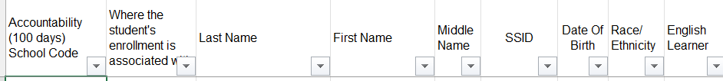
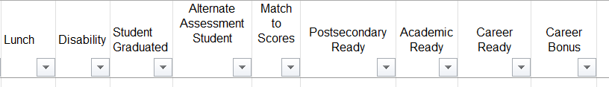
Demographics, Academic and Career Ready, Postsecondary Ready, Bonus
Student Data
PSR
Postsecondary Ready
This spreadsheet includes individual student level data for Academic and Career Readiness, including Bonus counts for earning industry certification in high-demand sectors.
Notes:
This spreadsheet lists individual student data for academic and career readiness, including bonus counts for industry certifications. These data are vital for understanding how well students are prepared for postsecondary opportunities.
For question related to career readiness, contact kdectedataservices@education.ky.gov with any questions.

Slide 43
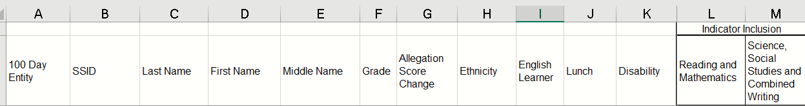
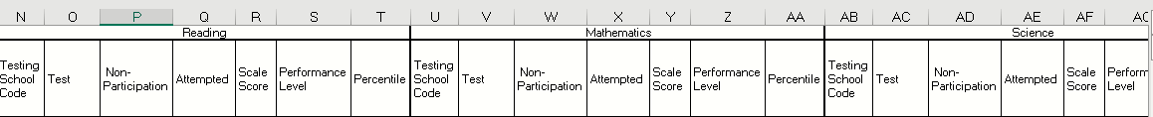
Content Assessments, Allegation Score Changes, Demographics, Indicator Inclusion
Student Data
Tests
Student Listings
Content Assessments Tab
This worksheet tab includes individual student level data for each content area test (reading, mathematics, science, social studies and writing). The data provide allegation score changes, status of students’ inclusion in each indicator, students’ scale scores, non-participation and performance levels for each assessment and percentile.
Notes:
The Content Assessments tab provides detailed student-level data for each test, such as reading, mathematics, and writing. These data help track student performance, non-participation, and percentile rankings.

Slide 44
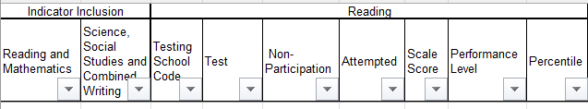
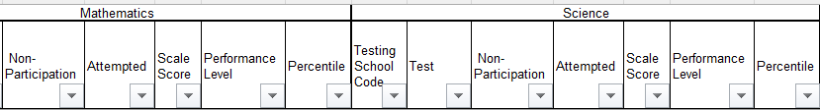
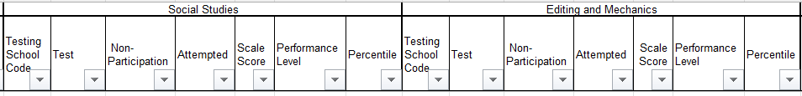
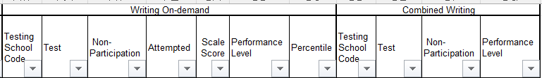
Student Data
Student Data
Tests
Student Listings
Content Assessments Tab, cont.
For content tests in Reading, Mathematics, Science, Social Studies, Editing and Mechanics and On Demand Writing, individual student data provide students’ scale scores and performance levels, non-participation status and percentile. Performance levels and nonparticipation status are also provided for Combined Writing.
Notes:
Let’s dive into the Content Assessments Tab for student data. This tab gives us a comprehensive breakdown of individual student performance across multiple subjects.
For content tests in Reading, Mathematics, Science, Social Studies, Editing and Mechanics, and On-Demand Writing, you’ll find important data points for each student. This includes:
Scale scores and performance levels, which give us insight into how each student is performing on the assessment.
Non-participation status, which shows if a student was absent or excused from taking the test.
Percentiles, which offer a comparison of a student's performance relative to their peers.
This tab also provides performance levels and non-participation status specifically for Combined Writing, giving a full picture of a student's writing abilities.

Slide 45
Content Assessments Allegation Score Changes
Student Data
Tests
Student Listings
Content Assessments Tab, cont.
Allegation Score Changes
Identifies if a score has been changed due to an allegation.
Allows DACs to quickly notice issues at schools.
Not all allegations have been processed. There is a possibility that additional score changes could impact reporting.
Notes:
This section highlights any score changes that occurred due to allegations. This is critical for ensuring that any issues are noted and addressed promptly. However, not all allegations may have been processed at this time.

Slide 46
Online QC Day
Materials and Procedures

Slide 47
Additional Resource: Accountability Calculator
The Accountability Calculator provides school and district staff with a way to calculate and estimate their performance in each indicator and overall rating. The tool prepopulates indicator and component values. District and school staff can enter various scenario values to estimate accountability results.
The accuracy of the estimation is based solely on the data input by the district.
It can be accessed with other QC Day Spreadsheet Folders.
Please note: The Accountability Calculator is not required as part of the QC Day review.
Notes:
The Accountability Calculator is an optional tool that allows districts to estimate their performance across indicators and overall ratings. This tool can help you explore various scenarios, but the accuracy depends on the data entered.

Slide 48
Begin Preparing for QC Day
Review these available resources now:
  2026 Accountability Indicator Trainings (PowerPoints)
  Understanding Kentucky’s Minimum N for School Accountability
  QC Day Nondisclosure Agreement
    DAC Nondisclosure Submission Google Form
  Print from Data Review in SDRR
    Student Listing and Change Listing
    Cohort
    Postsecondary Readiness Scores
  Access to KDE Secure Web Application
    Student Detail
Please note: Additional public release resources will be made available the week of Sept. 28.
Notes:
To prepare for QC Day, I encourage you to review all available resources, including the Accountability Indicator Training materials. Ensure all nondisclosure forms are signed and that you have access to the required data for review.

Slide 49
Tasks to Complete on QC Day
Complete the 2026 QC Checklist online. Submitting the QC Checklist indicates to KDE that you have finished your review.​
Complete the 2026 Data Discrepancy Report(s) online. This form communicates any systemic data issues or concerns to KDE (submit electronically immediately). ​
Both forms are password-protected and will be shared the morning of Sept. 23.
Notes:
On QC Day, you will need to complete two important tasks: the QC Checklist and the Data Discrepancy Report. These online forms will be password-protected. Submitting the checklist confirms that the review is complete.
The QC DAY Checklist focuses on key Quality Control steps. The QC DAY Checklist concludes by confirming that data is reasonable for public reporting or that issues have been submitted. Once you have completed the steps within the checklist, you will electronically sign and submit the form.
If you should find a systemic data issue, please complete the data discrepancy form. Student-specific issues may be addressed during the 10-day regulatory Data Review, after Public Release.

Slide 50
How to Communicate with OAA on QC Day
The key to district communication during QC Day is completing and submitting the Data Discrepancy Report.
Keep in mind staff are researching information submitted on the forms in the order in which the forms are received. It will take time, possibly a few days, to complete this process, but you will receive feedback from kdeassessment@education.ky.gov.
For general questions, contact OAA staff by email, phone or Teams.
Notes:
Effective communication with the OAA on QC Day is essential. Submit any data discrepancy reports as soon as possible so they can be processed in order. General inquiries can be directed to OAA staff via email, phone, or Teams.

Slide 51
QC Day Materials
KDE Secure Web Application
Summary files and spreadsheets (organized in folders under Student Data Detail).
Online Quality Control Checklist (online forms)
Data Discrepancy Report (online forms)
SDRR Files (can be downloaded prior to Sept. 23)
  Student Listing and Change Listing
  Cohort
  Postsecondary Readiness Scores
Notes:
For QC Day, materials will be available on the KDE Secure Web Application. This includes summary files, spreadsheets, and online forms such as the QC Checklist and Data Discrepancy Report. If you experience access issues, please contact your district WAAPOC (https://applications.education.ky.gov/sdci/Other.aspx), who may contact the KETS Service Desk if needed for support.

Slide 52
OAA Contacts for QC Day
Find your district range, then contact the assigned OAA staff member.
District range: Adair – Estill Co. & Kentucky National Guard Youth ChalleNGe Academies District support: (502) 564-2256 | OAA staff
Adair – Bellevue Ind. | Tony Igwe
Berea Ind.– Calloway | WookJoong Kim
Campbell – Corbin | Oliver Ackermann
Covington Ind. – Estill and Kentucky National Guard Youth ChalleNGe Academies | Ben Riley
District range: Fairview Ind. - Oldham District support: (502) 564-4394 | OAA staff
Fairview Ind. – Green | Christen Roseberry
Greenup – Jenkins Ind. | Devon Avery
Jessamine – Lincoln | Melissa Chandler
Livingston – Meade | Krista Mullins
Menifee – Oldham | Jessica Brumley
District range: Owen – Woodford & Fayette and Jefferson District support: (502) 564-4394 | OAA staff
Owen – Powell | Cindy VanAtter
Pulaski – Spencer | Tiffany Christopher
Taylor – Woodford | Chris Williams
Fayette and Jefferson | Helen Jones

Slide 53

QC DAY 2023

