Slide 1
Career Readiness Database
Fall 2024
Notes:
Welcome to the Career Readiness Database (CRD) training for Kentucky’s Alternate Assessment Program. The CRD houses data for both the Employability Skills Attainment Record (ESAR) and the Career Work Experience Certificate (CWEC).

Slide 2
Agenda
Overview of Career Readiness Database (CRD)
CRD Access and Login
Teacher Access and Use
Teacher Tools
Employability Skills Attainment Record (ESAR) Rating Scale Interface
The Career Work Experience Certificate (CWEC) coursework certification
District Assessment Coordinator (DAC) Access and Use
DAC Tools
Student Registration
Teacher Roster
Notes:
The agenda for today’s training is to provide an overview of the CRD to include access and login information. This training is broken down into two sections, the first for teachers where we will discuss Teacher access and use features of the teacher tools, the Employability Skills Attainment Record (ESAR) rating scale interface and the Career Work Certificate (CWEC) coursework certification. The second part will focus on District Assessment Coordinator (DAC) access and use to include the DAC tools, student registration and teacher rosters.

Slide 3
Career Readiness General Information
The CRD is the forward-facing interface that collects student data of the students participating in the Kentucky Alternate Assessment Program’s (KAAP) Post-secondary Career Readiness components.
The ESAR is a performance rating scale based on the Employability and Foundational Academic Standards – Alternate Assessment.
The CWEC certification verifies the required coursework and work-based learning opportunities.
Notes:
There are two components in the Kentucky Alternate Assessment Program’s (KAAP) Post-secondary Career Readiness: the ESAR and the CWEC.

Slide 4
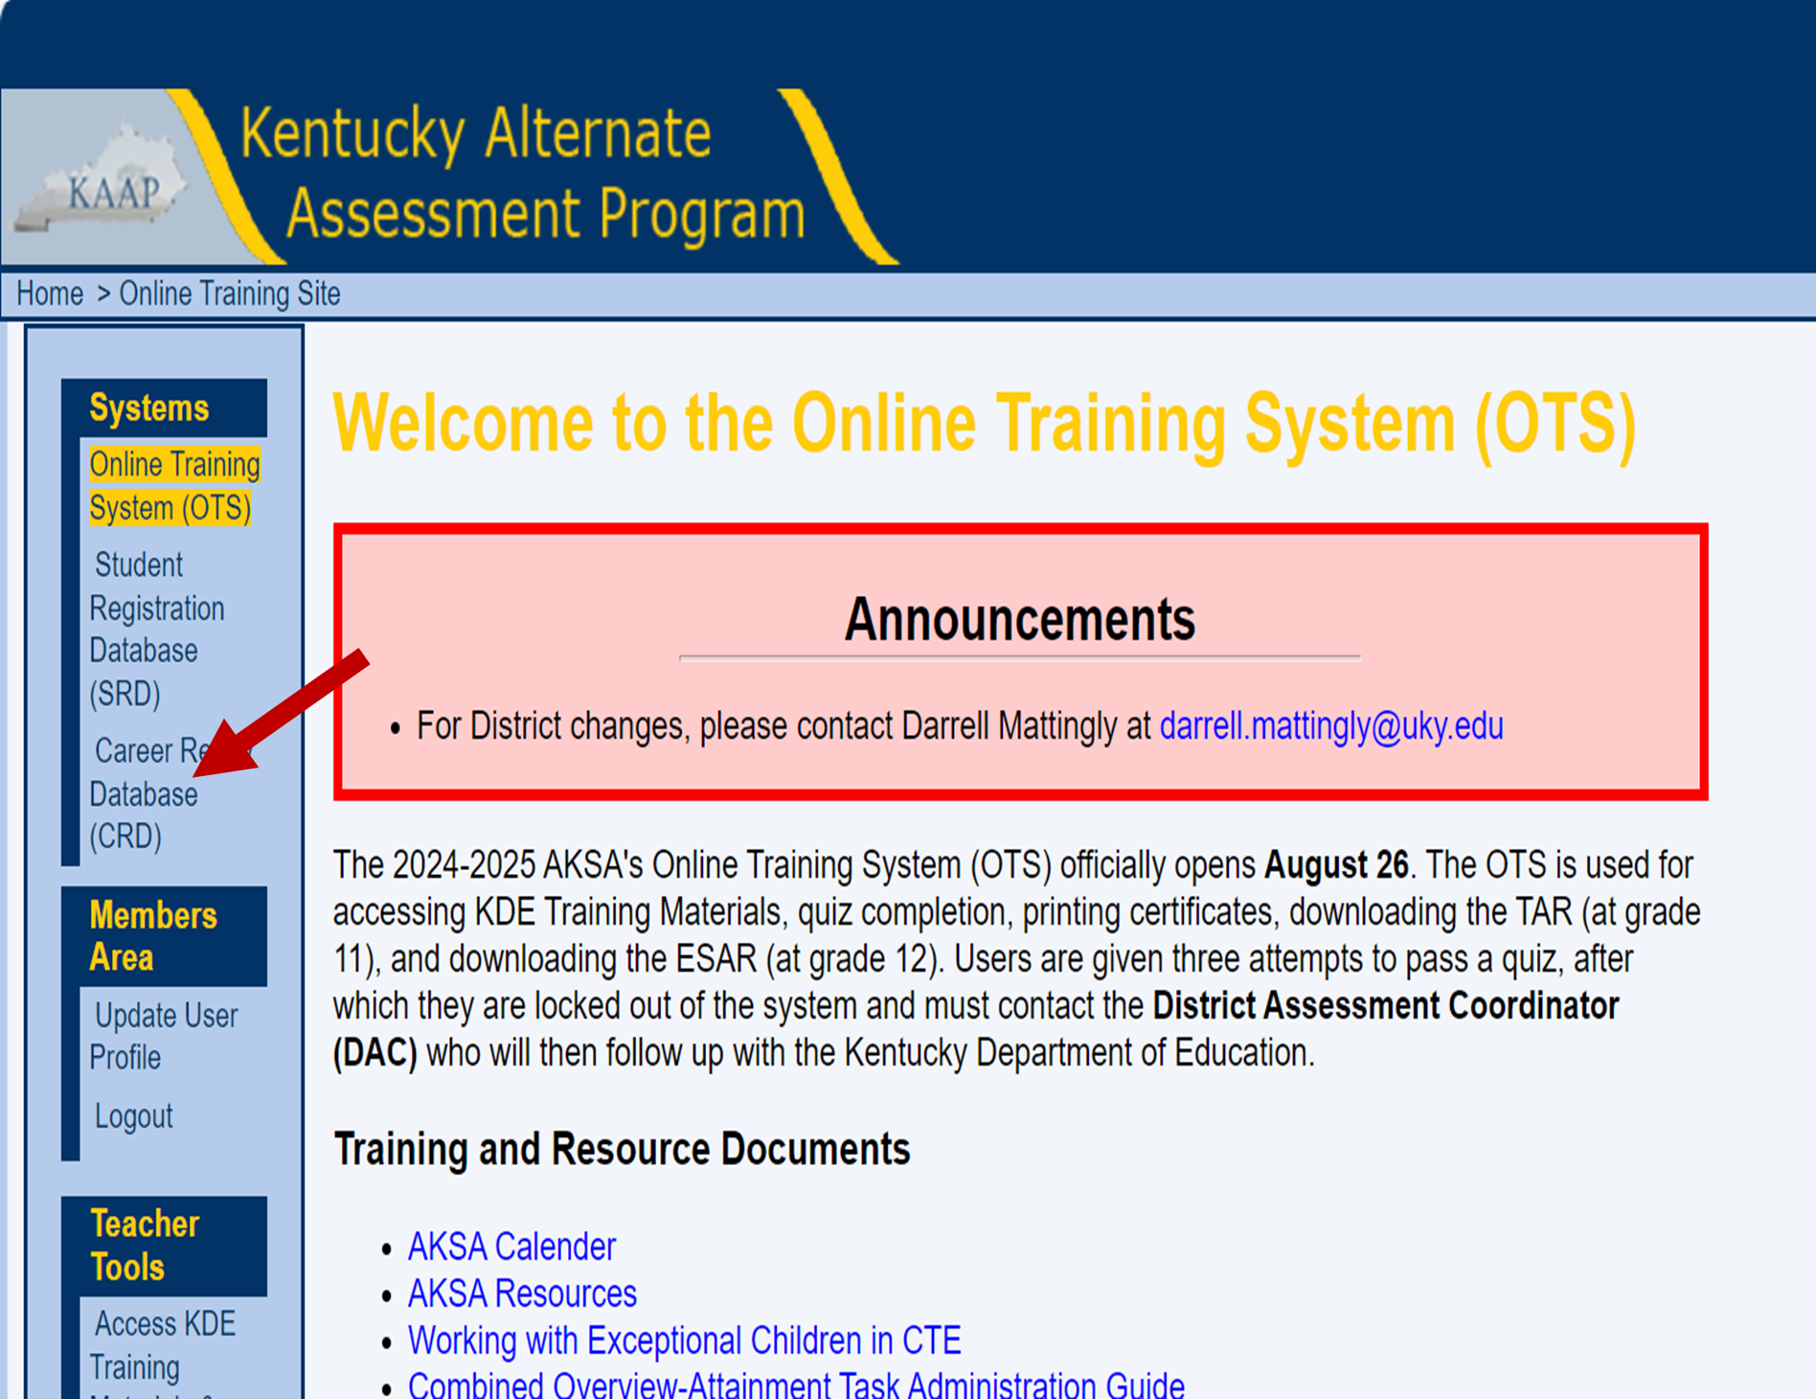
CRD Access
Users may access the CRD directly or via the KAAP Online Training System (OTS), listed under Systems
Notes:
Once users are enrolled in the OTS, and the CRD has been opened for data entry, users may click the link on this slide to access the CRD [or] Click the CRD link under systems.

Slide 5
Login Credentials
Log in credentials are synced between the Online Training System (OTS) and the CRD.
Teacher (or Qualified ESAR Administrator [QEA]) profile information will be transferred from the OTS to the CRD.
The same username and password is used to access both systems.
Notes:
The user log-in credentials are synced between the OTS and the CRD. The teacher or Qualified ESAR Administrator’s (QEA) information is transferred from the OTS to the CRD. The same username and password is used to access both systems.

Slide 6
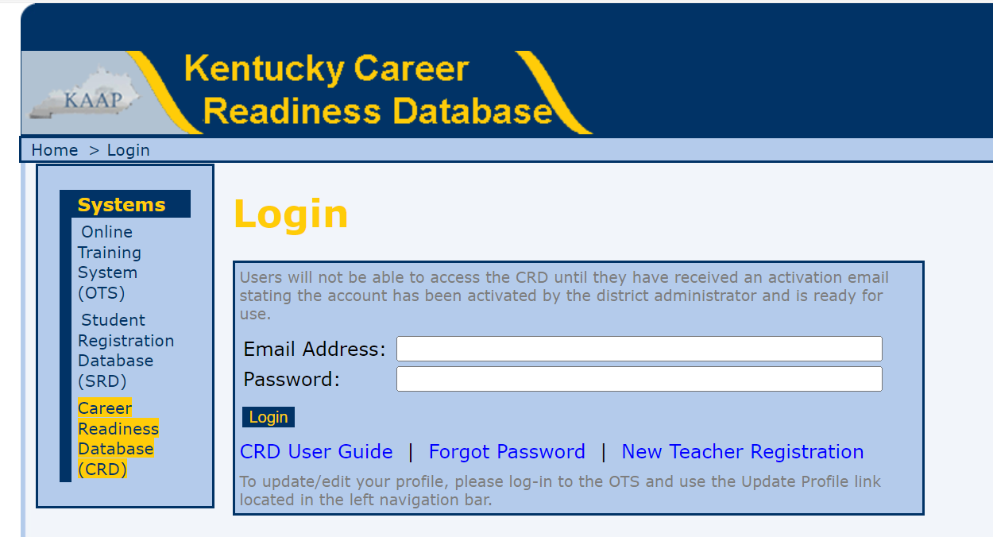
CRD Login Page
Notes:
Remember, the same username and password is used to access both the OTS and the CRD. Enter the user email and password and then click Login. Under the Login button are links to the CRD User Guide, Forgot Password and New Teacher Registration links. Users must be registered in the KAAP OTS to be granted access to the CRD. If users click on the New Teacher Registration link, it will take users to the Registration Page of the OTS. Users will complete the information on the registration page and click the Register link. This creates a user profile in the OTS, which is transfer to the CRD.

Slide 7
Teacher Use and Access
Users must be registered in the KAAP OTS to be granted access to the CRD.
Users who are having difficulty registering in the OTS should contact Darrell Mattingly at darrell.mattingly@uky.edu for access to the OTS.
Prior to gaining access to the CRD, users must successfully complete the ESAR and CWEC quizzes.
Teachers who pass the ESAR quiz are Qualified ESAR Administrators (QEA) and those who pass the CWEC quiz are Qualified CWEC Administrators (QCA).
Notes:
In order to gain access to the CRD, users must first be registered in the OTS. If users are having difficulty registering for the OTS, please contact Darrell Mattingly via email at Darrell.Mattingly@uky.edu. Before teachers will be able to log into the CRD, they must first successfully complete the ESAR and CWEC quizzes. Teachers who pass the ESAR quiz are Qualified ESAR Administrators (QEA) and those who pass the CWEC quiz are Qualified CWEC Administrators (QCA).
Before activation, the DAC or district CRD Administrator confirms that a teacher has successfully completed the ESAR and CWEC quizzes. The Student Registration Database (SRD) is the system interface for data entry of the KAAP academic components. The SRD requires that the DAC, or district administrator, certify teachers so they can enter data. If a teacher has successfully completed both the ESAR and CWEC quizzes prior to being certified in the SRD, the teacher will automatically be activated in the CRD with their SRD certification; otherwise, the DAC will need to manually activate the user in the CRD. Teachers who do not need access to the SRD will also need to be manually activated in the CRD.

Slide 8
Teacher Tools
Notes:
After logging into the CRD, users are taken to the Welcome page. Along the left side of the screen on the Welcome page, users will note navigation links labeled: Home, Student Roster, CRD User Guide and Printable ESAR. Clicking any link in the tool menu will take the user to the interface named in the link. The Welcome page is also the home page. The Logout link remains in the top-right corner of each page. If a user clicks the Logout link, a system alert asks if they want to logout. To logout, click Logout or click Cancel to cancel the request. The resources links, CWEC Administration Guide, ESAR Administration Guide and the District CWEC Checklist are links that take the user to the Kentucky Department of Education’s (KDE) website and the resources for the post-secondary career readiness components. For specific information about the CWEC and ESAR, users should activate these links.

Slide 9
Student Rosters (Teacher)
Student lists can be located by selecting the Student Roster link.
As a Teacher participating students enrolled at the teacher’s school will be available.
*Note, only teachers who are QEAs and QCAs will be permitted to access the CRD.
Notes:
Only teachers who have passed the required quizzes and are QEAs and QCAs will have access to student rosters. Student rosters are based on the students enrolled at grade 12 (or earlier when meeting criteria) at the teacher’s school.

Slide 10
Student Roster Interface
The Student roster contains the following for each student on a teacher’s roster:
CRDID - Career Readiness Database Identifier
SSID - state student identifier
First Name, Middle Name, Last Name, Grade, Gender - Student’s demographic information
ESAR - active link to access the student’s ESAR rating interface
CWEC - active link to access the student’s CWEC verification page
Notes:
On the student roster page, QEAs will have access to their student’s information. For each student, the following information is available; the student’s Career Readiness Database Identifier (CRDID), a unique identifier generated in the CRD, their state student identifier (SSID) number, their demographic information (e.g., name, grade, gender), and links to both their ESAR rating interface and their CWEC verification page.

Slide 11
CRD User Guide and Printable ESAR
The last two links under teacher tools are the:
CRD User Guide, click this link to download a PDF copy of the CRD User Guide.
Printable ESAR, click this link to download a PDF copy of the ESAR to administer the ESAR rating scale.

Slide 12
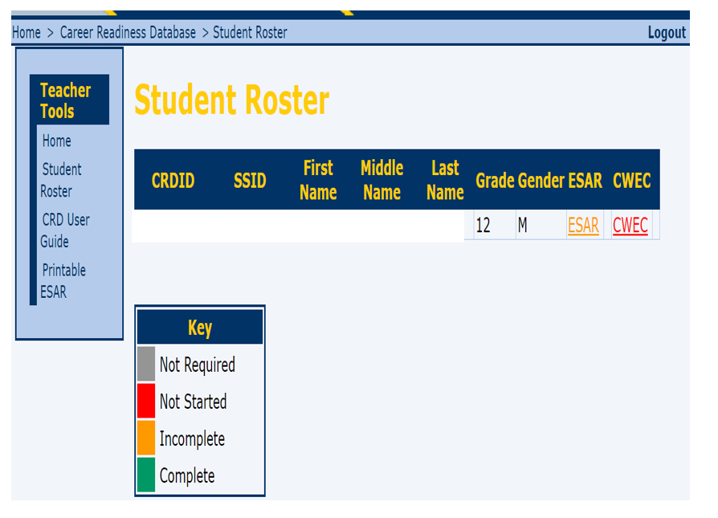
List of Students
The link to the student’s ESAR will be color-coded according to the key:
Notes:
On the student roster page, the teacher’s list of students is presented. If any students expected to be on this list are missing, teachers should contact their DAC to have the students manually added. As described above, the students’ information is listed in the student roster with both the ESAR and CWEC links at the end of the student line. You must locate the student in the list to access data entry for that specific student. The links are color coded. Grey indicates the student is not required to complete the component. Red means the component is not started, Orange means the component has been started but is incomplete and Green indicates that the component is complete.

Slide 13
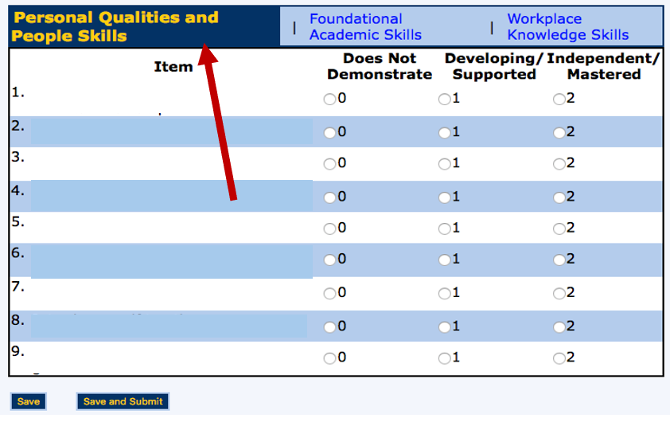
ESAR Response Entry Interface
The active page will be highlighted.
Notes:
Click on the ESAR link to access the first page of the ESAR skills which is Personal Qualities and People Skills . There are three categories in the ESAR, and each domain is listed across the top of the interface (screen). For every question, there are radio buttons for response options of 0, 1, or 2. Users may click the links save or save and submit located in the bottom left-hand corner of the page for the data entered on each each page.
NOTE: it is possible to navigate from one page (category) to another at any point in time. Using the category titles across the top of the page, users may navigate between pages. Users may complete the data process in any order they choose.

Slide 14
ESAR Save Feature
Notes:
Save will retain the data but does not finalize it in the system. Responses that users have selected on a page (i.e. Personal Qualities and People Skills) will be saved in the CRD, but not submitted. Users can navigate to the other pages using the linked category title (blue link at the top of the score entry field).
Users will receive an alert indicating that scores have been saved but not submitted. Click OK to save the data. *Note: If data has been saved, but not submitted users may continue to add data.

Slide 15
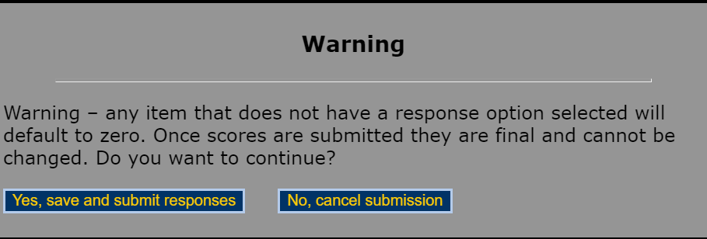
ESAR Save and Submit Feature
Notes:
Data is not submitted to KDE until it is saved and submitted. If users select save and submit : Responses entered on a page (e.g., Personal Qualities and People Skills) will be saved in the CRD permanently and submitted to KDE. Any item that does not have a selection (no response selected) will default to 0.
Users will get an alert indicating that if the save and submit button is selected, the data will be permanently entered and submitted to KDE. Click Yes, save and submit the responses to submit the data and No, cancel submission to cancel the data. Once data is submitted, the system will take the user to the next ESAR category (e.g., Functional Academic Skills) until all three categories have been saved and submitted.

Slide 16
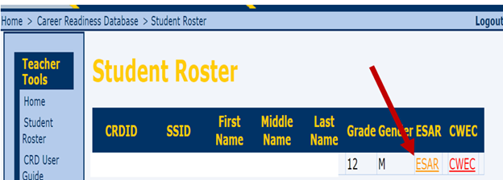
ESAR Orange and Green Link
When any data in a student record has been saved, the ESAR link will appear in orange in the student roster.
When data in a student record have been saved and submitted for one or two pages (categories), the ESAR link will appear in orange in the student roster.
Notes:
Until all three categories have been saved and submitted, the ESAR link will appear ORANGE. Once all three categories have been submitted, the link will appear GREEN.

Slide 17
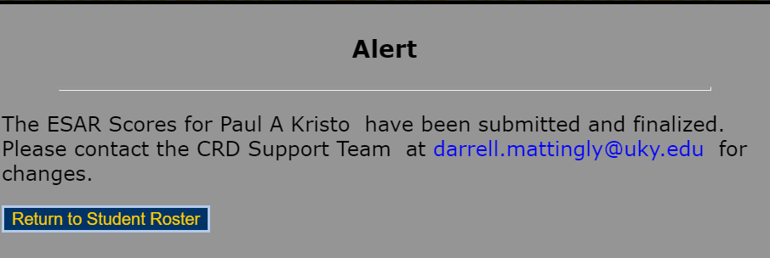
Caution:
Student records with complete response submission (green link) cannot be accessed through the student roster.
Notes:
Once a record is complete (all 30 responses have been entered) and the link is green, the record is no longer accessible via the student roster link. System alert messaging will provide support contact information. Click the return to student roster link to exit the alert.

Slide 18
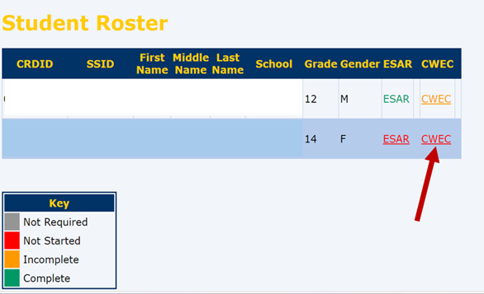
Career Work Experience Certification (CWEC)
The CWEC link is red when the student has not been certified. The user can access the certification by clicking on the red link.

Slide 19
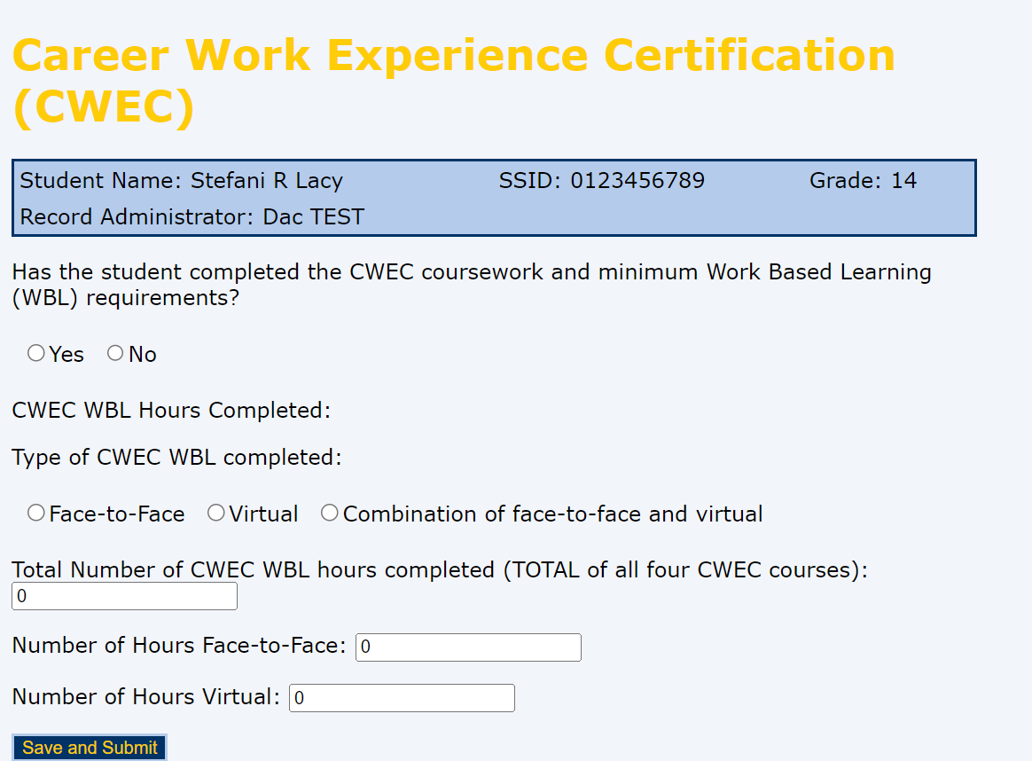
CWEC Certification Validation
Notes:
There are now five fields a user must include in the CWEC Certification Screen. First, has the student completed the CWEC and Work-based Learning (WBL) requirements? This is a yes or no question. Then, the certification requires the number of WBL Hours that have been completed and what type of hours (Face-to-Face, Virtual or a combination of both) have been completed. Then the user must identify the number of hours for each Face-to-Face and Virtual CWEC hours. To submit the data, click Save and Submit in the bottom left-hand corner of the screen.

Slide 20
CWEC Data Submission
Responses that have been saved and submitted cannot be changed.
Notes:
As with the ESAR, once the CWEC Certification is entered, saved and submitted the responses cannot be edited. Users will receive a prompt to either cancel the submission or to save and submit the responses. Select No, cancel submission to edit responses. Click Yes, save and submit the responses to permanently submit data to KDE.

Slide 21
CWEC Orange and Green Link
The CWEC link in the student list will appear orange when there are data entered and saved but not submitted.
The CWEC link in the student list will appear in green when data entered is saved and submitted.
Notes:
Again, as with the ESAR, incomplete records or records that have not been saved will have a CWEC link that appears Orange. Once the responses are entered, saved and submitted the link will appear Green.

Slide 22
DAC Use and Access
Notes:
DACs registered in the OTS will automatically have access to the CRD. DACs will have access to everything described in the teacher section and all interfaces will work in the same fashion. Along the left side of the screen on the welcome screen, DAC users will note DAC tools with navigation links labeled: Home, Student Roster, Student Registration, Teacher Roster, CRD User Guide, Printable ESAR. As with the teacher tools, clicking any link in the tool menu will take the user to the interface named in the link. The Welcome page is also the home page. The resources links, CWEC Administration Guide, ESAR Administration Guide and the District CWEC Checklist are links that take the user to the Kentucky Department of Education’s (KDE) website and the resources for the post-secondary career readiness components. For specific information about the CWEC and ESAR, users should activate these links.

Slide 23
Student Rosters (DAC)
Student lists can be located by selecting the Student Roster link.
As a DAC, participating students enrolled at all schools in the DAC’s district will be available.
Notes:
DACs will have access to teacher rosters for all schools in their districts. Student rosters are based on the students enrolled at grade 12 (or earlier when meeting criteria) at the schools in the district.

Slide 24
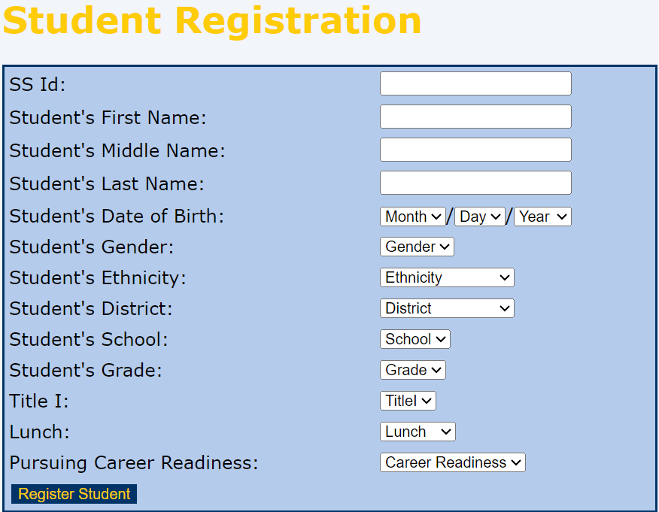
Student Registration (DAC Only)
DACs may add students to the CRD student roster, click on the Student Registration Link
Enter all relevant information
All fields must be completed
Notes:
DACs may add students to the CRD. Please ensure all fields are completed. Per the ESAR Administration Guidelines, grade 11 students may be added early to the CRD if they have completed the first two courses leading to the CWEC and are on schedule to complete the remaining two courses before graduation. In order for any student to be added to the CRD, they must be pursuing career readiness.

Slide 25
Teacher Rosters (DAC only)
Notes:
All the district’s teachers who have students participating in the post-secondary career readiness component of the KAAP, will appear in the teacher roster. If the teacher has passed the required quizzes, prior to DAC teacher certification in the Student Registration Database (SRD) for the academic components of the KAAP, then teachers will be automatically activated in the CRD. In the screenshot presented all three teachers have been activated and therefore their Activate link is greyed out, or unavailable. There is also a Delete link that the DAC can use to delete any teachers who should not be listed in the CRD. This includes teachers who have moved out of district, or retired, as well as teachers who do not have students identified as pursuing the career readiness component.

Slide 26
Division of Assessment and Accountability Support
For ESAR and CWEC Questions:
Sherri Craig, Systems Consultant, Office of Career and Technical Education
sherri.craig@education.ky.gov
For CRD Support:
Darrell Mattingly, Computer Specialist II
University of Kentucky, HDI, Darrell.Mattingly@uky.edu
OAA/DAAS (502) 564-4394 dacinfo@education.ky.gov
Notes:
If users have specific questions about the ESAR administration of CWEC verification, they should contact Sherri Craig, a systems consultant in the KDE’s Office of Career and Technical Education via email at sherri.craig@education.ky.gov. CRD system support questions should be directed to Darrell Mattingly, a computer specialist at the University of Kentucky and system administrator via email at Darrell.Mattingly@uky.edu.

