Slide 1
Session 6: Connecting Skilled Reading to Skilled Writing
Notes:
Guiding Notes:​
Welcome! Please see the Notes section of slides 2 and 3 for extensive planning and facilitation considerations:​
Slide 2: A Note to Facilitators Leading a Group​
Slide 3: A Note to Individuals Completing This Series​
Please contact ELATeam@education.ky.gov with any questions. ​

Slide 2
A Note to Facilitators Leading a Group:
For complete considerations for facilitators, see the Notes section of this slide.
These slides are part four of a six-part series.
See the Webinar Series Learning Plan on the Landing Page for a detailed view of session objectives and materials. You may wish to make this available to participants.
Print or make a digital copy of the Series Participant Guide for participants to complete the pre-work.
This series is built around the Institute for Education Science and What Works Clearinghouse 2022 Practice Guide, Providing Reading Interventions to Students in Grades 4-9, a free resource available for print. Consider making copies or providing digital access to participants to complete the pre-session readings.
Notes:
Series Overview:
This slide is purposefully hidden from participants.
The purpose of this series is to provide Kentucky 6-12 educators with declarative knowledge of how the brain learns to read, including ways to support all students in middle and high school access complex, grade-level text and skills through decoding multisyllabic words, fluency building, knowledge building, vocabulary building, comprehension and skilled writing.
The Developing Skilled Middle and High School Readers Webinar Series is intended to support classroom teachers across the state in engaging students in grade-level reading across subject areas; however, some content may be relevant for instructional leaders wishing to build their own knowledge of adolescent learners and their literacy needs. The sessions are designed to provide flexibility for districts and schools and, as such, can be viewed as stand-alone lessons or within the progression of the series as provided. You are supported in engaging with this series individually, if desired.
This entire series is six sessions and will take approximately 9 total hours to complete. We recommend accessing one session monthly; however, adaptations may be made to accommodate for more or less time. Each individual session is 1.5 hours.
Materials Needed:
The session slides with Guiding Notes
The Series Participant Guide
Access to the participants’ high-quality instructional resource (HQIR)
A Note about HQIRs:
The Reading and Writing HQIR Consumer Guide points districts to the markers of high-quality literacy instruction for Kentucky. Note that HQIRs are grounded in research and written by experts. While these resources do engage students in strategies that support reading, many students may need more targeted supports in Tier 1 instruction. As such, it is recommended that facilitators continually ground discussions in the texts, tasks and protocols provided in the district-adopted HQIR and prompt participants to make connections between this learning and their upcoming lessons or units.
Guiding Notes:
Guiding notes are provided in the Notes section of the PowerPoint to support your learning. The Notes section includes additional information and directions for the activities on the slide. It is critical that you read the material presented in the Notes section to ensure that you are acquiring the important knowledge, skills and understanding required when engaging with this series.
Virtual Training Note:
If you plan to engage with this series virtually as a group, consider directing participants to the Developing Skilled Middle and High School Readers landing page:
Intended Audiences:
Participants
Series participants may include, but are not limited to, district leadership, school administrators, instructional specialists/coaches, intervention specialists, department chairs, special educators and classroom teachers.
Facilitators
While this series is designed for a teacher to engage with it individually, it may be implemented with a group of educators led by a facilitator. If this series is being completed as a group, facilitators may include, but are not limited to, cooperative staff, district leaders, school administrators, instructional specialists/coaches, intervention specialists, department chairs, special educators, and classroom teachers. Facilitators may need to revise specific tasks in order to meet the needs of the participants or to be respectful of the time planned within the work session.
Helpful Hint for Facilitators:
The learning that will take place in this series may cause Kentucky educators to face changes in instructional practices amidst this transition. It is important to realize that while you are the facilitator of these work sessions, you may not have all the answers to the questions asked by participants, which is part of the learning process for all educators at all levels. Throughout the series, participants may have questions that will be addressed in future work sessions. When that happens, reflect on this quote from Graham Fletcher, “Every teachable moment doesn’t need to be a teachable moment in that moment.” Use these moments to encourage participants to attend future work sessions where those questions will be addressed. If participants ask questions you are not prepared to answer, offer to follow up on that during the next work session. Please contact ELATeam@education.ky.gov if you have questions or comments.
Planning Ahead for Facilitators:
Determine which stakeholders to invite as participants. In the invitation, describe how the work sessions will benefit them.
A few days before the meeting, you may want to remind participants to be prepared to have their Participant Guide available during the meeting. You may also choose to print these for participants.
Reserve adequate space and equipment. Tables or desks should be set up to support small-group discussion. If conducting this series virtually, ensure that your technology platform can support break out rooms to support small group collaboration.
Ensure that participants have access to the Internet.
Preparation
Participant Documents Needed:
Participant Guide
Access to upcoming lessons or units within their district-adopted curriculum supported by an HQIR
Supplies Needed:
These slides
Technology with projection and sound capability if in person. Technology platform where presenters have sharing ability and breakout room options if virtual.
Participant Guides printed or available virtually
Parking Lot for questions - If completing as a group, you may consider providing a poster on which participants can write or post questions, or you may prefer to have a digital parking lot where participants can access a Google document, for example, to post questions and that you can modify as the participants work through the sections of the series
Self-Sticking Notes (optional)
Poster paper (optional)
Highlighters and/or colored pens/markers (optional)
Building a Community:
Building a community is important for any group that will work together, especially if participants have not worked together before. The concept is the same as building a safe, respectful, productive classroom climate. Incorporating community-building into each session builds trust, shows participants that they are valuable as individuals and engages them in the learning process. It is also useful for creating a professional learning network where participants can be supported in their work. Community-building can be as simple as allowing participants to introduce themselves and their role in the school/district, developing or refining group norms, allowing for questions, and/or the sharing of answers to reflection questions or individual discovery task items that are included in this series. Again, time allotted for community-building will allow participants to have a voice and be engaged as active contributors and learners in the sessions.
Virtual Training Options: Be sure to conduct continual check-ins throughout the presentation. Build Google documents to continue to collect feedback, such as questions, hopes, and/or concerns to which participants may continually add.

Slide 3
A Note to Individuals Completing this Series:
For complete considerations for complete this series individually, see the Notes section of this slide.
Print or make a digital copy of the Participant Guide to capture your thinking.
These slides are part four of a six-part series.
See the Webinar Series Learning Plan on the Landing Page for a detailed view of session objectives and materials. You may wish to make this available to participants.
This series is built around the Institute for Education Science and What Works Clearinghouse 2022 Practice Guide, Providing Reading Interventions to Students in Grades 4-9, a free resource available for print. Consider making copies or providing digital access to participants to complete the pre-session readings.
Notes:
Series Overview:
This slide is purposefully hidden from participants.
The purpose of this series is to provide Kentucky 6-12 educators with declarative knowledge of how the brain learns to read, including ways to support all students in middle and high school access complex, grade-level text and skills through decoding multisyllabic words, fluency building, knowledge building, vocabulary building, comprehension and skilled writing.
The Developing Skilled Middle and High School Readers Webinar Series is intended to support classroom teachers across the state in engaging students in grade-level reading across subject areas; however, some content may be relevant for instructional leaders wishing to build their own knowledge of adolescent learners and their literacy needs. The sessions are designed to provide flexibility for districts and schools and, as such, can be viewed as stand-alone lessons or within the progression of the series as provided. You are supported in engaging with this series individually, if desired.
This entire series is six sessions and will take approximately 9 total hours to complete. We recommend accessing one session monthly; however, adaptations may be made to accommodate for more or less time. Each individual session is 1.5 hours.
Materials Needed:
The session slides with Guiding Notes
The Series Participant Guide
Access to the participants’ high-quality instructional resource (HQIR)
A Note about HQIRs:
The Reading and Writing HQIR Consumer Guide points districts to the markers of high-quality literacy instruction for Kentucky. Note that HQIRs are grounded in research and written by experts. While these resources do engage students in strategies that support reading, many students may need more targeted supports in Tier 1 instruction. As such, it is recommended that facilitators continually ground discussions in the texts, tasks and protocols provided in the district-adopted HQIR and prompt participants to make connections between this learning and their upcoming lessons or units.
Guiding Notes:
Guiding notes are provided in the Notes section of the PowerPoint to support your learning. The Notes section includes additional information and directions for the activities on the slide. It is critical that you read the material presented in the Notes section to ensure that you are acquiring the important knowledge, skills and understanding required when engaging with this series.
Intended Audiences:
Participants
Series participants may include, but are not limited to, district leadership, school administrators, instructional specialists/coaches, intervention specialists, department chairs, special educators and classroom teachers.
Facilitators
While this series is designed for a teacher to engage with it individually, it may be implemented with a group of educators led by a facilitator. If this series is being completed as a group, facilitators may include, but are not limited to, cooperative staff, district leaders, school administrators, instructional specialists/coaches, intervention specialists, department chairs, special educators, and classroom teachers. Facilitators may need to revise specific tasks in order to meet the needs of the participants or to be respectful of the time planned within the work session.
Helpful Hint for Completing this Series Individually:
Throughout the series, you may have questions that you would like to discuss with colleagues or leadership at your school. When that happens, make a note to share or discuss this resource with others. The creators of this series are also available should you have questions or want to discuss the content of the videos. Please contact ELATeam@education.ky.gov if you have questions or comments.
Preparation
Participant Documents Needed:
Participant Guide
Access to upcoming lessons or units within your district-adopted curriculum supported by an HQIR

Slide 4
Series Overview
Session 1 | Session 2 | Session 3 | Session 4 | Session 5 | Session 6
How Do We Learn to Read? Exploring Theoretical Frameworks for Reading Development | Decoding Multisyllabic Words within Complex, Grade-Level Texts | Fluency Building within Complex, Grade-Level Texts | Vocabulary and Knowledge Building Essentials | Comprehension as Both Process and Product | Connecting Skilled Reading to Skilled Writing
Notes:
Guiding Notes:
This slide provides an overview of this series. It is recommended to complete one session per month to allow time for implementation of practices between sessions.

Slide 5
Series Goals:
Learn what research says about supporting skilled adolescent reading of complex, grade-level texts.
2. Improve Tier 1, universal reading and writing instruction with strategies that support skilled reading for all students.
Notes:
Guiding Notes:​
This series may address the needs of educators in a variety of roles in districts. The primary goal is to support middle and high school readers with complex, grade-level texts in tier 1, universal instruction. While some secondary students may need intervention to build foundational skills, this series intends to strengthen Tier 1 instruction using evidence-based practices.

Slide 6
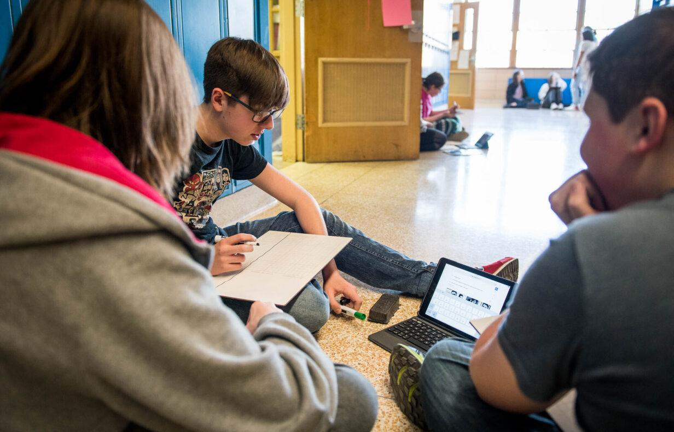
With small and intentional shifts, we can make a real difference for the students in our classes right now who need supports as readers.
Notes:
Guiding Notes:
This series represents the start of larger systemic shifts to support adolescent reading improvement within districts.

Slide 7
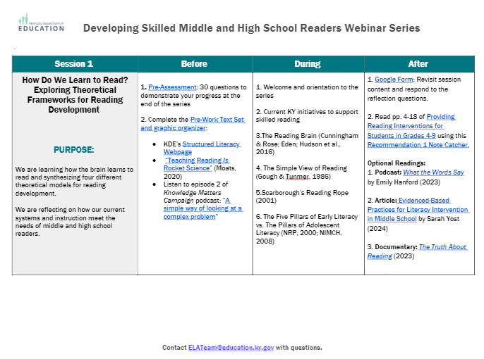
Sessions at a Glance
This document is a tool to know what to do before, during and after a learning session and is available on the Landing Page.
Notes:
Guiding Notes:​
Use this Learning Plan to monitor learning throughout the series.

Slide 8
Connecting Skilled Reading to Skilled Writing
Notes:
Guiding Notes:
Remind participants that this is the sixth session in the series. This session will conclude the study of the IES Practice Guide Providing Reading Interventions for Students in Grades 4-9 and incorporates research about connecting skilled reading to skilled writing.
https://ies.ed.gov/ncee/wwc/Docs/PracticeGuide/WWC-practice-guide-reading-intervention-full-text.pdf

Slide 9
Session Learning Objectives:
Participants will learn strategies for reading and teaching complex, grade level text (i.e., “stretch” texts) with developing readers.
2. Participants will learn evidence-based practices to connect reading and writing.
Notes:
Guiding Notes:
This session provides participants with an understanding of the importance of giving students access to complex, grade level text. Next, the session will model evidence-based instructional practices to connect skilled reading to skilled writing.

Slide 10
Learning Agreements
Assume best intentions of facilitators and participants.
Look for opportunities to learn and grow.
Ask questions on the sign out form. We will respond.
When in breakout rooms, allow a chance for everyone to participate.
Center students in the conversation.
Preference learning over performing.
Feel free to attend even if you haven’t completed the pre-work.
Process your learning with colleagues.
Notes:
Guiding Notes:
For groups working through this series together, these are recommended learning agreements for collaboration. These may be modified to suit local needs and expectations.

Slide 11
Materials Needed for This Learning:
Access to materials on Landing Page
Scrap paper or sticky notes
Print or ensure digital access to our text, Providing Reading Interventions for Students in Grades 4-9
Notes:
Guiding Notes:
The text for this series is available free online and can be printed for individuals to access and study for each session.

Slide 12
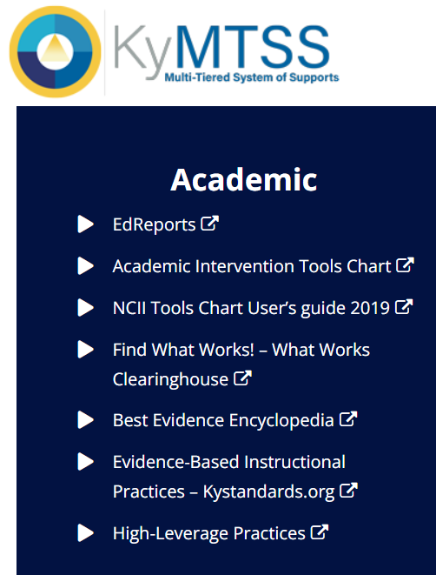
This slide details the topics from the IES Guide we will be using to study during this series.
Released March 2022
Build decoding skills so students can read complex multisyllabic words.
Provide purposeful fluency building activities.
Routinely use comprehension-building activities:
Build word and world knowledge (morphology & vocabulary);
Create opportunities to ask & answer questions about the text;
Teach a routine for summarizing;
Teach how to monitor comprehension as they read.
Practice with more challenging “stretch texts” to introduce more complex information.
Notes:
Guiding Notes:​
This slide outlines the recommendations provided in the IES Practice Guide. This series will address each of these recommendations.

Slide 13
Major Takeaways from this Series
Notes:
Guiding Notes:
This section provides highlights from major takeaways from the last five sessions of this series.

Slide 14
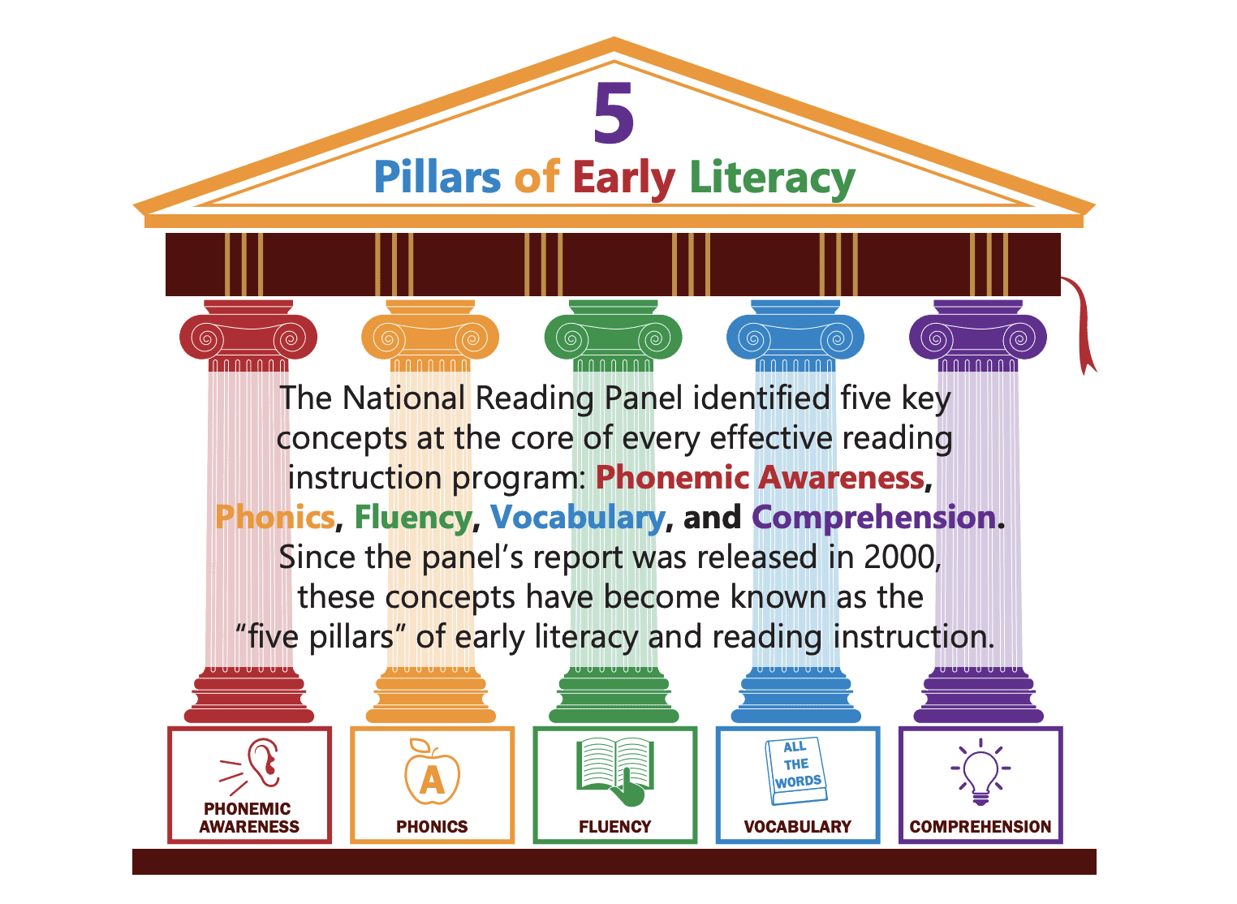
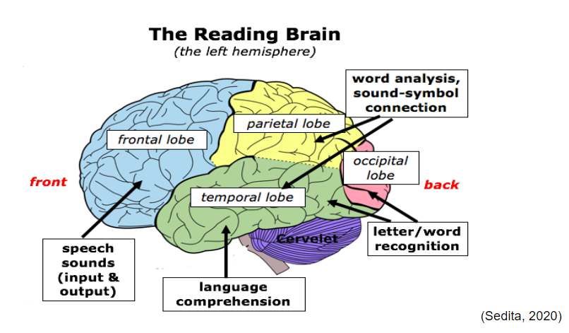
Major Takeaways from This Series:
Session 1:
Theoretical models such as the Five Pillars of Early Reading, the Simple View of Reading, Scarborough’s Reading Rope and the Reading Brain explain the skills necessary to become a skilled reader.
Notes:
Guiding Notes:
Participants may recall these theoretical models from Session 1. The facilitator may choose to ask participants to share what they recall from each of these models.
The Five Pillars of Early Literacy (National Reading Panel, 2000): The five pillars of early literacy are phonemic awareness, phonics, fluency, vocabulary and comprehension. These concepts are core to reading instruction in the early grades.
The Simple View of Reading (Gough & Tunmer, 1986): This model is represented by an equation that states that reading comprehension can be predicted by a student’s ability to recognize (or decode) words times (X) a student’s ability to understand language. While reading itself is far from simple, this model indicates that students must have skills in both areas in order to comprehend text.
Scarborough’s Reading Rope (Scarborough, 2001): The Reading Rope demonstrates that there are many components of skilled reading. Word recognition consists of phonological awareness, decoding (and spelling) and sight recognition of words. These skills become more accurate and automatic as students become more skilled readers. Language comprehension consists of background knowledge, vocabulary knowledge, language structures, verbal reasoning and literacy knowledge. These components of the rope may vary based on student, text or task, and teachers can support students in becoming increasingly strategic with these skills.
The Reading Brain (graphic provided courtesy of Sedita, 2020): This graphic emphasizes that reading is not a visual skill as many researchers once believed, but it is a cognitive skill that engages many areas of the brain. Participants may recall that, in typical development, children first begin learning phonology, or the speech sounds of English. Explicit, systematic, sequential instruction in the early grades helps students orthographically map words. Orthographic mapping is the mental process used to store words for immediate and effortless retrieval. Students also make sense of language based on context and their knowledge of the world and words. The Reading Brain serves to remind educators that students need strong reading instruction that accounts for multiple regions of the brain.

Slide 15
What is essential for grades 6-12 reading?
Advanced Decoding
Morphology
Fluency
Vocabulary
Comprehension
Composition
Motivation
Session 1:
While these models explain the skills for learning to read, the NIL (2006) established Principles of Adolescent Literacy.
Notes:
Guiding Notes:
Participants may recall that the National Reading Panel Report (2000) indicated that the 5 Pillars of Early Literacy are phonemic awareness, phonics, fluency, vocabulary and comprehension. While these are essential for students first learning to read, adolescent students require different instruction in ALL content area instruction to become skilled readers across their lifespans. The National Institute for Literacy Report (2006) cites the following as essential for students reading across all disciplines: advanced decoding (of multisyllabic words), morphology, fluency, vocabulary, comprehension, composition and motivation. The report indicates that these components can support reading instruction in Tier 1 instruction across all content areas.

Slide 16
Major Takeaways from Session 2:
Decoding Multisyllabic Words within Complex, Grade-level Texts
Read a list of high-frequency prefixes and suffixes aloud as a group. Ask students to underline prefixes and suffixes in each word in a word list, and then read the prefixes and suffixes aloud as a group. Ask students to write words by adding a prefix and/or a suffix to a base word. Read sentences containing multisyllabic words aloud as a group or with a teacher reading first and then the students reading next. Ask students to read the passage containing the words they are learning at least twice. Providing Reading Interventions for Students in Grades 4-9, page 11
Session 2:
All readers use knowledge of phonics and morphology to decode and make meaning from unknown words.
Notes:
Guiding Notes:
Participants may recall from Session 2 that readers use knowledge of phonics and morphology to decode and make meaning from unknown words. This session provided participants with recommendations for supporting students with making sense of multisyllabic words using grade-appropriate morphology.

Slide 17
Major Takeaways from Session 3:
Building Fluency with Complex, Grade-level Texts
Building purpose for Rereadings Students should always have a clear purpose/outcome. “Say Something” Choral Reading Considerations for Silent Reading Pair silent with oral reading. Provide structure and accountability for comprehension with text dependent questions. Build stamina. Utilize portions of grade-level, complex texts being used in class. Providing Reading Interventions for Students in Grades 4-9, pages 12-17
Session 3:
Fluency is the bridge between decoding and comprehension!
Notes:
Guiding Notes:
Participants may recall that session 3 was about how fluency is the bridge between decoding and comprehension. The session covers recommendations for supporting students with becoming more fluent readers with purposeful, choral or paired partner readings.

Slide 18
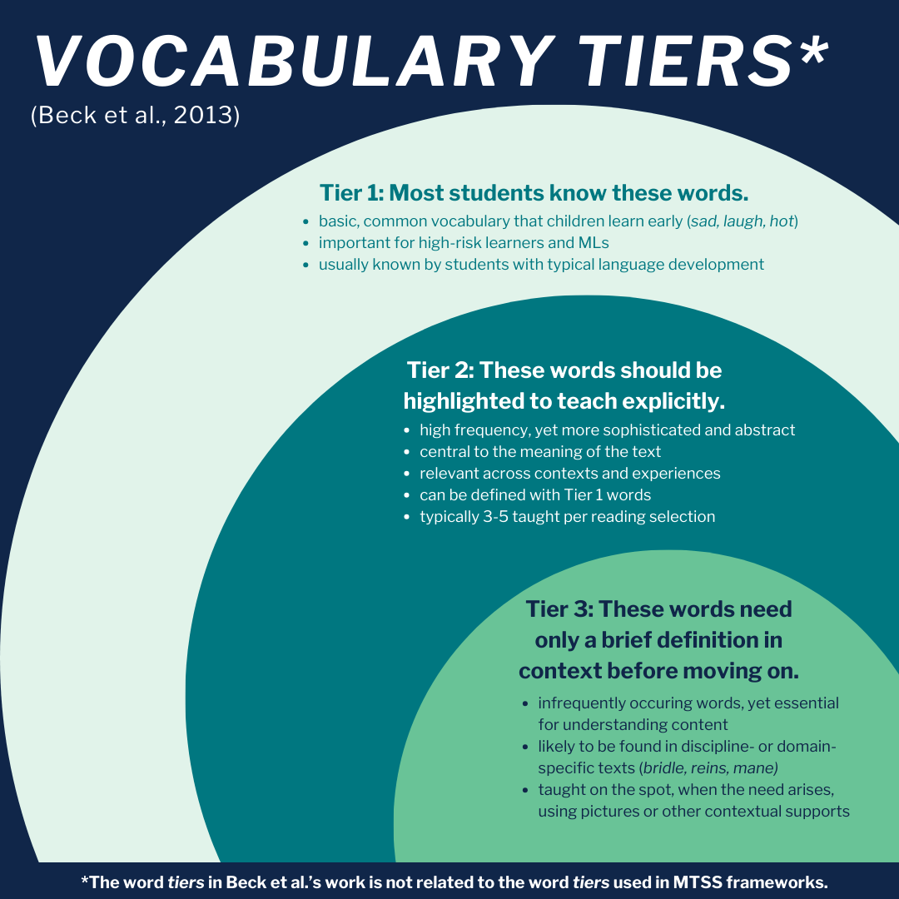
Major Takeaways from Session 4:
Session 4:
Explicit vocabulary instruction supports comprehension of the texts read in class.
Notes:
Guiding Notes:
Session 4 covers the steps for explicit vocabulary instruction. The Vocabulary Tiers image comes from Isabel Beck and Margaret McKeown’s work on selecting words to teach. Participants may recall that Tier 1 words are words that many students already know, and Tier 3 words are so domain-specific or infrequently occurring that they only need a brief definition before moving on. Tier 2 words are intentionally selected to teach explicitly because they are high frequency and are conceptually central to understanding the text studied.

Slide 19
Our last session: Comprehension as Both Process and Product!
Strategy | # of Studies Cited to Support
Comprehension monitoring | 22
Graphic organizers | 11
Question answering | 17
Question generating | 27
Summarization | 18
Cooperative learning | 10
Text structure | 17
Multiple-strategy instruction | 38
Sample Internal Processes | Sample External Products
connecting concepts with prior knowledge | unit exam
predicting or anticipating while reading | arranging sentences in a logical order
deciding to re-read when something doesn’t make sense | answering comprehension questions
inferring what is meant by a multiple-meaning word | making an outline
generating mental pictures while reading | writing a literary or rhetorical analysis
Discussion: What’s something from our last session (or any session from this series) that is impacting your instruction?
Notes:
Guiding Notes:
Session 5 discusses the importance of background knowledge AND comprehension strategies. Despite the overwhelming evidence for the importance of background knowledge and vocabulary to support comprehension, multiple studies from the National Reading Panel Report (2000) still support some comprehension strategy instruction for fluent decoders.
We also discussed the importance of not only treating comprehension as a product of skilled reading but also as a process.
Note that this chart highlights the differences between various internal processes that are just as essential to student reading as the
products we tend to emphasize in education.
Finally, we also discussed syntactic analysis and various ways to use language instruction to support comprehension of complex texts.

Slide 20
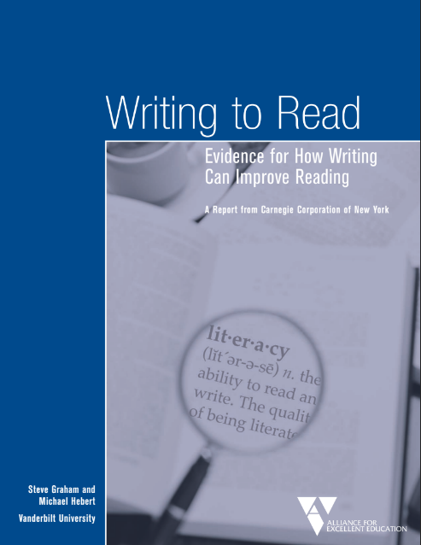
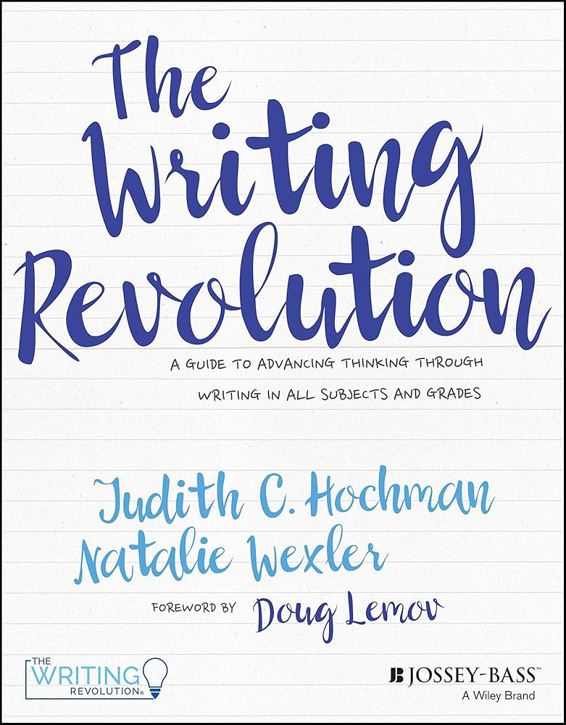
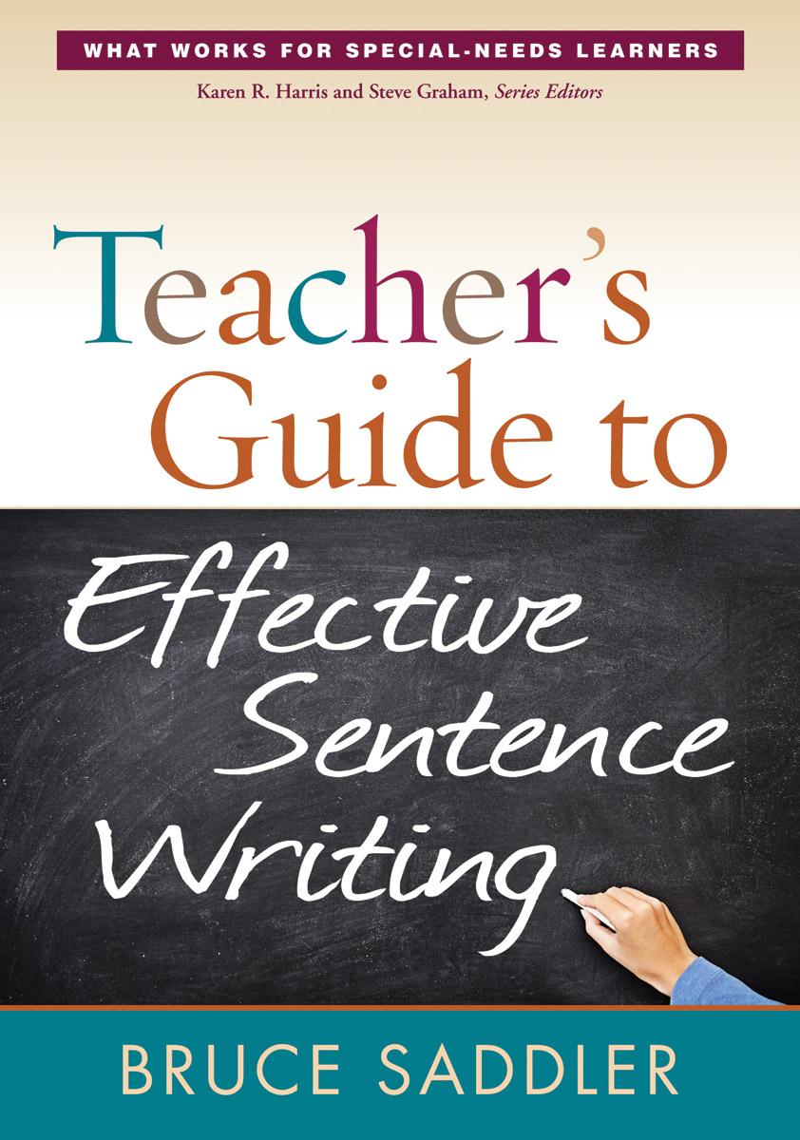
This Session Draws From:
IES Guide: “Teaching Secondary Students to Write Effectively”
Writing to Read Report:
“Evidence for How Writing Can Improve Reading”
The Writing Revolution
(The Hochman Method)
Sentence Combining
(Bruce Saddler)
Notes:
Guiding Notes:
The linked texts on this slide represent evidence-based, reputable sources for addressing writing instruction across a variety of contexts.

Slide 21
What does the IES Guide say about “stretch” texts?
Notes:
Guiding Notes:
This section discusses Recommendation 4 of the IES Guide: Practice with more challenging “stretch texts” to introduce more complex information.

Slide 22
Why purposefully use challenging texts?
“Stretch texts can provide students with exposure to sophisticated vocabulary, more intricate sentence structures and complex ideas. Exposure to these higher-level vocabulary words, sentences, and ideas can help students develop confidence, deeper knowledge, and richer perspectives on the texts they read in the future.”
p. 68
Notes:
Guiding Notes:
While it may seem counterintuitive to some to give striving readers challenging texts, the IES Guide affirms that students who have supported exposure to grade-level texts develop confidence, deeper knowledge, and richer perspectives on the texts they read in the future.

Slide 23
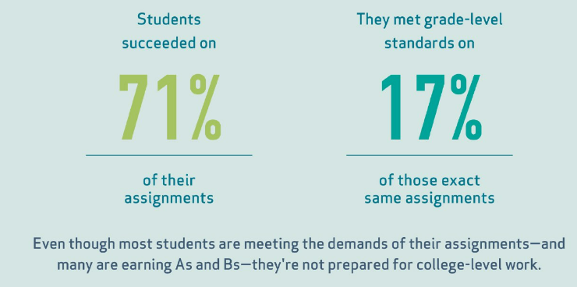
17%
of assignments in The Opportunity Myth study required grade-level work.
Most students performed well on their assignments, yet very few of those assignments met the depth and rigor required for their grade level.
SOURCE: The Opportunity Myth, 2018
Notes:
Guiding Notes:
The New Teacher Project (TNTP) conducted a large study that examined tens of thousands of assignments from around the United States. This study, known as The Opportunity Myth, shed light on a difficult reality of American schools: Students succeeded on 71% of their assignments. However, of those assignments, only 17% required students to do grade-level work. Even though most students are meeting the demands of their assignments--and many are earning As and Bs--they're not prepared for college-level work.

Slide 24
How might we support students when reading stretch texts?
Prepare for the lesson by carefully selecting* appropriate stretch texts, choosing points to stop for discussion and clarification, and identifying Tier 2 words to teach.
* Note: If your district has adopted an HQIR, make sure you are implementing the resources and texts in alignment with the resource as intended and/or in consultation with your district.
Notes:
Guiding Notes:
Because students do deserve opportunities to have access to grade-level work and expectations, the IES Guide provides clear recommendations to support teachers and students with this moral imperative. Note that this particular recommendation mentions teachers selecting texts, which may vary within each district. Note that if a district has adopted an HQIR, it is recommended to implement the resource as intended and/or in consultation with the district.

Slide 25
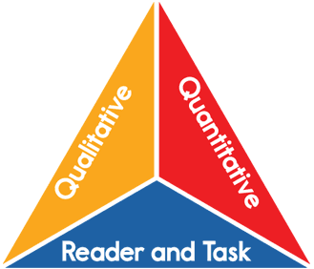
What makes text complex?
Quantitative: sentence and word length (i.e., Lexile)
Qualitative: text structure, language features, meaning, knowledge demands
Reader and Task: attention, memory, critical thinking, comprehension, interest and motivation, topic, vocabulary, genre, language, developmental appropriateness, complexity of questions and assignments
Image source: Student Achievement Partners
Notes:
Guiding Notes:
Many factors contribute to a text’s complexity. There is often a temptation to reduce text complexity to quantitative complexity alone, meaning only looking at measures such as Lexile, which only measure sentence or word length. In reality, qualitative factors such as text structure, language features, meaning and knowledge demands also contribute to the complexity of a text. Finally, when determining the complexity of a text, educators may also consider factors related to the reader and/or text such as attention, memory, critical thinking, comprehension, interest and motivation, topic, vocabulary, genre, language, developmental appropriateness, complexity of questions and assignments.

Slide 26
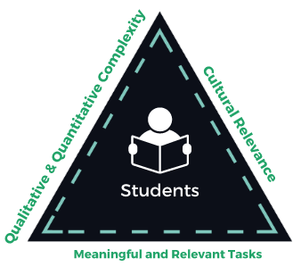
What makes text complex? (Updated 2022)
Places Students (the reader) at the center
Adds Cultural Relevance as one of the components of complexity
Further qualifies Tasks as Meaningful and Relevant
Includes dashed lines to indicate that reading complex texts is a dynamic, moving process
Image source: Student Achievement Partners
Notes:
Guiding Notes:
Though the triangle on the previous slide has long represented the components of text complexity, in 2022, Student Achievement Partners updated their graphic to more accurately represent a dynamic process that places students at the center, includes cultural relevance and requires meaningful and relevant reading tasks.
Student Achievement Partners Text Complexity Toolkit

Slide 27
Text Complexity Resources to Consider:
Text Complexity Module
Interactive professional learning module, “Quantitative and Qualitative Analysis,” helps teachers analyze text complexity.
Notes:
Guiding Notes:
This slide includes a resource that may support participants who may wish to learn more about text complexity. KyStandards.org includes a short module called “Quantitative and Qualitative Analysis.” This module includes direct instruction as well as application/practice to support understanding of what makes text complex as well as considerations for supporting students with complex text.

Slide 28
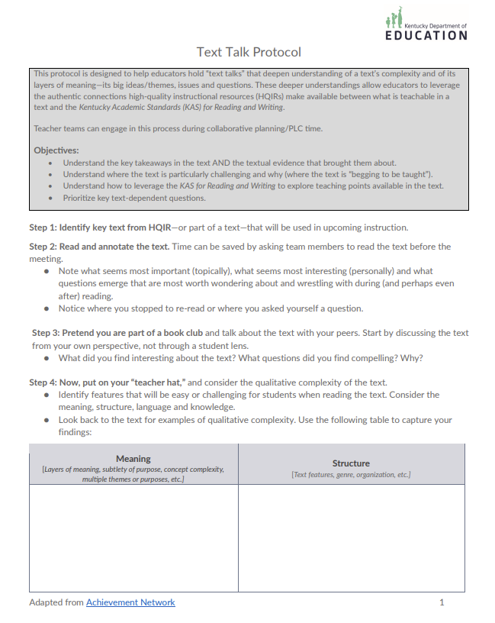
Text Complexity
Resources to Consider:
Text Talk Protocol
Designed to help educators hold “text talks” with each other that deepen understanding of a text’s complexity and of its layers of meaning—its big ideas/themes, issues and questions all before reading the text with students.
Notes:
Guiding Notes:
This slide includes a resource that may support participants who may wish to work individually or with their PLC to closely read and analyze a text’s complexity. This Text Talk Protocol is designed to facilitate a “text talk” that peels back multiple layers of meaning within an instructional text.

Slide 29
Limitations of Quantitative Measurement
There Will Come Soft Rains
by Ray Bradbury
720L (grades 4-5)
EL Education Grade 7
910L (grades 6-7)
myPerspectives Grade 9
880L (grades 5-6)
StudySync Grade 11
Discuss: Why is qualitative complexity an important consideration when working with striving readers?
Notes:
Guiding Notes:
There are limitations to using quantitative measure as the only indicator of text complexity. A text may be relatively simplistic to decode, but the topics or language within the text may present difficulties for students or even require substantial support for analysis despite having a lower Lexile level. For this reason, many high-quality instructional resources (HQIRs) may include quantitatively “simplistic” texts that may have more complex ideas or language for students to grapple with despite the simplistic words or sentences. Some examples on the slide include:
From EL Education: A Long Walk to Water by Linda Sue Park: While this text is considered a grade 4-5 text by Lexile level, it is structurally complex because it contains 2 parallel narratives: one of a Sudanese Lost Boy immigrating to the US in the 1990s and one of a young woman living in modern day Sudan. In addition to the structure of the novel, the material covered requires students to have geopolitical knowledge of the Sudan, knowledge of the immigration process, and knowledge of life in African villages.
From myPerspectives: “There Will Come Soft Rains” by Ray Bradbury: This short story slowly reveals the results of nuclear war where all that is left in a community is a house and its gadgets. Because of the high percentage of literary ambiguity, the text requires substantial inference-making and interpretation as well as knowledge of nuclear warfare.
From StudySync: The Woman Warrior by Maxine Hong Kingston: While this text is technically non-fiction, it weaves together multiple narratives from ancient Chinese lore with stories from the author’s family. Though the words and sentences are relatively simplistic, the text itself deals with challenging themes such as grief, intergenerational trauma and the challenges of a minoritized community.

Slide 30
Supporting Students with Stretch Text
2. Provide significant support as the group works through the text together.
“Students will need ongoing support and direction to make sense of more challenging words and sentences so that they can articulate and discuss the ideas.”
p. 71
Notes:
Guiding Notes:
Because students do deserve opportunities to have access to grade-level work and expectations, the IES Guide provides clear recommendations to support teachers and students with this moral imperative. As part of this recommendation, the Guide recommends providing substantial support to students as they encounter the complex ideas. This series has been built around ways to support any student with any text in any classroom.

Slide 31
Is assigning a text to read the same as teaching?
2. Provide significant support as the group works through the text together.
assigning ≠ teaching
We have learned MANY ways to support students with accessing complex text! Let’s review!
p. 71
Notes:
Guiding Notes:
As educators who want to support students with accessing complex, grade-level text, it is important to keep in mind that merely assigning a text or a writing assignment is not the same as teaching a student to access the text or write about it. Participants may want to take a few moments to reflect on what it means to assign vs. to teach.

Slide 32
2. Provide significant support as the group works through the text together.
IN GROUPS:
Consider a complex text your students will read this week.
Based on what we have been learning, identify the supports you might provide for challenging:
words
sentences
ideas
Resources to Consider:
p. 71 of the Guide
Series Overview
Any notes or other resources
p. 71
Notes:
Guiding Notes:
This slide creates space for participants to work in grade-level teams or PLCs to consider a complex text students will be reading in the next few weeks. Participants may wish to access p. 71 of the IES Practice Guide or the Series Overview (both linked on the slide). These resources may support participants in planning how they might support all students with complex, grade-level texts.

Slide 33
The Simple View of Writing & the Writing Rope
Notes:
Guiding Notes:
This section begins the discussion of evidence-based writing practices.

Slide 34
What makes writing challenging?
Put your pen or pencil in your non-dominant hand.
Write every 4th letter backwards.
Respond to this prompt:
Describe the phases of the mitosis and meiosis, including a rationale for why this content should be included in high school biology class.
Notes:
Guiding Notes:
The purpose of this exercise is to reinforce participants’ understandings of the difficulty of writing. Writing is a cognitive and motor skill that requires attention to the technical skill of transcribing and the mental process of composing ideas. Allow space for participants to reflect on this exercise and what might be the implications for students in their classrooms.

Slide 35
Review: The Simple View of Reading
WORD RECOGNITION
LANGUAGE
COMPREHENSION
READING
COMPREHENSION
- Print Awareness
- Phonological and Phonemic Awareness
- Decoding (phonics, advanced phonics)
- Sight word recognition
x
- Vocabulary
- Background knowledge
- Language structures and conventions
- Verbal reasoning (e.g., making inferences)
- Literary knowledge
=
Ability to derive meaning from text
DECODING
Notes:
Guiding Notes:
Participants may recall that the Simple View of Reading explains the relationship between word recognition skills and language comprehension skills for skilled reading.

Slide 36
The Simple View of Writing
FOUNDATIONAL
SKILLS
COMPOSITION SKILLS
SKILLED
WRITTEN EXPRESSION
- Letter Formation
- Handwriting AND Typing Fluency
- Spelling
- Punctuation
- Spatial Organization of Words and Sentences
x
- Topic knowledge
- Vocabulary knowledge and word choice
- Sentence formulation
- Knowledge of audience, genre, purpose
=
Ability to express meaning in text
ENCODING
KNOWLEDGE
Notes:
Guiding Notes:
The Simple View of Writing has a similar function. It expresses the relationship between foundational writing skills and composition skills to be a skilled writer. Note that knowledge is key not only for reading but also for having something to say in writing.

Slide 37
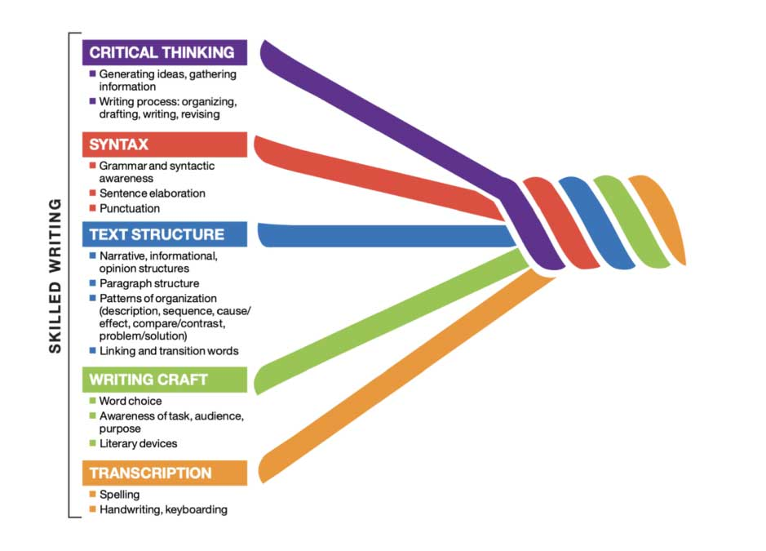
The Writing Rope (Sedita, 2019)
Like reading, many skills make up skilled writing.
Writing is challenging because it requires a variety of motor, cognitive, and verbal skills.
Notes:
Guiding Notes:
The Writing Rope is also a book by Joan Sedita that provides an explanation of the skills that comprise writing. Allow participants time to examine how complex the writing process can be.

Slide 38
How is writing taught in younger grades?
Notes:
Guiding Notes:
This section explains what skills students learn in grades K-5. The purpose of this section is to provide participants with a cursory understanding of the skills middle and high school students should be learning in elementary school.

Slide 39
When do K-5 students learn essential writing skills?
 | K | 1 | 2 | 3 | 4 | 5
Handwriting Print
Handwriting Cursive
Compose Opinion Pieces
Compose Informational Pieces
Compose Narratives
Publish Over Time
Use Digital Resources to Publish
Research
Text-Dependent Tasks
On-Demand Writing
Notes:
Guiding Notes:
The Kentucky Academic Standards for Reading and Writing provide the details for what students should be learning in grades K-5. Note that the standards require students to compose, publish, research and engage in text-dependent tasks K-5.

Slide 40
Grade-level Expectations
Grade-level | Kentucky Academic Standards (KAS) | Example Sentence
Kindergarten | L.K.1 When writing or speaking, demonstrate appropriate use of: e. complete sentences. L.K.2 When writing: a. Capitalize the first word in a sentence and the pronoun I. | I lik my sistr
1st Grade | L.1.1 When writing or speaking, demonstrate appropriate use of: h. declarative, interrogative, imperative and exclamatory sentences in response to prompts. L.1.2 When writing: b. Demonstrate appropriate use of end punctuation. | My favrit animal is a cat. She liecks to play. She liecks to snugl and pur.
2nd Grade | L.2.1 In writing or speaking, demonstrate appropriate use of: e. adjectives and adverbs in sentence formation. f. producing, expanding and rearranging complete simple and compound sentences. L.2.2 When writing: b. Demonstrate appropriate use of commas in varied communication. | Dear Grandma, Our new pet is a kitten who likes to be petted. Mom gets made if I do not feed her. Love, Ryn
3rd Grade | L.3.1 When writing or speaking, demonstrate command of the conventions of standard English grammar and usage. h. Use coordinating and subordinating conjunctions. i. Produce simple, compound and complex sentences. L.3.2 When writing: c. Use commas and quotation marks in dialogue. | Taking care of a pet cat means giving her a home to live in, food to eat, and water to drink. You can also say, “good kitty,” to her.
Notes:
Guiding Notes:
This chart demonstrates what kinds of sentences students might compose at each grade level.

Slide 41
How is writing taught in younger grades?
KNOWLEDGE
Notes:
Guiding Notes:
Just as knowledge building is an essential component of reading comprehension, knowledge also gives students something to say when they write.

Slide 42
What is Text-Based Writing?
Notes:
Guiding Notes:
This section introduces participants to the concept of “text-based” writing in the Kentucky Academic Standards for Reading and Writing.

Slide 43
Grade-Level Overviews: pp. 20, 222, 319
What do the Kentucky Academic Standards expect from middle and high school students as writers?
“Emphasis should be placed on text-based and evidence based writing experiences. Text-based writing greatly benefits reading comprehension by encouraging students to review and reflect on what they have read.”
Notes:
Guiding Notes:
This slide quotes the grade-level overviews for middle and high school composition within the Kentucky Academic Standards for Reading and Writing. While these do not represent the standards themselves, the overviews do provide an overarching vision of how the standards might be implemented within a local curriculum.
On this slide, point out that text-based writing simply means making opportunities for students to write about what they are reading.

Slide 44
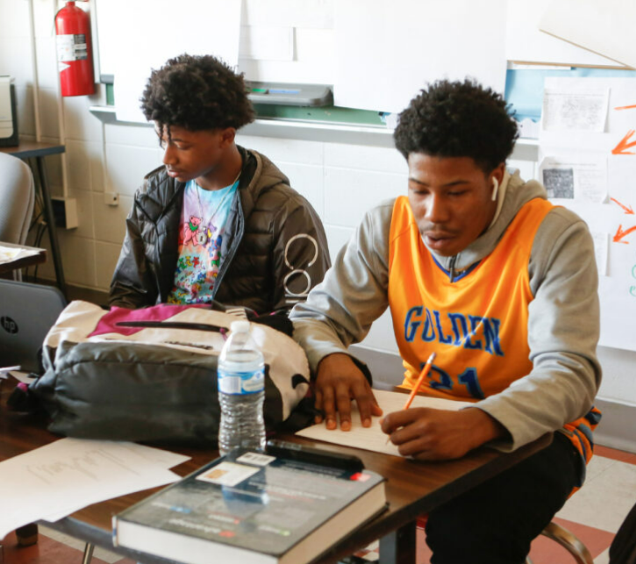
*Grade-Level Overviews: pp. 20, 222, 319
What do the Kentucky Academic Standards expect from middle and high school students as writers?
2. “Reading and writing should be viewed as complementary learning rather than as separate subjects.”
Notes:
Guiding Notes:
This slide quotes the grade-level overviews for middle and high school composition within the Kentucky Academic Standards for Reading and Writing. While these do not represent the standards themselves, the overviews do provide an overarching vision of how the standards might be implemented within a local curriculum.
On this slide, point out that reading and writing should go hand-in-hand during instruction. Students should have opportunities to read and write about what they read daily.

Slide 45
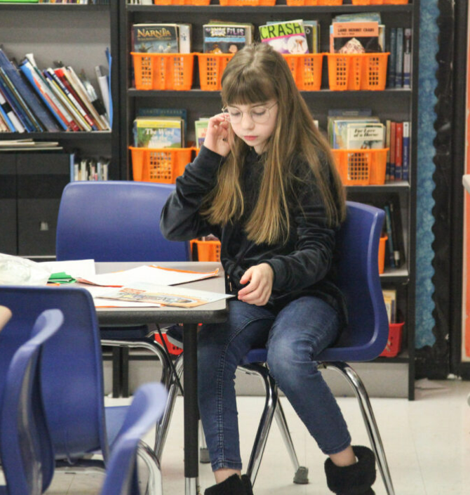
What do the Kentucky Academic Standards expect from middle and high school students as writers?
3. “Through interdisciplinary literacy practices, teachers help students employ the writing process for various purposes and audiences to become effective, independent communicators.”
4. “Students must write in both short and extended time frames.”
Notes:
Guiding Notes:
This slide quotes the grade-level overviews for middle and high school composition within the Kentucky Academic Standards for Reading and Writing. While these do not represent the standards themselves, the overviews do provide an overarching vision of how the standards might be implemented within a local curriculum.
On this slide, point out that students should be writing for a variety of purposes and audiences and in both short and extended time frames.

Slide 46
93%
“Writing about a text should enhance comprehension because it provides students with a tool for visibly and permanently recording, connecting, analyzing, personalizing, and manipulating key ideas in text…The evidence shows that having students write about the material they read does enhance their reading abilities.”
of the 100+ studies examined found that writing about reading improved reading comprehension, particularly in grades 3-12.
p. 21
Notes:
Guiding Notes:
Not only do the Kentucky Academic Standards for Reading and Writing emphasize the reading-writing connection, so does the evidence. This meta-analysis examined over 100 studies about the reading-writing connection and found that 93% of the studies showed considerable evidence for the importance of writing daily about what is read in class.

Slide 47
Three Types of Text-Based Writing
Notes:
Guiding Notes:
This section provides more details about what is meant by “text-based” writing in the Kentucky Academic Standards for Reading and Writing. Note that many of the slides in this section are purposefully hidden to make time to discuss Sentence Expansion and Sentence Combining. However, many participants may benefit from a discussion of the content in this section, which includes definitions and examples for Writing to Learn, Writing to Demonstrate Learning and Writing for Publication.

Slide 48
Three Types of Text-Based Writing
 | Purpose for Teachers: | Purpose for Students: | Audience:
Writing to Learn: Informal, low-stakes writing tasks that occur frequently in the classroom setting to practice skills or deepen knowledge in response to text | - to create an opportunity to acquire knowledge, deepen understanding or practice a skill in an informal, low-stakes setting in response to text - to provide informal feedback on progress towards mastery of the skill or content | - to acquire knowledge, deepen understanding or practice a skill with teacher or peer support in response to text - to receive timely, often immediate, feedback on progress towards mastery of the skill or content | The primary audience is the students and/or peer collaborators. Teachers may read the writing to provide informal feedback through comments or checkmarks.
Writing to Demonstrate Learning: Tasks that require students to apply learning at the end of a text, unit or series of lessons to demonstrate mastery | - to assess student mastery of a skill or conceptual understanding as students respond to text - to provide more formal feedback on long term growth towards mastery of skills or content | - to apply skills or conceptual understanding to demonstrate mastery as students respond to text - to receive more formal feedback about long term growth towards mastery of skills or content | The teacher is the primary audience and assigns a grade or score based on student progress towards mastery.
Writing to Publish: Tasks born out of a variety of studied texts and that are shared with an authentic audience beyond the classroom to engage in real-world communication skills | - to create opportunities for students to share their learning from reading with the community or world, either digitally or in-person - to engage students in authentic communication of their stories, ideas, or research beyond the classroom | - to share their learning from reading with the community or world, either digitally or in-person - to engage an authentic audience with their stories, ideas, or research beyond the classroom | Authentic readers, often beyond the classroom, are the primary audience.
Notes:
Guiding Notes:
This slide is intended to serve as a reference for participants to return to after the session and should not be read aloud to participants. The facilitator may wish to facilitate a discussion using questions such as:
Which of these types of writing do you use most frequently in your classroom?
Which of these types of writing do you use lease frequently in your classroom?
How do you see your adopted high-quality instructional resource (HQIR) engaging students in each of these types of writing?
What are the benefits of giving students an opportunity to engage in all three types of writing?

Slide 49
Writing to Learn
Informal, low-stakes writing tasks that occur frequently in the classroom setting to practice skills or deepen knowledge in response to text
Would you volunteer to travel to a place with yellow fever to investigate the cause of the disease? Describe two details from the text that impact your decision to go or not go.
Notes:
Guiding Notes:
Allow participants to read the definition of Writing to Learn, emphasizing that Writing to Learn tasks are informal, frequent writing tasks that are often ungraded and serve only to give students a space to think. This slide features an example of Writing to Learn from Amplify ELA, a green-rated high-quality instructional resource (HQIR).

Slide 50
Writing to Learn
Consider your complex text from earlier:
What Writing to Learn tasks does your resource provide?
2. If you do not yet have a high-quality resource, how might you engage students in Writing to Learn?
Informal, low-stakes writing tasks that occur frequently in the classroom setting to practice skills or deepen knowledge in response to text
Notes:
Guiding Notes:
The purpose of this slide is for participants to reflect on how they or their instructional resource leverage Writing to Learn. If time permits, allow space for participants to share their thinking or collaborate with PLC members to consider what Writing to Learn might look like in their classrooms.

Slide 51
Writing to Demonstrate Learning
Tasks that require students to apply learning at the end of a text, unit or series of lessons to demonstrate mastery
What techniques do writers from this unit use to demonstrate the impact of diseases on communities? Use three examples to support your claim.
Notes:
Guiding Notes:
Allow participants to read the definition of Writing to Demonstrate Learning, emphasizing that Writing to Demonstrate Learning tasks are often graded and serve as formative assessments to communicate mastery and feedback towards mastery between the teacher and student. This slide features an example of Writing to Demonstrate Learning from Amplify ELA, a green-rated high-quality instructional resource (HQIR).

Slide 52
Writing to Demonstrate Learning
Consider your complex text from earlier:
What Writing to Demonstrate Learning tasks does your resource provide?
2. If you do not yet have a high-quality resource, how might you engage students in Writing to Demonstrate Learning?
Tasks that require students to apply learning at the end of a text, unit or series of lessons to demonstrate mastery
Notes:
Guiding Notes:
The purpose of this slide is for participants to reflect on how they or their instructional resource leverage Writing to Demonstrate Learning. If time permits, allow space for participants to share their thinking or collaborate with PLC members to consider what Writing to Demonstrate Learning might look like in their classrooms.

Slide 53
Writing for Publication
Tasks born out of a variety of studied texts and that are shared with an authentic audience beyond the classroom to engage in real-world communication skills
Consider all of the texts from this unit. Select a communicable disease we studied. Create an infographic to serve as a public service announcement about the impacts, risks, and prevention measures to post in the public health department.
Notes:
Guiding Notes:
Allow participants to read the definition of Writing for Publication, emphasizing that Writing for Publication tasks represent vibrant student experiences that engage students in communication skills beyond the classroom.. This slide features an example of Writing for Publication from Amplify ELA, a green-rated high-quality instructional resource (HQIR).

Slide 54
Sentence Expansion & Combining
Notes:
Guiding Notes:
This section provides details about what is meant in sentence expansion and combining grounded in complex, grade-level text.

Slide 55
Sentence Expansion in HQIRs
Language Dives
Many HQIRs engage students in sentence work using the texts studied in class.
Notes:
Guiding Notes:
Many high-quality instructional resources (HQIRs) such as EL Education include instructional routines related to sentence expansion or combining. This Sentence Variety Anchor Chart represents a tool that educators might use to support students in improving writing using texts studied in class.

Slide 56
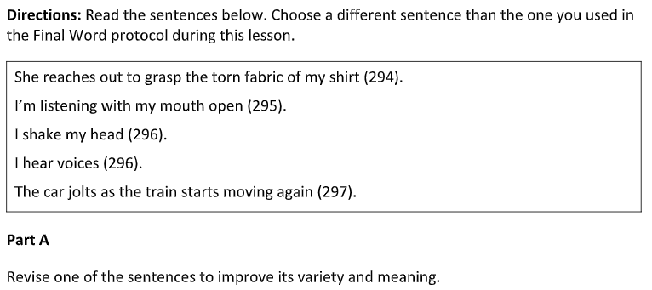
Sentence Expansion Example
Language Dives
Many HQIRs engage students in sentence work using the texts studied in class.
Notes:
Guiding Notes:
This slide builds on the previous slide with a specific example of how an HQIR might engage students in sentence expansion using the texts studied in class. Note that this exercise includes 5 simple sentences from the student text for students to expand upon.

Slide 57
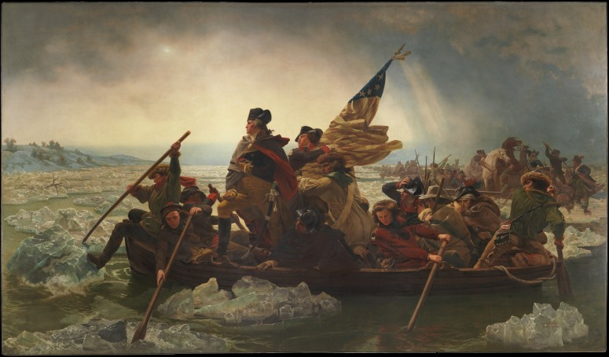
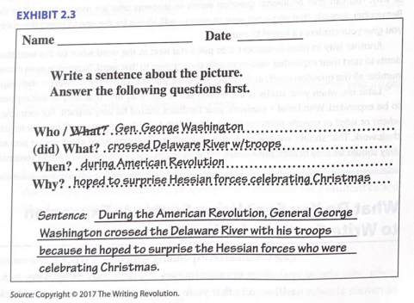
Sentence Expansion from the Hochman Method
Chapter 2,
p. 62
Image courtesy of Mount Vernon’s Washington Library
Notes:
Guiding Notes:
This slide contains an example from the Hochman Method (i.e., The Writing Revolution) that teachers may consider using in the absence of a green-rated high-quality instructional resource.

Slide 58
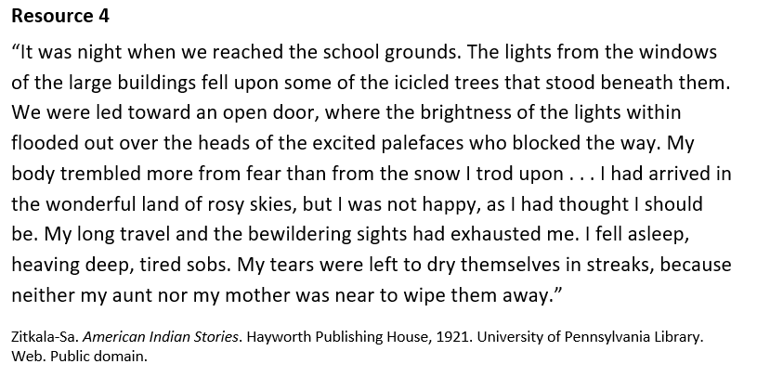
Sentence Expansion from the Hochman Method:
Let’s Try One!
Chapter 2,
p. 62
Write a sentence about the text. Answer these questions first:
Who?
(did) What?
When?
Why?
Sentence: ____________
This exercise is based on the work of Judith Hochman and Natalie Wexler using a primary source as it appears in EL Education.
Notes:
Guiding Notes:
Participants have an opportunity to practice the Hochman Method using this material. Note that the “who” is somewhat ambiguous, so participants may choose to identify the writer as “a young person,” “a young American Indian,” or simply “the writer.” The “what,” “when,” and “why” may have a variety of answers based on what the participants choose to focus on in their reading. While this step takes some time during the facilitation of this session, providing participants time to experience a strategy as a student might creates space for planning and instructional implications.

Slide 59
Sentence Combining for Specific Writing Needs
Student has short, choppy sentences. | Teach how to make compound subjects, predicates and adjective modifiers. Teach how to make compound sentences using and, but, and or.
Student writing uses simple transitions (first, second, then or next). | Teach how to make complex sentences using subordinate clauses that express time relationships (before, after, when, while, until, whenever or as).
Student writing overuses but and so. | Teach how to make complex sentences using subordinate clauses that express cause and effect relationships using because, since, so and although.
Student writing is unsophisticated and simplistic. | Teach how to make complex sentences using subordinate clauses that express conditional relationships (unless,if, although and otherwise). Teach how to use appositives, participle phrases, and adjective phrases using who, whom, whose, that, and which.
Notes:
Guiding Notes:
This chart appears in Bruce Saddler’s work as a guide for when and why to teach specific sentence combining skills. This chart represents a way teachers might support students and does not represent curricular requirements. Teachers may wish to consult with adopted resources within the local curriculum and their PLCs to consider inclusion of practices or materials.

Slide 60
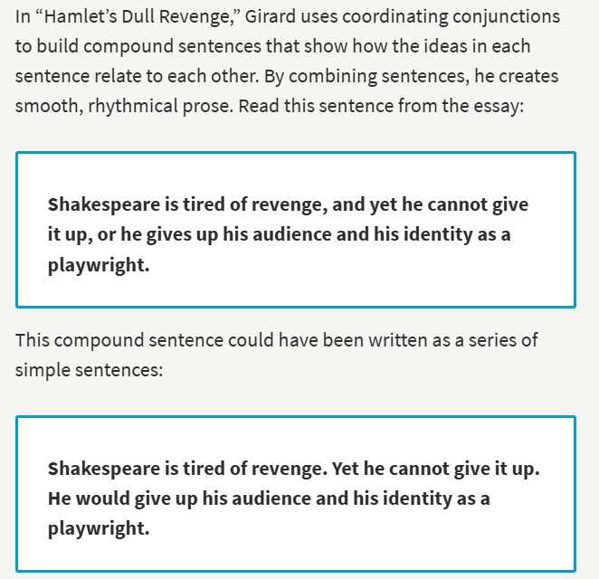
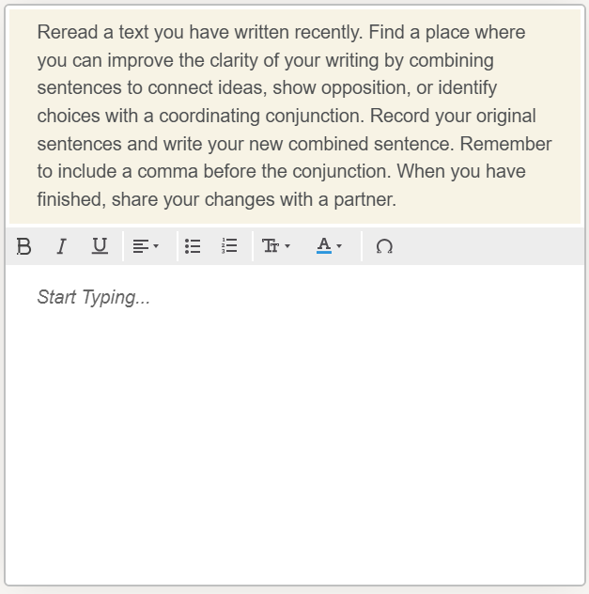
Sentence Combining in HQIRs
Watch Your Language
Notes:
Guiding Notes:
This example comes from a green-rated high-quality instructional resource (HQIR), HMH’s Into Literature for Grade 12. Note that many HQIRs may contain language components to support composition skills for shorter and longer texts. In this example, students examine how the writer of “Hamlet’s Dull Revenge” combined or could have combined sentences. Next, students have an opportunity to use the examples to revise a piece of their own writing.

Slide 61
Sentence Combining without an HQIR:
Combine the ideas below into 1-2 sentence(s):
Hamlet is a Shakespearean tragedy.
The genre of Hamlet is revenge tragedy.
There were many revenge tragedies in Shakespeare’s day.
Revenge tragedies are like modern-day “thrillers.”
Revenge tragedies are cathartic.
Cathartic describes plays that eliminate tension through the release of repressed emotions.
This exercise is based on the work of Bruce Saddler using “Hamlet’s Dull Revenge” as it appears in Into Literature Grade 12.
Notes:
Guiding Notes:
The exercise on this slide relies on the work of Bruce Saddler’s sentence combining using the texts students are studying. This exercise is based on a text students are studying, “Hamlet’s Dull Revenge” and includes 6 simple statements that restate the content of the text. Students are given an opportunity to deepen their understanding of the relationships between the ideas in the text as well as sharpen their composition skills. Providing simple sentences based on the knowledge acquired from the text creates more cognitive desk space for students to engage in the challenging task of composing.

Slide 62
A Closing Thought on Writing:
“Critical thinking occurs in every discipline, and writing leads students to think critically about content and ideas presented in all classes.”
IES Guide:
“Teaching Secondary Students to Write Effectively”
Notes:
Guiding Notes:
This quote comes from the IES Practice Guide “Teaching Secondary Students to Write Effectively.” This concept asks schools to consider how writing might be leveraged in all subjects and grade levels to deepen student critical thinking.

Slide 63
Reflection:
Use your calendar or planner. When and how might you incorporate concepts from this session into your instruction this week?
Designate a person to share with the larger group.
Notes:
Guiding Notes:
Use this time for teachers or PLCs to meet to discuss how learning from this session may impact upcoming instruction. Teachers or PLCs may also consider systemic routines or structures that may support more evidence-based instruction.

