Slide 1
Curriculum Development Process
Introduction
Notes:
Hello and welcome to the Curriculum Development Process professional learning series. The purpose of this video is to introduce you to the CDP and its role in creating a-local high-quality standards aligned curriculum.

Slide 2
Common Acronyms
KDE – Kentucky Department of Education
KAS - Kentucky Academic Standards
MCF - Model Curriculum Framework
CDP - Curriculum Development Process
HQIR - High-Quality Instructional Resource
HQPL – High-Quality Professional Learning
Notes:
Because document names and key terms repeat throughout the Curriculum Development Process PL series, for ease of communication we may use the acronyms on this slide throughout the videos. Take just a minute to review the acronyms on the slide.
Please note that we will say KAS for the Kentucky Academic Standards.

Slide 3
Building Context for the Curriculum Development Process
Focus on each of the following:
United We Learn
KBE Board Resolution (July 2020)
Curricular Coherence
Model Curriculum Framework
Notes:
In the first part of this video we want to build some background context for the Curriculum Development Process by focusing on:
The United We Learn vision for public education for all KY students
the KBE Resolution from July 2020 regarding student equity
the importance of creating curricular coherence at the local level to help improve student outcomes and
the role of the Model Curriculum Framework in supporting districts and schools in creating coherence and equitable learning environments for all students

Slide 4
KBE Resolution – July 2020
KBE Resolution states that every student in the Commonwealth deserves equitable access to effective educators who have unique experiences and perspectives, quality preparation and are committed to the success of all learners.
Deliberate actions educators must take to ensure equitable access to learning for each and every student across the state:
Local school and district implementation of the Kentucky Academic Standards
Provide access to local high quality, standards-aligned curriculum and instructional resources
Notes:
To address student equity, in July 2020, the Kentucky Board of Education passed a resolution AFFIRMING ITS COMMITMENT TO EQUITY IN KENTUCKY PUBLIC SCHOOLS.
(Read the resolution)
Based on this resolution, what deliberate actions must educators take to ensure equitable access to learning for each and every student across the state? It starts with local school and district implementation of the Kentucky Academic Standards and then providing teachers and students with access to local high-quality, standards-aligned curriculum and instructional resources designed to help students meet the grade-level expectations within the KAS.

Slide 5
United We Learn
Notes:
The United We Learn vision for public education in KY also takes up the issue of equity, arriving at three central themes: vibrant student experiences, encouraging innovation, and collaboration with our communities. While the Curriculum Development Process can support all three themes and you may notice evidence of that throughout, for our purposes here we will focus primarily on how it facilitates vibrant student experiences in content area learning. All KY students deserve experiences that spark curiosity, motivation and engagement, while cultivating enthusiasm for lifelong learning. A strong local curriculum with a primary HQIR can provide a foundation for this while also ensuring all learners have equitable access to grade-level learning and aligned assessments.

Slide 6
Creating Curricular Coherence
In order to improve student outcomes, schools and districts need to create curricular coherence.
Alignment of standards, curriculum, instructional resources, assessment, instructional practices and professional learning within and across grade levels
A critical first step in this work is to ensure alignment of the standards, curriculum and instructional resources at the district and/or school level.
Notes:
How do we ensure equitable opportunities and vibrant learning experiences for all students…by creating curricular coherence, which research identifies as one of the most important initiatives for improving student outcomes at the school and district level.
Curricular coherence is about aligning the standards, curriculum, instructional resources, assessment, instructional practices and professional learning within and across grade levels to create equitable learning environments that foster vibrant student experiences, and this work begins with an effective curriculum process at the local level.
Fullan, M. & Quinn, J. (2016). Coherence: The right drivers in action for schools, districts, and systems. Thousand Oaks, CA: Corwin
Cobb, P., Jackson, K., Henrick, E., & Smith, M. (2018). Systems for instructional improvement: Creating coherence from the classroom to the district office. Cambridge , MA: Harvard Education Press
Newmann, F., Smith, B., Allensworth, E., & Bryk, A. (2001). Instructional program coherence: What it is and why it should guide school improvement policy. Educational Evaluation and Policy Analysis, 23(4), 297–321.
Oaxley, Diana. (2008). Creating Instructional Program Coherence. Accessed at https://www.duplinschools.net/cms/lib/NC01001360/Centricity/Domain/22/CreatingInstructionalCoherence.pdf

Slide 7
Model Curriculum Framework:
KRS 159.6451
Purpose according to statute:
(2) The Kentucky Board of Education shall disseminate to local school districts and schools a model curriculum framework which is directly tied to the goals, outcomes, and assessment strategies developed pursuant to this section and KRS 158.645 and 158.6453.
The framework shall provide direction to local districts and schools as they develop their curriculum. The framework shall identify teaching and assessment strategies, instructional material resources, ideas on how to incorporate the resources of the community, a directory of model teaching sites, alternative ways of using school time, and strategies to incorporate character education throughout the curriculum.
Notes:
One of main resources available from the Kentucky Department of Education to support districts and schools in creating curricular coherence is the Model Curriculum Framework. The MCF is outlined in KY law and is designed to provide guidance to districts and schools in the areas of curriculum development, selection of instructional resources, as well as assessment and instructional strategies.

Slide 8
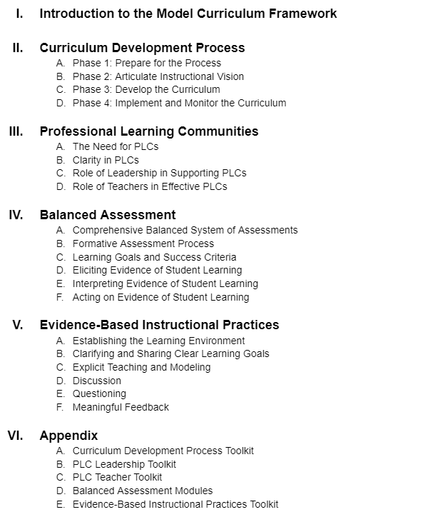
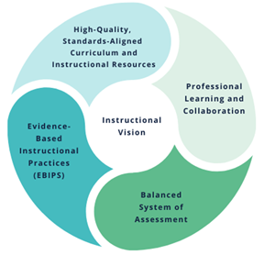
Model Curriculum Framework
Model Curriculum Framework
Key Components of Curricular Coherence
Notes:
When you look at the table of contents from the entire MCF you can see all the key areas addressed within this document play a critical role in creating curricular coherence. There are three sections that specifically support the work of developing a local curriculum aligned to the KAS and selecting high quality instructional resources to support implementation:
(click) The Introduction to the MCF which differentiates the role of standards, curriculum and instructional resources at defined in KY law
(click) The Curriculum Development Process which outlines a possible process districts can use to develop their curriculum and select their primary HQIR
(click) Appendix A - which contains a toolkit of sample district artifacts and other resources to support implementation of the CDP at the local level

Slide 9
Curriculum Development Process Overview
Accessing the Curriculum Development Process within the Model Curriculum Framework
The structure and contents of the CDP
Professional learning supports
Notes:
Now that you have a little more background context around the importance of the CDP, we are going to move into our next section that will focus on:
how to access the MCF and the CDP
how the CDP is organized–its structure, content and supports
resources for professional learning around the CDP

Slide 10
Your standards resources
Notes:
To access the MCF, go to kystandards.org and on the homepage click on Your Standards Resources

Slide 11
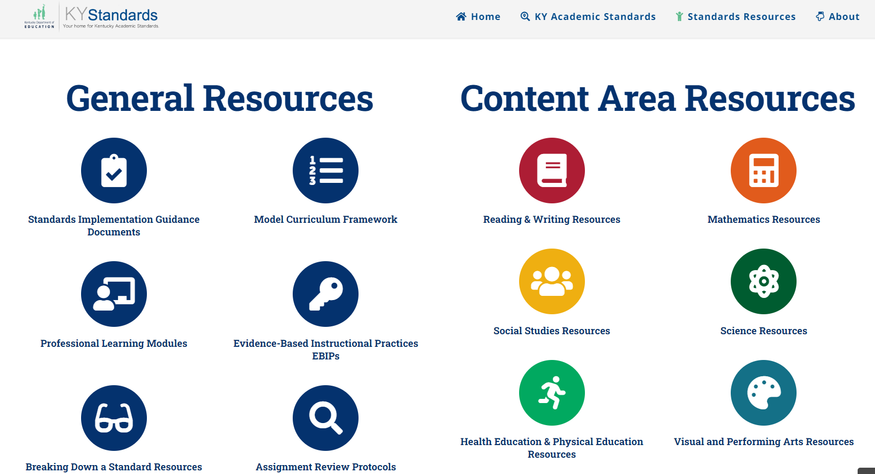
MCF on Kystandards.org
Notes:
On the next page, under General Resources click on the icon for Model Curriculum Framework

Slide 12
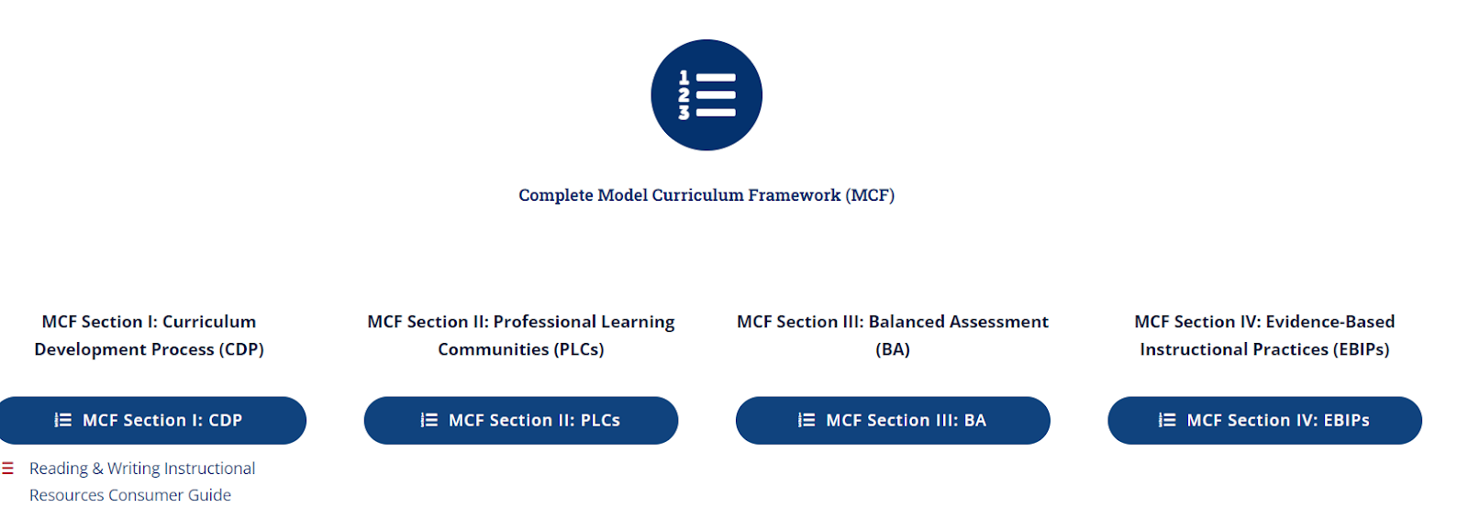
CDP Section of the MCF
Notes:
That will take you to a page where you can access the MCF. The first icon allows you to download the entire MCF. Below that, you can access each individual section:
CDP
PLCs
Balanced Assessment
EBIPs
The Introduction to the MCF begins each of the four sections.

Slide 13
CDP within the MCF
Model Curriculum Framework
Key Components of Curricular Coherence
Notes:
The first step in creating curricular coherence is to develop a local high-quality curriculum built around an instructional vision for teaching and learning in the content area and anchored in a primary HQIR.
(click) The CDP section of the MCF provides districts with a possible process for this work. This process should be undertaken by a curriculum team back at your district because creating curricular coherence is systems-level work to help ensure equitable access and opportunities for all students, and it is designed to be replicated with each content area as they come up in your local curriculum review cycle.

Slide 14
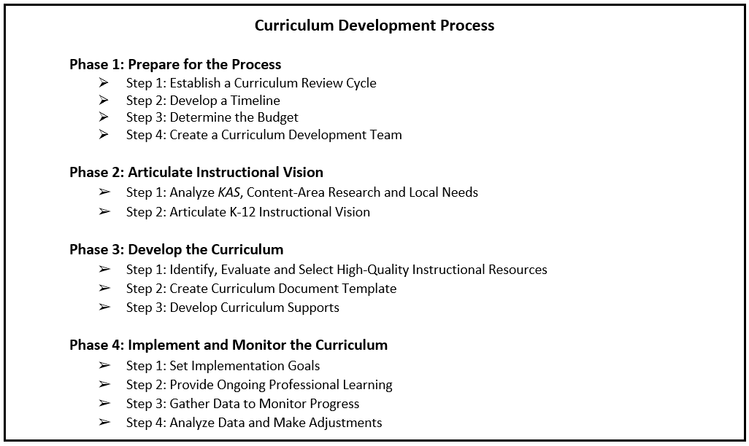
CDP Phases
Notes:
There are four phases of the CDP and they are meant to be completed in order so the learning and work from one phase can fully inform the next.
(Click) Phase 1 is about preparing for the process thinking about the budget, timeline and other logistics to help streamline the work and make it more manageable.
(Click) In Phase 2, the curriculum team you form engages in analysis of the standards and current research on teaching and learning in the specific content area of focus, matching that to an inventory of local needs. As a result of this analysis, the team works to articulate their instructional vision of what they want the student experience to be in the content area across all classrooms in the school or district.
(Click) The instructional vision then drives the work of Phase 3 as the team selects a primary HQIR and develops the local curriculum anchored in that HQIR.
(Click) Phase 4 focuses on implementing and monitoring the curriculum to make necessary adjustments in support of continuous improvement. The icon for this phase illustrates this is a cycle that repeats each year of implementation as the district strives to get closer and closer to actualizing the instructional vision in all classrooms across the district.

Slide 15
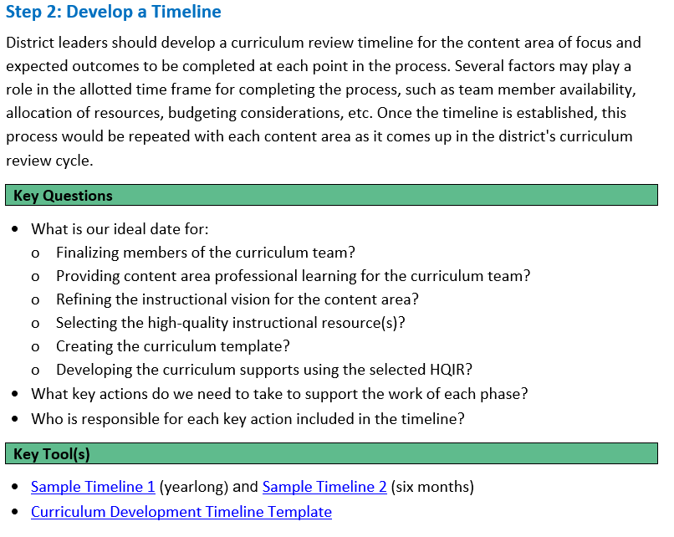
Curriculum Development Process
Each step in the process includes:
Purpose and Brief Description
Key Questions
Key Tools
Notes:
For each phase of the process in the CDP, there is
section of text that addresses the purpose and brief description of the steps within each phase
key questions for the team to consider as they work through the steps of each phase
Key tools to support the work with links for easy access
On the slide you can see an example of the layout and format from Phase 1, Step 2

Slide 16
Professional Learning Supports
Curriculum Development Process
CDP Phase One Module
CDP Phase Two Module
CDP Phase Three Module
CDP Phase Four Module
Notes:
To further support implementation of the CDP at the local level, the KDE has created professional learning modules to assist districts in better understanding each phase of the process and curated sample artifacts and videos from districts across the state.

Slide 17
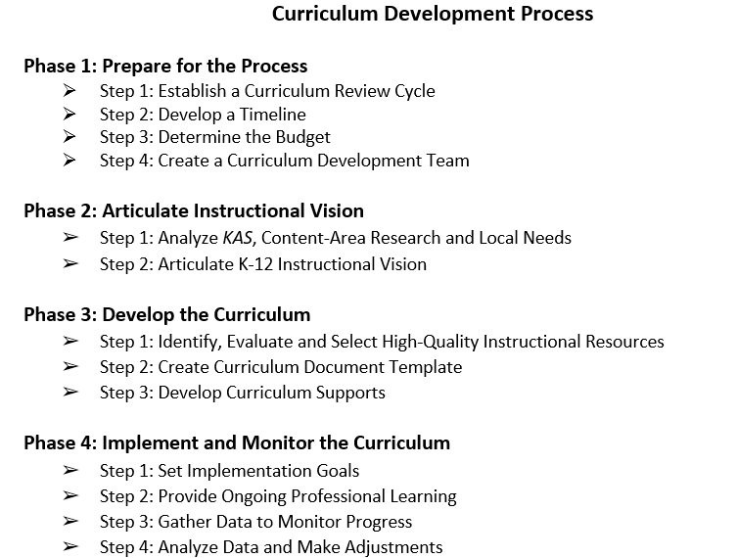
Closing Reflection
Team Discussion:
What is the current process in your district for developing local curriculum and selecting high-quality instructional resources aligned to the Kentucky Academic Standards?
What are some similarities and differences between your current process and the one outlined in KDE’s Curriculum Development Process?
Notes:
As we close out this introduction to the CDP, we would like for you to think about your current process for developing a local curriculum and selecting high-quality instructional resources aligned to the Kentucky Academic Standards. What are some similarities and differences you notice between this process and the one currently used in your district?
Please the pause the video and then resume after the closing reflection.

Slide 18
Questions
Questions for OTL?
Fox DeMoisey
fox.demoisey@ducation.ky.gov
Misty Higgins
misty.higgins@education.ky.gov
Notes:
Thank you for viewing this overview of the Curriculum Development Process. If you have any questions, please feel free to email either Misty or me. To build on this learning experience, proceed to CDP professional learning module one.

