Slide 1
Reinforcing Vocabulary Across Lessons/Texts
SESSION 9
ACADEMIC VOCABULARY
1
Notes:
1 min
Frame: 1 min
“Welcome to our final shared learning session in this content cycle. In today’s session, we will delve into how we can support students to continue to maintain and extend their understanding of vocabulary beyond the first lesson where it is taught. Just as athletes engage in ball-handling drills and other exercises to refine their skills, so too do our students need to continue to work with the vocabulary they have learned so that they can build a deeper understanding of more words, which will help them to become stronger communicators and readers.”

Slide 2
Do Now
ACADEMIC VOCABULARY
SESSION 9
“The limits of my language mean the limits of my world”
--Ludwig Wittgenstein
What does this quote mean to you?
How has this been true in your classroom?
2
Notes:
5 min:
Directions/Framing:
Facilitator shares the quote, “The limits of my language mean the limits of my world” by Ludwig Wittgenstein. Participants reflect on the following questions:
What does this quote mean to you?
How has this been true in your classroom?
1 min: Reflect independently.
3 min: Share reflections with a partner.
Thank you all for sharing! As I heard many of you reflect, language is critical to students’ having access to texts, conversations, and understanding new content. Vocabulary can expand our horizons and cultivate joy and interest for students. Today we’ll explore additional strategies for supporting students in strengthening their vocabularies so there are no limits!
Look or Listen Fors/Evidence of Mastery:
The world reflects opportunities, open doors, possibilities
Without a strong vocabulary, there is a limit to opportunities
We all have the capacity to improve our limits

Slide 3
Content Cycle Overview
Session | Type of Learning | Focus Area
1 | Shared Learning | Introduction to Vocabulary and Why It Matters
2 | Shared Learning | Implicit Vocabulary Instruction
3 | Planning & Practice | Implicit Vocabulary Instruction
4 | Shared Learning | Explicit Vocabulary Instruction
5 | Planning & Practice | Explicit Vocabulary Instruction
6 | Student Progress | Implicit and Explicit Vocabulary Instruction
7 | Shared Learning | Text Sets
8 | Planning & Practice | Text Sets
9 | Shared Learning | Maintaining & Extending Vocabulary
10 | Planning & Practice | Maintaining & Extending Vocabulary
11 | Student Progress | Text Sets, Implicit and Explicit Vocabulary
Notes:
Cycle Overview (1 min)
Share 11 week path of the cycle, reminding teachers how the professional learning includes opportunities for shared learning, planning and practice, and studying student progress.

Slide 4
Objectives
ACADEMIC VOCABULARY SESSION 9
Agenda
01. Opening
02. Why This Matters
03. Strategies for Maintaining and Extending Vocabulary
04. Practice with a Lesson
05. Reflection
01. Reinforce prioritized vocabulary across lessons/texts
4
Notes:
2 min
Directions/Framing/Key Points:
Here are the objectives for the session. May I have 2 volunteers read them aloud?
Here is our path for learning.
Look or Listen Fors/Evidence of Mastery:
NA

Slide 5
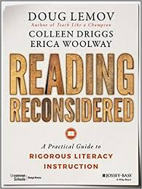
Maintenance & Extension of Vocabulary
Pre-work reading debrief:
ACADEMIC VOCABULARY SESSION 9
In partners, return to your notes from the pre-work reading and share your answers to the following:
Why is it important that teachers are thoughtful and intentional about creating and using systems for students to meaningfully revisit words?
What are some strategies for maintaining and extending students’ vocabulary?
How does this compare to your current practice?
What do you want to learn?
5
Notes:
10 min
Directions/Framing:
“Let’s begin by returning to our pre-work reading to make sure that we understand the key points around systems and routines for supporting students in maintaining and extending their vocabularies.”
5 min: In partners, participants return to their notes from the pre-work article, and share their answers to the following questions:
Why is it important that teachers are thoughtful and intentional about creating and using systems for students to meaningfully revisit words?
What are some strategies for maintaining and extending students’ vocabulary?
How does this compare to your current practice?
What do you want to learn?
5 min: Whole group share out, with the facilitator soliciting and reinforcing the key takeaways.
Look or Listen Fors/Evidence of Mastery:
The end goal is for students to retain vocabulary for later use in reading writing and speaking
In order to solidify student understanding of vocabulary words, students must use them
Spiraling back involves revisiting words you've already taught, giving students the kind of practice that can lead to mastery.
Many different approaches to reinforcing and maintaining previously taught vocabulary.
Engaging in wordplay
Reviewing several words at once
Active practice questions - Useful in providing an additional prompt for rigorously applying a word - Helps with spiraling back on previously taught vocab
Choose between two words - which is best for _______
Pose questions that force students to think about relationships between words Could a ___ be a ____ Why? Why not?
Prompting students to upgrade word choice in discussion and writing
Applying words to reading / Connecting to Text
Utilizing the classroom environment - Word Walls

Slide 6
Key Takeaways: Reinforcing Vocabulary Across Lessons & Texts
The end goal of vocabulary instruction is for students to retain vocabulary for later use in reading comprehension, writing, and speaking.
Research show that students need at least six repetitions with a word before they can master it.
Students need to hear, say, write, think deeply about words in order to begin to use them in their regular speech and writing and understand them well in reading.
Spiraling back involves revisiting words you've already taught, giving students the kind of practice that can lead to mastery.
There are many different approaches to reinforcing and maintaining previously taught vocabulary.
6
Notes:
Key Takeaways: Reinforcing Vocabulary Across Lessons & Texts (3 min)
Directions/Framing/Key Points:
1 min: “Here are some key takeaways about reinforcing vocabulary, many of which you have surfaced.”
2 min: Provide time for teachers to review the slide and ask clarifying questions, as needed.
Look and/or Listen For:
The end goal of vocabulary instruction is for students to retain vocabulary for later use in reading comprehension, writing, and speaking.
Research show that students need at least six repetitions with a word before they can master it.
Students need to hear, say, write, think deeply about words in order to begin to use them in their regular speech and writing and understand them well in reading.
Spiraling back involves revisiting words you've already taught, giving students the kind of practice that can lead to mastery.
There are many different approaches to reinforcing and maintaining previously taught vocabulary. Some include:
Engaging in wordplay to review
Prompting students to upgrade word choice in discussion and writing
Applying words to reading / Connecting to Text
Utilizing the classroom environment - Word Walls

Slide 7
Example 1:
Interactive Word Wall
ACADEMIC VOCABULARY
SESSION 9
Capture in your handout:
How does this strategy work?
How does it help to maintain or extend student understanding of vocabulary previously taught?
How could you use this in your classroom?
7
Notes:
6 min: https://vimeo.com/84900192
Directions/Framing:
We will now have the opportunity to take a look at some example protocols for maintaining and extending vocabulary.
As we explore each strategy, please use your handout to capture thinking about each one.
First, let’s take a look at the “Interactive Word Wall” strategy. This is an 8th grade ELA classroom working on a unit with texts focused on war.
2 min: Watch video and capture notes.
3 min: Give participants time to add any additional thinking into their handout. Facilitator can also invite participants to share with a partner.
Look or Listen Fors/Evidence of Mastery:
Students have opportunities to make and explain connections between words, challenging them to more deeply consider the meaning and nuances of words.
This strategy can get students using and hearing multiple vocabulary words during a short period of time.
This could also be adjusted so that students are writing their responses using a word wall that is on a wall. It could also be adjusted so that each table or pair of students has their own interactive word wall so that there is more cognitive demand on more students. The teacher could include a writing prompt at the end of the lesson that asks students to write a paragraph explaining the connections between 2-3 words.

Slide 8
Example 2:
Quiz, Quiz, Trade
ACADEMIC VOCABULARY
SESSION 9
Capture in your handout:
How does this strategy work?
How does it help to maintain or extend student understanding of vocabulary previously taught?
How could you use this in your classroom?
8
Notes:
7 min
Directions/Framing:
Let’s take a look at another example. This protocol is called “Quiz Quiz Trade.”
The video we’re going to see is actually of a fourth grade classroom, but is one of the best available videos of this strategy; it showcases the ways that students are engaging with the words as a result of the protocol. In our classrooms with older students, the protocol would look the same but just with different words.
2 min: Watch video and capture notes.
3 min: Give participants time to add any additional thinking into their handout. Facilitator can also invite participants to share with a partner.
Look or Listen Fors/Evidence of Mastery:
Students each have a card with a word, and then they take turns quizzing their partner, then trading cards with their partner. Then they find a new partner, and repeat the process. This gives students exposure to many vocabulary words. It challenges students to understand the meaning of the words, say them, and read them.

Slide 9
Example 3:
“Word Play Questions”
ACADEMIC VOCABULARY
SESSION 9
Tell a story about this picture using at least three vocabulary words below:
immortal
incentive
dearth
benevolent
vain
ethical
9
Notes:
6 min
Directions/Framing:
Let’s see another example, only this time we’re going to sit in the seats of students!
The article we read as pre-work mentioned the power of ‘word play questions.’ These can be questions that are part of the Do Now, homework, or some other regular classroom routine. The idea is that they are questions that challenge students to think more deeply about the meaning of multiple vocabulary words, and then students have opportunities to talk or write about those words.
Let’s try this example. The vocabulary words in this example were taken from an EngageNY Module focused on ethics and equity in the medical field. Can I get a volunteer to read our task and vocabulary words?
2 min: Jot down your story! *students may use phones or dictionaries to look up any unfamiliar words
3 min: Share with a partner.
Look or Listen Fors/Evidence of Mastery:
Participants are talking about the picture using the vocabulary words.

Slide 10
Example 3:
“Word Play Questions”
ACADEMIC VOCABULARY
SESSION 9
Capture in your handout:
How does this strategy work?
How does it help to maintain or extend student understanding of vocabulary previously taught?
How could you use this in your classroom?
10
Notes:
3 min
Directions/Framing:
3 min: Give participants time to add any additional thinking into their handout. Facilitator can also invite participants to share with a partner.
Look or Listen Fors/Evidence of Mastery:
This strategy could be used during Do Nows, homework, or other regular classroom routines.

Slide 11
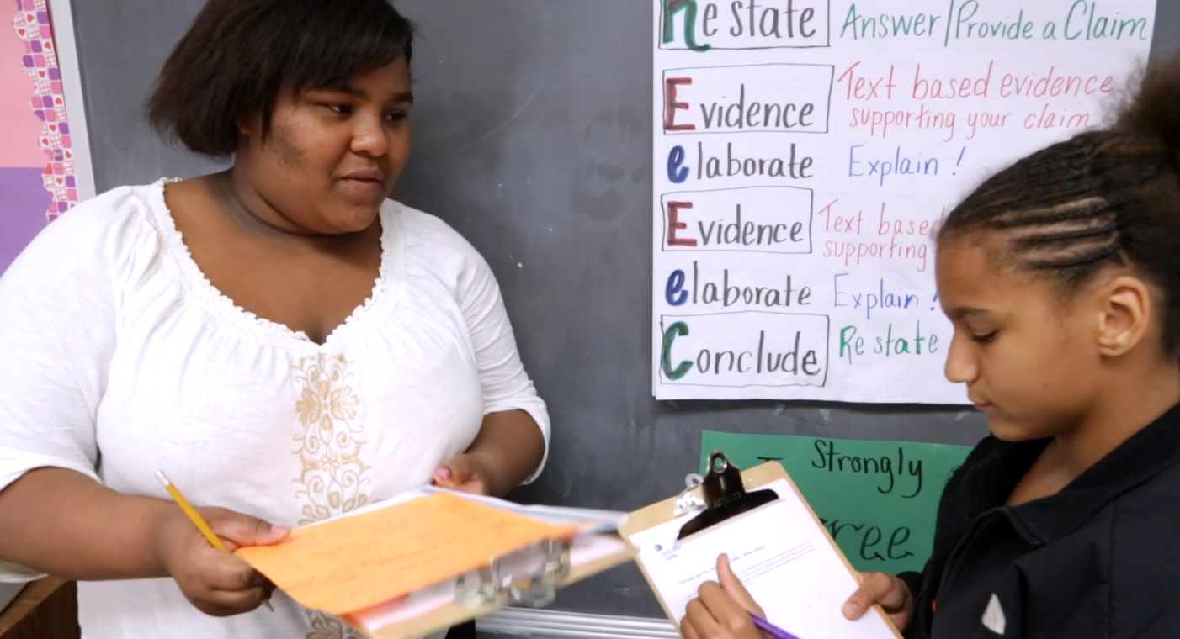
Example 4:
Give One, Get One, Move On (GOGOMO)
ACADEMIC VOCABULARY
SESSION 9
Capture in your handout:
How does this strategy work?
How does it help to maintain or extend student understanding of vocabulary previously taught?
How could you use this in your classroom?
11
Notes:
7 min
Directions/Framing:
Let’s take a look at one last classroom example. This protocol is called “Give One, Get One, Move On,” or GOGOMO. We used this strategy in our last shared learning session!
This video is of an eighth grade classroom studying the word “metamorphosis.” Again, this is the best video for this strategy and something that could be tailored to intermediate grade students.
2 min: Watch video and capture notes.
3 min: Give participants time to add any additional thinking into their handout. Facilitator can also invite participants to share with a partner.
Look or Listen Fors/Evidence of Mastery:
This strategy could be used to review an entire unit or topic (so could include many vocabulary words); it could also be used to study a single word, with students writing examples, non-examples, or other characteristics in each of the boxes. This strategy can get students to write and talk about many unit vocabulary words at once, or it can support students in building a deeper understanding of a single vocabulary word that has more depth and nuance.

Slide 12
Practice
ACADEMIC VOCABULARY SESSION 9
Review lesson you will be teaching.
Identify 3-5 vocabulary words that you will teach.
Explain how you could use one of the four vocabulary strategies we just viewed..
How well does this lesson meet the look for?
What adaptations could be made?
Look For:
Over the course of the unit, students have opportunities to maintain and extend vocabulary through additional practice with words previously taught
12
Notes:
25 min
Directions/Framing:
“Let’s take a look at a lesson from your unit of study where students read informational text to support their thinking. As you review this lesson, you will determine ways these lessons support previously taught vocabulary and how you might incorporate one vocabulary strategy to reinforce the vocabulary from your lesson.”
Today when we practice, we’re going to take a look at one lesson from your curriculum. We’ll consider 3-5 vocabulary words that you will teach. Then we’ll consider one task or strategy we could add or adjust in this lesson in order to also review some of the previously learned vocabulary. Please capture your thinking in your handout.
20 min: Work Time (independently or in groups)
5 min: whole group share out
Look or Listen Fors/Evidence of Mastery:
Selection of 3-5 vocabulary words from lesson
Selection/Adaptation of vocabulary strategy from today’s session
Discussion of how to implement

Slide 13
Closing
Reflection:
ACADEMIC VOCABULARY SESSION 9
Why is vocabulary instruction critical for equity in literacy for all students, including (and especially) English Language Learners, students who are struggling readers, or students with special needs?
What is one next step you can take in your classroom to support students in maintaining or extending vocabulary?
Notes:
5 min
Directions/Framing:
Our reflection for today goes back to our first session during which we discussed the relationship between vocabulary instruction and equity.
Why is vocabulary instruction critical for equity in literacy for all students, including (and especially) English Language Learners, students who are struggling readers, or students with special needs? What is one next step you can take in your classroom to support students in maintaining or extending vocabulary?
1 min: Participants reflect.
4 min: Whole group whip-around with each participant sharing one key takeaway in response to one of the questions.
Look or Listen Fors/Evidence of Mastery:
Strong understanding of vocabulary is essential for reading comprehension, and in particular for accessing grade-level complex texts
English Language Learners and students who are struggling readers often have lower comprehension because they don’t know as many vocabulary words
Vocabulary instruction can help to create access to texts for all students

Slide 14
Preparing for Next Week’s Application
ACADEMIC VOCABULARY SESSION 9
Bring a current or upcoming unit or lesson that includes reinforcement opportunities.
How do students have opportunities to maintain and extend vocabulary through additional practice with words previously taught?
Look For:
Over the course of the unit, students have opportunities to maintain and extend vocabulary through additional practice with words previously taught
14
Notes:
1 min
Directions/Framing:
Before we close out, I want to take a minute to preview the learning that we will engage in next week. We will have an opportunity to review an upcoming text and lesson and analyze it against our look fors.
Thank you all for your engagement in today’s learning!
Look or Listen Fors/Evidence of Mastery:
NA

