Slide 1
Creating Collaborative Civic Spaces Module Series
Module Two:
What do we do with variation?
Notes:
Module Series Overview:
Creating Collaborative Civic Spaces module series is a set of four of modules designed to support teachers in creating collaborative civic spaces that supports student engagement in deliberative and democratic processes and democratic discourse as required by the Kentucky Academic Standards (KAS) for Social Studies.
Creating Collaborative Civic Spaces module series is intended to support the successful implementation of the KAS for Social Studies in classrooms across the state. The duration, scope and sequence of the module sections may be customized to accommodate local needs and conditions. The sections are designed to provide flexibility for districts and schools and, as such, can be viewed as stand-alone lessons or within the progression of the module as written. You are supported in engaging with this module individually, if desired.
Materials:
The following materials are part of this module:
Kentucky Academic Standards (KAS) for Social Studies
Module Two Notecatcher: https://www.education.ky.gov/_layouts/download.aspx?SourceUrl=/curriculum/standards/kyacadstand/Documents/Module_Two_Note_Catcher_for_Civic_Spaces_Module_Series.docx
Additional materials, such as but not limited to, articles, discussion strategies, etc. are provided within the notes section of applicable slides throughout the module.
Guiding Notes
Guiding notes are provided in the Notes section of the PowerPoint to support your learning. The information provided in the Notes section includes additional information, directions for the activities on the slide, and citations of used resources, where appropriate. It is critical that you read the material presented in the Notes section to ensure that you are acquiring the important knowledge, skills and understanding required when engaging with this module.
Virtual Training Note:
If you plan to engage with this module virtually as a group, consider directing participants to the Social Studies Professional Learning Modules page so that you may access the resources used directly from the links provided in the PowerPoint: https://kystandards.org/standards-resources/ss-resources/ss-pl-modules/
Additionally, you may consider downloading the resources contained within each section of the module and placing them into a Google folder for you or your colleagues to access.
Module One: Compelling and Supporting Questions with Learning Goals and Success Criteria
Compelling Question: How do I create collaborative civic spaces that support student collaboration and discourse?
Supporting Question: Why is it important for educators and students to create classrooms that are collaborative civic spaces?
Learning Target: I can create collaborative civic spaces that support student collaboration and discourse.
Success Criteria: I can explain why it is important for educators and students to create classrooms that are collaborative civic spaces.
Intended Audiences:
Participants
Module participants may include, but are not limited to, district leadership, school administrators, instructional specialists/coaches, intervention specialists, department chairs, special educators and classroom teachers.
Facilitators:
This module series may be implemented with by a teacher individually or a group of educators led by a facilitator. If this module is being completed as a group, facilitators may include, but are not limited to, district leaders, school administrators, instructional specialists/coaches, intervention specialists, department chairs, special educators, and classroom teachers. Facilitators may need to revise specific tasks in order to meet the needs of the participants or to be respectful of the time planned within the work session.
Helpful Hint for Facilitators:
The learning that will take place in this module may cause Kentucky educators to face changes in instructional practices amidst this transition. It is important to realize that while you are the facilitator of these work sessions, you may not have all the answers to the questions asked by participants, and that is okay. Throughout the module, participants may have questions that will be addressed in future work sessions. When that happens, reflect on this quote from Graham Fletcher, “Every teachable moment doesn’t need to be a teachable moment in that moment.” Use these moments to encourage participants to attend future work sessions where those questions will be addressed. If participants ask questions you are not prepared to answer, offer to follow up on that during the next work session.
Planning Ahead for Facilitators:
Determine which stakeholders to invite as participants. In the invitation, describe how the work sessions will benefit them.
A few days before the meeting, you may want to remind participants to be prepared to have their documents available during the meeting. (See below for Participant Documents Needed.)
Reserve adequate space and equipment. Tables or desks should be set up to support small-group discussion. If conducting this module virtually, ensure that your technology platform can support break out rooms to support small group collaboration.
Ensure that participants have access to the Internet.
Consider how you might handle participants who may not be in attendance at all work sessions. It might be worthwhile to consider how those participants might access missed sections of the module between work sessions in order to feel as prepared as the other participants.
Preparation
Participant Documents Needed:
Plan ahead regarding how you will feel most comfortable engaging with the KAS for Social Studies, either:
A device with access to the KAS for Social Studies, or
A hard copy of the KAS for Social Studies
Additional documents needed include:
Module One Note catcher
Crosby, Kimberly D. (Fall 2018) Fostering Civil Discourse within the Democratic Classroom. AILACTE Journal, v15 n1 p1-14. https://eric.ed.gov/?id=EJ1205082
Supplies Needed:
• Computer with Module One: Why is it important for educators and students to create classrooms that are collaborative civic spaces? PowerPoint presentation.
• Technology with projection capability if in person. Technology platform where presenters have sharing ability and breakout room options if virtual.
• Copies of the handouts needed for the session either in hard copy format or available in a folder online. Links to the participant handouts needed for the session also may be built right into the agenda.
• Parking Lot for questions - If completing as a group, you may consider providing a poster on which participants can write or post questions, or you may prefer to have a digital parking lot where participants can access a Google document, for example, to post questions and that you can modify as the participants work through the sections of the module.
• Self-Sticking Notes (optional)
• Poster paper (optional)
• Highlighters and/or colored pens/markers (optional)
Building a Community:
Building a community is important for any group that will work together, especially if participants have not worked together before. The concept is the same as building a safe, respectful, productive classroom climate. Incorporating community-building into each session builds trust, shows participants that they are valuable as individuals and engages them in the learning process. It is also useful for creating a professional learning network where participants can be supported in their work. Community-building can be as simple as allowing participants to introduce themselves and their role in the school/district, developing or refining group norms, allowing for questions, and/or the sharing of answers to reflection questions or individual discovery task items that are included in this module. Again, time allotted for community-building will allow participants to have a voice and be engaged as active contributors and learners in the sessions.
Virtual Training Options: Be sure to conduct continual check-ins throughout the presentation. Build Google documents to continue to collect feedback, such as questions, hopes, and/or concerns to which participants may continually add.
Module Attribution
Collaborative Civic Spaces was originally created by Mary Ellen Daneels for the Hawaii Department of Education, Office of Curriculum and Instructional Design, as seen at https://sites.google.com/view/hawaiicorestandardsforsocialst/online-professional-development-modules and has been modified here with permission.
All content was based on Colorado Department of Education – Standards and Instructional Support Modules https://sitesed.cde.state.co.us/course/index.php?categoryid=24.

Slide 2
Introduction
Compelling Question: How do I create collaborative civic spaces that support student collaboration and discourse?
Supporting Question: What do we do with variation?
Learning Target: I can create collaborative civic spaces that support student collaboration and discourse.
Success Criteria: I can explain what to do with variation in the classroom.
Notes:
Guiding Notes:
Creating Collaborative Civic Spaces Module series has four modules that build on one another to support a participant in answering the compelling question: How do I create collaborative civic spaces that support student collaboration and discourse? Participants will answer this question after completing the module series. Answering this question will support participants in meeting the Learning Target: I can create collaborative civic spaces that support student collaboration and discourse.
Each module within the module series supports a participant in answering a supporting question. At the conclusion of engaging with Module Two of this series, participants will answer the supporting question: What do we do with variation? Participants will meet the success criteria for Module Two when they can demonstrate the Success Criteria: I can explain what to do with variation in the classroom.
For more information on compelling questions, visit Section 3B: “What are Compelling Questions and how do students ask them?” from the Inquiry Practices module: https://education.ky.gov/curriculum/standards/kyacadstand/Documents/Inquiry_Practices_of_KAS_for_Social_Studies.pptx
For more information on supporting questions, visit “Section C: What are Supporting Questions, and how do students ask them?” from the Inquiry Practices module: https://education.ky.gov/curriculum/standards/kyacadstand/Documents/Inquiry_Practices_of_KAS_for_Social_Studies.pptx
For more information on Learning Goals and Success Criteria and their alignment to the KAS for Social Studies, visit Learning Goals, Success Criteria and the KAS for Social Studies: https://kystandards.org/standards-resources/ss-resources/learning-goals-success-criteria-and-the-kas-for-social-studies/

Slide 3
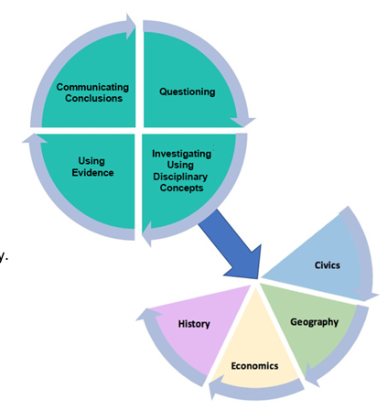
Inquiry Practices of the KAS for Social Studies
The Kentucky Academic Standards (KAS) for Social Studies guide student exploration of the relationships and interactions among individuals and groups at local, state, national and international levels through the disciplines of civics, economics, geography and history and the inquiry practices of questioning, investigating, using evidence and communicating conclusions.
Student inquiry into open ended, enduring compelling questions that investigate “variations” in our community anchors this process.
Notes:
Guiding Notes:
Read the slide.

Slide 4
What is variation?
Variation is the act, process or accident of differing in condition, character or degree.
Notes:
Guiding Notes:
Read the definition of variation and reflect on it independently.
On your Note Catcher where it says Slide Four, define this term.

Slide 5
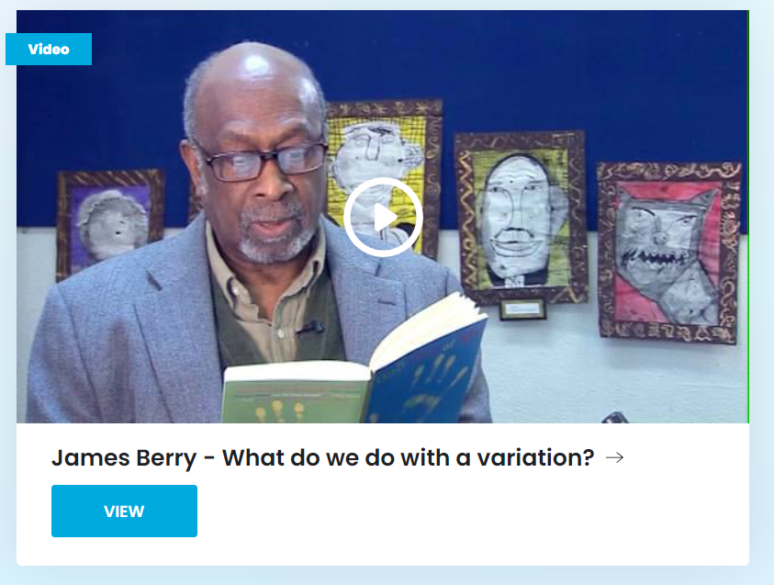
What do we do with variation?
Read along as James Berry reads his poem, What Do We Do With a Variation?
Notes:
Guiding Notes:
Click the link above to access the video where the author reads his poem. Scroll to the bottom of the screen and click the image of the author to hear him read the poem as the text is projected on the screen. https://clpe.org.uk/poetry/poems/what-do-we-do-variation
Resource:
Berry, James. What do we do with variation? (2004) Only One of Me. https://clpe.org.uk/poetry/poems/what-do-we-do-variation

Slide 6
What do we do with variation? (2)
Complete the Sentence-Phrase-Word Thinking Strategy on your note catcher, using James Berry’s poem, What Do We Do With a Variation?
In one sentence: What is the message of the poem?
Pick out one phrase that connects to an experience you have had with difference in your classroom. Briefly explain.
Berry uses many verbs and verb phrases to express how people respond to differences. Which of these words would most connect to your students’ lived experiences? Why?
Notes:
Guiding Notes:
Read the slide and complete this task on your Note Catcher where it says Slide Six.
Resources:
Berry, James. What do we do with variation? (2004) Only One of Me. https://clpe.org.uk/poetry/poems/what-do-we-do-variation
Project Zero. (2019). Sentence, Phrase, Word Thinking Strategy. Harvard Graduate School of Education. https://pz.harvard.edu/sites/default/files/Sentence%20Phrase%20Word.pdf

Slide 7
Evidence of Variation
There is increased polarization in the general public.
What do you notice about the data represented in these images?
What do you wonder about the data represented in these images?
Notes:
Guiding Notes:
Using the two images on this slide, examine the increasing political polarization in the general public between 1994 and 2017 as evidenced by Pew Research Center. To view a larger version of these images, access the link for The Shift in the American public's political values in the resources below. On your note catcher where it says Slide Seven, write down any notice and wonderings that you have about this data. What do you notice about the data represented in these images? What do you wonder about the data represented in these images?
Resources:
The Pew Research Center. The Shift in the American public’s political values. The Pew Research Center. https://www.pewresearch.org/politics/interactives/political-polarization-1994-2017/
Macie Hall (May 21, 2018). Notice and Wonder. Johns Hopkins University Center for Teaching Excellence & Innovation. https://ii.library.jhu.edu/2018/05/21/notice-and-wonder/

Slide 8
The Effects of Political Polarization on Social Studies Education
“—how should the nation’s social studies educators respond to the rise in political polarization and its accompanying affective polarization? Fortunately, there are social studies educators across the nation working assiduously to embrace the possibility that what we teach and the way we teach could, at a minimum, combat some of the worst effects of political polarization. Even more ambitiously and ideally, social studies could help the nation’s students learn how to imagine a political climate in which difference is not demonized, hostility toward others is not reified, and trust and political friendship are the aims to which we should target our pedagogical and curricular practices.”
Stoddard, Jeremy and Diana E. Hess (January/February 2024). The Effects of Political Polarization on Social Studies Education and What We Should Do. Social Education. National Council of Social Studies. https://www.socialstudies.org/88/1/effects-political-polarization-social-studies-education-and-what-we-should-do
Notes:
Guiding Notes:
Read the slide.
Resource:
Stoddard, Jeremy and Diana E. Hess (January/February 2024). The Effects of Political Polarization on Social Studies Education and What We Should Do. Social Education. National Council of Social Studies. https://www.socialstudies.org/88/1/effects-political-polarization-social-studies-education-and-what-we-should-do

Slide 9
What do we do with a variation?
Center for Information and Research on Civic Learning and Engagement's All Together Now: Collaboration and Innovation for Youth Engagement report states:
The Challenge:
Civic education is especially difficult when young people have good reasons to view politics as polarized and dysfunctional.
The Opportunities:
Teaching a new generation to be civil, responsible, and constructive citizens may be part of the solution to our polarized and dysfunctional politics.”
Notes:
Guiding Notes:
Read the slide. This slide provide quotes from Center for Information and Research on Civic Learning and Engagement's “All Together Now” report.
Resources:
All Together Now: Collaboration and Innovation for Youth Engagement: The Report of the Commission on Youth Voting and Civic Knowledge (2013). Center for Information & Research on Civic Learning and Engagement. https://circle.tufts.edu/sites/default/files/2020-01/all_together_now_commission_report_2013.pdf

Slide 10
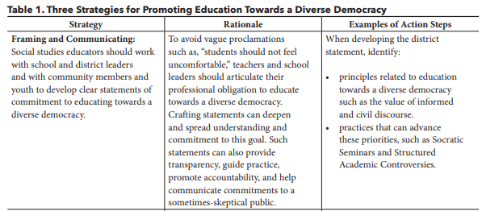
How Social Studies Educators Can Lead Towards a Diverse Democracy
One –Word Summary
Write one word that summarizes the central idea of each column in this chart.
Notes:
Guiding Notes:
In this excerpt, Kahne and Rogers have “identified three priorities through which social studies educators can help fortify and advance education towards a diverse democracy.” Using the One-Word Strategy on the screen, summarize each column of these priorities on your note catcher where it says Slide Ten. Once you have completed your One-Word Summary, share with a neighbor or a group, if possible.
Resources
Kahne, Joseph and John Rogers (January/February 2024). Facing Partisan Conflict: How Social Studies Educators Can Lead Towards a Diverse Democracy. Social Education. National Council of Social Studies. https://www.socialstudies.org/social-education/88/1/facing-partisan-conflict-how-social-studies-educators-can-lead-towards
Thinking Collaborative, LLC and Robert Garmston and Bruce Wellman (2017). The Adaptive School: Strategies & Moves for Facilitating Groups. Thinking Collaborative, LLC. https://www.thinkingcollaborative.com/_files/ugd/6a5cc9_ed28b325ab6a4362b834f4bbf295d408.pdf

Slide 11
How Social Studies Educators Can Lead Towards a Diverse Democracy (2)
One –Word Summary
Write one word that summarizes the central idea of each column in this chart.
Notes:
Guiding Notes:
Repeat the One-Word summary completed on slide 10 for this slide. The directions are:
“In this excerpt, Kahne and Rogers have “identified three priorities through which social studies educators can help fortify and advance education towards a diverse democracy.” Using the One-Word Strategy on the screen, summarize each column of these priorities on your note catcher where it says Slide Eleven. Once you have completed your One-Word Summary, share with a neighbor or a group, if possible.”
Resources
Kahne, Joseph and John Rogers (January/February 2024). Facing Partisan Conflict: How Social Studies Educators Can Lead Towards a Diverse Democracy. Social Education. National Council of Social Studies. https://www.socialstudies.org/social-education/88/1/facing-partisan-conflict-how-social-studies-educators-can-lead-towards
Thinking Collaborative, LLC and Robert Garmston and Bruce Wellman (2017). The Adaptive School: Strategies & Moves for Facilitating Groups. Thinking Collaborative, LLC. https://www.thinkingcollaborative.com/_files/ugd/6a5cc9_ed28b325ab6a4362b834f4bbf295d408.pdf

Slide 12
How Social Studies Educators Can Lead Towards a Diverse Democracy (3)
One –Word Summary
Write one word that summarizes the central idea of each column in this chart.
Notes:
Guiding Notes:
Repeat the One-Word summary completed on slide 10 for this slide. The directions are:
“In this excerpt, Kahne and Rogers have “identified three priorities through which social studies educators can help fortify and advance education towards a diverse democracy.” Using the One-Word Strategy on the screen, summarize each column of these priorities on your note catcher where it says Slide Twelve. Once you have completed your One-Word Summary, share with a neighbor or a group, if possible.”
Resources
Kahne, Joseph and John Rogers (January/February 2024). Facing Partisan Conflict: How Social Studies Educators Can Lead Towards a Diverse Democracy. Social Education. National Council of Social Studies. https://www.socialstudies.org/social-education/88/1/facing-partisan-conflict-how-social-studies-educators-can-lead-towards
Thinking Collaborative, LLC and Robert Garmston and Bruce Wellman (2017). The Adaptive School: Strategies & Moves for Facilitating Groups. Thinking Collaborative, LLC. https://www.thinkingcollaborative.com/_files/ugd/6a5cc9_ed28b325ab6a4362b834f4bbf295d408.pdf

Slide 13
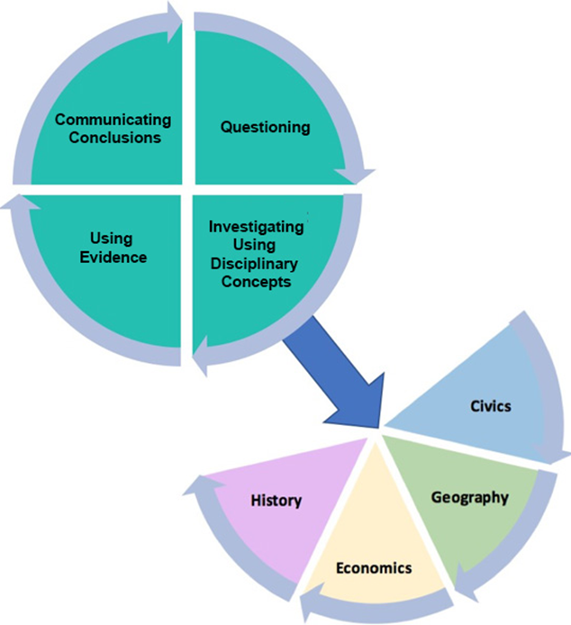
Variations and the KAS for Social Studies
Communicating conclusions is defined by a student’s ability to effectively communicate their own conclusions and listen carefully to the conclusions of others whose conclusions may be different.
This requires that students listen to the conclusions of others, apply a range of deliberative and democratic procedures, engage in civil discussion, reach consensus when appropriate and respect diverse opinions relevant to compelling and/or supporting questions.
Notes:
Guiding Notes:
Complete the See, Hear, Think, Wonder Teaching Strategy after you watching the video.
Resources:
Civic Engagement Research Group- University of California- Riverside. (n.d.) Structured Academic Controversy (SAC). Series CPS/CERG Civic Discussion Videos. https://www.youtube.com/watch?v=5MPekCd0mHk
* The See, Hear, Think, Wonder strategy is based on the See, Think, Wonder Thinking Strategy from Project Zero:
Project Zero. (2019). See, Think, Wonder Thinking Strategy. Harvard Graduate School of Education. https://pz.harvard.edu/sites/default/files/See%20Think%20Wonder_3.pdf

Slide 14
Communicating Conclusions
Sample of grade level standards (excerpt)
K.I.CC.4 | Use listening skills to decide on and take action in their classrooms.
3.I.CC.4 | Use listening, consensus-building and voting procedures to determine the best strategies to take to address local, regional and global problems.
5.I.CC.4 | Use a range of deliberative and democratic procedures to identify strategies on how to address a current issue.
6.I.CC.4 | Engage in a range of deliberative and democratic procedures to discuss current local, regional and global issues.
8.I.CC.4 | Apply a range of deliberative and democratic procedures to make decisions about ways to take action on current local, regional and global issues.
HS.C.I.CC.1 | Engage in civil discussion, reach consensus when appropriate and respect diverse opinions relevant to compelling and/or supporting questions in civics.
Notes:
Guiding Notes:
Read this slide. After you have read this slide, identify words or phrases that support variations in classrooms on your note catcher where it says Slide Fourteen.

Slide 15
Engaging with variation: What does this look like in practice?
Access one of the following grade level examples and scroll to the Task Aligned to the Compelling Question:
Kindergarten Example (pg. 6)
Grade 7 Example (pg. 15)
High School Example (pg. 10)
How does the task require students to engage with variation?
Notes:
Guiding Notes:
Read the slide and access the example that is closest to your grade level. When you access the example, scroll to the page number indicated to read the Task Aligned to the Compelling Question. As you are reading these tasks, answer the question: “How does this task require students to engage with variation?” on your note catcher where it says Slide Fifteen.
Some responses may include, but are not limited to the following:
Kindergarten: Students have to use listening skills when engaging in a discussion to identify ways to improve their classroom community. The have to reach consensus with their peers when deciding on a new classroom rule that helps them improve their classroom community.
Grade 7: Students have to use their evaluation of how individuals and groups addressed local, regional and global problems throughout the growth and expansion of civilizations to examine a modern problem using historical thinking skills. Students use what they learned about how technology can transform civilization to discuss current local, regional and global issues. Students share your thinking through deliberative and democratic procedures.
High School: Students use the knowledge they gain from constructing their argument to answer the compelling question: “How does the desire for inexpensive goods lead to unintended consequences?” to identify a local, regional or global problem that results from the unintended consequences of desiring goods at low prices. Students share their responses through meaningful discussions and democratic discourse. In these discussions, students must respect diverse opinions related to the problems that result from the unintended consequences of desiring goods at low prices.

Slide 16
Engaging with variation: What does this look like in practice? (?)
Complete the Connect, Extend, Challenge strategy to reflect on how the task you read required that students engage with variation.
How are the ideas and information connected to what you already know?
What new ideas did you get that broadened your thinking or extended it in different directions?
What challenges or puzzles emerge for you?
Notes:
Guiding Notes:
Read the slide, and complete the Connect, Extend, Challenge prompts on your note catcher where it says Slide Sixteen.
Resource:
Project Zero. (2019). Connect, Extend, Challenge. Harvard Graduate School of Education. https://pz.harvard.edu/sites/default/files/Connect%20Extend%20Challenge_2.pdf

Slide 17
Reflection: One more stanza...
Revisit the poem, “What do we do with a variation?”
How would you like your students to respond to “variations” that emerge as a result of inquiry into compelling questions? Write a final stanza to the poem.
Notes:
Guiding Notes:
Read directions on the slide, and return to poem text at https://clpe.org.uk/poetry/poems/what-do-we-do-variation
Write the final stanza to the poem on your note catcher where it says Slide Seventeen.
Share your response with a partner, if possible.
Resources:
Berry, James. What do we do with a variation? (2004) Only One of Me. https://clpe.org.uk/poetryline/poems/what-do-we-do-variation

Slide 18
How might the strategies in this module be used to support inquiry in the classroom?
Sentence-Phrase-Word
Annotated Reading
Think Pair Share
3-2-1 reflection
A final stanza...
Notes:
Guiding Notes:
Brainstorm how you might/currently use the strategies shared in this module in your own classrooms to support inquiry. Write your responses where it says Slide Eighteen on your note catcher.

Slide 19
Creating Collaborative Civic Spaces Module Series 2
Module Two:
What do we do with variation?
Notes:
Guiding Notes:
This concludes Module Two.
The KDE needs your feedback on the effectiveness of this module, the learning platform and how the consultants may best support you as you take the next steps in the implementation process. Complete a short survey to share our thinking and provide them with feedback on how the KDE can best meet our needs. Feedback from our surveys will be used by the KDE to plan and prepare future professional learning.
Post Survey: https://docs.google.com/forms/d/e/1FAIpQLScCoWs8UDMqBOge_dr_Z1LOYRaBwQQOu8MtkLrVRpzhGGDMbg/viewform?usp=sf_link

