Slide 1
Kentucky’s Interdisciplinary
Literacy
Practices
in Action
Notes:
Guiding Notes:
Welcome! Please see the Notes section of slides 2 and 3 for extensive planning and facilitation considerations:
Slide 2: A Note to Facilitators Leading a Group
Slide 3: A Note to Individuals Completing This Module
Please contact ELATeam@education.ky.gov with any questions.

Slide 2
A Note to Facilitators Leading a Group:
For complete considerations for facilitators, see the Notes section of this slide.
These slides are adaptable for your grade level, content area and/or allotted learning time.
Print or make a digital copy of the Participant Guide for participants.
These slides are divided into three sections:
Part 1: What are the Interdisciplinary Literacy Practices (ILPs)?
Part 2: How are Kentucky teachers engaging students in the ILPs?
Part 3: How might we engage students in the Interdisciplinary Literacy Practices in our instruction?
Use the videos that are relevant to your audience’s grade level or content area.
Complete Parts 1-3 and complete this survey to receive 3 hours of professional development/EILA credit.
Notes:
Module Overview:
This slide is purposefully hidden from participants.
The purpose of this module is to provide Kentucky K-12 educators with clear examples of how the Interdisciplinary Literacy Practices in the Kentucky Academic Standards (KAS) for Reading and Writing might engage students in reading and writing instruction supported by a high-quality instructional resource (HQIR).
Kentucky’s Interdisciplinary Literacy Practices in Action is intended to support classrooms across the state in engaging students in meaningful reading and writing across content areas. The duration, scope and sequence of the module sections may be customized to accommodate local needs and conditions. The sections are designed to provide flexibility for districts and schools and, as such, can be viewed as stand-alone lessons or within the progression of the module as written. You are supported in engaging with this module individually, if desired.
This module will take approximately 3 hours to complete; however, adaptations may be made to accommodate for more or less time.
Module Parts:
Part 1: What are the Interdisciplinary Literacy Practices?
Part 2: How are Kentucky teachers engaging students in the ILPs?
Part 3: How might we engage students in the ILPs in our instruction?
Materials Needed:
These module slides with Guiding Notes
The Participant Guide
Access to the participants’ high-quality instructional resource (HQIR)
A Note about HQIRs:
The Reading and Writing HQIR Consumer Guide points districts to the markers of high-quality literacy instruction for Kentucky. Note that HQIRs are grounded in research and written by experts. While these resources do engage students in the Interdisciplinary Literacy Practices (ILPs), they may not specifically label these tasks, routines or protocols with Kentucky’s ILPs. As such, it is recommended that facilitators continually ground discussions in the texts, tasks and protocols provided in the district-adopted HQIR and prompt participants to make connections between this learning and their upcoming lessons or units.
Another important HQIR consideration for this module: If your district has adopted an HQIR, consider using a sample lesson from that resource to engage participants in curriculum-based professional learning, especially in Part 1 when participants experience the ILPs as a learner. This module uses a sample lesson from Amplify ELA Grade 6 to demonstrate the ILPs in action; however, you may wish to substitute this sample with a lesson from your locally adopted curriculum supported by an HQIR. To learn more about structuring and supporting teachers with curriculum-based professional learning (CBPL), access KDE’s CBPL Guidance Document.
Guiding Notes:
Guiding notes are provided in the Notes section of the PowerPoint to support your learning. The Notes section includes additional information and directions for the activities on the slide. It is critical that you read the material presented in the Notes section to ensure that you are acquiring the important knowledge, skills and understanding required when engaging with this module.
Virtual Training Note:
If you plan to engage with this module virtually as a group, consider directing participants to the Interdisciplinary Literacy Practices in Action landing page so that you may access the resources used directly from the links provided in the PowerPoint: https://kystandards.org/standards-resources/rw-resources/rw-pl-modules/interdisciplinary-literacy-practices-in-action/
Intended Audiences:
Participants
Module participants may include, but are not limited to, district leadership, school administrators, instructional specialists/coaches, intervention specialists, department chairs, special educators and classroom teachers.
Facilitators
While this module series is designed for a teacher to engage with it individually, it may be implemented with a group of educators led by a facilitator. If this module is being completed as a group, facilitators may include, but are not limited to, cooperative staff, district leaders, school administrators, instructional specialists/coaches, intervention specialists, department chairs, special educators, and classroom teachers. Facilitators may need to revise specific tasks in order to meet the needs of the participants or to be respectful of the time planned within the work session.
Helpful Hint for Facilitators:
The learning that will take place in this module may cause Kentucky educators to face changes in instructional practices amidst this transition. It is important to realize that while you are the facilitator of these work sessions, you may not have all the answers to the questions asked by participants, which is part of the learning process for all educators at all levels. Throughout the module, participants may have questions that will be addressed in future work sessions. When that happens, reflect on this quote from Graham Fletcher, “Every teachable moment doesn’t need to be a teachable moment in that moment.” Use these moments to encourage participants to attend future work sessions where those questions will be addressed. If participants ask questions you are not prepared to answer, offer to follow up on that during the next work session. Please contact ELATeam@education.ky.gov if you have questions or comments.
Planning Ahead for Facilitators:
Determine which stakeholders to invite as participants. In the invitation, describe how the work sessions will benefit them.
Select which grade level videos or content areas should be a priority for this audience. It is recommended that participants engage with 2-3 of the videos included in the series.
A few days before the meeting, you may want to remind participants to be prepared to have their Participant Guide available during the meeting. You may also choose to print these for participants.
Reserve adequate space and equipment, including a projector with clear and audible sound. Tables or desks should be set up to support small-group discussion. If conducting this module virtually, ensure that your technology platform can support break out rooms to support small group collaboration.
Ensure that participants have access to the Internet.
Preparation
Participant Documents Needed:
Participant Guide
Access to upcoming lessons or units within their district-adopted curriculum supported by an HQIR
Supplies Needed:
These slides
Technology with projection and sound capability if in person. Technology platform where presenters have sharing ability and breakout room options if virtual.
Participant Guides printed or available virtually
Parking Lot for questions - If completing as a group, you may consider providing a poster on which participants can write or post questions, or you may prefer to have a digital parking lot where participants can access a Google document, for example, to post questions and that you can modify as the participants work through the sections of the module
Self-Sticking Notes (optional)
Poster paper (optional)
Highlighters and/or colored pens/markers (optional)
Building a Community:
Building a community is important for any group that will work together, especially if participants have not worked together before. The concept is the same as building a safe, respectful, productive classroom climate. Incorporating community-building into each session builds trust, shows participants that they are valuable as individuals and engages them in the learning process. It is also useful for creating a professional learning network where participants can be supported in their work. Community-building can be as simple as allowing participants to introduce themselves and their role in the school/district, developing or refining group norms, allowing for questions, and/or the sharing of answers to reflection questions or individual discovery task items that are included in this module. Again, time allotted for community-building will allow participants to have a voice and be engaged as active contributors and learners in the sessions.
Virtual Training Options: Be sure to conduct continual check-ins throughout the presentation. Build Google documents to continue to collect feedback, such as questions, hopes, and/or concerns to which participants may continually add.

Slide 3
A Note to Individuals Completing this Module:
For complete considerations for complete this module individually, see the Notes section of this slide. Print or make a digital copy of the Participant Guide to capture your thinking.
These slides are divided into three sections:
Part 1: What are the Interdisciplinary Literacy Practices?
Part 2: How are Kentucky teachers engaging students in the ILPs?
Part 3: How might we engage students in the Interdisciplinary
Literacy Practices in our instruction?
Complete Parts 1-3 and complete this survey to receive 3 hours of professional development/EILA credit.
Notes:
Module Overview:
This slide is purposefully hidden from participants.
The purpose of this module is to provide Kentucky K-12 educators with clear examples of how the Interdisciplinary Literacy Practices (ILPs) in the Kentucky Academic Standards (KAS) for Reading and Writing might engage students in reading and writing instruction supported by a high-quality instructional resource (HQIR).
Kentucky’s Interdisciplinary Literacy Practices in Action is intended to support classroom’s across the state in engaging students in meaningful reading and writing across content areas. The duration, scope and sequence of the module sections may be customized to accommodate local needs and conditions. The sections are designed to provide flexibility for districts and schools and, as such, can be viewed as stand-alone lessons or within the progression of the module as written. You are supported in engaging with this module individually, if desired.
This module will take approximately 3 hours to complete; however, adaptations may be made to accommodate for more or less time.
Module Parts:
Part 1: What are the Interdisciplinary Literacy Practices?
Part 2: How are Kentucky teachers engaging students in the ILPs?
Part 3: How might we engage students in the ILPs in our instruction?
Materials Needed:
These module slides with Guiding Notes
The Participant Guide (provided)
Access to your high-quality instructional resource (HQIR)
A Note about HQIRs:
The Reading and Writing HQIR Consumer Guide points districts to the markers of high-quality literacy instruction for Kentucky. Note that HQIRs are grounded in research, written by experts and externally reviewed and validated. While these resources do engage students in the Interdisciplinary Literacy Practices (ILPs), they may not specifically label these tasks, routines or protocols with Kentucky’s ILPs. As such, it is recommended that facilitators continually ground discussions in the texts, tasks and protocols provided in the district-adopted HQIR and prompt participants to make connections between this learning and their upcoming lessons or units.
Another important HQIR consideration for this module: If your district has adopted an HQIR, consider using a sample lesson from that resource to engage participants in curriculum-based professional learning, especially in Part 1 when participants experience the ILPs as a learner. This module uses a sample lesson from Amplify ELA Grade 6 to demonstrate the ILPs in action; however, you may wish to substitute this sample with a lesson from your locally adopted curriculum supported by an HQIR. To learn more about structuring and supporting teachers with curriculum-based professional learning (CBPL), access KDE’s CBPL Guidance Document.
Guiding Notes:
Guiding notes are provided in the Notes section of the PowerPoint to support your learning. The Notes section includes additional information and directions for the activities on the slide. It is critical that you read the material presented in the Notes section to ensure that you are acquiring the important knowledge, skills and understanding required when engaging with this module.
Intended Audiences:
Participants
Module participants may include, but are not limited to, district leadership, school administrators, instructional specialists/coaches, intervention specialists, department chairs, special educators and classroom teachers.
Facilitators
While this module series is designed for a teacher to engage with it individually, it may be implemented with a group of educators led by a facilitator. If this module is being completed as a group, facilitators may include, but are not limited to, cooperative staff, district leaders, school administrators, instructional specialists/coaches, intervention specialists, department chairs, special educators, and classroom teachers. Facilitators may need to revise specific tasks in order to meet the needs of the participants or to be respectful of the time planned within the work session.
Helpful Hint for Completing this Module Individually:
Throughout the module, you may have questions that you would like to discuss with colleagues or leadership at your school. When that happens, make a note to share or discuss this resource with others. The creators of this module are also available should you have questions or want to discuss the content of the videos. Please contact ELATeam@education.ky.gov if you have questions or comments.
Preparation
Participant Documents Needed:
Participant Guide
Access to upcoming lessons or units within your district-adopted curriculum supported by an HQIR

Slide 4
Module Overview
Part 1: What are the Interdisciplinary Literacy Practices (ILPs)?
Part 2: How are Kentucky teachers engaging students in the ILPs?
Part 3: How might we engage students in the ILPs in our instruction?
Notes:
Guiding Notes:
This slide provides an overview of the questions today’s learning will address. The links allow you to jump to those sections of the slides:
Part 1: What are the Interdisciplinary Literacy Practices?
Part 2: How are Kentucky teachers engaging students in the ILPs?
Part 3: How might we engage students in the ILPs in our instruction?

Slide 5
The Acronyms Used in this Learning:
Kentucky uses the acronym “ILP” more broadly to refer to Individual Learning Plans, the career and self-exploration tool for middle and high school students.
In this context, we will shorten Interdisciplinary Literacy Practices to “ILPs” or “The Practices” for convenience, but they are not explicitly connected to Individual Learning Plans.
Notes:
Guiding Notes:
If you work in a middle or high school, you have likely heard the acronym “ILP” before as it refers to career- and self-exploration required by the Individual Learning Plan. You may have even seen this image of Kentucky Career Clusters.
While career exploration is extremely important for Kentucky students, references to “ILPs” in this presentation are not connected to these documents. We shorten Interdisciplinary Literacy Practices to ILPs (or simply, “the Practices”) for convenience.

Slide 6
Other Acronyms Used in this Learning:
KAS: Kentucky Academic Standards
HQIR: high-quality instructional resource
CKLA: Core Knowledge Language Arts
EL Education: formerly known as Expeditionary Learning
IM: Illustrative Mathematics
Notes:
Guiding Notes:
There are a few other acronyms to be mindful of in this module. The Interdisciplinary Literacy Practices are on every page of the KAS, or Kentucky Academic Standards, for Reading and Writing. This module will also prompt you to think about how literacy is a part of other content area KAS documents such as the KAS for Mathematics, the KAS for Science, the KAS for Social Studies, the KAS for Visual and Performing Arts and the KAS for Physical Education.
Because the Practices are one part of high-quality literacy instruction, the module often contextualizes them within a district-adopted HQIR, or high-quality instructional resource. Some HQIRs themselves even have acronyms. You can see examples of these that may be used throughout the presentation or in the videos.

Slide 7
Module Objectives, Part 1:
Part 1: What are the Interdisciplinary Literacy Practices (ILPs)?
Understand the purpose of the ILPs in reading and writing instruction.
Experience the ILPs as a learner might using a sixth grade informational text from a high-quality instructional resource (HQIR).
Explain the difference between content area literacy and disciplinary literacy.
Notes:
Guiding Notes:
As mentioned, this module is divided into three sections. This slide indicates what you should learn and experience in Part 1.
Note that an important component of Part 1 is experiencing the ILPs as a learner. The Practices center the student experience as a literacy learner, so it is vital that educators have a symmetrical experience.
To learn more about how ensuring that high-quality professional learning is symmetrical to a vibrant student experience, access the Kentucky Department of Education’s Characteristics of High-Quality Professional Learning.

Slide 8
Module Objectives, Part 2:
Part 2: What do the Interdisciplinary Literacy Practices (ILPs) look and sound like in Kentucky classrooms?
Watch 2-3 Kentucky teachers from various grade levels and content areas as they engage students in the ILPs.
Reflect on how these teachers engage students in the ILPs.
Notes:
Guiding Notes:
After learning about and exploring the instructional implications of the Practices, you will have an opportunity to see the Practices in action in Kentucky classrooms.
A Note to Facilitators:
Consider informing participants that they will have choice and/or opportunity to watch videos that are relevant to their grade level, content area or resource. While not every subject is represented in each grade level, the videos offer opportunities to learn from a variety of expert Kentucky colleagues.

Slide 9
Module Objectives, Part 3:
Part 3: How might we engage students in the Interdisciplinary Literacy Practices in our instruction?
Reflect on your own use of the ILPs in your instruction.
Plan to engage students in 1-2 ILPs in upcoming instruction.
Notes:
Guiding Notes:
Part 3 provides time and space to consider what was learned in the module and videos and begin planning to engage students in the Practices while leveraging your own HQIR.

Slide 10
Materials Needed:
Participant Guide: Look for the letters on selected slides to follow along with notes and activities on the Participant Guide.
Example:
Access to upcoming lessons in your district-selected high-quality instructional resource (HQIR)
A
Notes:
Guiding Notes:
In addition to these slides, make sure you have printed or made a copy of the Participant Guide. Note that selected slides will have this yellow circle with a letter to help participants follow along with the notes and activities.
As mentioned, professional learning grounded in local curriculum supported by a high-quality instructional resource supports both teachers and students. Ensure that all participants have access to upcoming lessons or units in their adopted HQIR so that they may make considerations for how the HQIR engages students in the Practices.

Slide 11
Part 1:
What are the Interdisciplinary Literacy Practices?
Notes:
Guiding Notes:
This section allows us to explore what the Interdisciplinary Literacy Practices are by experiencing them as a learner and distinguishing between content area and disciplinary literacy.

Slide 12
Prepare to Learn: Varying definitions of "literacy"
The field of education has traditionally defined literacy as “reading and writing.”
Silently read the excerpt from the Kentucky Academic Standards (KAS) for Reading and Writing on the next slide and in your participant guide.
As you read, mark phrases that more broadly define literacy beyond “reading and writing.”
Notes:
Guiding Notes:
Establish that the field of education has traditionally narrowly defined literacy as “reading and writing.” Consider asking participants to share examples of this traditional definition of literacy.
Direct participants to Part A of the Participant Guide where there is a brief excerpt from the KAS for Reading and Writing.
Point out that the yellow A in the corner of the slide indicates that this material can be found under Part A of the Participant Guide.

Slide 13
Prepare to Learn: What is literacy?
Mark phrases that more broadly define literacy beyond “reading and writing.”
The Interdisciplinary Literacy Practices are built upon a foundation of common understandings — or practices — which provide the overarching goals for literacy instruction for each student across the state. These ten foundational practices are fundamental to fostering an environment that goes beyond teaching and learning isolated skills. This literacy-rich environment focuses on the larger vision and objective of empowering independent, lifelong learners who think deeply and critically about text. The practices should not be confused as additional standards, but they should guide teachers in providing intentional opportunities for students to practice the behaviors of a literate citizen” (p. 10).
Notes:
Guiding Notes:
Allow participants to read and annotate this excerpt for phrases that more broadly define literacy beyond traditional reading and writing.
Then, allow time for participants to share their thinking with their table or partner. If available, you may wish to use annotation tools included with your display technology or virtual platform.

Slide 14
Think-Pair-Share:
A
What from your current instruction and/or local curriculum empowers students to be independent, lifelong learners?
What are the essential skills that a student might practice in your class to become a literate citizen?
Notes:
Guiding Notes:
Following the discussion of how the KAS more broadly defines literacy, provide 1-2 minutes for participants to Write to Learn in response to these questions. Note there is space on the Participant Guide to record their responses.
Next, prompt participants to pair with a table or shoulder partner to discuss their responses to these questions. Allow 1-2 minutes for discussion.
Finally, ask partners or tables to share a takeaway from their discussions, focusing on the strengths and assets within the room where participants are already engaging students in the Interdisciplinary Literacy Practices. Establish that many educators and HQIRS are already leveraging the Practices, and today’s learning will provide concrete tools and space to engage students in the ILPs more intentionally.

Slide 15
Interdisciplinary Literacy Practices
B
Inter- implies within and across multiple disciplines (content areas), meaning the ILPs can be used in any grade-level classroom in any content area.
-disciplinary likewise implies that each content area may its own unique approaches to reading and writing (i.e., reading like a scientist or writing like a historian).
Traditional reading and writing AND the skills required to be successful beyond the classroom
These are student practices for deeper learning and not additional standards.
Notes:
Guiding Notes:
While these may be terms we are accustomed to seeing and using, it can be helpful to break down the implications of each word.
Inter- implies within AND across disciplines, what we often refer to as content areas. This means that the Practices can be used in any grade-level classroom in any content area.
-disciplinary likewise implies that each content area may have its own unique approaches to reading and writing (i.e., reading like a scientist or writing like a historian).
Literacy: As we have discussed, reading and writing are paramount skills for students at all grade levels. The Practices support those skills as well as any other specialized communication skills beyond the classroom.
Practices: While teachers are tasked with delivering high-quality instruction, the ILPs are genuinely STUDENT practices for deeper learning. Similarly, they are practices and not standards, which will be discussed in subsequent slides.

Slide 16
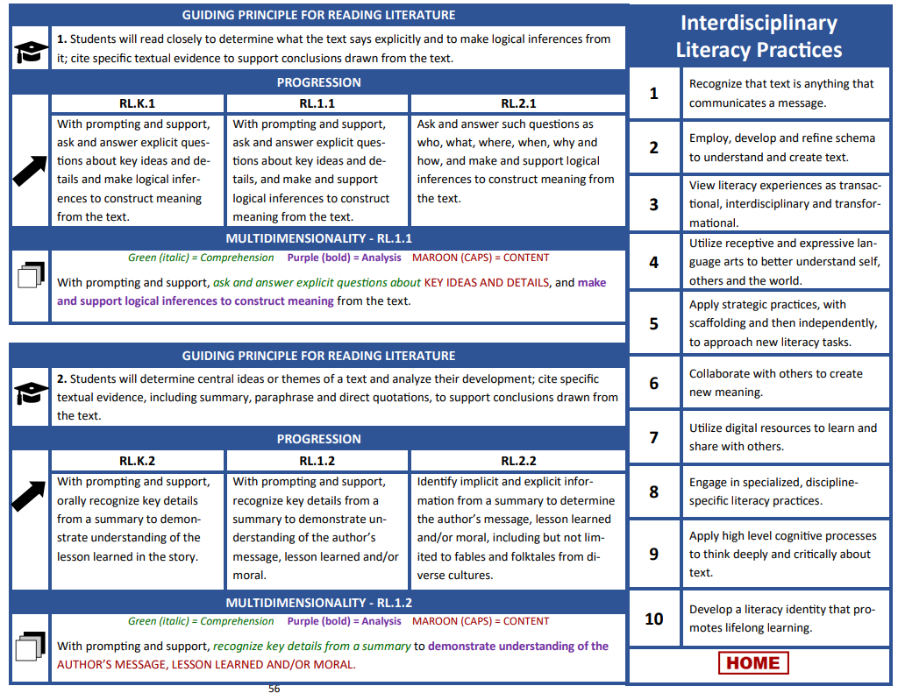
Where can I find the Interdisciplinary Literacy Practices (ILPs)?
They are on every grade-level page of the KAS for Reading and Writing.
Standards are outcomes of instruction.
The Practices are vehicles to reach those outcomes.
Notes:
Guiding Notes:
If you have ever used the KAS for Reading and Writing, you have likely noticed that the ILPs appear on every grade level and with every strand: Reading Foundational Skills, Handwriting, Reading Informational Text, Reading Literature, Language and Composition.
Imagine that you are a first grade teacher who is teaching students the center standard on this screenshot, RI.1.1. During that time, students will read a complex informational text from a high-quality instructional resource and then answer explicit questions about key ideas and details. While this represents the OUTCOME of instruction, the Interdisciplinary Literacy Practices represent possible VEHICLES to reach those outcomes.

Slide 17
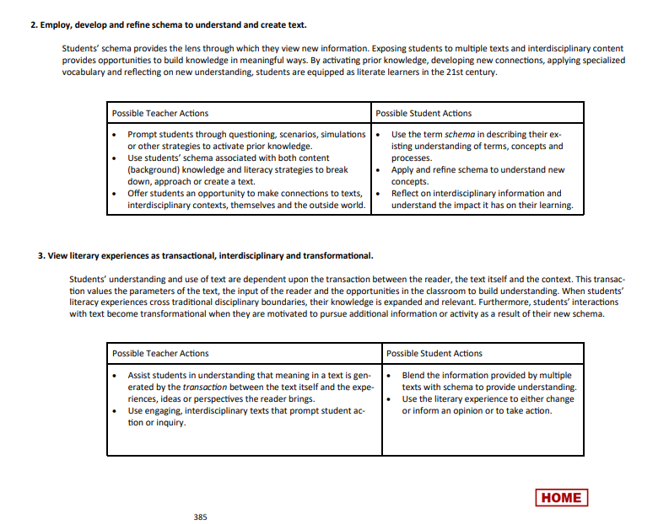
More Resources in the KAS
Additional “look-fors” for possible teacher actions and possible student actions are available on. pp. 384-390.
Notes:
Guiding Notes:
You also may not know that the KAS for Reading and Writing also includes an appendix that describes possible teacher actions and possible student actions to engage students in the ILPs.
This link will take you directly to pp. 384-390 where you can access more information about each individual Practice. We will explore these possible actions later in the module.

Slide 18
Relationship Status:
STANDARDS:
Represent goals or outcomes of an educational program
Are vertically aligned expected outcomes for all students
ILPs:
Are built upon a foundation of common understandings – or practices – which provide the overarching goals for literacy instruction for each student across the state
Notes:
Guiding Notes:
We alluded to this in a previous slide, but the following slides provide further clarification to distinguish between the standards and the ILPs.
While standards are outcomes of each grade individual grade level or grade band, the ILPs are overarching goals that help students reach those individual goals outlined in the standards.

Slide 19
Relationship Status, continued:
STANDARDS:
Establish a statewide baseline of what students should know and be able to do at the conclusion of a grade or grade-span; the minimum content to be learned in each grade or grade-span
ILPS
Are fundamental to fostering a literacy-rich environment that goes beyond teaching and learning isolated skills
Notes:
Guiding Notes:
Likewise, standards are important benchmarks, or targets, for what students should be able to do at the end of a given grade level or grade span; the ILPs speak more broadly to the environment fostered by literacy-rich teaching and learning.

Slide 20
In order to consider how we might engage students in these practices, we are going to do a reading and writing task so that we can experience the Interdisciplinary Literacy Practices as a learner might.
Notes:
Guiding Notes:
The slides that follow represent an opportunity for us to engage with a grade 6 lesson to experience the ILPs as a learner might.
Facilitator Note:
As mentioned in the facilitator notes on slide 2, the following lesson excerpt comes from Amplify ELA Grade 6. If facilitating at the district or school level where an HQIR has been adopted, consider replacing this portion with a lesson from your local curriculum (e.g., EL Education, Wit & Wisdom, StudySync, Into Literature, etc.) This would represent curriculum-based professional learning (CBPL), an essential part of the adoption of high-quality resources.
To learn more about structuring and supporting teachers with curriculum-based professional learning (CBPL), access KDE’s CBPL Guidance Document.

Slide 21
The following lesson is adapted from Amplify ELA Grade 6, Unit 6B: Subunit 2.
C
Notes:
Guiding Notes:
The resources used here come from Amplify ELA Grade 6, Unit 6B: Subunit 2. This unit is entitled, “Mysteries and Investigations.”

Slide 22
Amplify ELA is a green-rated high-quality instructional resource (HQIR).
Read more about HQIRs like Amplify ELA on KyStandards.org.
C
Notes:
Guiding Notes:
As mentioned, this ILP module uses the acronym HQIR repeatedly throughout. If your district has not yet adopted a resource for your grade level, you can learn more about the importance of high-quality literacy resources at the HQIR page on KyStandards.org.

Slide 23
Lesson Objectives from Amplify ELA Grade 6, Unit 6B: Subunit 2.
C
Reading: Students will analyze in detail the techniques, examples and anecdotes that the author uses to introduce and illustrate the topic of yellow fever in The Secret of the Yellow Death: A True Story of Medical Sleuthing.
Writing: Students will use details from the passage to support their claim about whether they would or would not volunteer to investigate the cause of the disease.
Notes:
Guiding Notes:
Take a few moments to read the lesson objectives, which incorporate both the skill that students are learning as well as the knowledge they will be acquiring.
Note that there is both a reading and a writing objective for this sample lesson, indicating that reading and writing are not isolated but complementary subjects.

Slide 24
Standards Addressed in Amplify ELA Grade 6, Unit 6B: Subunit 2.
C
RI.6.3 Analyze in detail how an author develops a key individual, event or idea over the course of a text.
C.6.1 Compose arguments to support claims with clear reasons and relevant evidence.
Notes:
Guiding Notes:
Notice that in addition to the knowledge about yellow fever that students will acquire, the objectives are aligned to grade-level expectations detailed in the KAS for Reading and Writing.

Slide 25
Introduction to Amplify ELA Grade 6, Unit 6B: Subunit 2.
C
Today, we will be reading a text that traces a medical investigation conducted by the U.S. Army, who are hunting for an invisible monster.

Slide 26
Answer the questions under C about ONE of the images.
C
Examine the images on the following slides. These images were created during the outbreak of a deadly disease known as yellow fever.
Notes:
Guiding Notes:
Ensure participants can access the images on the following slides by either projecting them clearly, printing the images for participant tables or giving participants access to the slides.
Direct participants to Letter C in their Participant Guide.

Slide 27
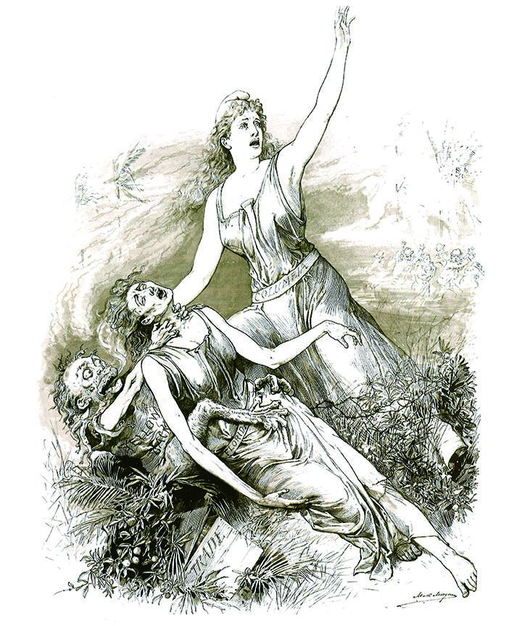
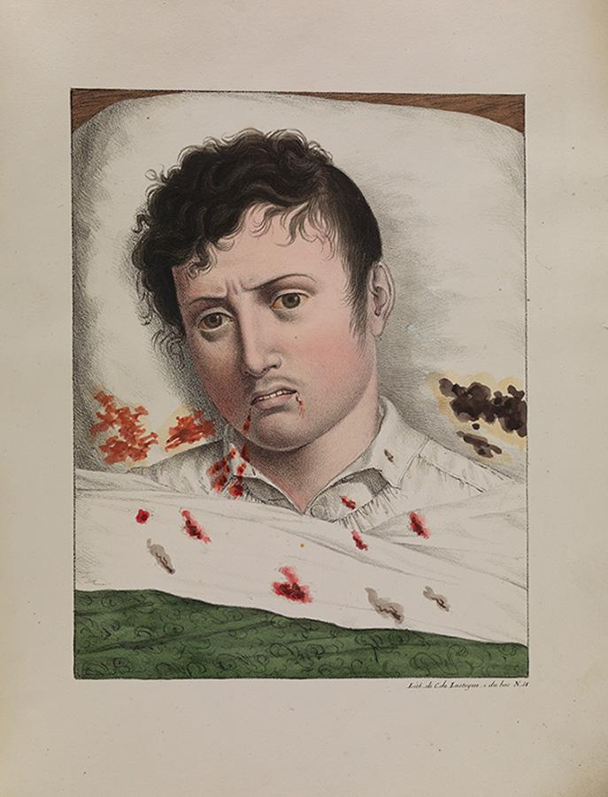
Image Investigation
C
Notes:
Guiding Notes:
Ensure participants can access the images by either projecting them clearly, printing the images for participant tables or giving participants access to these slides.
Give participants 3 silent minutes to observe and make notes about ONE of the images. They should record their thinking on the Participant Guide. As time permits, allow time for partner, table and/or whole group discussion.
Note this exercise engages participants in the following ILPs:
ILP 1: Recognize that text is anything that communicates a message.
Participants must decipher the micromessages contained within the visual depictions of yellow fever while also making inferences about the impact of yellow fever on the body and population.
ILP 2: Employ, develop and refine schema to understand and create text.
Participants rely on existing knowledge (schema) that they have about illnesses and/or epidemics. This exercise allows them to consolidate prior knowledge with new information depicted about the nature of yellow fever.
ILP 4: Utilize receptive and expressive language arts to better understand self, others and the world.
Participants both read/comprehend (receptive) and write/interpret (expressive) their ideas about what was happening in the world during this period.

Slide 28
FIRST READ:
D
Say Something! Determine who is Partner A and who is Partner B. Follow along as your partner reads. Once they have finished their portion, your job is to say something:
something interesting that you learned,
a personal reaction or belief about what is said,
a question/wondering,
or something you want to learn more about.
Notes:
Guiding Notes:
Participants will engage in a paired partner reading of “Summer 1899” by Suzanne Jurmain from The Secret of the Yellow Fever.
This partner reading (called “Say Something”) prompts students to first determine who will be Partner A and who will be Partner B. Partner A then reads a designated portion of the text while Partner B follows along. Once Partner A has read their portion of the text, Partner B should “say something,” which can range from any of the following topics listed in bullets.
The partners should complete their reading in 8-10 minutes and then move immediately into their silent second reading (described on the next slide and under Letter D of the Participant Guide).
Note this exercise engages participants in the following ILPs:
ILP 6: Collaborate with others to create new meaning.
Participants alternate reading the passage to monitor comprehension and make meaning of the text.
ILP 2: Employ, develop and refine schema to understand and create text.
Participants continue to consolidate their understanding of yellow fever using details from the passage.
ILP 4: Utilize receptive and expressive language arts to better understand self, others and the world.
Participants both read/comprehend (receptive) and write/interpret (expressive) their ideas about what was happening in the world during this period.
ILP 5: Apply strategic practices, with scaffolding and then independently, to approach new literacy tasks.
Students work with a partner as a scaffold as they monitor their comprehension and make meaning of the text. This will support their silent second reading of the text.

Slide 29
SECOND READ:
D
After you’ve finished reading, re-read the passage silently and highlight two details in the text that stood out to you and helped create a vivid picture of yellow fever.
Once you finish, go to E to complete the writing prompt.
Notes:
Guiding Notes:
Monitor as participants finish their paired partner reading and begin working silently on the second reading.
As they finish reading for the second time, participants should proceed to letter E to complete the writing prompt (on the next slide).
Note this exercise engages participants in the following ILPs:
ILP 8: Engage in specialized, discipline-specific literacy practices.
Since the standard RI.6.3 requires students to analyze how authors develop ideas over the course of the text, this exercise demonstrates how re-reading with a specific purpose can help practice and acquire this skill.
ILP 9: Apply high level cognitive processes to think deeply and critically about text.
During the first reading with a partner, students read for comprehension. In this second silent reading, students are asked to consider the text from the perspective of the author who was developing the idea about the threat of yellow fever using specific details.

Slide 30
WRITING PROMPT
E
Would you volunteer to travel to a place with yellow fever to investigate the cause of the disease? Describe two details from the text that impact your decision to go or not go.
Notes:
Guiding Notes:
Participants should begin the writing prompt as soon as they finish the second reading of the text.
Note this exercise engages participants in the following ILPs:
ILP 3: View literacy experiences as transactional, interdisciplinary and transformational.
As participants engage with multiple texts (the images and the informational text), they must synthesize their new understanding of yellow fever from both a scientific and historical perspective. They must be aware of how this knowledge has transformed their thinking and then use that thinking to make a defensible claim about their choices.
ILP 10: Develop a literacy identity that promotes lifelong learning.
When participants must apply knowledge and skills acquired during a reading to a real-world situation, they experience the cumulative impact of reading and writing on life beyond school.

Slide 31
REFLECTION TASK
Your facilitator will assign you and your partner 1-2 Practices to reflect on:
As you reflect on the sample lesson we just experienced, use the following slides to determine how both the facilitator (teacher) and the participants (students) engaged in the ILPs.
Record your thinking on the Participant Guide. You will present your findings to the group.
F
Notes:
Guiding Notes:
Participants will need access to these slides in order to complete this exercise. You may wish to print the slides or provide them with a link.
If working with a group: Count off 1-10 with each group so that each group has one or two Practice(s) to reflect on from the sample lesson. You may also have cards numbered 1-10 for representatives from each group to draw to determine the Practice(s) they will reflect on. Depending on your group, you also may choose to pre-assign Practices by grade band (e.g., K-2 will reflect on ILPs 1-3, grades 4-5 will reflect on ILPs 4-6, etc.)
If working as an individual on this module: Select two ILPs that you would like to reflect on from the sample lesson.

Slide 32
ILP 1: Recognize that text is anything that communicates a message.
F
Possible Teacher Actions | Possible Student Actions
- Intentionally choose print and non-print interdisciplinary texts to demonstrate the variety of ways in which authors can communicate meaning. | - Recognize the author’s perspective and intended meaning in creating the message in both print and non-print text. - Recognize that messages are conveyed with different purposes and through varying forms, whether the text is visual, auditory or digital.
Reflect: How did you as a learner/participant engage in this Practice in the lesson? How did the facilitator plan for you to engage in this Practice?
Notes:
Guiding Notes:
Participants will use this slide as a reference to complete letter F.
The image investigation exercise engaged students in ILP 1; however, participants may identify other examples of engagement with this ILP from the sample lesson.
ILP 1: Recognize that text is anything that communicates a message.
Participants must decipher the micromessages contained within the visual depictions of yellow fever while also making inferences about the impact of yellow fever on the body and population.

Slide 33
ILP 2: Employ, develop and refine schema to understand and create text.
F
Possible Teacher Actions | Possible Student Actions
- Prompt students through questioning, scenarios, simulations or other strategies to activate prior knowledge. - Use students’ schema associated with both content (background) knowledge and literacy strategies to break down, approach or create a text. - Offer students an opportunity to make connections to texts, interdisciplinary contexts, themselves and the outside world. | - Use the term schema in describing their existing understanding of terms, concepts and processes. - Apply and refine schema to understand new concepts. - Reflect on interdisciplinary information and understand the impact it has on their learning
Reflect: How did you as a learner/participant engage in this Practice in the lesson? How did the facilitator plan for you to engage in this Practice?
Notes:
Guiding Notes:
Participants will use this slide as a reference to complete letter F.
The image investigation exercise and the shared partner reading engaged students in ILP 2; however, participants may identify other examples of engagement with this ILP from the sample lesson.
ILP 2: Recognize that text is anything that communicates a message.
Participants must decipher the micromessages contained within the visual depictions of yellow fever while also making inferences about the impact of yellow fever on the body and population.

Slide 34
ILP 3: View literary experiences as transactional, interdisciplinary and transformational.
F
Possible Teacher Actions | Possible Student Actions
- Assist students in understanding that meaning in a text is generated by the transaction between the text itself and the experiences, ideas or perspectives the reader brings. - Use engaging, interdisciplinary texts that prompt student action or inquiry. | - Blend the information provided by multiple texts with schema to provide understanding. - Use the literary experience to either change or inform an opinion or to take action.
Reflect: How did you as a learner/participant engage in this Practice in the lesson? How did the facilitator plan for you to engage in this Practice?
Notes:
Guiding Notes:
Participants will use this slide as a reference to complete letter F.
The writing prompt engaged students in ILP 3; however, participants may identify other examples of engagement with this ILP from the sample lesson.
ILP 3: View literacy experiences as transactional, interdisciplinary and transformational.
As participants engage with multiple texts (the images and the informational text), they must synthesize their new understanding of yellow fever from both a scientific and historical perspective. They must be aware of how this knowledge has transformed their thinking and then use that thinking to make a defensible claim about their choices.

Slide 35
ILP 4: Utilize receptive and expressive language arts to better understand self, others and the world.
F
Possible Teacher Actions | Possible Student Actions
- Provide students with connected and relevant literacy instruction so that they read like a writer/write like a reader, or speak like a listener/listen like a speaker, etc. - Offer varied but related messages from written, auditory and/or graphic texts to examine how receptive and expressive texts are interrelated. | - Create a product (using one of the expressive arts) that reflects a deep and critical understanding of content (using the receptive arts). - Engage actively in their listening, reading and viewing experiences.
Reflect: How did you as a learner/participant engage in this Practice in the lesson? How did the facilitator plan for you to engage in this Practice?
Notes:
Guiding Notes:
Participants will use this slide as a reference to complete letter F.
The image investigation and the shared partner reading engaged participants in ILP 4; however, participants may identify other examples of engagement with this ILP from the sample lesson.
ILP 4: Utilize receptive and expressive language arts to better understand self, others and the world.
Participants both read/comprehend (receptive) and write/interpret (expressive) their ideas about what was happening in the world during this period.
Participants both read/comprehend (receptive) and write/interpret (expressive) their ideas about what was happening in the world during this period.

Slide 36
ILP 5: Apply strategic practices, with scaffolding and then independently, to approach new literacy tasks.
F
Possible Teacher Actions | Possible Student Actions
- Offer and model various learning strategies for how to approach a new text. - Provide opportunities for students to self-regulate by choosing appropriate strategies for a new task. | - Use learning strategies to access unfamiliar or new literacy tasks. - Decide which strategy best meets the need for a particular text or task.
Reflect: How did you as a learner/participant engage in this Practice in the lesson? How did the facilitator plan for you to engage in this Practice?
Notes:
Guiding Notes:
Participants will use this slide as a reference to complete letter F.
The shared partner reading engaged participants in ILP 5; however, participants may identify other examples of engagement with this ILP from the sample lesson.
ILP 5: Apply strategic practices, with scaffolding and then independently, to approach new literacy tasks.
Students work with a partner as a scaffold as they monitor their comprehension and make meaning of the text. This will support their silent second reading of the text.

Slide 37
ILP 6: Collaborate with others to create new meaning.
F
Possible Teacher Actions | Possible Student Actions
- Provide multiple opportunities for collaboration on a variety of texts. - Use collaborative exercises to prompt students’ consideration of diverse experiences and perspectives. | - Listen actively and respectfully to one another to refine understanding and broaden perspectives. - Contribute ideas actively and respectfully in order to refine understanding and broaden perspectives.
Reflect: How did you as a learner/participant engage in this Practice in the lesson? How did the facilitator plan for you to engage in this Practice?
Notes:
Guiding Notes:
Participants will use this slide as a reference to complete letter F.
The shared partner reading engaged participants in ILP 6; however, participants may identify other examples of engagement with this ILP from the sample lesson.
ILP 6: Collaborate with others to create new meaning.
Participants alternate reading the passage to monitor comprehension and make meaning of the text.

Slide 38
ILP 7: Utilize digital resources to learn and share with others.
F
Possible Teacher Actions | Possible Student Actions
- Instruct students on the ethical use of technology and credibility of digital sources. - Provide students with multiple opportunities to learn, communicate and create using various digital resources. | - Demonstrate ethical use of technology in learning, communicating and creating. - Critique digital sources to determine their accuracy and usefulness.
Reflect: How did you as a learner/participant engage in this Practice in the lesson? How did the facilitator plan for you to engage in this Practice?
Notes:
Guiding Notes:
Participants will use this slide as a reference to complete letter F.
Depending on the structure of the module delivery, answers may vary. This sample lesson does not necessarily directly engage participants with ILP 7; however, participants may point out their use of devices during the module and/or capacity to collaborate via their devices.

Slide 39
ILP 8: Engage in specialized, discipline-specific literacy practices.
F
Possible Teacher Actions | Possible Student Actions
- Provide multiple examples of literary forms (e.g., poetry, prose, drama, etc. in ELA), focusing on the necessary approaches to comprehend the form presented. | - Employ discipline-specific approaches to interpret authentic texts. - Create text according to conventions, processes, information and forms that are valued by the discipline.
Reflect: How did you as a learner/participant engage in this Practice in the lesson? How did the facilitator plan for you to engage in this Practice?
Notes:
Guiding Notes:
Participants will use this slide as a reference to complete letter F.
The silent reading prompt engaged participants in ILP 8; however, participants may identify other examples of engagement with this ILP from the sample lesson.
ILP 8: Engage in specialized, discipline-specific literacy practices.
Since the standard RI.6.3 requires students to analyze how authors develop ideas over the course of the text, this exercise demonstrates how re-reading with a specific purpose can help practice and acquire this skill.

Slide 40
ILP 9: Apply high level cognitive processes to think deeply and critically about text.
F
Possible Teacher Actions | Possible Student Actions
- Use direct instruction to model and practice specific thinking processes (e.g., application, synthesis, analysis, creativity, etc.). - Scaffold instruction to assist students in synthesizing ideas from multiple texts. | - Reflect verbally and/or through written expression on the content of a text. - Annotate text to interact with and analyze the content. - Break down a text to determine the use of literary devices/techniques and their effect.
Reflect: How did you as a learner/participant engage in this Practice in the lesson? How did the facilitator plan for you to engage in this Practice?
Notes:
Guiding Notes:
Participants will use this slide as a reference to complete letter F.
The silent reading prompt engaged participants in ILP 9; however, participants may identify other examples of engagement with this ILP from the sample lesson.
ILP 9: Apply high level cognitive processes to think deeply and critically about text.
During the first reading with a partner, students read for comprehension. In this second silent reading, students are asked to consider the text from the perspective of the author who was developing the idea about the threat of yellow fever using specific details.

Slide 41
ILP 10: Develop a literacy identity that promotes lifelong learning.
F
Possible Teacher Actions | Possible Student Actions
- Discuss the role of an active and engaged reader. - Provide opportunities for all levels of readers and writers to experience success. - Offer a variety of engaging texts geared toward student interest, demonstrating that multiple reading options exist. | - Utilize a variety of texts for multiple purposes, both inside and outside of the classroom. - Take risks in applying various strategies and techniques in reading and writing.
Reflect: How did you as a learner/participant engage in this Practice in the lesson? How did the facilitator plan for you to engage in this Practice?
Notes:
Guiding Notes:
Participants will use this slide as a reference to complete letter F.
The writing prompt engaged participants in ILP 10; however, participants may identify other examples of engagement with this ILP from the sample lesson.
ILP 10: Develop a literacy identity that promotes lifelong learning.
When participants must apply knowledge and skills acquired during a reading to a real-world situation, they experience the cumulative impact of reading and writing on life beyond school.

Slide 42
Share your reflections:
F
How did the sample lesson meaningfully engage you as a learner in the ILPs?
How did you perceive the ILPs supporting your progress towards mastery of the standards?
Standards Addressed:
RI.6.3 Analyze in detail how an author develops a key individual, event or idea over the course of a text.
C.6.1 Compose arguments to support claims with clear reasons and relevant evidence.
Notes:
Guiding Notes:
Provide participants an opportunity to share their reflections on these questions with the group, re-emphasizing the following points:
The ILPs are STUDENT (or, in this case, learner) practices rather than teacher practices.
The ILPS are not additional standards but, instead, deepen student engagement with the skills they are learning.
The ILPs broaden our understanding of literacy to include but also expand reading and writing skills.

Slide 43
Break
Notes:
Guiding Notes:
It is recommended to take a 8-10 minute break.

Slide 44
REVIEW: The ILPs Are Not Additional Standards
Unlike the mathematical practices, the ten literacy practices are NOT additional standards.
Instead, think of the ILPs as levers to engage students more deeply with knowledge or skills they are accessing via the texts they read and write.
Notes:
Guiding Notes:
Participants may be familiar with the Standards for Mathematical Practice from the KAS for Mathematics. These are additional standards that are taught and assessed in mathematics instruction in Kentucky.
This is a particularly important distinction if working with participants across content areas or with elementary school educators who may be responsible for and/or familiar with the KAS in multiple content areas.

Slide 45
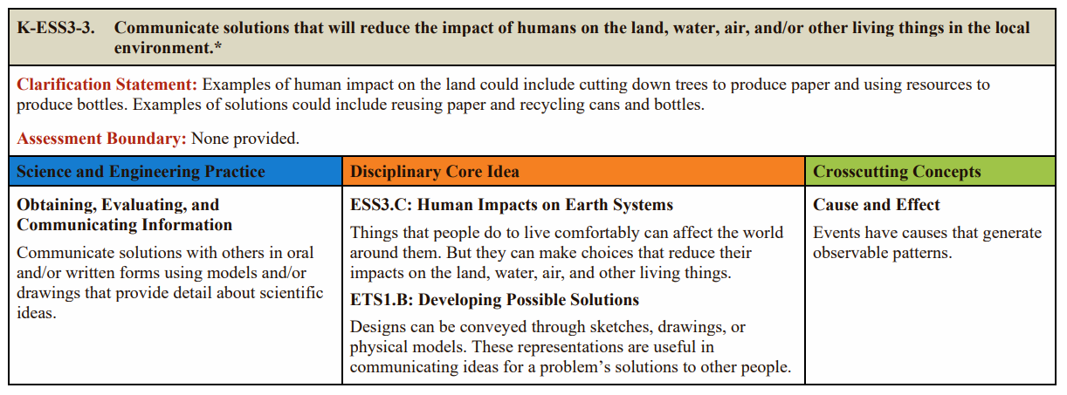
Not Attached to Specific Standards
Because ILPs are the overarching goals for creating a literacy-rich environment, they are not attached to specific standards as in the mathematics and science documents. Multiple literacy practices are engaged in the application and mastery of each reading and writing standard.
Notes:
Guiding Notes:
Similarly, participants may be familiar with the Science and Engineering Practices in the KAS for Science. These Practices, unlike the ILPs, are attached to specific standards as you can see in this excerpt from the grade 3 science standards.
As with the Standards for Mathematical Practice, this is a particularly important distinction if working with participants across content areas or with elementary school educators who may be responsible for and/or familiar with the KAS in multiple content areas.

Slide 46
Interdisciplinary, But Not Explicit Expectations of Other Disciplines
The ILPs promote the behaviors of a literate citizen within and across disciplines.
They are interdisciplinary literacy practices; however, they are not linked to other disciplines as the other content areas have been charged with incorporating literacy into their own discipline-specific document during the standards revision process.
Notes:
Guiding Notes:
Note that while the ILPs are interdisciplinary and can serve students in all of the subjects they study, there are specific discipline-specific approaches to literacy in each KAS document, a concept these slides will allow you to explore in a few moments.

Slide 47
What is disciplinary literacy?
G
“The reading and writing practices used within the disciplines (e.g., science, mathematics, social studies, the arts and literature) to create, communicate and evaluate concepts within the disciplines” (Shanahan & Shanahan, 2015).
Teaching students to read and write as disciplinary experts might read and write
Notes:
Guiding Notes:
This definition from Shanahan & Shanahan (2015) comes from Fundamentals of Literacy Instruction & Assessment edited by Martha C. Hougen, Chapter 9: “The What and Why of Disciplinary Literacy.”

Slide 48
What is a “disciplinary expert”?
Reading & Writing | literature scholars, journalists, linguists, writers
Mathematics | mathematicians, computer scientists, statisticians, data scientists
Science | earth scientists, meteorologists, chemists, biologists, physicists, medical professionals
Social Studies | political scientists, economists, geographers, historians, psychologists
Visual & Performing Arts | visual artists, media artists, musicians, curators, performers
*This does not represent an exhaustive list of experts within each discipline.
Notes:
Guiding Notes:
Note that this list is not an exhaustive list of experts in each discipline.

Slide 49
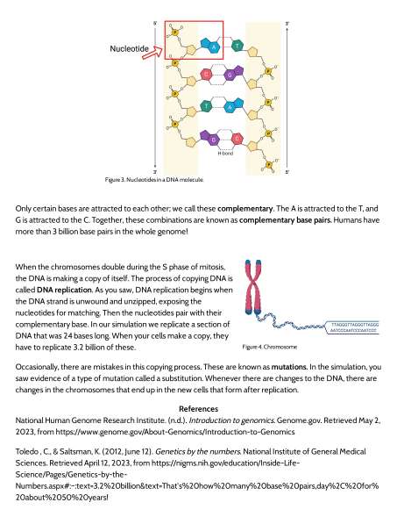
Why teach students to read and write as disciplinary experts?
H
Complex texts vary by discipline and have different conventions, purposes and audiences.
Consider this excerpt from OpenSciEd’s high school biology materials.
What features are specific to this text that students might need support with?
Notes:
Guiding Notes:
Participants may prefer to access the original version of this document rather than consider the screenshot. The original version can be found at OpenSciEd’s High School Biology materials. OpenSciEd is a green-rated HQIR for science.
Possible Answers:
Students would need prior knowledge of DNA as it is depicted in the diagrams.
Students would need understanding of text features such as captions, diagrams and references.
Students would need support with domain-specific vocabulary.

Slide 50
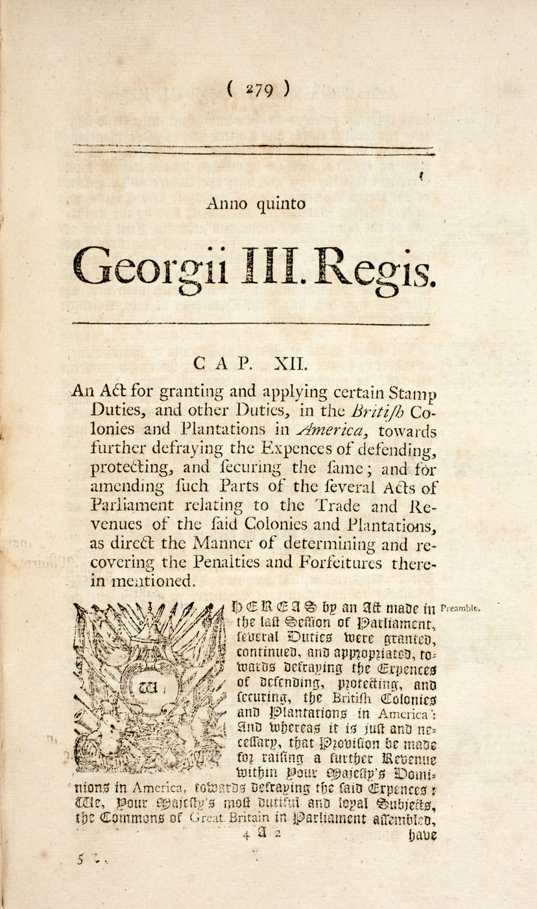
Why teach students to read and write as disciplinary experts?
Students need unique supports for each genre and its domain-specific vocabulary when reading or writing.
Excerpt from the 1765 Stamp Act
Notes:
Guiding Notes:
As discussed in the previous slide, as students read increasingly complex texts across disciplines, they need unique supports to understand the conventions and norms for each genre as well as domain-specific vocabulary when reading or writing.

Slide 51
Disciplinary Texts Students Might Read or Write
Reading & Writing | literature* (fiction, poetry, drama), narrative nonfiction* (memoir, creative nonfiction), informational texts (articles, images)
Mathematics | word problems, mathematical proofs, journal articles, statistical reports
Science | lab reports, scientific journal articles with experiments and observations
Social Studies | primary sources (treaties, newspaper articles, firsthand accounts, legislation, court cases), artifacts (photographs, paintings, tools) and secondary sources
Visual & Performing Arts | artists statements, reviews, critiques, interviews, essays, exhibition texts, handbooks, newspaper articles, scholarly journals, websites/blogs, gallery handouts
Note that beginning in Grade 8, the KAS for Reading and Writing specifies that students will use narratives strategically in other modes of writing; therefore, Grade 8-12 students would not be instructed to write a narrative in isolation.
Notes:
Guiding Notes:
This slide provides examples of disciplinary texts students might read or write. Just as speakers or writers change their tone for various audiences and purposes, disciplinary literacy supports students in navigating these various norms and conventions when reading and writing across all the subjects they study.

Slide 52
For more examples of disciplinary literacy built around complex texts:
Access the Text-Based Writing Across Disciplines webpage for 40 high-quality reading-writing prompts in:
Reading and Writing
Mathematics
Science
Social Studies
Visual & Performing Arts
Notes:
Guiding Notes:
Text-Based Writing Across Disciplines is a comprehensive set of sample reading-writing prompts that treat reading and writing as complementary (not isolated subjects) in the content areas listed on the slide. These provide high-quality examples of how teachers might engage students in disciplinary literacy using the KAS and the ILPs.

Slide 53
How is disciplinary literacy represented in the KAS? Step 1
I
For this exercise, you will select one of the following excerpts from the KAS on the slides that follow:
Mathematics - Grade 1
Science - Grade 5
Social Studies - Grade 7
Health Education - High School
Visual Arts - High School
Notes:
Guiding Notes:
In this exercise, participants will investigate the claim from a previous slide that “other content areas have been charged with incorporating literacy into their own discipline-specific document during the standards revision process.” In other words, they are looking at the interdisciplinary literacy implications of the KAS documents and how knowledge of the ILPs, though not the responsibility of all content area teachers, can support content and skills acquisition.
Participants may choose to select a content area or grade level closely aligned with their current role.

Slide 54
How is disciplinary literacy represented in the KAS? Step 2
I
Once you have located your excerpt from the KAS, read the excerpt and make notes on the following questions on your Participant Guide:
Where do you see literacy skills embedded within these content area standards?
What are the connections you see between these standards and potential engagement with the ILPs?
Notes:
Guiding Notes:
Participants will need access to these slides for this exercise. Share the link or print these slides prior to the session.
Note that participants are recording their thinking as they read. You may choose to ask participants to work in partners or small groups.

Slide 55
OPTION 1:
KAS for Mathematics Grade 1: Measurement and Data
I
This comes from p. 42 of the KAS for Mathematics.
Notes:
Guiding Notes:
Option 1 is a grade 1 standard from the KAS for Mathematics.
Possible Literacy Connections:
This standard requires students to ask and answer questions, using domain-specific language. Students write by organizing and representing data with up to three categories. Students read by interpreting data and making inferences about the data.
Possible ILP Connections: Participants may discuss the following or many other possible connections to the ILPs.
ILP 1: Recognize that text is anything that communicates a message.
Students interpret, organize and represent data into a table or chart, a discipline-specific text.
ILP 6: Collaborate with others to create new meaning.
Students gather data from peers.
ILP 8: Engage in specialized, discipline-specific literacy practices.
Students work with mathematical texts (charts/tables) and interpret data.

Slide 56
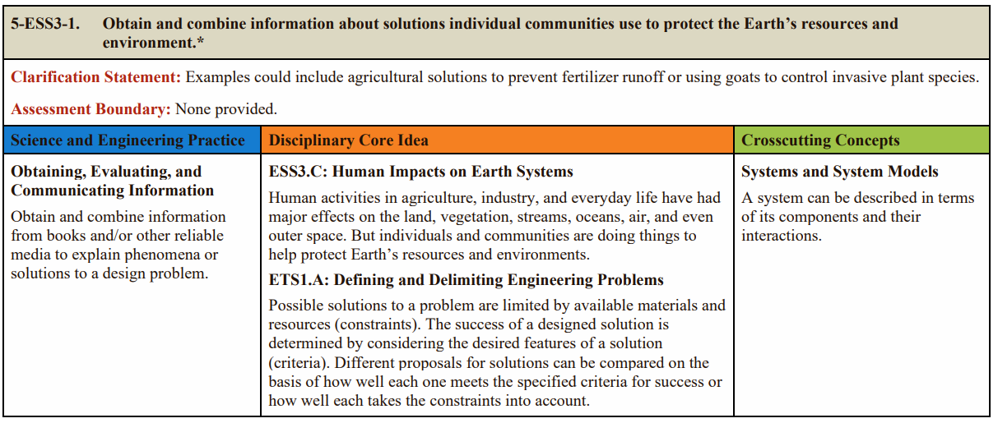
OPTION 2:
KAS for Science Grade 5
I
This comes from p. 96 of the KAS for Science.
Notes:
Guiding Notes:
Option 2 is a grade 5 standard from the KAS for Science.
Possible Literacy Connections:
This standard requires students obtain information from reliable sources and then synthesize what they have learned and apply it to an explanation of a phenomenon or solution to design a problem. Students should have the skills to evaluate sources for reliability as well as know how to apply synthesized information to real-life situations.
Possible ILP Connections: Participants may discuss the following or many other possible connections to the ILPs.
ILP 9: Apply high level cognitive processes to think deeply and critically about text.
Students must think critically about the reliability of information and then synthesize information from multiple sources.
ILP 8: Engage in specialized, discipline-specific literacy practices.
Students know how to read and evaluate scientific texts.
ILP 10: Develop a literacy identity that promotes lifelong learning.
Students apply scientific knowledge and skills to real-world scenarios.

Slide 57
OPTION 3:
KAS for Social Studies Grade 7
I
This comes from p. 117 of the KAS for Social Studies.
Notes:
Guiding Notes:
Option 3 is a grade 7 standard from the KAS for Social Studies.
Possible Literacy Connections:
This standard requires students to read and analyze multiple sources to answer compelling and supporting questions. They are also expected to construct explanations using reasoning, correct sequence, examples and details with relevant information and data. As students build their arguments, they address local, regional and global problems as well as work deliberately and democratically with others in their discussions.
Possible ILP Connections: Participants may discuss the following or many other possible connections to the ILPs.
ILP 9: Apply high level cognitive processes to think deeply and critically about text.
Students must think critically about the reliability of information and then synthesize information from multiple sources.
ILP 6: Collaborate with others to create new meaning.
Students work deliberately and democratically with others in their discussions.
ILP 10: Develop a literacy identity that promotes lifelong learning.
Students use information obtained from multiple sources and constructed arguments to address local, regional and global problems.

Slide 58
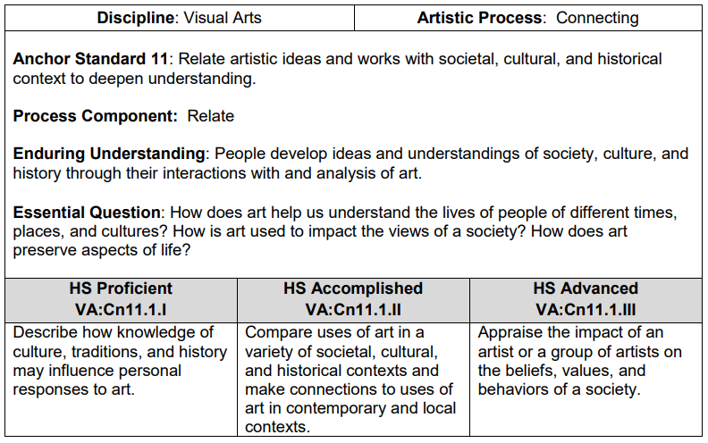
OPTION 4:
KAS for Visual and Performing Arts High School Visual Arts
I
This comes from p. 227 of the KAS for Visual and Performing Arts.
Notes:
Guiding Notes:
Option 4 is a high school visual arts standard from the KAS for Visual and Performing Arts.
Possible Literacy Connections:
This standard requires students to analyze visual texts and then contextualize them within a culture, tradition or history. They must think critically about the role of a piece of art as it reflects a society.
Possible ILP Connections: Participants may discuss the following or many other possible connections to the ILPs.
ILP 1: Recognize that text is anything that communicates a message.
Students analyze a visual (non-linguistic) text.
ILP 4: Utilize receptive and expressive language arts to better understand self, others and the world.
Students use art to better understand societal, cultural and historical contexts as well as the present day.
ILP ILP 9: Apply high level cognitive processes to think deeply and critically about text.
Students must use analytical skills to determine how a visual might represent an abstract concept.

Slide 59
OPTION 5:
KAS for Health Education High School
I
This comes from p. 49 of the KAS for Health Education.
Notes:
Guiding Notes:
Option 5 is a high school standard from the KAS for Health Education.
Possible Literacy Connections:
This standard requires students to read and evaluate health information for validity, reliability and accessibility.
Possible ILP Connections: Participants may discuss the following or many other possible connections to the ILPs.
ILP 1: Recognize that text is anything that communicates a message.
While some health information may be presented as linguistic text, others may be products, videos, images or other multimedia.
ILP 2: Employ, develop and refine schema to understand and create text.
Students use prior knowledge of validity and reliability to understand health information.
ILP 10: Develop a literacy identity that promotes lifelong learning.
Students use critical reading and writing skills to address a lifelong need to maintain health.

Slide 60
PAUSE
J
If you sent a text to a colleague right now explaining your major takeaway about the Interdisciplinary Literacy Practices, what would you say?
Notes:
Guiding Notes:
Direct participants to letter J on their Participant Guide to document their thinking.
Consider taking a break if needed before beginning Part 2.

Slide 61
Part 2:
How are Kentucky
teachers engaging
students in the
ILPs?
Notes:
Guiding Notes:
Now we are going to see some examples of Kentucky teachers from around the Commonwealth who are engaging students in the Interdisciplinary Literacy Practices.

Slide 62
Module Objectives, Part 2:
Part 2: What do the Interdisciplinary Literacy Practices (ILPs) look and sound like in Kentucky classrooms?
Watch 2-3 Kentucky teachers from various grade levels and content areas as they engage students in the ILPs.
Reflect on how these teachers engage students in the ILPs.
Notes:
Guiding Notes:
After learning about and exploring the instructional implications of the Practices, you will have an opportunity to see the Practices in action in Kentucky classrooms.
A Note to Facilitators:
Consider informing participants that they will have choice and/or opportunity to watch videos that are relevant to their grade level, content area or resource. While not every subject is represented in each grade level, the videos offer opportunities to learn from a variety of expert Kentucky colleagues.

Slide 63
Videos Available in this Series
K | Reading & Writing
1 | Science
2 | Reading & Writing
3 | Reading & Writing
4 | Reading & Writing
5 | Social Studies
6 | Math
7 | Reading & Writing
8 | Science
9-10 | Reading & Writing
11-12 | Reading & Writing
*Note that the high school videos available reflect the grade bands used in the KAS for Reading and Writing.
Notes:
Guiding Notes:
Depending on the length of the session and the participants attending, you may select 3-4 videos to view and discuss together based on participant:
grade level
subject area
adopted high-quality instructional resource
Each video is 5-6 minutes in length. As facilitators or individuals strategically select videos to watch, make considerations for time to discuss the video content as it applies to the local context.

Slide 64
Questions to Consider While Viewing
K L M
How did you see the teacher engaging students in the ILPs? | What from this video either confirms or challenges your instructional practices?
How do you see the teacher leveraging an HQIR in instruction? | How might these videos support your leadership/coaching?
Notes:
Guiding Notes:
These questions are available on letter K of the Participant Guide. They are intended to support a variety of levels of educators from classroom teachers to leaders.
Note participants may discuss other considerations or ideas beyond these recommended questions. These are a suggestion to support participant engagement with the video.

Slide 65
Kindergarten: Reading and Writing
Core Knowledge®
The kindergarten one-pager provides a detailed overview of the lesson, standards addressed and ILPs addressed.
This work is based on an original work of the Core Knowledge ® Foundation made available through licensing under a Creative Commons Attribution-NonCommercial- ShareAlike 4.0 International License. This does not in any way imply that the Core Knowledge Foundation endorses this work.
Notes:
Guiding Notes:
This video features Tabitha Lafferty from Fayette County Public Schools in Kentucky.
Transcript to this video: https://education.ky.gov/curriculum/standards/kyacadstand/Documents/Kindergarten_ILP_Video_Transcript.pdf
Possible Discussion Points to Support Participant Engagement:
ILP 1: Recognize that text is anything that communicates a message.
ILP 2: Employ, develop and refine schema to understand and create text.
ILP 4: Utilize receptive and expressive language arts to better understand self, others and the world.
ILP 5: Apply strategic practices, with scaffolding and then independently, to approach new literacy tasks.
ILP 6: Collaborate with others to create new meaning.
ILP 7: Utilize digital resources to learn and share with others.
ILP 8: Engage in specialized, discipline-specific literacy practices.
ILP 9: Apply high level cognitive processes to think deeply and critically about text.
Questions to Promote Discussion:
How did you see the teacher engaging students in the ILPs?
What from this video either confirms or challenges your instructional practices?
How do you see the teacher leveraging an HQIR in instruction?
How might these videos support your leadership/coaching?

Slide 66
Grade 1: Science
The grade 1 one-pager provides a detailed overview of the lesson, standards addressed and ILPs addressed.
Notes:
Guiding Notes:
This video features Melissa Cupp from Fayette County Public Schools in Kentucky.
Transcript to this video: https://education.ky.gov/curriculum/standards/kyacadstand/Documents/Grade_1_ILP_Video_Transcript.pdf
Possible Discussion Points to Support Participant Engagement:
ILP 1: Recognize that text is anything that communicates a message.
ILP 2: Employ, develop and refine schema to understand and create text.
ILP 3: View literacy experiences as transactional, interdisciplinary and transformational.
ILP 4: Utilize receptive and expressive language arts to better understand self, others and the world.
ILP 5: Apply strategic practices, with scaffolding and then independently, to approach new literacy tasks.
ILP 6: Collaborate with others to create new meaning.
ILP 8: Engage in specialized, discipline-specific literacy practices.
ILP 9: Apply high level cognitive processes to think deeply and critically about text.
ILP 10: Develop a literacy identity that promotes lifelong learning.
Questions to Promote Discussion:
How did you see the teacher engaging students in the ILPs?
What from this video either confirms or challenges your instructional practices?
How do you see the teacher leveraging an HQIR in instruction?
How might these videos support your leadership/coaching?

Slide 67
Grade 2: Reading and Writing
The grade 2 one-pager provides a detailed overview of the lesson, standards addressed and ILPs addressed.
Notes:
Guiding Notes:
This video features Catesby Spears from Madison County Schools in Kentucky.
Transcript to this video: https://education.ky.gov/curriculum/standards/kyacadstand/Documents/Grade_2_ILP_Video_Transcript.pdf
Possible Discussion Points to Support Participant Engagement:
ILP 1: Recognize that text is anything that communicates a message.
ILP 2: Employ, develop and refine schema to understand and create text.
ILP 4: Utilize receptive and expressive language arts to better understand self, others and the world.
ILP 5: Apply strategic practices, with scaffolding and then independently, to approach new literacy tasks.
ILP 6: Collaborate with others to create new meaning.
ILP 10: Develop a literacy identity that promotes lifelong learning.
Questions to Promote Discussion:
How did you see the teacher engaging students in the ILPs?
What from this video either confirms or challenges your instructional practices?
How do you see the teacher leveraging an HQIR in instruction?
How might these videos support your leadership/coaching?

Slide 68
Grade 3: Reading and Writing
The grade 3 one-pager provides a detailed overview of the lesson, standards addressed and ILPs addressed.
Notes:
Guiding Notes:
This video features Wendy Young from Fayette County Public Schools in Kentucky.
Transcript to this video: https://education.ky.gov/curriculum/standards/kyacadstand/Documents/Grade_3_ILP_Video_Transcript.pdf
Possible Discussion Points to Support Participant Engagement:
ILP 1: Recognize that text is anything that communicates a message.
ILP 2: Employ, develop and refine schema to understand and create text.
ILP 3: View literacy experiences as transactional, interdisciplinary and transformational.
ILP 4: Utilize receptive and expressive language arts to better understand self, others and the world.
ILP 6: Collaborate with others to create new meaning.
ILP 9: Apply high level cognitive processes to think deeply and critically about text.
ILP 10: Develop a literacy identity that promotes lifelong learning.
Questions to Promote Discussion:
How did you see the teacher engaging students in the ILPs?
What from this video either confirms or challenges your instructional practices?
How do you see the teacher leveraging an HQIR in instruction?
How might these videos support your leadership/coaching?

Slide 69
Grade 4: Reading and Writing
The grade 4 one-pager provides a detailed overview of the lesson, standards addressed and ILPs addressed.
Notes:
Guiding Notes:
This video features Jessie Holmes from Model Laboratory School in Kentucky.
Transcript to this video: https://education.ky.gov/curriculum/standards/kyacadstand/Documents/Grade_4_ILP_Video_Transcript.pdf
Possible Discussion Points to Support Participant Engagement:
ILP 1: Recognize that text is anything that communicates a message.
ILP 4: Utilize receptive and expressive language arts to better understand self, others and the world.
ILP 5: Apply strategic practices, with scaffolding and then independently, to approach new literacy tasks.
ILP 6: Collaborate with others to create new meaning.
Questions to Promote Discussion:
How did you see the teacher engaging students in the ILPs?
What from this video either confirms or challenges your instructional practices?
How do you see the teacher leveraging an HQIR in instruction?
How might these videos support your leadership/coaching?

Slide 70
Grade 5: Social Studies
The grade 5 one-pager provides a detailed overview of the lesson, standards addressed and ILPs addressed.
Notes:
Guiding Notes:
This video features Emily Morrett from Madison County Schools in Kentucky.
Transcript to this video: https://education.ky.gov/curriculum/standards/kyacadstand/Documents/Grade_5_ILP_Video_Transcript.pdf
Possible Discussion Points to Support Participant Engagement:
ILP 1: Recognize that text is anything that communicates a message.
ILP 6: Collaborate with others to create new meaning.
ILP 7: Utilize digital resources to learn and share with others.
ILP 8: Engage in specialized, discipline-specific literacy practices.
ILP 10: Develop a literacy identity that promotes lifelong learning.
Questions to Promote Discussion:
How did you see the teacher engaging students in the ILPs?
What from this video either confirms or challenges your instructional practices?
How do you see the teacher leveraging an HQIR in instruction?
How might these videos support your leadership/coaching?

Slide 71
Grade 6: Mathematics
The grade 6 one-pager provides a detailed overview of the lesson, standards addressed and ILPs addressed.
Notes:
Guiding Notes:
This video features Michael Dennis from Jefferson County Public Schools in Kentucky.
Transcript to this video: https://education.ky.gov/curriculum/standards/kyacadstand/Documents/Grade_6_ILP_Video_Transcript.pdf
Possible Discussion Points to Support Participant Engagement:
ILP 1: Recognize that text is anything that communicates a message.
ILP 3: View literacy experiences as transactional, interdisciplinary and transformational.
ILP 4: Utilize receptive and expressive language arts to better understand self, others and the world.
ILP 5: Apply strategic practices, with scaffolding and then independently, to approach new literacy tasks.
ILP 6: Collaborate with others to create new meaning.
ILP 8: Engage in specialized, discipline-specific literacy practices.
ILP 9: Apply high level cognitive processes to think deeply and critically about text.
Questions to Promote Discussion:
How did you see the teacher engaging students in the ILPs?
What from this video either confirms or challenges your instructional practices?
How do you see the teacher leveraging an HQIR in instruction?
How might these videos support your leadership/coaching?

Slide 72
Grade 7: Reading and Writing
The grade 7 one-pager provides a detailed overview of the lesson, standards addressed and ILPs addressed.
Notes:
Guiding Notes:
This video features Kennita Ballard from Jefferson County Public Schools in Kentucky.
Transcript to this video: https://education.ky.gov/curriculum/standards/kyacadstand/Documents/Grade_7_ILP_Video_Transcript.pdf
Possible Discussion Points to Support Participant Engagement:
ILP 1: Recognize that text is anything that communicates a message.
ILP 2: Employ, develop and refine schema to understand and create text.
ILP 3: View literacy experiences as transactional, interdisciplinary and transformational.
ILP 4: Utilize receptive and expressive language arts to better understand self, others and the world.
ILP 5: Apply strategic practices, with scaffolding and then independently, to approach new literacy tasks.
ILP 6: Collaborate with others to create new meaning.
ILP 7: Utilize digital resources to learn and share with others.
ILP 8: Engage in specialized, discipline-specific literacy practices.
ILP 10: Develop a literacy identity that promotes lifelong learning.
Questions to Promote Discussion:
How did you see the teacher engaging students in the ILPs?
What from this video either confirms or challenges your instructional practices?
How do you see the teacher leveraging an HQIR in instruction?
How might these videos support your leadership/coaching?

Slide 73
Grade 8: Science
The grade 8 one-pager provides a detailed overview of the lesson, standards addressed and ILPs addressed.
Notes:
Guiding Notes:
This video features Lauren Moorhead from Fayette County Public Schools in Kentucky.
Transcript to this video: https://education.ky.gov/curriculum/standards/kyacadstand/Documents/Grade_8_ILP_Video_Transcript.pdf
Possible Discussion Points to Support Participant Engagement:
ILP 2: Employ, develop and refine schema to understand and create text.
ILP 3: View literacy experiences as transactional, interdisciplinary and transformational.
ILP 5: Apply strategic practices, with scaffolding and then independently, to approach new literacy tasks.
ILP 8: Engage in specialized, discipline-specific literacy practices.
ILP 9: Apply high level cognitive processes to think deeply and critically about text.
ILP 10: Develop a literacy identity that promotes lifelong learning.
Questions to Promote Discussion:
How did you see the teacher engaging students in the ILPs?
What from this video either confirms or challenges your instructional practices?
How do you see the teacher leveraging an HQIR in instruction?
How might these videos support your leadership/coaching?

Slide 74
Grades 9-10: Reading and Writing
SpringBoard®
The grade 9 one-pager provides a detailed overview of the lesson, standards addressed and ILPs addressed.
SpringBoard® is a registered trademark of College Board, which is not affiliated with and does not endorse the institutions represented.
Notes:
Guiding Notes:
This video features Angela Hardin from Model Laboratory School in Kentucky.
Transcript to this video: https://education.ky.gov/curriculum/standards/kyacadstand/Documents/Grades_9-10_ILP_Video_Transcript.pdf
Possible Discussion Points to Support Participant Engagement:
ILP 1: Recognize that text is anything that communicates a message.
ILP 3: View literacy experiences as transactional, interdisciplinary and transformational.
ILP 4: Utilize receptive and expressive language arts to better understand self, others and the world.
ILP 6: Collaborate with others to create new meaning.
ILP 9: Apply high level cognitive processes to think deeply and critically about text.
ILP 10: Develop a literacy identity that promotes lifelong learning.
Questions to Promote Discussion:
How did you see the teacher engaging students in the ILPs?
What from this video either confirms or challenges your instructional practices?
How do you see the teacher leveraging an HQIR in instruction?
How might these videos support your leadership/coaching?

Slide 75
Grades 11-12: Reading and Writing
The grades 11-12 one-pager provides a detailed overview of the lesson, standards addressed and ILPs addressed.
Notes:
Guiding Notes:
This video features Renee Boss from Woodford County Schools in Kentucky.
Transcript to this video: https://education.ky.gov/curriculum/standards/kyacadstand/Documents/Grades_11-12_ILP_Video_Transcript.pdf
Possible Discussion Points to Support Participant Engagement:
ILP 1: Recognize that text is anything that communicates a message.
ILP 2: Employ, develop and refine schema to understand and create text.
ILP 3: View literacy experiences as transactional, interdisciplinary and transformational.
ILP 4: Utilize receptive and expressive language arts to better understand self, others and the world.
ILP 5: Apply strategic practices, with scaffolding and then independently, to approach new literacy tasks.
ILP 6: Collaborate with others to create new meaning.
ILP 8: Engage in specialized, discipline-specific literacy practices.
ILP 9: Apply high level cognitive processes to think deeply and critically about text.
ILP 10: Develop a literacy identity that promotes lifelong learning.
Questions to Promote Discussion:
How did you see the teacher engaging students in the ILPs?
What from this video either confirms or challenges your instructional practices?
How do you see the teacher leveraging an HQIR in instruction?
How might these videos support your leadership/coaching?

Slide 76
Part 3:
How might we engage students in the ILPs in our instruction?
Notes:
Guiding Notes:
This portion is perhaps the most important as this provides time for participants to consolidate their learning within the context of their local curriculum supported by HQIRs.
Encourage participants to work with grade-level or content area teams to have planning conversations about where this learning applies to their current work.

Slide 77
Module Objectives, Part 3:
Part 3: How might we engage students in the Interdisciplinary Literacy Practices in our instruction?
Reflect on your own use of the ILPs in your instruction.
Plan to engage students in 1-2 ILPs in upcoming instruction.
Notes:
Guiding Notes:
Part 3 provides time and space to consider what was learned in the module and videos and begin planning to engage students in the Practices while leveraging your own HQIR.

Slide 78
REFLECT
M
Reflect on your instruction last week.
When and where might you already be engaging students in one or more of the ILPs?
When and where might you have missed an opportunity to engage students in one or more of the ILPs?
Notes:
Guiding Notes:
Many teachers are already engaging students in the ILPs. This asset-based assumption exists throughout this module, but is included here for participants to reflect once again as they may have a deeper understanding of the ILPs in practice in various contexts.
Direct participants to reflect on their current practices and provide opportunities to share collaboratively in small groups or with the larger group.

Slide 79
PLAN
N
Access your upcoming lessons or units.
Note: Like the sample lesson from Part 1, HQIRs already contain student engagement with the ILPs that you can leverage to deepen student literacy experiences. While these protocols or routines may not be labeled with Kentucky language, they are still meaningful engagement with the ILPs.
Notes:
Guiding Notes:
This note is incredibly important. HQIRs are externally validated, evidence-based and written by experts who have carefully designed curriculum to comprehensively meet student needs over the course of a year. Make sure that participants do not misinterpret this module or the existence of Kentucky’s ILPs as a prompt to drastically modify their HQIR, even in the name of “enhancement.” Educators may choose to make small adjustments to pacing or individual exercises, but they should do so in consultation with their grade-level or content area teams. Since HQIRs do indeed engage students in protocols and routines that are the ILPs by another name, classroom teachers should have time to see those connections between the Kentucky’s ILP language and the intentional planning of their HQIR.
The links below are internalization tools to support teachers and leaders in getting to know their HQIR during implementation, including considerations for engaging students in the ILPs:
Reading and Writing Unit Internalization and Note Catcher
Reading and Writing Lesson Internalization and Note Catcher
Text Talk Protocol
Student Work Analysis
Reading and Writing Unit Reflection Protocol
These and other HQIR implementation tools for mathematics and science are available in the Curriculum-Based Professional Learning (CBPL) Guidance Document.

Slide 80
PLAN to Integrate the ILPs:
O
Access your upcoming lessons or units.
What reading or writing from the upcoming lessons or unit already engages students in the ILPs?
How can you intentionally plan to deepen student engagement with complex texts using the ILPs?
Identify at least one ILP you intend to engage students in in an upcoming lesson.
Notes:
Guiding Notes:
These guiding questions are on the Participant Guide and provide educators with an opportunity to reflect on their upcoming lessons or units and plan accordingly to leverage the ILPs to deepen student engagement with complex, grade-level texts.

Slide 81
To receive 3 hours of EILA or PD credit:
P
Survey: Upon completion, you will have access to an EILA and/or PD certificate.
Notes:
Guiding Notes:
The linked survey provides valuable feedback to the designers of this module. It also includes a professional development certificate and EILA certificate for 3 hours.
When possible, allow time for participants to complete this survey during the learning session.

Slide 82
Contact:
The Office of Teaching and Learning
Division of Program Standards
ELATeam@education.ky.gov
Notes:
Guiding Notes:
Thank you for completing this module and for your service to Kentucky students!
Contact the Office of Teaching and Learning Division of Program Standards with questions or comments about this module or video series.
ELATeam@education.ky.gov
Kristen Tinch (Grades 6-12)
kristen.tinch@education.ky.gov
Leigh Turner (Grades K-5)
kristen.tinch@education.ky.gov

