Slide 1
Getting to Know the Kentucky Academic Standards for Reading and Writing
Module 1: Section 1A
Revision Process Overview

Slide 2
Group Norms
Assume best intentions.
Listen carefully to one another.
Be open to new ideas.
Be open to working outside your comfort zone.
Ask questions.
Allow a chance for everyone to participate.

Slide 3
Coming Up
Section 1B: Understanding the Architecture
Section 1C: Deeper Dive into the Interdisciplinary
Literacy Practices
Section 1D: Spotlight: Unpacking Multidimensionality
Section 1E: Spotlight: Early Literacy
Section 1F: Additional Instructional Implications
Section 1G: Wrap up of Module 1 & Next Steps

Slide 4
Getting to Know the Kentucky Academic Standards for Reading and Writing
Module 1: Section 1B
Understanding the Architecture

Slide 5
Section 1B Learning Goals
Build a shared understanding of the architecture:
the overall organizational structure of the document,
the different ways to view the standards, and
the design considerations of the specific components within the KAS for Reading and Writing.
Strengthen an understanding of the connection between the components of the KAS for Reading and Writing and the way those components support teachers and other stakeholders.

Slide 6
Organization of the Standards
The KAS for Reading and Writing consists of 6 strands:
Reading Foundational Skills (K-5)
Reading Literature (K-12)
Reading Informational Text (K-12)
Handwriting Skills (K-3)
Composition (K-12)
Language (K-12)
NOTE: To parallel the federal Every Student Succeeds Act, the standards are now entitled Kentucky Academic Standards for Reading and Writing rather than for English/language arts.

Slide 7
The 6 Strands
The strand standards outline what a student should know and be able to do independently by the end of each grade in grades K-8 and each grade band for 9-10 and 11-12.
These grade-level specific and grade-banded standards intentionally support the learning progression as they strategically stair step students toward a guiding principle for each standard.
The Speaking and Listening Strand had to be removed due to “essential skills” curriculum legislation; however, we know that they are still essential to best practice instruction.

Slide 8
KAS for Reading and Writing Grade Level Overviews

Slide 9
Grade-Level Overview Reflection
Read through your grade-level overview, and underline, highlight, circle, etc., elements that impact instruction.
With these elements in mind, how might the information in the grade-level overview be useful in communicating with different stakeholders (parents, students, teachers, administrators, district leaders)?

Slide 10
Kentucky Academic Standards for Reading and Writing

Slide 11
Grade-Level Standards View Reflection
Do you understand the coding?
How would you explain the difference between the standards versus the practices?
How might this grade level view be useful to you in your role?
Where might you need additional support?

Slide 12
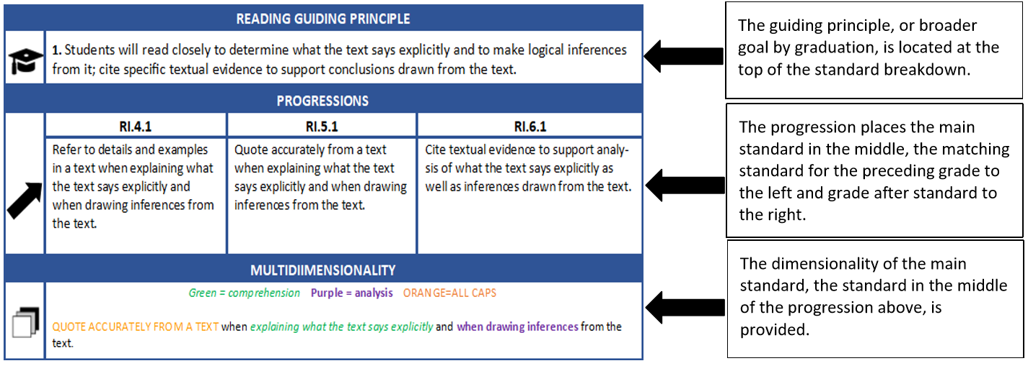
Kentucky Academic Standards for Reading and Writing

Slide 13
Standards Breakdown View Reflection
How might knowing the guiding principle for each standard be useful?
How will access to the mini-progression be helpful?
How will the multidimensionality be useful in providing a deconstruction of the standard?
Where might you need additional support?

Slide 14
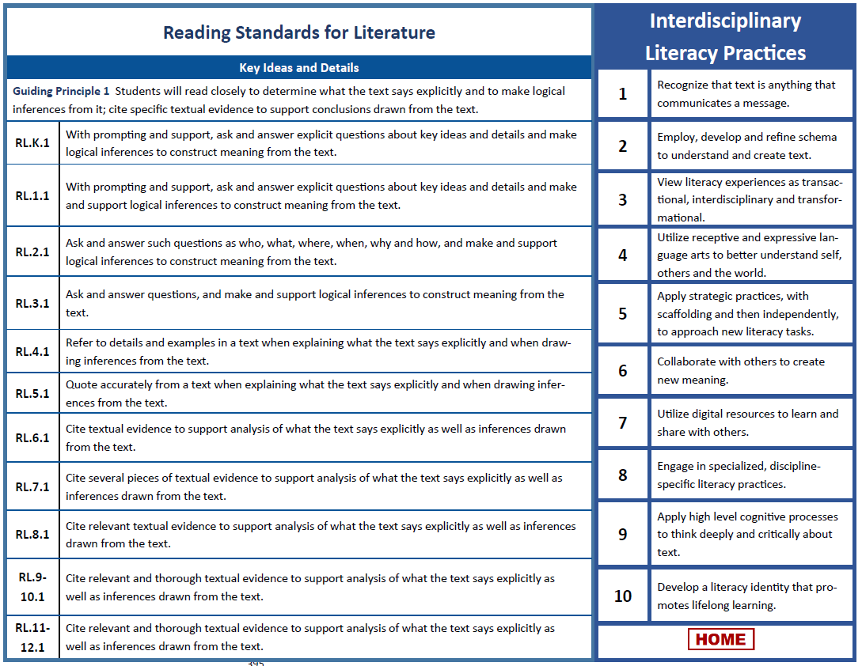
K-12 Standard Progressions

Slide 15
K-12 Progressions Reflection
How might the progressions be useful for vertical alignment? In PLCs?
Where might you need additional support?

Slide 16
Section 1B Learning Goals
Build a shared understanding of the architecture:
the overall organizational structure of the document,
the different ways to view the standards, and
the design considerations of the specific components within the KAS for Reading and Writing.
Strengthen an understanding of the connection between the components of the KAS for Reading and Writing and the way those components support teachers and other stakeholders.

Slide 17
Coming Up
Section 1C: Deeper Dive into the Interdisciplinary
Literacy Practices
Section 1D: Spotlight: Unpacking Multidimensionality
Section 1E: Spotlight: Early Literacy
Section 1F: Additional Instructional Implications
Section 1G: Wrap up of Module 1 & Next Steps

Slide 18
You have completed module 1.
You have completed Module 1: Section 1B: Understanding the Architecture only. After you have completed the entire module, you will be prompted to provide your valuable feedback and receive your certificate (PD/EILA) for six (6) hours credit.
If you would like to move to the next section of Module 1 at this time, continue onto the next slide to begin facilitating Module 1: Section 1C: Deeper Dive into the Interdisciplinary Literacy Practices.

Slide 19
Getting to Know the Kentucky Academic Standards for Reading and Writing
Module 1: Section 1C
Deeper Dive into the Interdisciplinary Literacy Practices

Slide 20
Group Norms
Assume best intentions.
Listen carefully to one another.
Be open to new ideas.
Be open to working outside your comfort zone.
Ask questions.
Allow a chance for everyone to participate.

Slide 21
Essential Questions
What is the purpose and function of the ten interdisciplinary literacy practices?
How are the practices different from the reading and writing content standards?
How does intentional engagement in the practices help to foster literacy and student learning?

Slide 22
Relationship Status
Reading and Writing Content Standards
Interdisciplinary Literacy Practices
Represent goals or outcomes of an educational program
Are vertically aligned expected outcomes for all students
Establish a statewide baseline of what students should know and be able to do at the conclusion of a grade or grade-span; the minimum content to be learned in each grade or grade-span
Address what is to be learned but do not address how learning experiences are to be designed or what resources should be used
Are built upon a foundation of common understandings – or practices – which provide the overarching goals for literacy instruction for each student across the state.
Are fundamental to fostering a literacy-rich environment that goes beyond teaching and learning isolated skills.
Focus on the larger vision and objective of empowering independent, lifelong learners who think deeply and critically about text.

Slide 23
Not Additional Standards
Unlike the mathematical practices, the ten literacy practices are NOT additional standards.
Instead, if utilized, they provide intentional opportunities for students to practice the behaviors of a literate citizen.
Because they are the overarching goals for creating a literacy-rich environment, they are not attached to specific standards as in the mathematics and science documents. Multiple literacy practices are engaged in the application and mastery of each reading and writing standard.
They are interdisciplinary literacy practices; however, they are also not linked to other disciplines as the other content areas have been charged with incorporating literacy into their own discipline-specific document during the standards revision process.

Slide 24
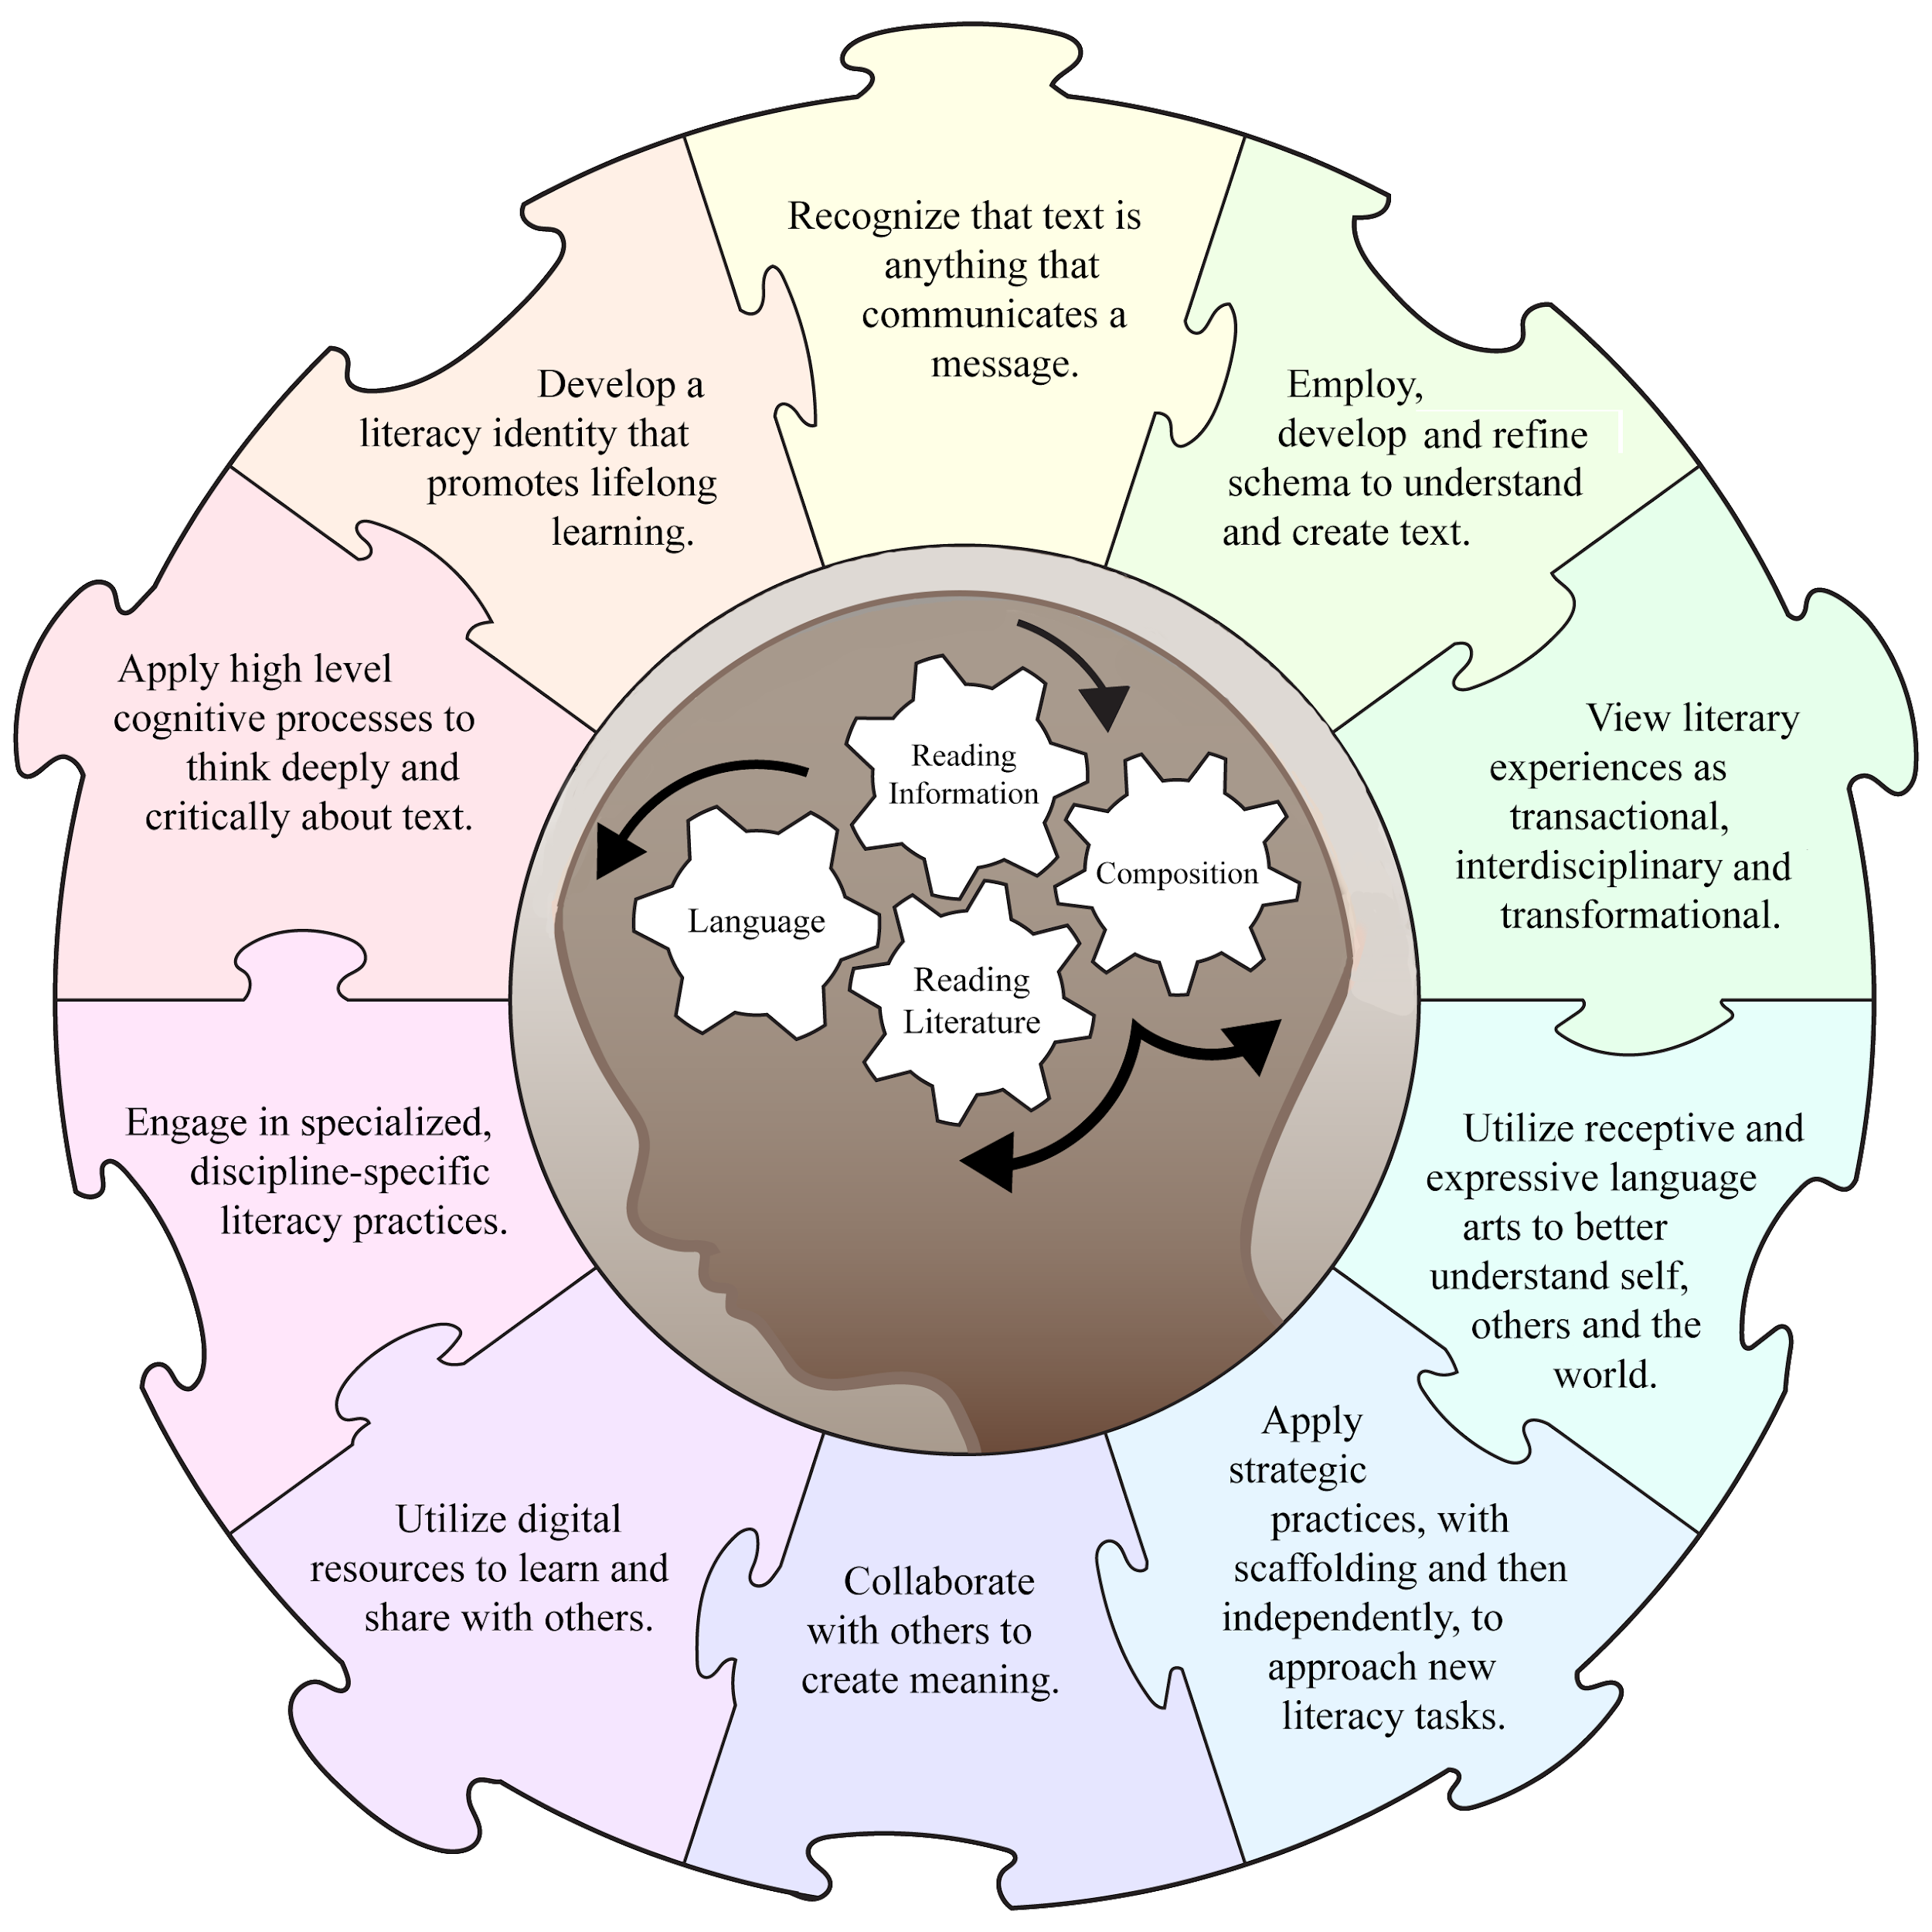
Interdisciplinary Literacy Practices

Slide 25
Instructional Application – Where do you see connections to the literacy practices in the instructional process and/or focusing question?
Source: TNTP Opportunity Myth, Grade 8 Assignments

Slide 26
Literacy Practices Clarifications
Within the KAS document, the ten Practices are clarified further by possible teacher and student actions.
These actions illustrate what the teacher and students may be doing in a classroom that employs the Interdisciplinary Literacy Practices.
While the examples do not provide an exhaustive list, they do demonstrate:
How TEACHERS can provide opportunities for students to experience the literacy practices, and
How STUDENTS will apply these practices, so they may become an innate part of life across the disciplines and beyond school.

Slide 27
Practice 1: Recognize that text is anything that communicates a message.
Possible Teacher Actions
Possible Student Actions
Intentionally choose print and non-print interdisciplinary texts to demonstrate the variety of ways in which authors can communicate meaning.
Recognize the author’s perspective and intended meaning in creating the message in both print and non-print text.
Recognize that messages are conveyed with different purposes and through varying forms, whether the text is visual, auditory or digital.

Slide 28
Practice 2: Employ, develop and refine schema to understand and create text.
Possible Teacher Actions
Possible Student Actions
Prompt students through questioning, scenarios, simulations or other strategies to activate prior knowledge.
Use students’ schema associated with both content (background) knowledge and literacy strategies to break down, approach or create a text.
Offer students an opportunity to make connections to texts, interdisciplinary contexts, themselves and the outside world.
Use the term schema in describing their existing understanding of terms, concepts and processes.
Apply and refine schema to understand new concepts.
Reflect on interdisciplinary information and understand the impact it has on their learning.

Slide 29
Practice 3: View literary experiences as transactional, interdisciplinary and transformational.
Possible Teacher Actions
Possible Student Actions
Assist students in understanding that meaning in a text is generated by the transaction between the text itself and the experiences, ideas or perspectives the reader brings.
Use engaging, interdisciplinary texts that prompt student action or inquiry.
Blend the information provided by multiple texts with schema to provide understanding.
Use the literary experience to either change or inform an opinion or to take action.

Slide 30
Practice 4: Utilize receptive and expressive language arts to better understand self, others and the world.
Possible Teacher Actions
Possible Student Actions
Provide students with connected and relevant literacy instruction so that they read like a writer/write like a reader, or speak like a listener/listen like a speaker, etc.
Offer varied but related messages from written, auditory and/or graphic texts to examine how receptive and expressive texts are interrelated.
Create a product (using one of the expressive arts) that reflects a deep and critical understanding of content (using the receptive arts).
Engage actively in their listening, reading and viewing experiences.

Slide 31
Practice 5: Apply strategic practices, with scaffolding and then independently, to approach new literacy tasks.
Possible Teacher Actions
Possible Student Actions
Offer and model various learning strategies for how to approach a new text.
Provide opportunities for students to self-regulate by choosing appropriate strategies for a new task.
Use learning strategies to access unfamiliar or new literacy tasks.
Decide which strategy best meets the need for a particular text or task.

Slide 32
Instructional Application – Where do you see connections to the literacy practices in the instructional process and/or focusing question?
Source: TNTP Opportunity Myth, Grade 8 Assignments

Slide 33
Practice 6: Collaborate with others to create meaning.
Possible Teacher Actions
Possible Student Actions
Provide multiple opportunities for collaboration on a variety of texts.
Use collaborative exercises to prompt students’ consideration of diverse experiences and perspectives.
Listen actively and respectfully to one another to refine understanding and broaden perspectives.
Contribute ideas actively and respectfully in order to refine understanding and broaden perspectives.

Slide 34
Practice 7: Utilize digital resources to learn and share with others.
Possible Teacher Actions
Possible Student Actions
Instruct students on the ethical use of technology and credibility of digital sources.
Provide students with multiple opportunities to learn, communicate and create using various digital resources.
Demonstrate ethical use of technology in learning, communicating and creating.
Critique digital sources to determine their accuracy and usefulness.

Slide 35
Practice 8: Engage in specialized, discipline-specific literacy practices
Possible Teacher Actions
Possible Student Actions
Provide multiple examples of literary forms (e.g., poetry, prose, drama, literary nonfiction, etc. in E/LA), focusing on the necessary approaches to comprehend the form presented.
Employ discipline-specific approaches to interpret authentic texts.
Create text according to conventions, processes, information and forms that are valued by the discipline.

Slide 36
Practice 9: Apply high level cognitive processes to think deeply and critically about text.
Possible Teacher Actions
Possible Student Actions
Use direct instruction to model and practice specific thinking processes (e.g., application, synthesis, analysis, creativity, etc.).
Scaffold instruction to assist students in synthesizing ideas from multiple texts.
Reflect verbally and/or through written expression on the content of a text.
Annotate text to interact with and analyze the content.
Break down a text to determine the use of literary devices/techniques and their effect.

Slide 37
Practice 10: Develop a literacy identity that promotes lifelong learning.
Possible Teacher Actions
Possible Student Actions
Discuss the role of an active and engaged reader.
Provide opportunities for all levels of readers and writers to experience success.
Offer a variety of engaging texts geared toward student interest, demonstrating that multiple reading options exist.
Utilize a variety of texts for multiple purposes, both inside and outside of the classroom.
Take risks in applying various strategies and techniques in reading and writing.

Slide 38
Instructional Application – Where do you see connections to the literacy practices in the instructional process and/or focusing question?
Source: TNTP Opportunity Myth, Grade 8 Assignments

Slide 39
Discovery Task:
For your current lesson plan or entry in a lesson plan book or digital planner:
Make note of the practices to which you are connecting in either the instructional process or in the student task/assignment.
Also consider how a practice(s) may need to be more explicitly addressed in the instructional process or student task/assignment.

Slide 40
Reflection – The WHY
Why will it be important to have intentional instructional links to the practices?
Why are they important in fostering literacy and student learning?

Slide 41
Coming Up
Section 1D: Spotlight: Unpacking Multidimensionality
Section 1E: Spotlight: Early Literacy
Section 1F: Additional Instructional Implications
Section 1G: Wrap up of Module 1 & Next Steps

Slide 42
You have completed Modul 1: Section 1C
You have completed Module 1: Section 1C: Deeper Dive into the Interdisciplinary Literacy Practices. After you have completed the entire module, you will be prompted to provide your valuable feedback and receive your certificate (PD/EILA) for six (6) hours credit.
If you would like to complete another section of Module 1 at this time, continue onto the next slide to begin facilitating Module 1: Section 1D: Spotlight: Unpacking Multidimensionality.

Slide 43
Getting to Know the Kentucky Academic Standards for Reading and Writing
Module 1: Section 1D
Unpacking Multidimensionality

Slide 44
Group Norms
Assume best intentions.
Listen carefully to one another.
Be open to new ideas.
Be open to working outside your comfort zone.
Ask questions.
Allow a chance for everyone to participate.

Slide 45
Section 1D Learning Goals
Build an understanding of the multidimensionality of the standards and the way this deconstruction can support teachers in the process of designing standards-aligned instruction and grade-level assignments.
Experience how the changes in the KAS for Reading and Writing can and will be reflected in student experiences within Kentucky classrooms.

Slide 46
Why Multiple Dimensions?
The previous English/language arts standards document lacked a focused dimensional approach; as a result, the perceived depth of a standard may have been limited to comprehension due to interpretation or deconstruction of opaque wording.
In the new KAS for Reading and Writing, the reading, composition and language standards consist of multiple dimensions or layers.
By specifying the 3 dimensions separately, this standards document better communicates the intent of each standard so that local instruction and assessment will align to the intended depth and rigor.

Slide 47
What are the dimensions?
The writing teams chose to highlight three dimensions for each standard:
Content
Comprehension
Analysis
The skills and content provide the “what” to help students access concrete and abstract “thinking” needed to practice the “doing” of reading and composing within the discipline.

Slide 48
How is the multidimensionality coded?
CONTENT - DENOTED BY WORDS IN ALL CAPS AND IN MAROON
The tools of an author and the objects of literacy woven into the skills students must access and apply when developing comprehension and performing analysis.
Examples: central idea, theme, tone, structure, syntax

Slide 49
How is the multidimensionality coded?
Comprehension – denoted by words in italics and in green
This concrete dimension requires the objective understanding of a text, topic or convention of language.
Examples: decoding language and words in context, being able to effectively summarize or retell what has been read, knowing the grammar rule

Slide 50
How is the multidimensionality coded?
Analysis – denoted by words in bold and in purple
This abstract dimension requires more than objective understanding of main ideas and key details. The ability to read “between or above the lines” is how students become critical thinkers.
Examples: critical reading to determine underlying meaning and purpose, determining WHY an author made particular choices, being able to effectively explain inferences and what is implied

Slide 51
Coded Example
RI.7.2 Determine CENTRAL IDEAS of a text and analyze their development through citing textual evidence, paraphrasing or summarizing.
CONTENT – The central idea is the content embedded in the standard.
Comprehension – Students must comprehend the text in order to cite, paraphrase or summarize effectively.
Analysis – Students must think abstractly to determine the central ideas and analyze their development.

Slide 52
Application of Multidimensionality
In planning and implementing instruction, one will need to know when and how to utilize the interdependence of comprehension and analysis when having students approach text so that students will develop the skills and knowledge to become independent and proficient thinkers.

Slide 53
Discovery Task: Using Multidimensionality to Check for Standards Alignment
Review the identified targeted standards for the grade level sample task. Note the dimensions:
What is the CONTENT in the standard?
What are the expectations for comprehension?
How are students expected to analyze?
Carefully review the sample task.
To what degree is the assignment aligned to the standards? Does it meet the depth and rigor of each standard?
Explain your thinking in the rationale section.
Follow the same process for sample task 2.

Slide 54
Coming Up
Section 1E: Spotlight: Early Literacy
Section 1F: Additional Instructional Implications
Section 1G: Wrap Up of Module 1 & Next Steps

Slide 55
You have completed Module 1: Section 1D: Spotlight: Unpacking Multidimensionality
If you would like to complete another section of Module 1 at this time, continue onto the next slide to begin facilitating Module 1: Section 1E: Spotlight: Early Literacy.

Slide 56
Getting to Know the Kentucky Academic Standards for Reading and Writing
Module 1: Section 1E
Spotlight: Early Literacy

Slide 57
Group Norms
Assume best intentions.
Listen carefully to one another.
Be open to new ideas.
Be open to working outside your comfort zone.
Ask questions.
Allow a chance for everyone to participate.

Slide 58
Section 1E Essential Questions
How will the changes to the K-3 standards impact instruction?
How will those changes be experienced by students?
How will grades 4-5 be impacted by the changes to the K-3 progressions?

Slide 59
Reading and Writing K-5 Standards
The K-5 Kentucky Academic Standards for Reading and Writing include expectations for:
Reading Foundational Skills applicable across disciplines,
Reading Literature and Reading Informational Text, and
Handwriting, Composition and Language.
The revisions to the K-5 standards align with and build upon the early childhood standards, providing a developmentally appropriate progression as students transition from preschool to kindergarten.

Slide 60
Rigorous Grade-Level Expectations
The standards articulate rigorous grade-level expectations essential to developing a strong infrastructure of essential early literacy skills.
The reading literature and informational text strands have increased rigor with analysis.
For example, kindergarten standards include making inferences to construct meaning rather than waiting until third grade as in the previous standards document.
Multiple standards and practices focus on the development of schema and building content knowledge.
Standard 10 addresses the need to teach comprehension strategies beginning in kindergarten and continuing through grade 12 because of their importance in aiding comprehension and analysis.

Slide 61
Importance of the Standards Revision
Changes to Early Literacy standards provide intentional opportunities for students’ critical thinking skills to begin developing much sooner than before.
The changes also promote the activation of those critical thinking skills as students learn to process the meaning of texts through comprehension and analysis in early primary.
The ultimate goal is to build a foundation that will equip students with the skills and knowledge critical to being successful in later years and, ultimately, in the transition after high school.

Slide 62
Spotlight on Revised Standards for Early Literacy
Early Literacy Strands:
Reading Standards for Foundational Skills
Reading Standards for Literature
Reading Standards for Informational Text
Handwriting Standards
Composition Standards
Language Standards

Slide 63
Spotlight on Revised Standards for Early Literacy
Reading Foundational (RF) Skills
Standard | Strand Category | Focus Grades
RF Standard 1 | Print Concepts | K-1
RF Standard 2 | Phonological Awareness | K-1
RF Standard 3 | Phonics and Word Recognition | K-5
RF Standard 4 | Fluency | K-5

Slide 64
Spotlight on Revised Standards for Early Literacy
Reading Foundational Skills:
Print Concepts/Standard 1
Addition of phrase “to aid in comprehension”
Phonological Awareness/RF Standard 2
Some combining of standards
Best predictor of early reading

Slide 65
Spotlight on Revised Standards for Early Literacy
Reading Foundational Skills:
Phonics and Word Recognition/RF Standard 3
Although the language of “high-frequency words” is only stated in kindergarten, the progression continues into first grade with the next step up in high frequency word recognition, which is decoding regularly spelled one-syllable words.
Specificity provided with the addition of words/phrases such as “orally”, “demonstrate” and “identify, decode and know”
Some combining of standards

Slide 66
Spotlight on Revised Standards for Early Literacy
Reading Foundational Skills:
Fluency/RF Standard 4
A statement about reading fluently on grade-level to support comprehension has been added at the beginning of each K-5 fluency standard.

Slide 67
Spotlight on Revised Standards for Early Literacy
Reading Literature and Reading Informational Text:
RL.1 and RI.1 – Inferencing added to K-3 to improve progression and add what is developmentally appropriate.
RL.2 and RI.2 – Significant changes to K-5 to improve progression, add what is developmentally appropriate and address public feedback about the lack of clarity of Standard 2 in the previous KAS for ELA.
RL.4 – Changes to the examples of non-literal language included in the grade-level standards

Slide 68
Spotlight on Revised Standards for Early Literacy
Reading Literature and Reading Informational Text:
RL.5 – Major changes to K-5 progression to better align to the guiding principle and address public feedback on the clarity of this standard.
RL.6 and RI.6 – Changes to the entire K-12 progression to eliminate confusion found in feedback on point of view versus perspective. Clarity in progression now denotes the depth of this standard and the intended rigor.
RI.8 – Addition of claim to K-5 to improve progression and better align with guiding principle and Composition Standard 1.

Slide 69
Spotlight on Revised Standards for Early Literacy
Reading Literature and Reading Informational Text:
RL.10 and RI.10 – Significant change with the inclusion of comprehension strategies. Students must be able to practice the strategies and apply them on their own in order to read independently and proficiently.
RL.10 and RI.10 – Also, notice the inclusion of the word “analyze”: “to read, comprehend and analyze grade-level appropriate, complex literary/informational texts independently and proficiently.

Slide 70
Spotlight on Revised Standards for Early Literacy
Handwriting Standards:
4 new standards have been written:
K-1 apply to printing.
Grades 2-3 apply to cursive handwriting.
Composition Standards:
The writing process has been incorporated and embedded into all writing modes instead of being an isolated, stand-alone standard.

Slide 71
Discovery Task
The coding and structure of the standards may look similar; however, the writing teams made significant revisions/additions.
Let’s investigate:
Select the Reading Literature strand for a specific grade-level (preferably the one being taught if you are a teacher participant).
Examine the differences between the KAS for ELA and the KAS for Reading and Writing and note the instructional impacts of the new standards.
Remember the multidimensionality view is helpful for highlighting the depth and rigor of the standard and for comparing/contrasting each dimension – content, comprehension and analysis – in both documents.
As time permits, continue your investigation for Reading Informational Text, Reading Foundational, etc.

Slide 72
Grade 2 Comparison Example
KAS for ELA
KAS for Reading and Writing
RL.2.2: Recount stories, including fables and folktales from diverse cultures, and determine their central message, lesson, or moral.
RL.2.5: Describe the overall structure of a story, including describing how the beginning introduces the story and the ending concludes the action.
RL.2.2: Identify implicit and explicit information from a summary to determine the AUTHOR’S MESSAGE, LESSON LEARNED AND/OR MORAL, including but not limited to FABLES AND FOLKTALES FROM DIVERSE CULTURES.
RL.2.5: Describe how parts of the text contribute to the overall STRUCTURE OF POEMS, STORIES AND DRAMAS, including but not limited to LINEAR, NONLINEAR AND CIRCULAR STRUCTURES.

Slide 73
Reflection
What did you notice in your initial comparisons?
How will the revisions benefit students?
What are some instructional implications of the standards revisions? In other words, how will the new standards impact instruction and student learning experiences?
What questions do you have?

Slide 74
Coming Up
Section 1F: Additional Instructional Implications
Section 1G: Wrap up of Module 1 & Next Steps

Slide 75
You have completed Module 1: Section 1E: Spotlight: Early Literacy.
If you would like to complete another section of Module 1 at this time, continue onto the next slide to begin facilitating Module 1: Section 1F: Additional Instructional Implications.

Slide 76
Getting to Know the Kentucky Academic Standards for Reading and Writing
Module 1: Section 1F
Additional Instructional Implications

Slide 77
Group Norms
Assume best intentions.
Listen carefully to one another.
Be open to new ideas.
Be open to working outside your comfort zone.
Ask questions.
Allow a chance for everyone to participate.

Slide 78
Section 1F Learning Goal
Consider additional instructional concerns for which planning, collaboration time, and professional learning opportunities may be needed in the implementation process for the new KAS for Reading and Writing.

Slide 79
Balance of Building Knowledge and Applying Skills and Strategies
The standards place equal emphasis on the sophistication of what students read and the skill with which they read.
For example, RL and RI Standard 10 defines a grade-by-grade “staircase” of increasing text complexity that rises from beginning reading and incorporates the skill of flexibly using a variety of reading strategies as the foundation to comprehension.

Slide 80
Balance of Building Knowledge and Applying Skills and Strategies
Current research and best practice suggest that students comprehend texts best when they are able to activate schema, make meaning and recognize vocabulary.
Exposing students to multiple texts and interdisciplinary content provides opportunities to build knowledge in meaningful ways.
Thus, students should be encouraged to read about their interests and curiosities and to see the transference and application of knowledge between English/language arts and other content areas, such as science, social studies and math.
They also should further that knowledge by writing about what they are reading and their existing understanding of terms, concepts and processes.

Slide 81
Text Complexity
To choose grade-level appropriate, complex texts (RL.10, RI.10), use three steps:
Use quantitative measures, such as Flesch-Kincaid or The Lexile Framework, to assign a text to a grade band.
Use qualitative measures to locate a text within a specific grade band. Qualitative features of text complexity include text structure, language clarity and conventions, knowledge demands and levels of meaning/purpose.
Use professional judgment to decide how suited a text is for a specific instructional purpose with a specific set of students.

Slide 82
Text Distribution and Types
The Reading and Writing Standards contain both a reading strand for literature and for informational text. Informational texts also are referenced in Composition Research Standards 5 and 6.
Literary and informational texts are distinguished in two separate strands due primarily to the varied purposes for which students read different texts and the structural differences that mark the text types.
In K-5, the standards follow the National Assessment of Educational Progress (NAEP) Reading Framework (2017) for balancing the reading of literature with the reading of informational texts, including texts in history/social studies, science and technical subjects.

Slide 83
Text Distribution and Types
In grades 6-12, the standards are in accordance with NAEP’s increased emphasis on informational texts. As a result, in the higher grades, the distribution requires that a significant amount of reading informational texts take place in and outside the ELA classroom.
Students should understand that text is anything that communicates a message (Practice 1). Interpreting visuals, charts, and data and analyzing the message conveyed in auditory and digital texts, such as podcasts, provide students with opportunities for understanding the purpose for different media.
To ensure transition readiness, all students must be consistently exposed to a wide variety of complex, grade-level texts, paired texts and text sets, so they are equipped to read, comprehend and analyze texts as literate citizens in the 21st century.

Slide 84
21st Century Literacy
Digital media skills and understandings are embedded throughout the Interdisciplinary Literacy Practices and reading and writing standards rather than addressed in a separate section.
The Practices focus on students recognizing digital media as text, and Practice 7 states that students must “[u]tilize digital resources to learn and share with others.”
The Composition strand calls for the use of digital resources to create, publish, and update individual or shared products in the writing process and to take advantage of technology’s capacity to link to other information and to display information flexibly and dynamically (C.4).

Slide 85
21st Century Literacy
Research standard C.5 requires students to participate in shared research and writing projects and to conduct research projects, drawing on several sources and, by grade 9, synthesizing multiple sources on the subject to demonstrate understanding.
In the progression of Research standard C.6, students are expected to gather relevant information from multiple authoritative print and digital sources, assess the credibility and accuracy of each source, and integrate information from the texts, avoiding plagiarism and overreliance on any one source and following a standard format for citation.
The demands of the research standards require broader instruction on digital media skills, understandings and responsibilities.

Slide 86
Writing Program Considerations
Effective writing programs encompass both writing to learn and writing to demonstrate learning.
Students should be writing about or in response to text everyday.
Students should have multiple opportunities to develop complex communication skills for a variety of purposes. Isolated “stop and drop” On-Demand practice does not account for multiple opportunities for a variety of purposes.

Slide 87
To Review:
Standards-aligned instruction is a balance of building knowledge and applying skills and strategies.
Students must be exposed to and have consistent practice reading grade-level appropriate, complex texts.
Text distribution and types must align with the expectations of the standards.
Students must be equipped to meet the 21st century demands of a literate person.
The standards should be the foundation for not only grade-level appropriate reading and writing classroom instruction, but also for schoolwide writing programs.

Slide 88
Reflection
In light of the additional instructional concerns:
In what areas might you need to do additional instructional planning and resource development?
In what areas might collaboration with others be helpful?
In what areas might professional learning opportunities be needed?

Slide 89
Coming Up
Section 1G: Wrap up of Module 1 & Next Steps

Slide 90
You have completed Module 1: Section 1F: Additional Instructional Implications.
If you would like to complete another section of Module 1 at this time, continue onto the next slide to begin facilitating Module 1: Section 1G: Wrap Up of Module 1 & Next Steps.

Slide 91
Getting to Know the Kentucky Academic Standards for Reading and Writing
Module 1: Section 1G
Wrap Up of Module 1 & Next Steps

Slide 92
Group Norms
Assume best intentions.
Listen carefully to one another.
Be open to new ideas.
Be open to working outside your comfort zone.
Ask questions.
Allow a chance for everyone to participate.

Slide 93
Module 1 Goals:
Build a shared understanding of the KAS for Reading and Writing document.
Strengthen the connection between the components of the KAS for Reading and Writing and the way those components can support teachers in the process of designing standards-aligned instruction and grade-level assignments.
Experience how the changes in the KAS for Reading and Writing can and will be reflected in student experiences within Kentucky classrooms.
Identify and prioritize areas where future professional learning opportunities will be needed in the implementation process with the new KAS for Reading and Writing and discuss plans to address those areas.

Slide 94
Module Wrap Up
Module 1: Getting to Know the Kentucky Academic Standards (KAS) for Reading and Writing
Section 1A: Revision Process Overview
Section 1B: Understanding the Architecture
Section 1C: Deeper Dive into the Interdisciplinary Literacy Practices
Section 1D: Spotlight: Unpacking Multidimensionality
Section 1E: Spotlight: Early Literacy
Section 1F: Additional Instructional Implications
Section 1G: Wrap up of Module 1 & Next Steps
These sessions are intended to support the successful transition to and implementation of the Kentucky Academic Standards (KAS) for Reading and Writing in classrooms across the state.

Slide 95
Consider:
How effective was Module 1 in meeting its goals? Most effective components? Least?
During the implementation process, in what areas do you foresee you/teachers might need additional instructional support? Additional content support?
What supports will you/teachers need in your school(s) to make implementation successful?

Slide 96
Planning for Next Steps
Where do we go from here?
The implementation of the KAS for Reading and Writing will mean that there are changes for educators across the state.
Districts and schools will need to prepare and prioritize the next steps in the implementation process.
Begin the Pain-Gain Map.

Slide 97
This is the end of Module 1: Getting to Know the KAS for Reading and Writing.

Slide 98
Certificate of Completion
Thank you for completing this asynchronous module provided by the KDE.
Please use the link below to provide valuable feedback and obtain your certificate of completion.
Kentucky Department of Education Professional Learning Modules
Educators can use the PLBB to find learning sessions, and it is the local school district who determines if they are acceptable for credit based on their district policies. See 704 KAR 3:035 for more details.

Slide 99
Getting to Know the Kentucky Academic Standards for Reading and Writing
Appendix Module 1: Section 1A
Standards Revision Process

Slide 100
Group Norms
Assume best intentions.
Listen carefully to one another.
Be open to new ideas.
Be open to working outside your comfort zone.
Ask questions.
Allow a chance for everyone to participate.

Slide 101
Revision Process Overview Essential Questions
Why were the standards revised?
What was the process for the revision?

Slide 102
SB1 (2017) Standards Revision Requirements
The standards revision to the content standards shall:
Focus on critical knowledge, skills, and capacities needed for success in the global economy;
Result in fewer, but more in-depth standards to facilitate mastery learning;
Communicate expectations more clearly and concisely to teachers, parents, students and citizens;
Be based on evidence-based research;
Consider international benchmarks; and
Ensure that the standards are aligned from elementary to high school to post-secondary education so that students can be successful at each education level.

Slide 103
Standards Creation Process
The Reading and Writing Standards Advisory Panel (AP) was composed of practicing classroom teachers, public post-secondary professors from institutions of higher education and business/community members.
The function of the AP was to review the standards and make recommendations for changes to a Review Development Committee (RDC).
In addition to revising the standards, the AP created a new architectural structure for the standards.

Slide 104
Standards Creation Process
The Reading and Writing Standards Review and Development Committee (RDC) was composed of practicing classroom teachers, public post-secondary professors from institutions of higher education and community members.
The function of the RDC was to review the work and findings from the AP and make recommendations to revise or replace existing standards.
Members of the AP and RDC applied and were selected based on their expertise in English/language arts and the need for statewide representation.

Slide 105
Writers’ Vision
The reading and writing standards were created by educators for educators with the purpose of preparing each and every Kentucky student for a productive post high school transition.
The standard architecture should be useful and practical for teachers as they consult the standards in their daily work.
Standards should be clear and directive, but not prescriptive. They should consolidate redundancies, reflect the current state of evidence-based research and align the incremental expectations among grade-levels.

Slide 106
You have completed Module 1: Section 1A: Standards Revision Process.

