Slide 1
What do the Kentucky Academic Standards (KAS) for Social Studies look like in practice?
A webinar designed to deepen social studies content knowledge and pedagogy.
Topic Focus: Grade 8 History

Slide 2
Webinar Goals
Learning Goal
I am learning about how to design instructional experiences aligned to the KAS for Social Studies by engaging in a demonstration about U.S. History.
Success Criteria
I can analyze 8.H.CH.6 to understand what this standard requires students to know and be able to do.
I can improve my content knowledge and pedagogical skills after exploring a grade level sample.

Slide 3
What are Standards?
Standards define what students should know, understand and be able to do at the end of a grade level.
 | Definition
Know | Refers to facts, dates, places, people, definitions, rules or information
Understand | Refers to theories, generalizations or “big ideas”
Do | Refers to skills such as communication, reading, computation, application and transfer to new situations

Slide 4
What Does it Mean to Unpack a Standard?
Breaking a standard into smaller, more explicit chunks for the purposes of curriculum development and/or unit and lesson planning.
For example, analyze the verb in the following standard to determine its meaning in terms of instruction and assessment.
“...understand the development of important community traditions and events.”
What does understand mean in this standard?
Does it mean “make meaning of” or “transfer”?
Does it mean to “accurately state and explain”? Or, does it simply mean to “know”?
What does the verb demand in terms of student learning?

Slide 5
Tool to Unpack Standards
Step 2
Step 4
Step 1
Unpacking the Standard
Standard | What Knowledge/Concepts/ Vocabulary do students need to know to reach this standard? | What skills do students need to be able to do to reach this standard? | What level of proficiency do students need to be at in order to reach this standard?
Step 3

Slide 6
Step 1: List the Standard
Cut and paste the standards, including the inquiry practices, into the furthest left column of the spreadsheet
Unpacking the Standard
Standard | What Knowledge/Concepts/ Vocabulary do students need to know to reach this standard? | What skills do students need to be able to do to reach this standard? | What level of proficiency do students need to be at in order to reach this standard?
8.H.CH.6 Analyze the impact of fundamental documents and speeches on the development of the United States from 1600-1877…

Slide 7
Step 2: What Knowledge, Concepts, Vocabulary will they need to Master? (1)
Closely look at each standard and identify the Knowledge/Concepts/Vocabulary
The “what” that students should learn
Unpacking the Standard
Standard | What Knowledge/Concepts/ Vocabulary do students need to know to reach this standard? | What skills do students need to be able to do to reach this standard? | What level of proficiency do students need to be at in order to reach this standard?
8.H.CH.6 Analyze the impact of fundamental documents and speeches on the development of the United States from 1600-1877… | Fundamental documents their impact on development of the U.S.

Slide 8
Step 2: What Knowledge, Concepts, Vocabulary will they need to Master? (2)
Teachers can use the Glossary of Terms for the Kentucky Academic Standards (KAS) for Social Studies to understand the definition of fundamental documents.
Fundamental documents: documents that provide significant insight into key actions, movements or moments or help establish a precedent or core principles.

Slide 9
Step 2: What Knowledge, Concepts, Vocabulary will they need to Master? (3)
Teachers can use the disciplinary clarifications to determine the Knowledge/Concepts/Vocabulary.
The disciplinary clarifications for Grade 8 begin on page 129 of the KAS for Social Studies.
Concepts and Practices | Standard | Disciplinary Clarifications
H: Change and Continuity | 8.H.CH.6 Analyze the impact of fundamental documents and speeches on the development of the United States from 1600-1877 that shall include but are not limited to: The Mayflower Compact; The Declaration of Independence; The Constitution of the United States; The Federalist No. 1 (Alexander Hamilton); The Federalist Nos. 10 and 51 (James Madison); The June 8, 1789 speech on amendments to the Constitution of the United States by James Madison; (continued) | All fundamental documents and speeches listed should be analyzed, as they help form the foundation of the American experience from 1600-1877. The sources listed in the standard are not a comprehensive list of documents needed to fully portray and understand American history, but they do provide insight into key actions, movements, and moments, in addition to establishing precedents and core principles. In addition to these documents and speeches, multiple source types that capture diverse perspectives and voices may be included to fully contextualize American history. For example, from this list, a teacher could use What to the Slave is the Fourth of July? speech by Frederick Douglas to help their students analyze and evaluate an enslaved person's perspective on the discord between the values of liberty and the institution of slavery.

Slide 10
Step 2: What Knowledge, Concepts, Vocabulary will they need to Master? (4)
Unpacking the Standard
Standard | What Knowledge/Concepts/ Vocabulary do students need to know to reach this standard? | What skills do students need to be able to do to reach this standard? | What level of proficiency do students need to be at in order to reach this standard?
8.H.CH.6 Analyze the impact of fundamental documents and speeches on the development of the United States from 1600-1877… | Fundamental documents their impact on development of the U.S. Fundamental documents: documents that provide significant insight into key actions, movements or moments or help establish a precedent or core principles.

Slide 11
Step 3: What Skills will they need to Master?
Closely look at the standard and identify the skills
Skills include the thinking skills and mental processes that require skillful application of the knowledge to solve problems, make a decision, etc.
Unpacking the Standard
Standard | What Knowledge/Concepts/ Vocabulary do students need to know to reach this standard? | What skills do students need to be able to do to reach this standard? | What level of proficiency do students need to be at in order to reach this standard?
8.H.CH.6 Analyze the impact of fundamental documents and speeches on the development of the United States from 1600-1877… | Fundamental documents their impact on development of the U.S. Fundamental documents: documents that provide significant insight into key actions, movements or moments or help establish a precedent or core principles. | Analyze

Slide 12
Step 4: What Level of Proficiency do Students need to be in order to Reach this Standard?
Look at the standard and identify what level of proficiency students will need to be in order to reach this standard.
One way to determine answers to this question is to look at the Depth of Knowledge.
Unpacking the Standard
Standard | What Knowledge/Concepts/ Vocabulary do students need to know to reach this standard? | What skills do students need to be able to do to reach this standard? | What level of proficiency do students need to be at in order to reach this standard?
5.H.CH.1 Describe the impact of fundamental documents on the development of the United States. | Fundamental documents their impact on development of the U.S. | Analyze | 3
Notes:
The fourth step is to determine the level of proficiency students are required to be at for a particular grade. Most often this can be identified using Bloom’s taxonomy and/or Webbs Depth of Knowledge.
It is important to note that when determining the DOK of a standard, the verb, such as analyze, should not be separated from the rest of the standard as the content and skills outlined in the standard impact the level of rigor students need to engage in order to demonstrate mastery of the standards. For example, in the DOK handout provided, “analyze similarities and differences in issues and problems” is a DOK 3 while “analyzing and synthesizing information from multiple sources” is a DOK 4.

Slide 13
What do the KAS for Social Studies look like in practice?
Topic Focus: Grade 5 History

Slide 14
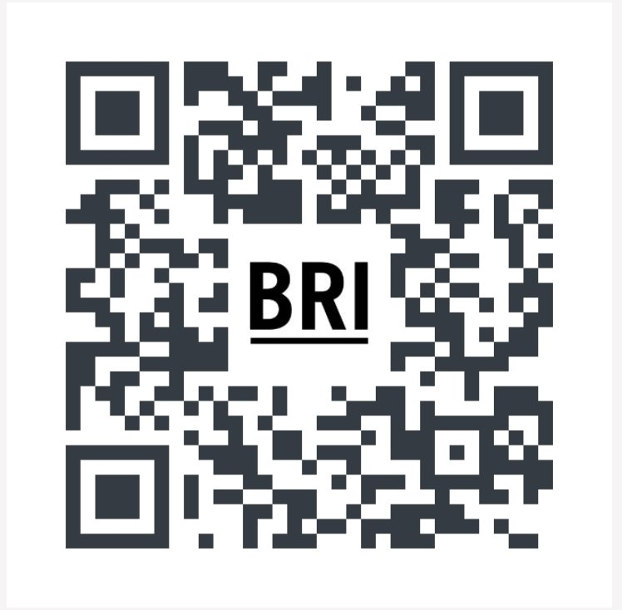
Please take a moment to sign in with the QR code.
Notes:
Prompt attendees to say hi and where they are from in the chat, we will use the chat extensively in this session so make sure you are familiar! (1-2 minutes before session start time).

Slide 15
Examining the U.S. Constitution in Eighth Grade U.S. History Kentucky Department of Education January 15, 2025
Notes:
Introduce title and ask what people teach in the chat (1-2 minutes)

Slide 16
Vision | The Bill of Rights Institute seeks an America where we more perfectly realize the promise of liberty and equality expressed in the Declaration of Independence. This calls for civic education that helps students examine the story of our country and exercise the skills of citizenship.
Mission | The Bill of Rights Institute teaches history and civics. We equip students and teachers to live the ideals of a free and just society.

Slide 17
Christopher Janson
Senior Project Lead, Civic Learning Initiatives
Joined BRI in February of 2017
Worked for The Washington Post’s Newspaper in Education Program for 17 years.
Worked for six years at Smithsonian’s National Portrait Gallery
B.A. in History and Drama, Thomas More University
M.A. Theatre History & Literature, Catholic University of America

Slide 18
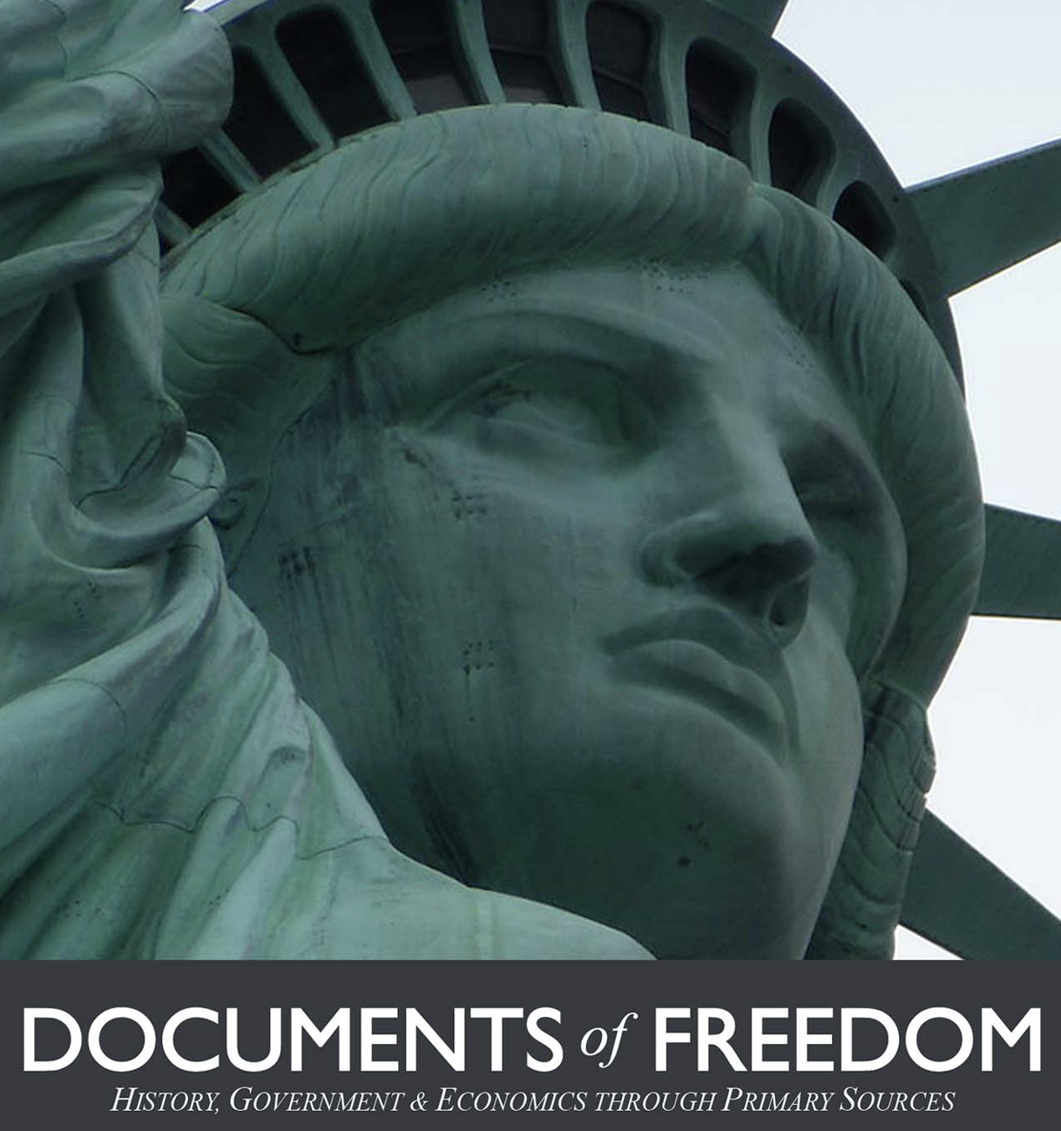
+Completely free, comprehensive digital course on history, government, and economics. + Focused on primary sources. + Designed to be used as a course or by accessing individual units and lessons. + Contains 66 ready-made lesson plans, an annotated handbook of Primary Sources, 76 essays, and over 100 student activities.
Resource Overview

Slide 19
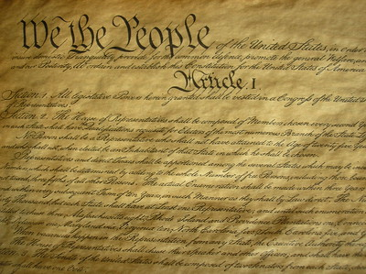
Lesson 2: The Constitution Activity: A Second Study
Notes:
This is the part you came here for: Are you ready for some tangible ideas and resources? Give me a thumbs up if you are ready.

Slide 20
Supporting Question: How did the Articles of the Constitution impact the structures and functions of the United States government?
Compelling Question:
How does the Constitution create a government with limited and specific authority that is strong enough to protect liberty and justice?

Slide 21
Watch the Video: Consequences of the American Revolution
What were some of the reasons for creating a new constitution?

Slide 22
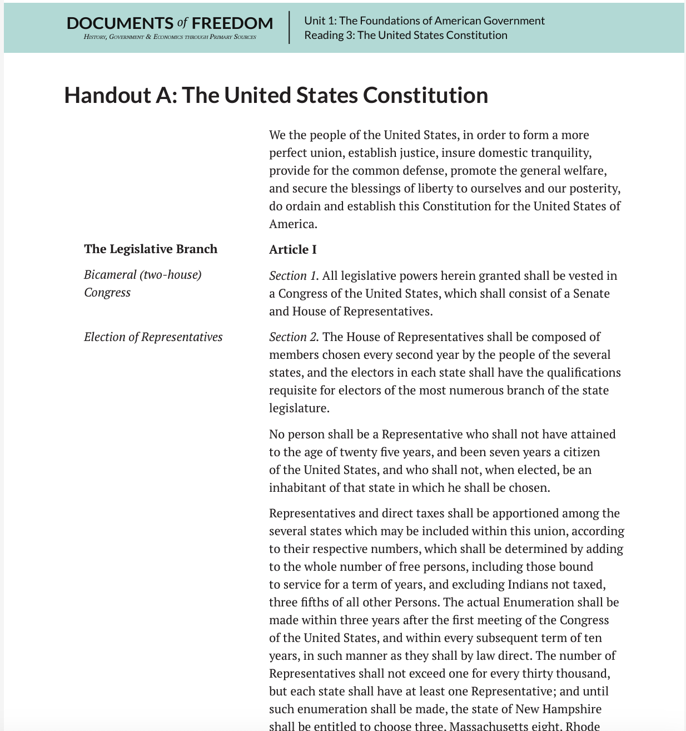
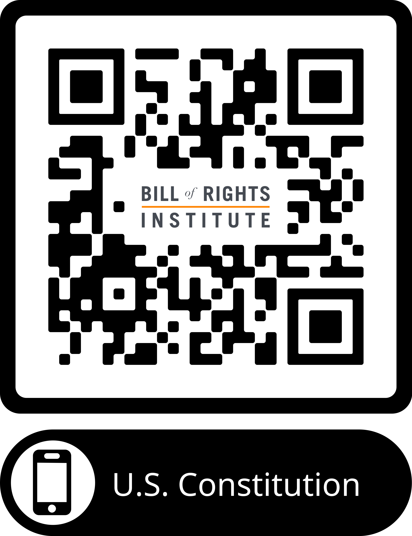
Use the QR Code to Pull up a PDF of the U.S. Constitution.
Text of the U.S. Constitution
Notes:
This sample is an activity from Lesson 2 of our U.S. History curriculum for grades 3-5. In Lesson 2, students investigate the Causes of the American Revolution.
In the curriculum there is a detailed lesson plan, additional scaffold supports, and a slide deck for use in the classroom. Here, you see the Students Handout that accompanies the Declaration of Independence investigation.
We use several strategies in this activity to make the Declaration of Independence accessible to young learners.
Viewing the DoI like art: You can see at the bottom of the Handout, students are participating in a see, think, wonder activity. The first step of accessing the primary source is just looking at it like a piece of art. This removes the barrier of needing to read the text which is beyond their level at this age.
Scaffolding: The see, think, wonder activity is scaffolded with additional prompts so that students have additional support to engage with the document.

Slide 23
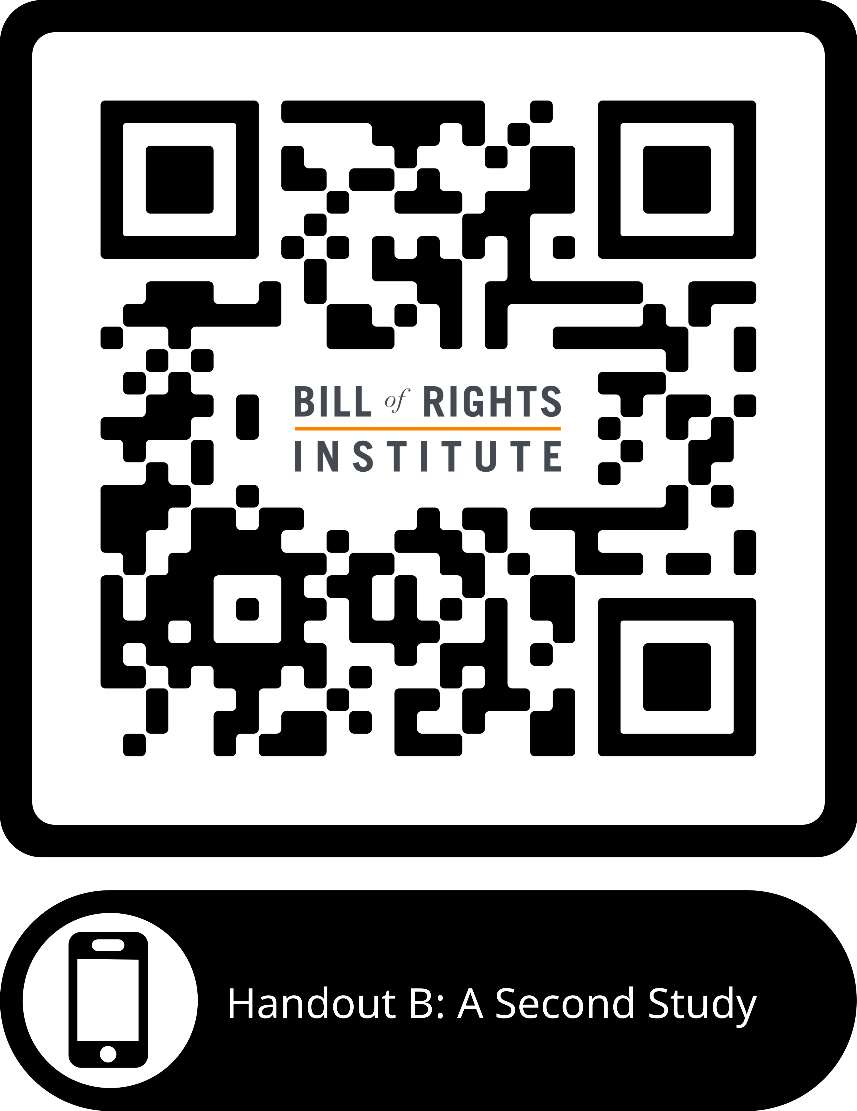
Pull Up Handout B: A Second Study
Divide into seven groups and each group will read through the following sections of the document:
Article I (A), Sections 1-4
Article I (B), Sections 5-7
Article I (C), Sections 8-10
Article II
Article III
Articles IV and V
Articles VI and VII

Slide 24
:
For the next 15 minutes, each group should:
Complete the information from the graphic organizer for their section only using padlet.
Write down the purpose and a summary of the section in your own words.
As you read, brainstorm some active reading strategies that you can use when implementing this with students. Use strategies from the “Supporting Students in Using Evidence Module.”

Slide 25
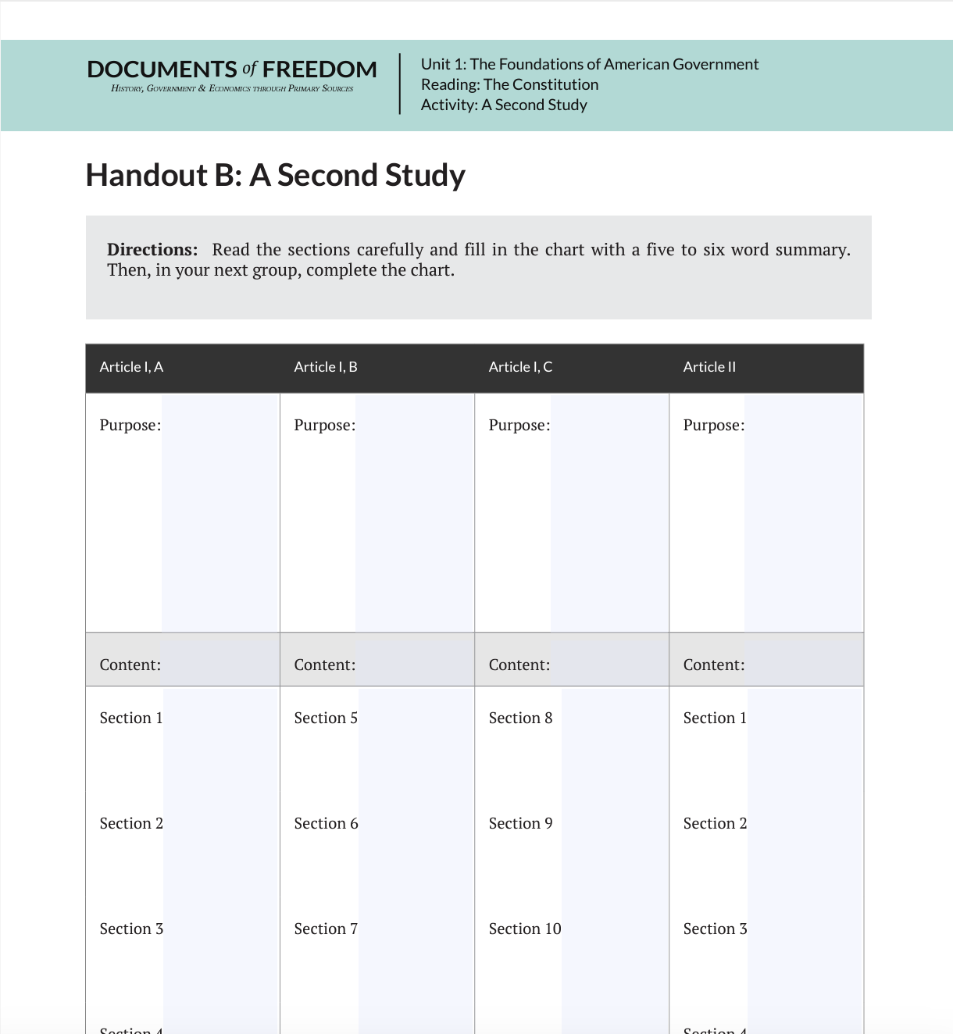
Whole Group Activity
Return to the main group and have one representative from each group fill in all of the information from Handout B in the main padlet page, in a jigsaw style.

Slide 26
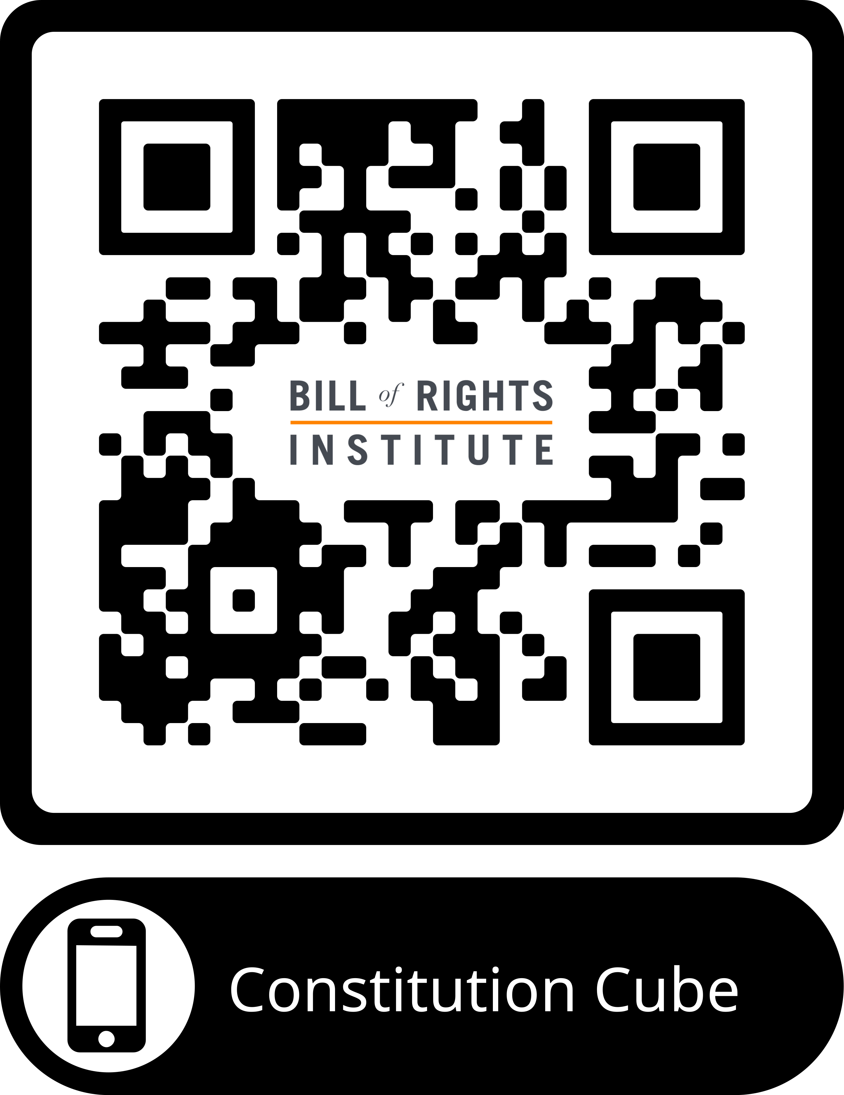
Handout C: Constitution Cube
Review and Prepare
Students can use the Constitution Cube to engage in a prewriting exercise. Have students roll to select a Constitutional principle and complete a quick write to explain how this principle is demonstrated in the Constitution, providing evidence to support their response.
Notes:
You could do nothing but look at the Declaration of Independence or read is aloud to your students and pat yourself on the back for a job well done. Seriously! You students HAVE interacted with a primary source document. I think sometimes we over complicate primary sources for young learners.
If you wanted to go a step further and allow your students to interact with the text, these are some strategies for you:
Chunking- dividing the text into "chunks" so that students can more easily interact with smaller sections.
Vocabulary support- we define the tricky terms right next to the text, rather than having a vocabulary box.
Interaction through questioning- Remember how we discussed students being wired for investigation and exploration? This gives them a structured way to do that so they don't get overwhelmed and give up.

Slide 27
Task Aligned to the Supporting Question:
Construct an explanation to answer the following question: How did the Articles of the Constitution impact the structure and function of the United States government? In your response, use examples and details from the Constitution to support your response.

Slide 28
Q
A

Slide 29
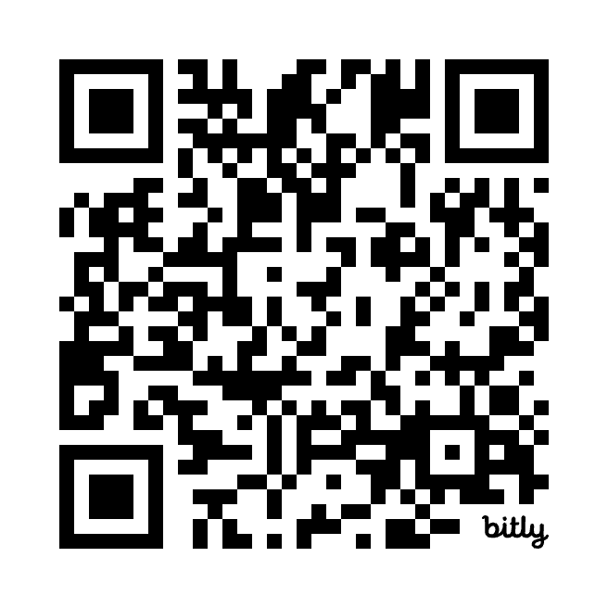
https://bit.ly/3z14ctG

Slide 30
Join our Newsletter to know when 3-5 resources arrive: https://bit.ly/3VBINif

