Slide 1
Text Sets
SESSION 8
PLANNING & PRACTICE
1
Notes:
Session Summary In this planning and practice session, teachers will apply learning of the instructional practice studied in the previous new learning session (text sets). As teachers plan, they will focus on the Planning and Instructional Look-Fors that will support them in meeting goals set in the previous session. Teachers will practice with a colleague, eliciting specific feedback to aid in effective instructional implementation. After collaborating with colleagues and giving/receiving feedback, teachers will modify their approach and complete or refine their instructional plans.
Session Length: 90 minutes

Slide 2
Do Now
ACADEMIC VOCABULARY
SESSION 8
Reflect on the past week using your content cycle goal-setting document:
What progress have you made in your goals?
What impact are you noticing on student learning?
What are some ways you want to continue to grow?
2
Notes:
Do Now (4 min): “Please take out the goal-setting document you completed during the first week of this content cycle. Take a couple of minutes to reflect on the progress you’ve seen in your practice and in your students over the past week. What are some ways you want to continue to grow?”

Slide 3
Content Cycle Overview
Session | Type of Learning | Focus Area
1 | Shared Learning | Introduction to Vocabulary and Why It Matters
2 | Shared Learning | Implicit Vocabulary Instruction
3 | Planning & Practice | Implicit Vocabulary Instruction
4 | Shared Learning | Explicit Vocabulary Instruction
5 | Planning & Practice | Explicit Vocabulary Instruction
6 | Student Progress | Implicit and Explicit Vocabulary Instruction
7 | Shared Learning | Text Sets
8 | Planning & Practice | Text Sets
9 | Shared Learning | Maintaining & Extending Vocabulary
10 | Planning & Practice | Maintaining & Extending Vocabulary
11 | Student Progress | Text Sets, Implicit and Explicit Vocabulary
Notes:
Cycle Overview (1 min)
Share path of the cycle, explaining how the professional learning includes opportunities for shared learning, planning and practice, and studying student progress.

Slide 4
Objectives
ACADEMIC VOCABULARY SESSION 8
Agenda
01. Apply knowledge of text set creation to curricular planning and practice
02. Give and receive feedback from colleagues in order to revise plans and refine practices
01. Opening
02. Plan
03. Practice
04. Closing
4
Notes:
2 min
Share objectives and agenda

Slide 5
Our Norms
ACADEMIC VOCABULARY SESSION 8
OWN your learning
RESPECT the learning space
CONNECT with the learning tools and each other
PROTECT learning time and minimize disruptions
HONOR every voice and experience
PRACTICE vulnerability and trust
5
Notes:
Norms (1 min)
Review norms

Slide 6
Review: The Role of Text Sets
How would you respond to these misconceptions?
ACADEMIC VOCABULARY SESSION 8
Quote A: All of my units already focus on knowledge and vocabulary! We just focus on that knowledge and vocabulary within a single text.
Quote B: My students need practice with skills like determining main idea and summarizing text. They need to read lots of different books that will let them practice that skill. It really doesn’t matter if the books are on the same topic -- it’s about transferring the understanding of how to find the main idea and summarize passages.
6
Notes:
10 min: Review Text Sets
Framing/Directions:
2 min: Before we dive into our text set planning and practice, let’s pause to reflect on what we learned in our last session. To do this, we have two quotes that represent some common misconceptions. Our job is going to be to explain to the “speaker” how to consider what we know about research and standards.
In partnerships, assign yourselves an A and a B. If you are A, you will read the A quote to your partner and your partner will respond. Make it a role play back and forth! Then you will switch and partner B will read the B quote while partner A responds.
4 min: Partners role play
4 min: Ask for volunteers to share talking points for A and B. Surface any questions or misunderstandings and guide teachers to talking points below.
Look or Listen Fors/Evidence of Mastery:
Responses include at least one key idea to clarify the misconception
Responses explain at least one piece of research
Key Idea(s)
In Response to Quote A
A single text may anchor a unit, but in order to build conceptual coherence, students should read additional (short) texts that connect to the concepts within the anchor text. This will allow for practice and deep knowledge of words and concepts.
The Cervetti study shows that when students read texts on the same topic, they actually learned more knowledge and vocabulary than students who read the same amount of texts but on all different topics.
In Response to Quote B
Historically, students have spent time on skills and have not had intentional knowledge building -- this hurts our most vulnerable students who need more time building background knowledge.
Knowledge begets knowledge -- the more you know, the more you learn about a topic/idea.
Students can use strategies like finding the main idea, but in service of making meaning from text. The skill doesn’t stand alone!

Slide 7
Plan
Discuss with a partner:
Individually or in co-teaching teams:
ACADEMIC VOCABULARY SESSION 8
What is the intended student learning for this unit? How will students show their understanding?
(30 min) Analyze your unit and texts.
How do the texts build knowledge for students?
How do the texts connect to the culminating task?
How are the texts organized?
What adaptations can you make to better align to the KAS?
7
Notes:
Planning (40 mins total) This slide for teams that have existing text sets outlined within curriculum
Intended Student Learning (8 mins)
Framing (1 min): “As we prepare to plan, identify a partner to work with. With that partner, discuss the intended student learning for the unit and text set you’ll be analyzing today. Internalizing student outcomes for this part of the curriculum is essential so that you can provide each other with specific and targeted feedback during our practice today.”
Partners (7 min): Discuss student outcomes for the targeted curricular resource and alignment to the goals for the content cycle.
Analyze and Adapt Curriculum (32 mins)
Framing (2 min): Our planning time today will look a little different than in previous sessions. Instead of looking at a particular lesson, we will look at a unit/text set as a whole. You will have the opportunity to consider how your text set builds knowledge and vocabulary understandings, and you will be able to make adaptations and adjustments based on the KAS.
Individually or in Co-teaching teams (30 min): Teachers analyze and adapt an existing text set that will elevate achievement for all students using the questions on the slide as guidance.
If teachers do not have a curricular resource that leverages text sets, use the next slide! (Unhide it.)

Slide 8
Plan
Discuss and plan with a partner:
Individually or in co-teaching teams:
ACADEMIC VOCABULARY SESSION 8
What is the intended student learning for this unit? How will students show their understanding? Create a culminating task.
(30 min) Create a text set that will support your students in building knowledge and vocabulary.
Strong Text Sets
Clearly build knowledge
Stay focused and coherent
Align to a culminating task
Include a variety of text types
May be sequenced to support students’ knowledge building
8
Notes:
Planning (40 mins total) This slide is for teams that DO NOT have existing text sets outlined within curriculum
Intended Student Learning (10 mins)
Framing (1 min): “As we prepare to plan, identify a partner to work with. With that partner, discuss the intended student learning for the topic and text set you’ll be creating today. Internalizing student outcomes for this part of the curriculum is essential so that you can provide each other with specific and targeted feedback during our practice today.”
Partners (9 min): Discuss topic and student knowledge outcomes. Draft culminating task that assesses the key knowledge for the unit.
Create Curriculum (30 mins)
Framing (1 min): Our planning time today will look a little different than in previous sessions. Instead of looking at a particular lesson, we will consider a unit/text set as a whole. You will have the opportunity to create a text set that aligns to your culminating task. Your text set will reflect what we know about the KAS and what goes into strong text sets.
Individually or in Co-teaching teams (29 min): Teachers create a text set that will elevate achievement for all students using the questions on the slide as guidance.

Slide 9
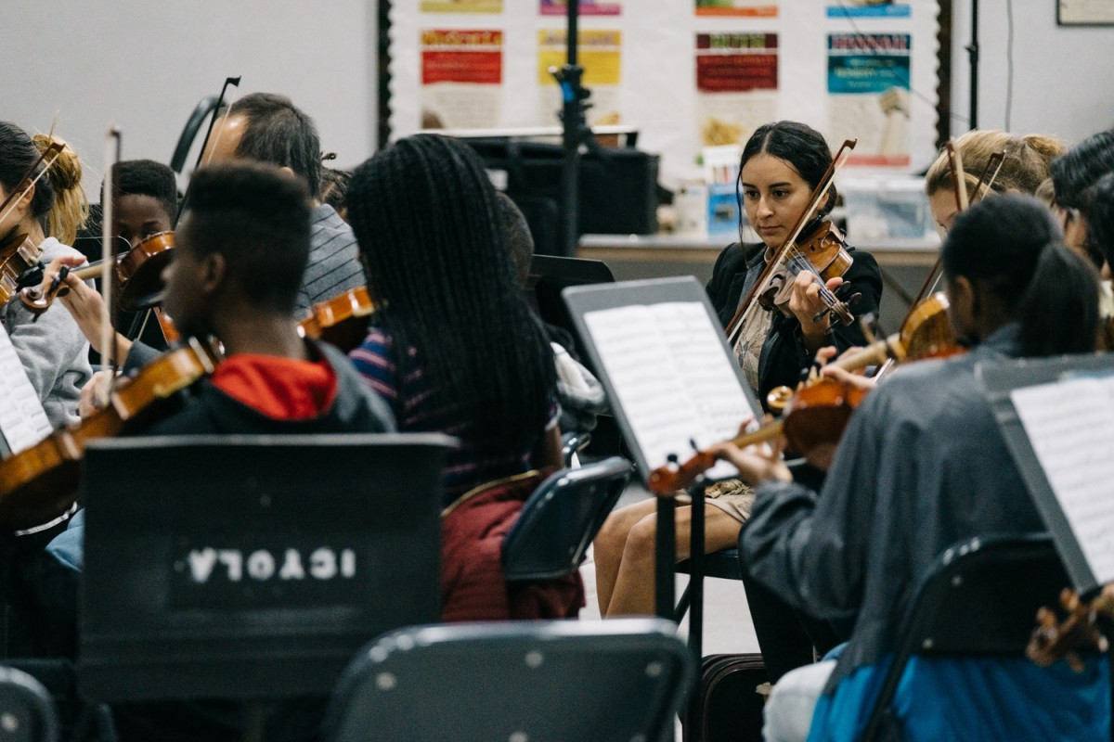
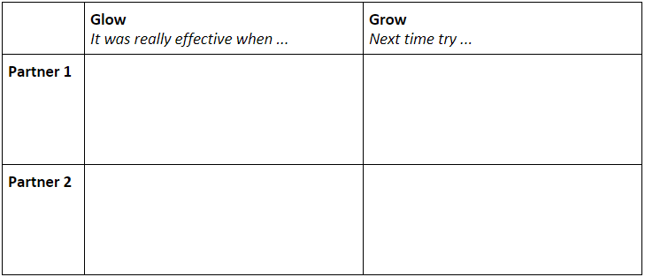
Practice/Share
ACADEMIC VOCABULARY SESSION 8
7 min: Partner 1 practices and records feedback
7 min: Partner 2 practices and records feedback
4 min: Individual reflection
9
Notes:
Practice (18 min)
Frame: Since it is tricky to “practice” text sets, we are going to use this time to share and talk through the planning we just did!
Practice/Feedback Loop Round 1 (7 min): Partner 1 shares text set (newly created or adapted) and records partner feedback aligned to relevant Planning and Practice Look-Fors. Partners may consider the following questions when providing feedback to consider:
Does the text set meet our criteria for strong text sets?
What additional revisions can be made to support students and to align to the KAS?
Practice/Feedback Loop Round 2 (7 min): Partner 2 shares text set and records partner feedback.
Individual Reflection (4 min): “As we prepare for revising, take a minute to jot down implications from your partner’s feedback, for your next steps with planning. A question to consider in your reflection is: What are my next steps, based on feedback received, that would ensure effective implementation for all learners?”

Slide 10
Closing
Debrief:
Partners: How did you apply your partner’s feedback?
Whole Group: What did you learn from engaging in the practice and feedback loop today?
Whip Share: What is one new understanding you have about creating or adjusting text sets for your students?
Notes:
10 min
Closing the Protocol (10 min total)
Partner Debrief (3 min): Teachers return to their original partner and share text set plans and modifications/adaptations made in response to the feedback received. A guiding question to facilitate this discussion might be: How did you apply your partner’s practice feedback into your revised lesson?
Whole Group Debrief (2 min):
What did you learn from engaging in the Practice and Feedback loop with your colleague?
Whip Share (5 min) :What is one new understanding you have about creating or adjusting text sets for your students? (Everyone shares one sentence; repeats are fine)

