Slide 1
What do the Kentucky Academic Standards (KAS) for Social Studies look like in practice?
A webinar designed to deepen social studies content knowledge and pedagogy.
Topic Focus: Grade 2 Economics

Slide 2
Webinar Goals
Learning Goal
I am learning about how to design instructional experiences aligned to the KAS for Social Studies by engaging in a demonstration about Kentucky economics.
Success Criteria
I can analyze 2.E.MA.2 to understand what this standard requires students to know and be able to do.
I can improve my content knowledge and pedagogical skills after exploring a grade level sample.

Slide 3
What are Standards?
Standards define what students should know, understand and be able to do at the end of a grade level.
 | Definition
Know | Refers to facts, dates, places, people, definitions, rules or information
Understand | Refers to theories, generalizations or “big ideas”
Do | Refers to skills such as communication, reading, computation, application and transfer to new situations

Slide 4
What Does it Mean to Unpack a Standard?
Breaking a standard into smaller, more explicit chunks for the purposes of curriculum development and/or unit and lesson planning.
For example, analyze the verb in the following standard to determine its meaning in terms of instruction and assessment.
“...understand the development of important community traditions and events.”
What does understand mean in this standard?
Does it mean “make meaning of” or “transfer”?
Does it mean to “accurately state and explain”? Or, does it simply mean to “know”?
What does the verb demand in terms of student learning?

Slide 5
Tool to Unpack Standards
Step 2
Step 4
Step 1
Unpacking the Standard
Standard | What Knowledge/Concepts/ Vocabulary do students need to know to reach this standard? | What skills do students need to be able to do to reach this standard? | What level of proficiency do students need to be at in order to reach this standard?
Step 3

Slide 6
Step 1: List the Standard
Cut and paste the standards, including the inquiry practices, into the furthest left column of the spreadsheet
Unpacking the Standard
Standard | What Knowledge/Concepts/ Vocabulary do students need to know to reach this standard? | What skills do students need to be able to do to reach this standard? | What level of proficiency do students need to be at in order to reach this standard?
2.E.MA.2 Explain the role of prices in an economic market.

Slide 7
Step 2: What Knowledge, Concepts, Vocabulary will they need to Master? (1)
Closely look at each standard and identify the Knowledge/Concepts/Vocabulary
The “what” that students should learn
Unpacking the Standard
Standard | What Knowledge/Concepts/ Vocabulary do students need to know to reach this standard? | What skills do students need to be able to do to reach this standard? | What level of proficiency do students need to be at in order to reach this standard?
2.E.MA.2 Explain the role of prices in an economic market. | Prices Economic market Role of prices

Slide 8
Step 2: What Knowledge, Concepts, Vocabulary will they need to Master? (2)
Teachers can use the disciplinary clarifications to determine the Knowledge/Concepts/Vocabulary.
The disciplinary clarifications for Grade 2 begin on page 51 of the KAS for Social Studies.
Concepts and Practices | Standard | Disciplinary Clarifications
E: Macroeconomics | 2.E.MA.2 Explain the role of prices in an economic market. | An economic market is created when goods and services are exchanged by producers and consumers. Prices are an indicator of what consumers are willing to pay for an item and what payment producers require to make an item.

Slide 9
Step 2: What Knowledge, Concepts, Vocabulary will they need to Master? (3)
Teachers can use the Glossary of Terms for the Kentucky Academic Standards (KAS) for Social Studies to understand the definition of these terms.
Economic markets - the exchange of goods and services by buyers and sellers.
Goods and services - a good or a service is something you can buy. A good is something you can touch; a service is a job that you pay someone else to do.
Goods - possessions or personal property; items of value used for trade or sale.
Services - to supply help to someone; systems to meet public needs, such as utilities and transportation.
Producers - provide a good or service of economic value.
Consumers - a person who uses economic goods.

Slide 10
Step 2: What Knowledge, Concepts, Vocabulary will they need to Master? (4)
Unpacking the Standard
Standard | What Knowledge/Concepts/ Vocabulary do students need to know to reach this standard? | What skills do students need to be able to do to reach this standard? | What level of proficiency do students need to be at in order to reach this standard?
2.E.MA.2 Explain the role of prices in an economic market. | Prices Economic market Role of prices Goods Services Producers Consumers

Slide 11
Step 3: What Skills will they need to Master?
Closely look at the standard and identify the skills
Skills include the thinking skills and mental processes that require skillful application of the knowledge to solve problems, make a decision, etc.
Unpacking the Standard
Standard | What Knowledge/Concepts/ Vocabulary do students need to know to reach this standard? | What skills do students need to be able to do to reach this standard? | What level of proficiency do students need to be at in order to reach this standard?
2.E.MA.2 Explain the role of prices in an economic market. | Prices Economic market Role of prices Goods Services Producers Consumers | Explain

Slide 12
Step 4: What Level of Proficiency do Students need to be in order to Reach this Standard?
Look at the standard and identify what level of proficiency students will need to be in order to reach this standard.
One way to determine answers to this question is to look at the Depth of Knowledge.
Unpacking the Standard
Standard | What Knowledge/Concepts/ Vocabulary do students need to know to reach this standard? | What skills do students need to be able to do to reach this standard? | What level of proficiency do students need to be at in order to reach this standard?
2.E.MA.2 Explain the role of prices in an economic market. | Prices Economic market Role of prices Goods Services Producers Consumers | Explain | 2
Notes:
The fourth step is to determine the level of proficiency students are required to be at for a particular grade. Most often this can be identified using Bloom’s taxonomy and/or Webbs Depth of Knowledge.
It is important to note that when determining the DOK of a standard, the verb, such as analyze, should not be separated from the rest of the standard as the content and skills outlined in the standard impact the level of rigor students need to engage in order to demonstrate mastery of the standards. For example, in the DOK handout provided, “analyze similarities and differences in issues and problems” is a DOK 3 while “analyzing and synthesizing information from multiple sources” is a DOK 4.

Slide 13
What do the KAS for Social Studies look like in practice?
Topic Focus: Grade 2 Economics

Slide 14
The views expressed in the presentation are ours and are not the views of the Federal Reserve Bank of St. Louis or the Federal Reserve System.
Amanda Geiger
Federal Reserve Bank of St. Louis
Amanda.Geiger@stls.frb.org

Slide 15
Disclaimer
The views expressed in this presentation are our own and do not reflect official positions of the Federal Reserve Bank of St. Louis or the Federal Reserve System.

Slide 16
Books

Slide 17
2.E.MA.2 Explain the role of prices in an economic market.

Slide 18
How does having to keep a spending budget influence our buying decisions?

Slide 19
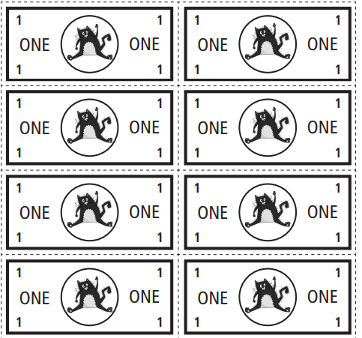
Work
Earn
Income
Market
Spending Budget
Save

Slide 20
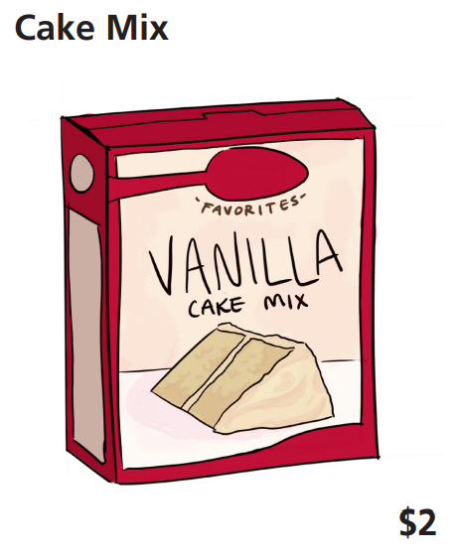
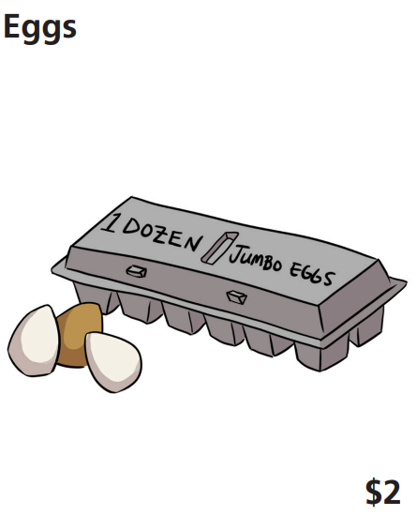
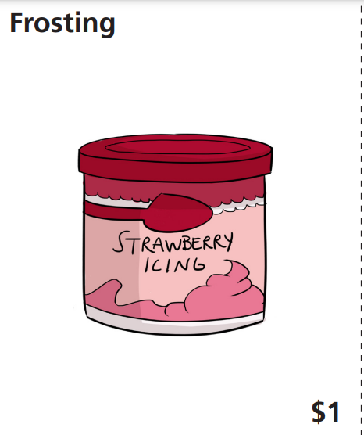
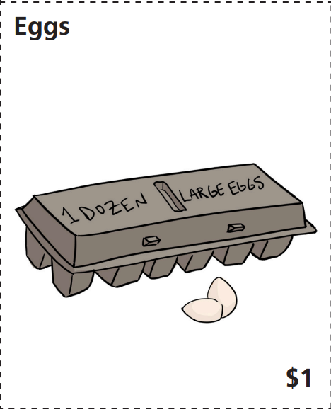
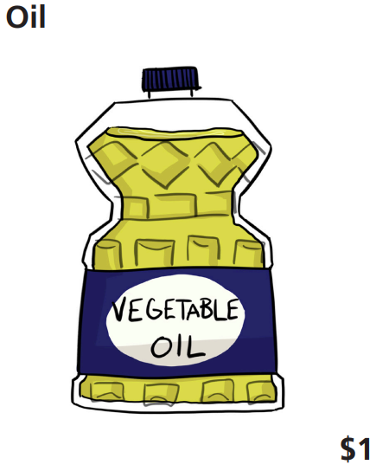
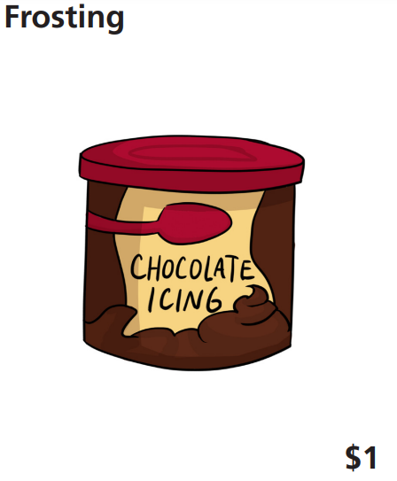
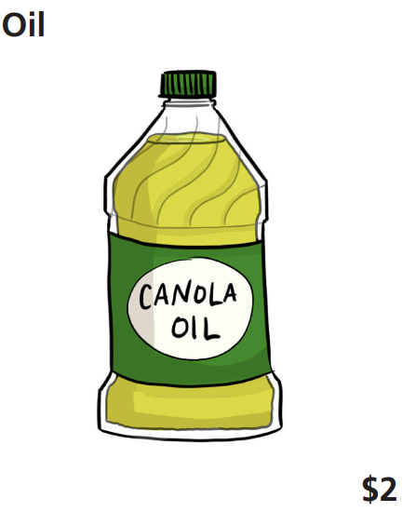
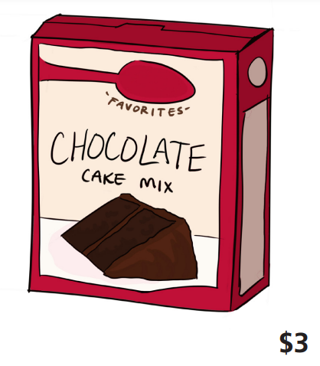
images

Slide 21
$8

Slide 22
$5

Slide 23
$4

Slide 24
$2

Slide 25
How does having to keep a spending budget influence our buying decisions?

Slide 26
Splat the Cat Takes the Cake
Objectives
Students will be able to
• define choice, earn, income, market, opportunity cost, save, spending budget, and work;
• explain how people earn income;
• identify the difference between saving and spending;
• track and calculate a spending budget;
• explain the cause and effect of decisions we make; and
• make inferences using information they read and their background knowledge

Slide 27
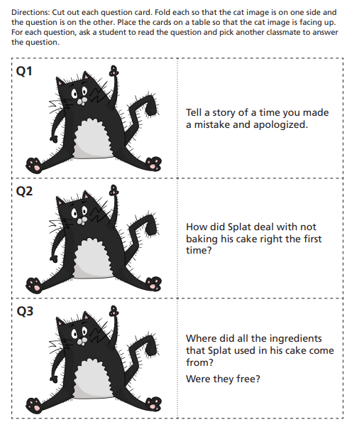
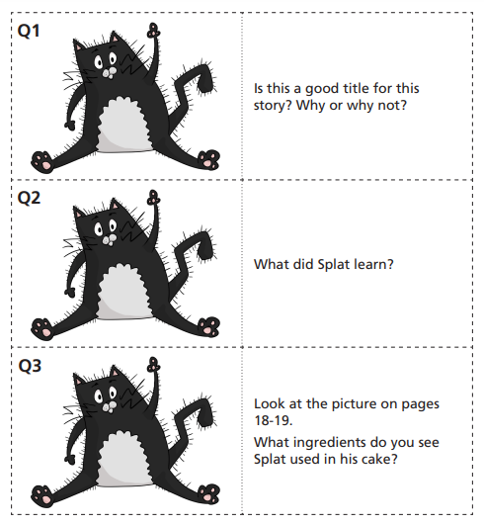
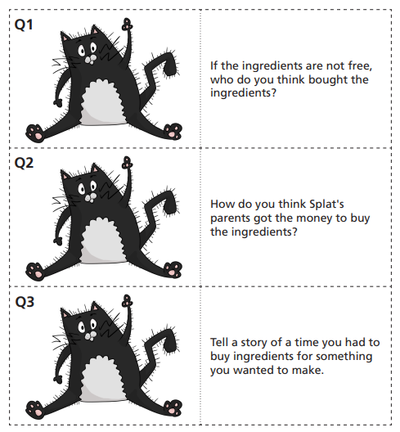
handouts

Slide 28
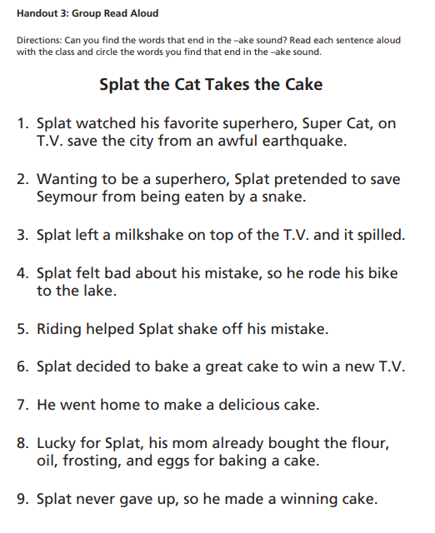
Do you have what you need right now to make a cake like Splat did?
Do you have money to buy a cake and decorate it?
How can we earn some income so that we can buy a cake and decorate with it?

Slide 29
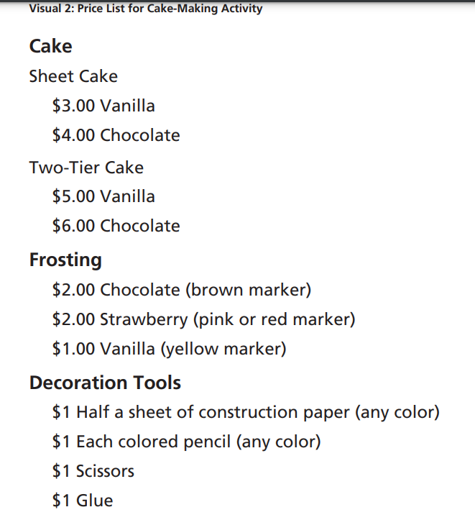
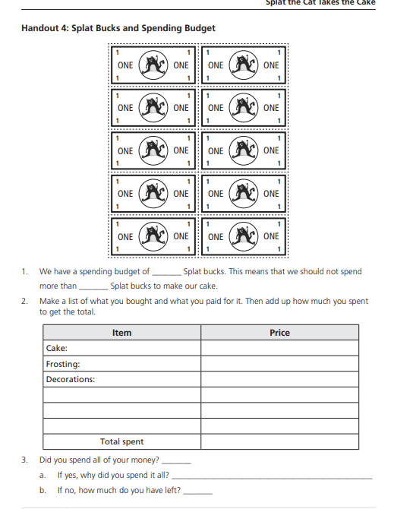
Handouts 2

Slide 30
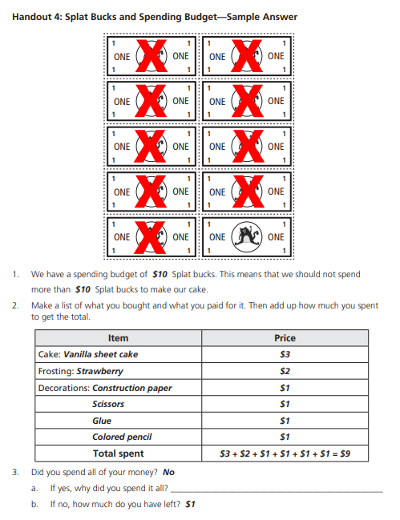
Handouts 3

Slide 31
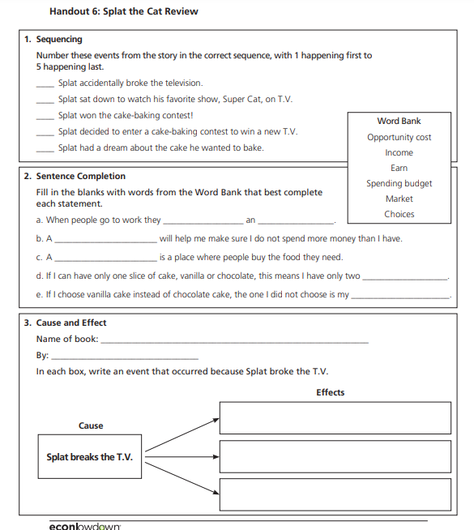
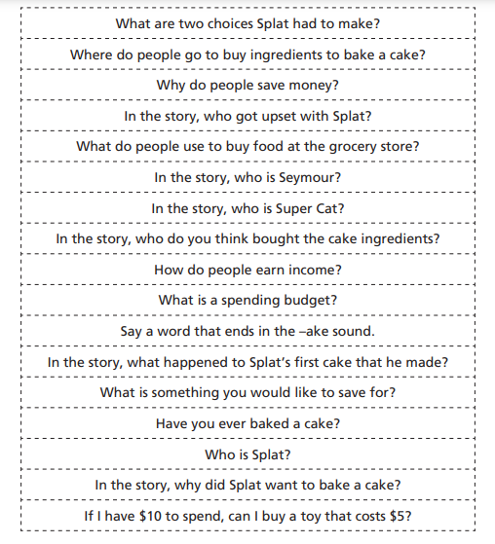
Handouts 4

Slide 32
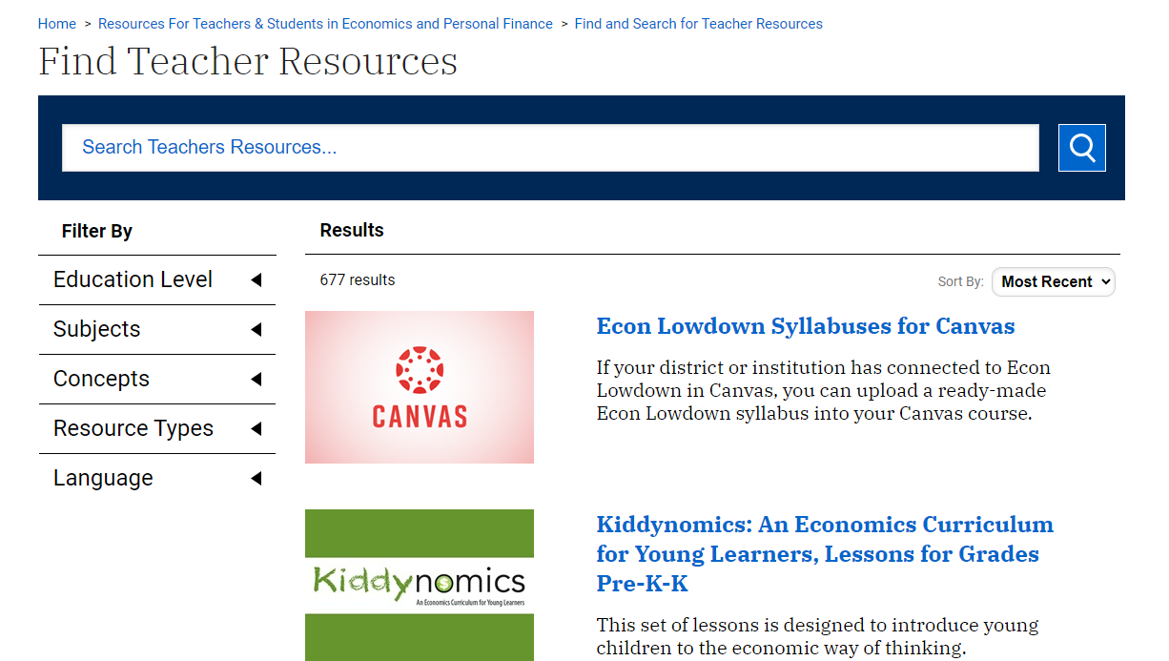
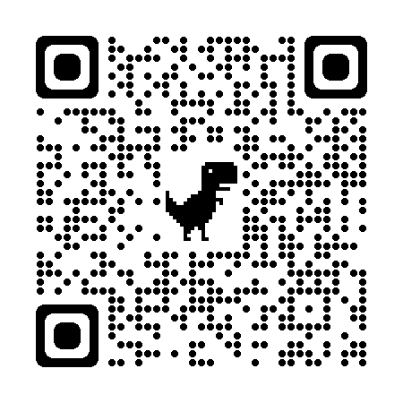
Where can you find more?
Stlouisfed.org/education

Slide 33
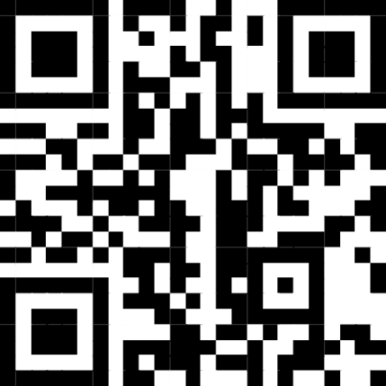
Sign up for our newsletters!
Thank you!
Amanda Geiger
Senior Economic Education Specialist
Amanda.Geiger@stls.frb.org

