Slide 1
Curriculum Development Process
Phase 2: Articulate Instructional Vision
Notes:
Hello and welcome to the Curriculum Development Process professional learning series. The focus of this module is Phase 2 : Articulating an Instructional Vision. There are four phases to the CDP and four corresponding modules. Before engaging Module 2 we recommend you access the Introduction to the Curriculum Development Process and Module 1 to gain context for the learning that follows.

Slide 2
Phase 2 Module Materials
For this session, you will need access to:
Curriculum Development Process (CDP)
Module 2 Participant Handout
CDP Self-Assessment Tool: Phase 2
Notes:
For this module, please make sure you have access to the following documents:
Curriculum Development Process from the Model Curriculum Framework
Copy of the participant handout to hold your thinking throughout the module
CDP Self-Assessment Tool which you will use to assess where your district may be in relation to the essential elements of Phase 2
All materials are hyperlinked on the slide for easy access.

Slide 3
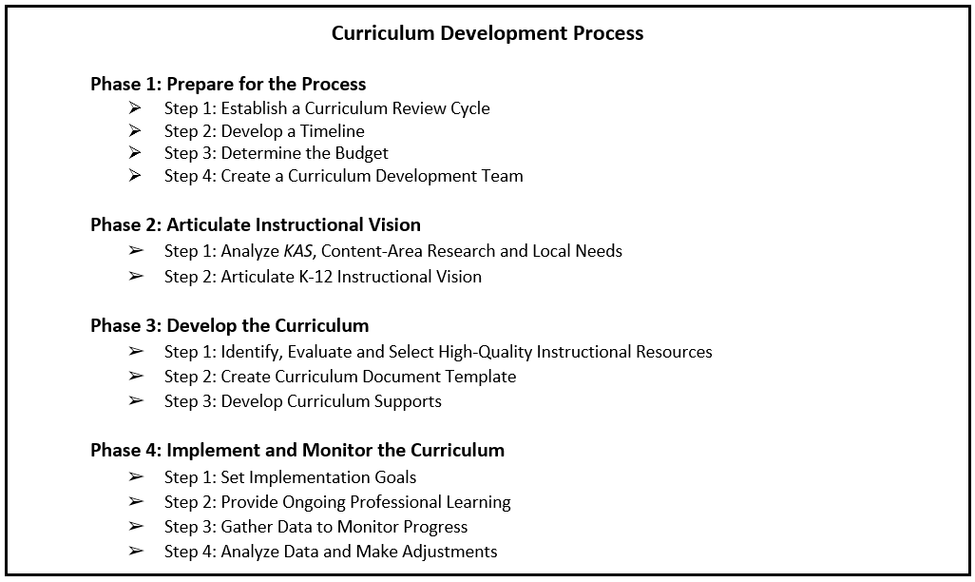
Phase 2: Articulate Instructional Vision
Learning Goal: We are learning about the importance of establishing a shared understanding of the subject area content, skills and pedagogy to inform a local instructional vision that guides the curriculum development process.
Notes:
Before we move into Phase 2 content, it will be helpful for you to establish a baseline level of understanding. Look briefly at the name Phase 2, “Articulate Instructional Vision,” and its two steps.
Next, consider our learning goal: “We are learning about the importance of establishing a shared understanding of the subject area content, skills and pedagogy to inform a local instructional vision that guides the curriculum development process.”
This information will be helpful on the next slide when we activate background knowledge you might have about this second phase of the curriculum development process and is also available at the top of your participant handout.

Slide 4
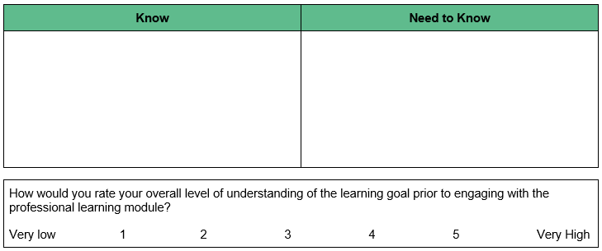
Phase 2 Self-Assessment
Notes:
We will use a Know/Need-to-Know approach for activating background knowledge. First, note things you may already “Know” about our learning goal, perhaps using the title and steps of Phase 2 for added insight. As we are beginning, this can certainly include hunches you may have as well. Next, infer things it may be important for you to find out based on our learning goal, things you may “Need to Know.” Both what you may know and what you may need to know can be recorded in the table at the top of p. 1 of your participant handout.
As the module unfolds, hold these lists in mind. You will be invited to update them during midpoint and closing reflections. After capturing what you may know and need to know, please synthesize your overall sense of understanding using the 1-5 scale provided. This too will be revisited during the closing reflection.
Pause the video and restart after completing the self-assessment.

Slide 5
Phase 2 Module Purpose
Learning Goal: We are learning about the importance of establishing a shared understanding of the subject area content, skills and pedagogy to inform a local instructional vision that guides the curriculum development process.
Success Criteria:
Identify key actions and products of Phase 2 of the Curriculum Development Process.
Access resources to support implementation of Phase 2 of the Curriculum Development Process.
Develop an action plan for implementing Phase 2 at the local level.
Notes:
Now that you have a preliminary sense of where you might be relative to our learning goal, let’s move into our success criteria for Module 2. By the end of this module, we want you to be able to:
Identify key actions and products of Phase 2 of the Curriculum Development Process.
Access resources to support implementation of Phase 2.
Begin to develop an action plan for implementing Phase 2 at the local level.
Let’s start with our first success criterion (CLICK), “Identify key actions and products of Phase 2 of the Curriculum Development Process.”

Slide 6
Phase 2
Notes:
Phase 2 is where the curriculum team you have formed engage in analysis of the standards and current research regarding teaching and learning in the content area of focus, matching that to an inventory of local needs. The team uses that analysis to craft a K-12 instructional vision of what teaching and learning in that content area should look like in classrooms across the district.
This is one of the most crucial components of the entire process because this is about setting the vision that serves as the instructional foundation and guides all your work moving forward.

Slide 7
Curriculum Development Process, Phase 2: Articulate Instructional Vision
Success criterion: Identify key actions and products of Phase 2 of the Curriculum Development Process.
As you read Phase 2, focus on the following information for each step:
What are the key actions?
What are the end products?
*Space provided under Success Criterion 1 on your participant handout to capture your thinking.
Notes:
We want to pause and give you a chance to read through Phase 2. As you read, focus on the key actions and products of each step of the phase.
If accessing the electronic version, simply go to the table of contents in the CDP document and click on Phase 2 and that will take you to the start of this section. Feel free to annotate directly on the text and space is provided under success criterion 1 on your participant handout to capture your thinking.
During your reading, focus in on the text and the key questions. We will take a closer look at the key tools a little later in this module.
Pause the video and restart after you have read Phase 2 and captured your thinking on your handout.

Slide 8
Processing Time
Team Discussion:
Discuss each step in order, focusing on key actions and products
Make connections to how you currently arrive at an instructional vision for teaching and learning in your district/school
*Add any new/additional ideas to your participant handout.
Notes:
We want to give you an opportunity to process what you read with your team. If there are more than 5 or 6 in your group, consider forming two or more teams.
With your team, discuss each step of Phase 2 in order focusing on the key actions and products. Make sure to equitably share ‘airtime’ as you ask each other clarifying questions and make connections to how you currently arrive at an instructional vision in your district/school.
Also, feel free to capture any new ideas on your participant handout.
Pause the video and restart after your team discussion.

Slide 9
Whole Group Share-out
What thoughts, ideas, connections or questions do you have regarding Phase 2 of the Curriculum Development Process?
Notes:
If you have more than one team, you may want to have a whole group share out to hear from others in the room. What thoughts, ideas, connections or questions do you have regarding Phase 2 of the Curriculum Development Process?
Pause the video and restart after the whole-group share out.

Slide 10
A Closer Look at Phase 2
Instructional Vision & Analyzing the Kentucky Academic Standards
Notes:
Because Phase 2 is so foundational to the rest of the process and throughout implementation of the curriculum, we want to spend some time taking a closer look at the instructional vision and importance of analyzing the Kentucky Academic Standards.

Slide 11
Instructional Vision
Serves as your North Star or guiding light - what we are working towards.
Ensures everyone is aligned with a common language and observable indicators.
Guides decisions about curriculum, instructional resources and professional learning.
It is a living, breathing, changing document that is regularly revisited.
Notes:
The instructional vision is like your North Star or guiding light and is what you are striving for. It does not mean you are there yet; it is not based on your current reality—it focuses on the student experience and details of what student learning should look like in action.
A well-articulated instructional vision ensures everyone throughout the district is aligned to and working from common language and a shared understanding of the observable indicators of the vision in action at the district, school and classroom levels.
The instructional vision should also guide decisions regarding curriculum, instructional resources and professional learning. It is your gut check when making decisions and thinking through the lens of will this decision or action move us closer to that instructional vision, which is why it is the first responsibility of the curriculum team. It influences all work moving forward and is a living document that is regularly revisited.

Slide 12
Our Approach: Three Lenses, One Focus
FOCUS:
Instructional Vision
LENS 1:
Alignment to Kentucky Academic Standards
LENS 3:
Needs of Our Community
LENS 2:
Alignment to Current Research
Notes:
When creating your instructional vision, there are three important lenses to focus on and ensure are reflected throughout:
Lens 1 is to ensure the vision is aligned to the KAS for the content area and the foundational beliefs within the standards document.
The second lens is to ensure alignment to current research. So, not about what we may think or feel to be true or based on the way we have always approached teaching and learning in a specific content area, but rather aligned to the research on what actually has been shown to improve student outcomes.
The third lens is to take into account the local needs of your community and the uniqueness of your student population.
Once the team has created a draft of the instructional vision it is critical to share it with stakeholders, provide opportunities for input and use that to guide any possible revisions before moving into the next phase of the Curriculum Development Process.

Slide 13
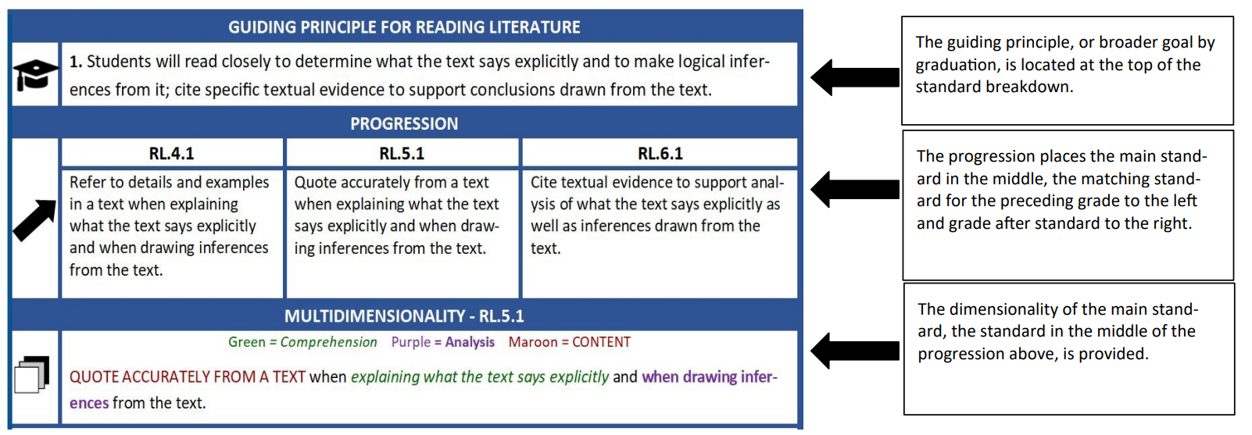
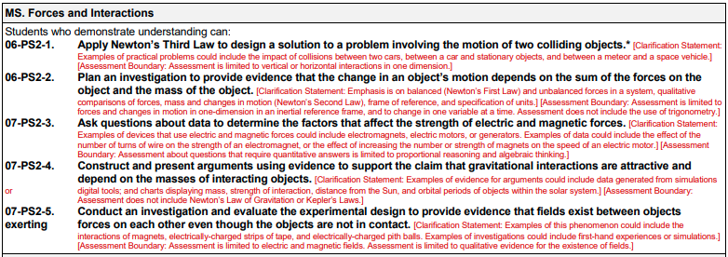
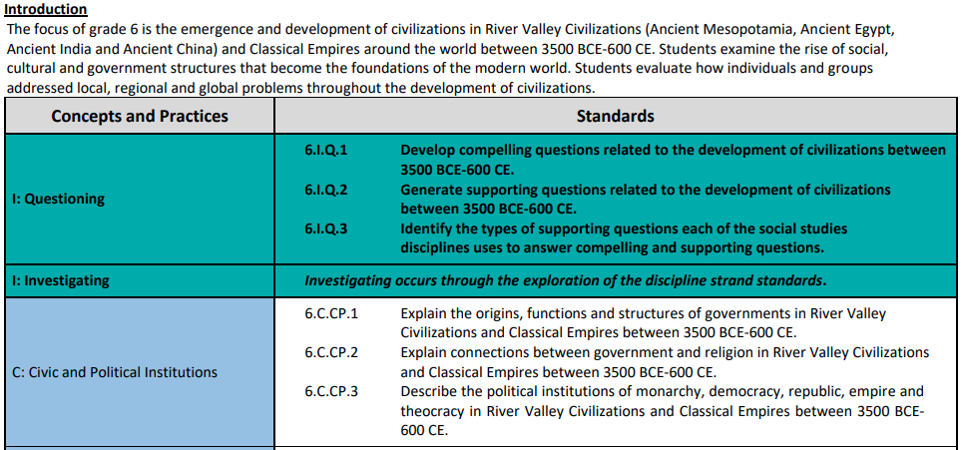
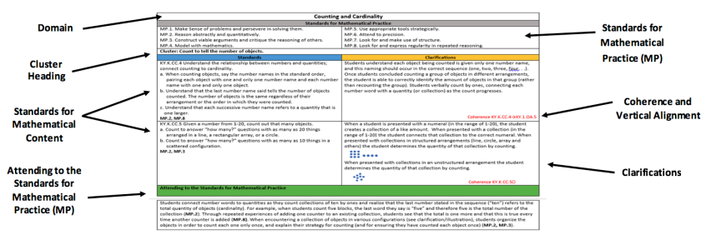
Kentucky Academic Standards
Kentucky Academic Standards
Notes:
For the instructional vision to align with the Kentucky Academic Standards, the curriculum development team should spend time analyzing the standards document. As they analyze the standards for the content area of focus, the team should consider:
how standards are organized,
what principles guide that organization,
how learning progresses, both vertically across grade levels and also within a course, and
what overarching knowledge, understandings and skills learning progresses toward
There are key sections built into a content area’s standards document to support these considerations including
the Writer's’ Vision Statement,
Design Considerations and
foundational documents used in creation of the standards.
Another useful tool is the Getting to Know the KAS Modules available on kystandards.org

Slide 14
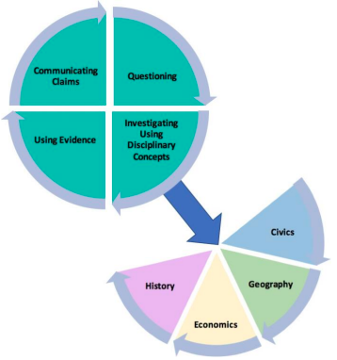
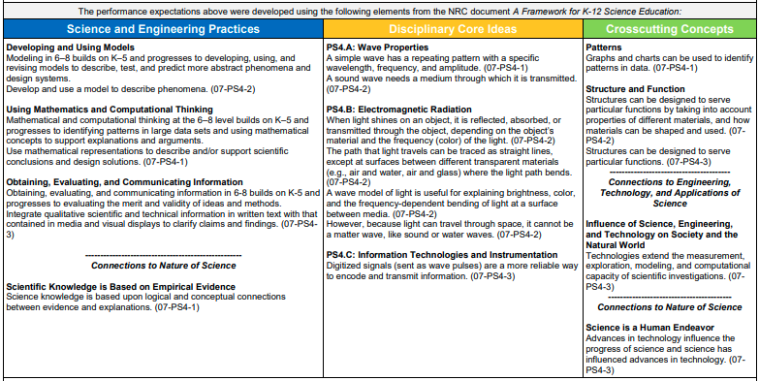
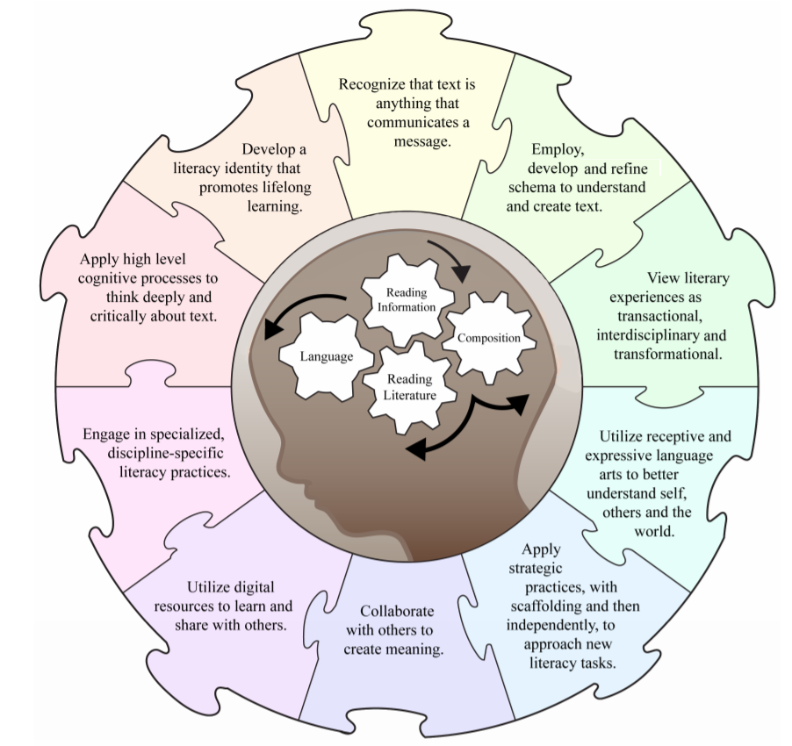
Kentucky Academic Standards cont.
Notes:
Be sure to give adequate consideration to the multiple dimensions and student practices of whichever content area is being focused on because they are fundamental to authentic learning within the discipline and empower students toward independent, lifelong learning comprised of deep and critical thinking. They are essential to the vibrant student learning experiences envisioned for Kentucky classrooms.

Slide 15
Processing Time
Individual Response Followed by Team Discussion:
In what ways might a clearly articulated instructional vision for each content area support curriculum development and decision-making within the district/school?
When analyzing the KAS, including its dimensions, practices and supporting materials, which aspect may warrant additional focus to meet existing content-area needs in your local context?
Thinking can be held in space provided under Success Criterion 1 of your handout.
Notes:
We want to stop and allow you a chance to process your learning. Think about the following two questions:
In what ways might a clearly articulated instructional vision for each content area support curriculum development and decision-making within the district/school?
When analyzing the Kentucky Academic Standards, including the dimensions, practices, and supporting materials, which aspect may warrant additional focus to meet existing content-area needs in your local context? So, thinking about areas of the standards that will be critical for your team to think through to help improve student outcomes in your school/district.
We would like for you to first individually capture your thinking around these two questions in the space provided under Success Criterion 1 on the participant handout. Then, have a team discussion ensuring each person has an opportunity to share their thinking. Add any new thinking from the team discussion to the same space on your handout.
Pause the video and restart after you have individually responded to the questions and have wrapped up your team discussion.

Slide 16
Mid-Point Reflection
Based on your learning so far, what might you now add to your “Know/Need to Know” table?
*Hold your thinking in the table back at the top of your participant handout.
Notes:
We are at the midpoint of the module, so we want to pause and give you a chance to reflect. Based on your learning so far, what might you now add to your “Know/Need to Know” table at the top of your participant handout. This can include transferring items from your Need to Know to your Know list when appropriate.
Pause the video and restart once you have added your thinking to the Know/Need to Know table.

Slide 17
Phase 2 Module Purpose
Learning Goal: We are learning about the importance of establishing a shared understanding of the subject area content, skills and pedagogy to inform a local instructional vision that guides the curriculum development process.
Success Criteria:
Identify key actions and products of Phase 2 of the Curriculum Development Process.
Access resources to support implementation of Phase 2 of the Curriculum Development Process.
Develop an action plan for implementing Phase 2 at the local level.
Notes:
We are going to move into our second success criterion, that you can access resources to support Phase 2 implementation.

Slide 18
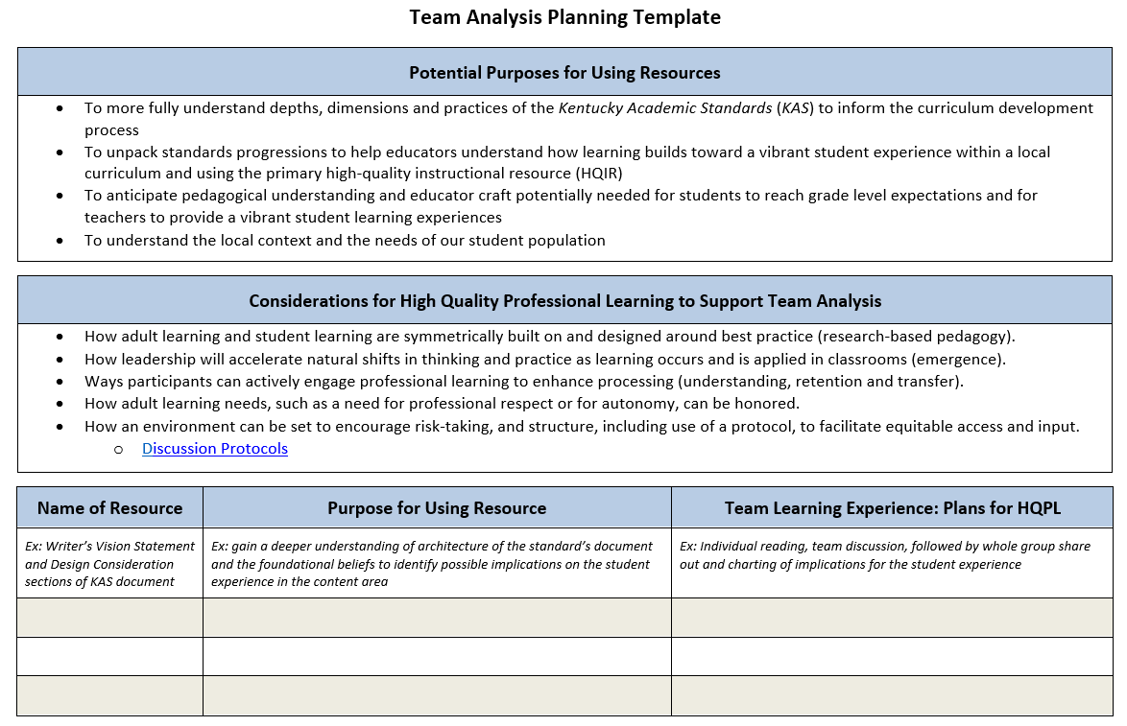
Phase 2: Step 1 (Analyze KAS, Content-Area Research and Local Needs)
Team Analysis Planning Template:
Identify resources to support understanding of the standards, relevant research and pedagogy and how they should inform the student experience
Consider how PL can be designed to maximize growth needed to craft an instructional vision.
Notes:
Step 1 is about planning and identifying resources for establishing a shared understanding of the subject area content, skills and relevant pedagogy prior to development/revision of the curriculum, which provides a common foundation for the work. The Team Analysis Planning Template allows a curriculum team to gain clarity around the essential purposes and PL considerations needed to help them reach a deep understanding of the content area. This ensures readiness for crafting an instructional vision.

Slide 19
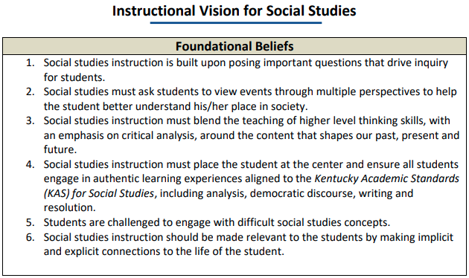
Phase 2: Step 2 (Articulate K-12 Instructional Vision)
Sample Instructional Visions:
Demonstrates one possible way of arranging critical components for effective communication to stakeholders.
Core values/beliefs
Incorporation of the KAS
Relevant research and pedagogy
Local needs/context
Notes:
Step 2 proceeds from the curriculum team’s shared understanding of the depth and rigor of the standards, a common view of content pedagogy grounded in current research and an understanding of the needs of the local community in order to develop an instructional vision of teaching and learning for that content area. Sample instructional visions linked as tools in the CDP, of which this Instructional Vision for Social Studies is one, offer a range of ways this task can be approached.

Slide 20
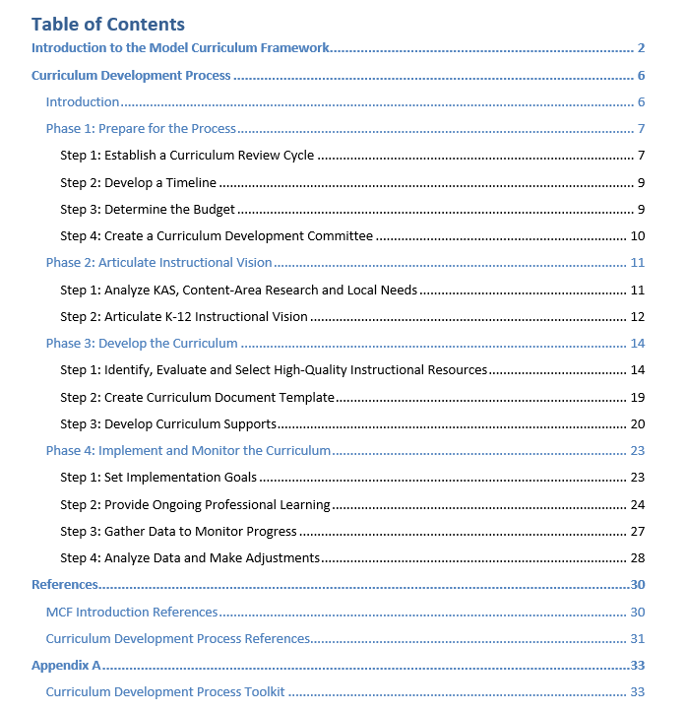
Appendix A
Notes:
In addition to the key tools, the CDP also contains an appendix that provides more support for implementing each phase.

Slide 21
Phase 2 Appendix
Notes:
​The Phase 2 toolkit includes the professional learning module and associated resources, sample artifacts from districts around the state and video clips from districts sharing their experiences as they worked through the process. We will move here into some sample artifacts.

Slide 22
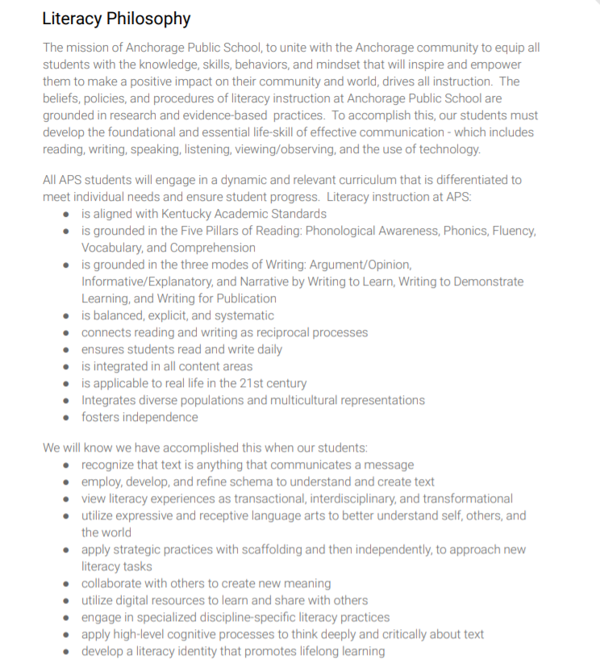
Reading & Writing Instructional Vision Example
Reading & Writing Instructional Vision Example
Notes:
Carefully crafting an instructional vision that allows for full alignment to the KAS while also embodying what matters most to a district’s vision and values gives the curriculum process its driver for ongoing decision-making. This is an example of an instructional vision for Reading and Writing from Anchorage Public School.

Slide 23
Reading & Writing Instructional vision Example 2
Reading & Writing Instructional Vision Example
Notes:
Here is an example of an instructional vision for Reading and Writing Garrard County created to drive their decision-making throughout the curriculum process.

Slide 24
Phase 2 Tools and Resources Exploration
Success criterion: Access resources to support implementation of Phase 2.
As you explore, focus on the following information:
Which tools and resources may be most beneficial to supporting the work of Phase 2?
What tools and/or resources may still be needed to support Phase 2?
Space provided under Success Criterion 2 on the participant handout to hold your thinking.
Notes:
We want to give you some time to explore Phase 2 tools and resources. As you explore, focus on:
Which tools and resources may be most beneficial to supporting the work of Phase 2?
What tools and/or resources may still be needed to support Phase 2?
You can hold your thinking in the designated section of the participant handout for this success criterion.
Pause the video and restart after exploring the resources and capturing your thinking on the participant handout.

Slide 25
Whole Group Share Out
Resource Feedback
Which tools and resources may be most beneficial to supporting the work of that phase?
What tools and/or resources may still be needed to support the work of that phase?
Notes:
If you have more than one team, you may want to have a whole group share out to hear from everyone. During your exploration, which tools and resources did you think will be most beneficial?
What were some tools and resources that might still be needed to support Phase 2?
Pause the video and restart after the whole group share-out.

Slide 26
Phase 2 Module Purpose
Learning Goal: We are learning about the importance of establishing a shared understanding of the subject area content, skills and pedagogy to inform a local instructional vision that guides the curriculum development process.
Success Criteria:
Identify key actions and products of Phase 2 of the Curriculum Development Process.
Access resources to support implementation of Phase 2 of the Curriculum Development Process.
Develop an action plan for implementing Phase 2 at the local level.
Notes:
We are to the last success criterion where we want to provide you time to begin to develop an action plan for implementing Phase 2 at the local level.

Slide 27
Phase 2 Module Reflection (A)
Reflection Goal: To anchor learning from the session for application.
Review items on your “Know” list. Update as needed. Of all you now understand about Phase 2, which item seems most important?
Review items on your “Need to Know” list. Update as needed. Which item seems most important to address in supporting implementation of Phase 2 in your district?
Record both items in the space provided under Success Criterion 3 on your participant handout.
Notes:
Before thinking though your action plan, we want to pause for a final reflection to anchor your learning from the session so you can move it forward into application. Go back to the “Know/Need to Know” table on page 1 of your participant handout.
Review the items on your “Know” list and update as needed. Which item seems most important for you to remember?
Then review the items on your “Need to Know” list and update as needed. Determine which item seems most important to address in supporting implementation of Phase 2 in your district.
Record both of those items in the space provided under success criterion 3 on your participant handout.
Pause the video and restart after completing this step of the final reflection.

Slide 28
Phase 2 Module Reflection (B)
Learning Goal: We are learning about the importance of establishing a shared understanding of the subject area content, skills and pedagogy to inform a local instructional vision that guides the curriculum development process.
Use the scale under success criterion 4 to reassess your overall level of understanding after engaging the module.
Notes:
Lastly, we want you to reassess your overall level of understanding of phase 2 after engaging in the module on that scale of 1-5. Determine your rating now in the space provided under success criterion 3.
Pause the video and restart after completing this second portion of the final reflection.

Slide 29
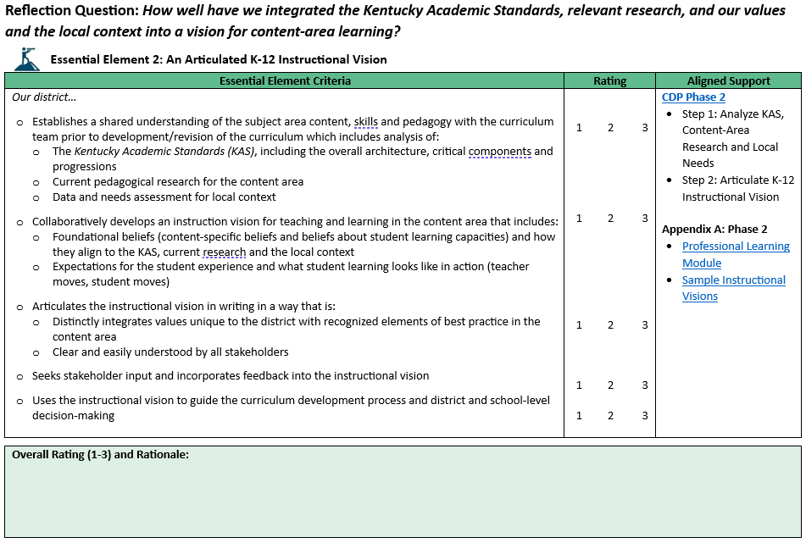
Reflection Question
Notes:
To help you determine possible next steps, we recommend you complete the first section from the CDP Self-Assessment Tool focused on Essential Element 2: An Articulated K-12 Instructional Vision. The element is broken down into specific criteria necessary for supporting that element with a place for you to give a rating on a scale of 1 being not yet present in our district to 3 being fully present and systematic in our district. Again, this may help you pinpoint specific aspects of Phase 2 you want to prioritize as a part of your action plan.

Slide 30
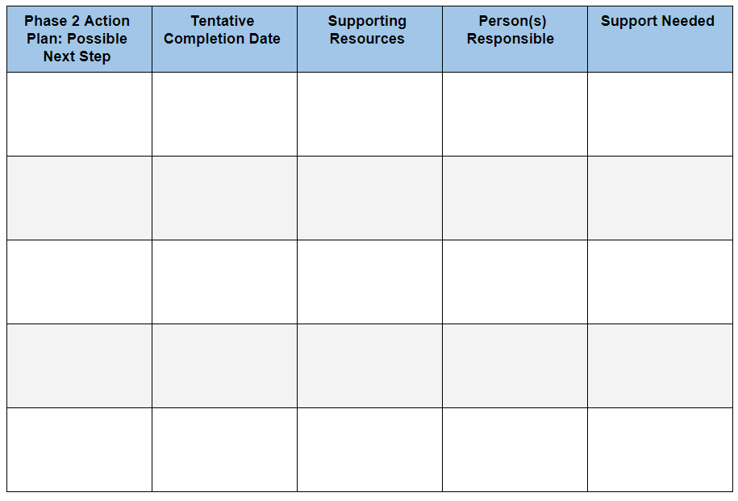
Time to Plan
Based on your learning today, develop an action plan for implementing Phase 2.
Planning template is provided under Success Criterion 3 on the participant handout.
Notes:
With your district teams, you’ll use your participant handout to begin thinking about possible next steps, completion dates, supporting resources, responsibilities and support you’ll need. Planning notes can be captured at the end of your participant handout.

Slide 31
Module Wrap-Up
Please complete the Module 2 Professional Learning Survey.
Questions for OTL?
Fox DeMoisey
fox.demoisey@ducation.ky.gov
Misty Higgins
misty.higgins@education.ky.gov
Notes:
Finally, we ask that you take time to complete the short PL survey to provide feedback on Module 2. An EILA certificate is available and can be accessed at the end of the survey.
Please feel free to reach out to Misty or to me with any questions you may have. Thank you for participating in Module 2 of the Curriculum Development Process professional learning series.

