Slide 1
Implicit Vocabulary Instruction
SESSION 3
PLANNING & PRACTICE
1
Notes:
Session Summary In this planning and practice session, teachers will apply learning of the instructional practice studied in the previous new learning session. As teachers plan, they will focus on the Planning and Instructional Look-Fors that will support them in meeting goals set in the previous session. Teachers will practice with a colleague, eliciting specific feedback to aid in effective instructional implementation. After collaborating with colleagues and giving/receiving feedback, teachers will modify their approach and complete or refine their instructional plans.
Session Length: 90 minutes

Slide 2
Do Now
ACADEMIC VOCABULARY
SESSION 3
Reflect on the past week using your content cycle goal-setting document:
What progress have you made in your goals?
What impact are you noticing on student learning?
What are some ways you want to continue to grow?
2
Notes:
Do Now (2 min): “Please take out the goal-setting document you completed during the first week of this content cycle. Take a couple of minutes to reflect on the progress you’ve seen in your practice and in your students over the past week. What are some ways you want to continue to grow?”

Slide 3
Content Cycle Overview
Session | Type of Learning | Focus Area
1 | Shared Learning | Introduction to Vocabulary and Why It Matters
2 | Shared Learning | Implicit Vocabulary Instruction
3 | Planning & Practice | Implicit Vocabulary Instruction
4 | Shared Learning | Explicit Vocabulary Instruction
5 | Planning & Practice | Explicit Vocabulary Instruction
6 | Student Progress | Implicit and Explicit Vocabulary Instruction
7 | Shared Learning | Text Sets
8 | Planning & Practice | Text Sets
9 | Shared Learning | Maintaining & Extending Vocabulary
10 | Planning & Practice | Maintaining & Extending Vocabulary
11 | Student Progress | Text Sets, Implicit and Explicit Vocabulary
Notes:
Cycle Overview (1 min)
Share path of the cycle, explaining how the professional learning includes opportunities for shared learning, planning and practice, and studying student progress.

Slide 4
Objectives
ACADEMIC VOCABULARY SESSION 3
Agenda
01. Apply knowledge of implicit vocabulary instruction to curricular planning and practice
02. Give and receive feedback from colleagues in order to revise plans and refine practices
01. Opening
02. Plan
03. Practice
04. Revise
05. Closing
4
Notes:
(3 min)
Framing (1 min): “This week, we’ll return to a planning protocol in which we plan and receive feedback on strategic ways that we can leverage our learning from last week as we work toward the goals and look-fors of this cycle. Just like musicians rehearsing, we are tuning and refining our practice off-stage before performing for our audience of students!”
Team Building (2 min): “Before we dig in, take a moment to share with a partner the reflections you noted during the Do Now. Additionally, discuss the instructional evidence you intend to include in your plan today that will reflect the growth identified in your goals. Revisiting our goals prior to planning will help to narrow our focus on the portions of our curriculum that we want to receive feedback on today.”

Slide 5
Our Norms
ACADEMIC VOCABULARY SESSION 3
OWN your learning
RESPECT the learning space
CONNECT with the learning tools and each other
PROTECT learning time and minimize disruptions
HONOR every voice and experience
PRACTICE vulnerability and trust
5
Notes:
Norms (1 min)
Review norms

Slide 6
Preparing for Planning and Practice
Gather the following:
ACADEMIC VOCABULARY SESSION 3
Content cycle goal-setting document
Upcoming read aloud and lesson
6
Notes:
Preparing for the Protocol (2 mins):
“In our previous sessions, we’ve discussed the importance of teaching vocabulary and we dove into the implicit approach to vocabulary instruction. Today, we’re going to plan and practice implementing our shared learning. Please make sure you have the following materials pulled up: your goal-setting document and an upcoming read aloud/lesson plan. (If there is no formal lesson plan, that is okay -- the text is the most important part)

Slide 7
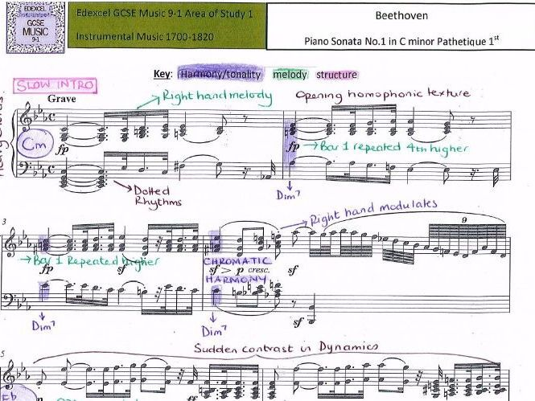
Plan
Discuss with a partner:
Individually or in co-teaching teams:
ACADEMIC VOCABULARY SESSION 3
What is the intended student learning for this lesson and text?
(20 min) Analyze your text and lesson.
What Tier 2 and Tier 3 vocabulary would you prioritize for the text? Why?
Annotate/analyze the lesson. How is the prioritized Tier 2/Tier 3 addressed through implicit vocabulary instruction?
What adaptations could you make?
7
Notes:
Planning (30 mins total)
Intended Student Learning (8 mins)
Framing (1 min): “As we prepare to plan, identify a partner to work with. With that partner, discuss the intended student learning for the Lesson plan you’ll be analyzing today. Internalizing student outcomes for this part of the curriculum is essential so that you can provide each other with specific and targeted feedback during our practice today.”
Partners (7 min): Discuss student outcomes for the targeted curricular resource and alignment to the goals for the content cycle.
Analyze and Adapt Curriculum (22 mins)
Framing (2 min): As a reminder... “In the planning and practice phase, we’ll be working like musicians who annotate their scores and shape the dynamics of even the most famous musical works before they perform these masterpieces on stage. Even when we use curriculum that is a high-quality resource, it’s our analysis and adaptation of the materials that will allow us to implement them masterfully with our students. In our first phase of planning today, we’ll hone in on vocabulary in our read aloud. Based on our shared learning from the past two weeks, we’ll be prioritizing Tier 2 and Tier 3 words that we think our students might struggle with. Then we will plan to teach those words using what we have learned about implicit vocabulary instruction.
Individually or in Co-teaching teams (20 min): Teachers analyze and adapt a portion of their curriculum that will elevate achievement for all students. If resource does not include implicit instruction, this is a place for adaptation, Teachers will also plan for effective implementation (i.e. oral instructions, visuals, relevant routines, etc.) of the instructional approach. When planning, teachers should consider how implementation aligns to the intended student learning and how it will impact and support the diverse needs of students.
If teachers do not have a high quality curricular resource that addresses vocabulary, use the next slide! (Unhide it.)

Slide 8
Plan
Discuss with a partner:
ACADEMIC VOCABULARY SESSION 3
Drop in a Definition
Could follow this up with “Call and Response”
Drop in a Picture
Glossary
Context Clues
Teacher models or asks students to define word using context clues.
Define and Practice
What should students be able to know and do by the end of the read aloud?
Plan your read aloud:
What Tier 2 and Tier 3 vocabulary would you prioritize for the text? Why?
Plan how you would implicitly teach them using your choice of the strategies we’ve discussed. .
8
Notes:
ALTERNATIVE VERSION TO SUPPORT LESSON CREATION -- UNHIDE SLIDE
Planning (30 mins total)
Intended Student Learning (8 mins)
Framing (1 min): “As we prepare to plan, identify a partner to work with. With that partner, discuss the text you will be reading and the intended student learning? What should they be able to know and do by the end of the read aloud?”
Partners (7 min): Discuss student outcomes for the text. These can include big ideas and understandings from the text (message, main idea) as well as practice with specific KAS.
Plan the read aloud (22 mins)
Framing (2 min): As a reminder... “In the planning and practice phase, we’ll be working like musicians who annotate their scores and shape the dynamics of even the most famous musical works before they perform these masterpieces on stage. In our first phase of planning today, we’ll hone in on vocabulary in our read aloud. Based on our shared learning from the past two weeks, we’ll be prioritizing Tier 2 and Tier 3 words that we think our students might struggle with. Then we will plan to teach those words using what we have learned about implicit vocabulary instruction.
Individually or in Co-teaching teams (20 min): Teachers first identify words to teach and select 3-4 to address using what they have learned about implicit vocabulary instruction.

Slide 9
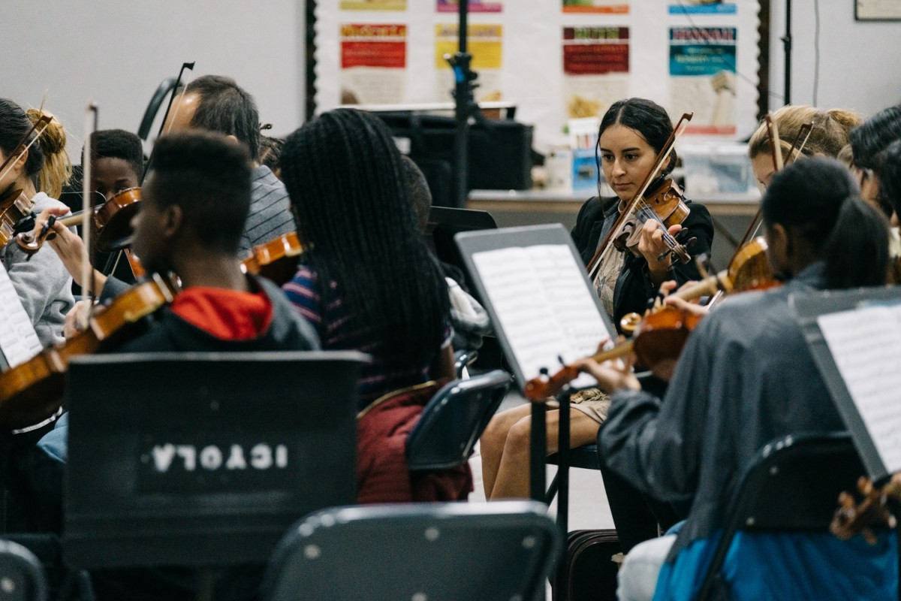
Why is lesson rehearsal important?
How does it connect to equity?
ACADEMIC VOCABULARY SESSION 3
9
Notes:
Framing for Practice (3 min): “Before we begin our “off-stage practice” let’s reflect: Why is lesson rehearsal important? How does it connect to equity? We will be practicing how we will teach 1-2 of the prioritized vocabulary words we identified during our planning”
Look/Listen for:
Lesson rehearsal allows us to “work out the kinks” in our practice off-stage before we’re in front of students.
Many professions practice: Musicians rehearse, doctors practice surgical procedures before they do them on living people, athletes go to practice. Teachers have one of the highest stakes audiences of all - and we can practice, too!
Lesson rehearsal is connected to equity for students, because it helps teachers refine their instruction before bringing it to students. This way all kids get their teacher’s very best.
Lesson rehearsal is connected to equity for teachers because we all vary in terms of our current knowledge and experience. Practice gives us a chance to prepare for our students in an environment where can get feedback and support from others.

Slide 10
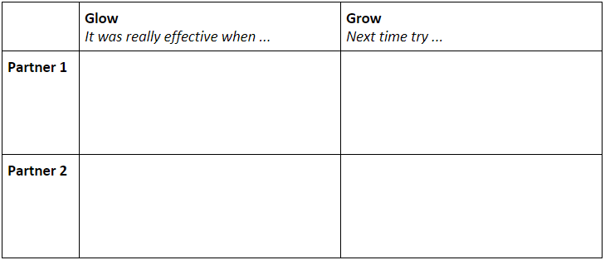
Practice
ACADEMIC VOCABULARY SESSION 3
7 min: Partner 1 practices and records feedback
7 min: Partner 2 practices and records feedback
4 min: Individual reflection
10
Notes:
Practice (18 min)
Practice/Feedback Loop Round 1 (7 min): Partner 1 practices instructional plan and records partner feedback aligned to relevant Planning and Practice Look-Fors. Partners may consider the following questions when providing feedback to consider:
Does the vocabulary instruction in this read aloud lesson work?
What modification would strengthen this lesson component for all students?
Does this lesson component/instructional approach align to and/or support the intended student learning?
Practice/Feedback Loop Round 2 (7 min): Partner 2 practices instructional plan and records partner feedback aligned to relevant Planning and Instructional Look-Fors.
Individual Reflection (4 min): “As we prepare for revising, take a minute to jot down implications from your partner’s feedback, for your next steps with planning. A question to consider in your reflection is: What are my next steps, based on feedback received, that would ensure effective implementation for all learners?”

Slide 11
Revise
ACADEMIC VOCABULARY SESSION 3
Using the feedback provided, continue analyzing and adapting your instructional sequence to support progress toward the intended student learning.
Look Fors:
Questions and tasks focus on academic or domain-specific words that are most likely to be encountered again in the future or are most critical for comprehending the text
Lesson broadens students’ word knowledge through instructional strategies (e.g. text-dependent questions, drop-in definitions, glossary, etc.) that teach words that can be understood quickly during reading
11
Notes:
Revising (20 min)
“Now is the time for you to reflect on the rehearsal experience and to think about the feedback you received from your partner.”
Using the feedback provided, teachers will revise their instructional approach and continue planning.

Slide 12
Closing
Debrief:
Partners: How did you apply your partner’s feedback?
Whole Group: What did you learn from engaging in the practice and feedback loop today?
Notes:
7 min
Closing the Protocol (7 min total)
Partner Debrief (3 min): Teachers return to their original partner and share instructional plans and modifications/adaptations made in response to the feedback received. A guiding question to facilitate this discussion might be: How did you apply your partner’s practice feedback into your revised lesson?
Whole Group Debrief (2 min):
What did you learn from engaging in the Practice and Feedback loop with your colleague?
How has this process increased my intentional support for the diverse needs of students in my class?
Upload Planning Artifacts (2 min): Teachers upload their planning artifacts

