Slide 1
Selecting Anchoring Phenomena for Equitable Three-Dimensional Teaching
Modified from Penuel, W. R., Bell, P., Neill, T., Morrison, D., & Tesoriero, G. (2018). Selecting Anchoring Phenomena for Equitable 3D Teaching. [OER Professional Development Session from the ACESSE Project] Retrieved from http://stemteachingtools.org/pd/sessione

Slide 2
Sessions Within this Module
Session A: Experiencing an Anchoring Phenomenon
Session B: What are Phenomena?
Session C: Analyzing Performance Expectations
Session D: Selecting Phenomena
Session E: Taking Stock

Slide 3
Module Goals
Explain to a peer the role of phenomena and design challenges in science teaching, with a particular focus on equity and justice.
Generate working definitions of phenomena, design challenges, and disciplinary core ideas.
Identify phenomena related to a bundle of performance expectations.
Experience how phenomena can be introduced at the start of a unit, in order to launch a student-driven series of questions.

Slide 4
Group Norms
Assume positive intentions.
Listen carefully to one another.
Be open to new ideas.
Be open to productive struggle.
Ask questions.
Allow a chance for everyone to participate.

Slide 5
Selecting Anchoring Phenomena for Equitable Three-Dimensional Teaching
Session A: Experiencing an Anchoring Phenomenon
Modified from Penuel, W. R., Bell, P., Neill, T., Morrison, D., & Tesoriero, G. (2018). Selecting Anchoring Phenomena for Equitable 3D Teaching. [OER Professional Development Session from the ACESSE Project] Retrieved from http://stemteachingtools.org/pd/sessione

Slide 6
Session Goals
Experience how phenomena can be introduced at the start of the unit, in order to launch a student driven series of questions

Slide 7
Initial Ideas, Experiences, and Questions
How have you heard “phenomena” described, especially in relation to science teaching?
What experiences inform your thinking about phenomena?
What questions do you have about phenomena we should answer together?

Slide 8
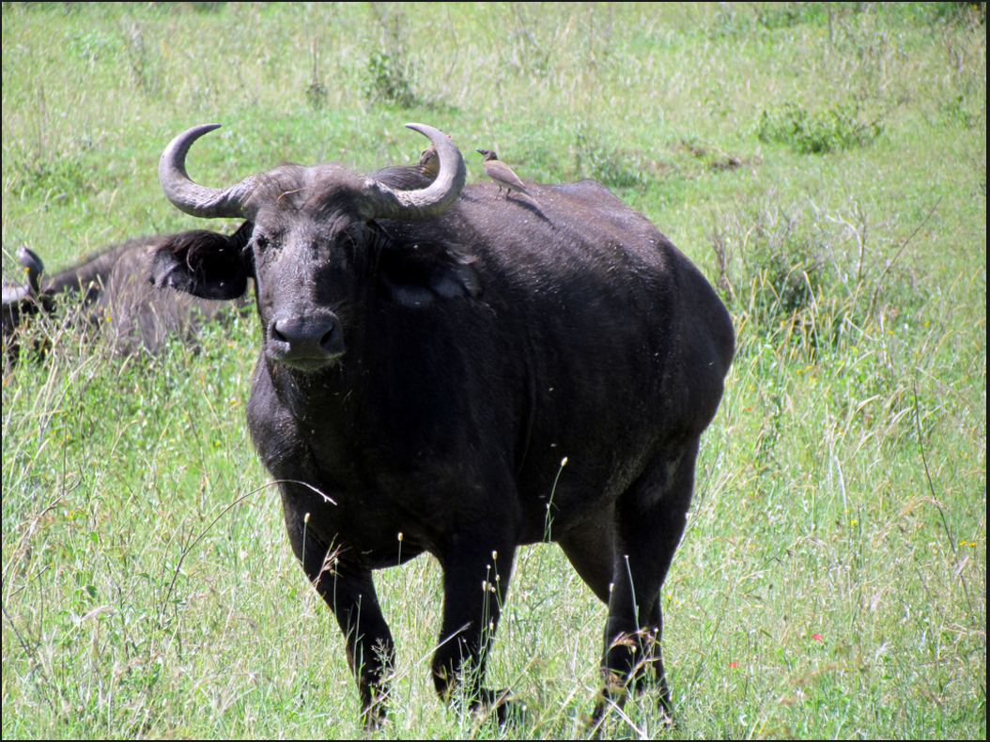
Animal Populations
This is a photograph of the African Buffalo (Syncerus caffer), which is an animal that lives in the Serengeti National Park, in the country of Tanzania.
Notes:
If time, you can visit www.google.com/maps/ to find Tanzania and the Serengeti National Park, located in the northeastern part of the country.
Although it is located just outside the Serengeti, this is an amazing aerial view of a herd of African buffalo on Google Maps. Copy and paste the following coordinates into Google Maps (satellite view) to see: 4°17’21.49″ S 31°23’46.46″ E

Slide 9
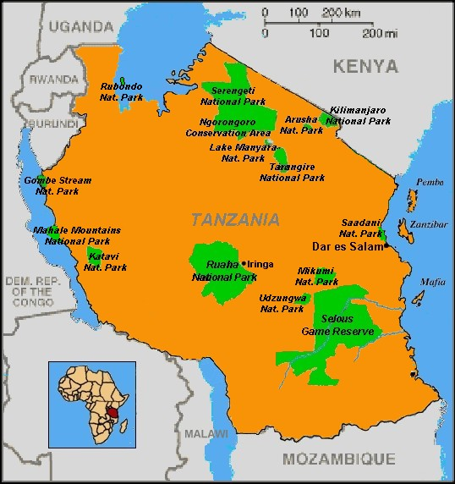
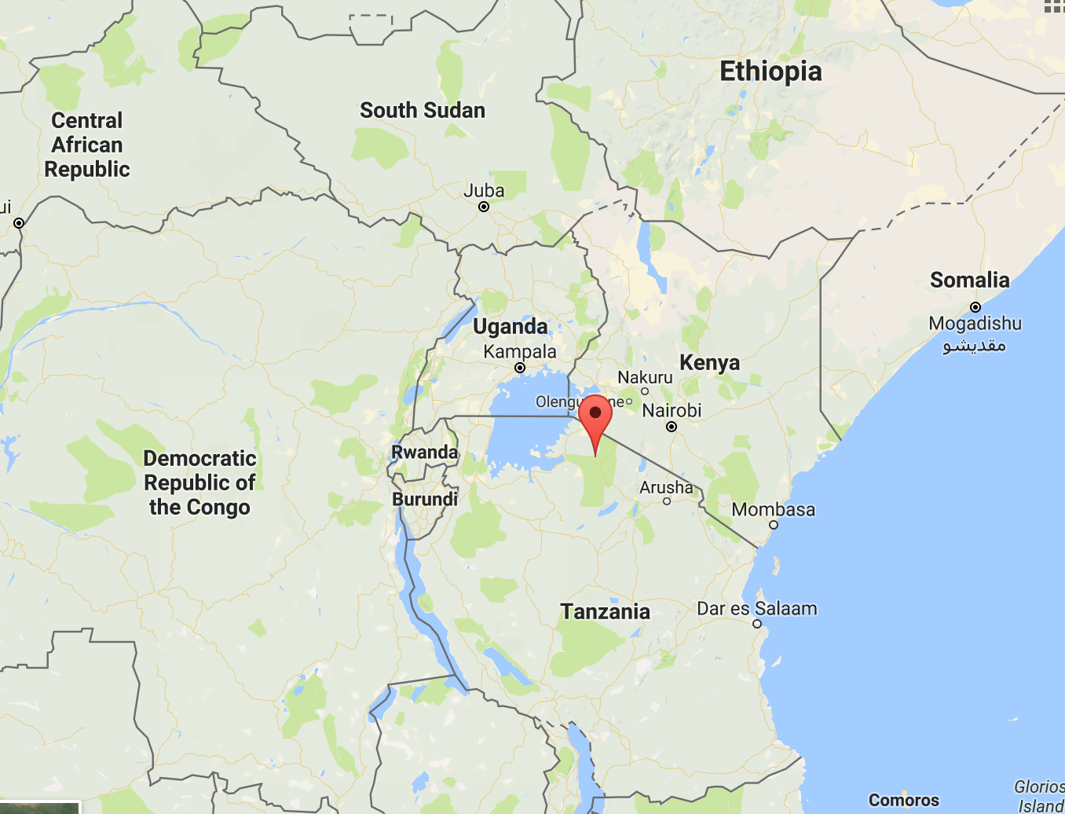
Maps
Notes:
Image comes from Google Maps and https://upload.wikimedia.org/wikipedia/commons/5/59/Tanzania_parks_map.jpg

Slide 10
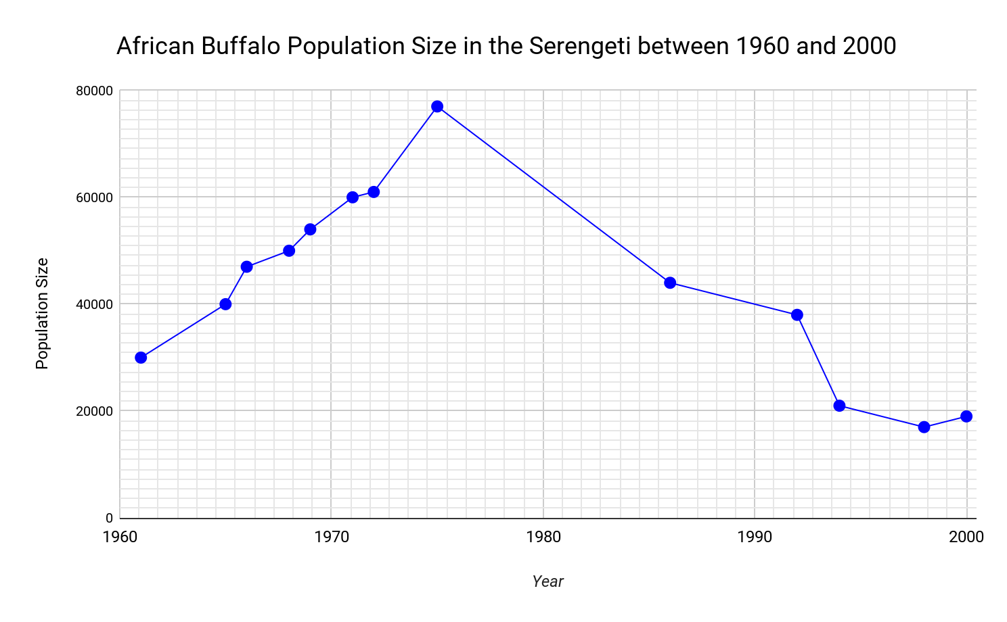
Buffalo Graph
What patterns do you notice in the graph? With a partner, brainstorm some possible causes for the change in the Buffalo population you observed in the graph.

Slide 11
Questions
What knowledge and experiences have you had, that might help us as a class explain what’s happening to the buffalo?
What questions do we need to answer, to test your ideas about what’s happening with the buffalo?
What other questions do you have about what we’ve shown so far?

Slide 12
If we were to continue this activity
We might…
Take your questions and build a public record of them
Prioritize them
Decide on a first investigation to conduct

Slide 13
And as part of this unit, we might also…
Ask students to complete a design challenge that requires them to apply their understanding of the phenomenon to solve a problem that addresses a concrete human need in society.
Join a citizen science effort to help monitor animal counts on the Serengeti that helps evaluate efforts to preserve biodiversity

Slide 14
Discussion
What is the phenomenon here?
What strikes you as similar to or different from how teachers have introduced science units in the past?

Slide 15
Initial Thoughts
Write down your initial thoughts or ideas as to what is a phenomenon.
We will add to these ideas in our later sessions.

Slide 16
Session Review
In this session, we experienced HOW a phenomenon may be introduced at the start of a unit.
In the next session, we will look more deeply at defining “phenomenon” and how it is different from a design challenge or a disciplinary core idea (DCI).

Slide 17
Selecting Anchoring Phenomena for Equitable Three-Dimensional Teaching
Session B: What are Phenomena?
Modified from Penuel, W. R., Bell, P., Neill, T., Morrison, D., & Tesoriero, G. (2018). Selecting Anchoring Phenomena for Equitable 3D Teaching. [OER Professional Development Session from the ACESSE Project] Retrieved from http://stemteachingtools.org/pd/sessione

Slide 18
In the previous session….
You experienced how a phenomenon can be introduced at the start of a unit
You generated your initial thoughts and ideas as to defining a phenomenon

Slide 19
This part of the session will prepare you to…
Generate working definitions of phenomena, design challenges, and disciplinary core ideas.
Explain to a peer the role of phenomena and design challenges in science teaching—with a particular focus on equity and justice.

Slide 20
But wait, is this a phenomenon?
Your task is to work in pairs to sort these strips of paper into three piles, to identify which of these is:
A phenomenon
A design challenge
A disciplinary core idea (DCI)

Slide 21
Discussion
Share one question and where you placed it. Share your reasoning.

Slide 22
Discussion
What are some criteria we can use to decide if something’s a phenomenon?
What are some criteria we can use to decide if something’s a design challenge?

Slide 23
Why Phenomena?
In this video, Dr. Brian Reiser, describes the role of phenomena in instruction.
Using Phenomena in NGSS-designed Instruction

Slide 24
What are phenomena?
Phenomena are observable events that occur in the universe and that we can use our science knowledge to explain or predict. The goal of building knowledge in science is to develop general ideas, based on evidence, that can explain and predict phenomena.
Definition from Achieve, Next Generation Science Storylines & STEM Teaching Tools

Slide 25
Different kinds of phenomena
Phenomena vary in how long they take students to explain or model.
Unit: Anchoring phenomenon
Days: Investigative phenomenon
Moments: Everyday phenomenon
Assessment: Scenario that presents a phenomenon

Slide 26
Different kinds of phenomena
A phenomenon can be a “case” of something (e.g., what happened to the aspens when wolves were introduced into the Yellowstone).
A phenomenon doesn't have to be “phenomenal” but rather something that people can observe.
A phenomenon can be a puzzling observation of the everyday (e.g., Rainwater isn’t salty, even when it is coming from the salt water in the ocean).
Everyday phenomena can sometimes become investigative or even anchor phenomena.

Slide 27
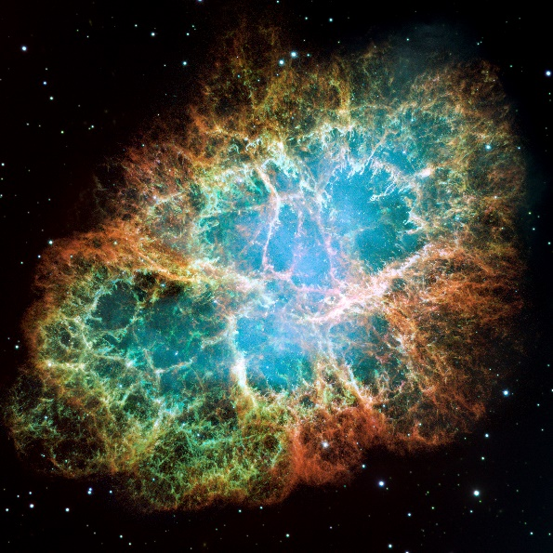
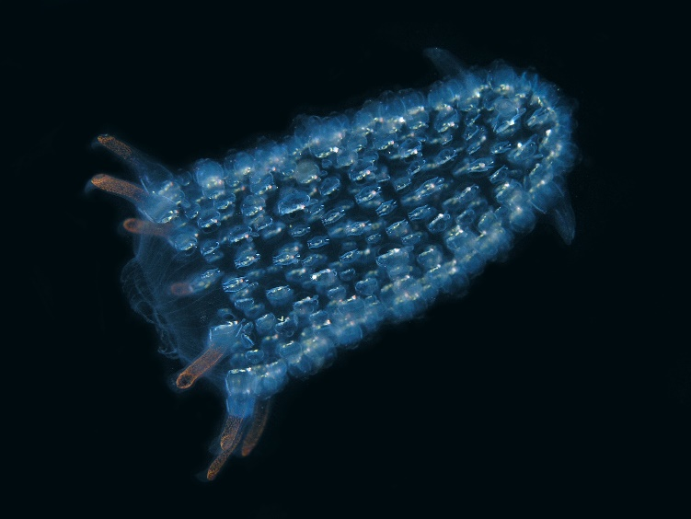
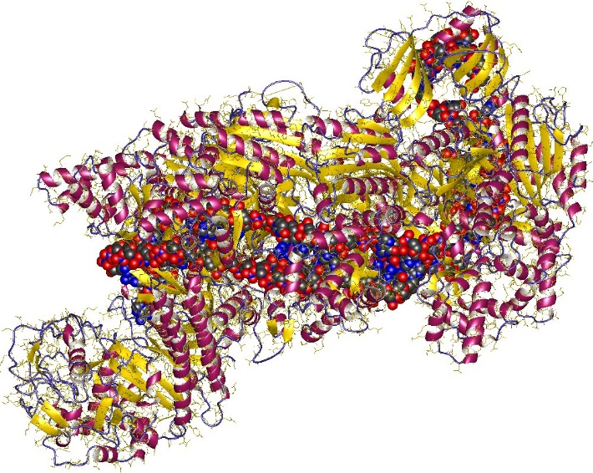
Phenomena are not just what we can observe directly…
Notes:
Image sources:
Bioluminescent Tunica: https://upload.wikimedia.org/Wikipedia/commons/5/5f/Tunicate_off_Atauro_island.jpg
Crab nebula: https://upload.wikimedia.org/Wikipedia/commons/0/00/Crab_Nebula.jpg
CRISPR-protein: https://upload.wikimedia.org/wikipedia/commons/c/cd/4qyz.jpg

Slide 28
Phenomena are not just what we can observe directly…
Following Carbon Dioxide Through the Atmosphere

Slide 29
Discussion
What are other contrasts or types of phenomena we should keep in mind, to make sure we are thinking broadly about possible phenomena?

Slide 30
Engineering Design Challenges
Engineering involves designing solutions to problems that arise from phenomena, and using explanations of phenomena to design solutions.
Definition from Achieve, Next Generation Science Storylines & STEM Teaching Tools

Slide 31
Equity and Justice in Science and Engineering
A major goal for science education should be to provide all students with the background to systematically investigate issues related to their personal and community priorities. They should be able to frame scientific questions pertinent to their interests, conduct investigations and seek out relevant scientific arguments and data, review and apply those arguments to the situation at hand, and communicate their scientific understanding and arguments to others.”
— NRC, 2012, p. 278

Slide 32
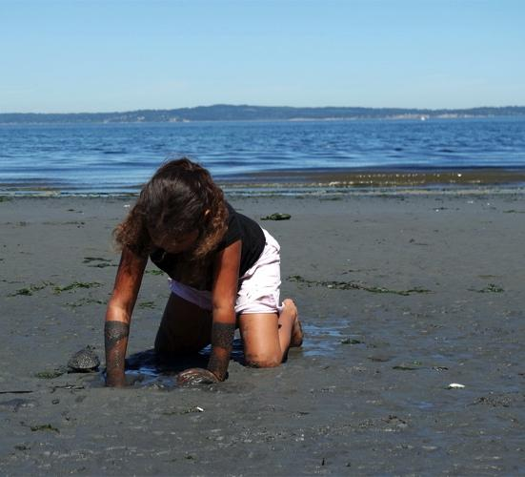
Equity: Inclusive Science Instruction (from NRC Framework Chapter 11)
Learning is cultural. Instruction should grow out of everyday experience of learners and connect to their interests and identities.
Instruction should leverage science-related values, knowledge, and practices of students’ families and cultural communities.
Instruction should allow students to bring their current communicative resources to bear through the full learning process.

Slide 33
Framework
The Framework stresses the importance of inclusive instructional strategies designed to engage students with diverse interests and backgrounds and points out that these principles should carry over into assessment design as well.
—NRC, 2014, p. 222

Slide 34
There are many kinds of design challenges
Build and test physical devices or processes
Participating in a citizen science project
Designing and implementing a dialogue or initiative about a socio-scientific issue
Contributing to a community initiative to promote justice using science

Slide 35
During this session
We have
Agreed upon criteria for phenomena and design challenges
Identified the characteristic of a phenomenon
Determined the role of equity when identifying phenomena for instruction

Slide 36
Reflection
How would you
Explain to others the role of phenomena and design challenges in instruction
Incorporate equity and justice as you design lessons

Slide 37
Selecting Anchoring Phenomena for Equitable Three-Dimensional Teaching
Session C: Analyzing Performance Expectations
Modified from Penuel, W. R., Bell, P., Neill, T., Morrison, D., & Tesoriero, G. (2018). Selecting Anchoring Phenomena for Equitable 3D Teaching. [OER Professional Development Session from the ACESSE Project] Retrieved from http://stemteachingtools.org/pd/sessione

Slide 38
In the previous session….
We developed a working definition of phenomenon and design challenge from agreed upon criteria
We identified characteristics of a phenomenon
We determined the role of equity of identifying a phenomenon for instruction

Slide 39
Initial Ideas
How could we go about choosing phenomena or design challenges to use in teaching?

Slide 40
Learning Goals
Analyze a bundle of performance expectations for each of the three dimensions
Brainstorm phenomena related to the bundle of performance expectations.

Slide 41
Why Analyze Standards?
Three dimensional standards are complex. Much is “packed” into each one.
Spending time making sense of the standard with others creates a clearer sense of the learning goals—and how they relate to events in the universe.
In analyzing standards, we often generate some initial ideas about phenomena that we can explore more deeply later.

Slide 42
Guidelines for Analysis
Use the Framework text as your guide, not your own ideas about “facts” you should teach that aren’t in the text.
Formulate as claims in complete sentences.
Consider facets or different aspects of the ideas represented.
Consider knowledge students would need that is foundational for understanding the ideas.
When tempted to write a definition, instead of writing “X is,” start a sentence with, “X explains…” or “X helps explain…”

Slide 43
Some Example Claims
3-LS4-1. Analyze and interpret data from fossils to provide evidence of the organisms and environments in which they lived long ago.
Facets | Prior Knowledge
Fossils help explain the environment that was once present. Fossils tell us about plants and animals that lived long ago. | Some plants and animals are no longer living. Some plants and animals, like sharks, look like those that are no longer living.

Slide 44
Building Understanding
What are some core ideas and crosscutting concepts that students will need to use, to explain a phenomenon we choose?
What practices will they need to engage in, that help us identify the kinds of evidence students will need to make sense of?

Slide 45
Homework!
Take or find photographs that are related to the focal performance expectations that we could use to help us come up with phenomena.
For each photo, write a sentence on a sticky note we provide you that represents your thinking about how the picture connects with the focal PEs.
Take or find photos that are focused on both everyday life (things you encounter in your world) and things that might captivate young people’s attention because they are puzzling in some way (or could be made into something puzzling).

Slide 46
Selecting Anchoring Phenomena for Equitable Three-Dimensional Teaching
Session D: Selecting Phenomena
Modified from Penuel, W. R., Bell, P., Neill, T., Morrison, D., & Tesoriero, G. (2018). Selecting Anchoring Phenomena for Equitable 3D Teaching. [OER Professional Development Session from the ACESSE Project] Retrieved from http://stemteachingtools.org/pd/sessione

Slide 47
Previously, we…..
Experienced how a phenomenon can be used to introduce learning
Generated working definitions for phenomenon and design challenge
Analyzed a bundle of performance expectations

Slide 48
Learning Goals
Select a phenomenon related to a bundle of three-dimensional standards we have analyzed.
Use tools to elicit student interest and related experiences to help select a phenomenon.

Slide 49
Coming to Consensus
What did we conclude last time about:
How to distinguish phenomena, DCIs, and design challenges?
What makes for good phenomena to anchor a unit?
What the key science ideas are that a phenomenon for our focal PEs needs to address?

Slide 50
Sharing our Homework
What pictures did we take?
What are some ideas for phenomena they generated?

Slide 51
Brainstorm Phenomena
What are some potential phenomena that might meet our criteria?
Make sure the phenomenon addresses as many of the unpacked components for both of the 2 PEs.
Go for quantity.
Describe as something observable.
Write a driving question to focus investigation.
EXAMPLE
Phenomenon: As CO₂ cycles the Earth in a year, it follows a swirling, complex pattern.
Driving Question: What explains how CO₂ moves in Earth’s atmosphere?

Slide 52
Share, Cluster, Reduce
Which phenomena are the same or similar?
Which ones do you think are the most viable, in terms of addressing the standards?
Let’s reduce the number we need to investigate further.

Slide 53
Construct a Student Explanation
What would an English learner who mastered the material give as an explanation of this phenomenon?
Write about 1 paragraph
Indicate standards or aspects of standards in the parentheses
Avoid scientific terminology unless absolutely necessary

Slide 54
Construct a Student Explanation
Phenomenon:
Most adults around the globe can’t drink milk without getting an upset stomach.
Student Explanation:
The ability to digest milk arose out of a random mutation (HS-LS-3-2), which scientists identified by looking for evidence of mutations that existed in milk-tolerant individuals but not milk-intolerant people (HS-LS-3-3). To test for whether this had an advantage for their survival, they looked for genes that were adjacent to the mutation (potential HS-LS-3-1 connection) that got “swept along” or “hitchhiked” along with the mutation, and found evidence of that indicating that the mutation was found in dairying populations (HS-LS-4-3, HSLS-4-4).

Slide 55
Building Understandings Discussion
What do you notice about our explanations?
What are you wondering about?

Slide 56
Connecting to Students’ Interests and Experiences
We still don’t have evidence that our phenomena are good ones for connecting to students’ interests and experiences!
We need assessment evidence related to our candidate phenomena!

Slide 57
Student Survey
Solicit student input through a survey in selecting an anchor to enhance likelihood of personal relevance.
How could a “superbug” produce an epidemic that affects a whole population?

Slide 58
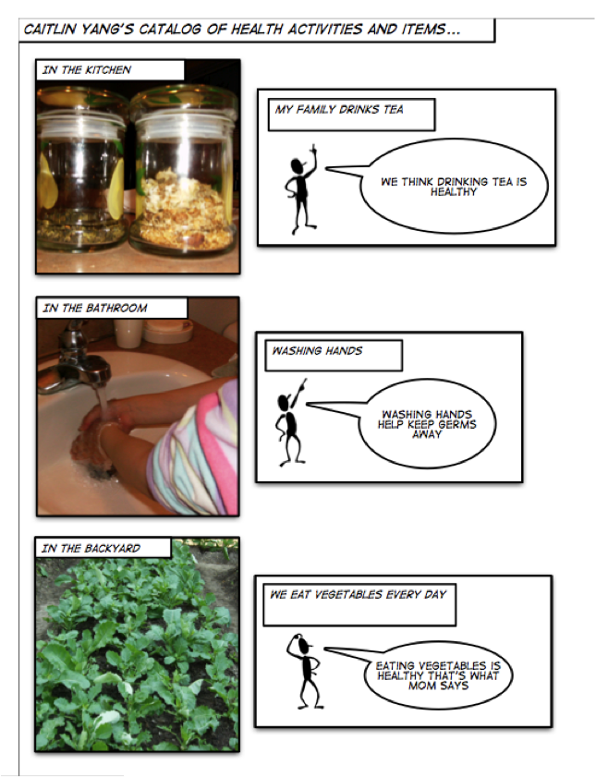
Self-Documentation
• Use community health practices to guide instruction
• Self-documentation technique used to bridge community activities with school inquiry and sense-making
(Tzou & Bell, 2010)

Slide 59
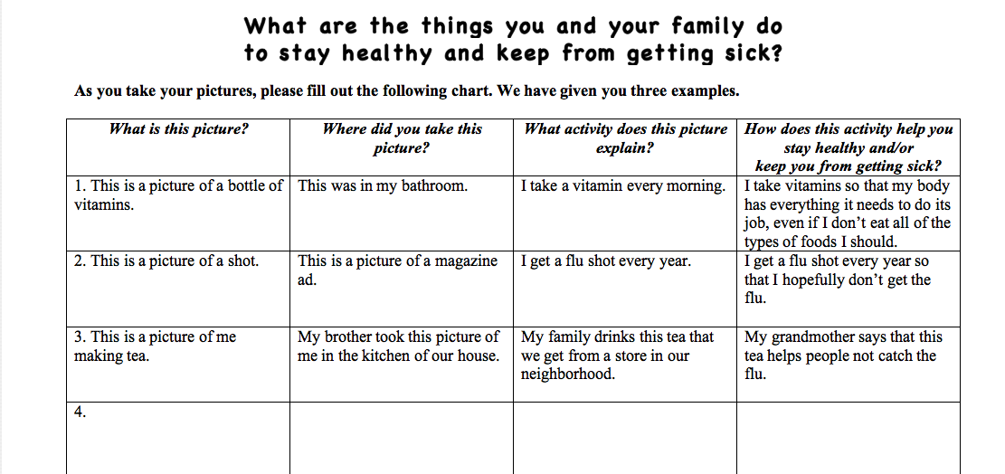
Self-Documentation

Slide 60
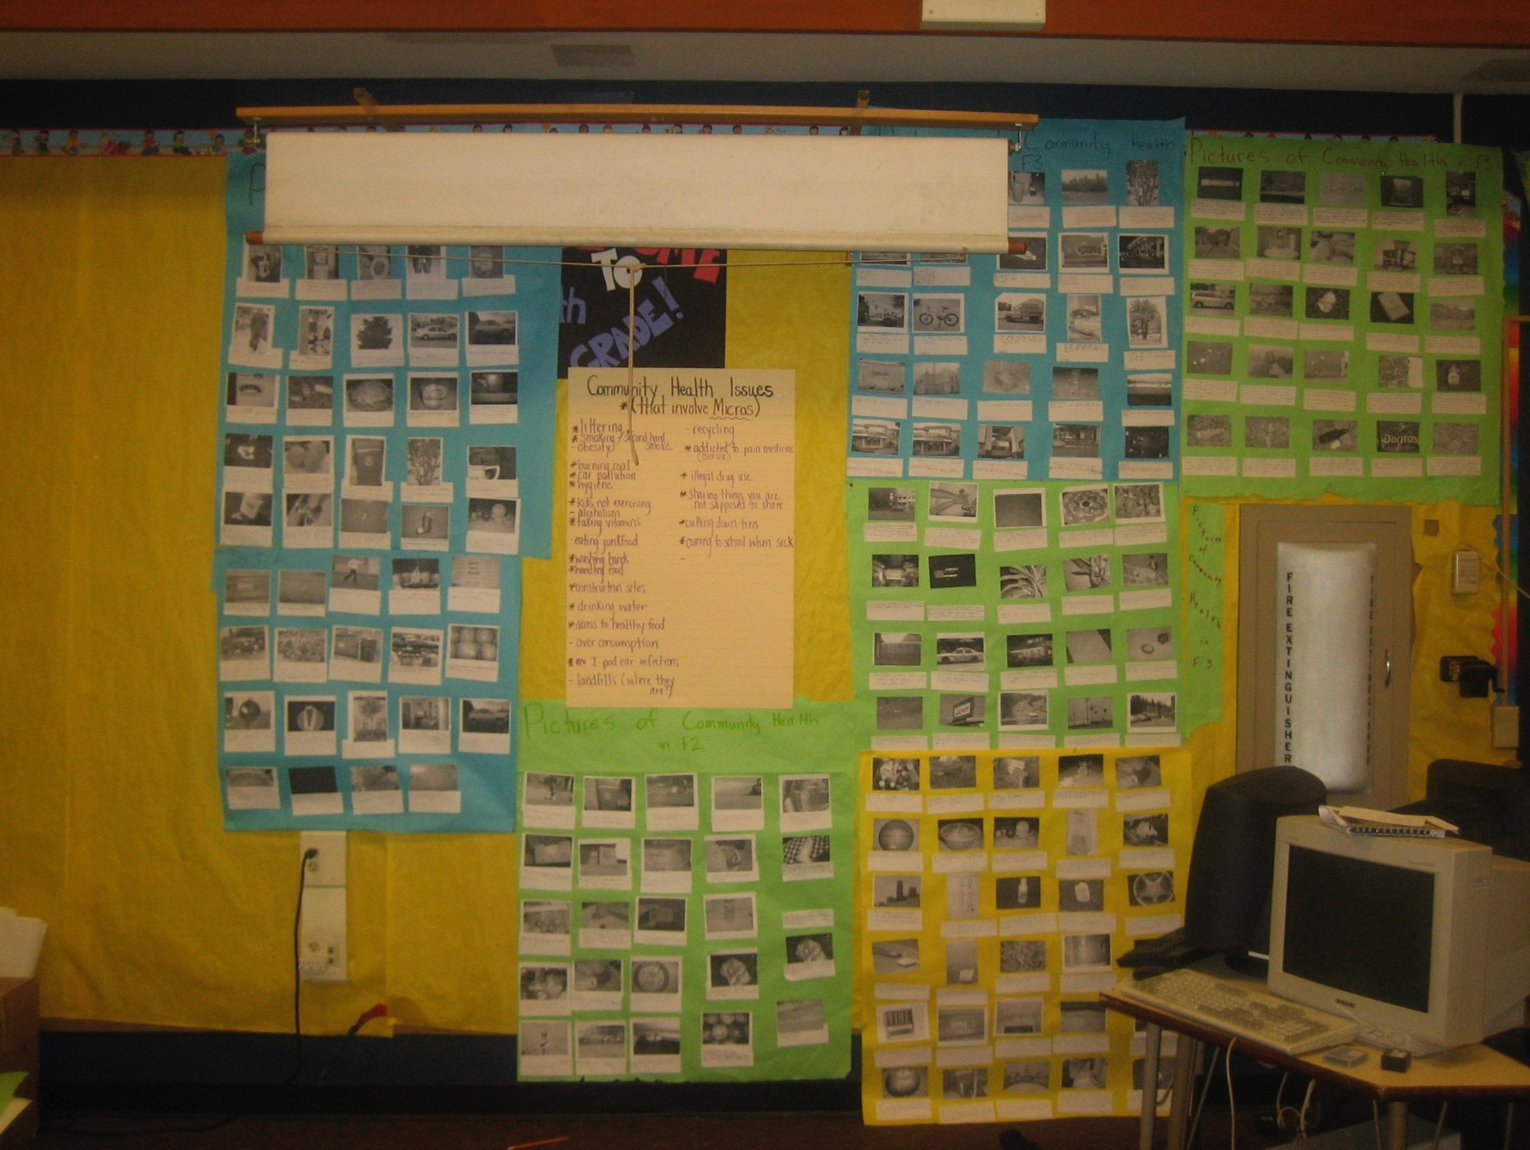
Image of self-documentation in the classroom

Slide 61
In this session, we..
Experienced a process that helped us identify a viable anchor phenomenon
Learned of two methods that could incorporate student voice in instructional design

Slide 62
Selecting Anchoring Phenomena for Equitable Three-Dimensional Teaching
Session E: Taking Stock
Modified from Penuel, W. R., Bell, P., Neill, T., Morrison, D., & Tesoriero, G. (2018). Selecting Anchoring Phenomena for Equitable 3D Teaching. [OER Professional Development Session from the ACESSE Project] Retrieved from http://stemteachingtools.org/pd/sessione

Slide 63
Taking Stock
Let’s review what we’ve done so far.
What are some steps here that strike you as really important? Why are those steps important?

Slide 64
Introducing Phenomena: Objectives
Experience one way to introduce phenomena
Build an initial sequence for a unit that is based on student questions
Help students make connections to their own ideas and experiences

Slide 65
Introducing a Phenomenon
Find a short video or piece of data to present in front of a group of educators or lead a demonstration / exploration with students.
Show the video / present the data / explore the object or process, and get their ideas about questions they have about the phenomenon.

Slide 66
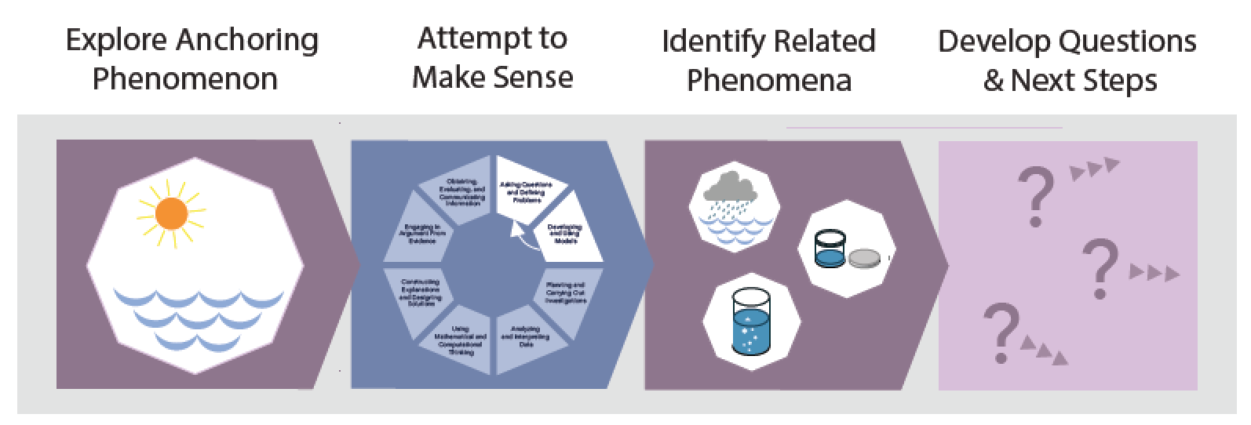
Anchoring Phenomenon Routine
tinyurl.com/AnchorPhenomRoutine

Slide 67
Introducing Phenomena
Many Faces of DUCHENNE Muscular Dystrophy

Slide 68
Observations and Questions
What did you notice in the video?
What did you wonder about?

Slide 69
Initial Ideas
What are some of your initial ideas about what could be going on here?
What are some related things we know about or have experienced, that could help us understand what’s going on here?

Slide 70
Prioritizing Questions
What questions are ones that we need to answer as a class?
What do we need to answer first? Why those questions?

Slide 71
Debriefing the Launch
The launch presents the phenomena, setting up the expectation that they will observe some things that need investigating.
The launch involves asking questions, and therefore puts students in the driver’s seat for a series of lessons.
The launch engages learners’ prior knowledge and related experiences as resources for understanding.
The launch requires them to prioritize when to take up what questions, providing a possible learning pathway for them to pursue.

Slide 72
Summary of Process
Analyze the standards
Brainstorm candidate phenomena
Share, cluster, and reduce list
Write student explanations
Get student input
Choose phenomenon and “launch” activity
Simulate the launch to establish a possible sequence for a unit

Slide 73
Places to Find Ideas for Phenomena
T.J. McKenna of Connecticut Science Center
http://ngssphenomena.com
#ProjectPhenomena in San Diego
https://sites.google.com/site/sciencephenomena
Science News feeds on social media (e.g., @EurekAlert on Twitter)
Podcasts: Radiolab (Science), 99 Percent Invisible (Design and Engineering), SCIENCE Magazine, Science Friday
For older students: Scijourner

Slide 74
You now have tools to
Identify an anchoring phenomenon for your unit of study
Develop a storyline for explaining the phenomenon
Gain student input into possible phenomena and the storyline

