Slide 1
Getting to Know the Kentucky Academic Standards for Science
An Overview

Slide 2
Components of this Module
Session A: Understanding the Architecture and the Components
Session B: Dimensions of Science: Disciplinary Core Ideas (DCIs)
Session C: Dimensions of Science: Science and Engineering Practices (SEPs)
Session D: Dimensions of Science: Crosscutting Concepts (CCC)

Slide 3
Group Norms
Presume positive intentions.
Listen carefully to one another.
Be open to new ideas.
Be open to productive struggle.
Ask questions.
Allow a chance for everyone to participate.

Slide 4
Setup for Success: Brainwriting
What is something you tried in your classroom this year for the first time? How did it go?
What is one way you grew professionally this year?
Who amongst your colleagues was the most helpful to you? Why?
In what ways were you helpful to your colleagues this year?

Slide 5
Module Goals:
Build a shared understanding of the architecture and components of the KAS for Science.
Strengthen the understanding of the three dimensions of science and recognize how they work together to support highly effective science teaching and learning.
Identify and prioritize areas where future professional learning will be needed for successful implementation of the KAS for Science and develop a plan to address those areas.

Slide 6
By the end of this module…..
You will be able to develop an argument as to how instruction for the Kentucky Academic Standards for Science is the same/different as is generally observed in your experiences.

Slide 7
Getting to Know the Kentucky Academic Standards for Science: An Overview
Session A: Understanding the Architecture and Components

Slide 8
Session A: Essential Question
How might the components of the architecture support teachers while creating new opportunities for engaging other stakeholders (students, parents, administrators, district leaders)?

Slide 9
Components to the Kentucky Academic Standards for Science
Background (page 3)
Kentucky Vision for Students (page 3)
Writers’ Vision Statement (page 6)
Standards Use and Development (page 9)
How to Read the Standards (page 12)
Grade Level Overviews
Grade Level Standards

Slide 10
Background and Kentucky Vision for Students
Go to page 3 of the Kentucky Academic Standards for Science to read the Background and Kentucky’s Vision for Students.
With these two sections in mind:
What do you notice and wonder about?
How does this information help us understand the rationale for these Three-Dimensional Standards?

Slide 11
Writers’ Vision Statement
Go to page 6 of the Kentucky Academic Standards for Science to read the Writers’ Vision Statement.
As you read, write down or highlight some of the foundational beliefs of the writers.
(Kentucky Academic Standards for Science –page 6)
Notes:
Read through the Writers’ Vision Statement, write down some of the foundational beliefs of the writers.
Examples found within the vision:
Receive equitable science education
Experience science learning beginning in kindergarten
Learning progresses yearly
Possess sufficient understanding of the science and engineering practices, crosscutting concepts and core ideas of science
Able to engage in public discussions on science-related issues
Become critical educated consumers of scientific information related to their everyday lives
Experience multiple sustained and authentic learning opportunities
Investigate phenomena
Engage in collaborative conversations
Reflect the diversity encountered within the classroom in the local community and across the globe
Work with and develop the ideas that underly science and engineering practices
See connections of science ideas over a period of years
Engage with the interconnectedness of the three dimensions of science
Make sense of the natural world
Have access to high-quality professional learning and resources

Slide 12
Writers’ Vision Statement (2)
“The writing team was guided by a vision for equitable science education in Kentucky that begins in kindergarten and progresses yearly through grade 12 to ensure that all students possess sufficient understanding of the science and engineering practices, crosscutting concepts and core ideas of science to engage in public discussions on science-related issues and are critically educated consumers of scientific information related to their everyday lives. To achieve this, all students at all grade levels must experience multiple sustained and authentic learning opportunities to investigate phenomena, engage in collaborative conversations and reflect the diversity encountered within the classroom in the local community and across the globe.
“To meet this vision, the writers recognize that students need sustained opportunities to work with and develop the ideas that underly science and engineering practices and to appreciate how those ideas are interconnected over a period of years rather than weeks or months. Students should be provided multiple, ongoing opportunities to engage with the interconnectedness of the three dimensions of science as they work to make sense of the natural world. To assist teachers in this endeavor, the writers recommend that teachers at all grade levels have ongoing access to high-quality professional learning and resources about science.”
.
.
(Kentucky Academic Standards for Science –page 6)

Slide 13
Reflect on the Writers’ Vision
What do those foundational beliefs mean for the student and teacher experiences in K-12?

Slide 14
Standards Use and Development
Standards are NOT:
A set of instructional or assessment tasks
Curriculum
Standards are:
Statewide baseline of what students should know and be able to do after instruction
“The standards address a foundational framework of what is to be learned, but do not address how learning experiences are to be designed or what resources should be used.”
(Kentucky Academic Standards for Science page 10)

Slide 15
Understanding the Architecture
Standards place an equal importance on the mastery of important science concepts and the use of the science and engineering practices and cross cutting concepts.
Standards are arranged in grade-level view, followed by standard breakdown, which provides clarity to the depth of rigor required.
Overviews were added for kindergarten through high school. These sections provide an overview of the key disciplinary science ideas at each grade, as well as the science and engineering practices and crosscutting concepts students are expected to use to demonstrate their understanding of these ideas.
Note: For high school teachers, the overviews are provided for each discipline as opposed to grade levels to coincide with the flexibility given to local districts to determine curriculum.

Slide 16
Grade Level Overview Sample
Kindergarten Overview
To meet the kindergarten performance expectations, students are expected to demonstrate grade-appropriate proficiency in asking questions; developing and using models; planning and carrying out investigations; analyzing and interpreting data; designing solutions; engaging in argument from evidence; and obtaining, evaluating and communicating information. Students are expected to use these practices to demonstrate their understanding of the core ideas. Kindergarten performance expectations include pushes and pulls, weather and animal habitats. Students are expected to develop understanding of patterns and variations in local weather and the purpose of weather forecasting to prepare for, and respond to, severe weather. Students can apply an understanding of the effects of different strengths or different directions of pushes and pulls on the motion of an object to analyze a design solution. Students also are expected to develop understanding of what plants and animals (including humans) need to survive and the relationship between their needs and where they live. The crosscutting concepts of patterns that include cause and effect, systems and system models are highlighted as organizing concepts for these disciplinary core ideas. *Note* While only a subset of science and engineering practices and crosscutting concepts are explicitly identified as the mechanism for how students demonstrate mastery at the end of instruction, students should still utilize all of the science and engineering practices and crosscutting concepts as they develop their understanding. See front matter for more information.
Notes:
This is the grade level overview document for Kindergarten.
Go to the standards document to locate the overview page for your grade level.

Slide 17
Reflect on the Grade-Level Overview
Read through your grade-level overview, and underline, highlight, circle, etc., elements that impact instruction.
With these elements in mind, how might the information in the grade-level overview be useful in communicating with different stakeholders (parents, students, teachers, administrators, district leaders)?

Slide 18
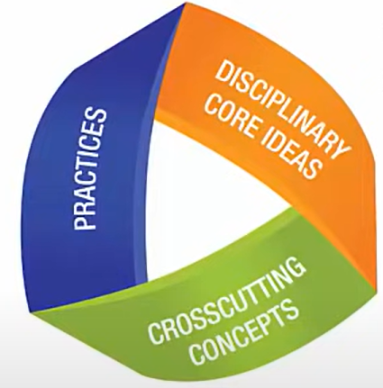
Three-Dimensional Standards
Practices describe behaviors scientists and engineers engage in
“What students DO”
Disciplinary core ideas describe the core ideas in the science disciplines
“What the students KNOW”
The crosscutting concepts describe concepts linking the different domains of science
“How the students think”
Notes:
Science and Engineering Practices: Practices refer to the way in which scientists and engineers engage in their work. They engage in wonder,
design, modeling, argumentation, communication, and engineering thinking. While a specific practice may be identified in each performance
expectation, students should engage in all practices because this helps them understand how scientific knowledge develops and the links between
science and engineering.
Disciplinary Core Ideas: Core ideas found in the Kentucky Academic Standards for Science are foundational understandings so that students may
later acquire additional information on their own. The core ideas are organized within physical, life and earth/space science, which are traditionally
associated with science knowledge. Also found here are the ideas used in the engineering design process, identified as ETS (engineering, technology,
and application of science).
Crosscutting Concepts: Crosscutting concepts are conceptual tools that are used as lenses for understanding the natural/designed world. They
provide ways of thinking and reasoning about phenomena across disciplines, uniting core ideas throughout the fields of science and engineering.
While specific crosscutting concepts may be identified in each performance expectation, explicit instruction and engagement in all of the crosscutting
concepts is expected. This will help deepen students’ sensemaking across a range of disciplinary contexts.

Slide 19
Three-Dimensional Standards (2)
As students engage in the science and engineering practices and look through the lens of the cross-cutting concepts, they learn the disciplinary core ideas to make sense of phenomena or design solutions to problems.
Notes:
Think of the three components of three-dimensional learning as three intertwining stands of a rope. While the rope can be separated into its three different strands, the strength of the rope is determined by the strands working together; separating the strands weakens the rope so that it is no longer effective for our intended use.
Likewise, while in the past we may have separated out the knowledge and skills students need in the study of science, in actuality, knowing and doing cannot be separated if our goal is the kind of usable, conceptual understanding students need to think, act, and learn like scientists.
Three-dimensional learning — practices, core ideas, and crosscutting concepts working together — is therefore a non-negotiable for NGSS lessons and units.

Slide 20
Three-Dimensional Standards (3)
Science and Engineering Practices | Disciplinary Core Ideas | Cross Cutting Concepts
Asking questions or defining problems Developing and using models Planning and carrying out investigations Analyzing and interpreting data Using mathematics and computational thinking Constructing explanations and designing solutions Engaging in argument from evidence Obtaining, evaluating and communicating information | Physical Sciences: (PS1) Matter and Its Interactions (PS2) Motion and Stability: Forces and Interactions (PS3) Energy (PS4) Waves Life Sciences: (LS1) Molecules to Organisms (LS2) Ecosystems (LS3) Heredity (LS4) Biological Evolution Earth and Space Sciences: (ESS1) Earth’s Place in the Universe (ESS2) Earth’s Systems (ESS3) Earth and Human Activity Engineering Design: (ETS1.A) Defining and Delimiting an Engineering Problem (ETS1.B) Developing Possible Solutions (ETS1.B) Optimizing the Design Solution | Patterns Cause and effect mechanisms and explanation Scale, proportion and quantity Systems and system models Energy and matter flows, cycles and conservation Structure and function Stability and change
Notes:
This table provides a summary of each science dimension.

Slide 21
Reflection on the Three-Dimensionality of the Standards
How is three-dimensional instruction the same and different from what you have experienced in the past as a student and/or as a teacher?

Slide 22
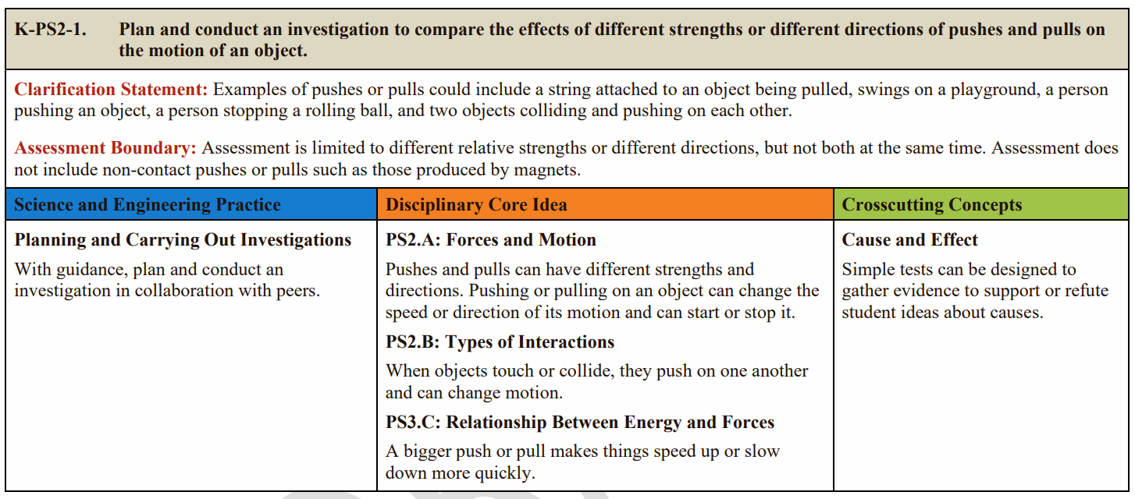
How to Read the Standards Sample Kentucky Academic Standards for Science
Performance Expectation (PE): The performance students demonstrate to show mastery
Clarification Statement: Provides examples or additional information
Assessment Boundary:
States the limit of assessment for large-scale assessment
Foundation Boxes: Provides further information about each dimension that was combined to develop the PE
Notes:
Performance Expectation: The performance students demonstrate to show mastery. It states how a student will demonstrate their understanding of a core idea on a large-scale assessment. Some performance expectations include an asterisk, which signifies the inclusion of engineering design.
Clarification Statement: These provide examples or additional information about the performance expectation. Not all performance expectations include a clarification statement. In instances in which the committee felt clarification was not necessary, the notation “none provided” is present.
Assessment Boundary: This states the limit of assessment for a large-scale assessment. It does not, however, limit the assessment that could occur in the classroom. The notation “none provided” indicates that the committee did not believe a boundary needed to be identified.
Foundation Boxes: These boxes represent the foundational components of three dimensions that encompass the performance expectation, which are:
• Science and Engineering Practices: This box describes the element of the practice associated with the performance expectation.
• Disciplinary Core Idea: This box includes conceptual information related to the overall core idea of the performance expectation. The coding found in this box is consistent with the coding and component ideas described in the framework.
• Crosscutting Concepts: This box describes the element of the concept associated with the performance expectation.

Slide 23
Performance Expectations (PEs)
Performance Expectations depict what students must do to show proficiency in science.
PEs are NOT a set of instructional or assessment tasks.
PEs with an * signify an engineering design component.

Slide 24
How to Read the Coding for Performance Expectations (PEs)?
07-PS4-2 Develop and use a model to describe that waves are reflected, absorbed, or transmitted through various materials.
Grade level or Band

Slide 25
How to Read the Coding for Performance Expectations (PEs)? (2)
07-PS4-2 Develop and use a model to describe that waves are reflected, absorbed, or transmitted through various materials.
Science Domains
Discipline
PS | Physical Science
LS | Life Science
ESS | Earth and Space Science
ETS | Engineering, Technology and Applications of Science
Grade level or Band

Slide 26
How to Read the Coding for Performance Expectations (PEs)? (3)
07-PS4-2 Develop and use a model to describe that waves are reflected, absorbed or transmitted through various materials.
Disciplinary Core Idea
Discipline
Grade level or Band

Slide 27
How to Read the Coding for Performance Expectations (PEs)? (4)
07-PS4-2 Develop and use a model to describe that waves are reflected, absorbed or transmitted through various materials.
Disciplinary Core Idea
Discipline
Grade level or Band
Standard sequence number
Notes:
There are several PE under the Disciplinary Core Idea PS4. Since this is the second one, it has a number 2 beside it.

Slide 28
Exploration
Using the standards pages for your grade level, identify the:
Performance Expectations
Foundation Boxes
Clarification Statements
Assessment Boundaries
Any PEs with an *
Notes:
Participants should have access to the Kentucky Academic Standards for Science

Slide 29
Exploration and Connections
Now that you have explored the standards for your grade level, go back to your grade level overview.
How does the grade level overview capture what you noticed during the standards exploration?
Notes:
Participants should have access to the Kentucky Academic Standards for Science

Slide 30
During this session we have investigated the general architecture and components of the KAS for Science
Future sections will investigate the dimensions in more detail.

Slide 31
Reflection for Session A
Now that you have completed Session A on the general architecture and components of the KAS for Science, complete the reflection below.
What three concepts am I taking away from this session?
What about the session squares with my beliefs?
What questions are still circling my mind?

Slide 32
The Kentucky Academic Standards for Science: An Overview
Session B: Dimensions of Science: Disciplinary Core Ideas (DCI)

Slide 33
In Session A, we…
Identified the purpose of the standards.
Explored the architecture and various components of the KAS for Science
Developed an understanding of three-dimensional standards

Slide 34
Session B Essential Question
What are the Disciplinary Core Ideas (DCIs) and why are they important?

Slide 35
Disciplinary Core Ideas (DCI)
Key scientific ideas that
Have broad importance across multiple science disciplines.
Work together to support students in explaining phenomenon or designing solutions.
Provide key conceptual tools for understanding more complex ideas.
Are accessible to younger students but broad enough to go into depth and sophistication over time.

Slide 36
Disciplinary Core Ideas
This video highlights the Disciplinary Core Ideas in a teacher Professional Learning Session.
Disciplinary Core Ideas
Notes:
Video can be found at https://www.nextgenscience.org/resources/video-ngss-disciplinary-core-ideas

Slide 37
Reflect on the Video
How is instruction around core ideas the same/different as instruction around traditional content?
How are core ideas used differently than content has been in the past?

Slide 38
Appendix E
demonstrates a progression of understanding of core ideas across grade levels.
is organized by grade bands (K-2, 3-5, 6-8 and 9-12) and disciplinary core ideas.
describes the content that should occur by the end of the grade band.
Notes:
Access to Appendix E at https://www.nextgenscience.org/sites/default/files/resource/files/AppendixE-ProgressionswithinNGSS-061617.pdf

Slide 39
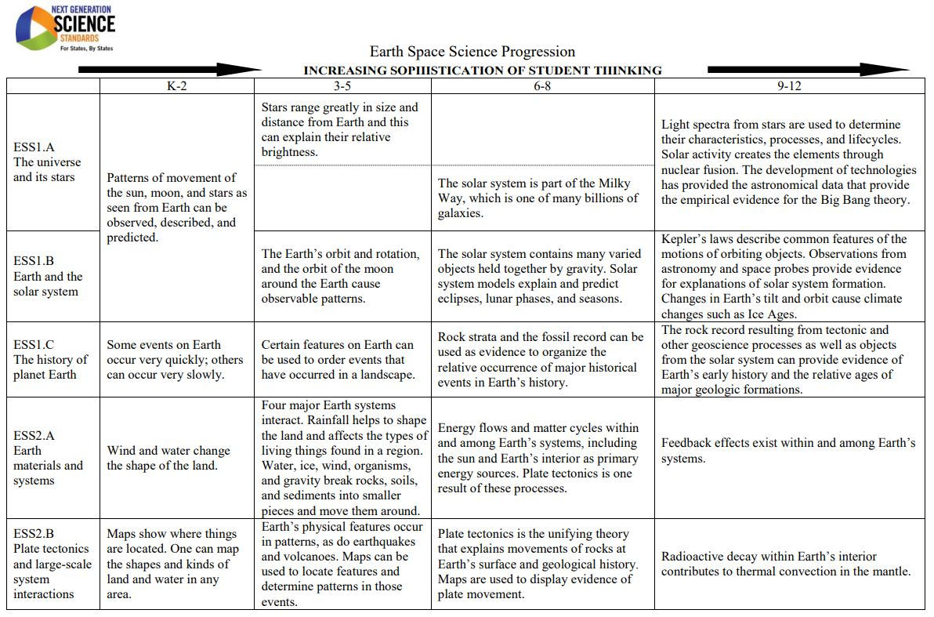
Progressions
Notes:
Sample page from Appendix E, showing how the progression some of the earth/space science DCIs.

Slide 40
Appendix E Exploration
Take a few moments to explore the general layout of Appendix E
How is the document laid out?
What shifts in grade-level expectations, if any, do you observe?
Is there anything that is surprising in this first dive into the Appendix?

Slide 41
Appendix E Exploration (2)
Choose a DCI to explore (e.g., LS2.A)
How does depth and sophistication progress from K-2 to HS?
What understandings should students have when coming to your classroom?
How do the understandings from your grade band help build understandings at the next grade band?
Notes:
Additional Resource for further exploration: https://www.nsta.org/store/product_detail.aspx?id=10.2505/9781938946417

Slide 42
Engineering Design
“Special” set of DCI standards that define the engineering design process
Defined by the Engineering, Technology and Applications of Science (ETS) Standards
Engineering design also incorporated within the Science and Engineering Practices

Slide 43
Definitions
Engineering: Any engagement in a systematic practice of design to achieve solutions to particular human problems
Technology: All types of human-made systems and processes. Technologies result when engineers apply their understanding to the natural world and of human behavior to design ways to satisfy human needs and wants
NRC, 2012, pp. 11-12

Slide 44
The Design Cycle
Define
Optimize
Develop
Solutions

Slide 45
Appendix I Exploration
Study Appendix I
How is it different from the DCI progression you have previously reviewed?
How do the three components of the design cycle increase in depth and sophistication at each grade band?
Notes:
Link to Appendix I: https://www.nextgenscience.org/sites/default/files/resource/files/Appendix%20I%20-%20Engineering%20Design%20in%20NGSS%20-%20FINAL_V2.pdf

Slide 46
In Session B, we…
determined the importance of the Disciplinary Core Ideas.
explored Appendix E to see how it might inform teachers of how they can support student learning.
examined how engineering design is represented in the Kentucky Academic Standards (KAS) for Science and how it progresses in depth and sophistication as students move through grade bands.

Slide 47
Reflection for Session B
Now that you have completed Session B on Disciplinary Core Ideas, complete this sentence stem on your own paper.
I used to think…but now I know…

Slide 48
The Kentucky Academic Standards for Science: An Overview
Session C: Dimensions of Science: Science and Engineering Practices (SEP)

Slide 49
In previous sessions we learned…
the KAS for Science depict what students must do and know to show proficiency in science.
the KAS for Science are composed of three dimensions.
the Disciplinary Core Ideas (DCIs) are the broad ideas of science.
the DCIs include Principles of Engineering Design.

Slide 50
Session C Essential Question
How do the practices help us move beyond “knowing about” science to making sense of the world around us?

Slide 51
Science and Engineering Practices (SEPs)
Major practices scientists use to investigate, model and develop theories about the natural world
Key practices engineers use to design and build systems

Slide 52
Why Practice?
The science and engineering practices are:
critical as the students are making sense of the world.
“the way we build, test, refine and use knowledge either to investigate questions or to solve problems.”
(Helping Students Make Sense of the World Using Next Generation Science and Engineering Practices, page 6)

Slide 53
Science and Engineering Practices
Science and Engineering Practices
Asking Questions/Defining Problems
Developing and Using Models
Planning and Carrying Out Investigations
Analyzing and Interpreting Data
Using Mathematics and Computational Thinking
Constructing Explanations/Designing Solutions
Engaging in Argument from Evidence
Obtaining, Evaluating and Communicating Information
Notes:
The science and engineering practices (SEP) are TOOLS that students use (they are the same tools that scientists and engineers use).
2 main points:
These tools are used to meaningfully access, process, synthesize, and explain information. While some tools may seem very specific to the discipline of science, all disciplines (Reading and Writing, Mathematics, Social Studies, etc) use tools similar to these and we should be intentional in our instruction so that students understand this.
Consider which of these SEP (or tools) are “hands-on.” Many think of science as “hands-on” learning, which can have the unintended effect of stakeholders assuming that when kids are engaged in a hands-on experience that they are learning science in a meaningful way. Only “carrying out investigations” is required to be “hands-on.” “Modeling” might be “hands-on” but doesn’t have to be because models are more than physical reproductions. Effective use of these tools results in “minds-on” experiences. Helping students build proficiency with these tools is one key to effective science instruction.

Slide 54
Science and Engineering Practices (2)
This video highlights the Science and Engineering Practices in a teacher Professional Learning Session.
Science and Engineering Practices
Notes:
Video can be found at https://www.nextgenscience.org/resources/video-ngss-science-engineering-practices

Slide 55
Reflect on the Video (2)
How are the use of the SEPs the same/different from a science experiment commonly seen in science classrooms?
How do the SEPs engage students in thinking deeply about their work?
How are the SEPs interrelated?

Slide 56
Appendix F
Identifies key characteristics of each practice
Shows the progression of depth-of-use of each practice across grade-bands

Slide 57
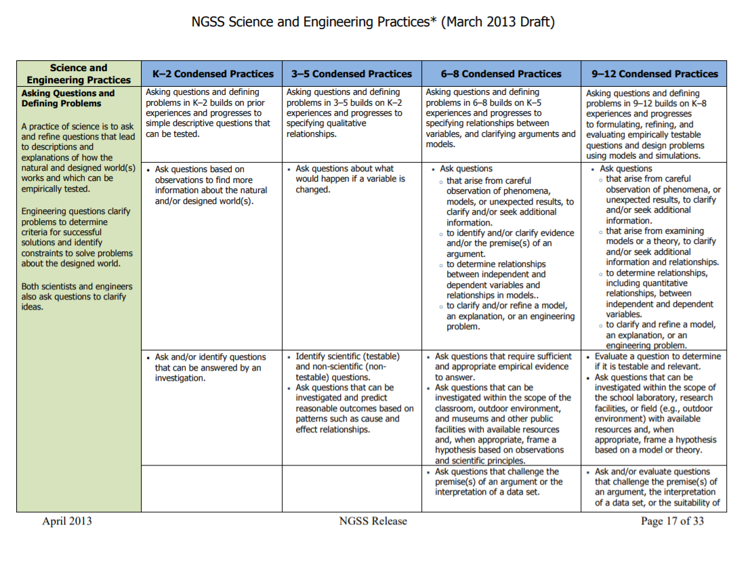
Appendix F (2)
Notes:
Sample page from Appendix F showing progression of the SEP “Asking Questions and Defining Problems”
Full appendix may be found at https://www.nextgenscience.org/sites/default/files/resource/files/Appendix%20F%20%20Science%20and%20Engineering%20Practices%20in%20the%20NGSS%20-%20FINAL%20060513.pdf

Slide 58
Explore
Choose a SEP to explore (e.g., Developing and Using Models):
How does the depth and sophistication progress from K-2 to HS?
What are the characteristics of this practice for your grade band?
Notes:
Additional Resources: https://www.nsta.org/store/product_detail.aspx?id=10.2505/9781938946042

Slide 59
In Session C, we…
developed a basic understanding of what the practices are and their purpose in the science classroom.
examined the characteristics of a practice at each of the grade bands to see how the practice increases in depth over time.
considered how the practices are interrelated and help students make sense of the world.

Slide 60
Reflection for Session C
It's all about social media:
Think about the learning from this session. Compose a social media post consisting of 280 characters to share your key take away. Consider sharing it on any social media along with the link to the resource!

Slide 61
The Kentucky Academic Standards for Science: An Overview
Session D: Dimensions of Science: Crosscutting Concepts (CCC)

Slide 62
Previous Learning
Students use the practices to learn and engage with the disciplinary core ideas.
Depth and sophistication of core ideas and the practices are demonstrated in the progressions.

Slide 63
Session D Essential Question
What role do the Crosscutting Concepts play in the Kentucky Academic Standards for Science?

Slide 64
Crosscutting Concepts (CCC)
Are lenses through which sense-making around a phenomenon or scenario occurs.
Provide students with connections and intellectual tools that are related across the differing areas of disciplinary content.
Enrich students’ application of practices and their understanding of core ideas.
(NRC, 2012, p. 233)
Notes:
National Academies of Sciences, Engineering, and Medicine. 2013. Next Generation Science Standards: For States, By States. Washington, DC: The National Academies Press. https://doi.org/10.17226/18290.

Slide 65
Crosscutting Concepts (2)
Patterns
Cause and Effect
Structure and Function
Scale Proportion and Quantity
Energy and Matter
System and System Models
Stability and Change
Notes:
The crosscutting concepts (CCC) are ways that people think in order to make sense of things – lenses for sense-making. While there are seven CCC defined in our standards, these seven CCCs can be grouped into three more general categories in order to more simply understand them: patterns, causality and systems thinking. These three ways of thinking are distinctly very different, and result in different approaches to problem solving. It can be a good professional learning experience for teachers to reason through placing each of the seven into the three categories because it deepens understanding of the CCC. Clearly, students will use all seven CCC in their K-12 science experiences and beyond, and the seven CCC provide more clarity about the three general categories.
Developing proficiency with the CCC, understanding how they are used to explain phenomena or solve problems, is very challenging but also very critical for developing lasting proficiency in sense-making/problem solving.
Finally, while the CCC are called “crosscutting” because they cross all disciplines of science, the also cross all general disciplines (Mathematics, Reading and Writing, Social Studies, etc). We should be intentional in our instruction so that students understand this connection to other content areas, and use these ways of thinking in all disciplines. This connection should also serve as a vehicle for interdisciplinary conversations among teachers.

Slide 66
Crosscutting Concepts (3)
This video highlights the Crosscutting Concepts in a teacher Professional Learning Session.
Crosscutting Concepts
Notes:
Link to video: http://www.nextgenscience.org/resources/video-ngss-crosscutting-concepts

Slide 67
Reflect on the Video
Why is it important to be explicit in the identification of the CCC during the sense-making?
How is what you saw in the teacher engagement the same/different from what is generally observed in the classroom?
How do students benefit from understanding the Crosscutting Concepts?

Slide 68
Appendix G
Identifies key characteristics of each crosscutting concept
Demonstrates a progression of depth and sophistication across grade-bands

Slide 69
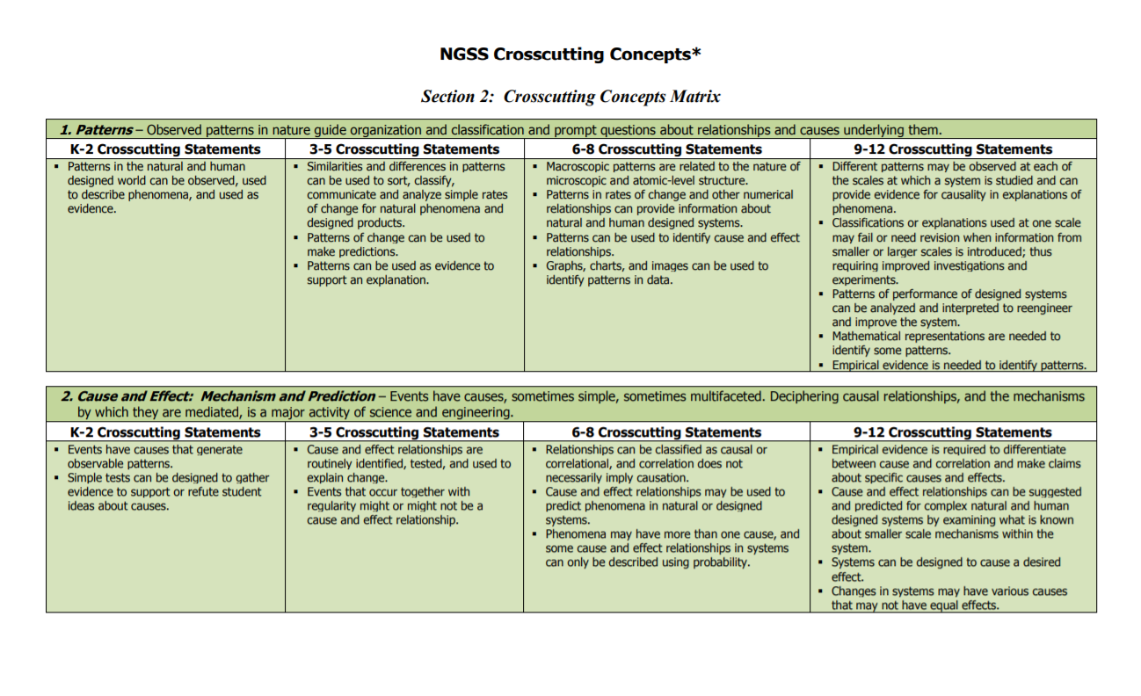
Appendix G (2)
Notes:
Appendix G can be found at https://www.nextgenscience.org/sites/default/files/resource/files/Appendix%20G%20-%20Crosscutting%20Concepts%20FINAL%20edited%204.10.13.pdf

Slide 70
Appendix G Exploration
Choose a CCC to explore (e.g., Cause and Effect):
How does the depth and sophistication progress from K-2 to HS?
What are the characteristics of this CCC for your grade band?

Slide 71
In Session D, we…
identified the role of the Crosscutting Concepts in the KAS for Science.
determined how the Crosscutting Concepts provide a lens or perspective to enrich students’ application of practices and their understanding of core ideas.
explored Appendix G to determine how the Crosscutting Concepts progress from one grade band to another.

Slide 72
Reflection for Session D
After completing Session D, pick an emoji that describes how you feel about your learning from this session. Explain why you chose that emoji.

Slide 73
Overall Key Takeaways from this Module
The standards are composed of three dimensions.
The dimensions are not “taught” in isolation from one another.
Instruction is the integration of these three dimensions.

Slide 74
Final Reflection
What is one thing you experienced in these sessions that makes you happy?
What is one thing that “pricks” you…that you feel you need to learn more about?
What is one idea that you plan to focus on?

Slide 75
By the end of this module… (2)
you will be able to develop an argument as to how instruction for the Kentucky Academic Standards for Science is the same/different as is generally observed during science instruction.

Slide 76
Certificate of Completion
Thank you for completing this asynchronous module provided by the KDE.
Please use the link below to obtain your certificate of completion.
Kentucky Department of Education Professional Learning Modules
Educators can use the PLBB to find learning sessions, and it is the local school district who determines if they are acceptable for credit based on their district policies. See 704 KAR 3:035 for more details.

