Slide 1
Creating Collaborative Civic Spaces Module Series
Module One:
Why is it important for educators and students to create classrooms that are collaborative civic spaces?
Notes:
Module Series Overview:
Creating Collaborative Civic Spaces module series is a set of four of modules designed to support teachers in creating collaborative civic spaces that supports student engagement in deliberative and democratic processes and democratic discourse as required by the Kentucky Academic Standards (KAS) for Social Studies.
Creating Collaborative Civic Spaces module series is intended to support the successful implementation of the KAS for Social Studies in classrooms across the state. The duration, scope and sequence of the module sections may be customized to accommodate local needs and conditions. The sections are designed to provide flexibility for districts and schools and, as such, can be viewed as stand-alone lessons or within the progression of the module as written. You are supported in engaging with this module individually, if desired.
Materials:
The following materials are part of this module:
Kentucky Academic Standards (KAS) for Social Studies
Module One Notecatcher: https://www.education.ky.gov/_layouts/download.aspx?SourceUrl=/curriculum/standards/kyacadstand/Documents/Module_One_Note_Catcher_Collaborative_Civic_Spaces.docx
Additional materials, such as but not limited to, articles, discussion strategies, etc. are provided within the notes section of applicable slides throughout the module.
Guiding Notes
Guiding notes are provided in the Notes section of the PowerPoint to support your learning. The information provided in the Notes section includes additional information, directions for the activities on the slide, and citations of used resources, where appropriate. It is critical that you read the material presented in the Notes section to ensure that you are acquiring the important knowledge, skills and understanding required when engaging with this module.
Virtual Training Note:
If you plan to engage with this module virtually as a group, consider directing participants to the Social Studies Professional Learning Modules page so that you may access the resources used directly from the links provided in the PowerPoint: https://kystandards.org/standards-resources/ss-resources/ss-pl-modules/
Additionally, you may consider downloading the resources contained within each section of the module and placing them into a Google folder for you or your colleagues to access.
Module One: Compelling and Supporting Questions with Learning Goals and Success Criteria
Compelling Question: How do I create collaborative civic spaces that support student collaboration and discourse?
Supporting Question: Why is it important for educators and students to create classrooms that are collaborative civic spaces?
Learning Target: I can create collaborative civic spaces that support student collaboration and discourse.
Success Criteria: I can explain why it is important for educators and students to create classrooms that are collaborative civic spaces.
Intended Audiences:
Participants
Module participants may include, but are not limited to, district leadership, school administrators, instructional specialists/coaches, intervention specialists, department chairs, special education educators and classroom teachers.
Facilitators:
This module series may be implemented with by a teacher individually or a group of educators led by a facilitator. If this module is being completed as a group, facilitators may include, but are not limited to, district leaders, school administrators, instructional specialists/coaches, intervention specialists, department chairs, special educators, and classroom teachers. Facilitators may need to revise specific tasks in order to meet the needs of the participants or to be respectful of the time planned within the work session.
Helpful Hint for Facilitators:
The learning that will take place in this module may cause Kentucky educators to face changes in instructional practices amidst this transition. It is important to realize that while you are the facilitator of these work sessions, you may not have all the answers to the questions asked by participants, and that is okay. Throughout the module, participants may have questions that will be addressed in future work sessions. When that happens, reflect on this quote from Graham Fletcher, “Every teachable moment doesn’t need to be a teachable moment in that moment.” Use these moments to encourage participants to attend future work sessions where those questions will be addressed. If participants ask questions you are not prepared to answer, offer to follow up on that during the next work session.
Planning Ahead for Facilitators:
Determine which stakeholders to invite as participants. In the invitation, describe how the work sessions will benefit them.
A few days before the meeting, you may want to remind participants to be prepared to have their documents available during the meeting. (See below for Participant Documents Needed.)
Reserve adequate space and equipment. Tables or desks should be set up to support small-group discussion. If conducting this module virtually, ensure that your technology platform can support break out rooms to support small group collaboration.
Ensure that participants have access to the Internet.
Consider how you might handle participants who may not be in attendance at all work sessions. It might be worthwhile to consider how those participants might access missed sections of the module between work sessions in order to feel as prepared as the other participants.
Preparation
Participant Documents Needed:
Plan ahead regarding how you will feel most comfortable engaging with the KAS for Social Studies, either:
A device with access to the KAS for Social Studies, or
A hard copy of the KAS for Social Studies
Additional documents needed include:
Module One Note catcher
Crosby, Kimberly D. (Fall 2018) Fostering Civil Discourse within the Democratic Classroom. AILACTE Journal, v15 n1 p1-14. https://eric.ed.gov/?id=EJ1205082
Supplies Needed:
• Computer with Module One: Why is it important for educators and students to create classrooms that are collaborative civic spaces? PowerPoint presentation.
• Technology with projection capability if in person. Technology platform where presenters have sharing ability and breakout room options if virtual.
• Copies of the handouts needed for the session either in hard copy format or available in a folder online. Links to the participant handouts needed for the session also may be built right into the agenda.
• Parking Lot for questions - If completing as a group, you may consider providing a poster on which participants can write or post questions, or you may prefer to have a digital parking lot where participants can access a Google document, for example, to post questions and that you can modify as the participants work through the sections of the module.
• Self-Sticking Notes (optional)
• Poster paper (optional)
• Highlighters and/or colored pens/markers (optional)
Building a Community:
Building a community is important for any group that will work together, especially if participants have not worked together before. The concept is the same as building a safe, respectful, productive classroom climate. Incorporating community-building into each session builds trust, shows participants that they are valuable as individuals and engages them in the learning process. It is also useful for creating a professional learning network where participants can be supported in their work. Community-building can be as simple as allowing participants to introduce themselves and their role in the school/district, developing or refining group norms, allowing for questions, and/or the sharing of answers to reflection questions or individual discovery task items that are included in this module. Again, time allotted for community-building will allow participants to have a voice and be engaged as active contributors and learners in the sessions.
Virtual Training Options: Be sure to conduct continual check-ins throughout the presentation. Build Google documents to continue to collect feedback, such as questions, hopes, and/or concerns to which participants may continually add.
Module Attribution
Collaborative Civic Spaces was originally created by Mary Ellen Daneels for the Hawaii Department of Education, Office of Curriculum and Instructional Design, as seen at https://sites.google.com/view/hawaiicorestandardsforsocialst/online-professional-development-modules and has been modified here with permission.
All content was based on Colorado Department of Education – Standards and Instructional Support Modules https://sitesed.cde.state.co.us/course/index.php?categoryid=24.

Slide 2
Introduction
Compelling Question: How do I create collaborative civic spaces that support student collaboration and discourse?
Supporting Question: Why is it important for educators and students to create classrooms that are collaborative civic spaces?
Learning Target: I can create collaborative civic spaces that support student collaboration and discourse.
Success Criteria: I can explain why it is important for educators and students to create classrooms that are collaborative civic spaces.
Notes:
Guiding Notes:
Creating Collaborative Civic Spaces Module series has four modules that build on one another to support a participant in answering the compelling question: How do I create collaborative civic spaces that support student collaboration and discourse? Participants will answer this question after completing the module series. Answering this question will support participants in meeting the Learning Target: I can create collaborative civic spaces that support student collaboration and discourse.
Each module within the module series supports a participant in answering a supporting question. At the conclusion of engaging with Module One of this series, participants will answer the supporting question: Why is it important for educators and students to create classrooms that are collaborative civic spaces? Participants will meet the success criteria for Module One when they can demonstrate the Success Criteria: I can explain why it is important for educators and students to create classrooms that are collaborative civic spaces.
For more information on compelling questions, visit Section 3B: “What are Compelling Questions and how do students ask them?” from the Inquiry Practices module: https://education.ky.gov/curriculum/standards/kyacadstand/Documents/Inquiry_Practices_of_KAS_for_Social_Studies.pptx
For more information on supporting questions, visit “Section C: What are Supporting Questions, and how do students ask them?” from the Inquiry Practices module: https://education.ky.gov/curriculum/standards/kyacadstand/Documents/Inquiry_Practices_of_KAS_for_Social_Studies.pptx
For more information on Learning Goals and Success Criteria and their alignment to the KAS for Social Studies, visit Learning Goals, Success Criteria and the KAS for Social Studies: https://kystandards.org/standards-resources/ss-resources/learning-goals-success-criteria-and-the-kas-for-social-studies/

Slide 3
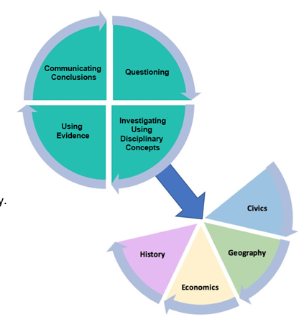
Communicating Conclusions:
Democratic Procedures and Civic Life
In order to support a student’s ability to engage in civic life, the Communicating Conclusions standards require that students engage in democratic procedures to identify problems.
•Deliberative and democratic processes - a process where deliberation is central to decision-making. This process also looks to generate outcomes that promote the common good through reasoning, rather than through a law-making process.
•Democratic discourse - debate where one or more highly-valued positions search for authentic truth and are recognized without giving up their valid claims/position.
Notes:
Guiding Notes:
Read the slide.
Define deliberative and democratic processes and democratic discourse on your Note Catcher where it says Slide Three.

Slide 4
Communicating Conclusions:
Democratic Procedures and Civic Life (2)
Some examples of how this skill progresses include:
K.I.CC.4 Use listening skills to decide on and take action in their classrooms.
3.I.CC.4 Use listening, consensus-building and voting procedures to determine the best strategies to take to address local, regional and global problems.
5.I.CC.4 Use a range of deliberative and democratic procedures to identify strategies on how to address a current issue.
6.I.CC.4 Engage in a range of deliberative and democratic procedures to discuss current local, regional and global issues.
HS.C.I.CC.1 Engage in civil discussion, reach consensus when appropriate and respect diverse opinions relevant to compelling and/or supporting questions in civics.
Notes:
Guiding Notes:
Read the slide.
On your Note Catcher where it says Slide Three, identify the Communicating Conclusion standard that most closely aligns with your grade level. How are students supposed to use deliberative and democratic processes and/or democratic discourse in the standard you identified?

Slide 5
Communicating Conclusions:
Democratic Procedures and Civic Life (3)
In order to engage in deliberative and democratic processes, such as listening, consensus-building and voting procedures, and democratic discourse, such as civil discussion and respecting diverse opinions, classrooms need to be collaborative civic spaces.
Notes:
Guiding Notes:
Read the slide.

Slide 6
Collaborative Civic Spaces
Collaborative civic spaces are safe places where students can collaborate on civic issues and action plans though civil discussion and democratic discourse while proposing solutions and developing action plans.
Notes:
Guiding Notes:
Read the slide.
On your Note Catcher where it says Slide Six, define collaborative civic spaces.

Slide 7
What does a collaborative civic space look and sound like?
Complete a Sketch to Stretch using the definition of collaborative civic spaces.
Notes:
Guiding Notes:
Read the slide.
On your Note Catcher where it says Slide Seven, complete a Sketch to Stretch in the space below to answer the question: “What does a collaborative civic space look like and sound like? Note: you will revisit this sketch and revise it later in the module.
Resource:
Sketch to Stretch. (July 14, 2021.) Facing History and Ourselves. https://www.facinghistory.org/resource-library/sketch-stretch

Slide 8
What does a collaborative civic space look and sound like? (2)
Sketch to Stretch
Collaborative Civics Spaces Definition
Read the definition of collaborative civic spaces.
Represent what you read in a visual, incorporating words and/or phrases into your drawing.
You may be literal or symbolic in your thinking.
Collaborative civic spaces are safe places where students can collaborate on civic issues and action plans though civil discussion and democratic discourse while proposing solutions and developing action plans.
Notes:
Guiding Notes:
Read the slide. Once you have completed the activity on the slide, work with a partner or in a small or whole group, and explain your representation. Cite the definition of collaborative civic spaces when sharing your response to support your thinking.
Once you have shared your sketch, place it to the side. You will come back to this sketch.
Resource:
Sketch to Stretch. (July 14, 2021.) Facing History and Ourselves. https://www.facinghistory.org/resource-library/sketch-stretch

Slide 9
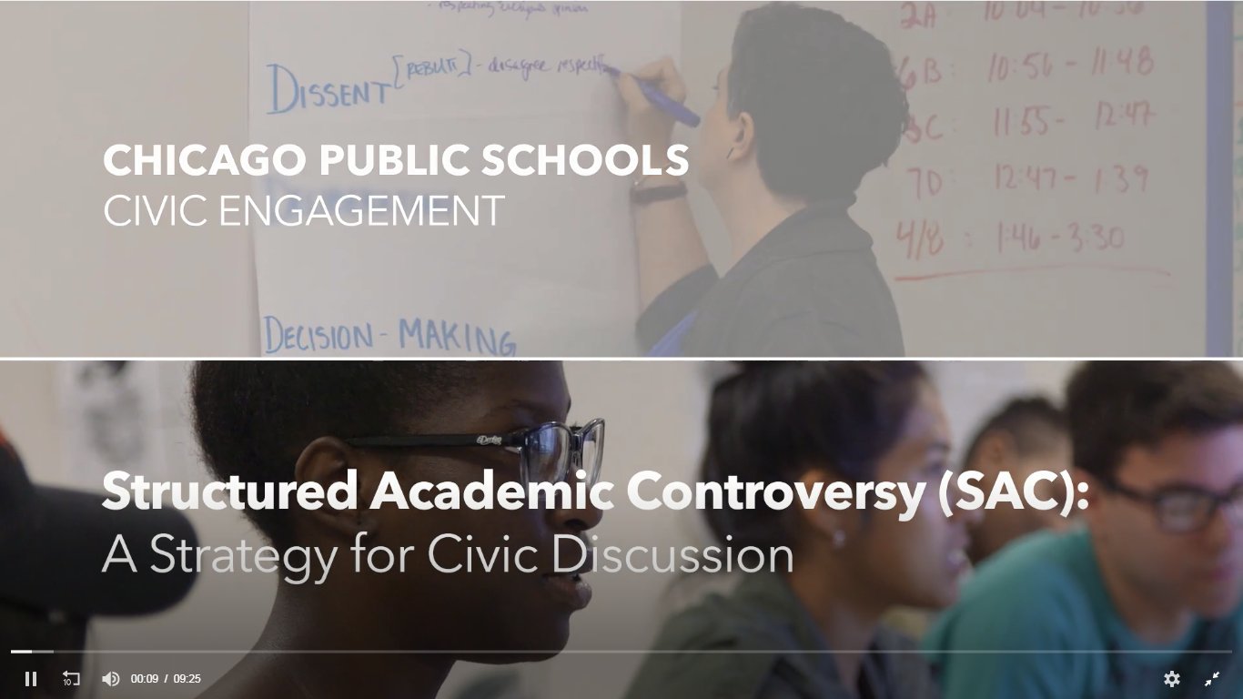
What does a collaborative civic space sound and look like? (3)
On the following slide, you are going to watch a video where students engage in civic discussion using the structured academic controversy method. Ask the following questions about the structured academic controversy discussion you will watch:
How is the discussion structured?
What is the role of the students in the discussion?
What is the role of the teacher the discussion?
Why is engaging in this discussion strategy beneficial for students?
Notes:
Guiding Notes:
Read this slide and learn about the questions you will answer from the Parts, People, Interactions Thinking Strategy as you watch the video on the following slide. Watch the video and complete the Parts, People, Interactions Thinking Strategy.
Resources:
Civic Engagement Research Group- University of California- Riverside. (n.d.) Structured Academic Controversy (SAC). Series CPS/CERG Civic Discussion Videos. https://www.youtube.com/watch?v=5MPekCd0mHk

Slide 10
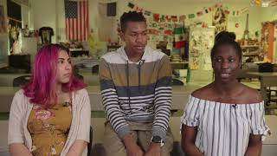
What does a collaborative civic space sound and look like? (4)
How is the discussion structured?
What is the role of the students in the discussion?
What is the role of the teacher the discussion?
Why is engaging in this discussion strategy beneficial for students?
Notes:
Guiding Notes:
On your Note Catcher where it says Slide Nine, answer the questions on this slide as you watch Structured Academic Controversy.
Resources:
Civic Engagement Research Group- University of California- Riverside. (n.d.) Structured Academic Controversy (SAC). Series CPS/CERG Civic Discussion Videos. https://www.youtube.com/watch?v=5MPekCd0mHk

Slide 11
See, Hear, Think, Wonder
After watching this video clip, complete the See, Hear, Think, Wonder Thinking Strategy by answering the following questions:
What did you see?
What did you hear?
What did you think about what you saw and heard?
What did this video make you wonder?
Notes:
Guiding Notes:
Complete the See, Hear, Think, Wonder Teaching Strategy after you watching the video.
Resources:
Civic Engagement Research Group- University of California- Riverside. (n.d.) Structured Academic Controversy (SAC). Series CPS/CERG Civic Discussion Videos. https://www.youtube.com/watch?v=5MPekCd0mHk
* The See, Hear, Think, Wonder strategy is based on the See, Think, Wonder Thinking Strategy from Project Zero:
Project Zero. (2019). See, Think, Wonder Thinking Strategy. Harvard Graduate School of Education. https://pz.harvard.edu/sites/default/files/See%20Think%20Wonder_3.pdf

Slide 12
Fostering Civil Discourse within the Democratic Classroom
Read the following excerpts from Fostering Civil Discourse within the Democratic Classroom:
Abstract (page one to two)
Stop at “Community: Establishing Mutual Respect, Understanding, and Purpose”
Civil Discourse: Manifesting Democratic Principles (page nine to ten)
Conclusion (page ten to eleven)
As you read this article, engage with The Gist Reading Strategy to support your comprehension of the main ideas of these excerpts.
Notes:
Guiding Notes:
Read the slide, and complete the reading strategy as you read the excerpts from the article.
It may be helpful to print out the article when completing the Gist Reading Strategy so that you may annotate directly on the article. However, space is provided on you on your Note Catcher where it says Slide 12, if you would like to capture your annotations on a separate document.
Resources:
Crosby, Kimberly D. (Fall 2018) Fostering Civil Discourse within the Democratic Classroom. AILACTE Journal, v15 n1 p1-14. https://eric.ed.gov/?id=EJ1205082
#iteachela. (2021). The Gist Reading Strategy. https://www.youtube.com/watch?v=4XTb5WDQkr8
For more information about active reading strategies, visit:
Reed, Deborah K. (2016) The Importance of Active Reading. Reading Rockets (courtesy of the Iowa Reading Research Center). https://www.readingrockets.org/article/importance-active-reading

Slide 13
What does a collaborative civic space look and sound like? (5)
Revisit your Sketch to Stretch
Choose a “golden line”—one or two sentences that resonate with you for one of the reasons listed below.
Because of something about myself (my identity and experiences)
Because it teaches me something about the world (other people, other places, other times, other ways of being and feeling)
Because it of how it is written (how the author uses language)
Copy your “golden line” on your sketch, either in words or visually.
If visually representing your line, include labels with quotations from the text with your own ideas.
Notes:
Guiding Notes:
Read the slide. Once you have completed the activity on the slide, work with a partner or in a small or whole group, and explain your addition to your representation. Was your thinking stretched? Cite the definition of collaborative civic spaces when sharing your response to support your thinking.
Once you have shared your sketch, place it to the side. You will come back to this sketch.
Resource:
Sketch to Stretch. (July 14, 2021.) Facing History and Ourselves. https://www.facinghistory.org/resource-library/sketch-stretch

Slide 14
Reflection
You learned that collaborative civic spaces are “safe places where students can collaborate on civic issues and action plans though civil discussion and democratic discourse while proposing solutions and developing action plans.”
Individually, with a partner, a small grade-banded group or with your Professional Learning Community, discuss or reflect upon the following question:
Why is it important for educators and students to create classrooms that are collaborative civic spaces?
Notes:
Guiding Notes:
Read the slide.
Ask participants, individually, with a partner or in a small grade-banded group, to discuss the question on the slide after engaging with Module One.
To support participants in this discussion, they may engage in Affinity Mapping to support their discussion. To engage in Affinity Mapping, participants should:
Break into small groups.
Independently answer this question by writing down their ideas on sticky notes. Participants should only have one idea per sticky note.
Once participants have written down each idea, have them place their ideas in a central location for the group (in the center of the table, on a poster board, on a white board, etc.).
Once participants have written down all of their ideas, have them engage in a group discussion to group the ideas into similar categories.
When the categories have been determined, have participants label the categories and share why the ideas fit into each category and how the categories relate to one another.
Once participants have completed their small group work, engage in a whole group discussion where participants share their small group categories, why the ideas fit into each category and how the categories relate to one another.
When the whole group discussion has concluded, complete the Task Aligned to the Supporting Question on your Note Catcher where it says Slide Fourteen.
Resource:
Drumm, Jessica. (May 26, 2015). Affinity Mapping. https://www.youtube.com/watch?v=UynxDyr0lAo

Slide 15
Creating Collaborative Civic Spaces Module Series
Module One:
Why is it important for educators and students to create classrooms that are collaborative civic spaces?
Notes:
Guiding Notes:
This concludes Module One.
The KDE needs your feedback on the effectiveness of this module, the learning platform and how the consultants may best support you as you take the next steps in the implementation process. Complete a short survey to share our thinking and provide them with feedback on how the KDE can best meet our needs. Feedback from our surveys will be used by the KDE to plan and prepare future professional learning.
Post Survey: https://docs.google.com/forms/d/e/1FAIpQLScCoWs8UDMqBOge_dr_Z1LOYRaBwQQOu8MtkLrVRpzhGGDMbg/viewform?usp=sf_link

