Slide 1
KDE Data Visualization

Slide 2
KDE Data Visualization Suite of Dashboards
KDE contracted with Infinite Campus partner Computer Information Concepts (CIC) to create data tools for KDE and districts.
What’s available right now:
Demographics
Attendance
Behavior
Equity – New
Reports included current actionable data.
Notes:
Introduce Melissa

Slide 3
Who should have access?
School/District Administrators (i.e., superintendents, principals, assistant principals, special education directors, PBIS Leads, DPP’s, counselors)
Consider “Need to Know”
Organization level permissions - as identified in Infinite Campus
Must be careful with sensitive student level data – FRAM, Homeless, Behavior
Dashboard views drillable down to the student level

Slide 4
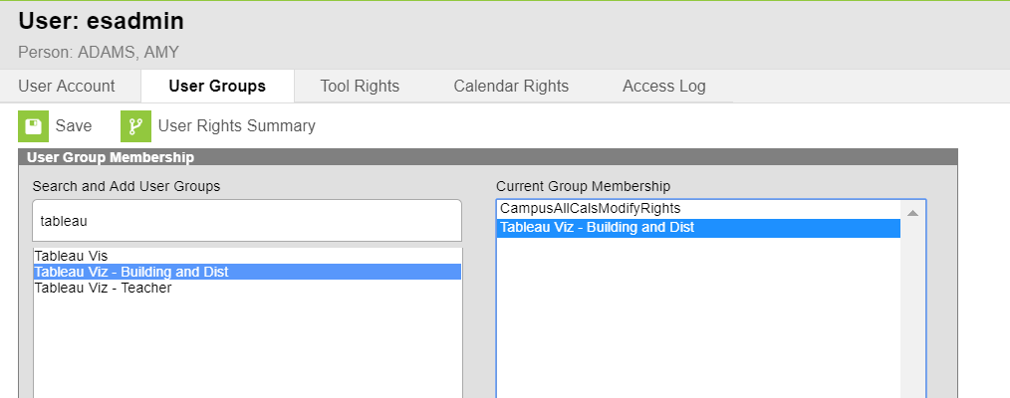
How do I access?
KSIS administrator adds user to “Tableau Viz – Building and Dist” user group. Do not use tool rights.
District email address (Microsoft) must be saved in the primary address field.
Single sign-in but must be signed into Microsoft using your district email address.
Users added will not have access to the Data Visualization tool until the following day.

Slide 5
How can I use this data?
View data easily to see what pops!
Filter dashboards to see variances based on student groups or from one year to another.
Charts can be downloaded in a variety of formats to use in meetings or presentations.
Eliminate dual data entry and redundant systems where possible with this free tool.

Slide 6
What’s New – Equity Dashboard
New Equity Dashboard is now available in Data Visualization suite

Slide 7
Equity Dashboard
Identifies student groups that may be either under or over-represented.
Overrepresented:
Students with disabilities
Chronic absenteeism
In and out-of-school suspensions
Underrepresented
Gifted and Talented
Advanced coursework
Career and Technical Education coursework and completers
Meeting assessment benchmarks

Slide 8
What is a Risk Ratio?
A risk ratio compares the likelihood of an event occurring for one group to the likelihood of the same event occurring for another group.
If disproportionality exists in the likelihoods of the two groups, a group may be considered “at risk” of an event occurring or not occurring.
Risk ratios are shown inside of circles that are color-coded blue if the group is not at risk, and orange if the group is at risk.

Slide 9
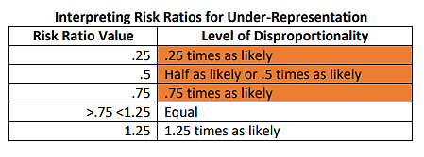
How are Risk Ratios Calculated for Under-Representation?
When two groups have around the same amount of risk, the risk ratio will be close to 1.
The Equity Dashboard uses a risk ratio threshold of .25 lower than 1 (.75 and below) for under-representation based on the work of Boneshefski and Runge (2014).

Slide 10
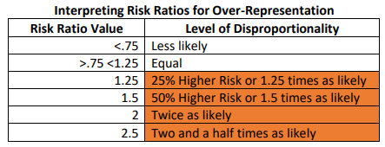
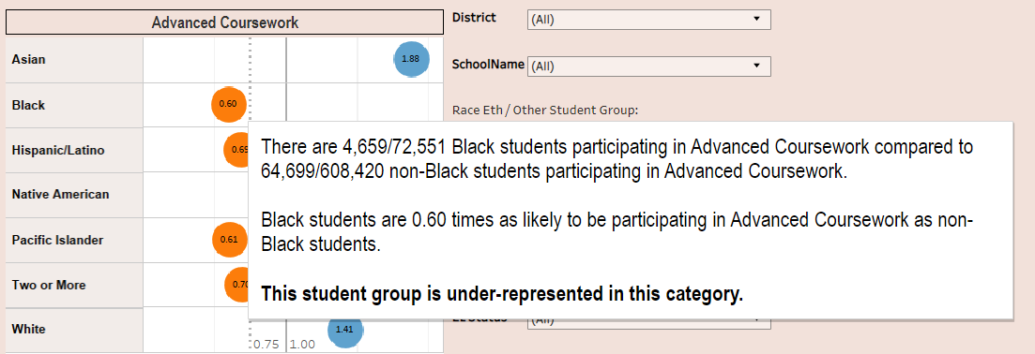
How are Risk Ratios Calculated for Over-Representation?
When two groups have around the same amount of risk, the risk ratio will be close to 1.
The Equity Dashboard uses a risk ratio threshold of .25 higher than 1 (1.25 and above) for over-representation based on the work of Boneshefski and Runge (2014).

Slide 11
Context Matters
The data in the Equity Dashboard represent quantitative data, or numbers describing trends.
It is important to remember that context matters and the anecdotal, or qualitative data, gained through speaking with students and their families can be just as valuable to build a more complete picture.
Honoring, valuing and lifting up the voices of students and families can offer a great deal of information about how school and the educational process are going for local communities.

Slide 12
Making the Data Actionable
Identify or create district and school leadership teams (e.g., MTSS leadership teams or other existing leadership team). Team members include leadership and key stakeholders that are representative of the staff, students and community they serve.
Identify roles and responsibilities of the team members and designate a data coordinator.
• Utilize a standardized problem-solving or data inquiry process.
Create a meeting schedule to review and analyze data (e.g., monthly or quarterly).

Slide 13
Live Demo for Equity Dashboard

Slide 14
Equity Dashboard Resources
Guidance document explains each data set and how the risk ratios work.
Training videos
Available on the KDE Data Visualization webpage.

Slide 15
KDE Data Visualization - Behavior
Data Views
Behavior Analysis
Student Event Analysis
Student Resolution Analysis
Student Events and Resolutions
Count of Days Removed
Staff Event Analysis
Events vs Resolutions
Event Counts by Student Group
Percent of Unduplicated Students with Events
Percent of Students with Resolutions
Summary/Detail Line Dashboards
Summary/Detail Heat Map Dashboards
Live Demo for Behavior
NOTE: Data is refreshed nightly, it is one day behind what is in Infinite Campus.

Slide 16
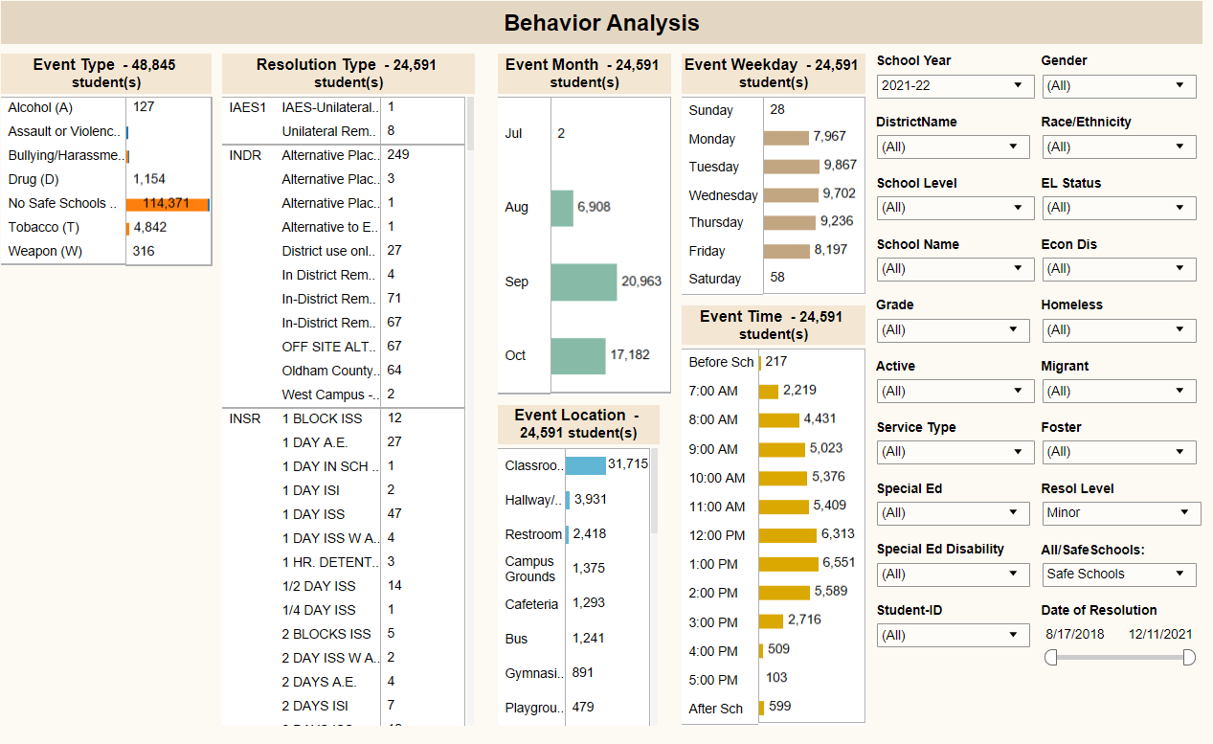
Behavior Analysis
Filters include options to see:
By state or all resolution codes
All students or an individual student.
Student subgroups

Slide 17
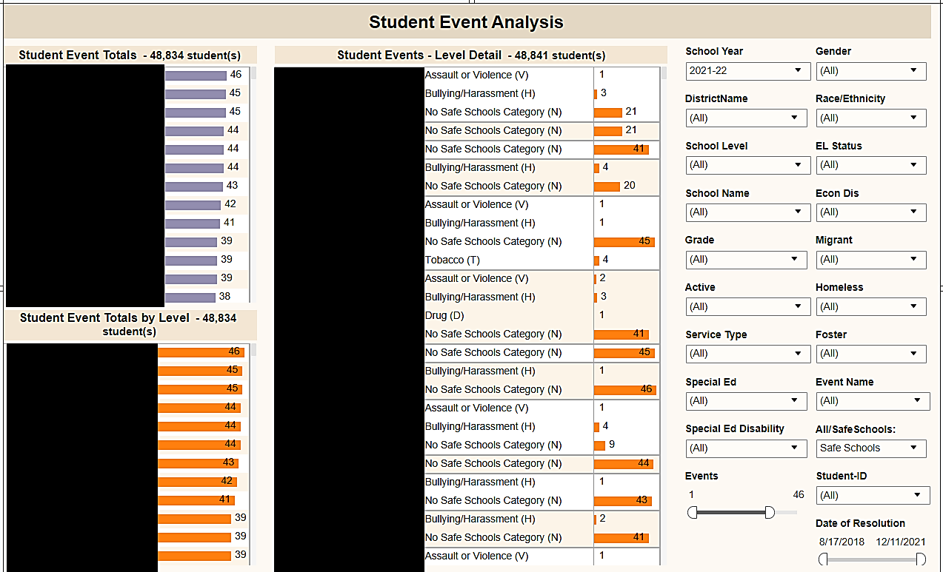
Student Event Analysis
Filters include options to see:
Single Event or All Events
Single Student or All Students

Slide 18
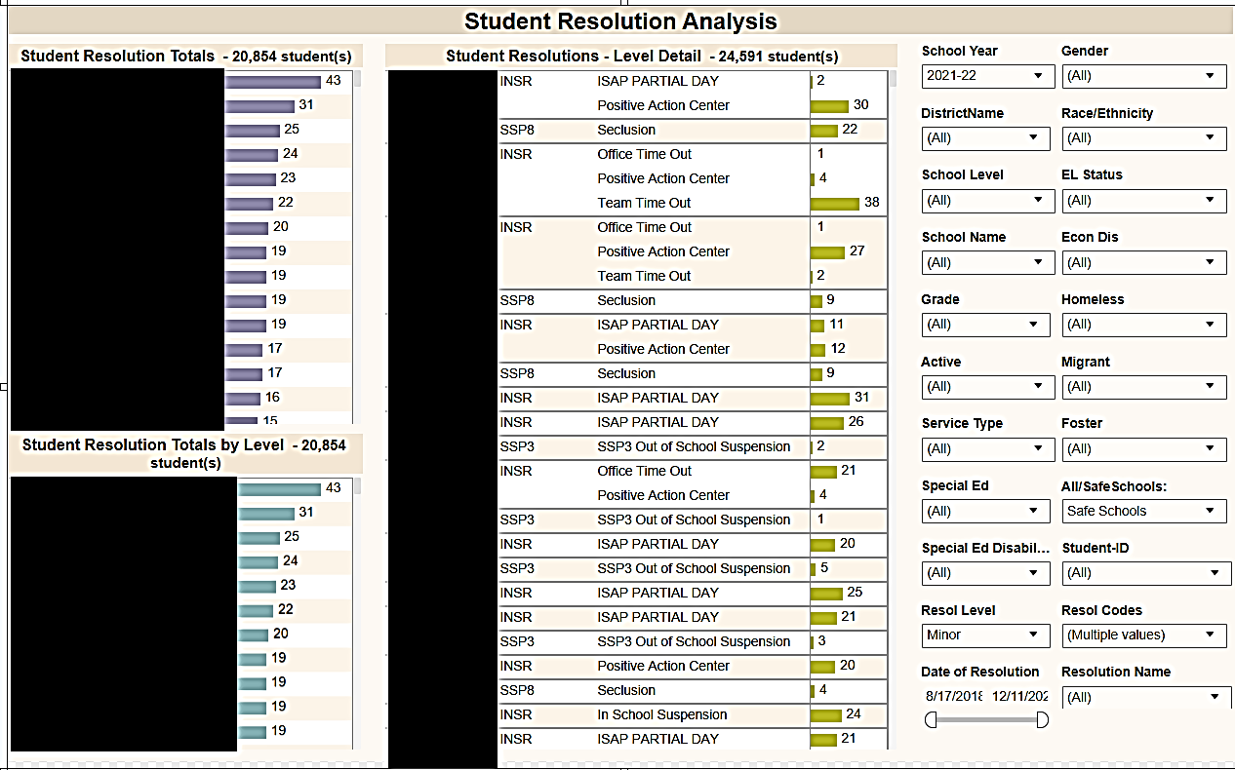
Student Resolution Analysis
Filters include options to see:
Single Event or All Events
Single Student or All Students

Slide 19
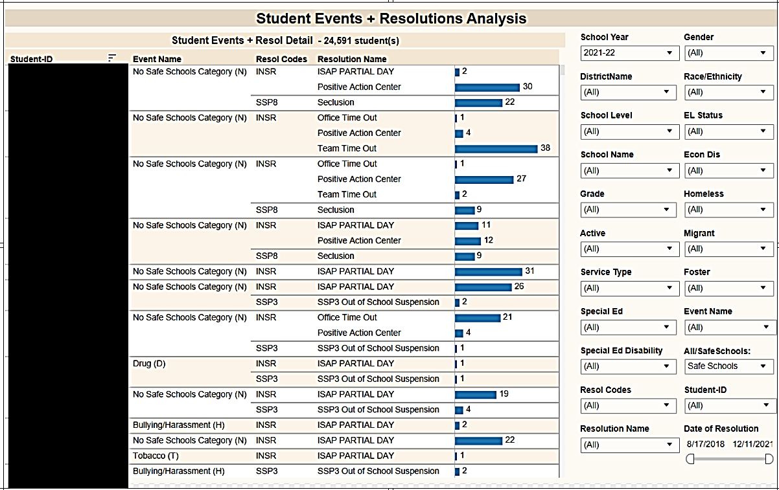
Student Event and Resolution Analysis
Filters include options to see:
View by one or all events
Select resolution code or name

Slide 20
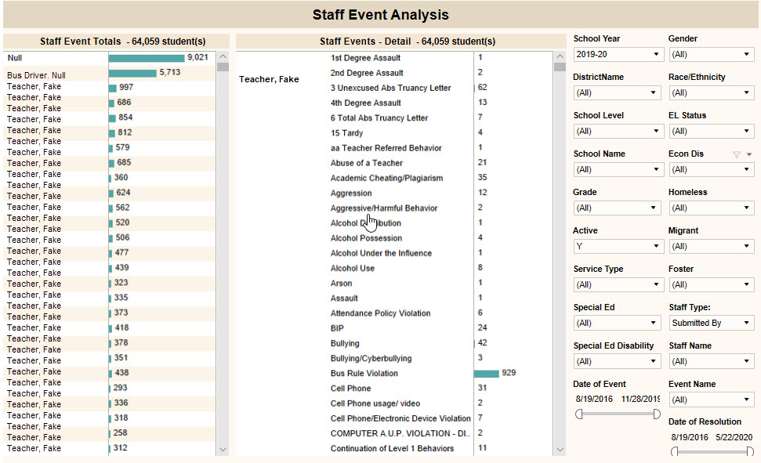
Staff Event Analysis
Filters include options to see:
View by staff type or staff name
View by events
Select date range for event or resolution.

Slide 21
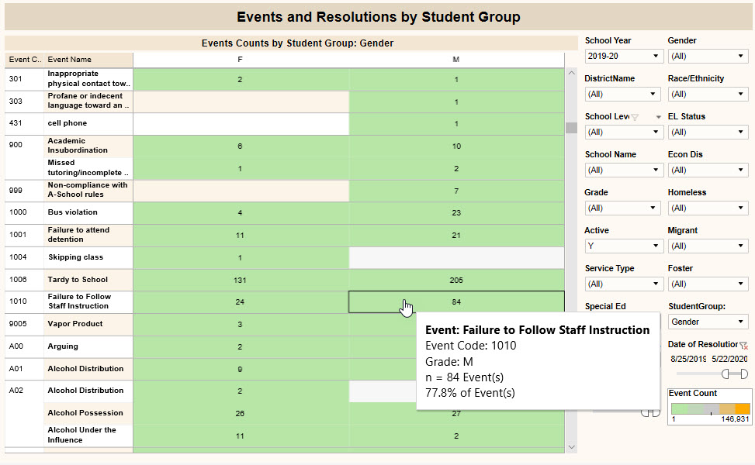
Event and Resolution by Student Group
Filters include options to see:
By student group – changes view to selected grouping

Slide 22
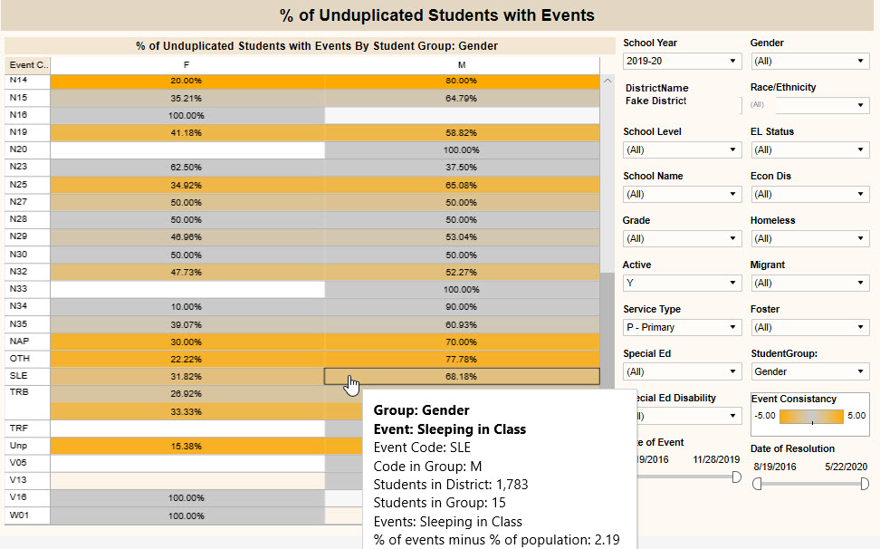
Percent unduplicated students with events
Displays the percentage of behavior events associated with the students in the selected student group.
Shading indicates data points in which the percentage of behavior events associated with the students belonging to the selected group is higher or lower than the percentages of total students in the selected group compared to the entire student population.

Slide 23
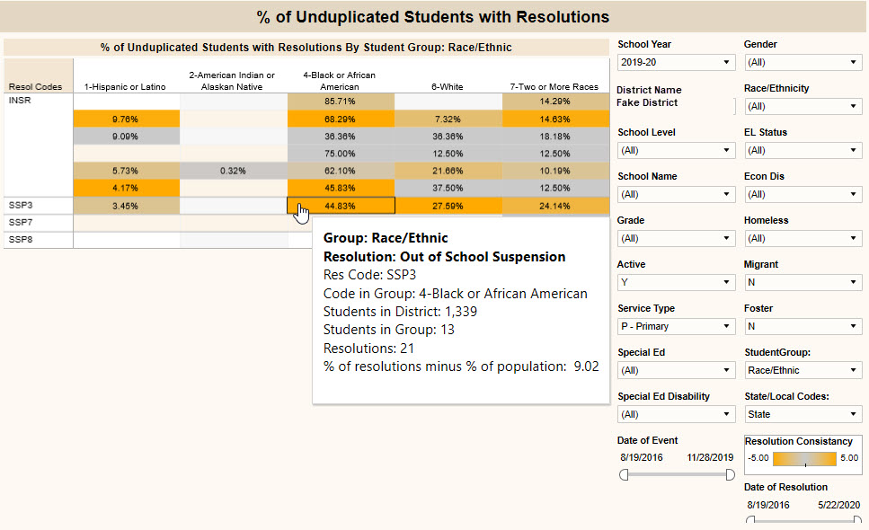
Percent unduplicated students with resolutions
Displays the percentage of behavior resolutions associated with the students in the selected student group.
Shading indicates data points in which the percentage of behavior resolutions associated with the students belonging to the selected group is higher or lower than the percentages of total students in the selected group compared to the entire student population.

Slide 24
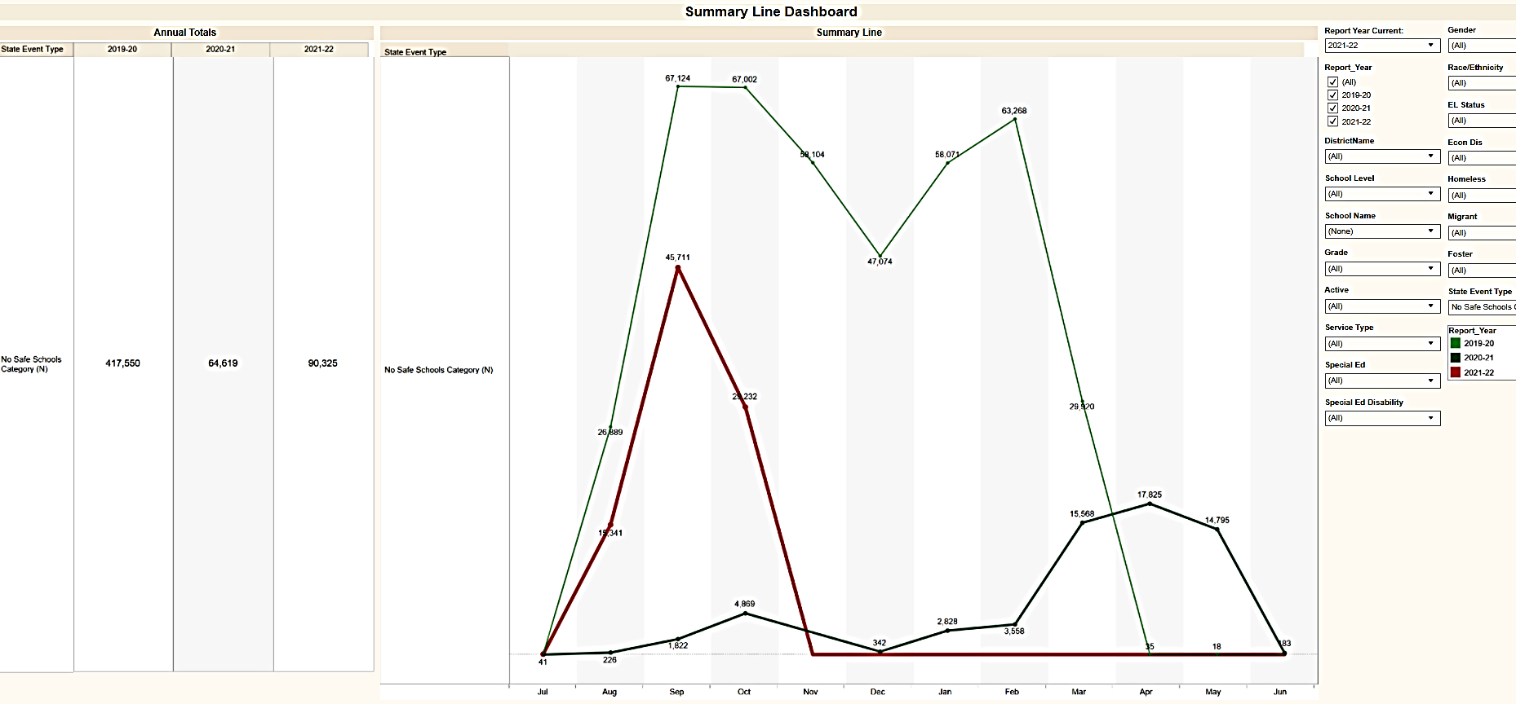
Summary Line Dashboard
See Trends: Compare multiple years by discipline category

Slide 25
Detail Line Dashboard
See Trends for Detail Line
Isolate individual behavior events and compare by multiple years
Compare two or three years

Slide 26
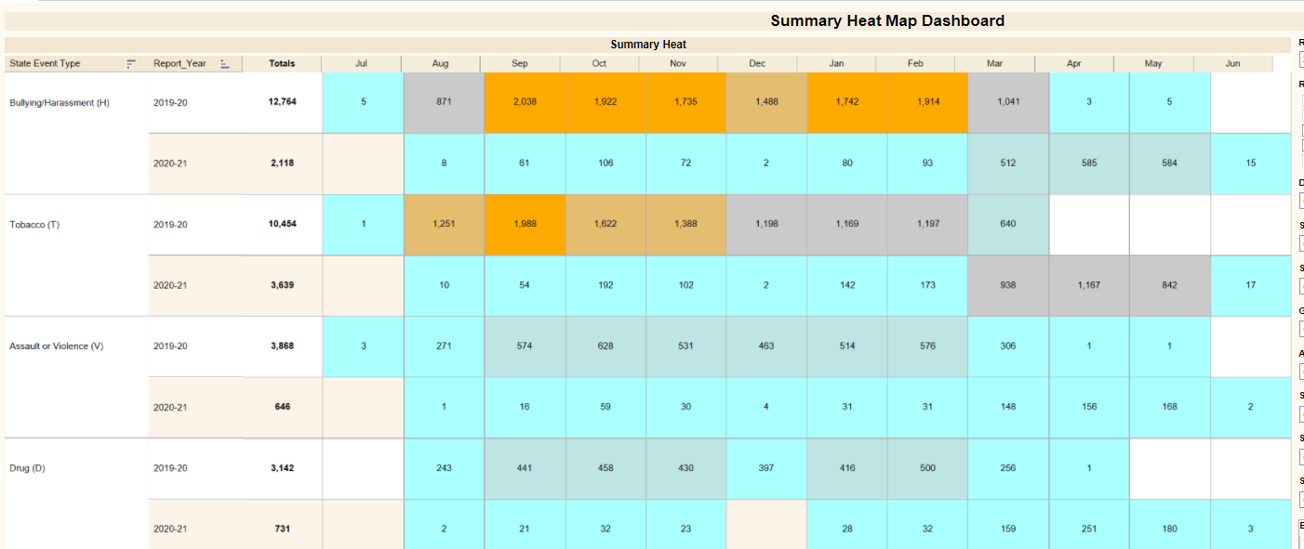
Summary Heat Map Dashboard

Slide 27
Detail Heat Map Dashboard

Slide 28
KDE Data Visualization KY Attendance
Two Attendance Views
Full Time Equivalent (FTE) Chronic Absent
Attendance Rate (full time-half time)
Attendance Dashboard
State rates for comparison
By school
By month
By grade
By weekday
Attendance Demographics
School Level
Grades
Race/Ethnicity
Special Ed
Economically Disadvantaged
Gender
English Learners
Live Demo for Attendance
NOTE: Data is refreshed nightly, it is one day behind what is in Infinite Campus.

Slide 29
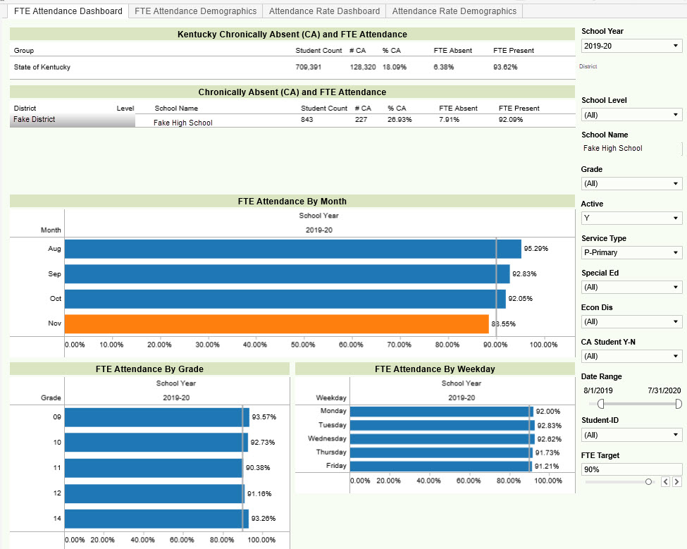
FTE Attendance Dashboard
Charts Include:
State comparison
School/District
Month
Grade
Weekday
Set FTE Target and anything below target turns orange.

Slide 30
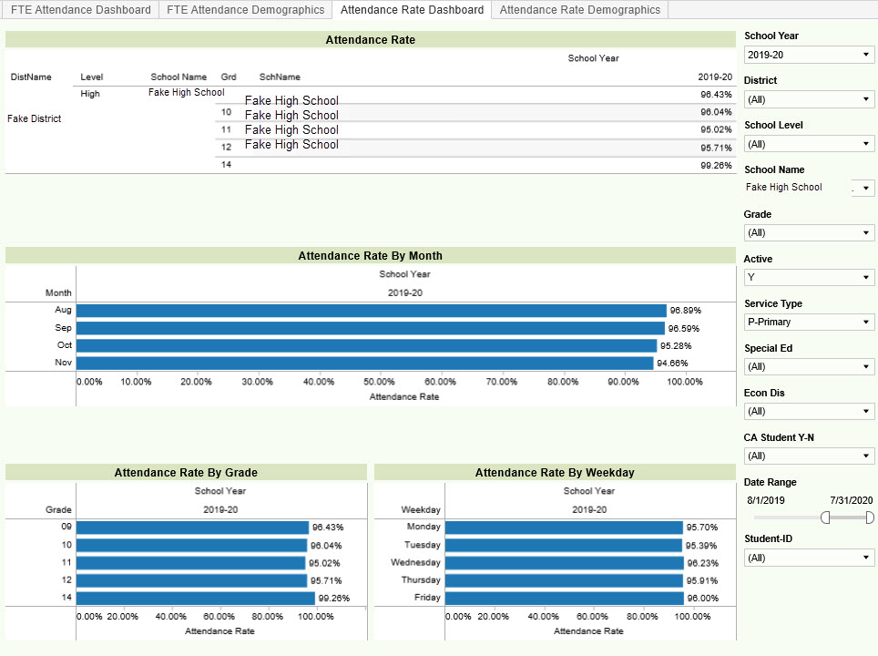
Attendance Rate Dashboard
Same view with whole day/half day calculation
Use filters and/or select date range
Option to view for a specific student.

Slide 31
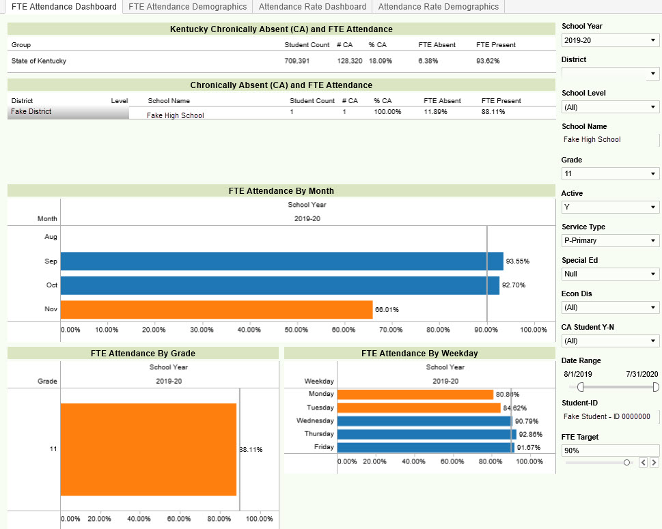
Individual Student View
Quickly identify if a when a attendance issue began or if there may problem days.

Slide 32
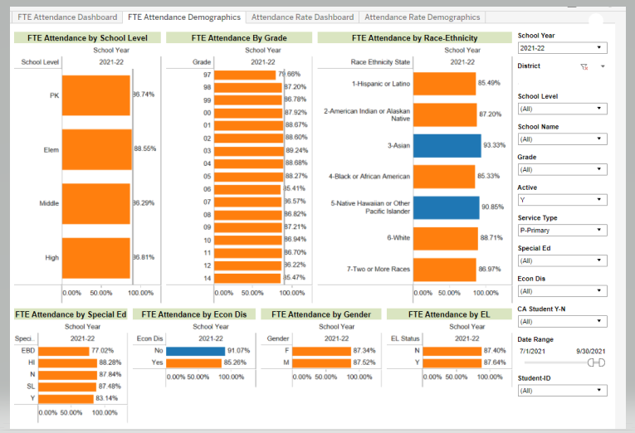
FTE Attendance Demographics
Compare data by:
School Level
Grade
Race-Ethnicity
Special Ed
Economically Disadvantaged
Gender
English Learner (EL)

Slide 33
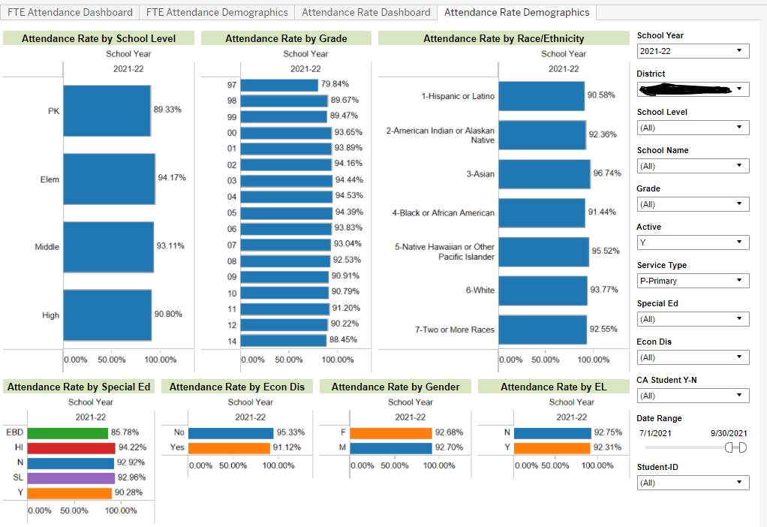
Attendance Rate Demographics
Same view as FTE Demo but for whole-day/half-day calc.
Select one area to focus on and the other charts will automatically reflect just that group of students.

Slide 34
Attendance Rate – Date Range Filter
2019-20
2018-19

Slide 35
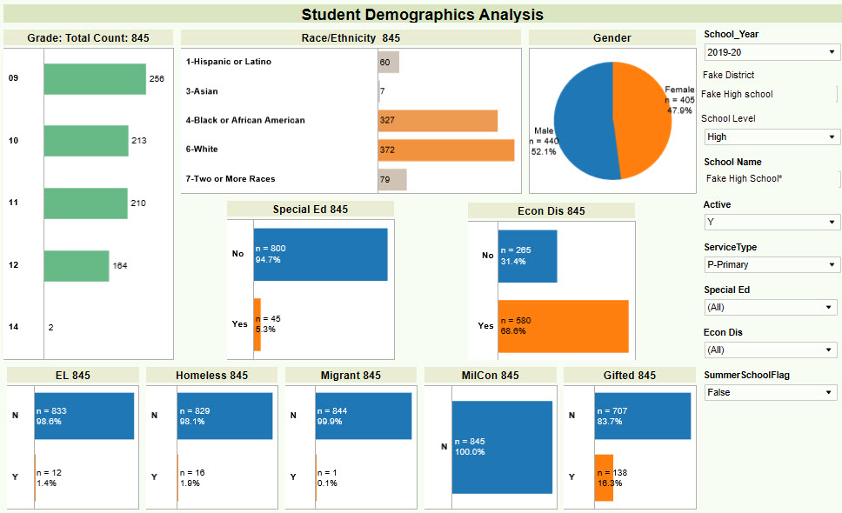
Student Demographics
Foundational Data
Board presentations
Data quality checks
Select any demographic group and other charts change just to reflect just that population. Use revert option to go back

Slide 36
KDE Data Visualization Resources
The KSIS Data Visualization webpage provides resources to introduce and support use of the data visualization tool.
Includes:
User Guide
Troubleshooting Guide
Links to training videos
What’s new section

Slide 37
Questions?

