Slide 1
HQIR Coordinator Convening
February 19, 2025
Virtual Meeting Tips
Remember to mute your microphone if you are not the one talking. This will reduce additional background sound and enable meeting attendees to hear better.
Utilize the chat box for specific questions or to share resources.
Minimize distractions and be present.

Slide 2
Welcome & Introduction

Slide 3
Agenda
Curriculum-Based Professional Learning (CBPL)
KY Numeracy Counts (KYNC) Updates
Breakout Rooms
Quick Updates

Slide 4
HQIRs and Curriculum-Based Professional Learning
What is curriculum-based professional learning and how can it support effective HQIR implementation?

Slide 5
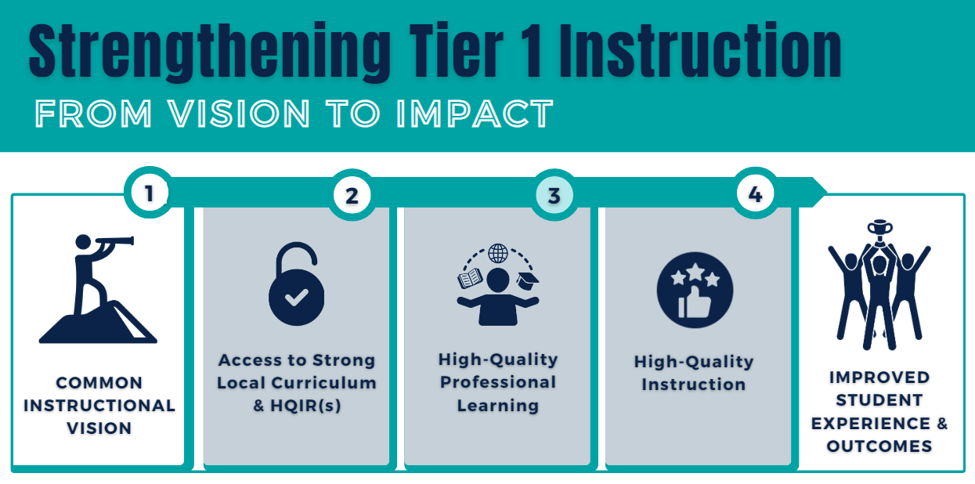
Strengthening Tier 1 Instruction

Slide 6
Professional Learning
“There’s a sort of disconnect,” said George Zuo, an associate economist at the RAND Corporation, and the lead author on the report. “The specific needs that teachers had were not always aligned with what professional development was able to provide” (from Ed Week).
Question: Based on your experience, in what ways does typical professional development tend to fall short of meeting teachers’ needs?

Slide 7
Curriculum-Based Professional Learning
According to 2022 report from Rivet Education:
“96% of teachers thought the number one factor leaders should consider when planning professional learning was whether it would help teachers effectively use their instructional materials.”

Slide 8
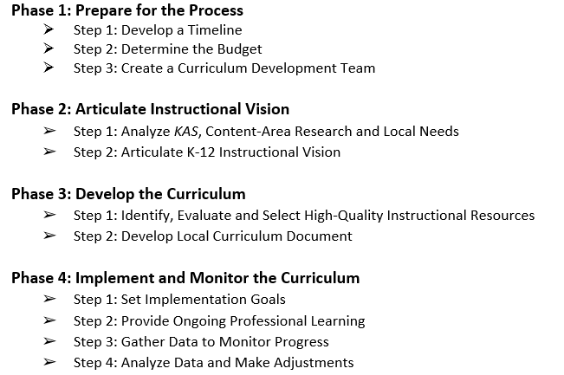
Curriculum Development Process: Phase 4

Slide 9
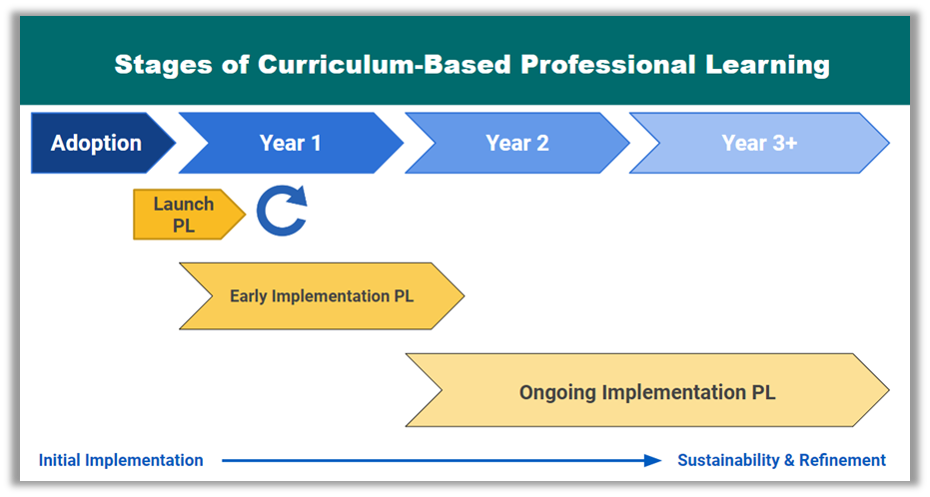
Stages of Curriculum Based Professional Learning

Slide 10
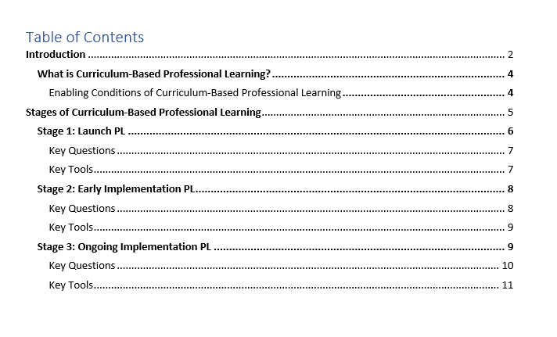
CBPL Guidance Document Structure

Slide 11
Curriculum-Based Professional Learning 2
As you read the “What is Curriculum-Based Professional Learning” and the “Enabling Conditions” sections (pgs. 4-6), notice:
How “ready” your district may be for doing CBPL well.
4-5 min. for independent reading. Space provided on pg. 1 of your participant handout to capture your thinking.

Slide 12
CBPL: Breakout Rooms
Team Discussion: From the CBPL Guidance document,
How might you define together what CBPL is (and isn't)?
How “ready” is your district currently for doing CBPL well?
What "assets" are currently in place?
What "barriers" are you finding?
6 min.

Slide 13
CBPL: Whole Group Share Out
Please post in the chat:
One "asset" and one "barrier" from your breakout room that seems worth lifting up to the group.

Slide 14
CBPL Guidance Document Structure 2

Slide 15
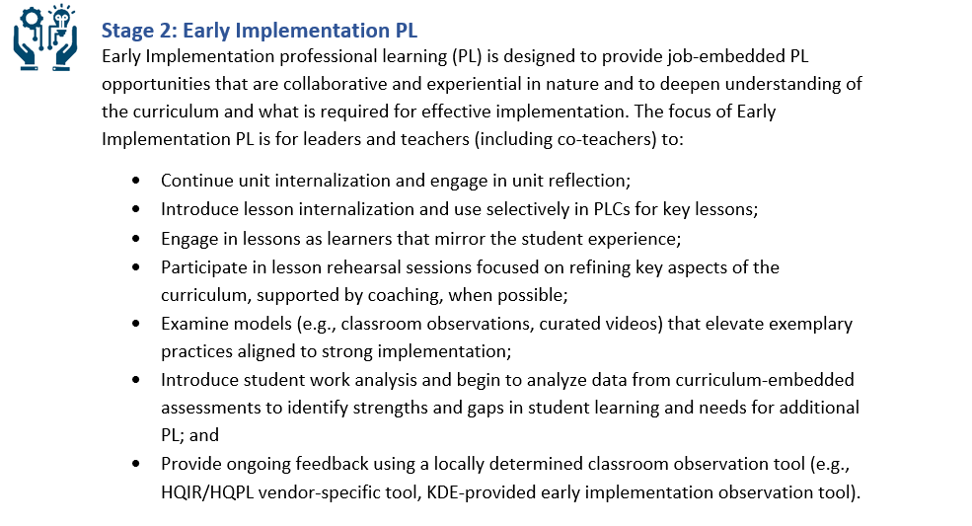
CBPL Guidance Document Structure 3
Each stage includes a list of the type of CBPL experiences necessary to reach the outcomes of that stage.

Slide 16
Stages of CBPL
Read through the PL experiences outlined for each of the three stages, note:
Which of these PL experiences may already be occurring in your district
Which you may be ready to incorporate based on implementation stage and educator readiness.
5 minutes.

Slide 17
Stages of CBPL: Whole Group
How might the PL experiences identified for each stage help meet the needs of teachers, those in their instructional practices and those that arise when implementing a new curriculum?

Slide 18
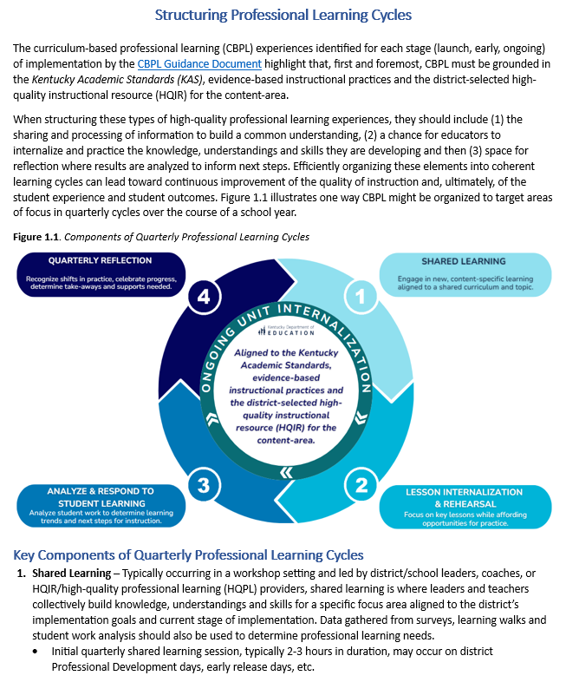
Creating System-Level Coherence in Professional Learning
A Model for Structuring CBPL

Slide 19
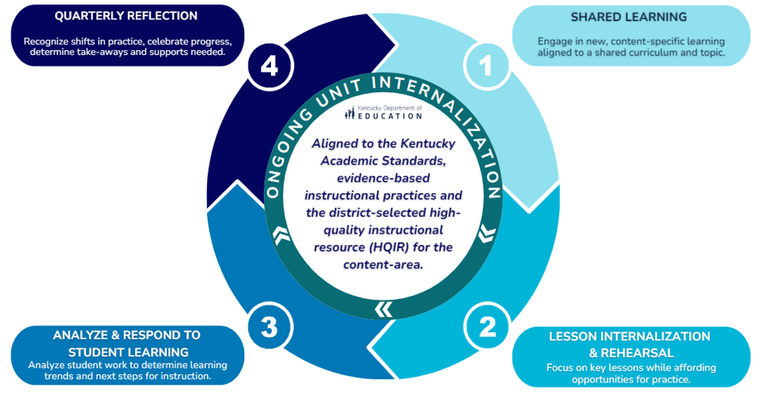
Structuring PL Cycles
;
;
;

Slide 20
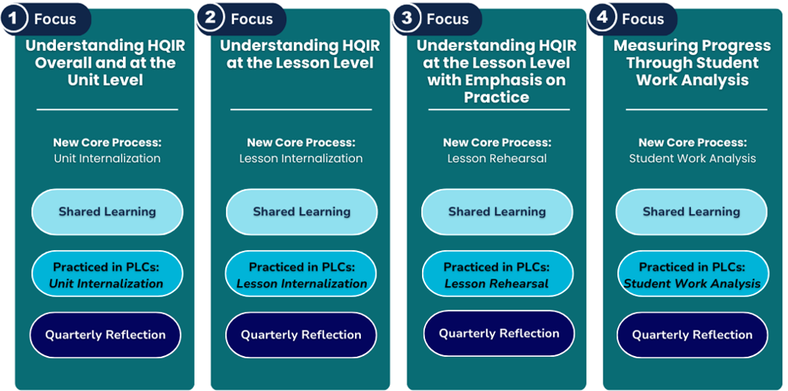
Structuring PL Cycles - Early Implementation
Launch PL
PL focuses on developing initial understanding of the resource and building capacity of CBPL core processes within PLCs.

Slide 21
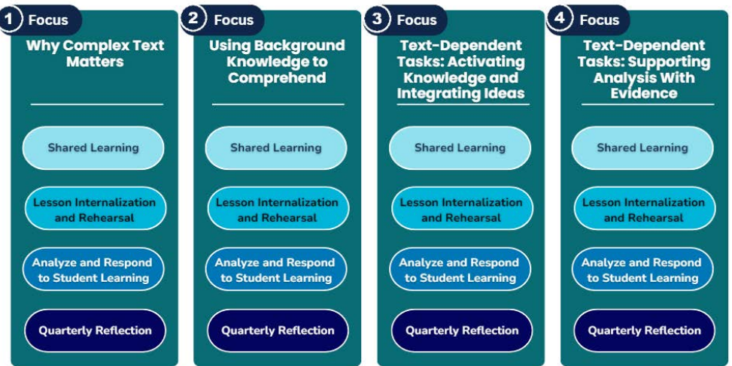
Structuring PL Cycles - Ongoing
Coherence:
PL focuses align to observation tool and learning walk look-fors.

Slide 22
CBPL: Breakout Rooms 2
Having explored what CBPL is, its enabling conditions and the experiences it provides, and now what it could look like structurally at the district level, what big ideas and big questions are coming up for you?
8 minutes

Slide 23
Structuring CBPL: Whole Group
What big ideas and big questions from your breakout room conversations may be important to lift up here?

Slide 24
Moving Forward
Recommendation: Based on your district’s stage of HQIR implementation, use the CBPL Guidance Document, the associated questions and tools to assess educator needs and identify next steps.

Slide 25
Questions
Key Resources:
Curriculum Implementation Framework
Curriculum-Based Professional Learning Guidance Document
Structuring Professional Learning Cycles
Fox DeMoisey
fox.demoisey@education.ky.gov
Misty Higgins
misty.higgins@education.ky.gov

Slide 26
Statewide Implementation February 2025 Updates Kentucky Numeracy Counts Act
Dr. Jennifer Fraley
Director of Mathematics Education
Office of Teaching and Learning

Slide 27
Status of K-12 Action Items
Action Item | Timeline
Published List of Universal Screeners and Diagnostics | List published. Assessments will be added as they are reviewed and approved. Superintendent notification January 2026 District adoption in 2026-2027 school year
K-8 Professional Learning Academies | EPIC Numeracy Alliance (3-8) AdvanceKY’s Access to Algebra (MS)-new cohort has been notified PIMSER Numeracy Counts Administrator Academy and Year One of KCM K-5 Numeracy Counts Academy-Application for both open 3/17 KCM K-5 and PIMSER Administrator Academy Informational Sessions 2/18 @1:00 pm, 2/20 @10:00 a.m., 2/25 @4:00 pm
HQIR Grants | RFA is available K-3 HQIR and/or Curriculum-Based Professional Learning Due March 6, 2025 Spring 2025-grants awarded

Slide 28
Status of Cross-Agency Action Items
EPSB work group recommended the change from Praxis 5000 to Praxis 7000 and this recommendation was approved at December 2024 EPSB Board Meeting.
EPSB work group recommended pilot of 4 math-specific observation rubrics in spring 2025 with recommendations coming after pilot.
Kentucky Mathematics Innovation Tool (KMIT)
Kentucky Instructional Practice Guide (IPG)
TNTP Math Observation Protocol
MCOP2-Mathematics Classroom Observation Protocol for Practices

Slide 29
Key Resources
House Bill 162
House Bill 162 (2024) Kentucky Numeracy Counts Act Implementation Timeline
KY Numeracy Counts Webpage

Slide 30
Questions and Conversations
Jennifer Fraley, Ed.D.
jennifer.fraley@education.ky.gov

Slide 31
BREAKOUT ROOM #1
ROOM 1 | ROOM 2 | ROOM 3
RIVET Education: Navigating the Professional Learning Partner Guide (PLPG) | Henry County: Establishing Enabling Conditions | Jefferson County: Assessing Implementation Needs

Slide 32
BREAKOUT ROOM #2
ROOM 1 | ROOM 2 | ROOM 3
RIVET Education: Navigating the Professional Learning Partner Guide (PLPG) | Henry County: Establishing Enabling Conditions | Jefferson County: Assessing Implementation Needs

Slide 33
HQIR Dashboard
Update: The HQIR Dashboard should now be updated with the 2024-2025 data!

Slide 34
March Leadership Meeting 2025
Academic Standards Review Process Update
Kentucky Academic Standards (KAS) for Reading and Writing, Social Studies and Mathematics
New KAS for Visual and Performing Arts Resources
TNTP Opportunity Makers Report (2024)
KDE Resources to Support MTSS and Trajectory-Changing Practices
Intellectual Preparation Guidance Documents
Instructional Practice Guides
Integrating Deeper Learning and HQIR to Strengthen Tier 1 Instruction Modules

Slide 35
Meeting Logistics
Intended audience: Superintendents, Chief Academic Officers, District Curriculum and Instruction Leads, District MTSS Coordinators and School Administrators
Held in-person in partnership with the regional cooperatives (most sessions will accommodate 50-100 attendees)
Sessions from 9 a.m. - 3 p.m. local time

Slide 36
2025 March Leadership Dates
Date | Time | Cooperative Location
Thursday, March 6 | 9 a.m. - 3:00 p.m. ET | SESC
Monday, March 10 | 9 a.m. - 3:00 p.m. ET | NKCES
Thursday, March 13 | 9 a.m. - 3:00 p.m. ET | KVEC
Friday, March 14 | 9 a.m. - 3:00 p.m. ET | KEDC
Tuesday, March 18 | 9 a.m. - 3:00 p.m. ET | OVEC
Friday, March 21 | 9 a.m. - 3:00 p.m. CT | GRREC
Tuesday, March 25 | 9 a.m. - 3:00 p.m. ET | CKEC
Friday, March 28 | 9 a.m. - 3:00 p.m. CT | WKEC
Click dates to access registration information.

Slide 37
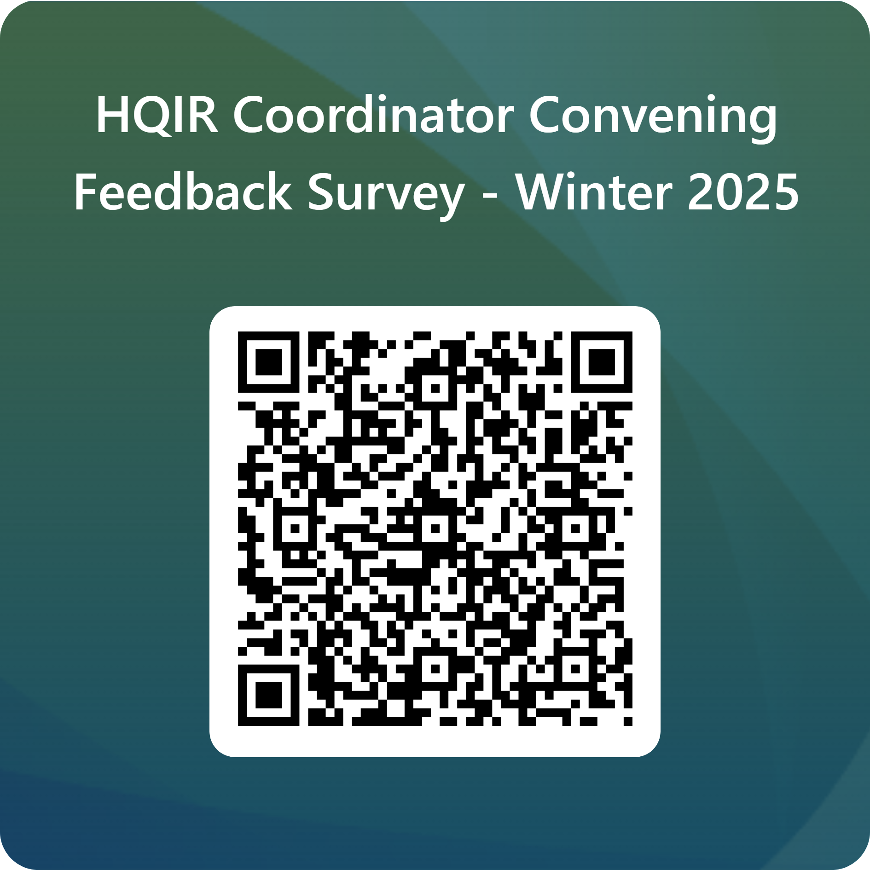
Contact Information
Feedback Survey & EILA Credit
CBPL Guidance Document | fox.demoisey@education.ky.gov misty.higgins@education.ky.gov
HQIR Survey & Dashboard | caryn.davidson@education.ky.gov
Kentucky Numeracy Act | jennifer.fraley@education.ky.gov
Read to Succeed | christie.biggerstaff@education.ky.gov

