Slide 1
Creating Collaborative Civic Spaces

Slide 2
Creating Collaborative Civic Spaces
Section A: Introduction

Slide 3
Group Norms
Assume best intentions.
Listen carefully to one another.
Be open to new ideas.
Be open to working outside your comfort zone.
Ask questions.
Allow a chance for everyone to participate.
Notes:
Explain that group norms can help to create a safe space where participants feel comfortable sharing their ideas and experiences. This slide is a starter. Take a moment to read the norms.
After people are finished, ask: “Would you like to revise, edit or add any norms to the list?” If so, make changes on the slide; if not, move on to your discussion of the parking lot.
Explain: “I realize you may not want to pose every question to the whole group, or we may not have time in the session to get to every question. Therefore, I want us to have a place for those questions.” Point out the location of the parking lot for questions. This may be a poster on which participants write or post questions, or you may prefer to have a digital parking lot where participants can access a Google document, for example, to post questions and that you can modify as the participants work through the sections of the module. The purpose of the parking lot is to provide participants with a safe way of asking questions. Remember that you may not know all of the answers to the questions, and that is okay. Some may be answered in future sections of the module.
If the question is pressing and doesn’t appear to be addressed in the sections of this module, talk to your district team and determine who would be the best person to contact at the KDE. You also may email questions or feedback to standards@education.ky.gov.

Slide 4
Overview of this module
Section A: Introduction
Section B: What Do We Do With Variation?
Section C: Engaging Student Voice in Community Building
Section D: The Proven Practice of Deliberation of Current and Controversial Issues
Section E: Strategies to Support Collaborative Civic Spaces
Section F: Reflection

Slide 5
Objectives
Review how the instructional shifts of the KAS for Social Studies require the cultivation and nurturing of collaborative civic spaces.
Examine data that highlights some of the challenges to creating collaborative civic spaces.
Examine the role of teachers and students in building a collaborative civic space.
Explore tools and resources to engage student voice in building a collaborative civic space.
Examine the proven practice of current and controversial issue discussions.
Analyze strategies that can be used to support current and controversial issue discussions in inquiry.

Slide 6
Compelling Questions
The following compelling questions will be addressed throughout this module:
What do we do with variation?
How do we create a collaborative civic space for inquiry?
What are the opportunities and challenges of creating collaborative civic spaces for current and controversial issue discussions?
What strategies might connect, support and extend collaborative and civic spaces in the classroom?

Slide 7
Warm-up
Collaborative civic spaces are safe places where students can collaborate on civic issues and action plans though civil discussion and democratic discourse while proposing solutions and developing action plans.
Individually, with a partner, a small grade-banded group or with your Professional Learning Community, discuss or reflect upon the following question:
Why is it important for educators and students to create classrooms that are collaborative civic spaces?
Notes:
Ask participants, individually, with a partner or in a small grade-banded group, to discuss the question on the slide after engaging with this introduction. Facilitate discussion over the reflection questions and address any comments that need further clarification or additional support.
Consider maintaining a Google document to house these reflections for continued consideration and further application.

Slide 8
Reflection
After reviewing the definition of collaborative civic spaces, consider the following questions:
What is your “why”? Why are you interested in learning about collaborative civic spaces?
Revisit the question on the previous slide. In what way(s) are you ready to engage in this work?
What are you excited to learn? What concern(s) do you have, if any?
Notes:
Ask participants, individually, with a partner or in a small grade-banded group, to discuss the questions on the slide after engaging with this introduction. Facilitate discussion over the reflection questions and address any comments that need further clarification or additional support.
Consider maintaining a Google document to house these reflections for continued consideration and further application.

Slide 9
Coming Up
Section A: Introduction
Section B: What Do We Do with Variation?
Section C: Engaging Student Voice in Community Building
Section D: The Proven Practice of Deliberation of Current and Controversial Issues
Section E: Strategies to Support Collaborative Civic Spaces
Section F: Reflection

Slide 10
Reflection End of Section A: Introduction
This is the end of Section A: “Introduction” within this module Creating Collaborative Civic Spaces.
If you would like to complete another section of this module at this time, continue onto the next slide to begin facilitating this module: Section B: “What Do We Do With Variation?”
Survey link: Collaborative Civic Spaces Professional Learning Survey
Notes:
The KDE needs your feedback on the effectiveness of this module, the learning platform and how the consultants may best support you as you take the next steps in the implementation process. Complete a short survey to share our thinking and provide them with feedback on how the KDE can best meet our needs. Feedback from our surveys will be used by the KDE to plan and prepare future professional learning.
Post-survey: https://docs.google.com/forms/d/e/1FAIpQLScCoWs8UDMqBOge_dr_Z1LOYRaBwQQOu8MtkLrVRpzhGGDMbg/viewform

Slide 11
Creating Collaborative Civic Spaces
Section B: What Do We Do With a Variation?

Slide 12
Overview of this module
Section A: Introduction
Section B: What Do We Do With Variation?
Section C: Engaging Student Voice in Community Building
Section D: The Proven Practice of Deliberation of Current and Controversial Issues
Section E: Strategies to Support Collaborative Civic Spaces
Section F: Reflection

Slide 13
Group Norms
Assume best intentions.
Listen carefully to one another.
Be open to new ideas.
Be open to working outside your comfort zone.
Ask questions.
Allow a chance for everyone to participate.

Slide 14
Objectives
In this module, participants will:
Review how the instructional shifts of the KAS for Social Studies require the cultivation and nurturing of collaborative civic spaces.
Examine data that highlights some of the challenges to creating collaborative civic spaces.
Explore research that points to the importance of discussing compelling questions that tap into “variations”.
Identify policies and practices to facilitate collaborative civic spaces that help “barriers fall down”.
Notes:
Read slide to participants.

Slide 15
Pre-Module Activity
Sentence-Phrase-Word
Read along as James Berry reads his poem, What Do We Do With a Variation? , and then complete the task in your notecatcher.
Notes:
Click the link above to access the poem. Scroll to the bottom of the screen and click the image of the author to hear him read the poem as the text is projected on the screen. https://clpe.org.uk/poetryline/poems/what-do-we-do-variation
Berry, James. What do we do with variation? (2004) Only One of Me. https://vimeo.com/20364818?embedded=true&source=vimeo_logo&owner=5906031

Slide 16
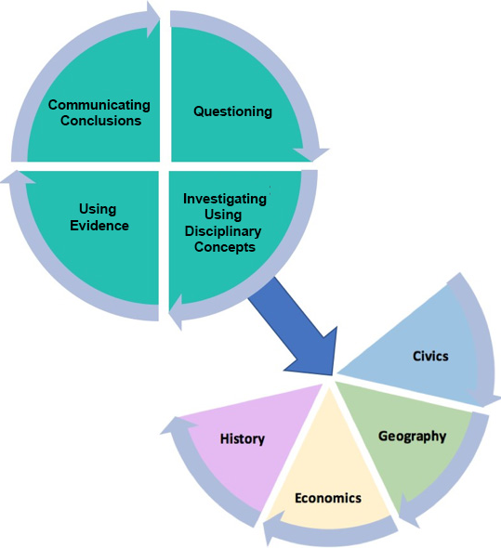
Inquiry Practices of the KAS for Social Studies
Notes:
Student inquiry into open ended, compelling questions that investigates “variations” in our community anchors this process.
The Kentucky Academic Standards for Social Studies is organized around the inquiry practices of questioning, investigating, using evidence and communicating conclusions. Students will consider or pose questions and then investigate those questions through the disciplinary lenses of civics, economics, geography and history. Students complete the inquiry process by communicating evidence-based conclusions. Within the architecture, the standards place an equal importance on both the mastery of important social studies concepts and disciplinary practices. Throughout a child’s social studies education, students engage in the inquiry practices – questioning, investigating, using evidence and communicating conclusions. Students use these practices to acquire, refine and extend knowledge and understanding of key social studies concepts within the four disciplinary lenses of civics, economics, geography and history. As indicated by the graphic, concept knowledge cannot be achieved effectively without the practice of inquiry.

Slide 17
Instructional Shifts of the KAS for Social Studies
Craft questions that spark and sustain inquiry
Cultivate and nurture collaborative civic spaces
Integrate content and skills purposefully
Promote literacy practices and outcomes
Provide tangible opportunities for communicating conclusions and taking action
Notes:
Review the instructional shifts in the KAS for Social Studies and highlight that, in this module, we will discuss some of the variations that can pose challenges to discussing compelling questions in the inquiry process. We also will examine policies and practices that can, in the words of James Barry, “help barriers fall down.”

Slide 18
What is variation?
Variation is the act, process or accident of differing in condition, character or degree.
Notes:
Have participants read the definition of variation and reflect on it independently.

Slide 19
Evidence of Variation: There is increased polarization in the general public
Source: Pew Research Center, 2017
Notes:
Click through slides 6-9 to highlight the increasing political polarization in the general public as evidenced by Pew Research Center.

Slide 20
Evidence of Variation: There is increased polarization in the general public
Source: Pew Research Center, 2017
Notes:
Click through slides 6-9 to highlight the increasing political polarization in the general public as evidenced by Pew Research Center.

Slide 21
Evidence of Variation: There is increased polarization in the general public
Source: Pew Research Center, 2017
Notes:
Click through slides 6-9 to highlight the increasing political polarization in the general public as evidenced by Pew Research Center.

Slide 22
Evidence of Variation: There is increased polarization in the general public
Source: Pew Research Center, 2017
Notes:
Click through slides 6-9 to highlight the increasing political polarization in the general public as evidenced by Pew Research Center.

Slide 23
What do we do with a variation?
Generally, we are taught not to talk “politics” in polite company.
When we do talk politics, it tends to be with like-minded individuals.
Notes:
As James Berry highlighted in his poem, we are taught not to talk politics in polite company and when we do, it tends to be with like minded individuals who echo our beliefs; or as Berry states, “Do we pass it stealthily or change route away from it? Do we will it to become like ourselves?”

Slide 24
What do we do with a variation?
Classrooms play a critical role in building skills and opportunities to address variations for barriers to fall down.
Notes:
No matter your opinion on the outcome of the 2016 election, many on both sides of the spectrum called the 2016 presidential election a “Sputnik moment” for civic education, highlighting the need to address our “variations” for barriers to fall down.

Slide 25
Polarization is not inevitable...
Notes:
Highlight these quotes from CIRCLE’s “All Together Now” report.
All Together Now: Collaboration and Innovation for Youth Engagement: The Report of the Commission on Youth Voting and Civic Knowledge (2013). Center for Information & Research on Civic Learning and Engagement. www.civicyouth.org/about-circle/ commission-on-youth-voting-civic-knowledge/

Slide 26
Annotated Reading
Underline key ideas and major points.
Write a ? next to anything that is confusing.
Circle key words or phrases.
Put an ! next to information that helps you make a connection to the poem, “What do we do with a variation?
Read, “Teaching Controversial Issues in an Age of Polarization,” and annotate the article using the codes to the right.
Notes:
Pass out article and read directions on the slide. If participants are not able to annotate the article using symbols, have participants select different highlighter colors for the directions outlined here.
Junco, Rey and Kawashima-Ginsberg, Kei. (2018). Teaching Controversial Issues in a Time of Polarization. Social Education. https://www.socialstudies.org/system/files/publications/articles/se_8206323.pdf

Slide 27
Article Discussion
After reading this article, engage in a Think Pair Share thinking routine with a partner. Share the following in your discussions:
What were the key ideas and major points that you underlined.
How do your responses compare with your partner’s?
What parts, indicated with a ?, were confusing to you?
Is your partner able to clarify any parts that you indicated?
What were the key words or phrases that you circled?
Did your partner identify any of the same key words or phrases?
What parts of the text, indicated with an !, helped you make a connection to the poem, “What do we do with a variation?
How do your responses compare with your partner’s?
Notes:
Ask participants to engage in a Think Pair Share with a partner to discuss the reflection on the article. Facilitate discussion over the reflection questions in a whole group discussion about the Think Pair Share and address any comments that need further clarification or additional support.
Consider maintaining a Google document to house these reflections for continued consideration and further application.
Project Zero. Think Pair Share. Harvard Graduate School of Education. https://pz.harvard.edu/sites/default/files/Think%20Pair%20Share_1.pdf

Slide 28
Post Discussion 3-2-1 Reflection
In your notecatcher, record:
3 things you learned as a result of this article and discussion;
2 people you need to share this information with; and
1 action you can take NOW to address variation.
Notes:
Have participants complete the 3-2-1 in the notecatcher and share results in pairs.

Slide 29
Reflection: One more stanza...
Revisit the poem, “What do we do with a variation?”
How would you like your students to respond to “variations” that emerge as a result of inquiry into compelling questions? Write a final stanza to the poem.
Notes:
Read directions on slide, and return to poem text at https://clpe.org.uk/poetryline/poems/what-do-we-do-variation
Have participants share their responses after 5 minutes.
Berry, James. What do we do with a variation? (2004) Only One of Me. https://clpe.org.uk/poetryline/poems/what-do-we-do-variation

Slide 30
How might the strategies in this module be used to support inquiry in the classroom?
Sentence-Phrase-Word
Annotated Reading
Think Pair Share
3-2-1 reflection
A final stanza...
Notes:
Have participants brainstorm how they might/or currently use the strategies shared in this lesson in their own classrooms to support inquiry

Slide 31
Section B: End
This is the end of Section B: “What Do We Do With Variation?” within this module Creating Collaborative Civic Spaces.
If you would like to complete another section of this module at this time, continue onto the next slide to begin facilitating this module: Section C: “Engaging Student Voice in Community Building.”
Survey link: Collaborative Civic Spaces Professional Learning Survey
Notes:
The KDE needs your feedback on the effectiveness of this module, the learning platform and how the consultants may best support you as you take the next steps in the implementation process. Complete a short survey to share our thinking and provide them with feedback on how the KDE can best meet our needs. Feedback from our surveys will be used by the KDE to plan and prepare future professional learning.
Post-survey: https://docs.google.com/forms/d/e/1FAIpQLScCoWs8UDMqBOge_dr_Z1LOYRaBwQQOu8MtkLrVRpzhGGDMbg/viewform

Slide 32
Creating Collaborative Civic Spaces
Section C: Engaging Student Voice in Community Building

Slide 33
Overview of this module
Section A: Introduction
Section B: What Do We Do With Variation?
Section C: Engaging Student Voice in Community Building
Section D: The Proven Practice of Deliberation of Current and Controversial Issues
Section E: Strategies to Support Collaborative Civic Spaces
Section F: Reflection

Slide 34
Group Norms
Assume best intentions.
Listen carefully to one another.
Be open to new ideas.
Be open to working outside your comfort zone.
Ask questions.
Allow a chance for everyone to participate.

Slide 35
Warm Up: What does a collaborative civic space look like, feel like and sound like?
Notes:
Ask participants to fill out the graphic organizer on the Section C notecatcher provided to reflect on what a civic collaborative space looks like, feels like and sounds like.
The graphic organizer is based on an example from the following:
Responsive Classroom. (n.d.) LFS Chart. https://www.responsiveclassroom.org/wp-content/uploads/2018/03/LSF-Chart-Template.pdf

Slide 36
Objectives
In this module, participants will:
Review how the instructional shifts of the KAS for Social Studies require the cultivation and nurturing of collaborative civic spaces.
Examine the role of teachers and students in building a collaborative civic space.
Explore tools and resources to engage student voice in building a collaborative civic space.
Notes:
Read slide to participants.

Slide 37
Instructional shifts of the KAS for Social Studies
Craft questions that spark and sustain inquiry
Cultivate and nurture collaborative civic spaces
Integrate content and skills purposefully
Promote literacy practices and outcomes
Provide tangible opportunities for communicating conclusions and taking action
Notes:
Review the instructional shifts in the KAS for Social Studies and highlight that, in this module, we will discuss the characteristics of collaborative civic spaces and tools that can engage student voice in community building.

Slide 38
Small Group Share
What does a collaborative civic space look like, feel like and sound like?
Notes:
Have participants share their graphic organizer with colleagues in small groups, adding attributes to their graphic organizer they learn from others.

Slide 39
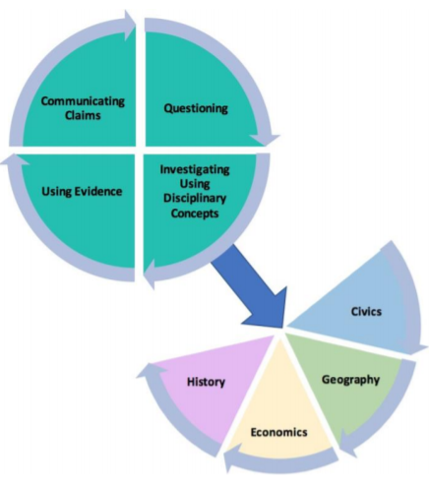
Building a Respectful Classroom
The KAS for Social Studies requires that students have a voice in the educational process as a student’s ability to effectively communicate their own conclusions and listen carefully to the conclusions of others can be considered a capstone of social studies disciplinary practices.
In the Communicating Conclusion standards, at minimum, students engage in civil discussion, reach consensus when appropriate and respect diverse opinions relevant to significant, unresolved issues students may face in their local, regional and global communities.
Students engage in disciplinary thinking and apply appropriate evidence to propose a solution or design an action plan.
Students apply a range of deliberative and democratic procedures to make decisions about ways to take action on current local, regional and global issues.
Notes:
Have participants read the slide.

Slide 40
Building a Respectful Classroom
Thus, social studies classrooms in Kentucky must be a safe space where students can engage in civil discussion, reach consensus when appropriate and respect diverse opinions.
How is this achieved?
Through building respectful relationships
Establishing and maintaining community expectations and agreements about behavior
Notes:
Have participants read the slide.

Slide 41
Building a Respectful Classroom
Building respectful relationships
Read the article entitled, Building Respectful Relationships.
As you read the article, add to your graphic organizer about how building respectful relationships contributes to a collaborative civic space.
Notes:
Have participants read the article entitled Building Respectful Relationships, linked on the slide and below. As participants read the article, have them add to their graphic organizer about how building respectful relationships contributes to a collaborative civic space.
Teaching Works Team. (2019, August) Building Respectful Relationships. TeachingWorks -University of Michigan. https://library.teachingworks.org/wp-content/uploads/10_BRR_decomp_092019.pdf

Slide 42
Building a Respectful Classroom
Establishing and maintaining community expectations and agreements about behavior
Read the article entitled, Establishing and maintaining community expectations and agreements about behavior decomposition.
As you read the article, add to your graphic organizer about how establishing and maintaining community expectations and agreements about behavior decomposition contributes to a collaborative civic space.
Notes:
Have participants read the article linked on the slide and below. As participants read the article, have participants add to their graphic organizer about how establishing and maintaining community expectations and agreements about behavior decomposition contributes to a collaborative civic space.
Teaching Works Team. (August 2019) Establishing and maintaining community expectations and agreements about behavior decomposition. TeachingWorks -University of Michigan. https://library.teachingworks.org/wp-content/uploads/Community-expectations-and-behavior_decomposition.pdf

Slide 43
Building Respectful Classrooms
In a whole group discussion, share your takeaways from the two articles you just read by answering the following question:
How do building respectful relationships and establishing and maintaining community expectations and agreements about behavior decomposition contribute to a collaborative civic space?
When you share, cite evidence from either or both of the articles to support your response.
Notes:
Have participants share their responses to this question in a whole group discussion while citing evidence from the two articles they just read.
It is important to note that participants should identify that respectful relationships and establishing and maintaining community expectations and agreements about behavior decomposition are essential to creating collaborative civic spaces. If a classroom is going to be a safe civic space, the classroom rules, procedures and routines should require respect among all members of the community.
Teaching Works Team. (2019, August) Building Respectful Relationships. TeachingWorks -University of Michigan. https://library.teachingworks.org/wp-content/uploads/10_BRR_decomp_092019.pdf
Teaching Works Team. (August 2019) Establishing and maintaining community expectations and agreements about behavior decomposition. TeachingWorks -University of Michigan. https://library.teachingworks.org/wp-content/uploads/Community-expectations-and-behavior_decomposition.pdf

Slide 44
Building a Respectful Classroom Example: General Discussion Strategies
General guidelines
Allow everyone the chance to speak.
Do not interrupt or engage in private conversations while others are speaking.
What is shared in the discussion circle, stays in the discussion circle. Keep confidential any personal information that comes up in the conversation.
As you listen to other participants…
Listen carefully and respectfully, without interrupting.
Be aware that tone and body language are powerful communicators. Show respectful listening by facing and looking at the speaker, making eye contact, staying quiet, nodding, etc.
Handout 1: General Discussion Guidelines
Notes:
In addition to establishing a classroom climate of respect, it is important to note that respect needs to be imbedded in classroom routines and procedures. This is especially true when students are asked to share their thoughts, ideas and perceptions on a topic. Have participants examine the general discussion strategies found on this slide (44) and the following (45, 46).
Inclusive Teaching Forum (n.d.) Handout 1: General Discussion Guidelines. Columbia Center for Teaching and Learning. https://learninginnovation.duke.edu/wp-content/uploads/2018/01/ITF-H1-discussionguide-17h5iob.pdf

Slide 45
Building a Respectful Classroom Example: General Discussion Strategies (2)
When it is your turn to speak…
Share briefly from your own experiences.
Use “I” statements to state your views.
Build on others’ comments. Acknowledge them, even if you disagree.
Be careful not to generalize about people and/or experiences.
Speaking up…
If you think something is missing from the conversation, do not wait for someone else to say it; say it yourself.
If you find another’s statement to be problematic, do speak up.
Try not to silence yourself out of concern for what others will think about what you say.
Handout 1: General Discussion Guidelines
Notes:
Inclusive Teaching Forum (n.d.) Handout 1: General Discussion Guidelines. Columbia Center for Teaching and Learning. https://learninginnovation.duke.edu/wp-content/uploads/2018/01/ITF-H1-discussionguide-17h5iob.pdf

Slide 46
Building a Respectful Classroom Example: General Discussion Strategies (3)
When interacting with other participants…
Commit to learning, not debating.
Challenge or criticize ideas, not individuals.
Avoid blame, speculation and inflammatory language.
Be careful about putting other participants on the spot. Do not demand that others speak for a group that you perceive them to represent.
Handout 1: General Discussion Guidelines
Notes:
Inclusive Teaching Forum (n.d.) Handout 1: General Discussion Guidelines. Columbia Center for Teaching and Learning. https://learninginnovation.duke.edu/wp-content/uploads/2018/01/ITF-H1-discussionguide-17h5iob.pdf

Slide 47
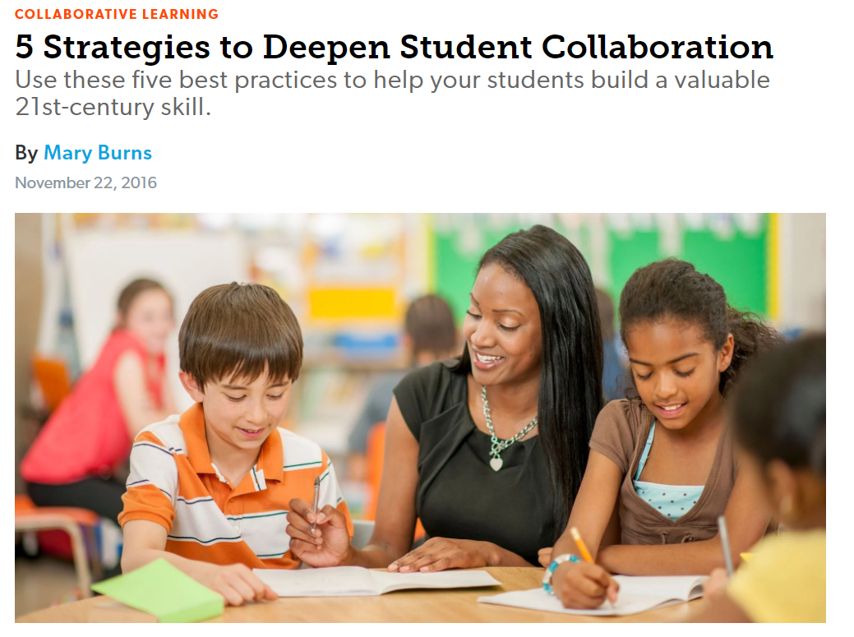
5 Strategies to Deepen Student Collaboration
Notes:
Have participants read the article entitled, “5 Strategies to Deepen Student Collaboration,” adding elements to their graphic organizer.
Burns, Mary. (2016, November 22). 5 Strategies to Deepen Student Collaboration. Edutopia. https://www.edutopia.org/article/5-strategies-deepen-student-collaboration-mary-burns

Slide 48
8 Components Blog: 3 Shape Annotation
Triangle (point instead of base at bottom): Something “pointed” and new
Square: Something that “squared” or agreed with your thinking
Circle: Something that is still going around in your head
Notes:
Have participants read the blog from Doc Miller on the 8 components of a reflective classroom- annotating their article with the shapes. Triangle= a pointed and new idea that describes a civic collaborative space, Square=and idea already on their graphic organizer, Circle= something they wonder about. If participants are not able to annotate the article using symbols, have participants select different highlighter colors for the directions outlined here.
Miller, Doc. (2015, August 5). 8 Components of a Reflective Classroom. Facing History and Ourselves. https://facingtoday.facinghistory.org/8-components-of-a-reflective-classroom

Slide 49
8 Components Blog: 3 Shape Discussion
Triangle (point instead of base at bottom): Something “pointed” and new
Square: Something that “squared” or agreed with your thinking
Circle: Something that is still going around in your head
Notes:
Have participants share in small groups what they annotated in the article.

Slide 50
Revisit the Warm Up: What does a collaborative civic space look like, feel like and sound like?
Notes:
Have participants add ideas from the reading and small group discussions they had to their graphic organizer.

Slide 51
Classroom Contract
A classroom contract is an agreement between the members of the classroom community (teacher, students) to which all parties are held accountable.
As you watch the following video, consider the following questions:
Why does the teacher identify himself as a member of the classroom community?
How does the teacher implementation of this strategy contribute to its effectiveness?
How can a classroom contract facilitate collaborative civic spaces?
Notes:
Have participants read the slide and preview the questions to consider while watching the video on the following slide. As they watch the video on the following slide, they will answer these questions on their Notecatcher, below their graphic organizer.

Slide 52
Classroom Contract (2)
Notes:
Have participants watch the video while considering the questions from the previous slide.
Facing History Ourselves. (n.d.) Teaching Strategy: Contracting. https://www.facinghistory.org/professional-development/ondemand/contracting

Slide 53
Classroom Contract (3)
In small groups, engage in Conver-Stations to discuss your responses to the questions below based on what you observed in the video:
Why does the teacher identify himself as a member of the classroom community?
How does the teacher implementation of this strategy contribute to its effectiveness?
How can a classroom contract facilitate collaborative civic spaces?
Notes:
Have participants engage in Conver-Stations to discuss their responses to the questions on the slide based on what they observed in the video.
A brief discussion of CONVER-STATIONS may be found in the following article:
Gonzalez, Jennifer. (2015, October 15). The Big List of Discussion Strategies. The Cult of Pedagogy. https://www.cultofpedagogy.com/speaking-listening-techniques/

Slide 54
Classroom Contracting
Work together in grade-banded groups to create a classroom contract that will result in the collaborative civic space described on your graphic organizer.
Notes:
Read instructions on slide, then click through slide 55 to show examples of class contracts.

Slide 55
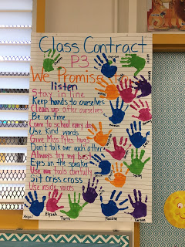
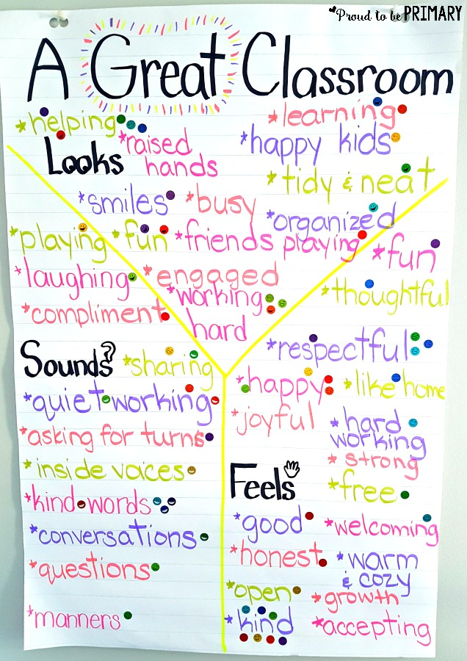
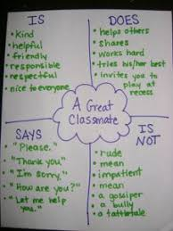
Class Contracts

Slide 56
Classroom Contracting
Work together in grade banded groups to create a classroom contract that will result in the collaborative civic space described on your graphic organizer.
Be prepared to share your contract with the larger group.
Notes:
Give participants 10 minutes to complete contracts, then have them share to larger group.

Slide 57
Application of Strategies
How might these tools engage students in the creation and nurturing of a collaborative and civic space in your classroom?
Looks Like, Feels Like, Sounds Like
Three Shape Annotation
Classroom Contracting
Conver-Stations

Slide 58
Reflection Section C: End
This is the end of Section C: “Engaging Student Voice in Community Building” within this module: Creating Collaborative Civic Spaces.
If you would like to complete another section of this module at this time, continue onto the next slide to begin facilitating Section D: “The Proven Practice of Deliberation of Current and Controversial Issues.”
Survey link: Collaborative Civic Spaces Professional Learning Survey
Notes:
The KDE needs your feedback on the effectiveness of this module, the learning platform and how the consultants may best support you as you take the next steps in the implementation process. Complete a short survey to share our thinking and provide them with feedback on how the KDE can best meet our needs. Feedback from our surveys will be used by the KDE to plan and prepare future professional learning.
Post-survey https://docs.google.com/forms/d/e/1FAIpQLScCoWs8UDMqBOge_dr_Z1LOYRaBwQQOu8MtkLrVRpzhGGDMbg/viewform

Slide 59
Creating Collaborative Civic Spaces
Section D: The Proven Practice of Deliberation of Current and Controversial Issues

Slide 60
Overview of this module
Section A: Introduction
Section B: What Do We Do With Variation?
Section C: Engaging Student Voice in Community Building
Section D: The Proven Practice of Deliberation of Current and Controversial Issues
Section E: Strategies to Support Collaborative Civic Spaces
Section F: Reflection

Slide 61
Group Norms
Assume best intentions.
Listen carefully to one another.
Be open to new ideas.
Be open to working outside your comfort zone.
Ask questions.
Allow a chance for everyone to participate.

Slide 62
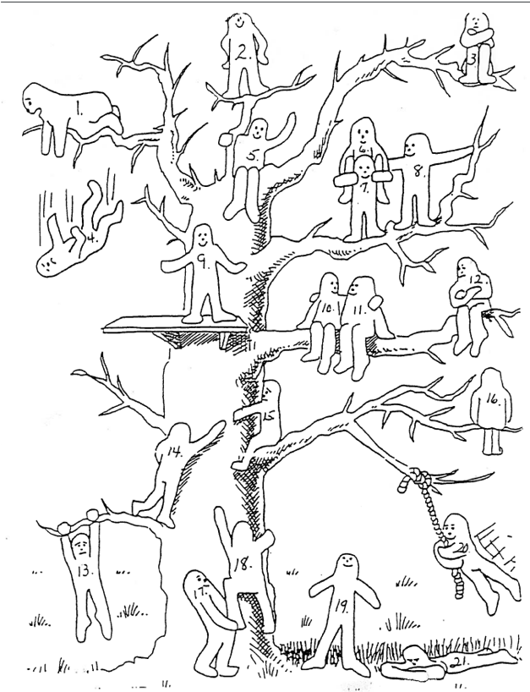
Warm Up Activity
The Blob Tree
How do you feel about facilitating discussions about controversial issues in your classroom?
Pick the image on the tree that corresponds to your comfort level in facilitating these conversations.
Explain your response.
Notes:
Pass out or share digitally the notecatcher and have participants respond to the prompt. Then, ask participants to share some of their placements and why. Note how participants who picked the same number might have interpreted the image differently.

Slide 63
Objectives
In this module, participants will:
Review how the instructional shifts of the KAS for Social Studies require the cultivation and nurturing of collaborative civic spaces for inquiry into compelling questions.
Examine the proven practice of current and controversial issue discussions.
Identify the qualities of effective current and controversial issue discussions.
Reflect on the use of current and controversial issue discussions in their own practice.
Notes:
Read slide to participants.

Slide 64
Instructional shifts of the KAS for Social Studies
Craft questions that spark and sustain inquiry
Cultivate and nurture collaborative civic spaces
Integrate content and skills purposefully
Promote literacy practices and outcomes
Provide tangible opportunities for communicating conclusions and taking action
Notes:
Review the instructional shifts in the KAS for Social Studies and highlight that in this module, we will discuss how collaborative and civic spaces facilitate the proven practice of current and controversial issue discussions that often result from inquiry into compelling questions with differing claims.

Slide 65
Compelling Questions
Compelling questions are open-ended, enduring and center on significant unresolved issues.
Characteristics of compelling questions:
focus on “big ideas,”
are intellectually challenging,
generate interest,
allow for multiple perspectives,
can be answered in a variety of ways
inspire investigation through the discipline strands.
Notes:
Remind participants how the best compelling questions provide for multiple perspectives, are not easily answered, lead to other questions, further discussion and collaboration.

Slide 66
Creating and nurturing collaborative civic spaces aligns with the proven practice of current and controversial issue discussions
Proven Practices of Civic Education
Course including civics, government, law and related topics
Deliberation of Current & Controversial Issues
Simulations of Democratic Processes
Student Voice in Schools
Student Led Volunteer Organizations
Service Learning
Individually, read the section entitled “Proven Practice #2: Discussion of Current Events and Controversial Issues” on pages 27-29. As you read, annotate the text to identify why the authors state that the discussion of current and controversial issues is a proven practice.
Notes:
The use of compelling questions in inquiry aligns with the proven practice of current and controversial issue discussions outlined on pages 27-29 in Guardian of Democracy: The Civic Mission of Schools. Individually, read the section entitled “Proven Practice #2: Discussion of Current Events and Controversial Issues” on pages 27-29. As you read, annotate the text to identify why the authors state that the discussion of current and controversial issues is a proven practice. For more information on text annotation, visit Annotating Texts: https://learningcenter.unc.edu/tips-and-tools/annotating-texts/
Jonathan, Kathleen Hall Jamieson, Peter Levine, Ted McConnell, and David B. Smith, eds. Guardian of Democracy: The Civic Mission of Schools. (2011) Leonore Annenberg Institute for Civics of the Annenberg Public Policy Center of the University of Pennsylvania. https://media.carnegie.org/filer_public/ab/dd/abdda62e-6e84-4Section A4-a043-348d2f2085ae/ccny_grantee_2011_guardian.pdf

Slide 67
What questions do you have about the proven practice of deliberation of current and controversial issues?
Proven Practices of Civic Education
Course including civics, government, law and related topics
Deliberation of Current & Controversial Issues
Simulations of Democratic Processes
Student Voice in Schools
Student Led Volunteer Organizations
Service Learning
Notes:
Have participants use the Visible Thinking Strategy of Question Starts (linked below) to brainstorm a list of at least 12 questions they have on the proven practice of current and controversial issue discussions in the classroom. Pass out or have participants access the worksheet of the protocol as you introduce this strategy.
Project Zero. Question Starts thinking routine. Harvard Graduate School of Education. https://pz.harvard.edu/sites/default/files/Question%20Starts_0.pdf

Slide 68
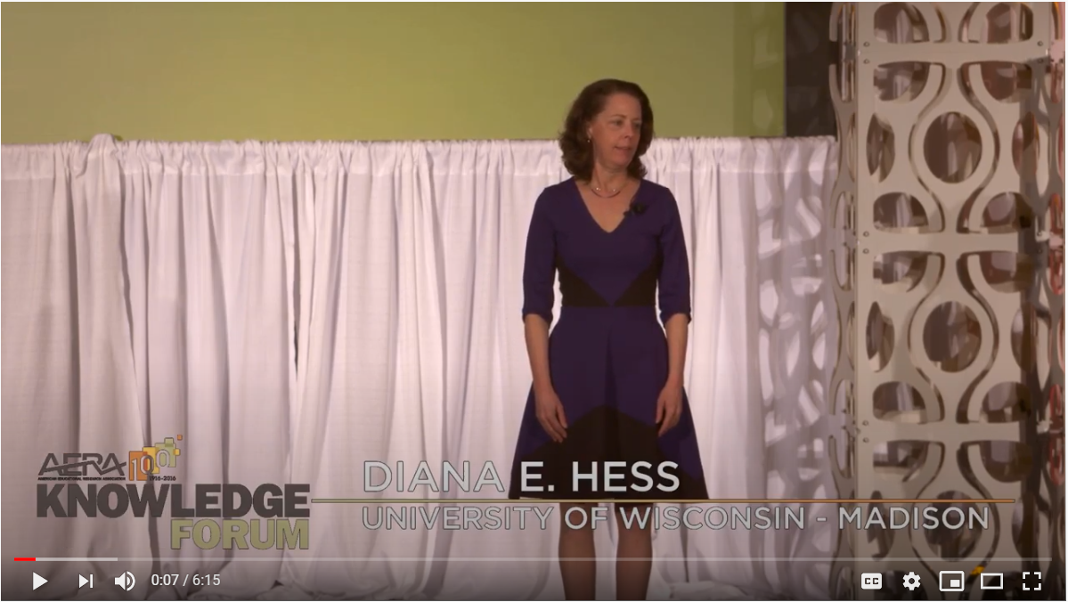
Political Education in Polarized Times
Notes:
Inform participants that they are going to watch a video of Dr. Diana Hess on political education in polarized times. Have participants note any information Dr. Hess shares that addresses the questions generated.
Hess, Diana. Ed-Talk: Political Education in Polarized Times. (2016, September 13). American Educational Research Association. https://www.youtube.com/watch?v=C8zgvTN1WQo

Slide 69
Small Group Share: Let’s Discuss
Notes:
Have participants review the brainstormed list of questions and star the questions that seem most interesting. Then, have them select one or more of the starred questions to discuss for a few moments in small groups. If time allows, have groups share the contents of their conversations. After conversations, have respondents revisit their question brainstorm to see if they can add any insights they gained from their colleagues.

Slide 70
Communicating Conclusions
In the Communicating Conclusion standards of the KAS for Social Studies, students engage in civil discussion, reach consensus when appropriate and respect diverse opinions relevant to significant, unresolved issues students may face in their local, regional and global communities.
How does engaging with current and controversial issues support students in meeting the requirements of the communicating conclusion standards?
Notes:
As a group, review the first bullet on the slide. Then, have participants discuss the question found in bullet two in pairs. Once participants have discussed the question in bullet two in pairs, have participants transition to small groups to continue discussing this question. Once participants have discussed this question in small groups, facilitate a whole group discussion where participants share their responses to the question in bullet two.
It is important to note that bullet one on this slide contains the culminating expectation of a students' interaction with the Communicating Conclusion standards found in the KAS for Social Studies. While this language can be found in the high school communicating conclusion standards, students build the knowledge and skills needed to engage with these standards throughout their kindergarten through high school education. Thus, it is imperative that participants understand their role in providing students with the skills and knowledge to engage with these standards. During the whole group facilitation, it will be beneficial for participants to review APPENDIX A: KINDERGARTEN THROUGH HIGH SCHOOL PROGRESSIONS in the KAS for Social Studies to emphasize how these skills develop over time.
For guidance on how to set up small group work, visit TeachingWorks Resource Library on setting up and managing small group work: https://library.teachingworks.org/curriculum-resources/teaching-practices/setting-up-and-managing-small-group-work/.
For guidance on how to conduct a large group discussion, visit TeachingWorks Resource Library on leading a discussion: https://library.teachingworks.org/curriculum-resources/materials/social-studies-leading-a-discussion/

Slide 71
Impact of Senate Bill 1 (2022)
On April 13, 2022, the Kentucky legislature passed Senate Bill 1 (SB 1), which includes changes to KRS 160.345 and language regarding the teaching of controversial issues.
Section 4, a new section of KRS Chapter 158, states the following about the teaching of current and controversial issues:
“Nothing in subsection (1) of this section shall be construed to restrict a public school or public charter school from providing instruction or using instructional materials that include:
(a) The history of an ethnic group, as described in textbooks and instructional materials adopted by a school district;
(b) The discussion of controversial aspects of history; or
(c) The instruction and instructional materials on the historical oppression of a particular group of people.
Notes:
Read the slide to understand how Senate Bill 1 (2022) impacts the teaching of controversial and current issues.
It is important to note that this legislation does not prevent the discussion of controversial aspects of history, nor does it prevent the discussion of current events.

Slide 72
Impact of Senate Bill 1 (2022) continued
Section 5 and 6 of SB 1 (2022) amend KRS 161.164(5) to read…
“Any instruction or instructional materials on current, controversial topics related to public policy or social affairs provided to public school or public charter school students, regardless of whether the individual that provides the instruction is employed by the local school district or public charter school, shall be:
(a) Within the range of knowledge, understanding, age, and maturity of the students receiving the instruction; and
(b) Relevant, objective, nondiscriminatory, and respectful to the differing perspectives of students.
An employee of a public school district or public charter school shall not violate a student's first amendment rights by requiring or incentivizing a student to advocate in a civic space on behalf of a perspective with which the student or the parent or guardian of a minor student does not agree.”
Notes:
Read the slide to understand how Senate Bill 1 (2022) impacts the teaching of controversial and current issues.
It is important to note that this legislation aligns with the requirements of the KAS for Social Studies. As discussed earlier, the Communicating Conclusions standards are built on progressions where students build more sophisticated and mature ways of thinking or understandings. When students conclude their K-12 social studies program, they are required to be able to engage in civil discussion, reach consensus when appropriate and respect diverse opinions relevant to compelling and/or supporting questions in the four disciplines of social studies (civics, economics, geography and history). Furthermore, students are required to analyze primary and secondary sources on the same event or topic, noting key similarities and differences in the perspective they represent. Additionally, students are required to analyze evidence from multiple perspectives and sources to support claims and refute opposing claims. Investigating multiple perspectives through the use of logical evidence provides the foundation for students to apply a range of deliberative and democratic procedures to make decisions about ways to take action on current local, regional and global issues.
A student’s ability to effectively communicate their own conclusions and listen carefully to the conclusions of others can be considered a capstone of social studies disciplinary practices.

Slide 73
Reflection Complete the following prompts about deliberating current and controversial issues.
I used to think….
Now, I think…
Notes:
Give participants a few minutes to complete the prompts. Then, facilitate a whole group discussion for participants to share their responses. More guidance available at https://pz.harvard.edu/sites/default/files/I%20Used%20to%20Think%20-%20Now%20I%20Think_1.pdf
Project Zero. I used to think… Now I think thinking routine. Harvard Graduate School of Education. https://pz.harvard.edu/sites/default/files/I%20Used%20to%20Think%20-%20Now%20I%20Think_1.pdf

Slide 74
Application
How might these tools be used to support students in current and controversial issue discussions?
Question Starts
I used to think… now I think
Notes:
Read slide

Slide 75
Reflection Section D: End
This is the end of Section D: “The Proven Practice of Deliberation of Current and Controversial Issues” within this module: Creating Collaborative Civic Spaces.
If you would like to complete another section of this module at this time, continue onto the next slide to begin facilitating Section E: “Strategies to Support Collaborative Civic Spaces.”
Survey link: Collaborative Civic Spaces Professional Learning Survey
Notes:
The KDE needs your feedback on the effectiveness of this module, the learning platform and how the consultants may best support you as you take the next steps in the implementation process. Complete a short survey to share our thinking and provide them with feedback on how the KDE can best meet our needs. Feedback from our surveys will be used by the KDE to plan and prepare future professional learning.
Post-survey: https://docs.google.com/forms/d/e/1FAIpQLScCoWs8UDMqBOge_dr_Z1LOYRaBwQQOu8MtkLrVRpzhGGDMbg/viewform

Slide 76
Creating Collaborative Civic Spaces
Section E: Strategies to Support Collaborative Civic Spaces

Slide 77
Overview of this module
Section A: Introduction
Section B: What Do We Do With Variation?
Section C: Engaging Student Voice in Community Building
Section D: The Proven Practice of Deliberation of Current and Controversial Issues
Section E: Strategies to Support Collaborative Civic Spaces
Section F: Reflection

Slide 78
Group Norms
Assume best intentions.
Listen carefully to one another.
Be open to new ideas.
Be open to working outside your comfort zone.
Ask questions.
Allow a chance for everyone to participate.

Slide 79
Warm Up Task
Compass points
E= Excited
W= Worrisome
N= Need to Know
S= Stance or Suggestion
Notes:
Pass out the notecatcher guide. Ask participants, when you think about engaging students in inquiry around compelling questions with competing and often controversial perspectives what excites you, worries you, what do you need to know and what are suggestions for moving forward with this idea? Complete the pre module activity independently in the column marked “Compass Points”.
Project Zero. (n.d.) Compass Points thinking routine. Harvard Graduate School of Education. https://pz.harvard.edu/sites/default/files/Compass%20Points_0.pdf

Slide 80
Give One, Get One
Find a partner.
Partner A share items from your Compass Points list until Partner B hears something that in not on their list.
Partner B adds the idea to the right of their list.
Once Partner B “GOT ONE”, roles reverse.
Once Partner A “GOT ONE”, find new partners and repeat.
Notes:
Read instructions for give one get one to participants and have them circulate for 5 minutes in the room, discussing their compass point results to fill in the far right column of the notecatcher.
Facing History and Ourselves. (n.d.) Give One, Get One. Teaching Strategy. https://www.facinghistory.org/resource-library/teaching-strategies/give-one-get-one

Slide 81
Objectives
In this module, participants will:
Review how the instructional shifts of the KAS for Social Studies require the cultivation and nurturing of collaborative civic spaces for inquiry into compelling questions.
Analyze strategies that can be used to support current and controversial issue discussions in inquiry.
Explore resources that can be used to support current and controversial issue discussions in inquiry.
Notes:
Read slide to participants.

Slide 82
Instructional shifts of the KAS for Social Studies
Craft questions that spark and sustain inquiry
Cultivate and nurture collaborative civic spaces
Integrate content and skills purposefully
Promote literacy practices and outcomes
Provide tangible opportunities for communicating conclusions and taking action
Notes:
Review the instructional shifts in the KAS for Social Studies and highlight that in this module, we will explore and experience strategies that support the cultivation and nurturing of collaborative and civic spaces to support inquiry into compelling questions with differing claims.

Slide 83
Attributes of Dialogue in Collaborative and Civic Spaces
Engages productively with the local, national, and international issues and events that animate our political system
Addresses meaningful and timely questions about public problems that deserve both students and the public's attention
Links issues to curricular goals
Selects issues that resonate with students
Locates or creates learning materials to provide students necessary background information
Through these learning materials, provides the best arguments on varying sides of an issue, multiple points of view and engages with multiple and complex perspectives
Notes:
Use the information on the next two slides to summarize the attributes of dialogue in collaborative and civic spaces outlined on Civic Learning Practice Indicators: Current and Controversial Issues from illinoiscivics.org, linked below.
Illinoiscivics.org. Civic Learning Practice Indicators. (n.d.) Civics Education Resource Site. https://www.illinoiscivics.org/resources/civic-learning-practices-indicators

Slide 84
Attributes of Dialogue in Collaborative and Civic Spaces (2)
Employs several different ways of making joint decisions (deliberating, debating and voting, agreeing to disagree, delegating the decision to experts, choosing randomly, etc.) and demonstrates the pros and cons of each
Develops ground rules to ensure inclusive and productive discussions occur in a climate of respect and civility in which all responsible perspectives are taken seriously
Facilitates in-depth understanding of issues or events to enable individuals to form their own opinions and participate effectively in a range of conversations and collaborations with diverse partners, building on others' ideas and expressing their own thoughts clearly and persuasively
Undertakes discussions with thoughtfulness related to the ethical dilemmas involved in teaching about controversial issues
Notes:
Use the information on the next two slides to summarize the attributes of dialogue in collaborative and civic spaces outlined on Civic Learning Practice Indicators: Current and Controversial Issues from illinoiscivics.org, linked below.
Illinoiscivics.org. Civic Learning Practice Indicators. (n.d.) Civics Education Resource Site. https://www.illinoiscivics.org/resources/civic-learning-practices-indicators

Slide 85
Structured Academic Controversy
Notes:
Instruct participants that they are going to analyze three strategies on their notecatcher based on the top ten list of dialogue in civic and collaborative spaces. They will begin with Structured Academic Controversy.
Resources used here:
Civic Engagement Research Group- University of California- Riverside. (n.d.) Structured Academic Controversy (SAC). Series CPS/CERG Civic Discussion Videos. https://www.youtube.com/watch?v=5MPekCd0mHk&t=36s

Slide 86
Socratic Seminar
Notes:
Instruct participants that they are going to analyze Socratic Seminar on their notecatcher based on the top ten list of dialogue in civic and collaborative spaces.
Resources used here:
Annenburg Learner. (n.d.). Facilitating a Socratic Seminar. https://www.learner.org/series/reading-writing-in-the-disciplines/bringing-it-all-together-history-social-studies/facilitating-a-socratic-seminar/

Slide 87
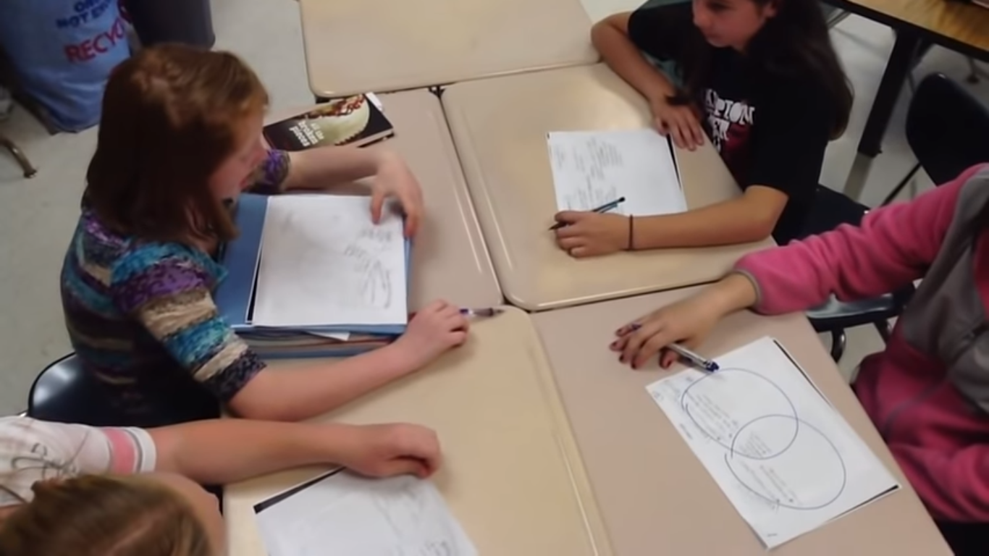
Philosophical Chairs
Notes:
Instruct participants that they are going to analyze Philosophical Chairs on their notecatcher based on the top ten list of dialogue in civic and collaborative spaces.
Resource:
Madland, Jennifer. (2012, June 5). Walker Middle School AVID Philosophical Chairs. https://www.youtube.com/watch?v=U0XTkCSb6a8

Slide 88
Reflection
CONNECT: How are the ideas and information presented CONNECTED to what you already knew?
EXTEND: What new ideas did you get that EXTENDED or pushed your thinking in new directions?
CHALLENGE: What is still CHALLENGING or confusing for you to get your mind around? What questions, wonderings or puzzles do you now have?
Notes:
Have participants reflect on their learning in this module using the Connect/Extend/Challenge thinking strategy, linked below.
Project Zero. (n.d.) Connect/Extend/Challenge thinking routine. Harvard Graduate School of Education. https://pz.harvard.edu/sites/default/files/Connect%20Extend%20Challenge_0.pdf

Slide 89
Application
How might the strategies in this module be used to support the cultivation and nurturing of collaborative civic spaces?
Compass Points
Give One, Get One
Connect-Extend-Challenge
Notes:
Read slide.

Slide 90
Reflection Section E: End
This is the end of Section E: “Strategies to Support Collaborative Civic Spaces” within this module: Creating Collaborative Civic Spaces.
If you would like to complete another section of this module at this time, continue onto the next slide to begin facilitating Section F: “Reflection.”
Survey link: Collaborative Civic Spaces Professional Learning Survey
Notes:
The KDE needs your feedback on the effectiveness of this module, the learning platform and how the consultants may best support you as you take the next steps in the implementation process. Complete a short survey to share our thinking and provide them with feedback on how the KDE can best meet our needs. Feedback from our surveys will be used by the KDE to plan and prepare future professional learning.
Post-survey: https://docs.google.com/forms/d/e/1FAIpQLScCoWs8UDMqBOge_dr_Z1LOYRaBwQQOu8MtkLrVRpzhGGDMbg/viewform

Slide 91
Creating Collaborative Civic Spaces Section F: Reflection

Slide 92
Group Norms
Assume best intentions.
Listen carefully to one another.
Be open to new ideas.
Be open to working outside your comfort zone.
Ask questions.
Allow a chance for everyone to participate.

Slide 93
Overview of this module
Section A: Introduction
Section B: What Do We Do With Variation?
Section C: Engaging Student Voice in Community Building
Section D: The Proven Practice of Deliberation of Current and Controversial Issues
Section E: Strategies to Support Collaborative Civic Spaces
Section F: Reflection

Slide 94
Module Objectives
Review how the instructional shifts of the KAS for Social Studies require the cultivation and nurturing of collaborative civic spaces.
Examine data that highlights some of the challenges to creating collaborative civic spaces.
Examine the role of teachers and students in building a collaborative civic space.
Explore tools and resources to engage student voice in building a collaborative civic space.
Examine the proven practice of current and controversial issue discussions.
Analyze strategies that can be used to support current and controversial issue discussions in inquiry.

Slide 95
Compelling Questions
Individually, with a partner, a small grade-banded group or your Professional Learning Community, answer the following questions using the What Makes You Say That? thinking strategy.
What do we do with variation?
How do we create a collaborative civic space for inquiry?
What are the opportunities and challenges of creating collaborative civic spaces for current and controversial issue discussions?
What strategies might connect, support and extend collaborative and civic spaces in the classroom?
Notes:
Ask participants, individually, with a partner or in a small grade-banded group, to discuss the questions on the slide after engaging with this module. Facilitate discussion over the reflection questions and address any comments that need further clarification or additional support.
Consider maintaining a Google document to house these reflections for continued consideration and further application.
Project Zero. (n.d.) What Makes You Say That? thinking routine. Harvard Graduate School of Education. https://pz.harvard.edu/sites/default/files/What%20Makes%20You%20Say%20That_1.pdf

Slide 96
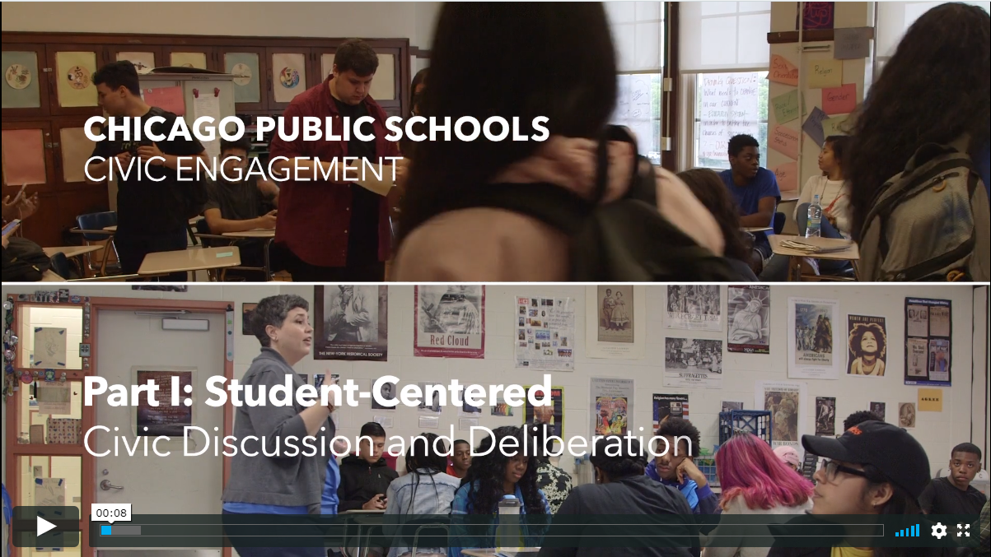
Why try it?
Notes:
As participants watch the clip, have them reflect on why they should engage in this work. Participants merely need to think about this question as they watch this clip; there is no need to write anything down at this point as they will have structured time to reflect on the video after viewing.
Civic Engagement Research Group- University of California- Riverside. (n.d.) Part I: Student-Centered Civic Discussion and Deliberation. Series CPS/CERG Civic Discussion Videos. https://vimeo.com/292405879

Slide 97
Why Try It Reflection
Individually, with a partner, a small grade-banded group or your Professional Learning Community, reflect on the question, “Why Try it?” using the 3 Y’s thinking strategy. Use this strategy to answer the questions below regarding why you should engage in student-centered civic discussion and deliberation.
1. Why might student-centered civic discussion and deliberation matter to me?
2. Why might it matter to people around me [family, friends, city, nation]?
3. Why might it matter to the world?
Notes:
As participants engage in this work, consider keeping a record of the participants responses that others can see. Participants may record their responses using a Google doc or post-it-notes.
Project Zero. (n.d.). The 3 Y’s thinking routine. Harvard Graduate School of Education. https://pz.harvard.edu/sites/default/files/The%203%20Ys_1.pdf

Slide 98
Reflection
Individually or with your Professional Learning Community, discuss the following questions:
What are some ways in which you can immediately start creating collaborative civic spaces in your classroom?
How will this learning impact your instruction?
What supports will you/teachers need in your school(s) to make the implementation of healthy integration successful?
Notes:
Ask participants, individually, with a partner or in a small grade-banded group, to discuss the questions on the slide after engaging with this module. Facilitate discussion over the reflection questions and address any comments that need further clarification or additional support.
Consider maintaining a Google document to house these reflections for continued consideration and further application.

Slide 99
Application
How might the strategies in this module be used to support the cultivation and nurturing of collaborative civic spaces?
What Makes You Say That
The 3 Y’s
Notes:
Read slide.

Slide 100
Reflection Section F: End
This is the end of Section F: “Reflection” within this module: Creating Collaborative Civic Spaces.
Please complete the KDE survey to provide feedback on the module and to share your needs.
Survey link: Collaborative Civic Spaces Professional Learning Survey
Notes:
The KDE needs your feedback on the effectiveness of this module, the learning platform and how the consultants may best support you as you take the next steps in the implementation process. Complete a short survey to share our thinking and provide them with feedback on how the KDE can best meet our needs. Feedback from our surveys will be used by the KDE to plan and prepare future professional learning.
Post-survey: https://docs.google.com/forms/d/e/1FAIpQLScCoWs8UDMqBOge_dr_Z1LOYRaBwQQOu8MtkLrVRpzhGGDMbg/viewform

Slide 101
Creating Collaborative Civic Spaces
Notes:
Module Attribution
Collaborative Civic Spaces was originally created by Mary Ellen Daneels for the Hawaii Department of Education, Office of Curriculum and Instructional Design, as seen at https://sites.google.com/view/hawaiicorestandardsforsocialst/online-professional-development-modules and has been modified here with permission.
All content was based on Colorado Department of Education – Standards and Instructional Support Modules https://sitesed.cde.state.co.us/course/index.php?categoryid=24.

