Slide 1
What do the Kentucky Academic Standards (KAS) for Social Studies look like in practice?
A webinar designed to deepen social studies content knowledge and pedagogy.
Topic Focus: Grade 5 History

Slide 2
Webinar Goals
Learning Goal
I am learning about how to design instructional experiences aligned to the KAS for Social Studies by engaging in a demonstration about Kentucky history.
Success Criteria
I can analyze 5.H.CH.1 to understand what this standard requires students to know and be able to do.
I can improve my content knowledge and pedagogical skills after exploring a grade level sample.

Slide 3
What are Standards?
Standards define what students should know, understand and be able to do at the end of a grade level.
 | Definition
Know | Refers to facts, dates, places, people, definitions, rules or information
Understand | Refers to theories, generalizations or “big ideas”
Do | Refers to skills such as communication, reading, computation, application and transfer to new situations

Slide 4
What Does it Mean to Unpack a Standard?
Breaking a standard into smaller, more explicit chunks for the purposes of curriculum development and/or unit and lesson planning.
For example, analyze the verb in the following standard to determine its meaning in terms of instruction and assessment.
“...understand the development of important community traditions and events.”
What does understand mean in this standard?
Does it mean “make meaning of” or “transfer”?
Does it mean to “accurately state and explain”? Or, does it simply mean to “know”?
What does the verb demand in terms of student learning?

Slide 5
Tool to Unpack Standards
Step 2
Step 4
Step 1
Unpacking the Standard
Standard | What Knowledge/Concepts/ Vocabulary do students need to know to reach this standard? | What skills do students need to be able to do to reach this standard? | What level of proficiency do students need to be at in order to reach this standard?
Step 3

Slide 6
Step 1: List the Standard
Cut and paste the standards, including the inquiry practices, into the furthest left column of the spreadsheet
Unpacking the Standard
Standard | What Knowledge/Concepts/ Vocabulary do students need to know to reach this standard? | What skills do students need to be able to do to reach this standard? | What level of proficiency do students need to be at in order to reach this standard?
5.H.CH.1 Describe the impact of fundamental documents on the development of the United States.

Slide 7
Step 2: What Knowledge, Concepts, Vocabulary will they need to Master? (1)
Closely look at each standard and identify the Knowledge/Concepts/Vocabulary
The “what” that students should learn
Unpacking the Standard
Standard | What Knowledge/Concepts/ Vocabulary do students need to know to reach this standard? | What skills do students need to be able to do to reach this standard? | What level of proficiency do students need to be at in order to reach this standard?
5.H.CH.1 Describe the impact of fundamental documents on the development of the United States. | Fundamental documents their impact on development of the U.S.

Slide 8
Step 2: What Knowledge, Concepts, Vocabulary will they need to Master? (2)
Teachers can use the Glossary of Terms for the Kentucky Academic Standards (KAS) for Social Studies to understand the definition of fundamental documents.
Fundamental documents: documents that provide significant insight into key actions, movements or moments or help establish a precedent or core principles.

Slide 9
Step 2: What Knowledge, Concepts, Vocabulary will they need to Master? (3)
Teachers can use the disciplinary clarifications to determine the Knowledge/Concepts/Vocabulary.
The disciplinary clarifications for Grade 5 begin on page 87 of the KAS for Social Studies.
Concepts and Practices | Standard | Disciplinary Clarifications
H: Change and Continuity | 5.H.CH.1 Describe the impact of fundamental documents on the development of the United States. | The fundamental documents, including, but not limited to, the Declaration of Independence, the Constitution of the United States and the first ten (10) amendments to the Constitution of the United States, also known as the Bill of Rights, established the United States government and presented the philosophical, traditional and political foundations on which the nation was built. New political ideologies influenced the democratic principles that guided the founding of the nation and formation of the government. Certain groups, including women, African Americans and American Indians, did not receive equal rights or representation. Protections for the institution of slavery were embedded in the fundamental documents.

Slide 10
Step 2: What Knowledge, Concepts, Vocabulary will they need to Master? (4)
Unpacking the Standard
Standard | What Knowledge/Concepts/ Vocabulary do students need to know to reach this standard? | What skills do students need to be able to do to reach this standard? | What level of proficiency do students need to be at in order to reach this standard?
5.H.CH.1 Describe the impact of fundamental documents on the development of the United States. | Fundamental documents their impact on development of the U.S. Declaration of Independence U.S. Constitution Bill of Rights philosophical, traditional and political foundations Lack of equal representation: women, African Americans, American Indians Institution of slavery protected

Slide 11
Step 3: What Skills will they need to Master?
Closely look at the standard and identify the skills
Skills include the thinking skills and mental processes that require skillful application of the knowledge to solve problems, make a decision, etc.
Unpacking the Standard
Standard | What Knowledge/Concepts/ Vocabulary do students need to know to reach this standard? | What skills do students need to be able to do to reach this standard? | What level of proficiency do students need to be at in order to reach this standard?
5.H.CH.1 Describe the impact of fundamental documents on the development of the United States. | Fundamental documents their impact on development of the U.S. Declaration of Independence U.S. Constitution Bill of Rights philosophical, traditional and political foundations Lack of equal representation: women, African Americans, American Indians Institution of slavery protected | Describe

Slide 12
Step 4: What Level of Proficiency do Students need to be in order to Reach this Standard?
Look at the standard and identify what level of proficiency students will need to be in order to reach this standard.
One way to determine answers to this question is to look at the Depth of Knowledge.
Unpacking the Standard
Standard | What Knowledge/Concepts/ Vocabulary do students need to know to reach this standard? | What skills do students need to be able to do to reach this standard? | What level of proficiency do students need to be at in order to reach this standard?
5.H.CH.1 Describe the impact of fundamental documents on the development of the United States. | Fundamental documents their impact on development of the U.S. Declaration of Independence U.S. Constitution Bill of Rights philosophical, traditional and political foundations Lack of equal representation: women, African Americans, American Indians Institution of slavery protected | Describe | 2
Notes:
The fourth step is to determine the level of proficiency students are required to be at for a particular grade. Most often this can be identified using Bloom’s taxonomy and/or Webbs Depth of Knowledge.
It is important to note that when determining the DOK of a standard, the verb, such as analyze, should not be separated from the rest of the standard as the content and skills outlined in the standard impact the level of rigor students need to engage in order to demonstrate mastery of the standards. For example, in the DOK handout provided, “analyze similarities and differences in issues and problems” is a DOK 3 while “analyzing and synthesizing information from multiple sources” is a DOK 4.

Slide 13
What do the KAS for Social Studies look like in practice?
Topic Focus: Grade 5 History

Slide 14
Please take a moment to sign in with the QR code.
Notes:
Prompt attendees to say hi and where they are from in the chat, we will use the chat extensively in this session so make sure you are familiar! (1-2 minutes before session start time).

Slide 15
Examining the Declaration of Independence in Early Grades Kentucky Department of Education October 16, 2024
Notes:
Introduce title and ask what people teach in the chat (1-2 minutes)

Slide 16
Vision and Mission
Vision | The Bill of Rights Institute seeks an America where we more perfectly realize the promise of liberty and equality expressed in the Declaration of Independence. This calls for civic education that helps students examine the story of our country and exercise the skills of citizenship.
Mission | The Bill of Rights Institute teaches history and civics. We equip students and teachers to live the ideals of a free and just society.

Slide 17
+Inquiry-based +Content-area literacy instruction +Performance-based assessments +Modular and time-friendly
Resource Overview

Slide 18
Lesson 2: The Causes of the American Revolution & Declaration of Independence
Notes:
This is the part you came here for: Are you ready for some tangible ideas and resources? Give me a thumbs up if you are ready.

Slide 19
Supporting Question: How does the Declaration of Independence show the American ideals of justice and natural rights?
Compelling Question:
How did the ideals of natural rights and justice inspire a revolution for independence in the colonies?

Slide 20
Distribute copies of the Principles and Virtues Poster. Ask students to read the definitions of the terms JUSTICE and NATURAL RIGHTS.
Prework: Vocabulary Word Study

Slide 21
Discussion Questions:
What are some examples of natural rights?
What examples of justice have you experienced?
How might justice and natural rights help everyone get along or be treated fairly?
How are justice and natural rights related?
What are some examples of ways you can respect the natural rights of others at home or at school?

Slide 22
Watch the Video: Causes of the American Revolution
Look for examples in the video of JUSTICE and NATURAL RIGHTS.
Notes:
https://billofrightsinstitute.org/videos/elementary-lessons-causes-of-the-american-revolution

Slide 23
Lead students in a quick true or false check for understanding:
The French and Indian War was only between France and the Native American tribes?
False
The British government began to tax the colonies because they thought the Americans should share in the cost of protecting themselves.
True
The “Intolerable Acts” were a punishment for the Boston Tea Party.
True
Taxes were the only reason Americans wanted to declare independence.
False

Slide 24
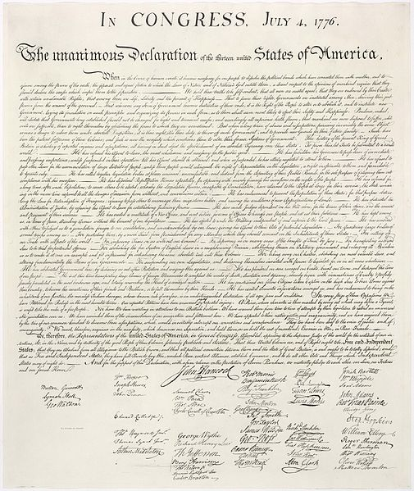
Display this copy of the Declaration of Independence.
Declaration of Independence Activity: Option 1
Notes:
This sample is an activity from Lesson 2 of our U.S. History curriculum for grades 3-5. In Lesson 2, students investigate the Causes of the American Revolution.
In the curriculum there is a detailed lesson plan, additional scaffold supports, and a slide deck for use in the classroom. Here, you see the Students Handout that accompanies the Declaration of Independence investigation.
We use several strategies in this activity to make the Declaration of Independence accessible to young learners.
Viewing the DoI like art: You can see at the bottom of the Handout, students are participating in a see, think, wonder activity. The first step of accessing the primary source is just looking at it like a piece of art. This removes the barrier of needing to read the text which is beyond their level at this age.
Scaffolding: The see, think, wonder activity is scaffolded with additional prompts so that students have additional support to engage with the document.

Slide 25
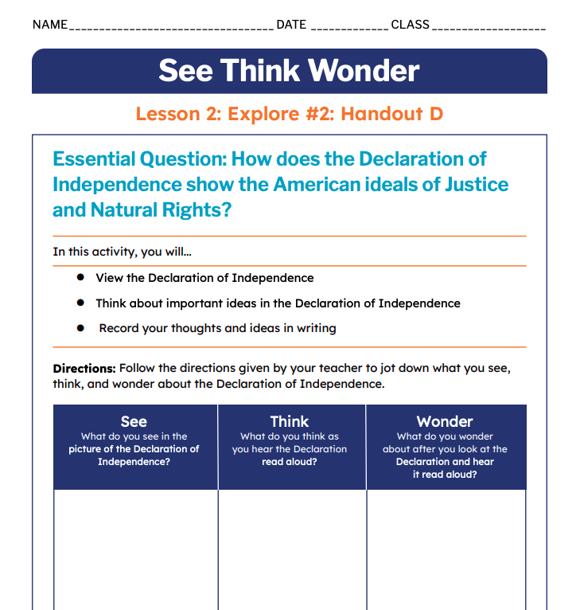
Distribute Handout D: See Think Wonder
Handout D

Slide 26
Fill in the “See” Column in Handout DD:
What do you think the Founders are trying to say by capitalizing “In Congress”?
Why is it significant that the document is “unanimous”?

Slide 27
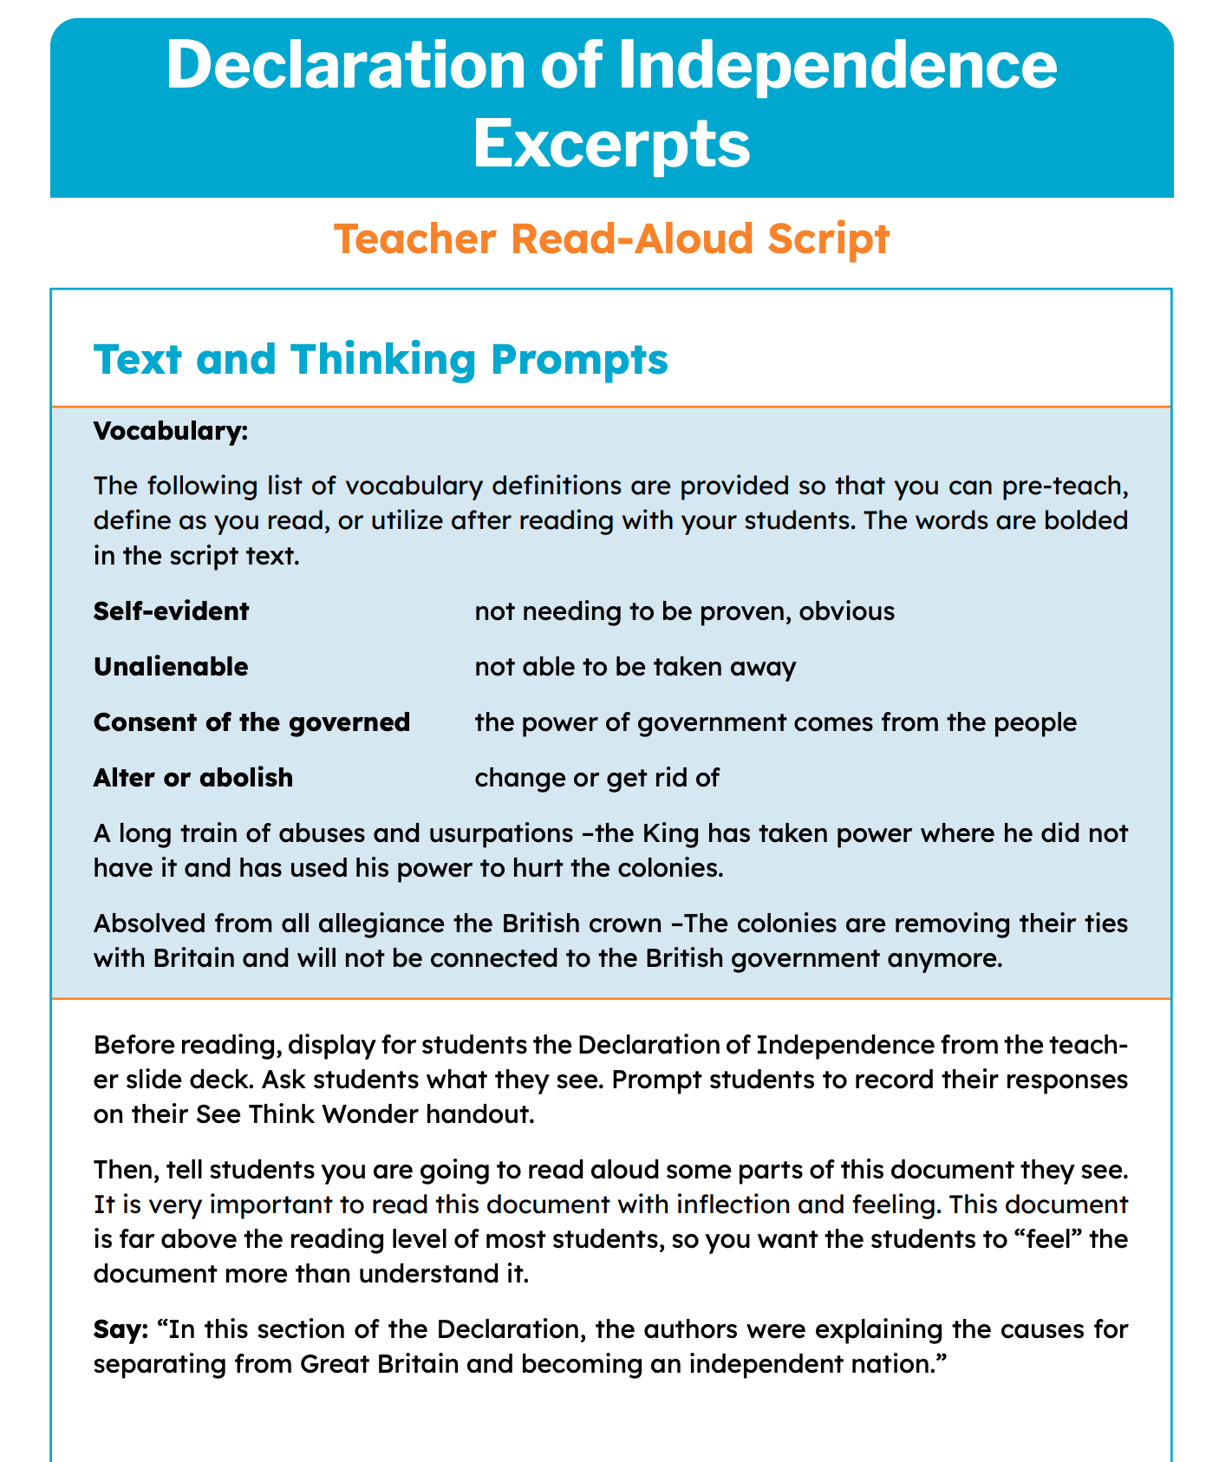
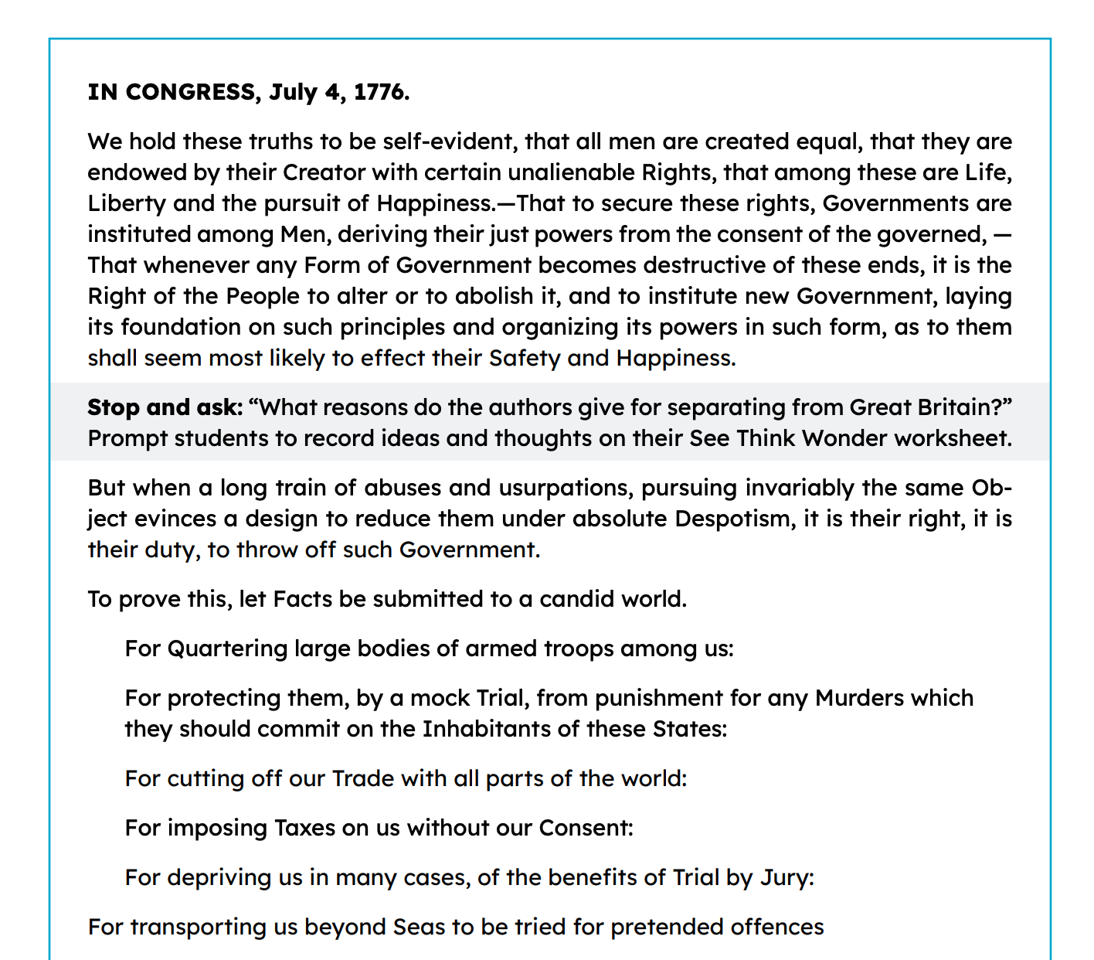
As we read aloud from this version, write your answers to each question in the chat:
Declaration of Independence
Notes:
Read-aloud: After viewing the DoI, students hear excerpts read-aloud by the teacher. Students may not be able to read the declaration, but they understand more than they can read. Students typically can understand texts read aloud at 2 to 3 grade levels above their reading level. In the Lesson Plan, teachers are prompted to read aloud the excerpts with "as much feeling and excitement as they can muster!" So that students can "feel" the meaning of the document, even if they don't entirely understand it. Another idea is to create or source recordings of historical documents. Imagine students listening to an FDR Fireside chat while learning about the Great Depression.
Vocabulary supports: You can see in the shaded vocabulary box that definitions are provided so you can pre-teach, define as you read, or answer questions from your students about the unfamiliar words in the declaration.

Slide 28
Whole Group Discussion Questions
Why does this document include a long list of grievances?
What section do you think is the most important? Why?
Where are natural rights discussed in the document?
How does the idea of justice show up in the Declaration of Independence?

Slide 29
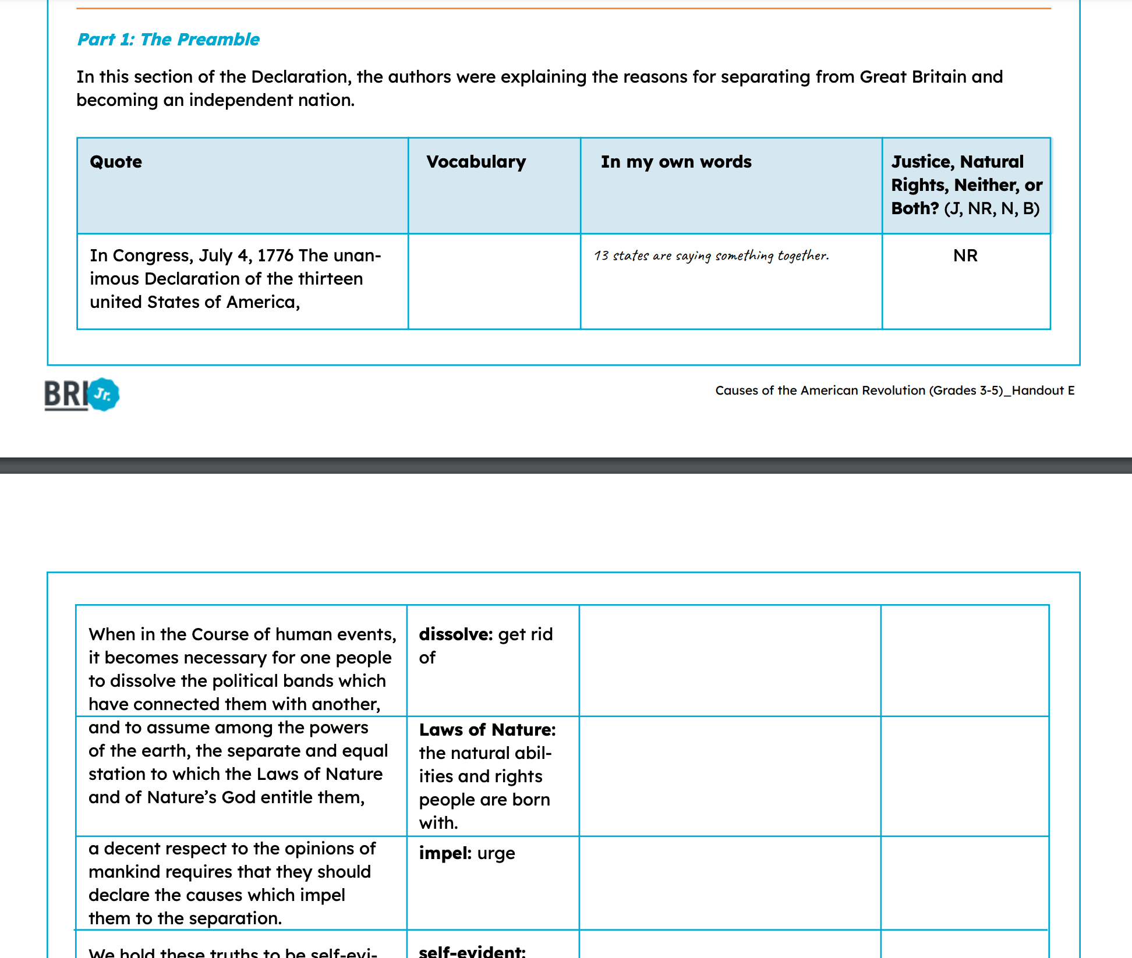
Strategies: 1. "Chunking" 2. Vocabulary support 3. Interaction through questioning
Declaration of Independence Activity-Option 2
Notes:
You could do nothing but look at the Declaration of Independence or read is aloud to your students and pat yourself on the back for a job well done. Seriously! You students HAVE interacted with a primary source document. I think sometimes we over complicate primary sources for young learners.
If you wanted to go a step further and allow your students to interact with the text, these are some strategies for you:
Chunking- dividing the text into "chunks" so that students can more easily interact with smaller sections.
Vocabulary support- we define the tricky terms right next to the text, rather than having a vocabulary box.
Interaction through questioning- Remember how we discussed students being wired for investigation and exploration? This gives them a structured way to do that so they don't get overwhelmed and give up.

Slide 30
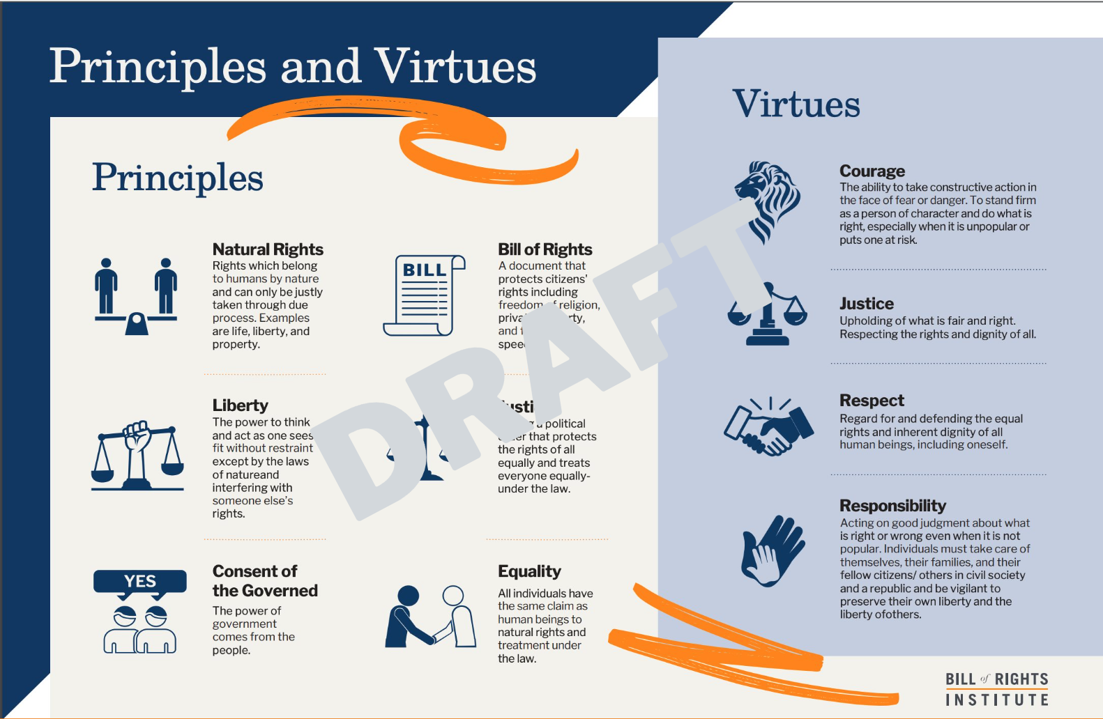
The principle and virtue for this lesson are highlighted in this activity.
Principles and Virtues
Notes:
Do you remember the Principles and Virtues I showed you earlier? I told you we would come back to them. This shows one way that big ideas like justice and natural rights can be scaled down for young learners.
In this activity, students "decode" the declaration in their own words and then assign a principle or virtue, if it applies.
Does anyone use character education programs in their schools that might be able to use something like this? Imagine your principles face when you are hitting literacy, social studies, and character education with one activity!

Slide 31
Write a short answer to the following questions in the Chat:
Develop a claim that answers the supporting question, “How does the Declaration of Independence show the American ideals of justice and natural rights?” In your response, include evidence from the sources you investigated.

Slide 32
Sample Exemplar
The Declaration of Independence shows justice because it complains that the King was imposing taxes on them without their consent. The Declaration of Independence shows the ideal of natural rights because it states that “all men are created equal” and that they have the unalienable rights of life, liberty and the pursuit of happiness.

Slide 33
A
Q

Slide 34
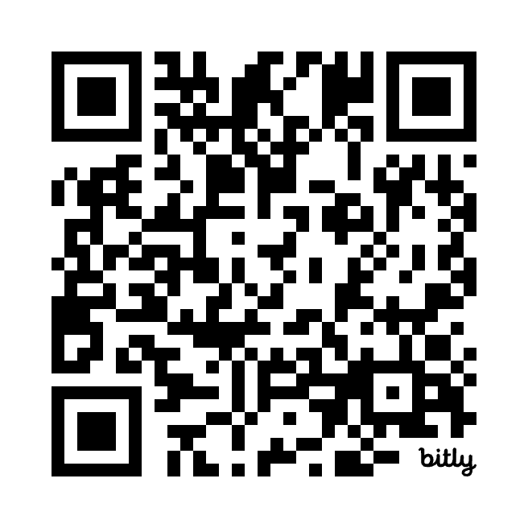
https://bit.ly/3z14ctG

Slide 35
Join our Newsletter to know when 3-5 resources arrive: https://bit.ly/3VBINif

