Slide 1
Elementary Focus: Healthy Integration
Kentucky Academic Standards (KAS) for Social Studies and the KAS for Reading and Writing
Notes:
Guiding Notes:
The following resources are part of this module:
KAS for Social Studies: https://education.ky.gov/curriculum/standards/kyacadstand/Documents/Kentucky_Academic_Standards_for_Social_Studies.pdf
KAS for Reading and Writing: https://education.ky.gov/curriculum/standards/kyacadstand/Documents/Kentucky_Academic_Standards_Reading_and_Writing.pdf
Duke, Nell K. (2019). Speaking up for Science and Social Studies [video]. Retrieved from https://www.youtube.com/watch?v=LAWO2lvAnjI&feature=emb_logo.
Council of Chief State School Officers. (2023). Effective Social Studies Integration in Elementary Classrooms. https://753a0706.flowpaper.com/CCSSOSocialStudiesIntegrationInfographic053023/
Council of Chief State School Officers. (2018). The Marginalization of Social Studies [infographic]. Retrieved from https://ccsso.org/sites/default/files/2018-11/Elementary%20SS%20Brief%2045%20Minute%20Version_0.pdf.
Section B Learning Guide: Why Teach Social Studies?: https://education.ky.gov/curriculum/standards/kyacadstand/Documents/Module_4_Section_B_Learning_Guide_Why_Teach_Social_Studies.docx
The Teaching Channel. (2019). Just the Facts: A Social Studies Lesson. Retrieved from https://learn.teachingchannel.com/video/teaching-facts-sfusd. Note: Participants will need to create an account to log in.
Social Studies Assignment Review Protocol: https://education.ky.gov/curriculum/standards/kyacadstand/Documents/Social_Studies_Assignment_Review_Protocol.docx
Social Studies Student Assignment Library: https://kystandards.org/standards-resources/sal/ss_sal/
Reading and Writing Student Assignment Library: https://kystandards.org/standards-resources/sal/rw_sal/
Assignment Review Protocol: Reading and Writing Module: https://sway.office.com/2kcaF3MuFTxHJkQN?ref=Link
Kindergarten Integration Collection: https://www.education.ky.gov/_layouts/download.aspx?SourceUrl=/curriculum/standards/kyacadstand/Documents/Kindergarten_Collection.docx
Grade 3 Integration Collection: https://www.education.ky.gov/_layouts/download.aspx?SourceUrl=//curriculum/standards/kyacadstand/Documents/Grade_3_Collection.docx
Grade 5 Integration Collection: https://www.education.ky.gov/_layouts/download.aspx?SourceUrl=//curriculum/standards/kyacadstand/Documents/Grade_5_Collection.docx
Grade 5 Social Studies Assignment Example: https://www.education.ky.gov/_layouts/download.aspx?SourceUrl=//curriculum/standards/kyacadstand/Documents/Grade_5_Is_it_healthy_stealthy_or_fractured_example.docx
Grade 5 Social Studies Assignment Review Protocol Example: https://www.education.ky.gov/_layouts/download.aspx?SourceUrl=//curriculum/standards/kyacadstand/Documents/Module_4_Section_F_Assignment_Review_Protocol_Example_Grade_5.docx
Goals:
The goals of the Elementary Focus: Healthy Integration of the Kentucky Academic Standards (KAS) for Social Studies and the Kentucky Academic Standards (KAS) for Reading and Writing Module are for districts and schools to:
Engage with the KAS for Social Studies and the KAS for Reading and Writing.
Answer the question, “Why teach social studies?”
Learn how to incorporate healthy integration between the KAS for Social Studies and the KAS for Reading and Writing while maintaining discipline integrity
Explore examples of healthy integration between the KAS for Social Studies and the KAS for Reading and Writing.
Intended Audiences:
Participants
Module participants may include, but are not limited to, district leadership, school administrators, instructional specialists/coaches, intervention specialists, department chairs, special educators and classroom teachers.
It is important to note that it is recommended that participants have engaged with the following modules prior to engaging with this module:
Getting to know the Kentucky Academic Standards (KAS) for Social Studies Module
Getting to know the Kentucky Academic Standards (KAS) for Reading and Writing Module
Facilitators:
While this module series is designed for a teacher to engage with individually, it may be implemented with a group of educators led by a facilitator. If this module is being completed as a group, facilitators may include, but are not limited to, district leaders, school administrators, instructional specialists/coaches, intervention specialists, department chairs, special educators, and classroom teachers. Facilitators may need to revise specific tasks in order to meet the needs of the participants or to be respectful of the time planned within the work session. As stated above, the Kentucky Department of Education (KDE) recommends that participants engage with the two modules mentioned above prior to engaging with this work. If the facilitator has not engaged with these modules, it is recommended that they complete the four modules mentioned before facilitating this module.
Helpful Hint for Facilitators:
The learning that will take place in this module may cause Kentucky educators to face changes in instructional practices amidst this transition. It is important to realize that while you are the facilitator of these work sessions, you may not have all the answers to the questions asked by participants, and that is okay. Throughout the module, participants may have questions that will be addressed in future work sessions. When that happens, reflect on this quote from Graham Fletcher, “Every teachable moment doesn’t need to be a teachable moment in that moment.” Use these moments to encourage participants to attend future work sessions where those questions will be addressed. If participants ask questions you are not prepared to answer, offer to follow up on that during the next work session.
Planning Ahead for Facilitators:
Determine which stakeholders to invite as participants. In the invitation, describe how the work sessions will benefit them.
A few days before the meeting, you may want to remind participants to be prepared to have their documents available during the meeting. (See below for Participant Documents Needed.
Reserve adequate space and equipment. Tables or desks should be set up to support small-group discussion. If conducting this module virtually, ensure that your technology platform can support break out rooms to support small group collaboration.
Ensure that participants have access to the Internet.
Consider how you might handle participants who may not be in attendance at all work sessions. It might be worthwhile to consider how those participants might access missed sections of the module between work sessions in order to feel as prepared as the other participants.
Guiding Notes
Guiding notes are provided in the Notes section of the PowerPoint to support your learning. The information provided in the Notes section includes additional information, directions for the activities on the slide, and citations of used resources, where appropriate. It is critical that you read the material presented in the Notes section to ensure that you are acquiring the important knowledge, skills and understanding required when engaging with this module.
Virtual Training Note:
If you plan to engage with this module virtually as a group, consider directing participants to the Professional Learning Modules page so that you may access the resources used directly from the links provided in the PowerPoint: https://kystandards.org/standards-resources/ss-resources/ss-pl-modules/
Additionally, you may consider downloading the resources contained within each section of the module and placing them into a Google folder for you or your colleagues to access.

Slide 2
Elementary Focus: Healthy Integration
Section A: Introduction

Slide 3
Overview of this module:
Section A: Introduction
Section B: Why teach social studies?
Section C: What is healthy integration?
Section D: How do I integrate social studies and reading and writing?
Section E: Case studies in healthy integration
Section F: Is it healthy, stealthy or fractured?
Section G: Application: Designing a healthy integration collection
Section H: Reflection
Notes:
Guiding Notes:
This slide provides an overview the sections included in this module.

Slide 4
Goals of this Module:
Engage with the Kentucky Academic Standards (KAS) for Social Studies and the Kentucky Academic Standards (KAS) for Reading and Writing.
Answer the question, “Why teach social studies?”
Learn how to incorporate healthy integration between the KAS for Social Studies and the KAS for Reading and Writing while maintaining discipline integrity
Explore examples of healthy integration between the KAS for Social Studies and the KAS for Reading and Writing.
Notes:
Guiding Notes:
The goals for this module are on this slide.

Slide 5
Compelling Question
How do I practice healthy integration between the KAS for Social Studies and the KAS for Reading and Writing in elementary school?
Notes:
Guiding Notes:
Section A of this module provides an overview of the definition of integration, why this work is important and caveats participants need to consider prior to engaging in this work. This compelling question will be answered by the end of the module.

Slide 6
What is integration?
“A purposeful teaching approach that draws on knowledge, skills, and methods of inquiry from multiple subject areas in addressing topics that have relevance to the world beyond school.”
National Council for the Social Studies. (2015). Becoming Integrated Thinkers: Case Studies in Elementary Social Studies. USA: Bennett and Hinde (p. 10)
Notes:
Guiding Notes:
Read this slide and consider the following:
What are some key words or phrases found in this definition?
How does this definition of integration align with your understanding of the term?
What are the possible implications for teaching and learning based on this definition?

Slide 7
Why is this work important?
“Effective integration can enhance school learning in ways that teaching subjects in isolation cannot.”
In the real world, people try to understand or solve a problem or make an informed decision using the information available. This generally requires operating within and beyond disciplinary boundaries.
National Council for the Social Studies. (2015). Becoming Integrated Thinkers: Case Studies in Elementary Social Studies. USA: Bennett and Hinde
Notes:
Guiding Notes:
This slide explains why integration is important and how the use of this teaching practice provides learning experiences that more closely reflect how students experience the disciplines in their everyday lives. As stated in the second bullet point, accessing what we know and then connecting that knowledge to other knowledge is common practice and automatic in our everyday lives. So much so that we do it without even realizing it. For example, even a seemingly simple task like determining what time to leave home in order to make it to work on time requires operating within and across disciplines. You must a) know the location of the destination and the appropriate route to take to get there (geography), b) know or determine the distance to the destination and convert that to an amount of time it will take to drive there (math skill), c) know and be able to tell time and calculate elapsed time (more math skills), d) take into account the traffic patterns for the time of the commute (engineering skills), and e) consider any evidence collected over time that would indicate a need to adjust the departure time due to frequently running late or often needing to stop for food or gas (history). Clearly, integration is prevalent and necessary in this real world example. When teachers apply an integrated teaching approach, students are given opportunities to engage in the same process. They are able to draw on their knowledge of various disciplines to maximize their learning in school as well as maximize application of that learning outside of school to make sense of the world around them.

Slide 8
Caveats
Prior to engaging with this work, the following should be considered:
Participants must have a good understanding of both the Kentucky Academic Standards (KAS) for Social Studies and the Kentucky Academic Standards (KAS) for Reading and Writing.
This includes, but is not limited to, participants completing the Getting to Know the KAS modules for both disciplines.
Participants must be able to evaluate and/or construct strongly aligned assignments to the KAS for Social Studies and the KAS for Reading and Writing.
Participants must be able to allow students to engage and appreciate the uniqueness of the disciplines of social studies and reading and writing to ensure discipline integrity when engaging in this work.
Notes:
Guiding Notes:
Read the caveats provided on this slide and engage in self-reflection to determine whether or not you are truly ready to engage in this work. Designing healthy integration aligned to the KAS for Social Studies and the KAS for Reading and Writing requires that participants:
have a good understanding of both standards documents
have completed the Getting to Know the KAS modules for both disciplines
can evaluate and/or construct strongly aligned assignments to both the KAS for Social Studies and the KAS for Reading and Writing
Having this foundational knowledge will enable you to provide students the opportunity to engage with and appreciate the uniqueness of the disciplines of social studies and reading and writing to ensure discipline integrity when engaging in this work. If you determine you are not ready to complete this work, visit www.kystandards.org to access the materials needed to address the areas where you might need more support prior to engaging with this module. Additional guidance to support participant learning can be found in the Social Studies Implementation Guide: https://education.ky.gov/curriculum/standards/kyacadstand/Documents/Standards_Implementation_Guidance_Document_Social_Studies.pdf

Slide 9
Warm-Up/Reflection
Prior to beginning this work, consider the following questions:
What is your “why”? Why are you interested in learning about healthy integration?
Review the caveats on the previous slide. Are you ready to engage in this work?
What are you excited to learn?
Notes:
Guiding Notes:
Engage in a self-reflection after completing Section A by responding to the questions on the slide.

Slide 10
Coming Up
Section B: Why teach social studies?
Section C: What is healthy integration?
Section D: How do I integrate social studies and reading and writing?
Section E: Case studies in healthy integration
Section F: Is it healthy, stealthy or fractured?
Section G: Application: Designing a healthy integration collection
Section H: Reflection
Notes:
Guiding notes:
This slide provides a preview of the additional contents of this module.
The KDE needs your feedback on the effectiveness of this module, the learning platform and how the consultants may best support you as you take the next steps in the implementation process. Complete a short survey to share our thinking and provide them with feedback on how the KDE can best meet our needs. Feedback from our surveys will be used by the KDE to plan and prepare future professional learning.
Post-survey: https://forms.gle/NU6gc7j69WrHSa9u5

Slide 11
Elementary Focus: Healthy Integration
Section B: Why teach social studies?
Notes:
Guiding Notes:
Materials needed for this section entitled, “Why teach social studies?”:
this module: Section B: “Why teach social studies?” Learning Guide
Duke, Nell K. (2019). Speaking up for Science and Social Studies [video]. https://www.youtube.com/watch?v=LAWO2lvAnjI&feature=emb_logo.
Council of Chief State School Officers. (2018). The Marginalization of Social Studies [infographic]. https://ccsso.org/sites/default/files/2018-11/Elementary%20SS%20Brief%2045%20Minute%20Version_0.pdf.

Slide 12
Goals of this Module:
Engage with the Kentucky Academic Standards (KAS) for Social Studies and the Kentucky Academic Standards (KAS) for Reading and Writing.
Answer the question, “Why teach social studies?”
Learn how to incorporate healthy integration between the KAS for Social Studies and the KAS for Reading and Writing while maintaining discipline integrity
Explore examples of healthy integration between the KAS for Social Studies and the KAS for Reading and Writing.
Notes:
Guiding Notes:
The goals for this module are on this slide.

Slide 13
Compelling Question
How do I practice healthy integration between the KAS for Social Studies and the KAS for Reading and Writing in elementary school?
Notes:
Guiding Notes:
In this section, you will view and reflect on Nell Duke's video, "Speaking up for Science and Social Studies" and view and discuss the "Marginalization of Social Studies" infographic. This compelling question will be answered by the end of the module.

Slide 14
Warm Up:
Access Section B: “Why teach social studies?” Learning Guide to record your responses during this section.
Directions: Read the text below. Then use drawing and/or writing to explain who the batsmen and bowlers are and what they are doing.
The batsmen were merciless against the bowlers. The bowlers placed their men in slips and covers. But to no avail. The batsmen hit one four after another with an occasional six. Not once did a ball look like it would hit their stumps or be caught.
(Tierney & Pearson, 1981)
Notes:
Guiding Notes:
Access the document linked on the slide in order to record your response to this passage.
This passage is designed to show that while you may be able to read the words on the screen, you may need additional content or background knowledge in order to fully understand the passage. It is important to consider how this experience translates to students in the classroom. Are there times when students may be able to read a passage but not be able to comprehend it because they do not have enough content knowledge?

Slide 15
Why teach social studies?
As you watch the video, complete the Speaking Up for Science and Social Studies reflection questions on the learning guide sheet provided.
Duke, Nell K. (2019). Speaking up for Science and Social Studies [video]. https://www.youtube.com/watch?v=LAWO2lvAnjI&feature=emb_logo.
Notes:
Guiding Notes:
Watch the video in the three timed sections indicated on the learning guide provided. As you watch each section, answer the corresponding questions. Once you complete each section, discuss your answers with a shoulder partner if completing as a group, or consider individually.
Note: The Section B Learning Guide provides questions for the video entitled, “Speaking Up for Science and Social Studies.” The learning guide divides the video into three sections to allow for participants to reflect on the content of each section. While the entire video is necessary to capture Nell Duke’s argument for the importance of including effective social studies instruction, you may decide to break the video into sections to watch at different times.
Duke, Nell K. (2019). Speaking up for Science and Social Studies [video]. https://www.youtube.com/watch?v=LAWO2lvAnjI&feature=emb_logo.

Slide 16
Why teach social studies? Part One
As you watch the video until 9:18, answer the questions provided.
Notes:
Guiding Notes:
Answer the questions for Part One on the Section B Learning Guide. This section lasts until 9:18.

Slide 17
Why teach social studies?
Part One Reflection
Discuss your responses to the questions found in Part One for Speaking Up for Science and Social Studies.
Notes:
Guiding Notes:
If working in groups, discuss your responses to the questions found in Part One for Speaking Up for Science and Social Studies found on their Section B Learning Guide. Identify one major takeaway from this section.

Slide 18
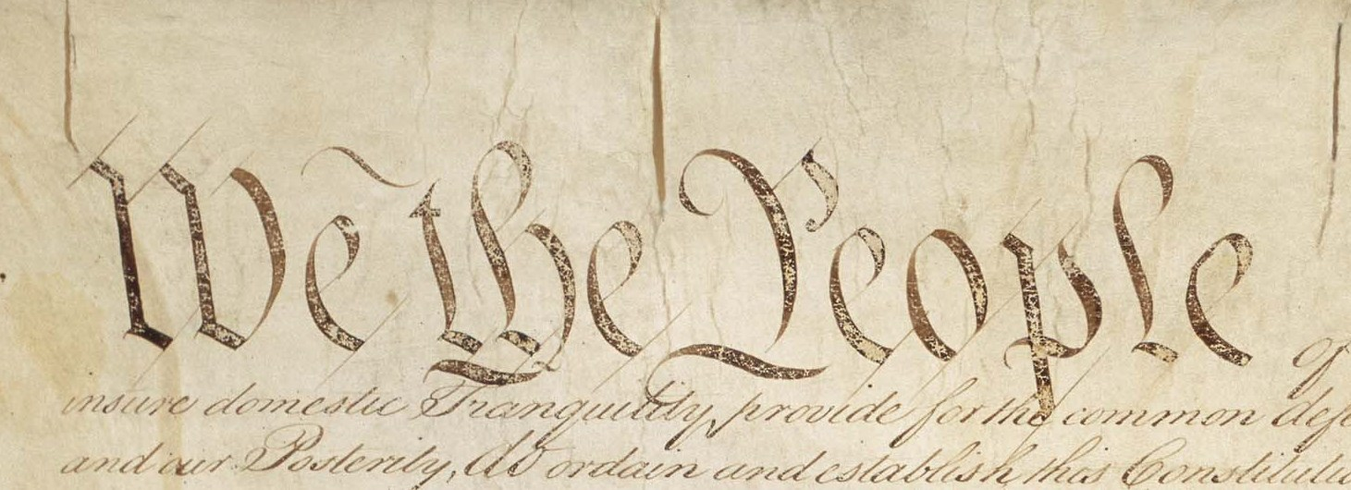
Why teach social studies? Part Two
As you watch the video from 9:18 to 20:22, answer the questions provided.
Notes:
Guiding Notes:
Answer the questions for Part Two on their Section B Learning Guide. This section lasts until 20:22.

Slide 19
Why teach social studies?
Part Two Reflection
Discuss your responses to the questions found in Part Two for Speaking Up for Science and Social Studies.
Notes:
Guiding Notes:
If working in groups, discuss your responses to the questions found in Part Two for Speaking Up for Science and Social Studies found on their Section B Learning Guide. Identify one major takeaway from this section.

Slide 20
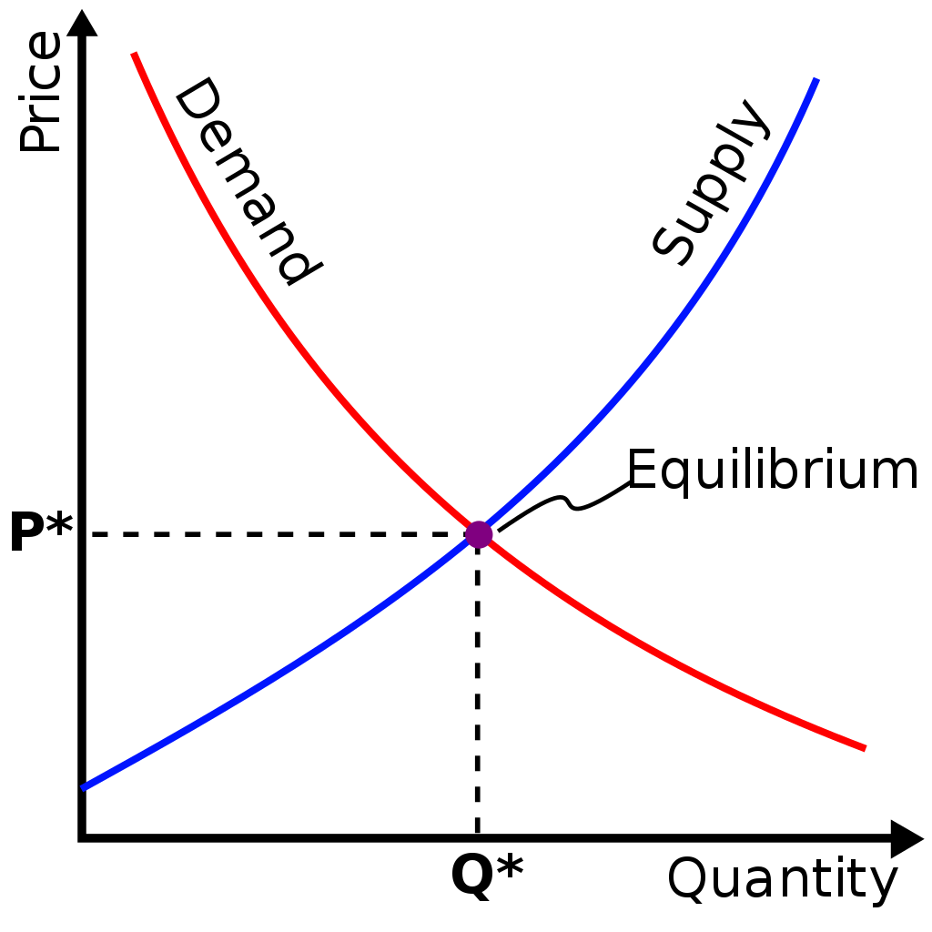
Why teach social studies?
Part Three
As you watch the remainder of the video, answer the questions provided.
Notes:
Guiding Notes:
Answer the questions for Part Three on their Section B Learning Guide.

Slide 21
Why teach social studies?
Part Three Reflection
Discuss your responses to the questions found in Part Three for Speaking Up for Science and Social Studies.
Notes:
Guiding Notes:
If working in a group, discuss your responses to the questions found in Part Three for Speaking Up for Science and Social Studies found on their Section B Learning Guide. Identify one major takeaway from this section.

Slide 22
The Marginalization of Social Studies
View the entire infographic: The Marginalization of Social Studies
Write down as much as you want in the time we have, but record at least one piece of information from the visual that includes a number.
Council of Chief State School Officers. (2018). The Marginalization of Social Studies [infographic]. https://ccsso.org/sites/default/files/2018-11/Elementary%20SS%20Brief%2045%20Minute%20Version_0.pdf.
Notes:
Guiding Notes:
Access the infographic via the link provided in the PowerPoint. Take 5 minutes to read the infographic. During this time, write down as much information as you want in the time we have, but record at least one piece of information from the visual that includes a number.
If working in a group, share a piece of information they wrote down or any additional information that may have resonated with them. Consider the following question: How does the Speaking Up for Science and Social Studies video support the information found in the marginalization infographic?
Council of Chief State School Officers. (2018). The Marginalization of Social Studies [infographic]. https://ccsso.org/sites/default/files/2018-11/Elementary%20SS%20Brief%2045%20Minute%20Version_0.pdf.

Slide 23
Discussion
What is the relationship between content knowledge and reading proficiency?
Why teach social studies?
What are the barriers to intentionally including social studies in the curriculum?
Notes:
Guiding Notes:
If working in a group, discuss the questions on the slide; otherwise consider individually. Record your responses on page 4 of the Section B Learning Guide.

Slide 24
Coming Up
Section C: What is healthy integration?
Section D: How do I integrate social studies and reading and writing?
Section E: Case studies in healthy integration
Section F: Is it healthy, stealthy or fractured?
Section G: Application: Designing a healthy integration collection
Section H: Reflection
Notes:
Guiding notes:
This slide provides a preview the additional contents of this module.
The KDE needs your feedback on the effectiveness of this module, the learning platform and how the consultants may best support you as you take the next steps in the implementation process. We are going to complete a short survey to share our thinking and provide them with feedback on how the KDE can best meet our needs. Feedback from our surveys will be used by the KDE to plan and prepare future professional learning.
Post-survey: https://forms.gle/NU6gc7j69WrHSa9u5

Slide 25
Elementary Focus: Healthy Integration
Section C: What is healthy integration?
Notes:
Guiding Notes:
Materials needed for this section entitled, “What is healthy integration?”:
The Teaching Channel. (2019). Just the Facts: A Social Studies Lesson. https://learn.teachingchannel.com/video/teaching-facts-sfusd.
Note: Participants will need to create an account to log in.

Slide 26
Goals of this Module:
Engage with the Kentucky Academic Standards (KAS) for Social Studies and the Kentucky Academic Standards (KAS) for Reading and Writing.
Answer the question, “Why teach social studies?”
Learn how to incorporate healthy integration between the KAS for Social Studies and the KAS for Reading and Writing while maintaining discipline integrity
Explore examples of healthy integration between the KAS for Social Studies and the KAS for Reading and Writing.
Notes:
Guiding Notes:
The goals for this module are on this slide.

Slide 27
Compelling Question
How do I practice healthy integration between the KAS for Social Studies and the KAS for Reading and Writing in elementary school?
Notes:
Guiding Notes:
Section C of this module defines healthy, stealthy and fractured integration. Teacher testimonials on fractured and stealthy integration are provided for participant reflection. Additionally, you will evaluate a “real-life” example of social studies and reading and writing in the classroom.
This compelling question will be answered by the end of the module.

Slide 28
What is healthy integration?
“Healthy integration of social studies helps students come to understand the world around them and other content areas. It renders social studies as the thread that ties the curriculum together and connects school learning to the world. They learn to use reading, writing, and mathematics as the tools by which they understand and communicate their understanding of the world.”
National Council for the Social Studies. (2015). Becoming Integrated Thinkers: Case Studies in Elementary Social Studies. USA: Bennett and Hinde
Notes:
Guiding Notes:
Read this slide and consider the following questions:
What are some key words or phrases found in this definition?
How does this definition of healthy integration align with your understanding of the term?
What are the possible implications for teaching and learning based on this definition?

Slide 29
What is healthy integration?
There are three “Common Manifestations of Curriculum Integration in Elementary Classrooms.” They are fractured, stealthy and healthy.
Fractured:
“Social studies is disconnected from a child’s life and the rest of the curriculum.”
“Small chunks of content area information relation to the weekly reading or language arts activities are presented to students without much depth.”
“The purpose of social studies is mainly to enhance reading/language arts…”
National Council for the Social Studies. (2015). Becoming Integrated Thinkers: Case Studies in Elementary Social Studies. USA: Bennett and Hinde
Notes:
Guiding Notes:
Read this slide to learn about fractured integration.

Slide 30
Testimonial
Reflect on this teacher’s experience as you watch this testimonial provided.
What characteristics of fractured integration did you hear in her experience?
Are there components of her story that resonate with you?
Notes:
Guiding Note:
Watch a teacher’s testimonial about her use of integration in the classroom. As you reflect on this teacher’s experience as you watch this testimonial, answer the following questions:
What characteristics of fractured integration did you hear in her experience?
Are there components of her story that resonate with you?
Transcript of Video: I taught 3rd grade for 15 years. Most of those years I was responsible for teaching all subjects in a self-contained classroom. I struggled. I struggled to get it all in - math, reading, writing, word study, science, social studies, intervention, F&Ps, handwriting, keyboarding, and even bully proofing lessons and probably a few other things I’m forgetting right now.
I was overwhelmed, but I had good intentions to get it all in. I wanted to. I tried. I subscribed to a current events magazine so that on Fridays during the reading block we could integrate social studies into language arts. I was also sure to plan a special activity or two around Black History Month, Election Day, Thanksgiving, or Martin Luther King, Jr. ’s Birthday. I saw those as opportunities to integrate social studies because otherwise, I didn’t have time to teach it.
I felt like I wasn’t doing Social Studies justice then, but I didn’t know that what I was doing had a name. Now, without a doubt, I know I was delivering fractured integration. The activities didn’t connect to one another or build upon previous learning or thinking or set students up for success with the next content they would learn. Because of that, my students weren’t given the chance to really learn social studies - certainly not at a deep level - and, the experiences I did give them weren’t connected to their lives outside of school.

Slide 31
What is healthy integration?
There are three “Common Manifestations of Curriculum Integration in Elementary Classrooms.” They are fractured, stealthy and healthy.
Stealthy:
“Disguises social studies content as language arts lessons.”
“Teacher chooses reading/language arts materials with rich spatial or historical content, but focuses on reading/language arts skills.”
National Council for the Social Studies. (2015). Becoming Integrated Thinkers: Case Studies in Elementary Social Studies. USA: Bennett and Hinde
Notes:
Guiding Notes:
Read this slide to learn about stealthy integration.

Slide 32
Testimonial
Reflect on this teacher’s experience as you watch this testimonial provided.
What characteristics of fractured integration did you hear in her experience?
Are there components of her story that resonate with you?
Notes:
Guiding Notes:
Watch another teacher’s testimonial about her use of integration in the classroom. As you reflect on this teacher’s experience as you watch this testimonial, answer the following questions:
What characteristics of stealthy integration did you hear in her experience?
Are there components of her story that resonate with you?
Transcript of Video: When I taught in a self-contained classroom, where I felt a lot of pressure on reading assessment, my instruction often fell into the “stealthy” category. I loved social studies and felt it was important to present the content any way I could fit it in. As a result, I tried to incorporate it into my reading block. I selected texts that were grade level appropriate and related to content that was aligned to our grade level social studies standards. My social studies lesson was disguised as a reading lesson. Even though students were learning appropriate content, the true focus was on reading skills, and students were really being assessed on these reading skills, not the social studies skills. Further, the lack of a connection to students’ lives was a missed opportunity for students to engage in inquiry.
Later, when I was departmentalized and only responsible for teaching social studies, I attempted to integrate my instruction with reading and writing by incorporating a variety of picture books and chapter books as a hook, and a variety of other text sources related to the content, but my instruction continued to be stealthy, now for the opposite reason as before. I was utilizing rich texts that were grade level appropriate and challenging, but I was only focused on the social studies content and skills. There were many missed opportunities to address reading and writing standards and skills while engaging with these texts. Integrating the contents in a healthy way is more engaging and beneficial for students, and looking back, I could have really focused on both content areas to do them both justice within my instruction in order to move my stealthy integration to healthy.

Slide 33
What is healthy integration?
There are three “Common Manifestations of Curriculum Integration in Elementary Classrooms.” They are fractured, stealthy and healthy.
Healthy:
“The connection of social studies to children’s lives and other content areas is explicit and clear to students.”
“Reading/language arts are recognized as tools for helping children to come to an understanding of the world (and how to communicate that understanding) and are not considered the purpose of schooling.”
National Council for the Social Studies. (2015). Becoming Integrated Thinkers: Case Studies in Elementary Social Studies. USA: Bennett and Hinde (p. 25)
Notes:
Guiding Notes:
Read this slide to learn about healthy integration.

Slide 34
Application
Watch this video of a Grade 5 lesson and answer the questions on the following slide.
Georgia Department of Education. (2020, March 30). Everyday Inquiry in K-5 Social Studies: 5th Grade - Presidential Advisors: Should We Go to War? https://www.youtube.com/watch?v=ME5BeiCWTDM&t=248s
Notes:
Guiding Notes:
Watch this video of a Grade 5 lesson and answer the questions on the slide that follows.
Georgia Department of Education. (2020, March 30). Everyday Inquiry in K-5 Social Studies: 5th Grade - Presidential Advisors: Should We Go to War? https://www.youtube.com/watch?v=ME5BeiCWTDM&t=248s

Slide 35
Application
Based on what you’ve learned so far, what characteristics of fractured, stealthy or healthy integration of social studies and reading and writing are found in this example? Support your response with evidence from the video.
How are students using their reading and writing skills within the social studies lesson? Explain.
What evidence of prior learning is evident in this lesson?
How are the students operating within and beyond the disciplines of social studies and reading and writing?
What questions do you have about the teacher’s instructional decisions and/or student learning?
Notes:
Guiding Notes:
Respond to the questions on the slide, based on the Grade 5 lesson video. It is important to note that this lesson is NOT aligned to the KAS for Social Studies, so the focus should not be on standards alignment, but the integration of reading and writing and social studies content and skills.
The video is provided to participants so that they may evaluate a “real-life” example for any evidence of integration between social studies and reading and writing. This video is merely an example. It is not a requirement nor a suggestion for school curriculum. While the Kentucky Department of Education (KDE) is responsible for the development of high-quality academic standards, state law assigns each local district the authority to develop the school’s curriculum and determine appropriate instructional resources based on language found in Kentucky Revised Statute (KRS) 160.345. It is under the discretion of the superintendent to determine the local curriculum, including the evaluation and selection of instructional resources. The KDE does not adopt, select or recommend specific curricula for coursework. Per KRS 160.345(g), “the local superintendent shall determine which curriculum, textbooks, instructional materials, and student support services shall be provided in the school after consulting with the local board of education, the school principal, and the school council and after a reasonable review and response period for stakeholders in accordance with local board of education policy.”

Slide 36
Coming Up
Section D: How do I integrate social studies and reading and writing?
Section E: How is healthy integration designed?
Section F: Case studies in healthy integration
Section G: Is it healthy, stealthy or fractured?
Section H: Application: Designing a healthy integration collection
Section I: Reflection
Notes:
Guiding notes:
This slide shows a preview of the upcoming sections.
The KDE needs your feedback on the effectiveness of this module, the learning platform and how the consultants may best support you as you take the next steps in the implementation process. We are going to complete a short survey to share our thinking and provide them with feedback on how the KDE can best meet our needs. Feedback from our surveys will be used by the KDE to plan and prepare future professional learning.
Post-survey: https://forms.gle/NU6gc7j69WrHSa9u5

Slide 37
Elementary Focus: Healthy Integration
Section F: How do I integrate social studies and reading and writing?
Notes:
Guiding Notes:
Materials needed for this section entitled, “How do I integrate social studies and reading and writing?”:
KAS for Social Studies: https://education.ky.gov/curriculum/standards/kyacadstand/Documents/Kentucky_Academic_Standards_for_Social_Studies.pdf
KAS for Reading and Writing: https://education.ky.gov/curriculum/standards/kyacadstand/Documents/Kentucky_Academic_Standards_Reading_and_Writing.pdf

Slide 38
Goals of this Module:
Engage with the Kentucky Academic Standards (KAS) for Social Studies and the Kentucky Academic Standards (KAS) for Reading and Writing
Answer the question, “Why teach social studies?”
Learn how to incorporate healthy integration between the KAS for Social Studies and the KAS for Reading and Writing while maintaining discipline integrity
Explore examples of healthy integration between the KAS for Social Studies and the KAS for Reading and Writing.
Notes:
Guiding Notes:
The goals for this module are on this slide.

Slide 39
Compelling Question
How do I practice healthy integration between the KAS for Social Studies and the KAS for Reading and Writing in elementary school?
Notes:
Guiding Notes:
This section of the module explains the steps for designing healthy integration and explains the design using the Grade 3 integrated collection example. This compelling question will be answered by the end of the module. Read the question on the slide.

Slide 40
Introduction
Social studies provides a compelling context for teaching reading and writing. Thus, it is important to design healthy integration connected to a compelling question that is aligned to the KAS for Social Studies.
The compelling question provides the compelling context for this work.
The compelling question is investigated through a supporting question.
The compelling and supporting questions are investigated through KAS for Social Studies and KAS for Reading and Writing strongly aligned assignments
Notes:
Guiding Notes:
It is important to activate the knowledge learned in the video Speaking Up for Science and Social Studies from earlier in the module. In the video, Dr. Duke states that social studies provides a compelling context for teaching reading and writing. When aligning this concept to the KAS for Social Studies, the compelling context is articulated by a standards-aligned compelling question. The KAS for Social Studies outlines grade level K-8 and high school grade band questioning standards. Thus, it is critical that participants understand and can identify and compose standards-aligned compelling questions prior to engaging in this work. Additionally, it is compelling that participants understand the relationship between compelling and supporting questions and how supporting questions drive the investigation of the disciplinary strands (civics, economics, geography and history) outlined in the KAS for Social Studies.

Slide 41
Questioning
Compelling questions are open-ended, enduring and center on significant unresolved issues.
Focus on “big ideas”
Are intellectually challenging
Generate interest
Allow for multiple perspectives
Can be answered in a variety of ways
Inspire investigation through the discipline strands
Notes:
Guiding Notes:
The KAS for Social Studies is organized around the inquiry practices of questioning, investigating, using evidence and communicating conclusions. Students will consider or pose questions and then investigate those questions through the disciplinary lenses of civics, economics, geography and history. Within the inquiry practice of questioning, there are two types of questions: compelling and supporting.

Slide 42
Questioning
Supporting questions:
These questions support the compelling question by asking more focused questions.
These can be answered through use of the concepts and practices of each social studies discipline (civics, economics, geography and history).
The supporting question drives the investigation of the compelling question.
Notes:
Guiding Notes:
Supporting questions support the compelling question by asking more focused questions. These can be answered through use of the concepts and practices of each social studies discipline. Supporting questions should provide students with knowledge that they can synthesize to answer the larger compelling question.

Slide 43
An example:
Compelling Question: What unites Americans?
Supporting Question examples:
Why did the British Parliament raise taxes on the colonists?
What actions taken by the British Parliament angered the colonists?
How do the founding documents establish the principles of the federal government?
Notes:
Guiding Notes:
Use this slide to practice exploring the connection between a compelling question and supporting questions.
Note: The example provided is an example modified from the KAS for Social Studies for Grade 5 and can be found on pages 84 and 85. A question such as “What unites Americans?” is compelling because it focuses on “big ideas,” allows for multiple perspectives and can be answered in a variety of ways, among other characteristics. Students could revisit this question over multiple units or multiple years of study because it aligns with the characteristics of a compelling question.
The supporting questions are supporting because they are more focused, discipline specific and the answers to these questions can be synthesized to answer the larger compelling question. The first question listed could be identified as a supporting question aligned to the economics disciplinary strand in the KAS for Social Studies for Grade 5; the second question listed could be identified as a supporting question aligned to the history disciplinary strand in the KAS for Social Studies for Grade 5; and the third question listed could be identified as a supporting question aligned to the civics disciplinary strand in the KAS for Social Studies for Grade 5.
It is important to note that when crafting supporting questions for compelling questions, the supporting questions must be aligned to the compelling question to help build the knowledge required to answer the compelling question. For example, a question such as “What doesn’t unite Americans?” is not a supporting question for the compelling question of “What unites Americans?” because it requires students to construct knowledge that does not answer the compelling question.

Slide 44
Application: Can you identify compelling and supporting questions?
What is the purpose of rules and laws in Kentucky?
What unites Americans?
How have cultural groups in the past and today shaped Mexico?
What makes a community healthy?
How did enslaved Africans resist?
Why did the colonists demand no taxation without representation?
How does a government compromise amidst polarization?
How do complex societies develop?
Notes:
Guiding Notes:
When designing healthy integration, your standards-aligned compelling question becomes the compelling context for integrating social studies and reading and writing. Thus, it is critical that participants be able to distinguish between the two types of questions outlined in the KAS for Social Studies. Thus, have the participants engage in this activity to see if they can distinguish between the two types of questions found in the KAS for Social Studies.
Individually or with a partner, identify which of the questions on the slide are compelling questions.
Note: On this slide, there are four questions that meet the characteristics of a compelling question. They are:
What unites Americans?
What makes a community healthy?
How does a government compromise amidst polarization?
How do complex societies develop?
When addressing why these questions are compelling, evaluate these questions based on the characteristics provided. It is important to note that just because a question is “big” or contains a lot of content (such as “How have cultural groups in the past and today shaped Mexico?”), it does not mean that the question is compelling.
Additionally, it is important to note that these question examples can be found in the assignments found in the Social Studies Student Assignment Library on www.kystandards.org.

Slide 45
Application: Can you identify compelling and supporting questions?
What is the purpose of rules and laws in Kentucky?
What unites Americans?
How have cultural groups in the past and today shaped Mexico?
What makes a community healthy?
How did enslaved Africans resist?
Why did the colonists demand no taxation without representation?
How does a government compromise amidst polarization?
How do complex societies develop?
Notes:
Guiding Notes:
When designing healthy integration, your standards-aligned compelling question becomes the compelling context for integrating social studies and reading and writing. Thus, it is critical that you are able to distinguish between the two types of questions outlined in the KAS for Social Studies.
The highlighted questions on this slide are the compelling questions because they meet the characteristics identified on a previous slide.

Slide 46
Getting Started
Gathering Resources:
Knowledge of the architectures of the KAS for Social Studies and the KAS for Reading and Writing
KAS for Social Studies
KAS for Reading and Writing
An understanding of your grade level topic in order to understand the function of compelling and supporting questions
Text sources rich in social studies content and aligned with standards in both areas
Notes:
Guiding Notes:
Read the slide. Access the following:
KAS for Social Studies: https://education.ky.gov/curriculum/standards/kyacadstand/Documents/Kentucky_Academic_Standards_for_Social_Studies.pdf
KAS for Reading and Writing: https://education.ky.gov/curriculum/standards/kyacadstand/Documents/Kentucky_Academic_Standards_Reading_and_Writing.pdf

Slide 47
Getting Started
Developing Mindset:
As healthy integration is designed, it is imperative that the integrity of instruction in these disciplines is not sacrificed.
When integrating social studies and reading and writing, it is imperative that students are engaging in the content and the skills of each discipline so that students can gain an appreciation of the uniqueness of each discipline.
Both disciplines are unique and provide a discipline specific way of studying content and applying skills. For integration to truly be healthy, students must engage with assignments that require demonstrating their mastery of the standards for each discipline. To not fully engage with the uniqueness of each discipline could result in fractured or stealthy integration.
Notes:
Guiding Note:
In the examples provided, one supporting question is used that is aligned to a compelling question. However, students may need to engage with more than one supporting question in order to fully engage with a compelling question.
To further develop your understanding of maintaining discipline integrity, consider reading the following blog post by Dr. Tim Shanahan:
Shanahan, Tim. (2018). Who Should Teach Disciplinary Literacy and Should We Integrate the Curriculum? [blog]. Retrieved from https://www.shanahanonliteracy.com/blog/who-should-teach-disciplinary-literacy-and-should-we-integrate-the-curriculum.

Slide 48
How is healthy integration designed?
Step One:
In order to identify or write a compelling question to provide the compelling context for healthy integration, you must begin with the KAS for Social Studies. Reviewing your grade-level standards will allow you to identify a standards-aligned topic of study. To start this work, complete the following:
Review your grade-level overview in the KAS for Social Studies to gain a deeper understanding of the grade-level theme.
Next, review the standards for your grade-level and identify standards that compliment each other in an instructional setting.
As you are identifying the standards, decide on a topic of study identified in the grade-level standards.
Note: Reviewing the disciplinary clarifications will provide additional clarity to the expectations of the standards.
Notes:
Guiding Notes:
Read the requirements of Step One. Complete the following before you begin this work:
Review your grade-level overview in the KAS for Social Studies to gain a deeper understanding of the grade-level theme.
Next, review the standards for your grade-level and identify standards that compliment each other in an instructional setting.
As you are identifying the standards, decide on a topic of study identified in the grade-level standards.
Note: Reviewing the disciplinary clarifications will provide additional clarity to the expectations of the standards.

Slide 49
How is healthy integration designed?
It is important to note that when you are selecting standards from the KAS for Social Studies to engage in this work, you must select standards from the following inquiry practices and the disciplinary strand standards:
Questioning standards for both the compelling and supporting questions
Disciplinary strand standards
Ideally, healthy integration assignments should include standards from more than one social studies discipline (civics, economics, geography and history) because the social studies disciplinary strands are meant to be taught in unison in Kentucky. Students recall and understand themes and topics better when the social studies strands are integrated and not taught in isolation.
Using evidence standards
Communicating conclusion standards
Notes:
Guiding Notes:
Read the requirements of selecting standards from the KAS for Social Studies for this work.

Slide 50
How is healthy integration designed?
The standards selected identified the topic of study for this healthy integration collection. For example, when designing the sample Grade 3 experiences and assignments in this module, the following standards were selected because they enhanced a child’s understanding of social studies concepts and themes when combined in a learning collection.
3.I.Q.1 Ask compelling questions about the interactions of diverse groups of people.
3.I.Q.2 Develop supporting questions that help answer compelling questions about the interactions of diverse groups of people.
3.E.ST.1 Describe examples of economic interdependence.
3.G.GR.1 Explain how physical and cultural characteristics of world regions affect people, using a variety of maps, photos and other geographic representations.
3.I.UE.2 Explain the relationship between two or more sources on the same theme or topic.
3.I.CC.1 Construct an explanation, using relevant information, to address a local, regional or global problem.
Notes:
Guiding Notes:
Read the Grade 3 standards from the KAS for Social Studies that were chosen for this work. Consider: Why do the standards selected complement each other when combined in a learning collection? Reflect on this question to see how the inquiry practices and disciplinary strands (here, economics and geography) compliment each other to support an investigation about global interactions.

Slide 51
How is healthy integration designed?
Step Two:
Once you have selected the KAS for Social Studies for this work, identify or compose your compelling and supporting questions. The following questions are from the Grade 3 collection provided in this module:
Compelling Question: “How does where we live affect how we live?”
Supporting Question: “Why do countries depend on each other to produce products?”
The compelling question provides the compelling context for this work, and the supporting question drives the investigation of the compelling question.
Notes:
Guiding Notes:
Read this slide that includes the compelling and supporting question for the Grade 3 healthy integration collection. Have participants evaluate each question on the characteristics of compelling and supporting questions.
For example, why is “Why do I have to be responsible?” a compelling question?
Does it focus on “big ideas”?
Is it intellectually challenging?
Does it generate interest?
Does it allow for multiple perspectives?
Can it be answered in a variety of ways?
Does it inspire investigation through the discipline strands?
Complete the same process for the supporting question. Why is “Why do I have to follow rules?” a supporting question?
Does it ask a more focused question?
Can it be answered through the disciplinary strand of civics?
Note: While a compelling and/or supporting question may meet the characteristics of each type, a compelling and supporting question is only useful for this work if it is aligned to the grade-level standards being examined. If the questions don’t align to the standards selected or to each other, then the questions must be revised. Students must have the opportunity to engage with grade-level, standards aligned assignments.
It is also important to note that while the KAS for Social Studies does not require that students ask supporting questions to engage with compelling questions for Kindergarten, a supporting question was provided for this work to provide a more focused question to drive student investigation of the compelling question. Additionally, the KAS for Social Studies outlines the minimum standards Kentucky students should learn in each grade level kindergarten through high school. In Kindergarten, students are not required to generate their own compelling question. However, if a teacher would like to have students generate their own compelling question, the standards do not prevent a student from generating their own questions. Questions are provided in examples from the KDE to illustrate between standards and questions.

Slide 52
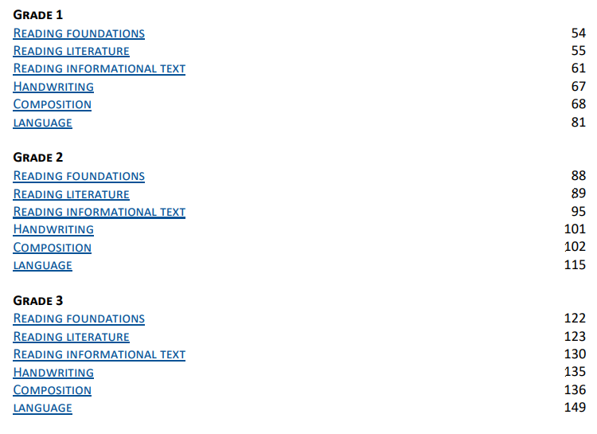
How is healthy integration designed?
Step Three:
Select complimentary reading and writing standards from these strands
Notes:
Guiding Notes:
The next step in the design process is selecting KAS for Reading & Writing standards that complement the KAS for Social Studies. For the purpose of this integration, primarily select standards from the Reading Literature, Reading Informational Text and/or Composition strands. The KAS for Reading & Writing are organized so that users can choose strands by grade level. This slide shows the appropriate kindergarten strands highlighted in yellow and circled in red to draw attention to where the standards for the sample Grade 3 collection came from.
To help you select complimentary reading and writing standards, make sure you understand the selected social studies standards first and then look for connections/alignment between the social studies and the reading and writing standards. Ask yourself which of the reading and writing standards would best assist students in gaining the knowledge needed to answer the supporting and compelling questions. Keep in mind that once an engaging text and primary and/or secondary sources have been selected, you will want to return to these strands to identify any additional standards that support the reading and/or writing needs brought about by the selected text(s) and primary and/or secondary sources.

Slide 53
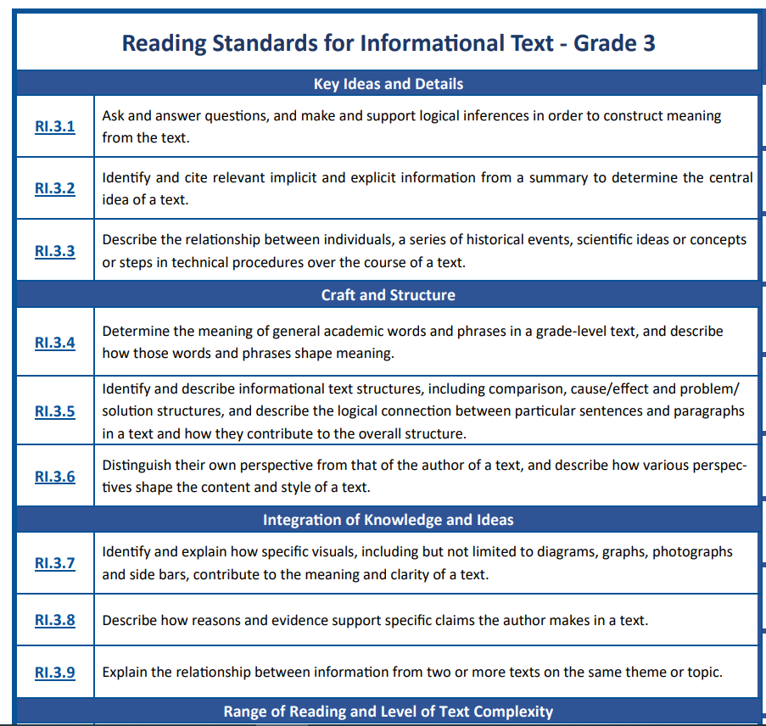
How is healthy integration designed?
Select Standards from Key Ideas & Details Standards 1-3 & Integration of Knowledge & Ideas Standards 7-9
Notes:
Guiding Notes:
Continue by examining Step Three: Selecting KAS for Reading & Writing.
It is important to know which strand categories to select standards from within the Reading Literature and Reading Informational Text strands. This slide suggests selecting standards mainly from two categories: Key Ideas and Details (Standards 1-3) and Integration of Knowledge and Ideas (Standards 7-9). Move to the next slide for further explanation on why to focus selection from these strands and when to select standards from each of these strand categories.

Slide 54
How is healthy integration designed?
Selecting Reading and Writing Standards from RI & RL Strand
Will students be working with a single source or multiple sources?
Single text/source: Choose from standards 1-3
These standards focus on key ideas/concepts and details of a text in order to aid comprehension and analysis.
Multiple texts/sources: Choose from standards 7-9
These standards integrate knowledge and ideas from multiple sources.
Notes:
Guiding Notes:
Read this slide for explanations of why/when to select standards 1-3 or 7-9 for the Reading Informational (RI) Texts and Reading Literature(RL) standards.
Standard 1-3 will be used to make sense of single texts or single primary/secondary sources and standards 6-9 will align when expecting students to think about and discuss two or more texts or primary/secondary sources. Consider maintaining a Google document to record discussion points and/or questions to return to for continued consideration, further explanation and/or clarification.

Slide 55
How is healthy integration designed?
Step Four:
Next, identify a text that will support students’ understanding of the larger compelling question.
Questions to consider when making this text selection:
Would this be an opportunity to utilize a literary text* to build interest around the topic?
Is the text engaging and grade-level appropriate?
Could a video, song, poem, piece of artwork or other non-traditional text work well? Remember: Text is anything that communicates a message (Interdisciplinary Practice 1 from the KAS for Reading & Writing)
NOTE: Identifying the text here is DIFFERENT than identifying the sources for the collection. In this work, the true social students content texts will be primary or secondary sources. Here, text can be whatever intentionally creates a compelling context for learning.
In this module:
When designing the Grade 3 Collection, How to Make an Apple Pie and See the World was selected for its engaging and compelling context. The exports chart and interactive global trade map are sources and were selected in a later step of the design process.
*In this module, literary texts are selected because they are effective for building a compelling context to engage in the learning.
Notes:
Guiding Notes:
Read Step Four. It is important to note Interdisciplinary Literacy Practices and especially practice one from the KAS for Reading & Writing. Practice one states that text is anything that communicates a message. Move to the next slide and allow time for participants to review the infographic showing practice one as well as the other nine practices that make up the ten Interdisciplinary Literacy Practices.
Literary texts were intentionally selected for the provided healthy integration collection examples because they provide a compelling context for students to become engaged in the content. These literature texts can provide content information, but they are not considered a primary or secondary source. Non-literary texts may be selected in this step of the design process, as indicated by the examples on this slide; however, in this module you will notice literary texts were selected for the purpose of engaging students in the compelling question and content aligned to the KAS for Social Studies.

Slide 56
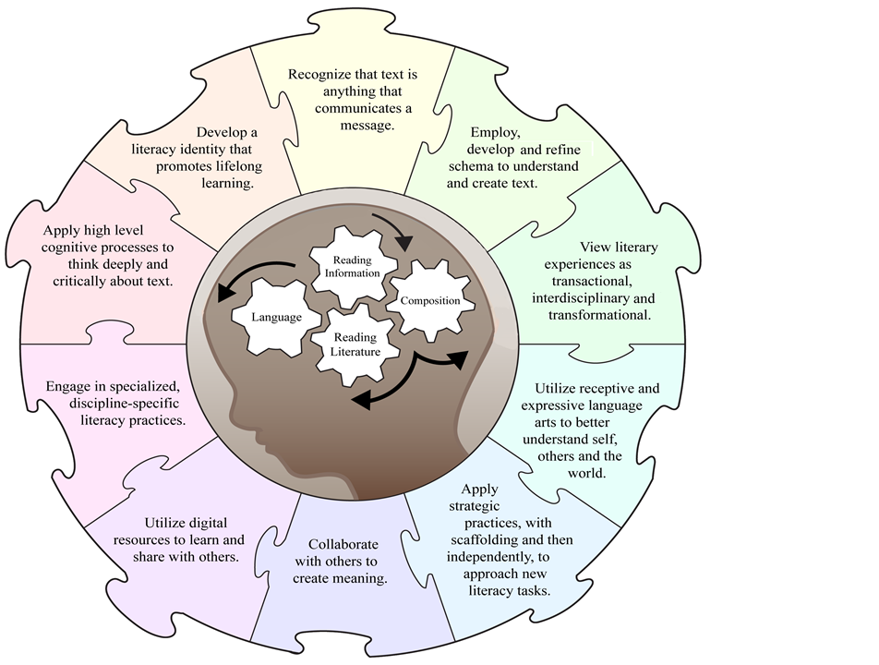
56
Notes:
Guiding Notes:
View the infographic for the Interdisciplinary Literacy Practices. This infographic found on page 390 in the KAS for Reading and Writing document illustrates how the practices fit together like a puzzle to support, equip and empower students as they build knowledge and master skills within the reading and writing strands. It is important to keep these practices in mind when designing integrated experiences and assignments. A great question to ask is, “How are these practices impacting the instructional process?” If answering this question is difficult, the practices likely need a stronger role in the thinking occurring when designing healthy integration experiences and assignments.

Slide 57
Not additional standards
Unlike the mathematics practices, the ten literacy practices are NOT additional standards.
Instead, if utilized, they provide intentional opportunities for students to practice the behaviors of a literate citizen.
Because they are the overarching goals of creating a literacy-rich environment, they are not attached to specific standards as in mathematics and science, Multiple literacy practices are engaged in the application and mastery of each reading and writing standard.
They are interdisciplinary literacy practices, however, they are also not linked to other disciplines as the other content areas have been charged with incorporating literacy into their own discipline-specific document during the standards revision process.
Notes:
Guiding Notes:
In order to understand the purpose and function of the Interdisciplinary Literacy Practices, we must first understand how the practices are different from the content standards for reading and writing. Use the components of the slide to build participant knowledge. Reiterate the Interdisciplinary Literacy Practices are not reading and writing standards and are not assessed.
NOTE: This information is found in the front matter of the KAS for Reading and Writing. The relationship between the Reading and Writing Standards and the ten Literacy Practices is different from those found in other KAS documents. This distinction is very important for participants to understand.

Slide 58
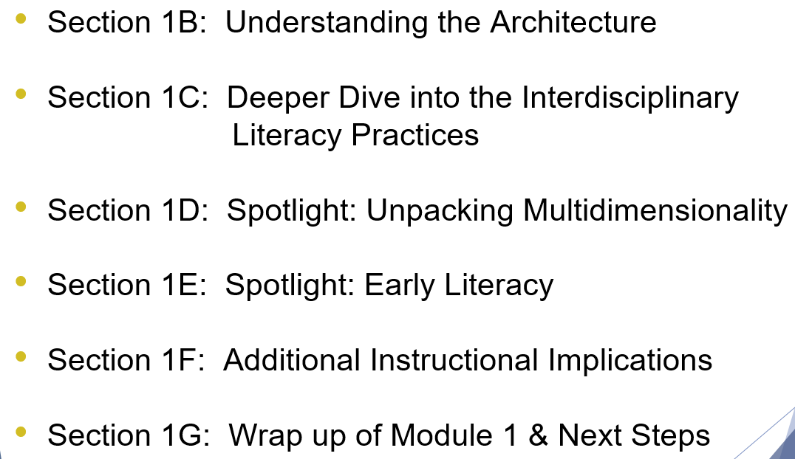
Need more time for Getting to Know the KAS for Reading & Writing?
Check out the Getting to Know the Kentucky Academic Standards (KAS) for Reading & Writing Module
Guiding Guide
Module Slides
Because the sections are designed to be viewed as stand-alone lessons or within the progression of the module as written, you may select to start at the beginning and complete all sections or select sections to meet your learning needs. The sections with arrows contain background information needed to successfully complete this integration module and are recommended for participants who are not yet comfortable with the KAS for Reading & Writing.
Notes:
Guiding Notes:
If you need more time to get to know the KAS for Reading & Writing, the Getting to Know the KAS for Reading & Writing Module is a good place to find support and includes:
sessions intended to support the successful transition to and implementation of the KAS for Reading & Writing.
sections that are designed to be viewed as stand-alone lessons or within the progression of the module as written.
information to build a shared understanding of the KAS for Reading and Writing document
information to strengthen the connection between the components of the KAS for Reading & Writing and the way those components can support teachers in the process of designing standards-aligned instruction and grade-level assignments.
opportunities to experience how the changes in the KAS for Reading & Writing can and will be reflected in student experiences within Kentucky classrooms.

Slide 59
Application: Designing a healthy integration collection
Step Five:
Identify sources that will provide evidence to help students engage with the compelling and supporting questions and the strongly aligned standards assignments.
Sources may include graphs, charts, newspaper articles, quotes, speeches, written correspondence, videos, podcasts, paintings, photographs, maps, etc.
Note: Standard selection may dictate...
the way in which the students engage with the sources.
For example, the social studies Using Evidence standards from the Grade 3 collection require that students explain the relationship between two or more sources on the same theme or topic.
which additional reading and writing standard(s) should be included in the integrated learning.
For example, because the Using Evidence standard requires explaining the relationship of of two or more sources, RI.3.1 requires readers to “make and support logical inferences in order to construct meaning from the text.” Students must be able to comprehend each source in order to explain the relationship between them.
Notes:
Guiding Notes:
Read the requirements of Step Five. Note: When identifying the sources, it is critical to emphasize that the standard selection may dictate the way in which the students engage with the sources and which additional reading and writing standard(s) should be included in the integrated learning.

Slide 60
How is healthy integration designed?
Step Six:
Design the grade-level aligned experiences and assignments. The Kentucky Academic Standards outlines the minimum standards Kentucky students should learn in each grade level kindergarten through high school.
A standard represents a goal or outcome of an educational program.
The standards establish a statewide baseline of what students should know and be able to do at the conclusion of a grade or grade-span.
The instructional program should emphasize the development of students' abilities to acquire and apply the standards.
The standards are not a set of instructional or assessment tasks, but rather statements of what students should be able to master after instruction.
Thus, throughout the Healthy Integration collection, students should have multiple opportunities to engage with strongly KAS for Social Studies and KAS for Reading and Writing aligned assignments to develop the skills and content needed in order to engage with the compelling and supporting questions provided.
Notes:
Guiding Notes:
Read the requirements of Step Six. Note: When designing grade-level aligned experiences and assignments, students must have the opportunity to demonstrate the knowledge and/or mastery of the standard identified.

Slide 61
How is healthy integration designed? (step six)
For example, in order for students to build the knowledge and skills required to answer the compelling and supporting questions provided, students may answer the following questions aligned to RL.3.1 from the KAS for Reading and Writing during a Read Aloud.
What does the narrator say to do since the market is closed? (“...go home and pack a suitcase. Take your shopping list and some walking shoes. Then catch a steam ship bound for Europe. Use the six days on board to brush up on your Italian.”)
Why does the narrator want you to pack a suitcase and get on a ship with your shopping list and walking shoes? (to go get the ingredients to make an apple pie if the market is closed) How do you know? (refer to details on subsequent pages- harvesting wheat, collecting eggs/chicken, etc.)
Is that something you or your family has ever done when the market, or grocery, was closed? (no - students may talk about going to another store to get what they needed or asking a neighbor or relative for the ingredients)
Do you think the author actually wants readers to do what the narrator is suggesting - travel all around the world to collect ingredients to make an apple pie, just because the market is closed? How do you know?
Why do you infer the narrator tells readers to do this if she doesn’t really mean it? (To teach us where the ingredients come from; to make baking an apple pie more fun; to make the story better)
Notes:
Guiding Notes:
Read the information provided in the slide. Consider why this assignment aligns to the standard identified and examine how this assignment aligns to the compelling question provided.

Slide 62
How is healthy integration designed? (step six)
For example, in order for students to build the knowledge and skills required to answer the compelling and supporting questions provided, students may do the following tasked aligned to 3.E.ST.1 of the KAS for Social Studies.
Present the chart showing the top U.S. agricultural exports to the class and ensure that students understand that “agricultural” refers to farming, and that exports are goods that are sold from the U.S. to other countries. Identify the top countries the U.S. exports agricultural goods to and identify the location of these countries on a world map or globe for students. Ask students to review the chart and do the following:
Work with a partner to conduct a See, Think, Wonder. Discuss the following questions: What do you see? What do you think about that? What does it make you wonder?
After students have had time to discuss with their partner, discuss as a whole group, allowing partners to share. Then, pose the following questions to students:
Why might we trade so much with Canada and Mexico?. Why might we trade with faraway places such as China, Japan, and Europe?
Notes:
Guiding Notes:
Read the information provided in the slide. Consider why this assignment aligns to the standard identified and examine how this assignment aligns to the compelling question provided.

Slide 63
Assignments Strongly Aligned to the KAS
In short, students should have multiple opportunities to engage with strongly aligned KAS for Social Studies and KAS for Reading and Writing assignments that drive investigation of the supporting and compelling questions. Additionally, when engaging with the assignments aligned to the supporting and compelling question(s), students should utilize the content and skills outlined in the social studies and reading and writing standards to construct their responses.
See the Healthy Integration Assignment examples in this module for more examples.
For more information on aligning assignments to the KAS for Social Studies and KAS for Reading and Writing, engage with the following resources:
Social Studies Assignment Review Protocol
Social Studies Student Assignment Library
Reading & Writing Student Assignment Library
Assignment Review Protocol - Reading & Writing Module
Notes:
Guiding Notes:
Read the information provided in the slide.

Slide 64
Coming Up
Section E: Case studies in healthy integration
Section F: Is it healthy, stealthy or fractured?
Section G: Application: Designing a healthy integration collection
Section H: Reflection
Notes:
Guiding notes:
This slide previews the upcoming sections of the module.
Explain: The KDE needs your feedback on the effectiveness of this module, the learning platform and how the consultants may best support you as you take the next steps in the implementation process. We are going to complete a short survey to share our thinking and provide them with feedback on how the KDE can best meet our needs. Feedback from our surveys will be used by the KDE to plan and prepare future professional learning.
Post-survey: https://forms.gle/NU6gc7j69WrHSa9u5

Slide 65
Elementary Focus: Healthy Integration
Section E: Case studies in healthy integration
Notes:
Guiding Notes:
Materials needed for this section entitled, “How do I integrate social studies and reading and writing?”:
KAS for Social Studies: https://education.ky.gov/curriculum/standards/kyacadstand/Documents/Kentucky_Academic_Standards_for_Social_Studies.pdf
KAS for Reading and Writing: https://education.ky.gov/curriculum/standards/kyacadstand/Documents/Kentucky_Academic_Standards_Reading_and_Writing.pdf

Slide 66
Goals of this Module:
Engage with the Kentucky Academic Standards (KAS) for Social Studies and the Kentucky Academic Standards (KAS) for Reading and Writing.
Answer the question, “Why teach social studies?”
Learn how to incorporate healthy integration between the KAS for Social Studies and the KAS for Reading and Writing while maintaining discipline integrity
Explore examples of healthy integration between the KAS for Social Studies and the KAS for Reading and Writing.
Notes:
Guiding Notes:
The goals for this module are on this slide.

Slide 67
Compelling Question
How do I practice healthy integration between the KAS for Social Studies and the KAS for Reading and Writing in elementary school?
Notes:
Guiding Notes:
Section E of this module provides three different grade level examples of healthy integration collections: Kindergarten, Grade 3 and Grade 5. This compelling question will be answered by the end of the module.

Slide 68
Case studies in healthy integration
In this section of the module, you will explore strongly-aligned KAS for Social Studies and KAS for Reading and Writing healthy integration collections.
On the following slides, the available collections are described. Select one, two or all three, depending on your needs, to engage with during this section of the module.
Notes:
Guiding Notes:
Read the information provided in the slide.

Slide 69
Case studies in healthy integration
Example One: Kindergarten Collection
Overview: After reading a literary text, Officer Buckle and Gloria by Peggy Rathman, students engage in a series of reading/writing and social studies experiences and assignments to identify examples of rules that apply in the school and community, and explain why they exist. Students will use their knowledge of existing school rules to identify a safety concern that does not have a school rule. Next, students will propose a new classroom rule that would make school safer for them and their friends. Students will use their knowledge of why following school rules is important to answer the compelling question, “How do I improve my classroom community?”
Notes:
Guiding Notes:
Read the information provided in the slide.

Slide 70
Case studies in healthy integration
Example Two: Grade 3 Collection
Overview: After reading a literary text, How to Make an Apple Pie and See the World by Marjorie Priceman, to introduce economic interdependence, students will research world regions to see how physical and cultural characteristics impact the goods a region can produce. Students demonstrate their knowledge of economic interdependence by constructing an argument to answer the compelling question: “How does where we live affect how we live?”
Notes:
Guiding Notes:
Read the information provided in the slide.

Slide 71
Case studies in healthy integration
Example Three: Grade 5 Collection
Overview:
As students read a chapter book, Landry News, they engage in a series of reading/writing and social studies experiences and assignments to identify what rights are given to Americans by the First Amendment in order to investigate the compelling question, “Why is the Bill of Rights needed and challenged?”
Notes:
Guiding Notes:
Read the information provided in the slide.

Slide 72
Explore a Healthy Integration Collection
Individually, select one of the healthy integration collections to read closely.
While reading, mark your noticings by underlining, writing in the margins, circling or highlighting. Noticings are your thoughts while reading - things you want to remember, places that confuse you, your questions, your connections and more.
Notes:
Guiding Notes:
Read the information provided in the slide. Closely read the healthy integration collection selected while marking your noticings by underlining, writing in the margins, circling or highlighting.

Slide 73
Deeper Dive: Exploring a Healthy Integration Collection
After reading the entire healthy integration collection, you will now examine each experience and assignment that makes up the collection. As you engage with each experience or assignment, answer the following questions:
How is what the students are being asked to know and do align to the standards identified for this assignment?
How does this assignment use the content and skills necessary in the standards to engage with the supporting question?
How does this experience or assignment build the skills and content necessary to answer the compelling question?
Answer these questions for each assignment contained in the collection.
Notes:
Guiding Notes:
Read the information on the slide. You will now examine each experience and assignment that makes up the collection by answering the questions provided on the slide.

Slide 74
Reflection
Why is the collection you reviewed an example of healthy integration?
How will this learning impact your instruction? In your response, think about your experience with healthy, stealthy and fractured integration.
What supports will you/teachers need in your school(s) to make healthy integration successful?
Notes:
Guiding Notes:
If working in a group, discuss the questions on the slide after engaging with this section. Otherwise, self reflect and consider individually.

Slide 75
Coming Up
Section F: Is it healthy, stealthy or fractured?
Section G: Application: Designing a healthy integration collection
Section H: Reflection
Notes:
Guiding notes:
This slide previews the upcoming contents of this module.
Explain: The KDE needs your feedback on the effectiveness of this module, the learning platform and how the consultants may best support you as you take the next steps in the implementation process. We are going to complete a short survey to share our thinking and provide them with feedback on how the KDE can best meet our needs. Feedback from our surveys will be used by the KDE to plan and prepare future professional learning.
Post-survey: https://forms.gle/NU6gc7j69WrHSa9u5

Slide 76
Elementary Focus: Healthy Integration
Section F: Is it healthy, stealthy or fractured?
Notes:
Guiding Notes:
The following materials are part of this section:
Social Studies Assignment Review Protocol: https://www.education.ky.gov/_layouts/download.aspx?SourceUrl=/curriculum/standards/kyacadstand/Documents/Social_Studies_Assignment_Review_Protocol.docx
Grade 5 Social Studies Assignment Examplehttps://www.education.ky.gov/_layouts/download.aspx?SourceUrl=/curriculum/standards/kyacadstand/Documents/Grade_5_Is_it_healthy_stealthy_or_fractured_example.docx
Grade 5 Social Studies Assignment Review Protocol Example: https://www.education.ky.gov/_layouts/download.aspx?SourceUrl=/curriculum/standards/kyacadstand/Documents/Module_4_Section_F_Assignment_Review_Protocol_Example_Grade_5.docx

Slide 77
Goals of this Module:
Engage with the Kentucky Academic Standards (KAS) for Social Studies and the Kentucky Academic Standards (KAS) for Reading and Writing.
Answer the question, “Why teach social studies?”
Learn how to incorporate healthy integration between the KAS for Social Studies and the KAS for Reading and Writing while maintaining discipline integrity
Explore examples of healthy integration between the KAS for Social Studies and the KAS for Reading and Writing.
Notes:
Guiding Notes:
The goals for this module are on this slide.

Slide 78
Compelling Question
How do I practice healthy integration between the KAS for Social Studies and the KAS for Reading and Writing in elementary school?
Notes:
Guiding Notes:
This section of the module provides a example from Grade 5 that requires participants to evaluate whether or not the example is:
Strongly, partially or weakly aligned to the KAS for Social Studies
Fractured, Stealthy or Healthy integration
The compelling question will be answered by the end of the module.
Note: You will use the Social Studies Assignment Review Protocol to evaluate this example. To aid you in assessing how well you evaluate the work, a completed Social Studies Assignment Review Protocol Example is provided: https://www.education.ky.gov/_layouts/download.aspx?SourceUrl=/curriculum/standards/kyacadstand/Documents/Module_4_Section_F_Assignment_Review_Protocol_Example_Grade_5.docx
This sample rubric evaluates the alignment to the standards and explains the unsuccessful shift of integrating literacy practices, with suggestions for improving alignment and integration.

Slide 79
Is it healthy, stealthy or fractured?
In this section of the module, you will determine if an experience or task provided is an example of healthy, stealthy or fractured integration.
Grade 5 Social Studies Assignment Example
To evaluate this assignment, use only the Social Studies Assignment Review Protocol for the purpose of this activity.
Part One: Review the assignment provided using the Assignment Review Protocol for Social Studies to determine alignment to the KAS for Social Studies.
Notes:
Guiding Notes:
Use the Social Studies Assignment Review Protocol to evaluate this Grade 5 assignment.
Notes: It is important to note that an compelling component of a healthy integrated collection is that it contains assignments and experiences that are aligned to the KAS for Social Studies and the KAS for Reading and Writing. Thus, when you are evaluating all of the experiences and/or assignments in a collection, you will use both of the following:
Social Studies Assignment Review Protocol: https://www.education.ky.gov/_layouts/download.aspx?SourceUrl=/curriculum/standards/kyacadstand/Documents/Social_Studies_Assignment_Review_Protocol.docx
Reading and Writing Assignment Review Protocol: https://www.education.ky.gov/_layouts/download.aspx?SourceUrl=/curriculum/standards/kyacadstand/Documents/Reading_and_Writing_Assignment_Review_Protocol.docx.
The protocol used for a specific assignment or experience will be determined based on the standards alignment of the assignment. If the assignment is aligned to the KAS for Social Studies, then use the Social Studies Assignment Review Protocol to evaluate the assignment or experience and vice versa for an assignment and/or experience aligned to the KAS for Reading and Writing.

Slide 80
Is it healthy, stealthy or fractured?
Part Two: Use your completed Assignment Review Protocol to determine if the assignment is an example of healthy, stealthy or fractured integration in the Impactful Instructional Strategies section.
Notes:
Guiding Notes:
Read the slide and complete this activity.

Slide 81
Is it healthy, stealthy or fractured?
Compare the results of your completed protocol with this sample completed protocol by engaging with the following questions:
Are there any discrepancies between how you rated the assignment and how the assignment is rated on the sample protocol? If not, move on to the next question. If so, discuss the differences with a colleague to determine the "Why?" behind the differences
Review the reflection section of the Social Studies Assignment Review Protocol. What changes are needed to improve alignment to the standards and to reach healthy integration?
Notes:
Guiding Notes:
Read the slide and complete this activity.

Slide 82
Reflection
How will this learning impact your instruction? In your response, think about your experience with the example you evaluated.
What supports will you/teachers need in your school(s) to make healthy integration successful?
Notes:
Guiding Notes:
If working in a group, discuss the questions on the slide; otherwise, consider individually.

Slide 83
Coming Up
Section G: Application: Designing a healthy integration collection
Section H: Reflection
Notes:
Guiding notes:
This slide previews the additional contents of this module.
The KDE needs your feedback on the effectiveness of this module, the learning platform and how the consultants may best support you as you take the next steps in the implementation process. We are going to complete a short survey to share our thinking and provide them with feedback on how the KDE can best meet our needs. Feedback from our surveys will be used by the KDE to plan and prepare future professional learning.
Post-survey: https://forms.gle/NU6gc7j69WrHSa9u5

Slide 84
Elementary Focus: Healthy Integration
Section C: Application: designing a healthy integration collection
Notes:
Guiding Notes:
Guiding Note:
Materials needed for this section entitled, “How do I integrate social studies and reading and writing?”:
KAS for Social Studies: https://education.ky.gov/curriculum/standards/kyacadstand/Documents/Kentucky_Academic_Standards_for_Social_Studies.pdf
KAS for Reading and Writing: https://education.ky.gov/curriculum/standards/kyacadstand/Documents/Kentucky_Academic_Standards_Reading_and_Writing.pdf

Slide 85
Goals of this Module:
Engage with the the Kentucky Academic Standards (KAS) for Social Studies and the Kentucky Academic Standards (KAS) for Reading and Writing.
Answer the question, “Why teach social studies?”
Learn how to incorporate healthy integration between the KAS for Social Studies and the KAS for Reading and Writing while maintaining discipline integrity
Explore examples of healthy integration between the KAS for Social Studies and the KAS for Reading and Writing.
Notes:
Guiding Notes:
The goals for this module are on this slide.

Slide 86
Compelling Question
How do I practice healthy integration between the KAS for Social Studies and the KAS for Reading and Writing in elementary school?
Notes:
Guiding Notes:
Section G of this module explains the steps necessary for designing a healthy integration collection. This compelling question will be answered by the end of the module.

Slide 87
Application: Designing a healthy integration collection
Now, apply what you have learned to design a healthy integration collection for your classroom.
If you are departmentalized and only teach either reading or social studies, you will want to collaborate with the teacher of the other discipline as well.
If you are self-contained, this is challenging work and collaboration may help!
Notes:
Guiding Notes:
Read the slide provided.
Note: Collaboration with others is beneficial in developing healthy integration collections. For departmentalized teachers who teach only one subject, it is critical that you collaborate with your colleagues. For example, the reading and writing teacher would need to collaborate with the social studies teacher in order maintain discipline integrity when designing experiences and/or assignments in a healthy integration collection. Teachers who are self-contained and are responsible for teaching both subjects may also find collaboration with their grade-level colleagues beneficial to engage in this work.

Slide 88
Application: Designing a healthy integration collection
Gathering resources:
Knowledge of the architectures of the KAS for Social Studies and the KAS for Reading and Writing
KAS for Social Studies
KAS for Reading and Writing
An understanding of your grade level topic in order to understand the function of compelling and supporting questions
Text sources rich in social studies content and aligned with standards in both areas
Notes:
Guiding Notes:
Read the slide. Access the following:
KAS for Social Studies: https://education.ky.gov/curriculum/standards/kyacadstand/Documents/Kentucky_Academic_Standards_for_Social_Studies.pdf
KAS for Reading and Writing: https://education.ky.gov/curriculum/standards/kyacadstand/Documents/Kentucky_Academic_Standards_Reading_and_Writing.pdf

Slide 89
Application: Designing a healthy integration collection
Step One:
To start this work, complete the following:
Review your grade-level overview in the KAS for Social Studies to gain a deeper understanding of the grade-level theme.
Next, review the standards for your grade-level and identify standards that compliment each other in an instructional setting.
As you are reviewing the standards, decide on a topic of study identified in the grade-level standards.
Note: Reviewing the disciplinary clarifications will provide additional clarity to the expectations of the standards.
For more information on this step in the design process, review Section D of this module.
Notes:
Guiding Notes:
Think back to previous learning about the role of compelling questions in this work.
Read this slide and consider the requirements of Step One and ensure that participants complete the following to start this work:
Review your grade-level overview in the KAS for Social Studies to gain a deeper understanding of the grade-level theme.
Next, review the standards for your grade-level and identify standards that compliment each other in an instructional setting.
As you are identifying the standards, decide on a topic of study identified in the grade-level standards.
Note: Reviewing the disciplinary clarifications will provide additional clarity to the expectations of the standards.
For more information on this step in the design process, review Section D of this module.

Slide 90
Application: Designing a healthy integration collection
Next, select standards from the inquiry practices and the disciplinary strand standards. Your selected standards should include:
Questioning standards for both the compelling and supporting questions
Disciplinary strand standards
Ideally, healthy integration assignments should include standards from more than one social studies discipline (civics, economics, geography and history).
Using evidence standards
Communicating conclusion standards
For more information on this step in the design process, review Section D of this module.
Notes:
Guiding Notes:
Read this slide and consider the requirements of selecting standards from the KAS for Social Studies for this work.
For more information on this step in the design process, review Section D of this module.

Slide 91
Application: Designing a healthy integration collection
Step Two
Once you have selected your KAS for Social Studies standards, identify or compose your compelling and supporting questions.
Compelling questions are open-ended, enduring and center on significant unresolved issues.
Supporting questions support the compelling question by asking more focused questions and can be answered through use of the concepts and practices of each social studies discipline (civics, economics, geography and history).
The questions you design must be aligned to the standards selected. Refer back to the KAS for Social Studies and the integration collection you explored in Section F for examples.
Notes:
Guiding Notes:
Read this slide and design the compelling and supporting question. When you have designed their compelling question and supporting question(s), evaluate each question on the characteristics of compelling and supporting questions.
For more information on this step in the design process, review Section D of this module.

Slide 92
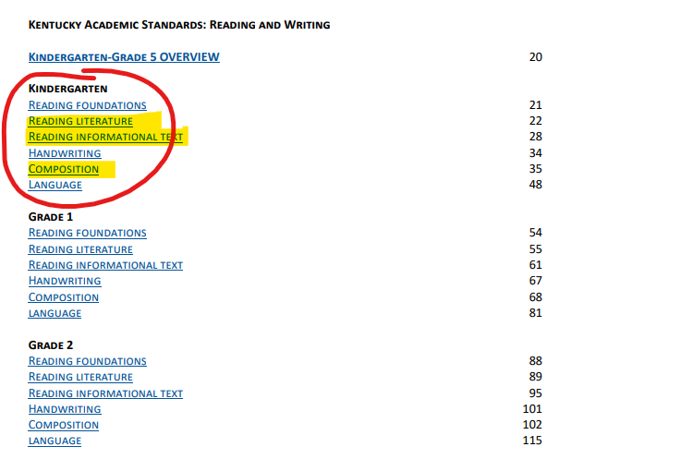
Application: Designing a healthy integration collection
Step Three:
Select complementary reading and writing standards from these strands
Notes:
Guiding Notes:
The KAS for Reading & Writing are organized so that users can choose the reading and writing strands by grade level. When integrating the KAS for Reading & Writing with the KAS for Social Studies, select standards primarily from the Reading Literature, Reading Informational Text and/or Composition strands. This slide shows these strands highlighted in yellow and circled in red to draw attention to where the standards for the sample kindergarten collection came from. Standards should be selected from these same strands when designing healthy integration experiences and assignments at any grade level.
To help you select complementary reading and writing standards, make sure you understand the selected social studies standards first and look for connections/alignment between the social studies and the reading and writing standards. Ask yourself which of the reading and writing standards would best assist students in gaining the knowledge needed to answer the supporting and compelling questions. Keep in mind that once an engaging text and primary and/or secondary sources have been selected, you will want to return to these strands to identify any additional standards that align to the reading and/or writing needs brought about by the selected text(s) and primary and/or secondary sources.
For more information on this step in the design process, review Section D of this module.

Slide 93
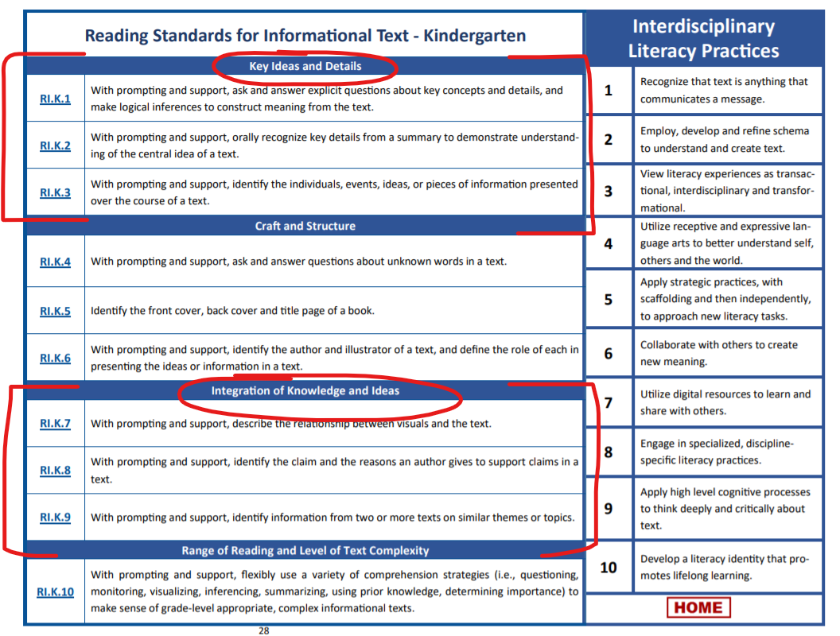
Application: Designing a healthy integration collection
Select Standards from Key Ideas & Details Standards 1-3 & Integration of Knowledge & Ideas Standards 6-9
Notes:
Guiding Notes:
Within the Reading Literature and Reading Informational Text strands, select standards from the Key Ideas and Details (Standards 1-3) and Integration of Knowledge and Ideas (Standards 7-9) strand categories. Move to the next slide for further explanation of selecting standards within these strand categories.
For more information on this step in the design process, review Section D of this module.

Slide 94
Application: Designing a healthy integration collection
Selecting Reading and Writing Standards
from RI & RL Strand
Will students be working with a single source or multiple sources?
Single source: Choose from standards 1-3
These standards focus on key ideas/concepts and details of a text in order to aid comprehension and analysis.
Multiple sources: Choose from standards 7-9
These standards integrate knowledge and ideas from multiple sources.
Notes:
Guiding Notes:
Read the slide. Standard 1-3 will be used to make sense of single texts or single primary/secondary sources and standards 7-9 will align when expecting students to think about and discuss two or more texts or primary/secondary sources.
For more information on this step in the design process, review Section D of this module.

Slide 95
Application- Designing a Healthy Integration Collection
Step Four:
Next, identify a text that will support students’ understanding of the larger compelling question.
Questions to consider when making this text selection:
Would this be an opportunity to utilize a literary text to build interest around the topic?
Is the text engaging and grade-level appropriate?
Could a video, song, poem, piece of artwork or other non-traditional text work well? Remember: Text is anything that communicates a message (Interdisciplinary Practice 1 from the KAS for Reading & Writing)
For more information on this step in the design process, review Section D of this module.
Notes:
Guiding Notes:
Read this slide and identify a text that will support students’ understanding of the larger compelling question. When making this text selection, consider the questions provided.
For more information on this step in the design process, review Section D of this module.

Slide 96
Application: Designing a healthy integration collection
Step Five:
Next, identify primary and/or secondary sources that will provide evidence to help students engage with the compelling and supporting questions and the strongly aligned standards assignments.
Standard selection may dictate...
the way in which the students engage with the sources.
which additional reading and writing standard(s) should be included in the integrated learning.
For more information on this step in the design process, review Section D of this module.
Notes:
Guiding Notes:
Read this slide and identify primary and/or secondary sources that will provide evidence to help students engage with the compelling and supporting questions and the strongly aligned standards assignments.
For more information on this step in the design process, review Section D of this module.

Slide 97
Application- Designing a Healthy Integration Collection
Step Six:
Now that your compelling and supporting questions and standards have been identified, design grade-level aligned assignments and/or experiences that will be a part of your healthy integration collection.
Note:
The number of grade-level aligned assignments or experiences included in a collection will depend on the standards you identified earlier in this module. A student must have the opportunity to demonstrate their mastery of the standards identified within this collection.
Throughout the Healthy Integration assignment collection, students should have multiple opportunities to engage with assignments that are strongly aligned to the KAS for Social Studies and KAS for Reading and Writing in order to develop the skills and content needed to engage with the compelling and supporting questions provided.
Notes:
Guiding Notes:
Read this slide and design grade-level aligned assignments and/or experiences that will be a part of your healthy integration collection.
Note: When designing grade-level aligned experiences and assignments, students must have the opportunity to demonstrate the knowledge and/or mastery of the standard identified.
For more information on this step in the design process, review Section D of this module.

Slide 98
Assignments strongly aligned to the KAS
Students should have multiple opportunities to engage with strongly aligned KAS for Social Studies and KAS for Reading and Writing assignments that drive investigation of the supporting and compelling questions. Additionally, when engaging with the assignments aligned to the supporting and compelling questions, students should utilize the content and skills outlined in the social studies and reading and writing standards to construct their responses.
See the Healthy Integration Assignment examples in this module for more examples.
For more information on aligning assignments to the KAS for Social Studies and KAS for Reading and Writing, engage with the following resources:
Social Studies Assignment Review Protocol
Social Studies Student Assignment Library
Reading & Writing Student Assignment Library
Assignment Review Protocol - Reading & Writing Module
Notes:
Guiding Notes:
Read the information provided in the slide. When you have created their experiences and/or assignments for the collection, evaluate them using the appropriate discipline Assignment Review Protocol. Remember, it is important to note that an compelling component of a healthy integrated collection is that it contains assignments and experiences that are aligned to the KAS for Social Studies and the KAS for Reading and Writing. Thus, when you are evaluating all of the experiences and/or assignments in a collection, you will use both the Social Studies and Reading and Writing Review Protocol. The protocol used for a specific assignment or experience will be determined based on the standards alignment of the assignment. If the assignment is aligned to the KAS for Social Studies, then use the Social Studies Assignment Review Protocol to evaluate the assignment or experience and vice versa for an assignment and/or experience aligned to the KAS for Reading and Writing.

Slide 99
Reflection
Now that you have started designing your own healthy integration collection, revisit the response you provided earlier in the module about supports needed to engage in this work.
Based on what you now know, what supports will you/teachers need in your school(s) to make healthy integration successful?
Answers may include, but are not limited to, time, resources, professional learning for discipline support, etc.
Notes:
Guiding Notes:
If working in a group, discuss the questions on the slide; otherwise, consider individually as a self-reflection.

Slide 100
Coming Up
Section H: Reflection
Notes:
Guiding notes:
This slide previews the additional contents of this module.
The KDE needs your feedback on the effectiveness of this module, the learning platform and how the consultants may best support you as you take the next steps in the implementation process. We are going to complete a short survey to share our thinking and provide them with feedback on how the KDE can best meet our needs. Feedback from our surveys will be used by the KDE to plan and prepare future professional learning.
Post-survey: https://forms.gle/NU6gc7j69WrHSa9u5

Slide 101
Elementary Focus: Healthy Integration
Section H: Reflection
Notes:
Guiding Notes:
Materials needed for this section:
Council of Chief State School Officers. (2023). Effective Social Studies Integration in Elementary Classrooms. https://753a0706.flowpaper.com/CCSSOSocialStudiesIntegrationInfographic053023/

Slide 102
Goals of this Module:
Engage with the Kentucky Academic Standards (KAS) for Social Studies and the Kentucky Academic Standards (KAS) for Reading and Writing.
Answer the question, “Why teach social studies?”
Learn how to incorporate healthy integration between the KAS for Social Studies and the KAS for Reading and Writing while maintaining discipline integrity
Explore examples of healthy integration between the KAS for Social Studies and the KAS for Reading and Writing.
Notes:
Guiding Notes:
The goals for this module are on this slide.

Slide 103
Effective Social Studies Integration in Elementary Classrooms
To review what you have learned in this module, access and review Effective Social Studies Integration in Elementary Classrooms while paying attention to:
The benefits
The characteristics of effective integration
Action steps
Notes:
Guiding Notes:
As you are reviewing this infographic, make connections to what you learned previously in the module.

Slide 104
Effective Social Studies Integration in Elementary Classrooms
Using this Mind Map template, answer the following question:
Which characteristics of effective integration did you observe in a strongly aligned collection in this module?
Notes:
Guiding Notes:
Access and view Effective Social Studies Integration in Elementary Classrooms: https://753a0706.flowpaper.com/CCSSOSocialStudiesIntegrationInfographic053023/#page=1
Use this infographic along with the information you have learned from this module to answer the question on the slide.

Slide 105
Compelling Question
How do I practice healthy integration between the KAS for Social Studies and the KAS for Reading and Writing in elementary school?
Notes:
Guiding Notes:
Throughout this module, you have focused on this compelling question. Answer this question at the bottom of your Mind Map template.

Slide 106
Self-Reflection
Effective integration is a process and it takes time. Reflect on your current integration practices to identify some priority areas with which to start your journey to effective integration.
Review the 4 benefits provided for social studies integration. Select ONE priority you have for your students over the next year.
Review the characteristics of effective and ineffective integration. Select TWO priority areas where you would like to focus on to shift toward ineffective over the next year.
Review the 5 action steps provided. Select ONE action step to prioritize over the next year.
Notes:
Guiding Notes:
Complete the tasks on the slide.

Slide 107
Action Plan
Which benefit are you focused on for the next year? Why is this important for your students?
What steps will you take to make the shifts required in the two priority areas you identified that will move your instruction toward effective?
What steps will you take to ensure your priority action step is implemented over the next year?
Notes:
Guiding Notes:
Create a plan of action that can be implemented over the next year to address the priorities you identified,

Slide 108
Elementary Focus: Healthy Integration
Kentucky Academic Standards (KAS) for Social Studies and the KAS for Reading and Writing
Notes:
Guiding Notes:
This concludes the Elementary Focus: Healthy Integration module.
The KDE needs your feedback on the effectiveness of this module, the learning platform and how the consultants may best support you as you take the next steps in the implementation process. We are going to complete a short survey to share our thinking and provide them with feedback on how the KDE can best meet our needs. Feedback from our surveys will be used by the KDE to plan and prepare future professional learning.
Post-survey: https://forms.gle/NU6gc7j69WrHSa9u5

