Slide 1
Developing Skilled Middle and High School Readers
Webinar Series
Notes:
Guiding Notes:​
Welcome! Please see the Notes section of slides 2 and 3 for extensive planning and facilitation considerations:​
Slide 2: A Note to Facilitators Leading a Group​
Slide 3: A Note to Individuals Completing This Series​
Please contact ELATeam@education.ky.gov with any questions. ​

Slide 2
A Note to Facilitators Leading a Group:
For complete considerations for facilitators, see the Notes section of this slide.
These slides are part three of a six-part series.
See the Webinar Series Learning Plan on the Landing Page for a detailed view of session objectives and materials. You may wish to make this available to participants.
Print or make a digital copy of the Series Participant Guide for participants to complete the pre-work.
This series is built around the Institute for Education Science and What Works Clearinghouse 2022 Practice Guide, Providing Reading Interventions to Students in Grades 4-9, a free resource available for print. Consider making copies or providing digital access to participants to complete the pre-session readings.
Notes:
Series Overview:
This slide is purposefully hidden from participants.
The purpose of this series is to provide Kentucky 6-12 educators with declarative knowledge of how the brain learns to read, including ways to support all students in middle and high school access complex, grade-level text and skills through decoding multisyllabic words, fluency building, knowledge building, vocabulary building, comprehension and skilled writing.
The Developing Skilled Middle and High School Readers Webinar Series is intended to support classroom teachers across the state in engaging students in grade-level reading across subject areas; however, some content may be relevant for instructional leaders wishing to build their own knowledge of adolescent learners and their literacy needs. The sessions are designed to provide flexibility for districts and schools and, as such, can be viewed as stand-alone lessons or within the progression of the series as provided. You are supported in engaging with this series individually, if desired.
This entire series is six sessions and will take approximately 9 total hours to complete. We recommend accessing one session monthly; however, adaptations may be made to accommodate for more or less time. Each individual session is 1.5 hours.
Materials Needed:
The session slides with Guiding Notes
The Series Participant Guide
Access to the participants’ high-quality instructional resource (HQIR)
A Note about HQIRs:
The Reading and Writing HQIR Consumer Guide points districts to the markers of high-quality literacy instruction for Kentucky. Note that HQIRs are grounded in research and written by experts. While these resources do engage students in strategies that support reading, many students may need more targeted supports in Tier 1 instruction. As such, it is recommended that facilitators continually ground discussions in the texts, tasks and protocols provided in the district-adopted HQIR and prompt participants to make connections between this learning and their upcoming lessons or units.
Guiding Notes:
Guiding notes are provided in the Notes section of the PowerPoint to support your learning. The Notes section includes additional information and directions for the activities on the slide. It is critical that you read the material presented in the Notes section to ensure that you are acquiring the important knowledge, skills and understanding required when engaging with this series.
Virtual Training Note:
If you plan to engage with this series virtually as a group, consider directing participants to the Developing Skilled Middle and High School Readers landing page:
Intended Audiences:
Participants
Series participants may include, but are not limited to, district leadership, school administrators, instructional specialists/coaches, intervention specialists, department chairs, special educators and classroom teachers.
Facilitators
While this series is designed for a teacher to engage with it individually, it may be implemented with a group of educators led by a facilitator. If this series is being completed as a group, facilitators may include, but are not limited to, cooperative staff, district leaders, school administrators, instructional specialists/coaches, intervention specialists, department chairs, special educators, and classroom teachers. Facilitators may need to revise specific tasks in order to meet the needs of the participants or to be respectful of the time planned within the work session.
Helpful Hint for Facilitators:
The learning that will take place in this series may cause Kentucky educators to face changes in instructional practices amidst this transition. It is important to realize that while you are the facilitator of these work sessions, you may not have all the answers to the questions asked by participants, which is part of the learning process for all educators at all levels. Throughout the series, participants may have questions that will be addressed in future work sessions. When that happens, reflect on this quote from Graham Fletcher, “Every teachable moment doesn’t need to be a teachable moment in that moment.” Use these moments to encourage participants to attend future work sessions where those questions will be addressed. If participants ask questions you are not prepared to answer, offer to follow up on that during the next work session. Please contact ELATeam@education.ky.gov if you have questions or comments.
Planning Ahead for Facilitators:
Determine which stakeholders to invite as participants. In the invitation, describe how the work sessions will benefit them.
A few days before the meeting, you may want to remind participants to be prepared to have their Participant Guide available during the meeting. You may also choose to print these for participants.
Reserve adequate space and equipment. Tables or desks should be set up to support small-group discussion. If conducting this series virtually, ensure that your technology platform can support break out rooms to support small group collaboration.
Ensure that participants have access to the Internet.
Preparation
Participant Documents Needed:
Participant Guide
Access to upcoming lessons or units within their district-adopted curriculum supported by an HQIR
Supplies Needed:
These slides
Technology with projection and sound capability if in person. Technology platform where presenters have sharing ability and breakout room options if virtual.
Participant Guides printed or available virtually
Parking Lot for questions - If completing as a group, you may consider providing a poster on which participants can write or post questions, or you may prefer to have a digital parking lot where participants can access a Google document, for example, to post questions and that you can modify as the participants work through the sections of the series
Self-Sticking Notes (optional)
Poster paper (optional)
Highlighters and/or colored pens/markers (optional)
Building a Community:
Building a community is important for any group that will work together, especially if participants have not worked together before. The concept is the same as building a safe, respectful, productive classroom climate. Incorporating community-building into each session builds trust, shows participants that they are valuable as individuals and engages them in the learning process. It is also useful for creating a professional learning network where participants can be supported in their work. Community-building can be as simple as allowing participants to introduce themselves and their role in the school/district, developing or refining group norms, allowing for questions, and/or the sharing of answers to reflection questions or individual discovery task items that are included in this series. Again, time allotted for community-building will allow participants to have a voice and be engaged as active contributors and learners in the sessions.
Virtual Training Options: Be sure to conduct continual check-ins throughout the presentation. Build Google documents to continue to collect feedback, such as questions, hopes, and/or concerns to which participants may continually add.

Slide 3
A Note to Individuals Completing this Series:
For complete considerations for complete this series individually, see the Notes section of this slide.
Print or make a digital copy of the Participant Guide to capture your thinking.
These slides are part three of a six-part series.
See the Webinar Series Learning Plan on the Landing Page for a detailed view of session objectives and materials. You may wish to make this available to participants.
This series is built around the Institute for Education Science and What Works Clearinghouse 2022 Practice Guide, Providing Reading Interventions to Students in Grades 4-9, a free resource available for print. Consider making copies or providing digital access to participants to complete the pre-session readings.
Notes:
Series Overview:
This slide is purposefully hidden from participants.
The purpose of this series is to provide Kentucky 6-12 educators with declarative knowledge of how the brain learns to read, including ways to support all students in middle and high school access complex, grade-level text and skills through decoding multisyllabic words, fluency building, knowledge building, vocabulary building, comprehension and skilled writing.
The Developing Skilled Middle and High School Readers Webinar Series is intended to support classroom teachers across the state in engaging students in grade-level reading across subject areas; however, some content may be relevant for instructional leaders wishing to build their own knowledge of adolescent learners and their literacy needs. The sessions are designed to provide flexibility for districts and schools and, as such, can be viewed as stand-alone lessons or within the progression of the series as provided. You are supported in engaging with this series individually, if desired.
This entire series is six sessions and will take approximately 9 total hours to complete. We recommend accessing one session monthly; however, adaptations may be made to accommodate for more or less time. Each individual session is 1.5 hours.
Materials Needed:
The session slides with Guiding Notes
The Series Participant Guide
Access to the participants’ high-quality instructional resource (HQIR)
A Note about HQIRs:
The Reading and Writing HQIR Consumer Guide points districts to the markers of high-quality literacy instruction for Kentucky. Note that HQIRs are grounded in research and written by experts. While these resources do engage students in strategies that support reading, many students may need more targeted supports in Tier 1 instruction. As such, it is recommended that facilitators continually ground discussions in the texts, tasks and protocols provided in the district-adopted HQIR and prompt participants to make connections between this learning and their upcoming lessons or units.
Guiding Notes:
Guiding notes are provided in the Notes section of the PowerPoint to support your learning. The Notes section includes additional information and directions for the activities on the slide. It is critical that you read the material presented in the Notes section to ensure that you are acquiring the important knowledge, skills and understanding required when engaging with this series.
Intended Audiences:
Participants
Series participants may include, but are not limited to, district leadership, school administrators, instructional specialists/coaches, intervention specialists, department chairs, special educators and classroom teachers.
Facilitators
While this series is designed for a teacher to engage with it individually, it may be implemented with a group of educators led by a facilitator. If this series is being completed as a group, facilitators may include, but are not limited to, cooperative staff, district leaders, school administrators, instructional specialists/coaches, intervention specialists, department chairs, special educators, and classroom teachers. Facilitators may need to revise specific tasks in order to meet the needs of the participants or to be respectful of the time planned within the work session.
Helpful Hint for Completing this Series Individually:
Throughout the series, you may have questions that you would like to discuss with colleagues or leadership at your school. When that happens, make a note to share or discuss this resource with others. The creators of this series are also available should you have questions or want to discuss the content of the videos. Please contact ELATeam@education.ky.gov if you have questions or comments.
Preparation
Participant Documents Needed:
Participant Guide
Access to upcoming lessons or units within your district-adopted curriculum supported by an HQIR

Slide 4
Series Overview
Session 1 | Session 2 | Session 3 | Session 4 | Session 5 | Session 6
How Do We Learn to Read? Exploring Theoretical Frameworks for Reading Development | Decoding Multisyllabic Words within Complex, Grade-Level Texts | Fluency Building within Complex, Grade-Level Texts | Vocabulary and Knowledge Building Essentials | Comprehension as Both Process and Product | Connecting Skilled Reading to Skilled Writing
Notes:
Guiding Notes:
This slide provides an overview of this series. It is recommended to complete one session per month to allow time for implementation of practices between sessions.

Slide 5
Series Goals:
Learn what research says about supporting skilled adolescent reading of complex, grade-level texts.
2. Improve Tier 1, universal reading and writing instruction with strategies that support skilled reading for all students.
Notes:
Guiding Notes:​
This series may address the needs of educators in a variety of roles in districts. The primary goal is to support middle and high school readers with complex, grade-level texts in tier 1, universal instruction. While some secondary students may need intervention to build foundational skills, this series intends to strengthen Tier 1 instruction using evidence-based practices.

Slide 6
With small and intentional shifts, we can make a real difference for the students in our classes right now who need supports as readers.
Notes:
Guiding Notes:​

Slide 7
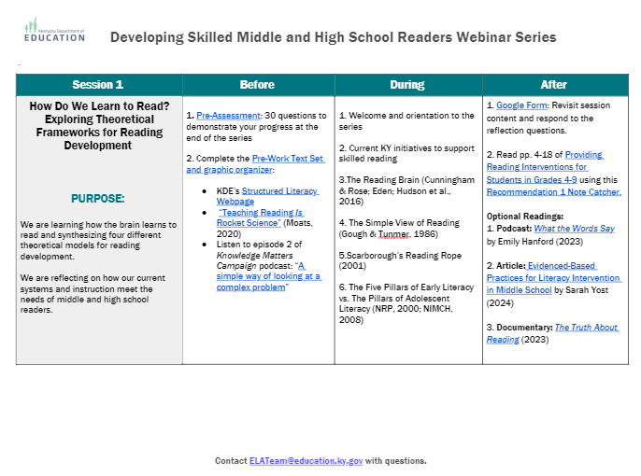
Sessions at a Glance
This document is a tool to know what to do before, during and after a learning session and is available on the Landing Page.
Notes:
Guiding Notes:​
Use this Learning Plan to monitor learning throughout the series.

Slide 8
Session 3: Building Fluency within Complex, Grade-Level Text

Slide 9
Session Learning Objectives:
Participants will learn how fluency bridges word recognition and language comprehension.
Participants will practice various methods for building fluent reading skills when reading complex texts both aloud and silently.
Notes:
Guiding Notes:
This session provides participants with an understanding of how students learn to read in early grades as well as applications for supporting fluent reading in middle and high school.

Slide 10
Learning Agreements
Assume best intentions of facilitators and participants.
Look for opportunities to learn and grow.
Ask questions on the sign out form. We will respond.
When in breakout rooms, allow a chance for everyone to participate.
Center students in the conversation.
Preference learning over performing.
Feel free to attend even if you haven’t completed the pre-work.
Process your learning with colleagues.
Notes:
Guiding Notes:
For groups working through this series together, these are recommended learning agreements for collaboration. These may be modified to suit local needs and expectations.

Slide 11
Materials Needed for This Learning:
Access to materials (on Google Classroom or Learning Plan)
Scrap paper or sticky notes
Print or ensure digital access to our text, Providing Reading Interventions for Students in Grades 4-9
Sample texts
Routines for Building Fluency in Grades 6-12
Notes:
Guiding Notes:
The text for this series is available free online and can be printed for individuals to access and study for each session.

Slide 12
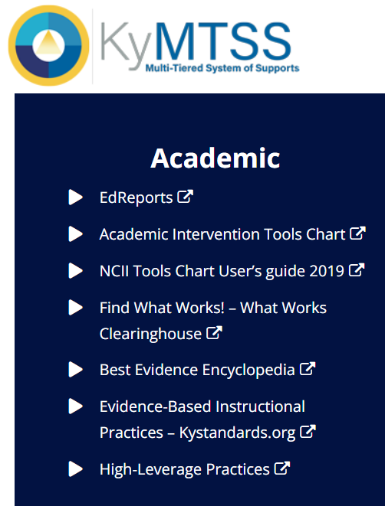
This slide details the topics from the IES Guide we will be using to study during this series.
Released March 2022
Build decoding skills so students can read complex multisyllabic words.
Provide purposeful fluency building activities.
Routinely use comprehension-building activities:
Build word and world knowledge (morphology & vocabulary);
Create opportunities to ask & answer questions about the text;
Teach a routine for summarizing;
Teach how to monitor comprehension as they read.
Practice with more challenging “stretch texts” to introduce more complex information.
Notes:
Guiding Notes:​
This slide outlines the recommendations provided in the IES Practice Guide. This series will address each of these recommendations.

Slide 13
Warm-Up Exercise:
Share your thinking with a partner to prepare for a large group discussion.
Review and Prepare for Learning:
1. How many morphemes are in each of these words containing the Latin root -funct-. -Funct- means to perform an action OR the use of an object. Example: function - funct/ion (2) a) malfunctions b) functional c) functionality d) functionalities e) defunct 2. Some evidence-based ways to support fluency in grades 6-12 include purposeful repeated readings, paired partner readings, choral reading and scaffolded silent reading. How are you currently leveraging these in your practice?
Notes:
Guiding Notes:
These warm-up questions give participants an opportunity to reconnect with each other and with content from the previous session.
Key for #1:
malfunctions – 4 morphemes (mal/funct/ion/s)
functional – 3 morphemes (funct/ion/al)
functionality – 4 morphemes (funct/ion/al/ity)
functionalities – 5 morphemes (funct/ion/al/iti/es)
defunct – 2 morphemes (de/funct)

Slide 14
Defining Fluency
Notes:
Guiding Notes:
This section discusses how various researchers have defined fluency over the two decades.

Slide 15
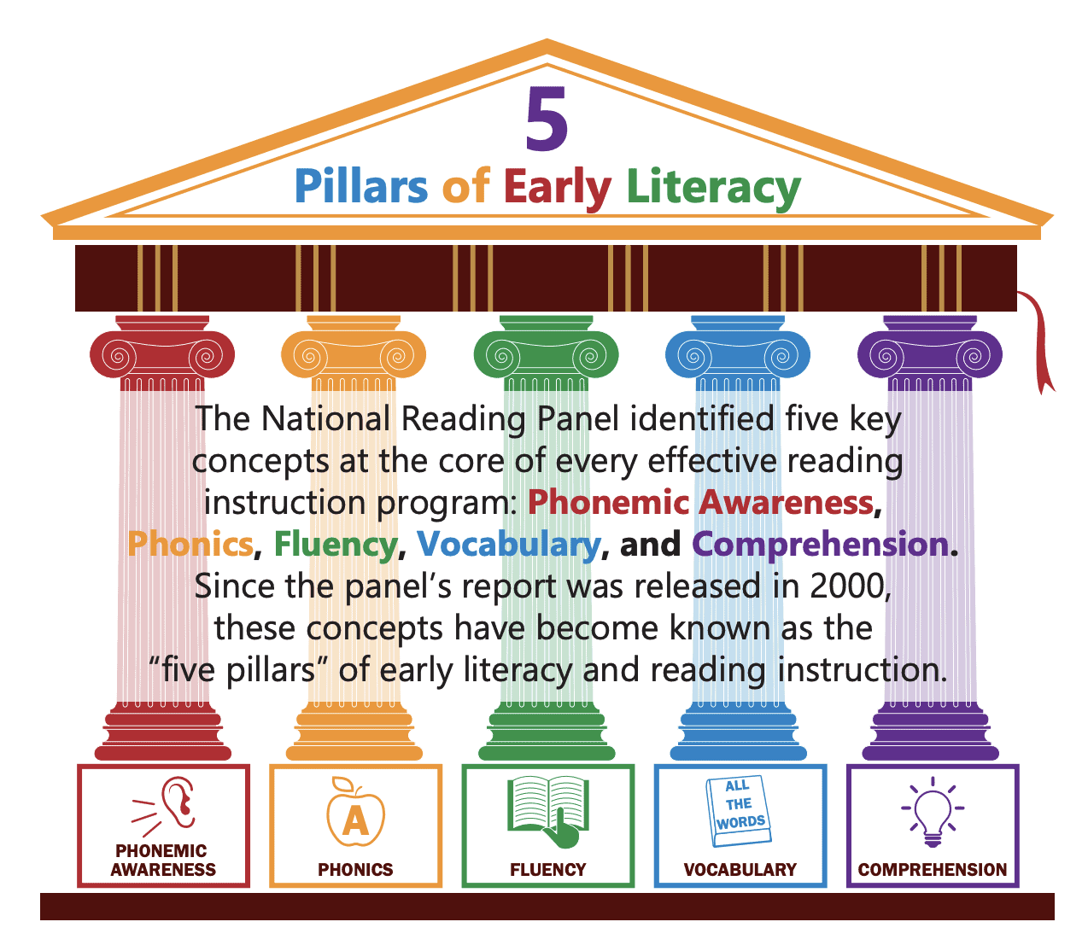
The National Reading Panel Report (2000)
KDE Division of Early Literacy (2023)
Fluency is “the ability to read text quickly, accurately, and with proper expression” (pp. 3-5).
Fluency is “the ability to read text with sufficient speed and accuracy to support comprehension.”
Image courtesy of The Knowledge Matter Campaign.
Notes:
Guiding Notes:
Like many terms in education, fluency has been defined by several different groups in different ways, all with the same goal–for students to be able to read fluently to comprehend text. Remember from Session 1 that Fluency is one of the 5 Pillars of Early Literacy identified in the 2000 National Reading Panel report. The same group also identified it as one of the pillars of adolescent literacy because fluency is that essential for comprehension.
The Kentucky Department of Education Division of Early Literacy has clarified that definition with the phrase “to support comprehension” to emphasize the role of fluent reading.

Slide 16
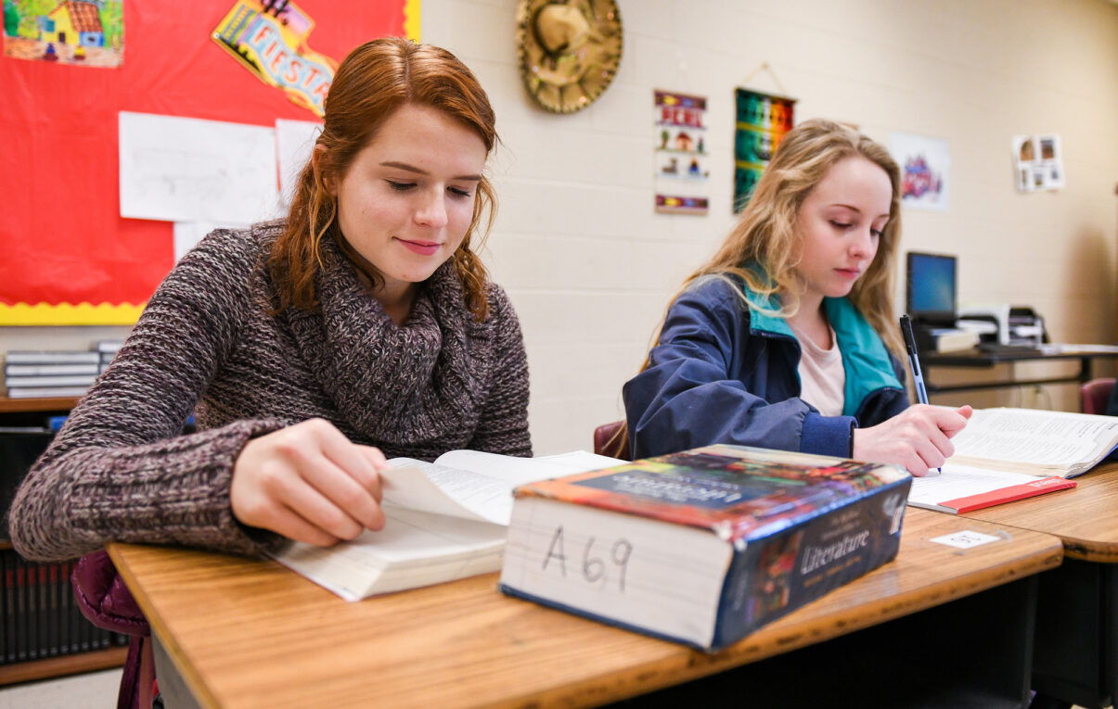
Pikulski & Chard (2005) definition:
“Fluency is manifested in accurate, rapid, expressive oral reading and is applied during, and makes possible, silent reading comprehension.”
Notes:
Guiding Notes:
Pikulski & Chard (2005) added on to this definition, emphasizing the importance of fluency for students to comprehend when they read silently.

Slide 17
Synthesizing Three Definitions:
Fluency is reading with sufficient speed, accuracy and expression (NRP, 2000) to support both oral reading comprehension (KDE, 2023) and silent reading comprehension (Pikulski & Chard, 2005).
Notes:
Guiding Notes:
This slide synthesizes those three definitions.

Slide 18
Tosto et al. (2017)
By 8th grade, fluency continues to explain 25% of the variance in reading comprehension.
That means if we could get all students to read fluently, the differences in comprehension would be reduced by 25%.
Notes:
Guiding Notes:
Data interpreted by Tim Shanahan (2024) in his blog post, “Do middle and high school students need fluency instruction and what counts as instruction?”
Tosto, M. G., Hayiou-Thomas, M., Harlaar, N., Prom-Wormley, E., Dale, P. S., & Plomin, R. (2017). The genetic architecture of oral language, reading fluency, and reading comprehension: A twin study from 7 to 16 years. Developmental Psychology, 53(6), 1115-1129. https://doi.org/10.1037/dev0000297
Full text of the article: https://psycnet.apa.org/fulltext/2017-22471-001.pdf

Slide 19
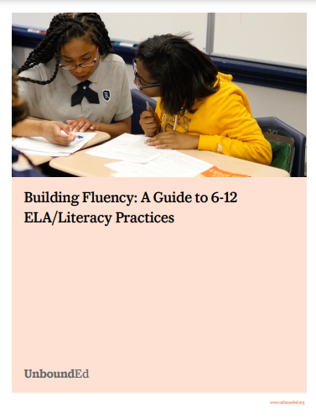
UnboundEd (2022):
“It takes a repeated exposure to a large amount of text to acquire a deep inventory of words that are instantly recognized. This additional reading also deepens the reader’s knowledge of the world, which increases comprehension. Unfortunately, struggling students—as a result of their poor reading—often lack the motivation to engage in the amount of reading that will, in turn, improve their reading. It is incumbent upon us, across all content areas, to find ways to support and encourage reading throughout the day.”
Notes:
Guiding Notes:
Unbound Ed Guide to Grades 6-12 Fluency is a report that provides recommendations for teachers and schools to support students with fluency. This particular quote emphasizes that students need a high volume of reading in order to become fluent readers.

Slide 20
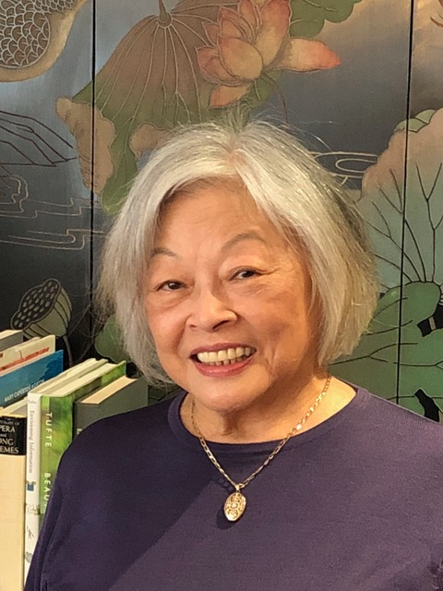
Lily Wong Fillmore (2013)
“No one is a native speaker of academic English.”
Fluency is a key factor to support ALL students with complex, grade-level text.
Notes:
Guiding Notes:
For more information on the work of Lily Wong Fillmore.

Slide 21
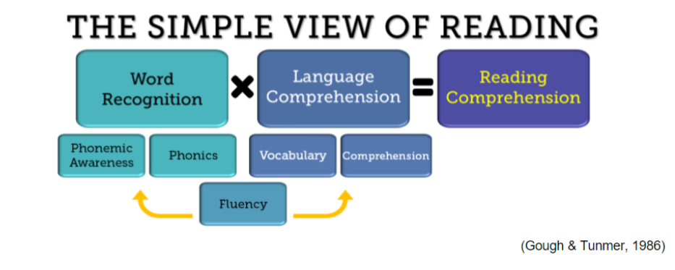
What are the root causes of poor fluency?
Notes:
Guiding Notes:
Recall the Simple View of Reading from Session 1. We know that reading comprehension is the result of strong word recognition AND strong language comprehension. Poor fluency may be the result of a word recognition difficulty, a language comprehension difficulty or both.
This diagram comes from the Division of Early Literacy webpages, and what we like about it is how it shows that fluency brings together both WR and LC to support skilled reading. Fluency is absolutely foundational in both aspects of skilled reading and takes practice and development across the lifespan.

Slide 22
What do I do when I suspect or even know a student has gaps in fluency?
Because fluency binds word recognition and language comprehension together, remember that a number of factors may contribute to a lack of oral or silent reading fluency.
Consult with your local leadership (i.e., reading specialist/interventionist, instructional coach, MTSS and/or special education coordinator) for assessments and instructional supports.
Notes:
Guiding Notes:
This slide is extremely important to emphasize that students and teachers need strong systems to change reading achievement in middle schools and high schools. Teachers should not be individually tasked with increasing reading achievement without proper support from administrators, interventionists, MTSS staff and/or special education specialists.
A number of factors may contribute to a lack of fluent reading. Schools working in teams can better support students and teachers.

Slide 23
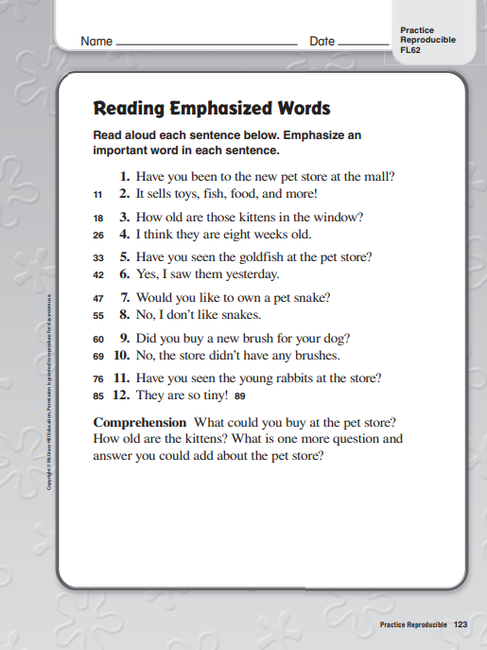
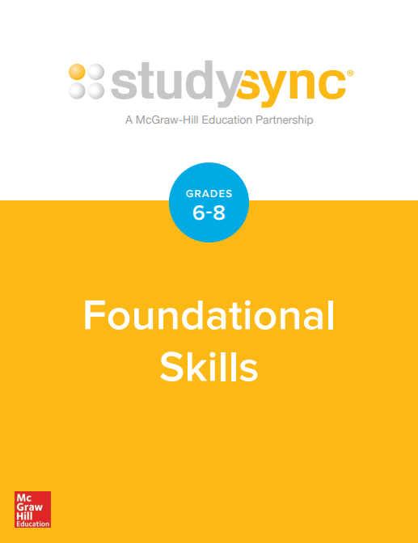
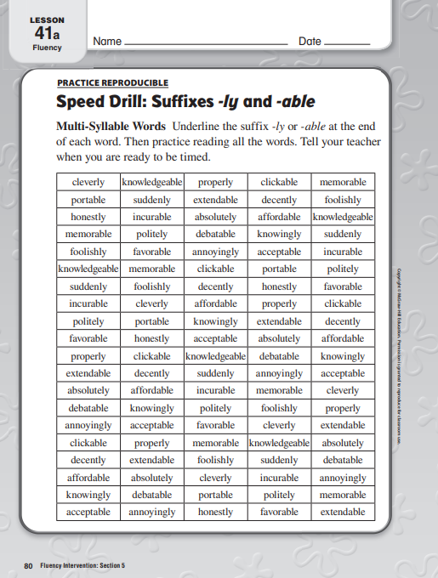
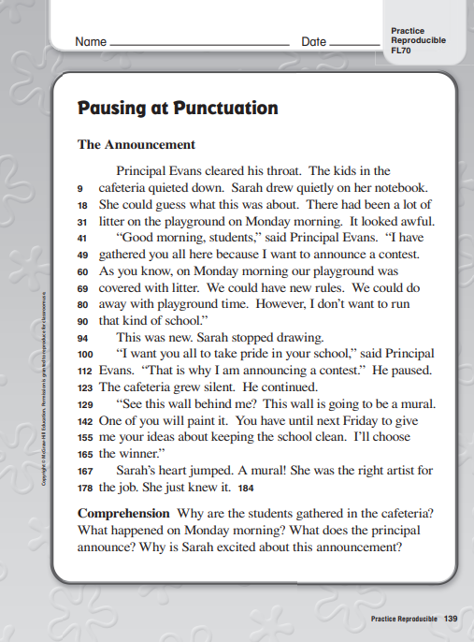
Consult your High-Quality Instructional Resource (HQIR)!
Notes:
Guiding Notes:
These examples of fluency resources are included with McGraw-Hill StudySync for grades 6-8. MANY HQIRs, even those intended for Tier 1 instruction, likewise include these types of resources and supports to both assess and provide instruction and feedback on various fluency skills like those you see here. Note that StudySync works from the word level (bridging what we learned last week with multisyllabic words and morphemes) all the way to practicing awareness of emphasis, punctuation and syntax.
If your district is still under a professional development/learning contract with your vendor, you may be able to request some sessions on using the resources you already have to support your developing readers.

Slide 24
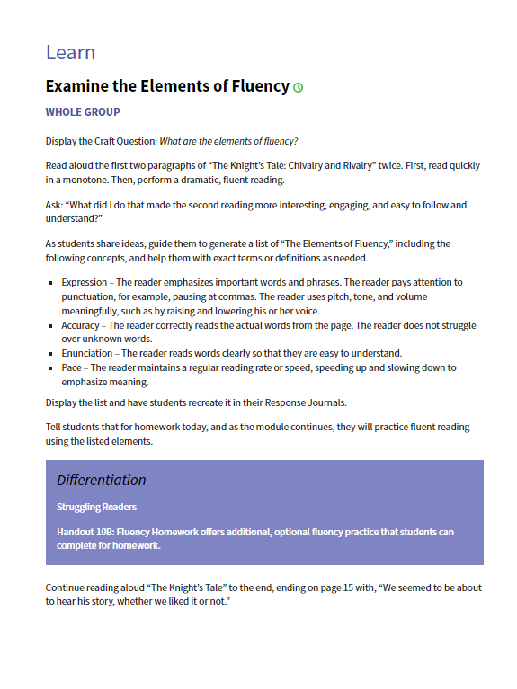
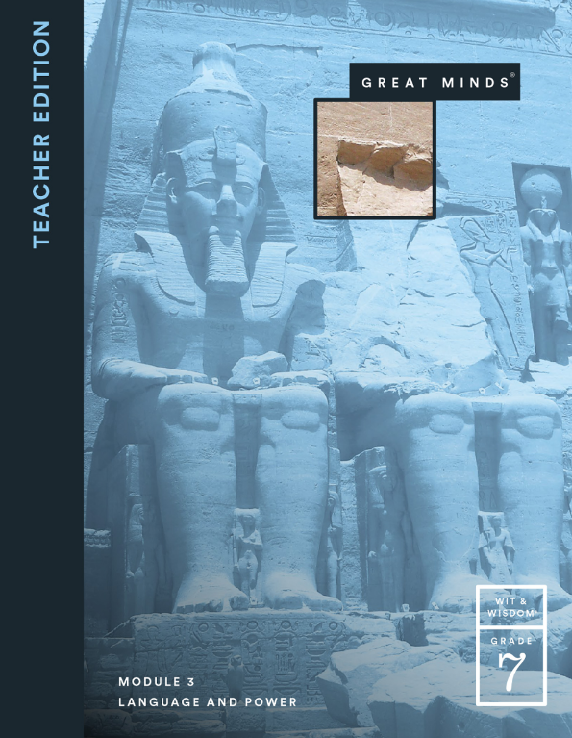
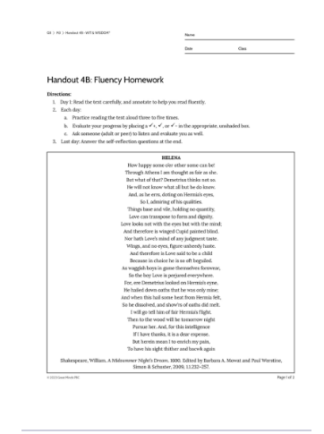
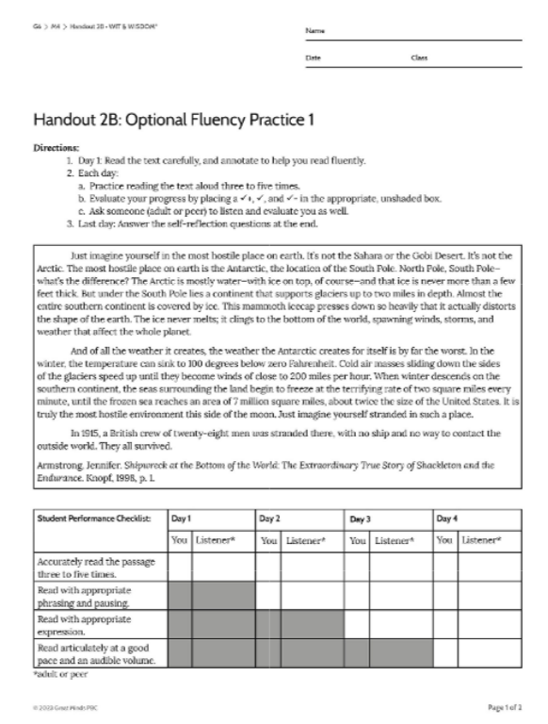
Consult your HQIR!
Notes:
Guiding Notes:
Similarly, Wit & Wisdom, another HQIR that we referenced last week also includes explicit fluency practice and homework for students to self-assess their growth.

Slide 25
What if a school or district hasn’t yet adopted a green-rated HQIR?
We will practice three fluency routines you can implement with any text at any time.
Notes:
Guiding Notes:
Is my resource green-rated? https://www.edreports.org/

Slide 26
How is fluency taught in early grades?
Notes:
Guiding Notes:
This section provides some information about fluency is taught in grades K-5 so that middle and high school teachers have awareness of what kinds of routines are often used with younger students.

Slide 27
Evidence-Based Fluency Routines in Grades K-5
Echo/Modeled Reading*
Repeated Reading*
Choral Reading*
Readers’ Theater
* Mentioned, but not by name, in the Practice Guide
Notes:
Guiding Notes:
This section provides some information about fluency is taught in grades K-5 so that middle and high school teachers have awareness of what kinds of routines are often used with younger students.
Repeated Readings, especially for younger students, helps expand the total number of words they can recognize instantaneously and consequently improve comprehension.
HQIR: Odell Education High School Literacy Program
Grade-level: 9
Unit: Global Food Production
Grade-level, Complex Text: The Food System | Food System Primer
Readers’ Theater is a strategy where students read from a script (no memorization, set, costumes). Repeated readings are part of the process prior to demonstrating oracy skills for the audience to imagine the story, much like an audiobook.
HQIR: EL Education
Grade-level: 2
Module 1, Unit 2, Lesson 8: Schools and Community
Grade-level, Complex Text: Boat School, Rainforest School, Tent School
HQIR: Odell Education High School Literacy Program
Grade-level: 9
Unit: Romeo & Juliet
Grade-level, Complex Text: Rome & Juliet by William Shakespear, published by Simon & Schuster

Slide 28
Pause and Reflect
"The research...demonstrates quite clearly a robust correlation between excessive oral reading and silent reading comprehension (Rasinski, Reutzel, Chard, & Linan-Thompson, 2011). That is, students who read orally with good expression are more likely to comprehend deeply when reading silently.”
Rasinski, Timothy V. The Megabook of Fluency: Strategies and Texts to Engage All Readers. Scholastic, 2018.
How does this research and our learning thus far affirm and/or challenge your current practices related to fluency instruction?
Notes:
Guiding Notes:
You may choose to lead the participants in a choral reading to discuss how parenthetical citations are not typically read aloud. This gives teachers the opportunity to experience choral reading as a routine.
Next, give participants an opportunity to discuss the question on the slide.

Slide 29
Routines for Building Fluency
Notes:
Guiding Notes:
This section is perhaps the most important as it demonstrates how to implement fluency instruction in grades 6-12.

Slide 30
Routines We Will Be Practicing
to Use in Instruction:
Building purpose for repeated readings (pp. 12-13)
“Say Something” & purposeful paired readings (p. 17)
Chorally reading and rehearsing pre-20th century texts (pp. 15-16)
Considerations for silent reading
Access a summary of these on this session’s Fluency Routines Sheet.
Page numbers indicate where to find explanations for these routines in the Practice Guide.
Notes:
Guiding Notes:
These are four simple, low-prep, evidence-based routines for supporting students with fluency in middle and high school.

Slide 31
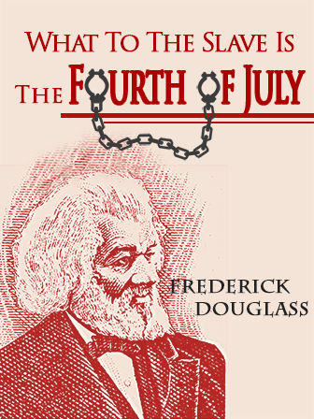
Tonight’s Sample Texts:
Macbeth (1606) by Shakespeare (No Lexile)
“What to the Slave is the Fourth of July?” (1852) by Frederick Douglass (1140L)
Animal Farm (1945) by George Orwell (1170L)
Notes:
Guiding Notes:
These are three texts that appear commonly in HQIRs as well as in KY grades 6-12 curricula. Note that our informational text, the Frederick Douglass speech, is also one of the 24 fundamental American documents and speeches KRS 158.196 incorporates into the middle and high school social studies as of July 2023.
Animal Farm is an optional text in StudySync grades 9-10, a central text in Wit & Wisdom grade 7, an optional text in MyPerspectives (Savvas) grade 12, and is commonly found in curricula around Kentucky.
Many HQIRs for middle and high school include Shakespearean texts, so we chose Macbeth as a sample text commonly taught in KY high schools. The skills we will practice will be transferable to other pre-20th century texts.

Slide 32
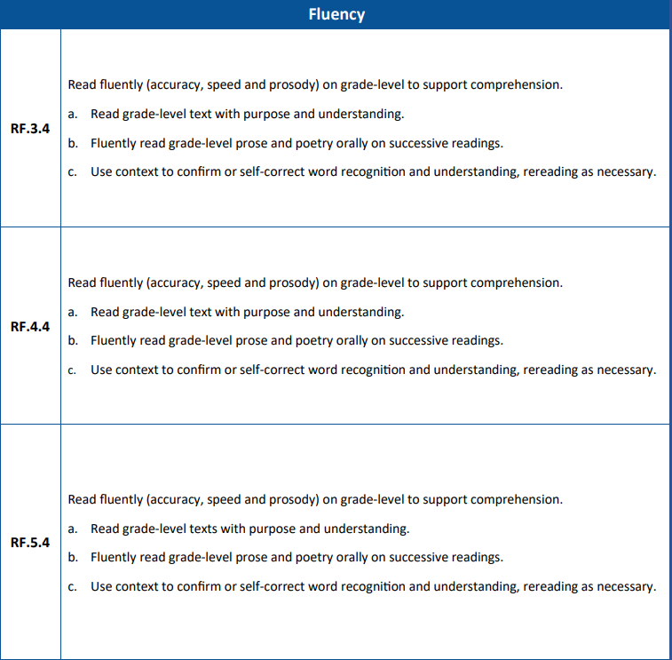
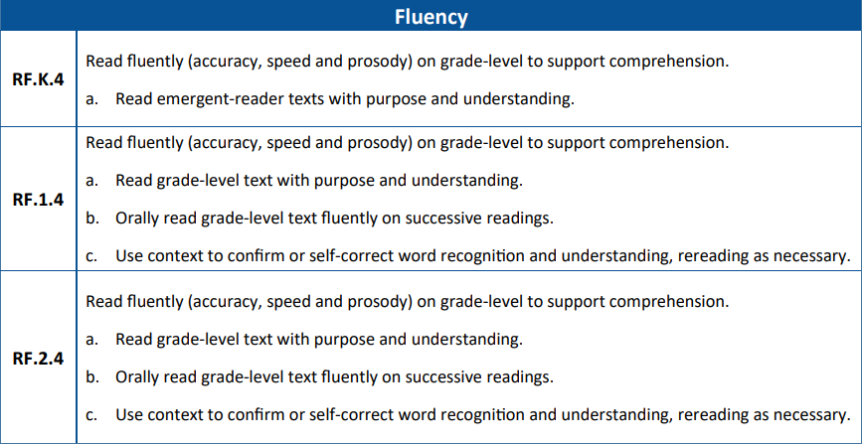
Where do we see fluency in the KAS for Reading and Writing?
Standard 4 in the Reading Foundational Skills (RF) strand explicitly names fluency as an essential skill from grades K-5.
Notes:
Guiding Notes:
Often, educators wonder if something like fluency is included in the state standards. In grades K-5, the Kentucky Academic Standards for Reading and Writing explicitly mention fluency in the reading foundational skills (RF) standards.

Slide 33
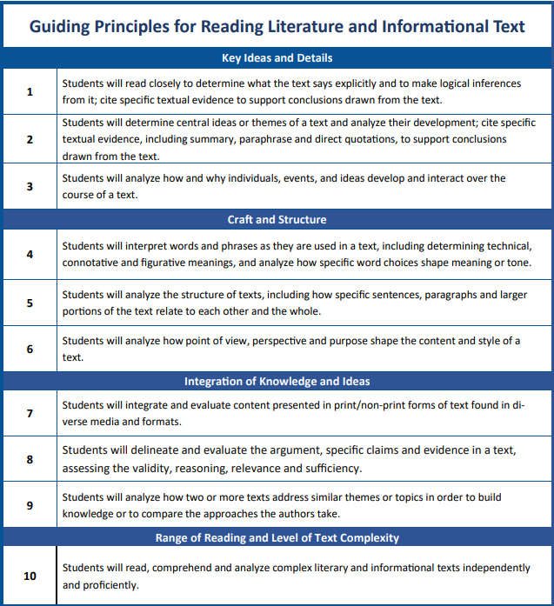
Are there standards for fluency in Grades 6-12?
The KAS for Reading and Writing does not explicitly name fluency in Grades 6-12.
However, fluency is essential for students to comprehend and then analyze texts. In order to analyze, students need sufficient cognitive “desk space” made available by fluent reading.
Notes:
Guiding Notes:
The purple boxes in the graphic represent times where students are expected to analyze or use analytical reasoning within the Guiding Principles for RL and RI. Since comprehension is essential for analysis and fluency is essential for comprehension we know that fluency is therefore absolutely necessary for students to even begin to analyze complex, grade-level texts. Again, while fluency is not explicitly named in the Grades 6-12 standards, we know that as students encounter increasingly complex, grade-level work and texts, they will likely need explicit supports in fluency in order to comprehend and then analyze texts. We can imagine how challenging analysis is for a student has strong word recognition skills but is still growing in fluency. Fluency is the bridge to comprehension and is also the bridge to analysis!

Slide 34
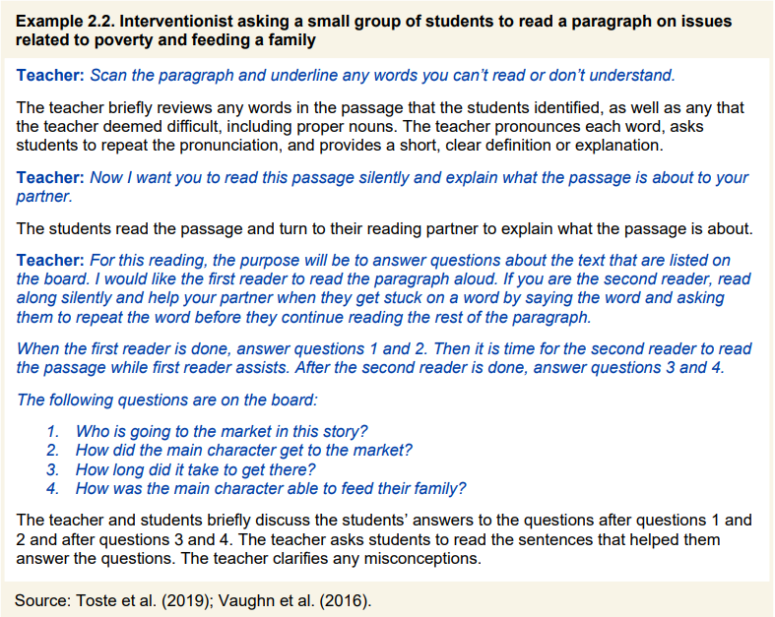
How do we build purpose for repeated readings of complex text?
The Guide provides two examples for purposeful repeated readings.
We will build on this with one of our sample texts, Animal Farm by George Orwell (1170L).
pp. 13-14
Notes:
Guiding Notes:
The IES Guide demonstrates how students might have multiple reasons for reading a complex text. These screenshots from pp. 13-14 provide those examples, and we have a sample we will examine as part of this session.

Slide 35
Routine 1:
Purposeful Repeated Readings
Realistically, we cannot do repeated readings of every passage.
What RL/RI standard are you addressing?
If having students read something multiple times, ensure they are working towards both comprehension AND analysis.
“Old Major’s Speech” from Chapter 1
RL.8.3
pp. 13-14
Notes:
Guiding Notes:
Carefully select passages for repeated readings. In this example, Old Major’s Speech from Chapter 1 of Animal Farm is conceptually central to students’ understanding of the text. It also provides a support early in the reading to support students with vocabulary and syntax of the complex text.
It is important to center use the standards to set a purpose for repeated readings. In this example, students are using RL.8.3 to support their comprehension.

Slide 36
Other considerations for fluency practice passage selection:
Creates space for a close read early in the novel
Creates equity for strong engagement with the text as well as generates interest in the plot
Introduces students to the language and register of the text to build familiarity and confidence
Supports multisyllabic word reading
“Old Major’s Speech” from Chapter 1
Notes:
Guiding Notes:
This slide details how teachers may strategically select a passage from a longer text for a repeated reading.

Slide 37
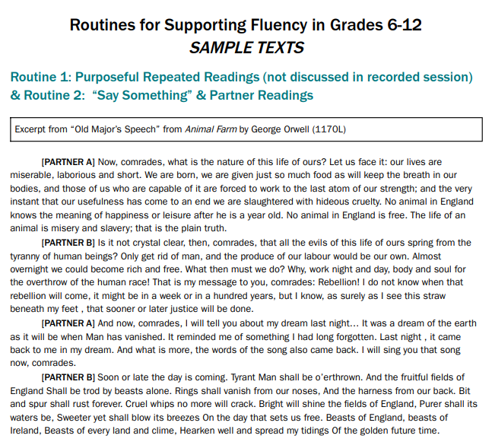
Purposeful Repeated Readings
First Read: Read for multisyllabic words.
Second Read: Read for comprehension using “right there” (“on the line”) questions.
Third Read: Read for analysis using questions tied to the Kentucky Academic Standards addressed.
Notes:
Guiding Notes:
This slide details three possible reasons to read a passage:
Multisyllabic word decoding
Comprehension
Analysis

Slide 38
Purposeful Repeated Reading Routine, Step 1:
First Read: Read paragraph one only. Write the words you see with the suffixes we’ve been learning:
Suffix: | Suffix Meaning: | Words I See With This Suffix:
-ness | state of | 2.
-able | capable of | 2.
-ous | full of | 2.
usefulness
happiness
miserable
capable
laborious
hideous
Notes:
Guiding Notes:
This slide shows how students may use a first read to scan for multisyllabic words. This is particularly important for students or groups who have been identified to need support with decoding multisyllabic words. In this example, morphemes –ness, -able, and –ous have been pre-selected. Students scan the text (in this example, Animal Farm) to write down words using those morphemes.
The purpose here is that students continue developing skills in multisyllabic word attack, which can support them in becoming rapid, automatic readers.

Slide 39
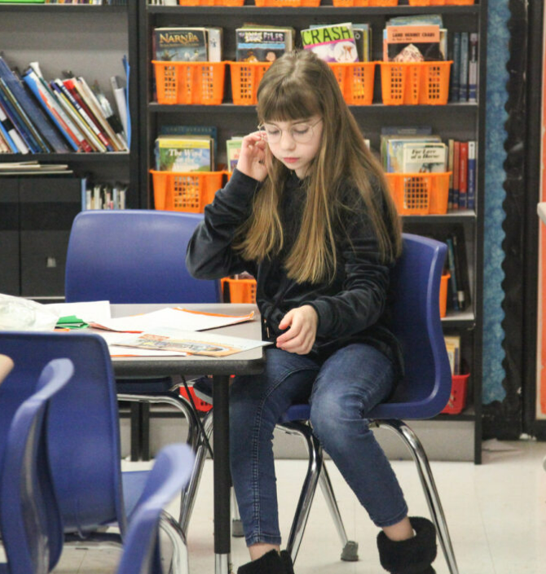
Purposeful Repeated Reading Routine, Step 2:
Step 2: Read the passage again and answer this comprehension question.
What is Old Major’s (the speaker) attitude towards the life of fellow animals? Cite a quote or summary from the text to support your idea.
Notes:
Guiding Notes:
After scanning the passage for the identified morphemes, students read with a second purpose aligned to a standard. In this example with Animal Farm, the question is aligned to RL.8.3: Analyze how particular lines of dialogue or incidents in a story or drama propel the action, reveal aspects of a character or provoke a decision.
Students use this skill to comprehend Old Major’s Speech by answering this question either in writing, discussion or both: What is Old Major’s (the speaker) attitude towards the life of fellow animals? Cite a quote or summary from the text to support your idea.

Slide 40
Purposeful Repeated Reading Routine, Step 3:
Step 3: Read the passage a third time and answer this analysis question (RL.8.3).
What does this first paragraph reveal about Old Major’s intentions for speaking to the other animals? Cite a quote or summary from the text to support your idea.
Notes:
Guiding Notes:
Finally, students read the passage a third time for analysis.
In this example with Animal Farm, the question is aligned to RL.8.3: Analyze how particular lines of dialogue or incidents in a story or drama propel the action, reveal aspects of a character or provoke a decision.
Students use this skill to comprehend Old Major’s Speech by answering this question either in writing, discussion or both: What does this first paragraph reveal about Old Major’s intentions for speaking to the other animals? Cite a quote or summary from the text to support your idea.

Slide 41
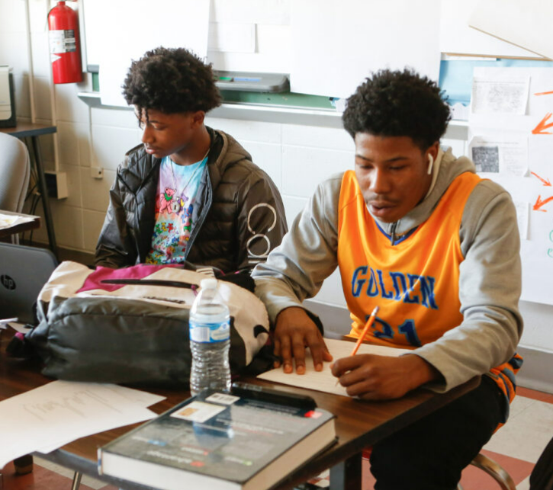
Routine 2: “Say Something” and Partner Reading
Partner reading is another pathway to purposeful repeated reading with models of fluent reading.
See pp. 17 of the IES Practice Guide for tips for pairing students so that partner work is productive.
Consider homogeneous and heterogeneous groupings.
p. 17
Notes:
Guiding Notes:
Consider grouping students with similar and different abilities. If you’re new to partner reading, you may consider pairing students in ways they feel comfortable at first.
IES Practice Guide: Providing Reading Interventions for Students in Grades 4-9

Slide 42
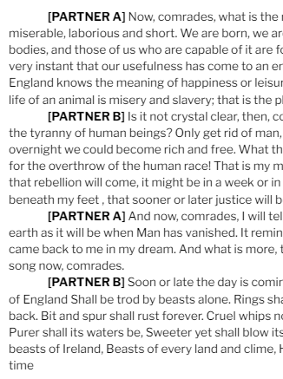
“Say Something” Benefits:
Works with any complex text in any grade level
Low-prep, low-stakes and high yield
Establishes a culture of talking about texts
Provides a rich opportunity for informal fluency practice without teacher-directed practice
See the full version of this exercise on the Fluency Routines Sheet.
“Old Major’s Speech” from Chapter 1
Notes:
Guiding Notes:
This slide the benefits of using a paired partner reading like “Say Something.”

Slide 43
FIRST READ:
Say Something! Determine who is Partner A and who is Partner B. Follow along as your partner reads. Once they have finished their portion, your job is to say something:
something interesting that you learned,
a personal reaction or belief about what is said,
a question/wondering
or something you want to learn more about
Notes:
Guiding Notes:
Note that students alternate reading aloud and making an observation about the text. In this example, students can say anything about the text, but the instructor may choose to focus comments on a particular aspect of the text such as character, tone, setting, or conflict.

Slide 44
SECOND READ:
After you’ve finished reading, re-read the passage silently and highlight two details in the text that stood out to you and helped create a vivid picture of Old Major’s intentions.
Note the second read requires students to read with a specific purpose: to analyze Old Major’s intentions.
Notes:
Guiding Notes:
Again, students are required to read a passage multiple times with the second reading requiring them to engage in more in-depth analysis of the text.

Slide 45
Routine 3:
Choral Reading and Rehearsing
Pre-20th Century Texts
Prosody connects the meaning and expression behind speech to printed text, thus supporting comprehension of what students read.
“Teach students to pause at commas, stop at periods, raise or lower their voice when encountering a question mark, and show emotion when encountering an exclamation point.”
pp. 15-16
Notes:
Guiding Notes:
This quote from the IES Practice Guide demonstrates how many students, even in middle and high school, may still need support with prosody.

Slide 46
Structured Literacy Tip:
Make sure students have a routine for productively providing each other corrective feedback.
Teach your students a protocol for providing corrective feedback: “Ask, Then Tell” (Archer, 2010).
When your partner pauses or reads a word incorrectly, ask: “Can you figure out this word?” (wait 4 seconds)
Tell them the word.
They read the sentence again with the correct word.
Notes:
Guiding Notes:
“Ask, Then Tell” comes from Anita Archer’s book, Explicit Instruction: Effective and Efficient Teaching (2010).

Slide 47
Routine 3:
Choral Reading and Rehearsing: Pre-20th Century Texts
Can be used with ANY text as a warm-up over several days
This should not take an entire class period (10-15 minutes).
Requires a culture of engagement and talk
May require students to “take off their cool jacket”
Engage classroom leaders.
Start with very low-stakes choral reads.
Enjoy! This feels like play, which older students don’t always experience!
Notes:
Guiding Notes:
Note that this prosody exercise is not intended to take an entire class period and may require some special considerations to support students.

Slide 48
Choral Reading and Rehearsing
of Pre-20th Century Texts
According to the Folger Shakespeare Library, the word “O” appears over 2,700 times in all of Shakespeare’s works.
In the Chat: What emotions might the word “O” express?
Notes:
Guiding Notes:
This exercise, including this information, comes from the Folger Shakespeare Library Teaching Resources: https://www.folger.edu/

Slide 49
Begin with low stakes practice to introduce prosody.
Say “O” with the following expression:
Other simple words to introduce prosody with ML students or students who do not read Shakespeare:
Hello!
Goodbye!
What?
Please!
Stop!
O! (suspicious)
O! (flirtatious)
O! (discouraged)
O! (terrified)
O! (confused)
O! (gleeful)
Notes:
Guiding Notes:
This activity is low-stakes, low-prep and preps students to become accustomed to the “feeling” or choral reading if it’s not a typical classroom practice. Note that even if you do not teach Shakespeare you can and should introduce the concept of “prosody” to students–intentionally connecting speech to print helps students engage with the very human meanings that words can carry in their reading.
However, this is just a starting point! Let’s look at how this prosody activity can support chorally reading longer texts.

Slide 50
Transition to short phrases from the text you will read:
Whisper read this line from Macbeth to yourself:
“O gentle lady, ‘tis not for you to hear what I can speak.”
Use sentences from the complex text your students are reading.
Notes:
Guiding Notes:
Again, with archaic (or any complex) texts, starting small builds confidence and reinforces the idea that words and sentences carry meaning. We are always signaling comprehension with every activity!

Slide 51
Now let’s read that same line aloud together:
“O gentle lady, ‘tis not for you to hear what I can speak.”
Notes:
Guiding Notes:
Again, with archaic (or any complex) texts, starting small builds confidence and reinforces the idea that words and sentences carry meaning. We are always signaling comprehension with every activity!

Slide 52
Read the same line now with gentleness or fondness:
“O gentle lady, ‘tis not for you to hear what I can speak.”
Notes:
Guiding Notes:
Again, with archaic (or any complex) texts, starting small builds confidence and reinforces the idea that words and sentences carry meaning. We are always signaling comprehension with every activity!

Slide 53
Read the same line now with disdain or hatred:
“O gentle lady, ‘tis not for you to hear what I can speak.”
Repeat this choral reading with 3-5 sentences that preview plot points, characters, themes or comprehension of the text.
Notes:
Guiding Notes:
Again, with archaic (or any complex) texts, starting small builds confidence and reinforces the idea that words and sentences carry meaning. We are always signaling comprehension and analysis with every activity!

Slide 54
Introduce and practice emphasis when reading.
Whisper read this passage from Macbeth to yourself:
“We will proceed no further in this business.”
Use sentences from the complex text your students are reading.
Notes:
Guiding Notes:
Emphasis is yet another component of prosody. Emphasis changes the interpretation of a line, particularly a line of dialogue.

Slide 55
Introduce and practice emphasis when reading aloud.
Now, read the sentence aloud as a class emphasizing the underlined word:
“We will proceed no further in this business.”
“We will proceed no further in this business.”
“We will proceed no further in this business.”
“We will proceed no further in this business.”
“We will proceed no further in this business.”
“We will proceed no further in this business.”
Notes:
Guiding Notes:
Ask participants to reflect on how meaning changes with emphasis.

Slide 56
Move on to longer passages to chorally read:
Whisper read this passage from Macbeth to yourself:
Was the hope drunk
Wherein you dress'd yourself? hath it slept since?
And wakes it now, to look so green and pale
At what it did so freely? From this time
Such I account thy love. Art thou afeard
To be the same in thine own act and valour
As thou art in desire?
After practicing reading this fluently as a group, ask comprehension questions like: How might you translate the final sentence to modern English?
Notes:
Guiding Notes:
This slide shows the length of passage a teacher may choose to read chorally beyond single lines. While the purpose is to support students with more confidently reading an older text, these exercises can also support students with comprehension.

Slide 57
Routine 4:
What about considerations for silent reading?
Rasinski, Rikli and Johnston (2011) report significant and substantial correlations between measures of fluency (prosody) among upper elementary and middle school students and a standardized test of silent reading comprehension.
They found that the more structures and scaffolds a student had prior to silent reading, the more they were able to comprehend independently.
Notes:
Guiding Notes:
Realistically, students are much more likely to need to read fluently silently than they are to read aloud. Silent fluent reading is not only an essential postsecondary readiness skill, students need to be able to read silently for high school coursework. These ideas present some considerations to support silent fluent reading that results in comprehension.
Note that the stamina challenge should also center comprehension. The goal is not for students to sit quietly and look at a text. As they build their silent reading fluency and stamina, they should also be working towards a task that requires them to comprehend what they are reading. This may include talking or writing with a partner or as a class about what was read after the silent reading is over.
“The Relationship Between a Silent Reading Fluency Instructional Protocol on Students’ Reading Comprehension and Achievement in an Urban School Setting” by Rasinski, Rikli and Johnston

Slide 58
Routine 4:
How can fluency support silent reading?
Fluency practice is the perfect avenue for us to avoid dropping students into complex texts with no supports, especially if a student is not yet a skilled reader.
“What to the Slave is the Fourth of July?” (1852) by Frederick Douglass (1140L)
Notes:
Guiding Notes:
Realistically, students are much more likely to need to read fluently silently than they are to read aloud. Silent fluent reading is not only an essential postsecondary readiness skill, students need to be able to read silently for high school coursework. These ideas present some considerations to support silent fluent reading that results in comprehension.
Note that the stamina challenge should also center comprehension. The goal is not for students to sit quietly and look at a text. As they build their silent reading fluency and stamina, they should also be working towards a task that requires them to comprehend what they are reading. This may include talking or writing with a partner or as a class about what was read after the silent reading is over.

Slide 59
Simple Ways to Support Silent Reading
Pair silent reading with oral reading and partner reading (see Routines 1-3!)
Provide structure and accountability for comprehension with text-dependent questions.
Work towards building stamina with increasingly longer periods of sustained reading and focus. Have a light-hearted class challenge to work towards 5-15 minutes of sustained reading.
Notes:
Guiding Notes:
Realistically, students are much more likely to need to read fluently silently than they are to read aloud. Silent fluent reading is not only an essential postsecondary readiness skill, students need to be able to read silently for high school coursework. These ideas present some considerations to support silent fluent reading that results in comprehension.
Note that the stamina challenge should also center comprehension. The goal is not for students to sit quietly and look at a text. As they build their silent reading fluency and stamina, they should also be working towards a task that requires them to comprehend what they are reading. This may include talking or writing with a partner or as a class about what was read after the silent reading is over.

Slide 60
Routine 4:
Considerations for Silent Reading
Whisper read this sentence from our text to yourself:
“This Fourth of July is yours, not mine. You may rejoice, I must mourn.”
Notes:
Guiding Notes:
Let’s take a look at what it might look like to set the stage for silently reading a complex informational text.

Slide 61
Setting the Stage for Silent Reading
Now, let’s read it chorally:
“This Fourth July is yours, not mine. You may rejoice, I must mourn.”
Why might a person mourn on the Fourth of July?
Notes:
Guiding Notes:
After reading chorally, we have a moment to reflect on this meaning of the words and make inferences about what the speaker is experiencing.

Slide 62
Setting the Stage for Silent Reading: Sentence Level
Whisper read this sentence from our text to yourself:
“Your high independence only reveals the immeasurable distance between us.”
Notes:
Guiding Notes:
Here students have a second sentence with more multisyllabic words that reveal why the speaker might mourn on the Fourth of July.

Slide 63
Ask students to make inferences:
Now read it chorally:
“Your high independence only reveals the immeasurable distance between us.”
Look at the title, picture and year published. Why is this speaker mourning on the Fourth of July?
1852
Notes:
Guiding Notes:
This question certainly requires students to make some inferences using possible background knowledge as well as understanding of the title.

Slide 64
Caution
Popcorn and Round Robin Reading
“Popcorn and round robin reading do not support comprehension; in fact, round robin reading was found to hinder comprehension because of its overemphasis on decoding and word accuracy (Gill, 2002).”
https://www.researchgate.net/publication/321336458
Text Complexity
“Fluency practice is best carried out with texts that students will struggle with…”
How to Teach Fluency So That It Takes | Shanahan on Literacy
Notes:
Guiding Notes:
Not all oral reading routines or practices are evidence-based. There is very little research that supports popcorn or round-robin reading as effective tools for increasing student comprehension. Research also reminds us that in order to become more fluent readers, students need practice with complex texts that may be challenging for them.
Caution: Popcorn & Round-robin Reading
How to Teach Fluency So That It Takes | Shanahan on Literacy

Slide 65
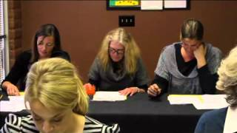
Caution:
What Round Robin Reading is Like for Striving Readers
While we are not watching this video in the session, we recommend watching on your own or with colleagues to replace round robin reading with some of the recommended, evidence-based routines.
Notes:
Guiding Notes:
This video simulates how anxiety-inducing and unproductive round robin reading is in classrooms.
Caution: Round-robin simulation video

Slide 66
Reflection
Use your calendar or planner. When and how might you incorporate one or two of these fluency routines into your instruction this week?
Notes:
Guiding Notes:
Prompt participants to reflect on the slides and routines from this session. How might these routines be incorporated into instruction In the coming weeks?

Slide 67
Next Steps

Slide 68
For Session 4:
Read pp. 27-43 of the Practice Guide .
(Recommendation 3A: World and Word Knowledge)
Note Catcher

