Slide 1
Integrating Deeper Learning and HQIRs to Strengthen Tier 1 Instruction
Surface Learning
Notes:
[Misty] Hello everyone, and welcome to the second module of a four-part series on “Integrating Deeper Learning and HQIRs to Strengthen Tier 1 Instruction with an emphasis here on the surface learning phase. My name is Misty Higgins and I am joined today by Fox DeMoisey. We are professional learning coordinators in the Division of Program Standards, Office of Teaching and Learning, at the Kentucky Department of Education.

Slide 2
Module Purpose
Module Objectives:
Build understanding of “surface learning” and associated findings from learning science.
Explore indicators of surface learning using examples from HQIRs.
Consider deeper learning practices to support potential adjustments to a HQIR.
Notes:
[Misty] This module has three primary objectives:
Build understanding of “surface learning” and associated findings from learning science;
Explore indicators of surface learning using examples from HQIRs; and
Consider deeper learning practices to support potential adjustments to a HQIR at the local level.
Our intention is that the information within this session and accompanying tool provided at the end will enable districts to assess where an adopted HQIR is strong, both foundationally through the lens of learning science and with regard to characteristics of deeper learning and where it might need “smart adjustments” to more fully provide vibrant learning experiences and improved academic outcomes for all students.
We will now move into the first objective [CLICK] where we want to build understanding of “surface learning” and associated findings from learning science.

Slide 3
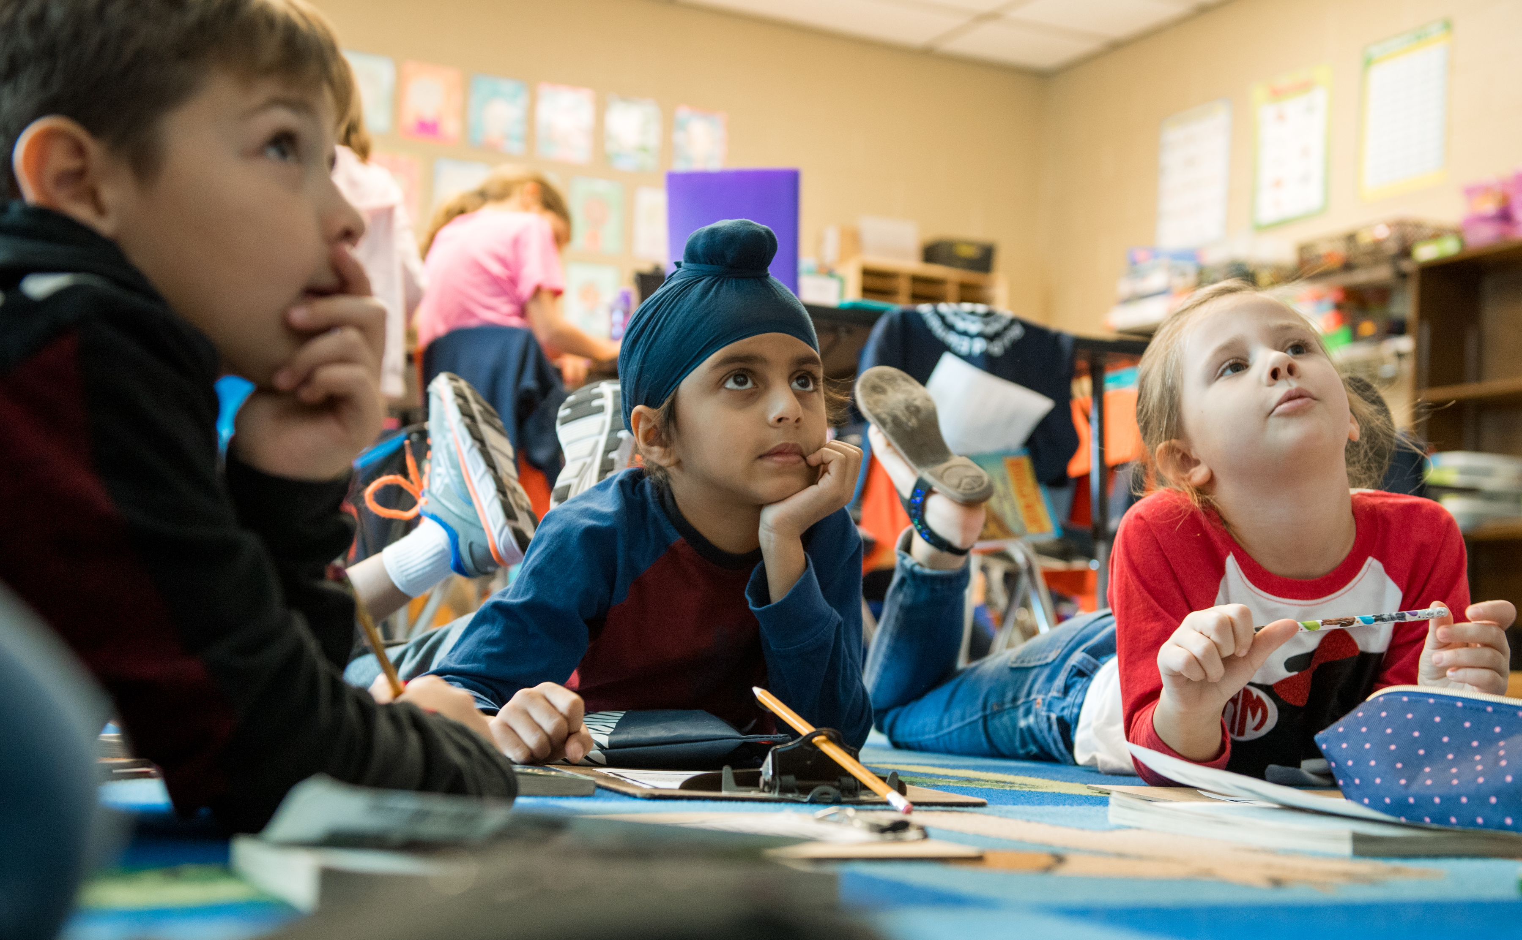
Opening Notes for Surface Learning
Priming for Learning helps cut through the clutter of all the environmental stimuli to gain students' initial attention, engaging emotions and sparking interest, so they are then motivated to commit to the learning ahead.¹
The “charging effect” from Priming for Learning needs to be sustained throughout surface learning to help ”magnetize” new knowledge, skills and strategies as they are introduced so they come together in working memory and can then be more readily moved to long-term memory.
If we want students to be able to transfer their knowledge to new situations, we must be intentional about how they acquire and store that knowledge in their brains in the first place. ²
Notes:
[Misty] In our first module, (click) we focused on the importance of priming for learning which helps to cut through all the clutter coming into students’ sensory register in order to gain their immediate attention.
(Click) It’s important to not only spark student interest at the beginning of a unit, but to also to sustain that “charging effect” in surface learning to help draw students to the new knowledge, skills and strategies they will encounter to better ensure the learning moves into working memory, and eventually into long-term memory.
(Click) As we transition into surface learning, an important note to keep in mind - If we want students to be able to transfer their knowledge to new situations, we must be intentional about how they acquire and store that knowledge in their brains in the first place.
References:
¹ Goodwin, B. (2020). Learning that sticks: A brain-based model for K-12 instructional design and delivery. Alexandria, VA: ASCD (ESSA Level IV)
² Stern, J., Ferraro, K., Duncan, K., & Aleo, T. (2021). Learning that transfers: Designing Curriculum for a changing world. Thousand Oaks, CA: Corwin (ESSA Level IV)

Slide 4
Phases of Learning
Notes:
[Misty] Anchoring back in the visual of the phases of learning, it is important to note these phases are not perfectly linear or distinct. Aspects of one phase may naturally occur in another, and there is likely to be some movement back and forth between them over the course of each unit of instruction.
Once we have the students immediate attention through priming for learning, the focus then shifts to taking in new learning and moving it into working memory. That takes us into the focus for this module on surface learning.
Link: https://education.ky.gov/curriculum/standards/kyacadstand/Documents/Integrating_HQIRs_and_Deeper_Learning_to_Strengthen_Tier_1_Instruction.pdf

Slide 5
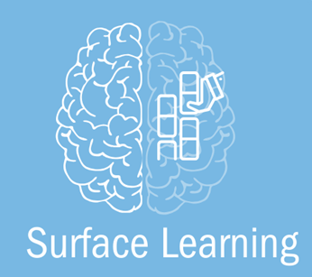
Surface Learning
Occurs when students are initially exposed to concepts, skills and strategies. It provides a foundation on which to build when students are asked to think more deeply and is associated with “declarative” and “procedural knowledge.”³
In surface learning, students must: ^{1,4}
Focus on new learning
Make initial sense of learning
Practice new learning
Notes:
[Misty] Surface learning (click) occurs when students are initially exposed to concepts, skills, and strategies that provide the foundation necessary for when students are asked to think more deeply. This phase is often associated with students encoding declarative and procedural knowledge into working memory, preparing it for long-term storage. (Click) In order for students to build this foundation, they must:
Focus on new learning;
Make initial sense of that learning; and
Practice with the new learning,
References:
¹ Goodwin, B. (2020). Learning that sticks: A brain-based model for K-12 instructional design and delivery. Alexandria, VA: ASCD (ESSA Level IV)
³ McTighe, J., & Willis, J. (2019.) Upgrade your teaching. Understanding by design meets neuroscience. Alexandria, VA: ASCD (ESSA Level IV)
⁴ Goodwin, B., Rouleau, K., Abla, C., Baptiste, K., Gibson, T., & Kimball, M. (2023). The new classroom instruction that works : the best research-based strategies for increasing student achievement (Third edition). ASCD, ; McREL International. (ESSA Level 4)

Slide 6
Rationale From Research
Why Surface Learning Matters
Notes:
[Fox 6-13] Now, we want to look at findings from research to better understand why surface learning matters. We will start by focusing on the specific findings around helping students focus on new learning and then look at the research on helping them make initial sense of learning. On each of the following slides, citations for the specific research referenced can be found in the slide notes for further exploration.

Slide 7
Focus on New Learning: Big Picture
For learning to occur, declarative knowledge (information) and procedural knowledge (skills, strategies) must move from working to long-term memory.
The brain’s storage process is binary: Information is either forgotten after 5 to 20 minutes, or it begins its journey toward long-term memory. ⁴
Working memory’s “bandwidth” can only code or carry a limited amount of cognitive demand or cognitive load. When that demand or load is exceeded, space is not available for additional information to be acquired. ⁵
There are “tricks” (strategies) to help “overcome” the limits of working memory. ⁴
*References included in the slide notes.
Notes:
[Fox] Let’s start with looking at the big picture around helping students focus on new learning. [CLICK] Surface learning is about optimally managing working memory so that declarative knowledge (information) and procedural knowledge (skills/strategies) have the best chance of reaching long term memory, which is the ultimate indicator learning has occurred. There are two significant logistical challenges to this teachers and students must contend with: [CLICK]
First, time: what's in working memory is forgotten after 5-20 minutes if it doesn't make it to long-term memory [CLICK]
Second, space: working memory’s “bandwidth” can only code or carry a limited amount of cognitive demand or cognitive load, about 4-7 items at a time. When that demand or load is exceeded, space is not available for additional information to be acquired.
And now for the good news [CLICK], there are ways of bending the rules of bandwidth a bit, which we will see on the following suite of slides.
References:
⁴ Goodwin, B., Rouleau, K., Abla, C., Baptiste, K., Gibson, T., & Kimball, M. (2023). The new classroom instruction that works : the best research-based strategies for increasing student achievement (Third edition). ASCD, ; McREL International. (ESSA Level 4)
⁵ Kirschner, P. A., & Hendrick, C. (2024). How learning happens: Seminal works in educational psychology and what they mean in practice (2nd ed.). Routledge.

Slide 8
Model of the Learning Process
Notes:
[Fox] This slide offers an illustration of the basic dynamics of how memory works. In the first module, we saw an emphasis on sparking student interest and then securing a commitment to learn in order to ”prime” students for the learning to follow so they are optimally receptive to it. In surface learning, this readiness helps student attention tune into what is important in the learning environment as teachers work to have informational inputs reach students in a rich way so they move from immediate memory to working memory [CLICK] ready to be effectively encoded. All of this, along with various kinds of active processing and practice, supports learning [CLICK] in eventually reaching long-term memory [CLICK] where it can be used over time. And for learning to endure without being forgotten [CLICK], it must be worked actively with.
References:
⁶ Sherrington, T. (2023). WalkThru 5-step guides to build great teaching (USA edition). John Catt.

Slide 9
Focus on New Learning: Specific Findings
Working memory is limited, but “dual coding” can help. ^{4, 7}
Working memory has an “informational bit limit” of 4-7 items at a time.
Information processing can “double” through dual coding, triggering both the visual and verbal memory systems together by offering images and text at the same time.
*References included in the slide notes.
Notes:
[Fox] Our first category from the research is about helping students “Focus on new learning,” and the first main takeaway here is [CLICK] “Working memory is limited, but “dual coding” can help.” I’ll pause to give you a moment to independently process two particular findings. [CLICK] (Allow time.)
Digging further into the research, we find working memory can only hold about 4-7 items at a time. Given all we want students to know and become able to do, that’s a tight spot. A first bit of encouraging news, however, is teachers can double information processing for their students through “dual coding,” which means by pairing images with text, spoken or written, so the visual and verbal systems engage together.
References:
⁴ Goodwin, B., Rouleau, K., Abla, C., Baptiste, K., Gibson, T., & Kimball, M. (2023). The new classroom instruction that works: The best research-based strategies for increasing student achievement (Third edition). ASCD, ; McREL International. (ESSA Level 4)
⁷ Clark, J. M., & Paivio, A. (1991). Dual coding theory and education. Educational Psychology Review, 3(3), 149-210. Accessed at https://nschwartz.yourweb.csuchico.edu/Clark%20&%20Paivio.pdf

Slide 10
Focus on New Learning: Specific Findings 2
Having new information as “written text” keeps it from “disappearing.” ⁸
“Transient information” is information that is presented to learners in spoken text or in instructional video, for example, but disappears from memory after a few seconds. ⁸
Having information written down makes it “non-transient,” ensuring it is all available to the learner at the same time and may be revisited when needed during practice. ⁸
*References included in the slide notes.
Notes:
[Fox] A second takeaway from the research here is [CLICK] “Having new information as ‘written text’ keeps it from ‘disappearing.’’’ I’ll pause to give you a moment to independently process two particular findings. [CLICK] (Allow time.)
If we think of “transient information” as information that’s passing through students’ minds as it’s presented, appearing to them and then disappearing for them almost as quickly, this effect can be counteracted by making the information “non-transient,” by holding it instead of letting it pass. Cognitive scientists also talk about this as a way of “extending the mind” and its capacities, here by outsourcing the holding of some information. This can be accomplished by capturing things like key ideas, steps of a skill and vocabulary on an anchor chart, having students take notes in an organizer or providing handouts that make information available for students to work with until they are able to automate or internalize it; or, said another way, until they have learned it.
References:
⁸ Sweller, J., van Merriënboer, J. J. G., & Paas, F. (2019). Cognitive architecture and instructional design: 20 years later. Educational Psychology Review, 31(2), 261–292. https://doi.org/10.1007/s10648-019-09465-5

Slide 11
Focus on New Learning: Specific Findings 3
Automating key processes and skills helps to reduce cognitive demand on working memory.⁴
When complex mental processes—procedures, skills, and strategies—move to long-term memory in the form of automated scripts, bandwidth is freed for new learning. ⁴
Automation happens through rounds of effective practice, early during surface learning and later during deep learning, with procedures, skills and strategies, ultimately allowing them to be engaged without requiring conscious focus.
*References included in the slide notes.
Notes:
[Fox] A third research takeaway is [CLICK] “Automating key processes and skills helps to reduce cognitive demand on working memory.” I’ll pause to give you a moment to independently process two particular findings. [CLICK] (Allow time.)
Through repeated exposures to and practice with complex mental processes like strategies and skills, bandwidth can be saved by automating them so conscious attention does not have to be spent thinking about their steps. These internalized “how-to” scripts increase fluency as they also leave room for new information and processes.
References:
⁴ Goodwin, B., Rouleau, K., Abla, C., Baptiste, K., Gibson, T., & Kimball, M. (2023). The new classroom instruction that works: The best research-based strategies for increasing student achievement (Third edition). ASCD, ; McREL International. (ESSA Level 4)

Slide 12
Focus on New Learning: Specific Findings 4
Direct instruction, including vocabulary instruction, makes learning easier and can support deep learning. ⁴
Automating key procedures and skills is made easier through direct instruction and demonstration (modeling, etc.). ⁴
Skills must be explicitly taught and modeled for students to develop them. ^{4, 9}
Vocabulary instruction builds declarative knowledge by helping students understand, recall and apply subject-specific words and academic terms relevant to current learning. ^{4, 10}
*References included in the slide notes.
Notes:
[Fox] A final takeaway from the research here is [CLICK] “Direct instruction, including vocabulary instruction, makes learning easier and can support deep learning.” I’ll pause to give you a moment to independently process three particular findings. [CLICK] (Allow time.)
Direct instruction with modeling makes automating key procedures and skills easier. This make sense, since explanation and modeling make how to do something, why it would be done that way, and what those “mental moves” look and sound like as they are executed explicit, which increases clarity. In fact, skill instruction requires explicit teaching and modeling for it to be done effectively. Few students would be able to intuit how to do something well and why it works to do things in certain ways on their own. Layering in vocabulary instruction brings the additional benefit of giving students consistent language to attach their learning to, which again supports clarity and also retention. Making sure vocabulary is connected to content area concepts strengthens both the vocabulary acquisition and understanding of the concepts.
References:
⁴ Goodwin, B., Rouleau, K., Abla, C., Baptiste, K., Gibson, T., & Kimball, M. (2023). The new classroom instruction that works : the best research-based strategies for increasing student achievement (Third edition). ASCD, ; McREL International. (ESSA Level 4)
⁹ Kim, J. S., Hemphill, L., Troyer, M., Thomson, J. M., Jones, S. M., LaRusso, M. D., & Donovan, S. (2017). Engaging struggling adolescent readers to improve reading skills. Reading Research Quarterly, 52(3), 357–382. Accessed at https://scholar.harvard.edu/jameskim/publications/engaging-struggling-adolescent-readers-improve-reading-skills (ESSA Level 1)
¹⁰ Tong, F., Irby, B. J., Lara-Alecio, R., Guerrero, C., Fan, Y., & Huerta, M. (2014). A randomized study of a literacy-integrated science intervention for low-socio-economic status middle school students: Findings from first-year implementation. International Journal of Science Education, 36(12), 2083–2109. Accessed at https://www.researchgate.net/publication/258670517_The_effect_of_an_instructional_intervention_on_Middle_School_English_Learners'_science_and_English_reading_achievement (ESSA Level I)

Slide 13
Focus on New Learning: Summary
Working memory has limits, but how information is presented and supported helps ensure it is effectively encoded.¹
Notes:
[Fox] A key take-away from the research on supporting students as they focus on new learning tells us “Working memory has limits, but how information is presented and supported helps ensure it is effectively encoded.”
Reference:
¹ Goodwin, B. (2020). Learning that sticks: A brain-based model for K-12 instructional design and delivery. Alexandria, VA: ASCD

Slide 14
Make Initial Sense of Learning: Big Picture
Inputs from new learning need to be arranged through “consolidation” and moved to long-term memory to keep from being forgotten.^{1,4}
Actively thinking about and working with new learning inputs helps organize and anchor them in the mind. ^{1,4}
The more ways new learning inputs are experienced and applied, the more effectively they are incorporated, stored and retrieved from memory. ³
Notes:
[Misty] Now let’s look at the big picture of making initial sense of learning. (Click) Once the brain has received new inputs, that learning must be consolidated and moved into long-term memory to ensure it is not forgotten. (Click) We do this by actively thinking about and working with new learning, which allows us to organize and anchor the inputs in our brain. (Click) The more ways we experience and apply new inputs , the more effectively the learning is encoded, stored and retrieved from memory.
References:
¹ Goodwin, B. (2020). Learning that sticks: A brain-based model for K-12 instructional design and delivery. Alexandria, VA: ASCD (ESSA Level IV)
³ McTighe, J., & Willis, J. (2019.) Upgrade your teaching. Understanding by design meets neuroscience. Alexandria, VA: ASCD (ESSA Level IV)
⁴ Goodwin, B. (2020). Learning that sticks: A brain-based model for K-12 instructional design and delivery. Alexandria, VA: ASCD (ESSA Level IV)

Slide 15
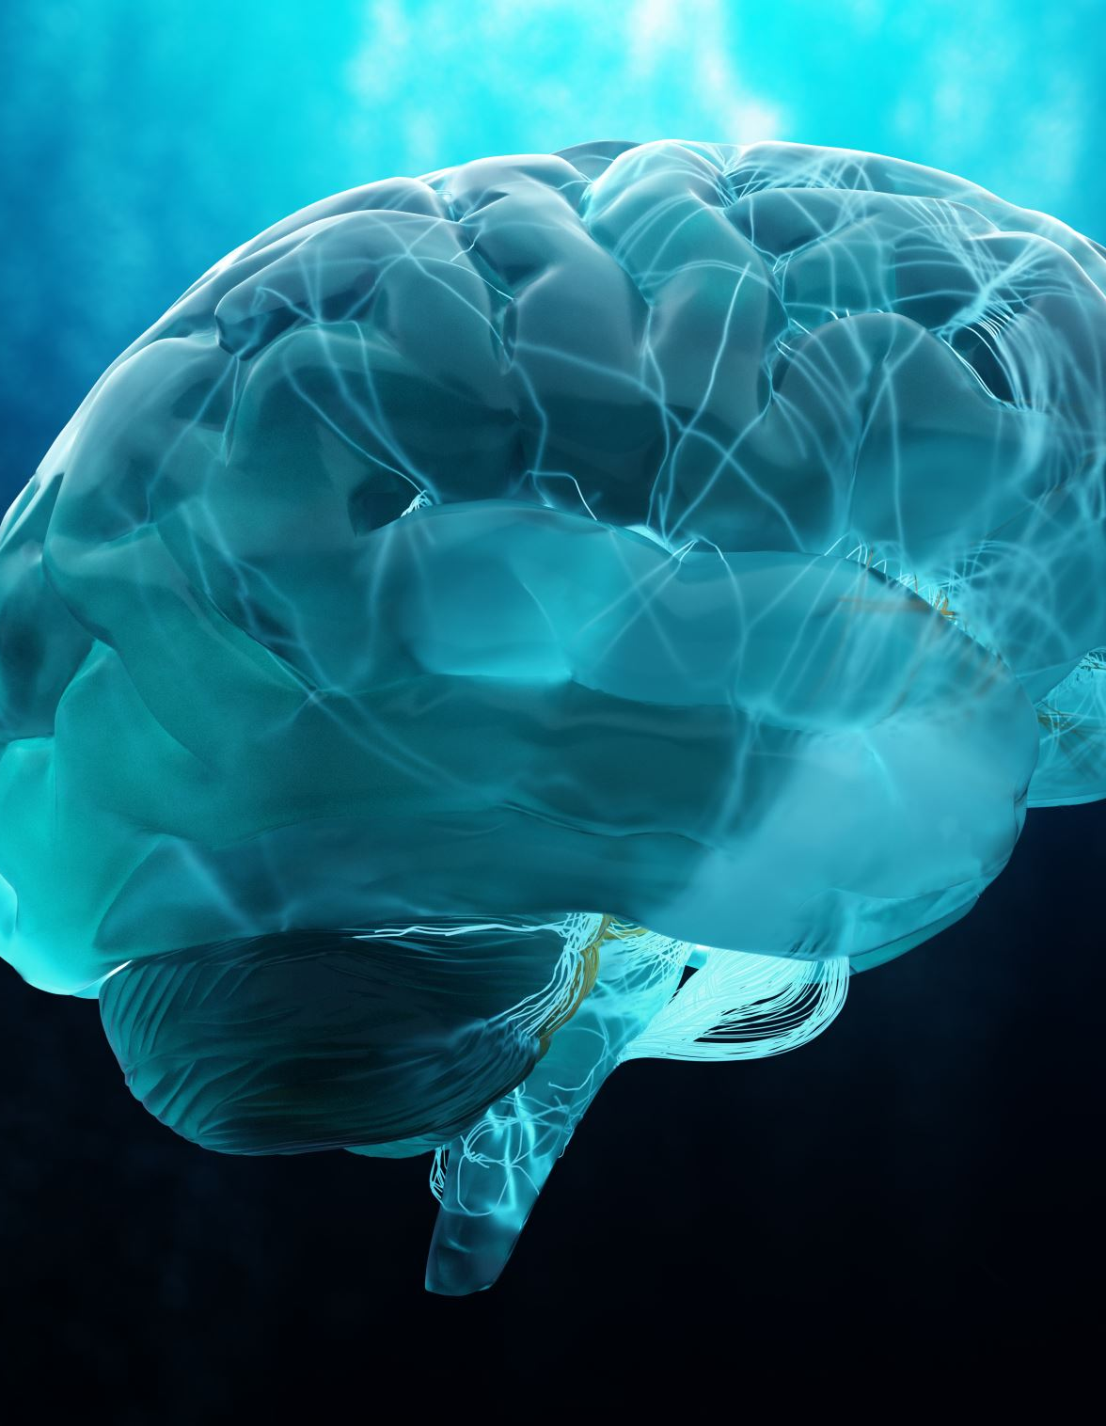
Make Initial Sense of Learning: Specific Findings
The more elaborately new learning is encoded, the more likely it is to be retained, and the more students think about it, the better it is consolidated. ^{4, 11}
For students to retain learning for future use, they need to actively encode it through engaging emotions and making connections. ¹
Students are more likely to consolidate information they think about, so they need to think about what they are learning as they are learning it. ^{1,4}
Our brains process information more effectively when images and nonlinguistic representations accompany spoken or written words, all of which help students integrate linguistic knowledge with sensory images of what they are learning.¹
*References included in the slide notes.
Notes:
[Misty] The first main takeaway from the research related to making initial sense of learning (click) is that the more elaborately new learning is encoded, the more likely it is to be retained, and the more students think about the learning the better it is consolidated. I’ll pause and give you a moment to (click) read through specific findings from the research to support this.
If students are to retain learning for future use, they must actively do something with it. The brain must make sensible, workable connections among all the different inputs before working memory times out. Actively thinking about what we are learning as we are learning it helps with this consolidation.
Consolidation is further enhanced when verbal and written words are paired with images and non-linguistic representations. According to Daniel Willingham “if we are to learn anything, we must concentrate on the visual and verbal inputs as they enter our brains; connect them to memories, other ideas, images and emotions and make sense of them to create meaning” (Willingham, 2003).
References:
¹ Goodwin, B. (2020). Learning that sticks: A brain-based model for K-12 instructional design and delivery. Alexandria, VA: ASCD (ESSA Level IV)
³ McTighe, J., & Willis, J. (2019.) Upgrade your teaching. Understanding by design meets neuroscience. Alexandria, VA: ASCD (ESSA Level IV)
⁴ Goodwin, B., Rouleau, K., Abla, C., Baptiste, K., Gibson, T., & Kimball, M. (2023). The new classroom instruction that works: The best research-based strategies for increasing student achievement (Third edition). ASCD, ; McREL International. (ESSA Level 4)
¹¹ Medina, J. (2008). Brain rules: 12 principles for surviving and thriving at work, home, and school. Pear Press.

Slide 16
Make Initial Sense of Learning: Specific Findings 2
Students begin to consolidate learning by connecting it with prior (background) knowledge.^{1,4}
The most significant factor is learning something new is prior knowledge. For new input to stick, it must link to a familiar pattern. ³
The more learners can connect new knowledge with prior knowledge, the more likely they will be to consolidate their learning. ⁴
Beginning learners tend to have some basic schema (background knowledge). New learning sticks either by fitting in with it or by modifying it. ⁵
Beginners often have misconceptions in their schema and these need to be corrected as new learning comes in.
*References included in the slide notes.
Notes:
[Misty] The next takeaway (click) from the research is that students begin to consolidate learning by connecting it with background knowledge. I’ll pause and give you a moment (click) to read through the related findings.
At the heart of sense-making is connecting what we are learning with what we already know so it is no surprise that the most significant factor in learning something new is being able to connect it with prior knowledge. The more opportunities we give learners to connect new knowledge with their prior knowledge, the more likely they are to consolidate their learning. According to developmental psychologist Marilyn Adams (2015), knowledge is like mental Velcro: it sticks best to other related knowledge.
When students are beginning learners, they do have some background knowledge (schema) and new learning either fits within that schema or modifies their existing schema. At this point in the learning process, students may often have misconceptions and it is important to uncover and address those errors as they work to make connections to the new learning.
References
¹ Goodwin, B. (2020). Learning that sticks: A brain-based model for K-12 instructional design and delivery. Alexandria, VA: ASCD (ESSA Level IV)
³ McTighe, J., & Willis, J. (2019.) Upgrade your teaching. Understanding by design meets neuroscience. Alexandria, VA: ASCD (ESSA Level IV)
⁴ Goodwin, B., Rouleau, K., Abla, C., Baptiste, K., Gibson, T., & Kimball, M. (2023). The new classroom instruction that works : the best research-based strategies for increasing student achievement (Third edition). ASCD, ; McREL International. (ESSA Level 4)
⁵ Kirschner, P., & Hendrick, C. (2024). How learning happens: Seminal works in educational psychology and what they mean in practice (2nd ed.). New York: NY: Routledge

Slide 17
Make Initial Sense of Learning: Specific Findings 3
The brain needs opportunities to pause and process. ^{1,4}
Working memories tend to time out after 5-10 minutes for young people and 10-20 minutes for adults. ¹²
It is important to include brief pauses in student learning, “chunking” learning into shorter segments, with frequent opportunities for mental processing and sense making between each interval. ^{1,4}
*References included in the slide notes.
Notes:
[Misty] The last overall idea (click) for making initial sense of learning is that the brain needs opportunities to pause and process. Take just a moment (click) to read two of the related findings.
Working memories tends to time out after about 5-10 minutes for young people and around 10-20 minutes for adults. After a few minutes of concentration, our brains needs a change of pace; a chance to encode the new learning into memory. We can help with this by chunking the learning into shorter segments with frequent opportunities for the brain to do some mental processing and sense making between each interval.
References
¹ Goodwin, B. (2020). Learning that sticks: A brain-based model for K-12 instructional design and delivery. Alexandria, VA: ASCD (ESSA Level IV)
⁴ Goodwin, B., Rouleau, K., Abla, C., Baptiste, K., Gibson, T., & Kimball, M. (2023). The new classroom instruction that works : the best research-based strategies for increasing student achievement (Third edition). ASCD, ; McREL International. (ESSA Level 4)
¹² Souza, D. A. (2011). How the brain learns. (4th ed.). Corwin Press.

Slide 18
Make Initial Sense of Learning: Summary
Students need meaningful opportunities to actively think about new knowledge, skills and strategies for learning to stick. ^{1,4}
Notes:
[Misty] In summary, if students are to make initial sense of new learning, they need meaningful opportunities to actively think about the new knowledge, skills and strategies for that learning to stick.
References
¹ Goodwin, B. (2020). Learning that sticks: A brain-based model for K-12 instructional design and delivery. Alexandria, VA: ASCD (ESSA Level IV)
⁴ Goodwin, B., Rouleau, K., Abla, C., Baptiste, K., Gibson, T., & Kimball, M. (2023). The new classroom instruction that works : the best research-based strategies for increasing student achievement (Third edition). ASCD, ; McREL International. (ESSA Level 4)

Slide 19
Practice New Learning: Big Picture
Repetition is key to memory. But how students engage in practice is the true key to memory. The quality of the practice is as important as the quantity. ⁴
Rehearsing new knowledge and practicing new skills and strategies helps students to automate them, which acts a foundation for deep, complex learning.⁴
Feedback during practice supports the acquisition, storing, reproduction and use of new learning. ¹³
Notes:
[Fox 19-25] As we turn now from “Make Initial Sense of Learning” to “Practice New Learning,” we begin by underscoring [CLICK] that while repetition is key to memory, how students engage in practice is the true key to memory. Quality practice has a larger impact than simply the quantity of practice.
As mentioned earlier [CLICK], practice helps students automate new skills and strategies, moving learning to long-term memory and freeing up bandwidth in working memory. This process is “deepened” during deep learning and is foundational for the eventual transfer of learning.
Finally, [CLICK], feedback is a vital support for acquiring, storing, reproducing and using new learning since it helps make sure what’s stored is correct and well understood.
⁴ Goodwin, B., Rouleau, K., Abla, C., Baptiste, K., Gibson, T., & Kimball, M. (2023). The new classroom instruction that works : the best research-based strategies for increasing student achievement (Third edition). ASCD, ; McREL International. https://public.ebookcentral.proquest.com/choice/PublicFullRecord.aspx?p=30160647
¹³ Hattie, J., & Timperley, H. (2007). The power of feedback. Review of Educational Research, 77(1), 81-112. https://doi.org/10.3102/003465430298487 Retrieved from http://www.columbia.edu/~mvp19/ETF/Feedback.pdf (ESSA Level IV)

Slide 20
Practice New Learning: Specific Findings
Spacing practice over time is the best way to encode learning into long-term memory.⁴
Students need to space practice repetitions over a period of days or weeks to best encode learning into long-term memory.
Returning to learning after a space of time reinforces the existing neural pathways that formed the memory and creates additional pathways to it, which provides more ways to retrieve it. ¹⁴
The more associations we make with a new memory, the more likely we able to store and retrieve it for later use. ¹¹
*References included in the slide notes.
*References included in the slide notes.
Notes:
[Fox] The first main takeaway from the research on Practice New learning is [CLICK] ”Spacing practice over time is the best way to encode learning into long-term memory.” I’ll pause to give you a moment to independently process three particular findings. [CLICK] (Allow time.)
The first point, simply put, is spacing practice out in installments over time rather than doing it in bulk is better for getting learning into long-term memory. Also, each time we return to learning, it reinforces neural pathways while creating additional pathways, which supports faster, more dynamic retrieval. And returning to new memories through different tasks and while making different associations increases the likelihood of its long-term storage and rapid retrieval.
References:
⁴ Goodwin, B., Rouleau, K., Abla, C., Baptiste, K., Gibson, T., & Kimball, M. (2023). The new classroom instruction that works : the best research-based strategies for increasing student achievement (Third edition). ASCD, ; McREL International. (ESSA Level 4)
¹¹ Medina, J. (2008). Brain rules: 12 principles for surviving and thriving at work, home, and school. Pear Press
¹⁴ Rohrer, D., Dedrick, R. F., & Burgess, K. (2014). The benefit of interleaved mathematics practice is not limited to superficially similar kinds of problems. Psychonomic Bulletin & Review, 21(5), 1323– 1330. Accessed at https://link.springer.com/article/10.3758/s13423-014-0588-3 (ESSA Level I)

Slide 21
Practice New Learning: Specific Findings 2
Retrieval practice helps commit new learning to memory. ^{4, 14}
Learners having to “rack their brains” to remember learning reactivates the neural networks that were used to store the memory, which in turn further myelinates those neural pathways which makes information easier to retrieve next time. ^{4, 15}
Tasks that have students retrieve learning are more effective than simply reviewing it. ^{4,15}
*References included in the slide notes.
*References included in the slide notes.
*References included in the slide notes.
Notes:
[Fox] A second takeaway for Practice New learning is [CLICK] “Retrieval practice helps commit new learning to memory.” I’ll pause to give you a moment to independently process two particular findings. [CLICK] (Allow time.)
The more students have to work to recall what they’ve learned, the stronger retrieval pathways become. Actively retrieving is much better for this than simply looking back at information, which is more passive in nature.
References:
⁴ Goodwin, B., Rouleau, K., Abla, C., Baptiste, K., Gibson, T., & Kimball, M. (2023). The new classroom instruction that works : the best research-based strategies for increasing student achievement (Third edition). ASCD, ; McREL International. (ESSA Level 4)
¹⁵ Fuchs, L. S., Geary, D. C., Compton, D. L., Fuchs, D., Schatschneider, C., Hamlett, C. L., DeSelms, J., Seethaler, P. M., Wilson, J., Craddock, C. F., Bryant, J. D., Luther, K., & Changas, P. (2013). Effects of first-grade number knowledge tutoring with contrasting forms of practice. Journal of Educational Psychology, 105(1), 58–77. Accessed at https://pmc.ncbi.nlm.nih.gov/articles/PMC3779611/ (ESSA Level I)

Slide 22
Practice New Learning: Specific Findings 3
Interleaving or “mixing up” different types of practice improves learning.⁴
Having students practice using knowledge, strategies and skills in a variety of ways and moving fluidly between them forces students’ brains to worker harder, making micro-adjustments and reflecting more deeply on what’s being practiced.^{4, 14}
The “desirable difficulties” of having to work through different kinds of tasks develops richer neural pathways to learning.⁴
This builds “conditional knowledge” by helping students better recognize problems and adjust their problem-solving strategies according to different problem types.⁴
*References included in the slide notes.
*References included in the slide notes.
*References included in the slide notes.
Notes:
[Fox] A third takeaway for Practice New learning is [CLICK] “Interleaving or ‘mixing up’ different types of practice improves learning.” I’ll pause to give you a moment to independently process three particular findings. [CLICK] (Allow time.)
Having to shift between different kinds of tasks is difficult, but that difficulty can be desirable since the hard work it requires develops richer neural pathways.
A key point here to also call attention to is conditional knowledge. When students have to assess a range of learning situations in order to figure out what type of problem they’re dealing with, what relevant knowledge, understandings and skills they have for that type of problem, and also what supports they might need, they become more able to do this independently under similar situations in the future, which is essential later for the transfer of learning.
References:
⁴ Goodwin, B., Rouleau, K., Abla, C., Baptiste, K., Gibson, T., & Kimball, M. (2023). The new classroom instruction that works : the best research-based strategies for increasing student achievement (Third edition). ASCD, ; McREL International. (ESSA Level 4)
¹⁴ Rohrer, D., Dedrick, R. F., & Burgess, K. (2014). The benefit of interleaved mathematics practice is not limited to superficially similar kinds of problems. Psychonomic Bulletin & Review, 21(5), 1323– 1330. Accessed at https://link.springer.com/article/10.3758/s13423-014-0588-3 (ESSA Level I)

Slide 23
Practice New Learning: Specific Findings 4
Feedback supports the acquisition, storing, reproduction and use of knowledge. ¹³
Students must learn how to receive and to practice with feedback. ¹⁶
Corrective feedback provides students with information about the accuracy and completeness of a task.¹⁷
Non-evaluative, formative feedback helps students reflect on their progress and improve their performance.¹
*References included in the slide notes.
*References included in the slide notes.
Notes:
[Fox] A final takeaway for Practice New learning is [CLICK] “Feedback supports the acquisition, storing, reproduction and use of knowledge.”
I’ll pause to give you a moment to independently processes three particular findings. [CLICK] (Allow time.)
Effective feedback helps ensure the learning students store is accurate. It also helps students reflect on their progress and improve performance. Those two things said, not all students arrive skilled at receiving and working with feedback, and so this skill, like others, requires its own instruction, practice and feedback.
References:
¹ Goodwin, B. (2020). Learning that sticks: A brain-based model for K-12 instructional design and delivery. Alexandria, VA: ASCD (ESSA Level IV)
¹³ Hattie, J., & Timperley, H. (2007). The power of feedback. Review of Educational Research, 77(1), 81-112. https://doi.org/10.3102/003465430298487 Retrieved from http://www.columbia.edu/~mvp19/ETF/Feedback.pdf (ESSA Level IV)
¹⁶ Hattie, J. (2023). Visible learning: the sequel: a synthesis of over 2,100 meta-analyses relating to achievement (First edition). Routledge.
¹⁷ Almarode, J., & Vandas, K. (2018). Clarity for learning: Five essential practices that empower students and teachers. Thousand Oaks, CA: Corwin Press (ESSA Level 4).

Slide 24
Practice New Learning: Summary
Without well-designed opportunities to practice new learning, students will forget most of what they learn. ¹
Notes:
[Fox] Summarizing now “Practice New Learning,” there’s a simple yet stark truth: Without well-designed opportunities to practice new learning, students will forget most of what they learn. Even though this reads like common sense, in the hustle to move forward through a curriculum, adequate time to practice new learning so that it has a chance to stick can be missed.
¹ Goodwin, B. (2020). Learning that sticks: A brain-based model for K-12 instructional design and delivery. Alexandria, VA: ASCD

Slide 25
Connections to Common Characteristics of Deeper Learning
Because deeper learning characteristics are affirmed by learning science, connections to research on surface learning and to the indicators to follow may be noted.
Notes:
[Fox] As we close this segment, let’s make a quick connection to deeper learning as we did in the prior module. On the slide, you see again the Common Characteristics of Deeper Learning laid out in the Integrating Deeper Learning and HQIR to Strengthen Tier 1 Instruction introduction document (linked below). For Surface Learning in particular, there are two we will call attention to:
[CLICK] Mastery of Core Academic Content– Surface learning begins to build the foundation from which students draw upon and develop disciplinary knowledge, understandings and skills
[CLICK] Critical Thinking and Problem-Solving– Surface learning is required for students to have the foundation necessary to analyze complex problems and develop solutions.
These two characteristics are supported by the five below them, of course, but are worth highlighting on their own since they connect so closely to the work of surface learning.
Link: https://education.ky.gov/curriculum/standards/kyacadstand/Documents/Integrating_HQIRs_and_Deeper_Learning_to_Strengthen_Tier_1_Instruction.pdf

Slide 26
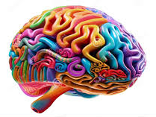
Module Purpose 2
Module Objectives:
Build understanding of “priming for learning” and associated findings from learning science.
Explore indicators of surface learning using examples from HQIRs.
Consider deeper learning practices to support potential adjustments to a HQIR.
Notes:
[Misty] Using our understanding of the research, we are now going to explore indicators of surface learning, highlighting examples from HQIRs to help build understanding of what they might look like in practice.

Slide 27
Priming for Learning Indicators
Surface Learning Indicators
Indicators
Students actively use background knowledge to support their learning. Routines are present to: Help students activate relevant prior knowledge to prepare the brain in advance to “catch” new inputs. Provide students opportunities to continue connecting learning to prior knowledge to support consolidation.
Vocabulary instruction builds declarative knowledge by helping students understand, recall and apply subject-specific words and academic terms. Students are tasked with using new words they acquire in a variety of ways and have multiple opportunities to practice and apply new vocabulary. Students receive direct instruction in word analysis and vocabulary learning strategies specific to the content area.
Strategy instruction and modeling develop procedural knowledge through direct instruction and demonstration of key skills, learning processes and cognitive (thinking) strategies. Teachers are supported in providing direct instruction and in demonstrating new skills and strategies (cognitive, metacognitive) as they model relevant thought processes.
Illustrations, animations, manipulatives, organizers, concrete and worked examples support conceptual understanding. Visual representations and examples support visual and verbal (dual-coding) comprehension of new ideas. Schematics (diagrams, flow charts, etc.) help guide and support procedural knowledge.
Regular opportunities are provided for retrieval practice with declarative knowledge. Retrieval practice (self- or peer-quizzing, ungraded practice tests, etc.) is deliberate, spaced over time and formative.
Regular opportunities are provided for practice of new skills with formative feedback. Skills practice is deliberate and spaced over time. Skills practice is mixed/interleaved to allow students to engage with the content in a variety of formats, problem types and contexts in order to help them think more deeply as they identify what is different and access appropriate strategies.
Notes:
[Misty] Based on the research, we have identified 6 surface learning indicators that need to be present in each unit of instruction. These indicators address areas such as using background knowledge, strategy instruction and modeling, and regular opportunities for practice. These indicators are included in the tool referenced at the end.

Slide 28
Surface Learning
Examples from HQIRs
Notes:
[Misty] What might the surface learning indicators look like when included in part of the instructional design of a unit/module within an HQIR? We are going to look at few examples that can give us a better sense of how these indicators may be present.

Slide 29
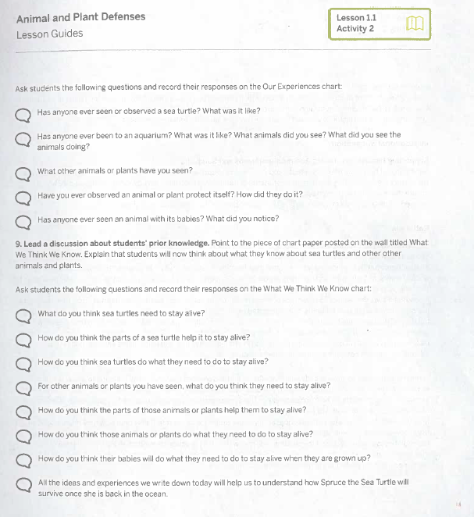
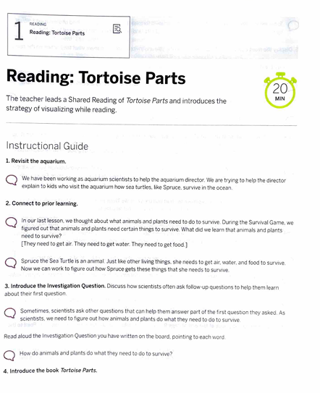
Example from Amplify Science
Students actively use background knowledge to support their learning.
Help students activate relevant prior knowledge to prepare the brain in advance to “catch” new inputs.
Provide students opportunities to continue connecting learning to prior knowledge to support consolidation.
1st Grade Example
Notes:
[Misty] This first example is from a 1st grade science unit in Amplify Science. At the beginning of every unit, (click) students are given an opportunity to activate their background knowledge through questions provided for the teacher to ask and their thoughts are captured on chart paper for the class to revisit throughout the unit.
At the beginning of each lesson, (click) students activate their background from the previous lesson to connect to where the lesson that day is headed which primes them to catch the new learning inputs within the lesson.

Slide 30
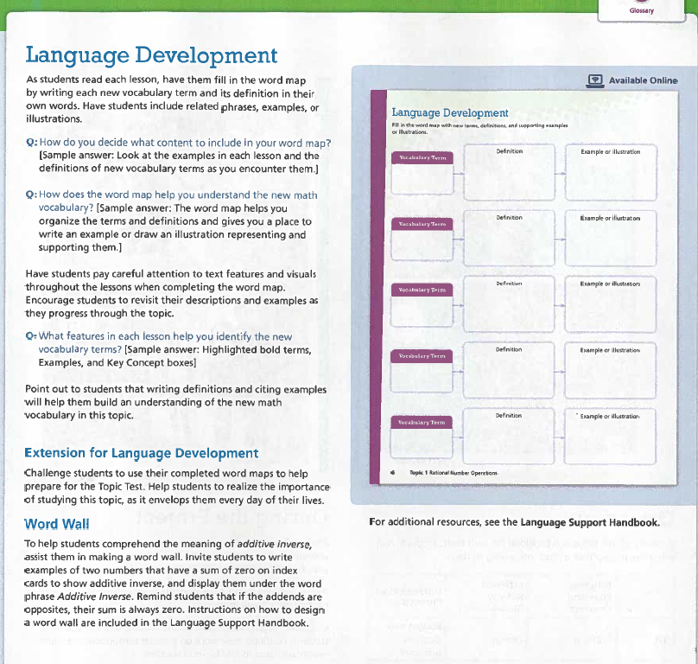
Example from Envision Math
Vocabulary instruction builds declarative knowledge by helping students understand, recall and apply subject-specific words and academic terms.
Students are tasked with using new words they acquire in a variety of ways and have multiple opportunities to practice and apply new vocabulary.
7th Grade Example
Notes:
[Misty] In this 7th grade example from Envision Mathematics, (click) students are provided a graphic organizer to support understanding, recalling and applying subject-specific words and academic terms. Each time they encounter a new word in the unit, they add to the organizer explaining it in their own words, along with an illustration or example to support understanding.
As they encounter new academic vocabulary throughout the unit, (click), they add it to the class word wall. Teachers are provided prompts they can use that task students with using the words on the word wall in a variety of ways.

Slide 31
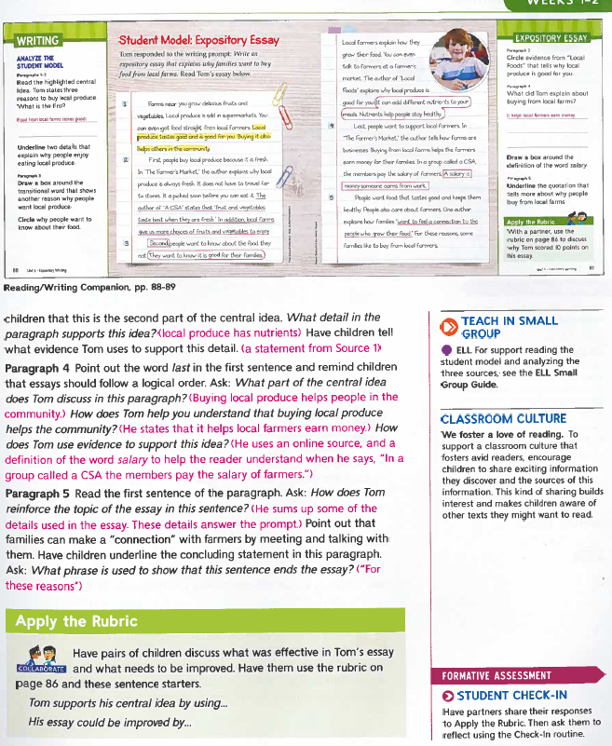
Reading/Writing Example from Wonders
Illustrations, animations, manipulatives, organizers, concrete and worked examples support conceptual understanding.
2nd Grade Example
Notes:
[Fox] This 2nd grade Reading/Writing example from Wonders offers a “worked example” in the form of [CLICK] a Student Model Expository Essay. Students are able to see what mastery looks like as they prepare to work toward writing their own expository essays. This demonstration of learning is further supported by [CLICK] applying the rubric, which clarifies and reinforces relevant criteria and the teaching points they represent. Once students have made sense of what doing the criteria well looks like in action, they are better prepared to make those moves themselves and to monitor their progress.

Slide 32
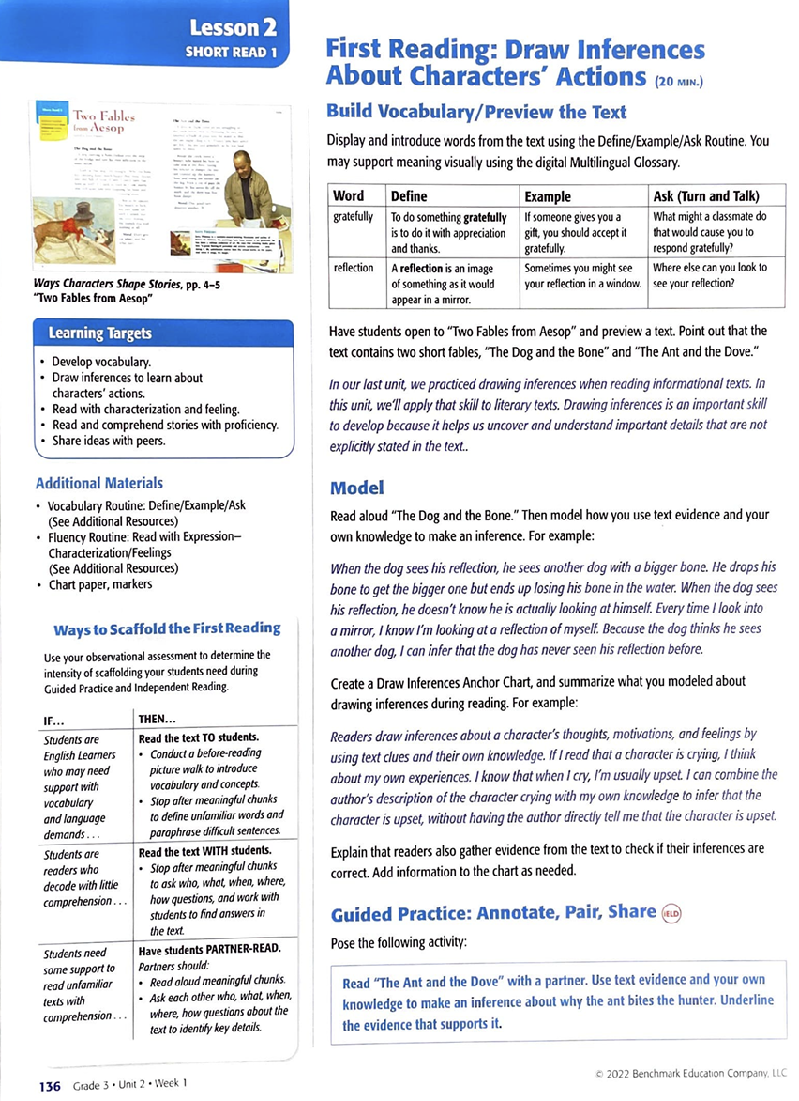
#
3rd Grade Example
Strategy instruction and modeling develop procedural knowledge through direct instruction and demonstration of key skills, learning processes and cognitive (thinking) strategies.
Teachers are supported in providing direct instruction and in demonstrating new skills and strategies (cognitive, metacognitive) as they model relevant thought processes.
Notes:
[Fox] This 3rd grade Reading/Writing example from Benchmark Advance shows [CLICK] readers being supported in the strategy of drawing inferences, here about characters’ actions in particular. And as support takes the form of modeling this for students [CLICK], teachers are also supported in thinking through their modeling.

Slide 33
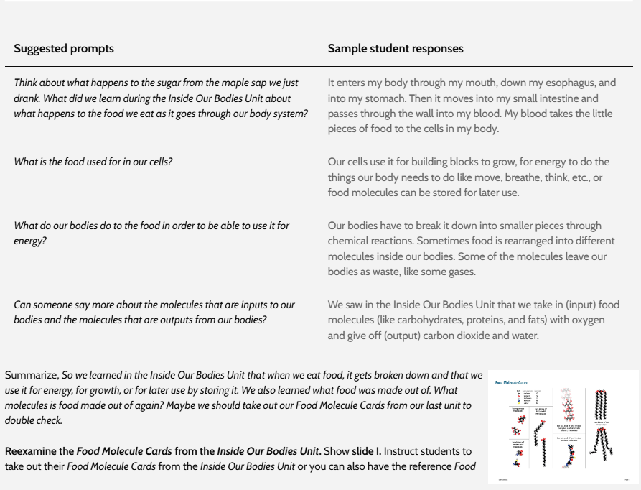
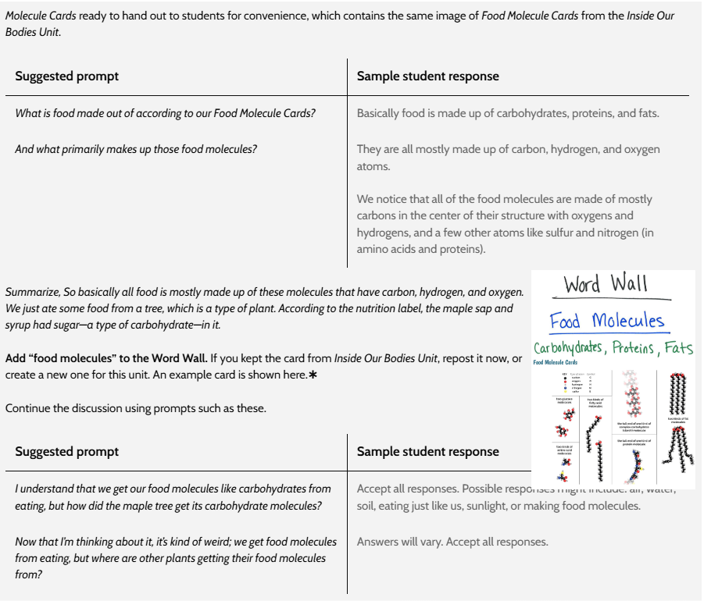
Regular opportunities are provided for retrieval practice with declarative knowledge.
7th Grade Unit
Notes:
[Misty] In this 7th grade example from OpenSciEd, (click) students are asked to recall specific declarative knowledge from the previous unit that will be built upon in this unit. Teacher questions (click) prompt retrieval of information as students are tasked with recalling what they know about food molecules form the last unit and they check their thinking using cards they made in the previous unit. This example shows how retrieval practice is not only important within a unit, but across units as well.

Slide 34
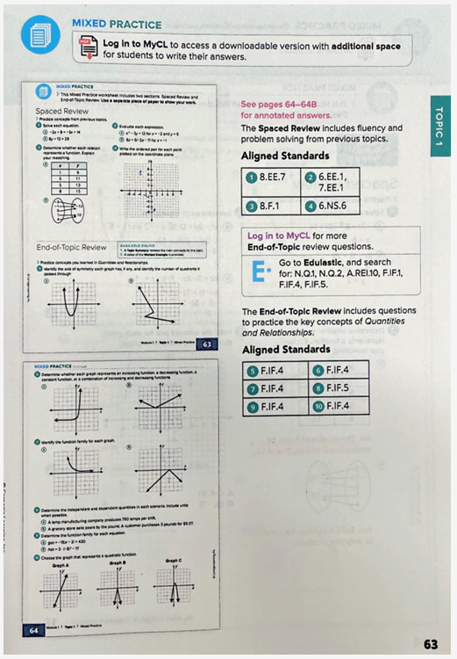
Carnegie Learning Example
Regular opportunities are provided for practice of new skills with continued formative feedback.
Skills practice is deliberate, spaced over time.
Algebra 1 Example
Notes:
[Misty] Here is an example from Carnegie Learning Algebra 1. Within each unit, (click) there are specific opportunities for students to engage in spaced practice that targets standards-aligned skills from previous units. Each (click) end-of-topic in the unit includes mixed practice of the different skills they encountered in that particular unit.

Slide 35
Module Purpose 3
Module Objectives:
Build understanding of “priming for learning” and associated findings from learning science.
Explore indicators of priming for learning using examples from HQIRs.
Consider deeper learning practices to support potential adjustments to a HQIR.
Notes:
[Fox 35-37] Moving now to the last objective for this module, we will “Consider deeper learning practices to support potential adjustments to a HQIR.”

Slide 36
Common Deeper Learning Practices
Authenticity (learning includes real-world context, tasks, tools, products, audiences and/or impacts, while also connecting to personal concerns, interests and/or issues in students’ lives)
Inquiry (learning is framed by a meaningful question or set of questions to be responded to at the appropriate level of challenge; students engage in a rigorous, extended process of posing questions, exploring resources and applying information)
Structured Collaboration (Students are supported in contributing to the learning and work of their peers as they share, challenge and build upon each other’s ideas to co-create understanding and products of learning)
Voice & Choice (Students make some decisions about the learning, including how they work and what they create, and express their own ideas in their own voice)
Notes:
[Fox] As we did in the first module, we will pivot again from the Common Characteristics of Deeper Learning on slide 25 to Common Deeper Learning Practices on this slide. If the common characteristics can help define our sense of what is meant by deeper learning, these aligned practices can help make those characteristics actionable. While we won’t take time to review them again here, it’s worth resetting they will be returned to in stage-specific ways during each module when we are ready to think about potential ”smart adjustments” that might be made to a curriculum after analysis using learning science indicators. For this module, we will look at adjustment options they afford for surface learning.
¹⁵ PBL Works

Slide 37
Priming for Learning Indicators 2
Surface Learning: Deeper Learning Practices and Considerations
Practices and Considerations
Authenticity Explore how new knowledge, skills and initial sensemaking can be connected to the relevant context established during priming. Make clear how demands for knowledge, understandings and skills from authentic topic, tools, product and audience necessitate the new learning to establish its value. Connect new knowledge to interests generated during priming. Make sure as knowledge is rehearsed and skills are practiced to strengthen surface learning, it is seen in the service of what students need to know, understand and be able to do when they are asked to transfer learning into a public product for a real-world audience. Connect the rounds of rehearsal and practice students experience to how experts in the field build their bases of knowledge and refine their skills.
Inquiry Connect back to the essential question so it is seen as driving new learning and practice with knowledge and skills. Add supporting questions that follow from the essential question and are relevant to new learning provided. Find ways to connect new learning to questions students asked during priming. As new topics, texts and tasks are experienced during surface learning, look for opportunities for students to refine and add to questions they generated during priming.
Structured Collaboration As students actively acquire and practice new knowledge (including vocabulary), skills and strategies, embed collaborative structures that support doing so together to capitalize upon the benefits of making learning more dynamic and social. Match appropriate structures to intended learning outcomes for surface learning and follow key principles for effective collaboration.
Voice & Choice When students activate relevant prior (background) knowledge, see how their individual funds of knowledge can be shared across the classroom community. Notice where needs for new learning—knowledge, understandings and skills—might be differentiated according to individual learner’s readiness levels. As students acquire subject-specific and academic vocabulary, notice where they might have choice in how this is done and how practice with new vocabulary could be integrated into their own voices (e.g., embedding vocabulary into their own spoken or written explanations or examples). Provide guided opportunities for students to create their own nonlinguistic representations (organizers, concept maps, models, etc.) of the learning. As students monitor and reflect on progress toward their individual goals (academic goals, portrait of a learner competency goals, interest goals, etc.) help them see how new learning supports reaching of those goals.
Notes:
[Fox] Here we have the deeper learning practices with potential suggestions for the stage of surface learning. These practices and considerations are included in the adjustment portion of the curriculum analysis and adjustment tool on the next slide. For each practice, the underlying bullets and sub-bullets offer high-level suggestions as to the where a district could look to make adjustments. You will notice these assume a fairly significant degree of local understanding and capacity. If precisely what is meant by these or how to effectively act upon them is not clear enough, this is where external partnership with a high-quality deeper learning provider and the tools those organizations may have can be invaluable.

Slide 38
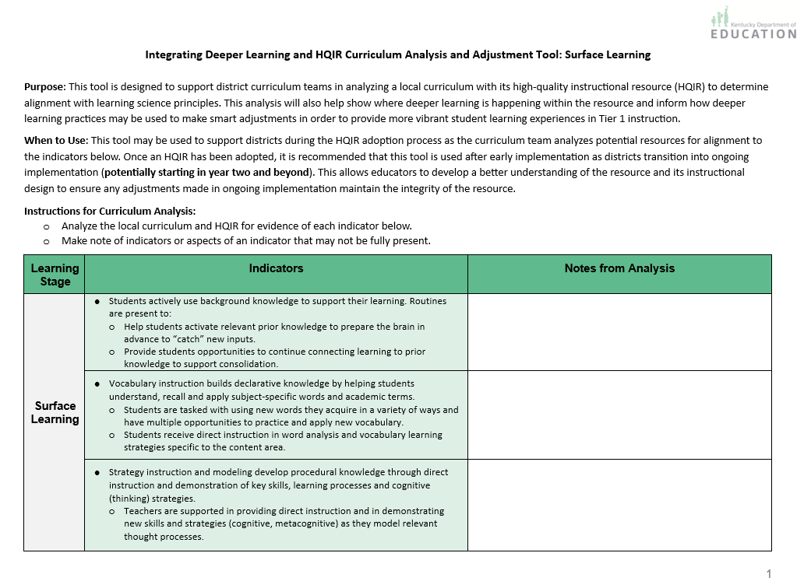
Curriculum Analysis and Adjustment Tool
The tool is designed to support:
Analysis of an HQIR using the Surface Learning Indicators
Making curricular adjustments using deeper learning practices
Notes:
[Misty] To help apply understanding from this module, the KDE created a Surface Learning Curriculum Analysis and Adjustment Tool. The purpose of the tool is to assist a district curriculum team in analyzing their HQIR for evidence of each of the surface learning indicators. The tool also offers suggestions for making curricular adjustments using deeper learning practices to further enhance their local curriculum in supporting vibrant learning experiences for all students.

Slide 39
Closing Notes for Surface Learning
The deep understandings at the heart of deeper learning require a significant bank of declarative and procedural knowledge so that it can be used for complex processes like developing interpretations, arguments and conclusions. ¹⁶
Although a significant portion of this bank of knowledge, skills and strategies is built during surface learning, it continues to be added to throughout later phases.
The aim of providing direct instruction, modeling, practice and feedback to students is to help them develop fluency with key knowledge and processes required to engage in critical thinking and problem-solving. ¹
Notes:
[Misty] We want to wrap up this module with a some important closing notes on surface learning. (click) The deep understandings at the heart of deeper learning requires students to have a significant bank of both declarative and procedural knowledge that can be used for complex processes like developing interpretations, arguments and conclusions. (click) Although a significant portion of this bank of knowledge, skills and strategies is built during surface learning, it continues throughout later phases as well.
Finally, (click) the goal of providing purposeful direct instruction, modeling, practice and feedback to students is to help them develop the fluency with the key knowledge and processes required to engage in critical thinking and problem-solving.
We must be careful to not stop at surface learning. While this helps to lay a critical foundation, the goal is that students can apply that learning in novel ways. This phase equips students with key knowledge and skills that will take with them into the next phase where they will make deeper sense of their learning to help ensure that learning is stored and able to be easily retrieved from long-term memory.
References:
¹ Goodwin, B. (2020). Learning that sticks: A brain-based model for K-12 instructional design and delivery. Alexandria, VA: ASCD (ESSA Level IV)
¹⁶ Bransford, J. D., Brown, A. L., Cocking, R. R., National Research Council (U.S.). Committee on Developments in the Science of Learning, & National Research Council (U.S.). Committee on Learning Research and Educational Practice. (2000). How People Learn : Brain, Mind, Experience and School (Expanded Edition). National Academies Press.

Slide 40
Questions?
Fox DeMoisey
fox.demoisey@education.ky.gov
Misty Higgins
misty.higgins@education.ky.gov
Notes:
Thank you for taking time to engage in this module and please reach out with any questions you might have.

