Slide 1
Developing Skilled Middle and High School Readers
Webinar Series
Notes:
Guiding Notes:​
Welcome! Please see the Notes section of slides 2 and 3 for extensive planning and facilitation considerations:​
Slide 2: A Note to Facilitators Leading a Group​
Slide 3: A Note to Individuals Completing This Series​
Please contact ELATeam@education.ky.gov with any questions. ​

Slide 2
A Note to Facilitators Leading a Group:
For complete considerations for facilitators, see the Notes section of this slide.
These slides are part four of a six-part series.
See the Webinar Series Learning Plan on the Landing Page for a detailed view of session objectives and materials. You may wish to make this available to participants.
Print or make a digital copy of the Series Participant Guide for participants to complete the pre-work.
This series is built around the Institute for Education Science and What Works Clearinghouse 2022 Practice Guide, Providing Reading Interventions to Students in Grades 4-9, a free resource available for print. Consider making copies or providing digital access to participants to complete the pre-session readings.
Notes:
Series Overview:
This slide is purposefully hidden from participants.
The purpose of this series is to provide Kentucky 6-12 educators with declarative knowledge of how the brain learns to read, including ways to support all students in middle and high school access complex, grade-level text and skills through decoding multisyllabic words, fluency building, knowledge building, vocabulary building, comprehension and skilled writing.
The Developing Skilled Middle and High School Readers Webinar Series is intended to support classroom teachers across the state in engaging students in grade-level reading across subject areas; however, some content may be relevant for instructional leaders wishing to build their own knowledge of adolescent learners and their literacy needs. The sessions are designed to provide flexibility for districts and schools and, as such, can be viewed as stand-alone lessons or within the progression of the series as provided. You are supported in engaging with this series individually, if desired.
This entire series is six sessions and will take approximately 9 total hours to complete. We recommend accessing one session monthly; however, adaptations may be made to accommodate for more or less time. Each individual session is 1.5 hours.
Materials Needed:
The session slides with Guiding Notes
The Series Participant Guide
Access to the participants’ high-quality instructional resource (HQIR)
A Note about HQIRs:
The Reading and Writing HQIR Consumer Guide points districts to the markers of high-quality literacy instruction for Kentucky. Note that HQIRs are grounded in research and written by experts. While these resources do engage students in strategies that support reading, many students may need more targeted supports in Tier 1 instruction. As such, it is recommended that facilitators continually ground discussions in the texts, tasks and protocols provided in the district-adopted HQIR and prompt participants to make connections between this learning and their upcoming lessons or units.
Guiding Notes:
Guiding notes are provided in the Notes section of the PowerPoint to support your learning. The Notes section includes additional information and directions for the activities on the slide. It is critical that you read the material presented in the Notes section to ensure that you are acquiring the important knowledge, skills and understanding required when engaging with this series.
Virtual Training Note:
If you plan to engage with this series virtually as a group, consider directing participants to the Developing Skilled Middle and High School Readers landing page:
Intended Audiences:
Participants
Series participants may include, but are not limited to, district leadership, school administrators, instructional specialists/coaches, intervention specialists, department chairs, special educators and classroom teachers.
Facilitators
While this series is designed for a teacher to engage with it individually, it may be implemented with a group of educators led by a facilitator. If this series is being completed as a group, facilitators may include, but are not limited to, cooperative staff, district leaders, school administrators, instructional specialists/coaches, intervention specialists, department chairs, special educators, and classroom teachers. Facilitators may need to revise specific tasks in order to meet the needs of the participants or to be respectful of the time planned within the work session.
Helpful Hint for Facilitators:
The learning that will take place in this series may cause Kentucky educators to face changes in instructional practices amidst this transition. It is important to realize that while you are the facilitator of these work sessions, you may not have all the answers to the questions asked by participants, which is part of the learning process for all educators at all levels. Throughout the series, participants may have questions that will be addressed in future work sessions. When that happens, reflect on this quote from Graham Fletcher, “Every teachable moment doesn’t need to be a teachable moment in that moment.” Use these moments to encourage participants to attend future work sessions where those questions will be addressed. If participants ask questions you are not prepared to answer, offer to follow up on that during the next work session. Please contact ELATeam@education.ky.gov if you have questions or comments.
Planning Ahead for Facilitators:
Determine which stakeholders to invite as participants. In the invitation, describe how the work sessions will benefit them.
A few days before the meeting, you may want to remind participants to be prepared to have their Participant Guide available during the meeting. You may also choose to print these for participants.
Reserve adequate space and equipment. Tables or desks should be set up to support small-group discussion. If conducting this series virtually, ensure that your technology platform can support break out rooms to support small group collaboration.
Ensure that participants have access to the Internet.
Preparation
Participant Documents Needed:
Participant Guide
Access to upcoming lessons or units within their district-adopted curriculum supported by an HQIR
Supplies Needed:
These slides
Technology with projection and sound capability if in person. Technology platform where presenters have sharing ability and breakout room options if virtual.
Participant Guides printed or available virtually
Parking Lot for questions - If completing as a group, you may consider providing a poster on which participants can write or post questions, or you may prefer to have a digital parking lot where participants can access a Google document, for example, to post questions and that you can modify as the participants work through the sections of the series
Self-Sticking Notes (optional)
Poster paper (optional)
Highlighters and/or colored pens/markers (optional)
Building a Community:
Building a community is important for any group that will work together, especially if participants have not worked together before. The concept is the same as building a safe, respectful, productive classroom climate. Incorporating community-building into each session builds trust, shows participants that they are valuable as individuals and engages them in the learning process. It is also useful for creating a professional learning network where participants can be supported in their work. Community-building can be as simple as allowing participants to introduce themselves and their role in the school/district, developing or refining group norms, allowing for questions, and/or the sharing of answers to reflection questions or individual discovery task items that are included in this series. Again, time allotted for community-building will allow participants to have a voice and be engaged as active contributors and learners in the sessions.
Virtual Training Options: Be sure to conduct continual check-ins throughout the presentation. Build Google documents to continue to collect feedback, such as questions, hopes, and/or concerns to which participants may continually add.

Slide 3
A Note to Individuals Completing this Series:
For complete considerations for complete this series individually, see the Notes section of this slide.
Print or make a digital copy of the Participant Guide to capture your thinking.
These slides are part four of a six-part series.
See the Webinar Series Learning Plan on the Landing Page for a detailed view of session objectives and materials. You may wish to make this available to participants.
This series is built around the Institute for Education Science and What Works Clearinghouse 2022 Practice Guide, Providing Reading Interventions to Students in Grades 4-9, a free resource available for print. Consider making copies or providing digital access to participants to complete the pre-session readings.
Notes:
Series Overview:
This slide is purposefully hidden from participants.
The purpose of this series is to provide Kentucky 6-12 educators with declarative knowledge of how the brain learns to read, including ways to support all students in middle and high school access complex, grade-level text and skills through decoding multisyllabic words, fluency building, knowledge building, vocabulary building, comprehension and skilled writing.
The Developing Skilled Middle and High School Readers Webinar Series is intended to support classroom teachers across the state in engaging students in grade-level reading across subject areas; however, some content may be relevant for instructional leaders wishing to build their own knowledge of adolescent learners and their literacy needs. The sessions are designed to provide flexibility for districts and schools and, as such, can be viewed as stand-alone lessons or within the progression of the series as provided. You are supported in engaging with this series individually, if desired.
This entire series is six sessions and will take approximately 9 total hours to complete. We recommend accessing one session monthly; however, adaptations may be made to accommodate for more or less time. Each individual session is 1.5 hours.
Materials Needed:
The session slides with Guiding Notes
The Series Participant Guide
Access to the participants’ high-quality instructional resource (HQIR)
A Note about HQIRs:
The Reading and Writing HQIR Consumer Guide points districts to the markers of high-quality literacy instruction for Kentucky. Note that HQIRs are grounded in research and written by experts. While these resources do engage students in strategies that support reading, many students may need more targeted supports in Tier 1 instruction. As such, it is recommended that facilitators continually ground discussions in the texts, tasks and protocols provided in the district-adopted HQIR and prompt participants to make connections between this learning and their upcoming lessons or units.
Guiding Notes:
Guiding notes are provided in the Notes section of the PowerPoint to support your learning. The Notes section includes additional information and directions for the activities on the slide. It is critical that you read the material presented in the Notes section to ensure that you are acquiring the important knowledge, skills and understanding required when engaging with this series.
Intended Audiences:
Participants
Series participants may include, but are not limited to, district leadership, school administrators, instructional specialists/coaches, intervention specialists, department chairs, special educators and classroom teachers.
Facilitators
While this series is designed for a teacher to engage with it individually, it may be implemented with a group of educators led by a facilitator. If this series is being completed as a group, facilitators may include, but are not limited to, cooperative staff, district leaders, school administrators, instructional specialists/coaches, intervention specialists, department chairs, special educators, and classroom teachers. Facilitators may need to revise specific tasks in order to meet the needs of the participants or to be respectful of the time planned within the work session.
Helpful Hint for Completing this Series Individually:
Throughout the series, you may have questions that you would like to discuss with colleagues or leadership at your school. When that happens, make a note to share or discuss this resource with others. The creators of this series are also available should you have questions or want to discuss the content of the videos. Please contact ELATeam@education.ky.gov if you have questions or comments.
Preparation
Participant Documents Needed:
Participant Guide
Access to upcoming lessons or units within your district-adopted curriculum supported by an HQIR

Slide 4
Series Overview
Session 1 | Session 2 | Session 3 | Session 4 | Session 5 | Session 6
How Do We Learn to Read? Exploring Theoretical Frameworks for Reading Development | Decoding Multisyllabic Words within Complex, Grade-Level Texts | Fluency Building within Complex, Grade-Level Texts | Vocabulary and Knowledge Building Essentials | Comprehension as Both Process and Product | Connecting Skilled Reading to Skilled Writing
Notes:
Guiding Notes:
This slide provides an overview of this series. It is recommended to complete one session per month to allow time for implementation of practices between sessions.

Slide 5
Series Goals:
Learn what research says about supporting skilled adolescent reading of complex, grade-level texts.
2. Improve Tier 1, universal reading and writing instruction with strategies that support skilled reading for all students.
Notes:
Guiding Notes:​
This series may address the needs of educators in a variety of roles in districts. The primary goal is to support middle and high school readers with complex, grade-level texts in tier 1, universal instruction. While some secondary students may need intervention to build foundational skills, this series intends to strengthen Tier 1 instruction using evidence-based practices.

Slide 6
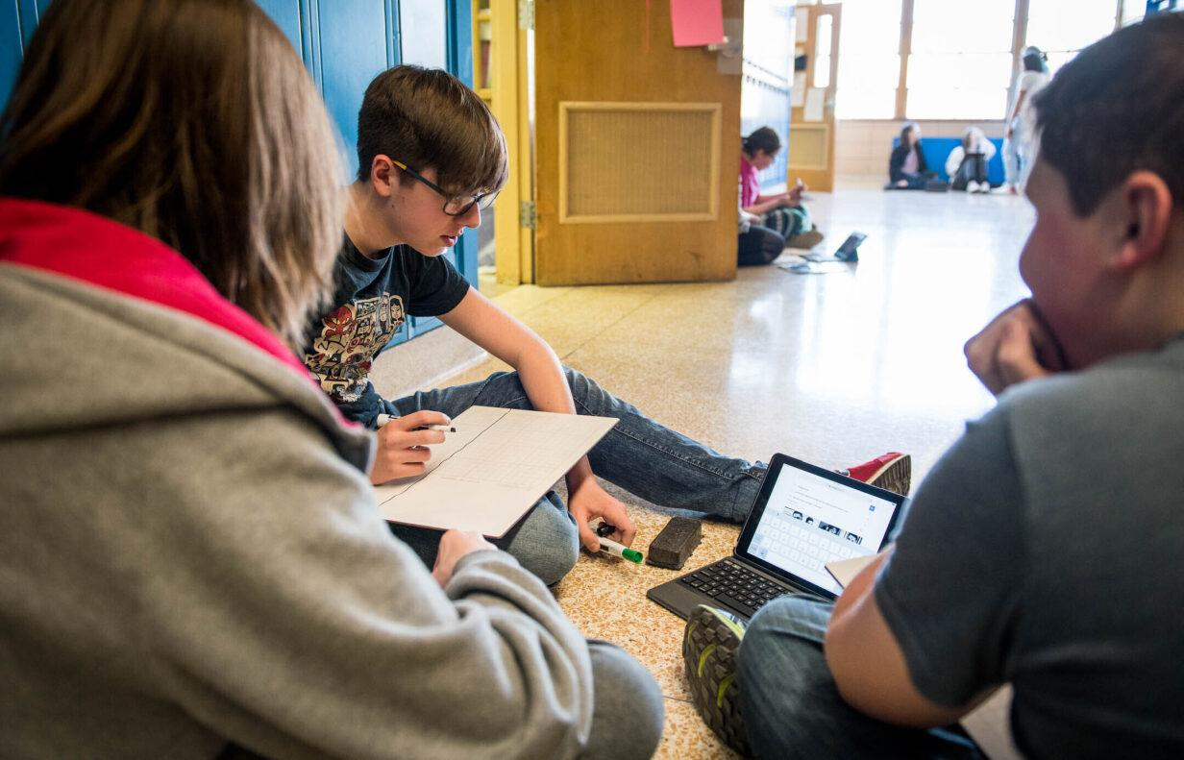
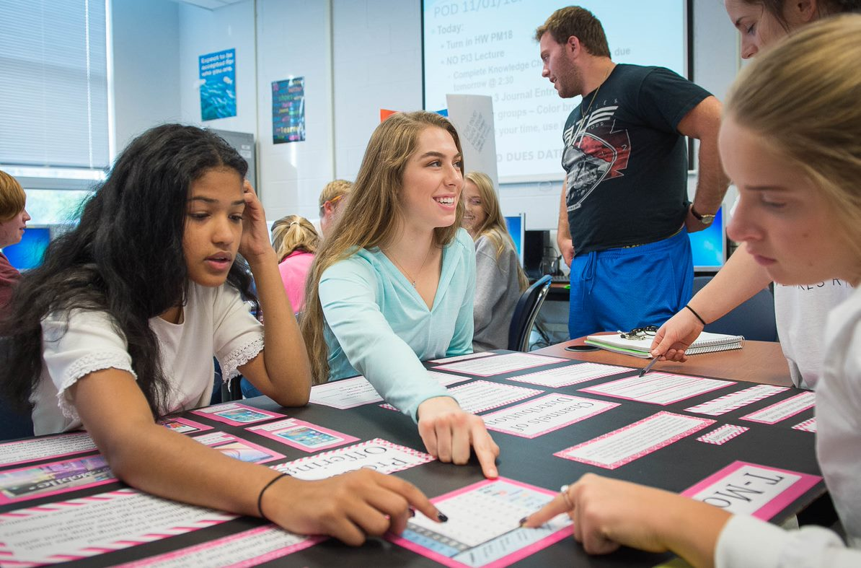
With small and intentional shifts, we can make a real difference for the students in our classes right now who need supports as readers.
Notes:
Guiding Notes:
This series represents the start of larger systemic shifts to support adolescent reading improvement within districts.

Slide 7
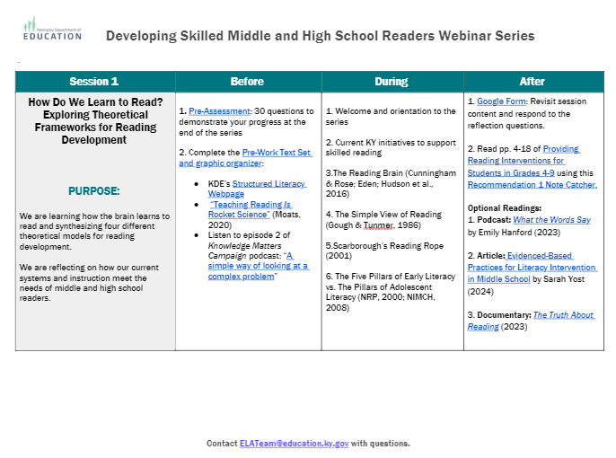
Sessions at a Glance
This document is a tool to know what to do before, during and after a learning session and is available on the Landing Page.
Notes:
Guiding Notes:​
Use this Learning Plan to monitor learning throughout the series.

Slide 8
Session 5: Comprehension as a Process and Product
Notes:
Sign In

Slide 9
Session Learning Objectives:
Participants will learn how to maximize knowledge building and comprehension strategies to support comprehension of complex text.
Participants will learn evidence-based practices to support both the process and product of comprehension.
Notes:
Guiding Notes:
This session provides participants with an understanding of how students develop vocabulary across the lifespan as well as instructional practices to teach vocabulary in middle and high school.

Slide 10
Learning Agreements
Assume best intentions of facilitators and participants.
Look for opportunities to learn and grow.
Ask questions on the sign out form. We will respond.
When in breakout rooms, allow a chance for everyone to participate.
Center students in the conversation.
Preference learning over performing.
Feel free to attend even if you haven’t completed the pre-work.
Process your learning with colleagues.
Notes:
Guiding Notes:
For groups working through this series together, these are recommended learning agreements for collaboration. These may be modified to suit local needs and expectations.

Slide 11
Materials Needed for This Learning:
Access to materials on Landing Page
Scrap paper or sticky notes
Print or ensure digital access to our text, Providing Reading Interventions for Students in Grades 4-9
Notes:
Guiding Notes:
The text for this series is available free online and can be printed for individuals to access and study for each session.

Slide 12
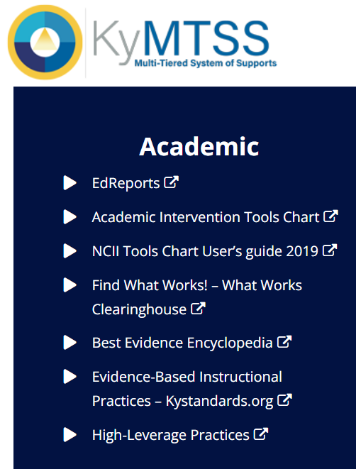
This slide details the topics from the IES Guide we will be using to study during this series.
Released March 2022
Build decoding skills so students can read complex multisyllabic words.
Provide purposeful fluency building activities.
Routinely use comprehension-building activities:
Build word and world knowledge (morphology & vocabulary);
Create opportunities to ask & answer questions about the text;
Teach a routine for summarizing;
Teach how to monitor comprehension as they read.
Practice with more challenging “stretch texts” to introduce more complex information.
Notes:
Guiding Notes:​
This slide outlines the recommendations provided in the IES Practice Guide. This series will address each of these recommendations.

Slide 13
Warm-Up Exercise:
Share your thinking with a partner to prepare for a large group discussion.
Review and Prepare for Learning:
1. How do you and/or your PLC currently ensure students have access to complex, grade-level text? 2. How do you and/or your PLC currently support students with comprehending complex, grade-level text?
Notes:
Guiding Notes:
These warm-up questions give participants an opportunity to reconnect with each other and with content from the previous session. Facilitators may choose to provide time for participants to think on their own, share with a partner or participate in a group discussion.

Slide 14
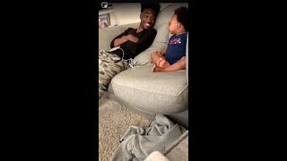
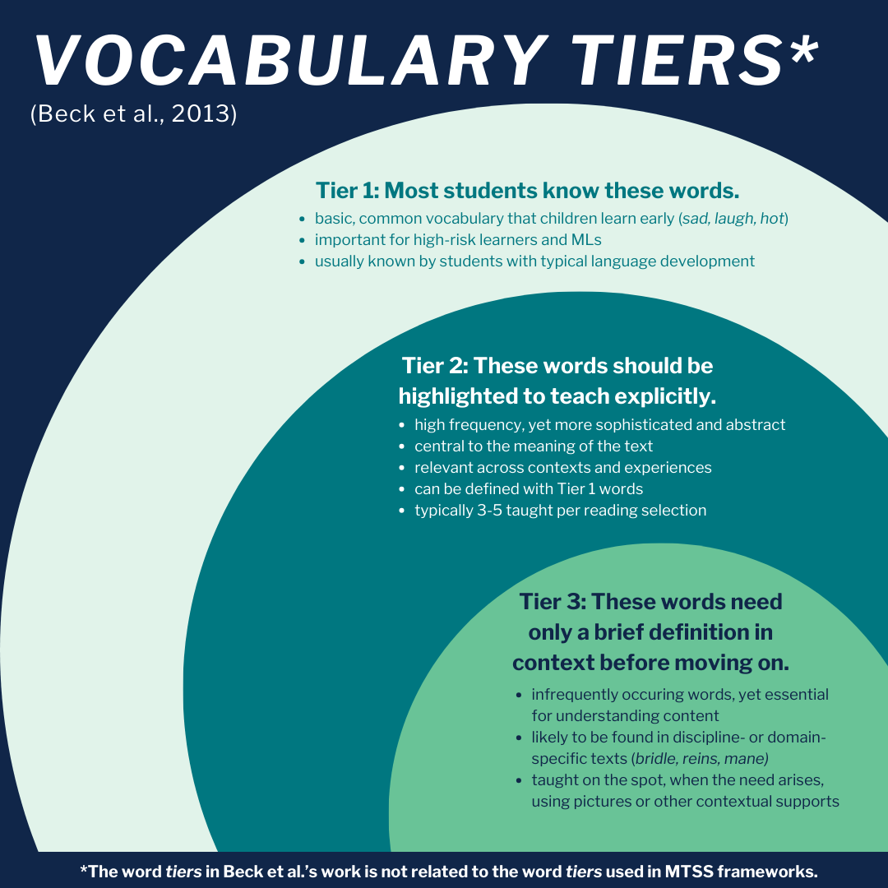
Our last session: Vocabulary and Background Knowledge!
With a partner: What’s something from the previous session (or any session from this series) that is impacting your instruction?
Notes:
Guiding Notes:
This slide contains images from the previous session on building world and word knowledge to support comprehension of complex, grade-level text. These images are intended to remind participants of previous content:
The father and son on the couch is from a video of a parent having multiple conversational turns with a child to promote oral language development. Participants may recall the importance of oral language development early in life to develop listening comprehension skills which translate to reading comprehension skills as children become strong decoders.
The image from the Hart and Risley (1995) study serves to remind participants of how word gaps or word poverty may develop if small children do not have intentional conversations and interactions with adults. When words are intentionally directed at children, they have a stronger chance of oral language development, listening comprehension and reading comprehension.
The Vocabulary Tiers image comes from Isabel Beck and Margaret McKeown’s work on selecting words to teach. Participants may recall that Tier 1 words are words that many students already know, and Tier 3 words are so domain-specific or infrequently occurring that they only need a brief definition before moving on. Tier 2 words are intentionally selected to teach explicitly because they are high frequency and are conceptually central to understanding the text studied.
The cover of Anita Archer’s Explicit Instruction: Effective and Efficient Teaching may remind participants that in reading and writing instruction (or ELA instruction), Tier 2 vocabulary words should be taught explicitly to support student clarity and knowledge of a word.

Slide 15
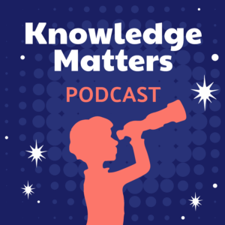
Should comprehension instruction focus on background knowledge or comprehension strategies?
Notes:
Guiding Notes:
This slide introduces a core question related to comprehension instruction as students are reading complex, grade level informational and literary texts: Should teachers focus on building students’ background knowledge of a topic before reading a text, or should instruction focus on teaching students how to use comprehension strategies such as finding the main idea or summarizing?
Because the Kentucky Academic Standards for Reading and Writing focus on students demonstrating their ability to comprehend, teachers may get the sense that strategies should be the focus of instruction. However, recent publications and research advocate otherwise: Participants may recall listening to The Knowledge Matters Podcast or references to The Knowledge Gap by Natalie Wexler. Both of these publications point to decades of research to support the importance of knowledge building to support comprehension.

Slide 16
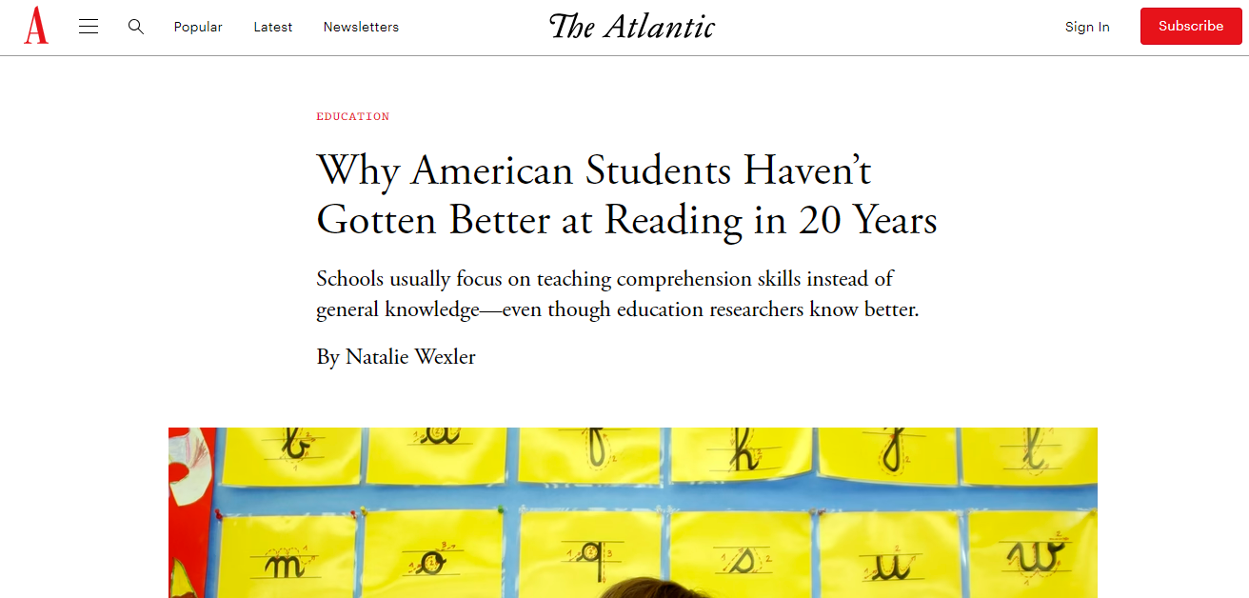
The role of background knowledge in comprehension is well-documented and a part of current discourse: Should we abandon teaching comprehension strategies and just focus on background knowledge?
Notes:
Guiding Notes:
This slide continues the discussion of the current discourse around knowledge and/or strategies in reading instruction. Participants may find both of these articles helpful to read on their own or with members of their PLC.
Wexler, Natalie. (2018). “Why American Students Haven’t Gotten Better at Reading in 20 Years. The Atlantic. Available at https://www.theatlantic.com/education/archive/2018/04/-american-students-reading/557915/
Shanahan, Timothy. (2023). “Knowledge or Comprehension Strategies—What Should We Teach?” Shanahan on Literacy. Available at https://www.shanahanonliteracy.com/blog/knowledge-or-comprehension-strategies-what-should-we-teach

Slide 17
The Kentucky Academic Standards for Reading and Writing also emphasizes the importance of knowledge building:
“Current research and best practice suggest that students comprehend texts best when they are able to activate schema, make meaning and recognize vocabulary. Exposing students to multiple texts and interdisciplinary content provides opportunities to build knowledge in meaningful ways.”
Notes:
Guiding Notes:
Because “knowledge building” has become a buzzword in recent years in the structured literacy movement, many educators may not be aware of the role of knowledge building in the development of the Kentucky Academic Standards (KAS) for Reading and Writing (2018).
The quote on this slide comes from p. 9 of the KAS for Reading and Writing, highlighting the role of knowledge for comprehension, particularly as students encounter more complex texts.

Slide 18
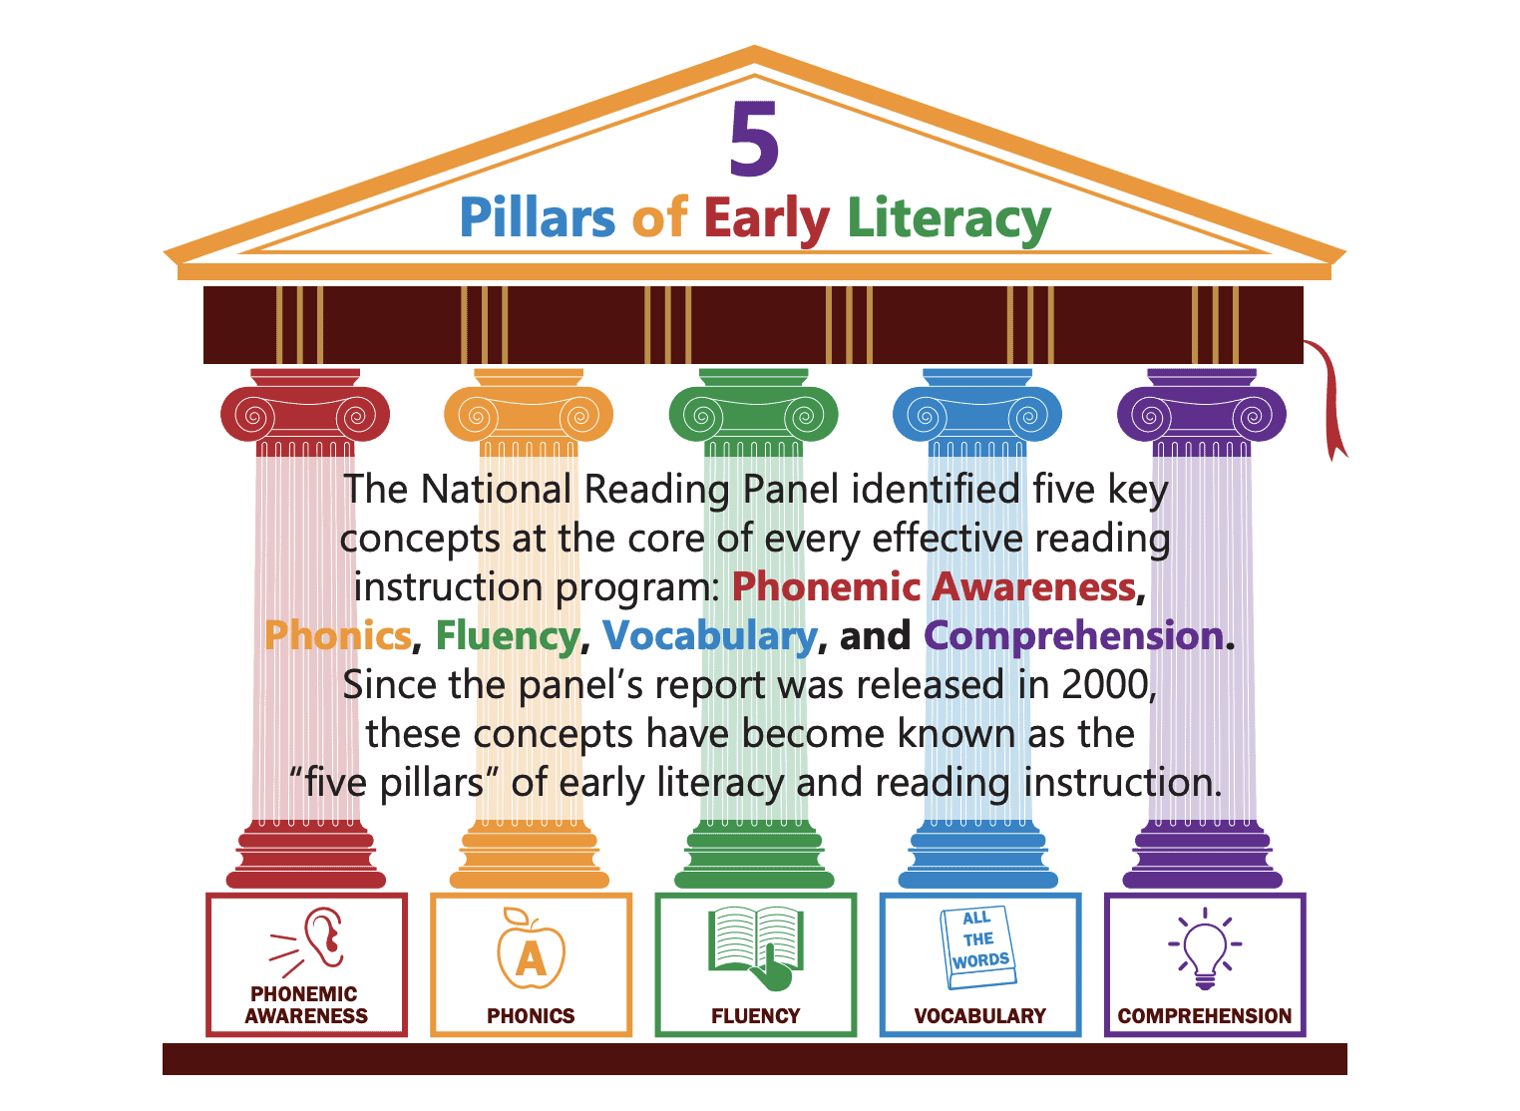
National Reading Panel (2000)
Reflect: Which of these evidence-based strategies are already part of your instruction?
Strategy | # of Studies Cited to Support | Definition or Description of the Strategy
Comprehension monitoring | 22 | Becoming aware of when they do not understand by identifying what is causing them difficulty
Graphic organizers | 11 | Making graphic representations of text
Question answering | 17 | Posing questions that emphasize the information students should have gained from the text
Question generating | 27 | Learning to generate questions that integrate units of meaning and which are to be posed during reading
Summarization | 18 | Learning techniques for summarizing
Cooperative learning | 10 | Enacting comprehension strategies in small groups rather than with the teacher
Text structure | 17 | Learning how literary or informational genres are structured
Multiple-strategy instruction | 38 | Engaging in multiple strategies at once to clarify passages (e.g., generating questions in a small group)
Notes:
Guiding Notes:
This chart demonstrates that many studies have validated the use of some strategies for teaching students to make sense of text. Each of these studies is cited in the National Reading Panel Report (2000), the report that established the five Pillars of Early Literacy as phonemic awareness, phonics, vocabulary, fluency and comprehension. Participants may find that they may be using some of these already to help students learn to become more independent readers.

Slide 19
Willingham (2006)
Reviewed the studies that the National Reading Panel cited (see previous slide)
Found that brief reading strategy instruction was most appropriate for proficient readers in grades 4-12 able to access a complex text independently (not students still learning to decode)
YET background and vocabulary knowledge were still strong predictors of comprehension for all ages.
Willingham, D.T. (2006). The usefulness of brief instruction in reading comprehension strategies. American Educator, 30(4), 39-50.
Notes:
Guiding Notes:
Dr. Dan Willingham, a researcher in cognitive neuroscience at the University of Virginia, examined each of the studies cited to support the use of comprehension instruction in the National Reading Panel report. As he examined the data closely, he found that BRIEF reading strategy instruction was only appropriate for proficient readers in grades 4-12 and that background and vocabulary knowledge were still strong predictors of comprehension.

Slide 20
Carlisle & Rice (2002)
Sample Internal Processes | Sample External Products
connecting concepts with prior knowledge | unit exam
predicting or anticipating while reading | arranging sentences in a logical order
deciding to re-read when something doesn’t make sense | answering comprehension questions
inferring what is meant by a multiple-meaning word | making an outline
generating mental pictures while reading | writing a literary or rhetorical analysis
Comprehension is “a process, not a product, through which the reader draws meaning from the text.”
Processes are covert, internal mental activities that draw meaning from text.
Products are the end result of comprehension.
Carlisle, J.F., & Rice, M.S. (2002). Improving reading comprehension: Research-based principles and practices. Baltimore, MD: York Press.
Notes:
Guiding Notes:
We know with the emphasis on comprehension tests, educators may tend to focus on the PRODUCT of comprehension while students likewise or perhaps, more importantly, need to understand the process of extracting information from text using multiple internal processes. Participants may need an opportunity to read the chart and reflect on this question: “What are we emphasizing in our current instruction at our school—processes or products?”

Slide 21
How is comprehension instruction changing in younger grades?
Notes:
Guiding Notes:
Because of the emphasis on early literacy changes in Kentucky, this section provides some valuable context for how comprehension instruction is shifting to align more closely with the science of reading.

Slide 22
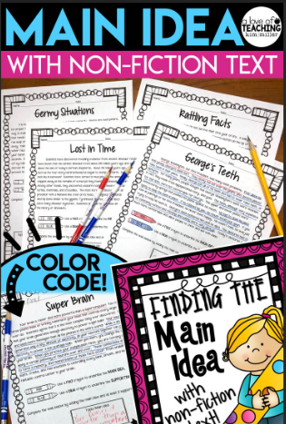
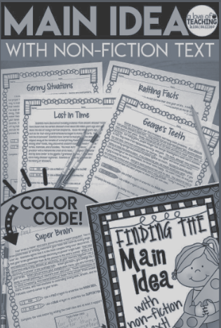
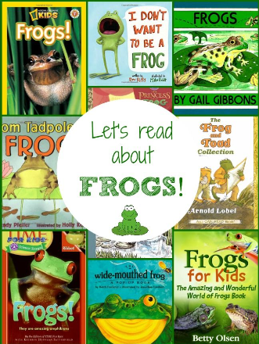
Shifting from
Skills to Knowledge
Many standards, skills, strategies bundled together using texts around a singular topic
One standard, skill, strategy using texts with familiar content
Lessons deliberately build on each other, giving students a chance to see vocabulary and content used in multiple ways
Notes:
Guiding Notes:
The notes below provide some context for how comprehension instruction is shifting in Kentucky in grades K-5, particularly with the use of knowledge-building high-quality instructional resources (HQIR).
Characteristics of Skill/Strategy-Based Instruction
● The curriculum uses a variety of topics, with one day’s text on hurricanes, another on ants, and a third on families. Instead, the common thread is a comprehension skill being learned and practiced such as identifying the main idea or inferring the theme.
● Texts are used to practice comprehension skills globally, versus build knowledge about a particular topic specifically. For example, after students read a text about hurricanes they are asked to point to the captions and explain what a caption is. Or, after reading a text about some different uses of plants, they are asked to practice using context clues to figure out what different words in the text might mean.
● The texts are typically about topics students already know. For example, a basal reader might include many stories about the community or families, where most of the content is familiar and redundant. For exercises, students might be asked to describe the sequence of activities that a character followed to make his dinner.
Characteristics of Knowledge-Based Instruction
● Students spend a series of lessons or time with texts focused on different aspects of the same or similar topic. This is because it’s easier to learn new material and vocabulary when you are familiar with a topic.
● Lessons deliberately build on each other, giving students a chance to see new vocabulary used in multiple ways and become familiar with new topics as they return to them in slightly different ways. For example, a unit on weather would include multiple readings and lessons in which students would encounter hurricanes, rain, and sleet-along with such repeating ideas and vocabulary as atmosphere, climate, meteorology, and air currents. Both academic vocabulary (perceive, excessive, frightening) and domain-specific vocabulary (hypertrophy in the example) are taught.
The lessons are aimed at understanding different aspects of weather. Questions and assignments (and indeed reading skills!) are aimed at building that knowledge and understanding. For example, students would be asked to compare and contrast how different weather systems get started or to describe the sequence of events that leads to a hurricane.

Slide 23
Routine 1:
Monitoring Comprehension
Partner Discussion: How do you currently support students with monitoring their comprehension?
Notes:
Guiding Notes:
This is the first of four comprehension routines discussed during this session. Participants may reflect on the question and/or share their responses with other participants.

Slide 24
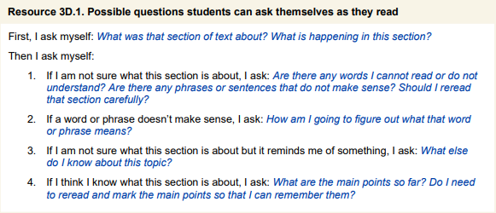
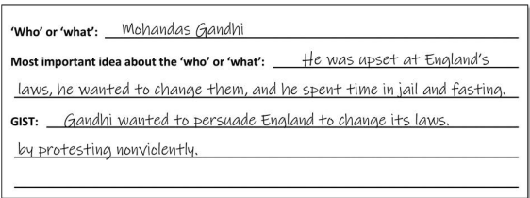
Teacher Modeling & Graphic Organizers
pp. 61
Notes:
Guiding Notes:
This slide points participants to p. 61 of the IES Practice Guide. Consider having participants turn or scroll to this page to look at these questions and graphic organizers. Good readers are metacognitively aware of their own thinking and understanding while they read, and they monitor their comprehension using questions like those included in the screenshot on the slide. Participants may find it helpful to reflect on times they ask themselves questions such as these while reading, particularly when reading about a new topic or a topic they know little about.
First I ask myself: What was that section of text about? What is happening in this section?
Then I ask myself:
1. If I am not sure what this section is about, I ask: Are there any words I cannot read or do not understand? Are there phrases or sentences that do not make sense? Should I rereads that section carefully?
2. If a word or phrase doesn't make sense, I ask: How am I going to figure out what that word or phrase means?
3. If I am not sure what this section is about but it reminds me of something, I ask: What else do I know about this topic?
4. If I think I know what this section is about, I ask: What are the main points so far? Do I need to reread and mark the main points so that I can remember them?"

Slide 25
Ask and model: “When did your comprehension break down? Why?”
Reasons Comprehension May Break Down:
Gaps in decoding and fluency
Missing assumed background knowledge
Gaps in vocabulary knowledge
Complex syntax/structure
Gaps in knowledge of the genre/author’s purpose (e.g., satire)
Lost focus / interrupted focus
Motivation
Our Goal: Students are aware of their own thinking (metacognition) while reading and are empowered to comprehend any text.
“My comprehension broke down in the fourth paragraph because I wasn’t sure what the author meant by ‘mores’ in that sentence, so I had to re-read and infer.”
Notes:
Guiding Notes:
Students (and even adults) are often not aware of why they didn’t comprehend something. Many say they lost focus or assume they’re just not motivated, but there are more nuanced reasons we may lose focus or motivation. For example, students may lose motivation if they have gaps in decoding or fluency that are making the reading nearly impossible to comprehend. Or perhaps they can decode the words but have gaps in knowledge that would support understanding. Maybe they understand the content knowledge, but the syntax is so varied and complicated that they get lost in the sentences themselves. The goal of comprehension instruction is to support proficient readers in being metacognitively aware enough to diagnose when and why their comprehension broke down. Not only would they know when/why they lost comprehension, but they would have tools to support themselves.

Slide 26
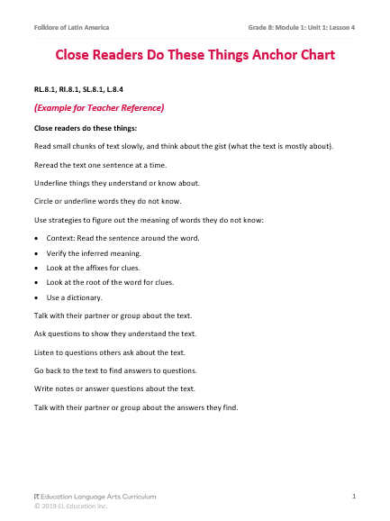
An HQIR may have supports to teach and mentor students as readers.
Found in EL Education, Grade 8: Module 1, Unit 1 (Latin American Folktales)
Notes:
Guiding Notes:
This slide is intended to remind participants to use the resources provided within their high-quality instructional resource (HQIR) to support Comprehension Monitoring. This example comes from EL Education, which is an open-source (free) resource.
If participants do not have access to a resource, they may consider creating an anchor chart with the list included on the sample:
Close Readers Do These Things:
Read small chunks of text slowly, and think about the gist (what the text is mostly about).
Reread the text one sentence at a time.
Underline things they understand or know about.
Circle or underline words they do not know.
Use strategies to figure out the meaning of words they do not know:
Context: Read the sentence around the word.
Verify the inferred meaning.
Look at the affixes for clues.
Look at the root of the word for clues.
Use a dictionary.
6. Talk with their partner or group about the text.
7. Ask questions to show they understand the text.
8. Listen to questions others ask about the text.
9. Go back to the text to find answers to questions.
10. Write notes or answer questions about the text.
11. Talk with their partner or group about the answers they find.

Slide 27
Comprehension Breakdown and Potential Responses
Comprehension Breakdown | Potential Teacher Actions | Potential Student Actions
Missing assumed background knowledge | building knowledge through text sets from HQIR, engagement exercises, student discussion (Session 4) | identify what knowledge you’re missing, reflect on previous reading and learning, use external resources to build knowledge
Gaps in vocabulary knowledge | explicit vocabulary instruction of Tier 2 words (Session 4), multiple reads | use reference materials as needed, read for context clues, determine meanings of multiple meaning words
Complex syntax/structure | teacher think aloud and questioning, multiple reads | multiple reads, rearrange word order, think in synonyms
Gaps in knowledge of the genre/author’s purpose (e.g., satire) | teacher modeling, building knowledge of the genre | ask and answer questions while reading, engage in criticality
Lost focus / interrupted focus | set a clear purpose for reading, eliminate distractions as much as possible, prompt student to re-read | set a clear purpose for reading, eliminate distractions as much as possible, re-read
Motivation | set a purpose for reading, provide relevant background and vocabulary knowledge | set a purpose for reading, collaborate with others, build your own knowledge as necessary
Notes:
Guiding Notes:
Note that this chart does not account for gaps in decoding and/or fluency skills, which is a significant barrier to comprehension for many students. This chart is for consideration for students who do not have significant gaps in decoding and/or fluency skills. The teacher actions for a gap in decoding ability (phonemic awareness or phonics) would include a multi-tiered systems of support (MTSS) structure with diagnostic assessments, progress monitoring and focused interventions if a middle or high school student has gaps in those skills.
This chart can be used to support students in their own metacognitive awareness. Many middle and high school instructors are already doing the actions in the middle column to support our students. However, as students become increasingly independent, proficient readers, they are empowered to be capable of monitoring their own comprehension and then taking actions to respond to moments when they have lapses in comprehension.

Slide 28
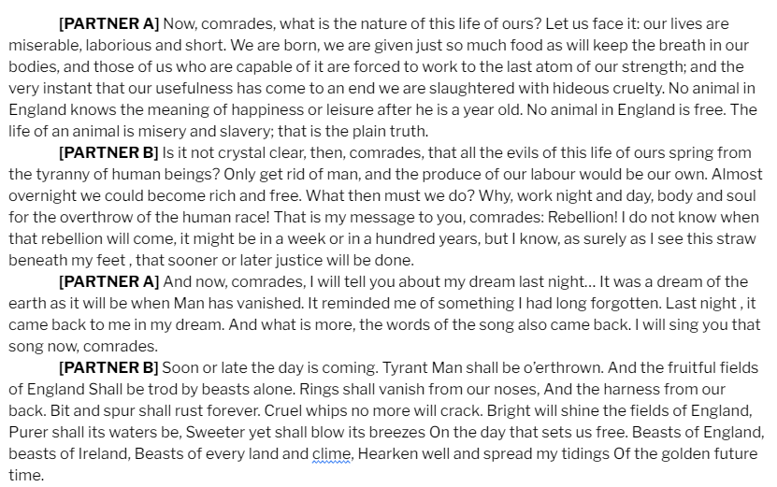
Try “Say Something” (from the fluency session)
Students may be reluctant to share with the whole class when and where their comprehension broke down.
Ask students to identify where comprehension breaks down and work cooperatively to build comprehension.
Notes:
Guiding Notes:
In addition to the chart on the previous slide, another cooperative way to introduce students to the concept of comprehension monitoring is to use the “Say Something” strategy we discussed in session 2. Not only does a strategy like this build fluency skills and potentially provide models of fluent reading to students, this is also safer setting for students to reflect on how and when their comprehension breaks down with a partner instead of in front of an entire class. Many teachers may find it helpful to model how their own comprehension breaks down when encountering new information, new genres, new forms or new texts.

Slide 29
Routine 2: Syntactic
Analysis
Notes:
Guiding Notes:
This is the second of four comprehension routines discussed during this session.

Slide 30
Syntax: rules that govern permissible word order
From Grade 6-8 Overview: “They must come to appreciate that language is as much a matter of craft as of rules and be able to choose words, syntax and punctuation to express themselves and achieve intended effects” (p. 222).
From Grade 9-12 Overview: “To enhance their craft and express themselves convincingly, students must make intentional choices in diction, syntax and rhetoric” (p. 319).
Notes:
Guiding Notes:
The Kentucky Academic Standards (KAS) for Reading and Writing mentions syntax as a composition (or writing) skill; however, syntax (and understanding how word order may impact meaning) is also essential for reading comprehension, particularly when syntax is complicated.
Kentucky Academic Standards for Reading and Writing (pages 222 and 319) https://www.education.ky.gov/curriculum/standards/kyacadstand/Documents/Kentucky_Academic_Standards_Reading_and_Writing.pdf

Slide 31
How does knowledge of syntax likewise support reading comprehension?
“As students explore a wider range of texts, they
are exposed to unfamiliar words and syntax,
and their reading becomes more fluent (p. 16).”
Furthermore, the top strand of Scarborough’s Rope points to language structure and verbal reasoning as foundational to comprehension.
Notes:
Guiding Notes:
Recall that syntax is defined as the rules that govern word order.
The IES Guide studied in this series demonstrates the relationship between syntax and comprehension, “As students explore a wider range of texts, they
are exposed to unfamiliar words and syntax, and their reading becomes more fluent (p. 16).”
Participants may make the connection between language structures in the top strand of the rope and syntax. Syntax is considered an aspect of language comprehension.

Slide 32
What are some types of sentence constructions that challenge comprehension for your students?
Challenging Feature | Function in a Sentence | Example
Passive Voice | The subject receives the action | The boat was rocked by the strong waves.
Double Negatives | Contains two negative elements | I did not advise him to never speak up.
Conditional Verb Forms | Expresses a situation that is hypothetical or unlikely | If he had been taller, he might have tried out for the team.
Subjunctive Mood | Expresses mood or something wished for/imagined | What could he be doing if he were here with me?
Articles the vs. a | The referring to a specific one of something A referring to one of a number of things | This is the major problem This is a major problem.
Unusual Word Order | Does not follow common syntax patterns; subject separated from verb | Only they will understand this. Mark and I–both veteran teachers–continue to struggle with behavior.
Pronoun/Antecedent | May not clearly indicate who/what a pronoun refers to | Olivia was frustrated when they gave her a ticket.
Notes:
Guided Notes:
This chart (adapted for middle and high school based on the Kentucky Academic Standards (KAS) for Reading and Writing and LETRS, Volume 2, p. 154) demonstrates complicated or challenging language forms students may encounter in complex, grade-level text. The work of reading and writing instruction addresses the Language (L) strand to support students in both comprehending and composing sentences using these features. Participants may share which of these language features present challenges for students in their grade level or grade band.

Slide 33
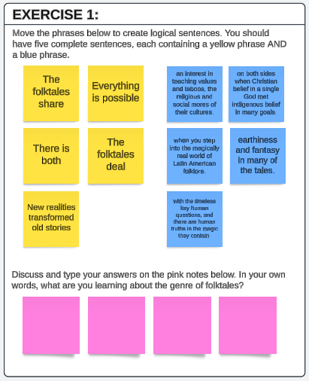
Breakout Room: Syntactic Analysis Exercises
1. Sentence Building
2. Phrase Order
3. Complex Syntax
Based on Language Dives activities found in EL Education, Grade 8: Module 1, Unit 1 (Latin American Folktales)
Notes:
Guiding Notes:
This slide contains examples for three exercises that teachers might leverage to engage students in syntactic analysis to support comprehension of complicated sentences. These exercises are available as samples on LucidSpark, an online app used for collaboration and learning: https://lucid.app/lucidspark/4d7e6564-c7d7-41d1-a85c-dc83268b0e37/edit?viewport_loc=-899%2C-917%2C3443%2C3120%2C0_0&invitationId=inv_af0622ac-2aa1-4889-9255-f1ee099f1d8b
Exercise 1: Sentence Building
This Sentence Building Exercise shows an example of one way teachers might engage students in syntactic analysis. Teachers find five sentences in a text studied and divide each sentence into two parts for students to match. Column A contains sentence beginnings, and Column B contains sentence endings.
Column A
- The folktales share
- There is both
- New realities transformed old stories
- Everything is possible
- The folktales deal
Column B
- an interest in teaching values and taboos, the religious and social mores of their cultures.
- when you step into the magically real world of Latin American folklore.
- with the timeless key human questions, and there are human truths in the magic they contain.
- on both sides when Christian belief in a single God met indigenous belief in many goals.
- earthiness and fantasy in many of the tales.
Answer Key:
The folktales share an interest in teaching values and taboos, the religious and social mores of their cultures.
There is both earthiness and fantasy in many of the tales.
New realities transformed old stories on both sides when Christian belief in a single God met indigenous belief in many goals.
Everything is possible when you step into the magically real world of Latin American folklore.
The folktales deal with the timeless key human questions, and there are human truths in the magic they contain.
Exercise 2: Phrase Order
This exercise also gives students an opportunity to consider how different phrases within a sentence work together to create meaning. Students are given three phrases to place in logical order to build a sentence:
who now represent the majority of the population in most cities throughout the region.”
“Amazonian realities are still a present and active part of the lives of the non-indigenous
As Jaun Carlos Galeano writes,
Answer Key: As Jaun Carlos Galeano writes, “Amazonian realities are still a present and active part of the lives of the non-indigenous who now represent the majority of the population in most cities throughout the region.”
Next students answer two reflection questions. Possible answers are included in parenthesis:
What is the purpose of the first phrase in your new sentence? (attribution, to show the origin of a quote)
What does the whole sentence tell us about the majority of Latin American cities? (

Slide 34
Routine 3:
Text-
Dependent Questions
Notes:
Guiding Notes:
This is the second of four comprehension routines discussed during this session.

Slide 35
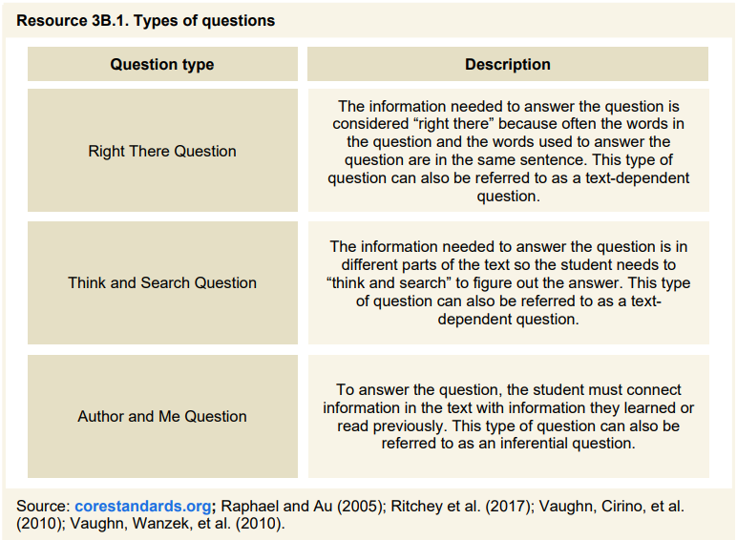
Three Types of Questions
on the line
between the line
beyond the line
p. 38
Notes:
Guiding Notes:
Text-dependent questions require students to refer to the details or inferences made in the text in order to fully address the question. Text-dependent questions are essential to ensure students are not only reading the actual text but also engaging meaningfully with the text. The IES Guide studied in this series points out that we should not only have text-dependent questions, but we should have questions that require students to read, re-read and think critically about the complex texts assigned to them.

Slide 36
Why does question quality matter?
On the Line/
Right There Questions:
1. What kind of farkle is in the story?
2. What did he yest through?
3. How long did he yest?
4. What did he prip?
The gubbly farkle yested through the pimmel for most of the day, until he finally pripped, “Slup!”
Notes:
Guiding Notes:
This nonsense exercise is intended to support teachers in considering the importance of question quality. All of these questions are text-dependent, but they do not require students to make inferences or analyze the text. This exercise (while silly) illustrates the depth of reading some students engage in–they can decode the words, but they have very little deep comprehension of what they are reading, why it is relevant to them, or how the knowledge they gain from reading will support their work in the class. This illustrates the importance of moving beyond Right There questions to higher order thinking.

Slide 37
What are text-dependent questions?
Only answerable by referring to the text being read
May be literal, recall questions but should work towards analysis, synthesis and evaluation
May include prompts for writing and discussion
Relevant across all content areas as students should be engaging deeply with texts (anything that communicates a message) in all of their classes
Notes:
Guiding Notes:
Text-dependent questions anchor students in the texts studied and require students to read and re-read texts carefully. Students may encounter text-dependent questions in all grade levels and content areas to engage with knowledge and skills required to comprehend grade-level, complex text.

Slide 38
Why use text-dependent questions?
To help students focus on difficult portions of text to enhance reading proficiency through deeper engagement
To deepen students’ understanding of a text by sequencing questions to build on each other, including analysis, synthesis and evaluation
To direct students to specific words, sentences and paragraphs meanings as well as large ideas, themes or events
Notes:
Guiding Notes:
This slide is adapted from the Reading and Writing Text-Dependent Questions (TDQ) Webcast that aired on KDE’s Office of Teaching and Learning YouTube channel in March 2020. This slide indicates reasons why text-dependent questions may provide essential supports for students in accessing and analyzing complex, grade-level text.

Slide 39
Text-Dependent Questions Promote Equity!
TDQs DO Ground student responses in complex text: one of the key components of excellent literacy instruction. | TDQs DO NOT Assume a student has background knowledge that can’t be found in text.
Notes:
Guiding Notes:
This slide is adapted from the Reading and Writing Text-Dependent Questions (TDQ) Webcast that aired on KDE’s Office of Teaching and Learning YouTube channel in March 2020. Participants may require an opportunity to reflect on how equity often hinges on student background knowledge prior to reading a text. All questions should ground students in the texts studied.

Slide 40
Examples from “Latin American Folktales”
TDQs DO Ground student responses in complex text–one of the key components of excellent literacy instruction. | TDQs DO NOT Assume a student has background knowledge that can’t be found in text.
What purpose do Latin American folktales serve in the cultures described? | How did Latin American folktales contribute to the development of magical realism as a genre?
Notes:
Guiding Notes:
This slide is adapted from the Reading and Writing Text-Dependent Questions (TDQ) Webcast that aired on KDE’s Office of Teaching and Learning YouTube channel in March 2020. Participants may require an opportunity to reflect on how equity often hinges on student background knowledge prior to reading a text. All questions should ground students in the texts studied.
The first question comes from EL Education Grade 8 and requires students to engage with and cite information from the text studied. The second question is NOT text-dependent and would require students to have knowledge that is not included in the text.

Slide 41
We need a variety of TDQs to support student engagement with text:
Vocabulary & Comprehension: Does the student understand what the text is saying?
Syntax & Structure: Does the student understand the elements of craft and authorial choice that make meaning?
Theme/Central Idea Analysis: Does the student understand how themes and central ideas develop over the course of a text?
Notes:
Guiding Notes:
This slide is adapted from the Reading and Writing Text-Dependent Questions (TDQ) Webcast that aired on KDE’s Office of Teaching and Learning YouTube channel in March 2020. This slide emphasizes that students may engage with a variety of text-dependent questions to address a variety of comprehension needs within a text. Different texts may present different challenges to students, so instructors may consider or anticipate questions that would clarify vocabulary, syntax/structure and theme/central idea analysis.

Slide 42
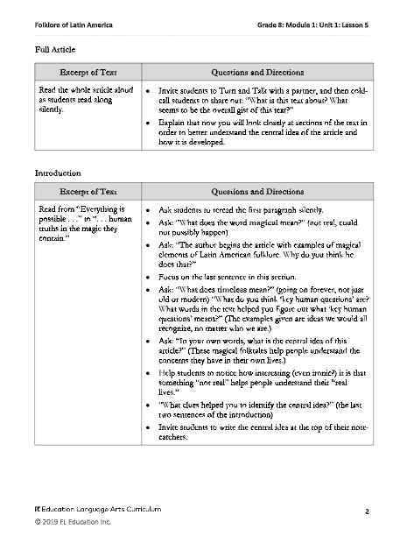
High-Quality Instructional Resources (HQIRs) provide a variety text-dependent questions to accompany texts.
If your district has not yet adopted an HQIR (or you simply want to know more), access this module to support the writing of high-quality questions.
Notes:
Guiding Notes:
This slide points participants to their adopted high-quality instructional resource. While the slide uses EL Education as an example, districts may have access to another green-rated HQIR. If a district has not yet adopted an HQIR, KDE has a module available to support the writing of high-quality questions available at the link below.
Text-Dependent Questions Module https://kystandards.org/utdq/

Slide 43
Text-Dependent or Not?
(From “Latin American Folktales”)
What do you think the word “originated” might mean in the text? How does the context help you figure it out?
YES! This is a Vocabulary & Comprehension question that requires students to refer to the text and could not be answered with prior knowledge.
This question comes from EL Education, Grade 8: Module 1, Unit 1 (Latin American Folktales).
Notes:
Guiding Notes:
This slide is adapted from the Reading and Writing Text-Dependent Questions (TDQ) Webcast that aired on KDE’s Office of Teaching and Learning YouTube channel in March 2020. Participants will read the question and have an opportunity to discuss if the question as written is text-dependent or not. This question comes directly from EL Education and requires students to refer to the text to substantiate their answer.

Slide 44
This question comes from EL Education, Grade 8: Module 1, Unit 1 (Latin American Folktales).
Text-Dependent or Not?
(From “Latin American Folktales”)
The author begins the article with examples of magical elements of Latin American folklore. Why do you think he does that? Use an example from the text to support your answer.
YES! This is a Syntax & Structure question that requires students to refer to the text and could not be answered with prior knowledge.
Notes:
Guiding Notes:
This slide is adapted from the Reading and Writing Text-Dependent Questions (TDQ) Webcast that aired on KDE’s Office of Teaching and Learning YouTube channel in March 2020. Participants will read the question and have an opportunity to discuss if the question as written is text-dependent or not. This question comes directly from EL Education and requires students to refer to the text to substantiate their answer.

Slide 45
No! This question does not require students to engage with the text and requires knowledge not necessarily provided in the text.
Text-Dependent or Not?
(From “Latin American Folktales”)
What is a metaphor? Make up a metaphor for how Latin Americans relate with their folktales.
Notes:
Guiding Notes:
This slide is adapted from the Reading and Writing Text-Dependent Questions (TDQ) Webcast that aired on KDE’s Office of Teaching and Learning YouTube channel in March 2020. Participants will read the question and have an opportunity to discuss if the question as written is text-dependent or not. This question does not require students to engage with the text and requires knowledge not necessarily provided in the text.

Slide 46
If you do not yet have access to an HQIR, consider these question stems:
Right There Recall | What happened…? How many…? How did…? Who…? What is…? Which… ?
Think and Search Inferential | Why did…? What was…? What do you think about…? Can you explain…? How was this similar to…?
Author and Me Application | How would you…? Do you agree…? What would have happened if…? How might…? What effect does…? If you were…how might you…?
Reflect: Why do students need all three types of questions?
Notes:
Guiding Notes:
This slide is adapted from the Reading and Writing Text-Dependent Questions (TDQ) Webcast that aired on KDE’s Office of Teaching and Learning YouTube channel in March 2020. These question stems provide some guidance for writing or improving text-dependent questions to support deeper comprehension of a text.

Slide 47
Routine 4:
Summarizing with “Gist” Statements
Notes:
Guiding Notes:
This is the third of four comprehension routines discussed during this session.

Slide 48
The Steps for Writing a Gist Statement
This routine may also support students in learning how to annotate texts/how to highlight in independent reading as college students.
p. 48
Notes:
Guiding Notes:
This slide explicitly provides a routine for teaching students to generate a gist statement as described in the IES Guide. Note that this routine also supports students in making stronger annotations of texts.

Slide 49
1. Who or what is the passage about?
Everything is possible when you step into the magically real world of Latin American folklore—a buzzard can change places with a wife’s lazy husband; a hunter may hurl lightning bolts and thunder down on the tribesmen who cheated him of his share of the meat; a shapeshifting pink dolphin from the Amazon may seduce a young woman to his underwater city; and the lizard a padre scoops off a dusty road may become an emerald when he hands it to a poor peasant who needs to buy medicine for his wife. Here, a lone man after a cataclysmic flood sees his black dog slip out of its skin and become a young woman who cooks tortillas and will become his companion in the new world. The folktales deal with timeless key human questions, and there are human truths in the magic they contain.
From EL Education, Grade 8: Module 1, Unit 1 (Latin American Folktales)
Notes:
Guiding Notes:
In this example, the slide uses EL Education’s Grade 8 Text “Latin American Folktales.” The highlighted portion represents what students might identify in Step 1: Who or what is the passage about?

Slide 50
2. What is important about Latin American folklore in the passage?
Everything is possible when you step into the magically real world of Latin American folklore—a buzzard can change places with a wife’s lazy husband; a hunter may hurl lightning bolts and thunder down on the tribesmen who cheated him of his share of the meat; a shapeshifting pink dolphin from the Amazon may seduce a young woman to his underwater city; and the lizard a padre scoops off a dusty road may become an emerald when he hands it to a poor peasant who needs to buy medicine for his wife. Here, a lone man after a cataclysmic flood sees his black dog slip out of its skin and become a young woman who cooks tortillas and will become his companion in the new world. The folktales deal with timeless key human questions, and there are human truths in the magic they contain.
Notes:
Guiding Notes:
In this example, the slide uses EL Education’s Grade 8 Text “Latin American Folktales.” The underlined portion represents the important facts about Latin American folktales detailed in the passage.

Slide 51
3. Synthesize important information.
Everything is possible when you step into the magically real world of Latin American folklore—a buzzard can change places with a wife’s lazy husband; a hunter may hurl lightning bolts and thunder down on the tribesmen who cheated him of his share of the meat; a shapeshifting pink dolphin from the Amazon may seduce a young woman to his underwater city; and the lizard a padre scoops off a dusty road may become an emerald when he hands it to a poor peasant who needs to buy medicine for his wife. Here, a lone man after a cataclysmic flood sees his black dog slip out of its skin and become a young woman who cooks tortillas and will become his companion in the new world. The folktales deal with timeless key human questions, and there are human truths in the magic they contain.
“These are examples that support my understanding of the folktale genre, but they’re not individually essential to my summary.”
Notes:
Guiding Notes:
In this example, the slide uses EL Education’s Grade 8 Text “Latin American Folktales.” Students might need support understanding the function of the listed examples as evidence to support the idea that folktales address human questions and truths.

Slide 52
4. Write a gist statement and revise with peers.
Everything is possible when you step into the magically real world of Latin American folklore—a buzzard can change places with a wife’s lazy husband; a hunter may hurl lightning bolts and thunder down on the tribesmen who cheated him of his share of the meat; a shapeshifting pink dolphin from the Amazon may seduce a young woman to his underwater city; and the lizard a padre scoops off a dusty road may become an emerald when he hands it to a poor peasant who needs to buy medicine for his wife. Here, a lone man after a cataclysmic flood sees his black dog slip out of its skin and become a young woman who cooks tortillas and will become his companion in the new world. The folktales deal with timeless key human questions, and there are human truths in the magic they contain.
“These are examples that support my understanding of the folktale genre, but they’re not individually essential to my summary.”
Latin American folklore is storytelling tradition that uses a mixture of magic and the real world to explain answers to human questions.
Notes:
Guiding Notes:
The blue box represents a possible gist statement teachers might model or teachers might write for this passage in particular.

Slide 53
What might all of this look like in a classroom? Note that this is merely a sample not intended as a requirement.
2 minutes | World Knowledge: Activate schema and build knowledge.
2 minutes | Word Knowledge: Introduce Tier 2 vocabulary to teach explicitly.
20-25 minutes | Generating a summary, developing word knowledge, monitoring for understanding: Read complex text with three types of questions and modeling.
3-5 minutes | World and word knowledge: Ask students to write using essential knowledge and vocabulary from the day’s reading.
3-5 minutes | Monitoring for understanding: Time for connecting to the next day or individual conferencing
See the Guide for a detailed sample of how to connect all of these practices.
pp. 65-67
Notes:
Guiding Notes:
Note that this possible schedule represents a sample and is not intended as a requirement. The IES Guide provides a sample schedule for pacing individual lessons.

Slide 54
Caution
Sample Internal Processes | Sample External Products
connecting concepts with prior knowledge | unit exam
predicting or anticipating while reading | arranging sentences in a logical order
deciding to re-read when something doesn’t make sense | answering comprehension questions
inferring what is meant by a multiple-meaning word | making an outline
generating mental pictures while reading | writing a literary or rhetorical analysis
Comprehension is not merely a product!
Comprehension is “a process, not a [only] product, through which the reader draws meaning from the text” (Carlisle & Rice, 2002).
Notes:
Guiding Notes:
This slide uses the same chart from the research of Carlisle and Rice cited previously. This is an opportunity for teachers to reflect on the challenges of focusing on comprehension as both a process AND a product. When teachers allow students to engage in comprehension and not just demonstrate comprehension, this provides opportunities for students to engage more deeply in text as well as gain more knowledge.

Slide 55
Reflection:
Use your calendar or planner. When and how might you incorporate one or two of these comprehension routines into your instruction this week?
Designate a person to share with the larger group.
Notes:
Guiding Notes:
Use this time for teachers or PLCs to meet to discuss how learning from this session may impact upcoming instruction. Teachers or PLCs may also consider systemic routines or structures that may support more evidence-based instruction.

