Slide 1
Supporting Students in Using Evidence
Module Series Overview

Slide 2
Supporting Students in Using Evidence 2
Module Six: What Should Students Do After Engaging with Complex Sources?
Notes:
Module Series Overview:
Supporting Students in Using Evidence module series is a set of six of modules designed to support students when using evidence as required by the Kentucky Academic Standards (KAS) for Social Studies. While this module series is designed in a progression, you may engage with the module section that best meets your professional learning needs.
Supporting Students in Using Evidence module series is intended to support the successful implementation of the KAS for Social Studies in classrooms across the state. The duration, scope and sequence of the module sections may be customized to accommodate local needs and conditions. The sections are designed to provide flexibility for districts and schools and, as such, can be viewed as stand-alone lessons or within the progression of the module as written. You are supported in engaging with this module individually, if desired.
Materials:
The following materials are part of this module:
●Kentucky Academic Standards (KAS) for Social Studies
●Additional materials, such as but not limited to, articles, discussion strategies, etc. are provided within the notes section of applicable slides throughout the module.
Guiding Notes
Guiding notes are provided in the Notes section of the PowerPoint to support your learning. The information provided in the Notes section includes additional information, directions for the activities on the slide, and citations of used resources, where appropriate. It is critical that you read the material presented in the Notes section to ensure that you are acquiring the important knowledge, skills and understanding required when engaging with this module.
Virtual Training Note:
If you plan to engage with this module virtually as a group, consider directing participants to the Social Studies Professional Learning Modules webpage on kystandards.org so that you may access the resources used directly from the links provided in the PowerPoint. Additionally, you may consider downloading the resources contained within each section of the module and placing them into a Google folder for you or your colleagues to access.
Module Six: Compelling and Supporting Questions
Compelling Question: How do I support students in communicating their own conclusions, using evidence to substantiate their claims?
Supporting Question: How do I use students’ comprehension of primary and secondary sources to demonstrate mastery of the Using Evidence standards?
Learning Target and Success Criteria:
The Learning Target and Success Criteria for districts and schools of Module Four: What should students do before engaging with complex sources? are:
Learning Target: I can support students in using evidence to substantiate their claims.
Success Criteria: I will be successful when I can develop coherent periods of learning that support students’ mastery of the grade level Using Evidence standards of the KAS for Social Studies.
Intended Audiences:
Participants
Module participants may include, but are not limited to, district leadership, school administrators, instructional specialists/coaches, intervention specialists, department chairs, special educators and classroom teachers.
It is important to note that it is recommended that participants have engaged with the following modules prior to engaging with this module:
Getting to know the Kentucky Academic Standards (KAS) for Social Studies Module
The Minding the Gap Module
The Inquiry Practices of the Kentucky Academic Standards (KAS) for Social Studies Module
Thus, participants are encouraged to engage with these modules prior to participating in this module.
Facilitators:
While this module series is designed for a teacher to engage with it individually, it may be implemented with a group of educators led by a facilitator. If this module is being completed as a group, facilitators may include, but are not limited to, district leaders, school administrators, instructional specialists/coaches, intervention specialists, department chairs, special educators, and classroom teachers. Facilitators may need to revise specific tasks in order to meet the needs of the participants or to be respectful of the time planned within the work session. As stated above, the Kentucky Department of Education (KDE) recommends that participants engage with the four modules mentioned above prior to engaging with this work. If the facilitator has not engaged with these modules, it is recommended that they complete the four modules mentioned before facilitating this module.
Helpful Hint for Facilitators:
The learning that will take place in this module may cause Kentucky educators to face changes in instructional practices amidst this transition. It is important to realize that while you are the facilitator of these work sessions, you may not have all the answers to the questions asked by participants, and that is okay. Throughout the module, participants may have questions that will be addressed in future work sessions. When that happens, reflect on this quote from Graham Fletcher, “Every teachable moment doesn’t need to be a teachable moment in that moment.” Use these moments to encourage participants to attend future work sessions where those questions will be addressed. If participants ask questions you are not prepared to answer, offer to follow up on that during the next work session.
Planning Ahead for Facilitators:
• Determine which stakeholders to invite as participants. In the invitation, describe how the work sessions will benefit them.
• A few days before the meeting, you may want to remind participants to be prepared to have their documents available during the meeting. (See below for Participant Documents Needed.)
• Reserve adequate space and equipment. Tables or desks should be set up to support small-group discussion. If conducting this module virtually, ensure that your technology platform can support break out rooms to support small group collaboration.
• Ensure that participants have access to the Internet.
• Consider how you might handle participants who may not be in attendance at all work sessions. It might be worthwhile to consider how those participants might access missed sections of the module between work sessions in order to feel as prepared as the other participants.
Preparation
Participant Documents Needed:
Plan ahead regarding how you will feel most comfortable engaging with the KAS for Social Studies, either:
• A device with access to the KAS for Social Studies, or
• A hard copy of the KAS for Social Studies
Supplies Needed:
• Computer with the Module Four: What should students do before engaging with complex sources? PowerPoint presentation.
• Technology with projection capability if in person with a group. Technology platform where presenters have sharing ability and breakout room options if virtual with a group.
• Copies of the handouts needed for the session either in hard copy format or available in a folder online. If facilitating this work with a group, links to the participant handouts needed for the session also may be built right into the agenda.
• Parking Lot for questions - If completing as a group, you may consider providing a poster on which participants can write or post questions, or you may prefer to have a digital parking lot where participants can access a Google document, for example, to post questions and that you can modify as the participants work through the sections of the module.
• Self-Sticking Notes (optional)
• Poster paper (optional)
• Highlighters and/or colored pens/markers (optional)
Building a Community:
Building a community is important for any group that will work together, especially if participants have not worked together before. The concept is the same as building a safe, respectful, productive classroom climate. Incorporating community-building into each session builds trust, shows participants that they are valuable as individuals and engages them in the learning process. It is also useful for creating a professional learning network where participants can be supported in their work. Community-building can be as simple as allowing participants to introduce themselves and their role in the school/district, developing or refining group norms, allowing for questions, and/or the sharing of answers to reflection questions or individual discovery task items that are included in this module. Again, time allotted for community-building will allow participants to have a voice and be engaged as active contributors and learners in the sessions.
Virtual Training Options: Be sure to conduct continual check-ins throughout the presentation. Build Google documents to continue to collect feedback, such as questions, hopes, and/or concerns to which participants may continually add.

Slide 3
Module Six: What should students do after engaging with complex sources?
Compelling Question: How do I support students in communicating their own conclusions when substantiating their claims using evidence?
Supporting Question: How do I use students’ comprehension of primary and secondary sources to demonstrate mastery of the Using Evidence standards?
Learning Target: I can support students in using evidence to substantiate their claims.
Success Criteria: I will be successful when I can develop coherent periods of learning that support students’ mastery of the grade level Using Evidence standards of the KAS for Social Studies.
Notes:
Guiding Notes:
For more information on compelling questions, visit Section 3B: “What are Compelling Questions and how do students ask them?” from the Inquiry Practices of the KAS for Social Studies module: https://www.education.ky.gov/_layouts/download.aspx?SourceUrl=/curriculum/standards/kyacadstand/Documents/Inquiry_Practices_of_KAS_for_Social_Studies.pptx
For more information on supporting questions, visit “Section C: What are Supporting Questions, and how do students ask them?” from the Inquiry Practices of the KAS for Social Studies module: https://www.education.ky.gov/_layouts/download.aspx?SourceUrl=/curriculum/standards/kyacadstand/Documents/Inquiry_Practices_of_KAS_for_Social_Studies.pptx
For more information on Learning Goals and Success Criteria and their alignment to the KAS for Social Studies, visit Learning Goals, Success Criteria and the KAS for Social Studies: https://kystandards.org/standards-resources/ss-resources/learning-goals-success-criteria-and-the-kas-for-social-studies/

Slide 4
Supporting Students When Engaging With Complex Sources
The Phases of Engaging with Sources
Before Engaging with the Source(s)
While Engaging with the Source(s)
After Engaging with the Source(s)
Notes:
Guiding Notes:
Supporting student comprehension of complex sources may occur in three phases. When implementing a complex source in the local curriculum, teachers can support student comprehension of the source by using strategies before, during and after reading the complex source. Module Six discusses ways what students should after engaging with complex sources comprehension.
As you engage with Module Six, you are encouraged to view this PowerPoint in slideshow or presentation mode to ensure that you can read the text featured on each slide.

Slide 5
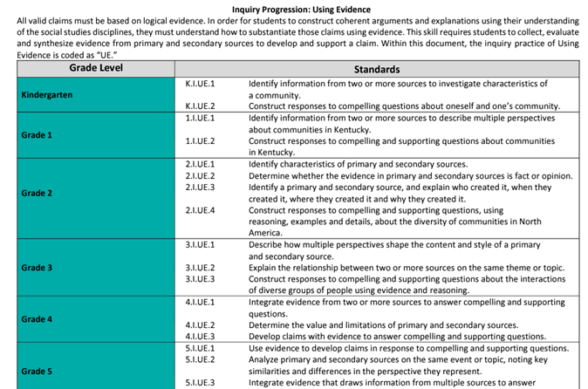
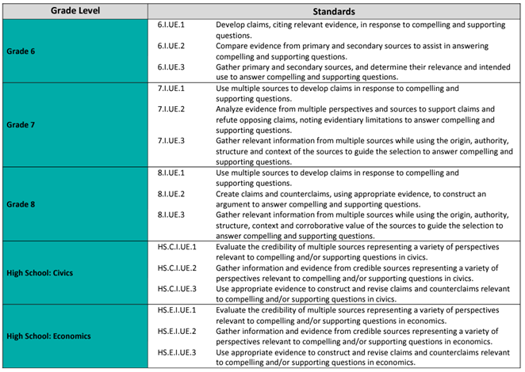
Supporting Students When Engaging With Complex Sources:
After Engaging with the Source(s)
After actively reading complex sources, students should regularly refer to the source(s) to reflect on what they read and to engage in more complex social studies skills.
What are more complex social studies skills?
In order to answer this question, refer to your work from Module One where you annotated the sourcing skills students have to demonstrate at each grade level or grade band according to the Inquiry Progression: Using Evidence on pg. 157 of the KAS for Social Studies.
Notes:
Guiding Notes:
Read the slide and complete the activity provided.
If you did not complete Module One of this series, complete the following to understand what complex social studies skills are required by the KAS for Social Studies:
Access the Inquiry Progression: Using Evidence on pg. 157 of the KAS for Social Studies and read the progressions of the Using Evidence standards from kindergarten through high school. As you read, annotate the sourcing skills students have to demonstrate at each grade level or grade band by highlighting or underlining the sourcing vocabulary found in the standards.

Slide 6
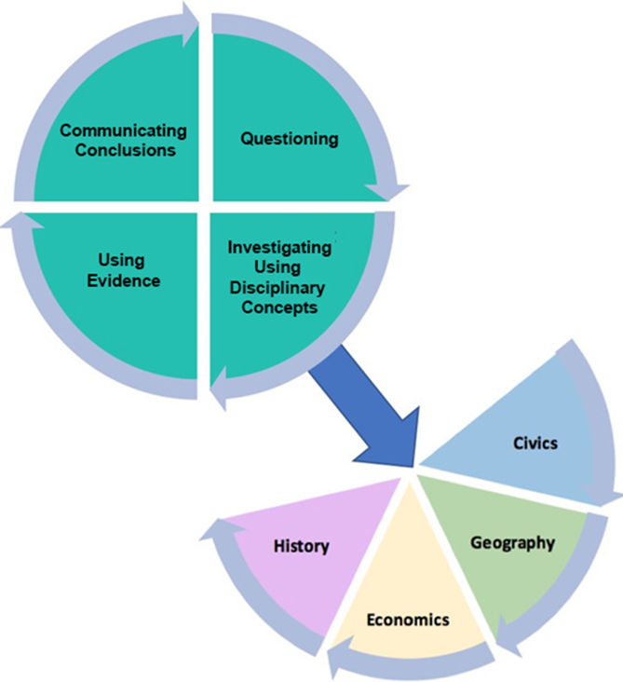
Using Evidence
In order for students to construct coherent arguments and explanations using their understanding of the social studies disciplines, they must understand how to substantiate those claims using evidence.
This skill requires students to collect, evaluate and synthesize evidence from primary and secondary sources to develop and support a claim.
Notes:
Guiding Notes:
Read the slide. It is important to note that in order for students to construct coherent arguments and explanations using their understanding of the social studies disciplines, they must understand how to substantiate those claims using evidence. This skill requires students to collect, evaluate and synthesize evidence from primary and secondary sources to develop and support a claim.

Slide 7
Supporting Students When Engaging With Complex Sources:
After Engaging with the Source(s) (1)
When referencing previously read sources to engage in more complex social studies skills, students should use their reflection time to:
Consider new ideas
Clarify and refine their understanding of content
Connect what they have learned through this source with other information or social studies concepts
Engage in evaluating the source, such as through corroboration or contextualization
Additionally, teacher should assess what students have learned from engaging with the source to support a student when conducting social studies investigations.
Notes:
Guiding Notes:
Read the slide.

Slide 8
Supporting Students When Engaging With Complex Sources:
After Engaging with the Source(s) (2)
After students engage with a source, they can use the information they have learned to deepen their understanding of social studies concepts, practices and ideas. After students have engaged with sources about cultural characteristics of Mexico, they use this knowledge to respond to the supporting question, “How have cultural groups in the past and today shaped Mexico? The example below is from Grade 2.
Cultural characteristic | How did cultural groups in Mexico shape this?
Holidays/Celebrations | Day of the Dead is still a popular holiday in Mexico today that started long ago from ancient Aztec and Spanish traditions.
Music | Traditional mariachi music is still heard in Mexico today, although it originated long ago.
Food | Popular food in Mexico today is inspired by different cultures based on their tradition and geographical features.
Sports | Ulama is an ancient ball game that is being practiced today, and indigenous ball games such as this inspired the sports that are popular in Mexico today.
Notes:
Guiding Notes:
Read the slide.
This slide provides an excerpt of a Teacher Note that shows how a student is supporting in meeting the source during an investigation. You may access the full Teacher Note using the link provided in the word “example.”

Slide 9
Supporting Students When Engaging With Complex Sources:
After Engaging with the Source(s) (3)
In the Grade 6 example below, students use the information they have learned from the sources they read to describe their assigned River Valley Civilization and explain how this civilization impacted the modern world.
Once students understand the characteristics of a high-quality poster, present the questions that their poster needs to answer:
What is the name of your assigned River Valley Civilization? Where was your assigned River Valley Civilization located? What are the dates of your assigned River Valley Civilization? Describe the physical environment of your assigned River Valley Civilization. How did the physical environment shape the development of your assigned River Valley Civilization? What were the origins, functions and structures of governments in your assigned River Valley Civilization?
Notes:
Guiding Notes:
Read the slide.
This slide provides an excerpt of a Teacher Note that shows how a student is supporting in meeting the source during an investigation. You may access the full Teacher Note using the link provided in the word “example.”

Slide 10
Supporting Students When Engaging With Complex Sources:
After Engaging with the Source(s) (4)
In the Grade 8 example below, the teacher uses Funneling and Focusing Questions to support students’ comprehension of the Missouri Compromise after students have read the source.
Prior to continuing to the next Investigation, teachers need to check for understanding of the Missouri Compromise. To do so, teachers may use funneling questions when facilitating whole group discussion. Funneling questions “intentionally send students down a cognitive path with a known endpoint.” Funneling questions are appropriate to use here as students are “in the surface acquisition period” of the Missouri Compromise. To check for student understanding, teachers may use some of the questions from the Analyze a Written Document tool such as:
Who wrote The Missouri Compromise?
Who read/received The Missouri Compromise?
When and where is The Missouri Compromise from? Where is it from?
What is The Missouri Compromise talking about?
As students complete the funneling questions in the whole group discussion, transition to using focusing questions to support a more in-depth discussion of the Missouri Compromise and to prepare students for Investigation: Part 3. Focusing questions “prompt more discussion.” Some questions may be drawn from the Analyze a Written Document tool, and may include, but are not limited to the following:
Write one sentence summarizing this document.
Why did the author write it? Quote evidence from the document that tells you this.
What was happening at the time in history this document was created?
How does the meaning of “compromise” apply to the Missouri Compromise?
Notes:
Guiding Notes:
Read the slide.
This slide provides an excerpt of a Teacher Note that shows how a student is supporting in meeting the source during an investigation. You may access the full Teacher Note using the link provided in the word “example.”

Slide 11
Supporting Students When Engaging With Complex Sources:
After Engaging with the Source(s) (5)
In this High School example, students engage in a small group Three Step Interview to review the articles they read to review the articles they read to understand how global interactions impacted American culture and society in 2001.
Once students have sourced and summarized their assigned article, divide students into groups of three to complete a Three Step Interview to interview each other on the article they read. At the end of this activity, students should have a good understanding of each article. This will be essential for students to establish the connections between these articles prior to constructing a claim. If students need support in asking each other questions about what they read, they may engage with the Reporter’s Notebook or What Makes You Say That? thinking strategies to learn more about the topic their peers read about. Note takers may take notes in a Google doc so that all students can have access to the notes taken during the interviews.
In groups of three, conduct a Three Step Interview over the articles you read. To prepare for your interview, take two to three minutes to compose a summary of what you read. In your groups of three, you will take turns assuming the role of the interviewer, the interviewee and note taker. Each interviewer will have three to four minutes to ask the interviewee questions about their article while the note taker takes notes about key events and details from the article. You will have one to two minutes in between each interview to prepare for your new role until each member of your group has assumed all of the roles in this activity (interviewer, interviewee and note taker). Once each interview has concluded, take two minutes to collect any information that was missed between note takers.
Notes:
Guiding Notes:
Read the slide.
This slide provides an excerpt of a Teacher Note that shows how a student is supporting in meeting the source during an investigation. You may access the full Teacher Note using the link provided in the word “example.”

Slide 12
After Engaging with the Source(s): Application (1)
Access the Grade 5 Assignment with Teacher Notes.
Find Investigation: Part Three on page 6.
Answer the following questions as you review the complex social studies skills students are engaging with in this investigation.
How does this sourcing activity require students to:
consider new ideas?
clarify and refine their understanding of content?
connect what they have learned through these sources with other information or social studies concepts?
engage in evaluating the source(s), such as through corroboration or contextualization?
Notes:
Guiding Notes:
Read the slide and complete the activity provided using the Grade 5 Assignment with Teacher Notes: https://www.education.ky.gov/_layouts/download.aspx?SourceUrl=/curriculum/standards/kyacadstand/Documents/Grade_5_SS_Strongly_Aligned_Assigment_TN.docx

Slide 13
Using Evidence Purpose and Function
Within the Using Evidence standards, students are required to:
Use sources to answer compelling and supporting questions; and
Analyze sources and apply relevant information to make evidence-based claims when answering compelling and supporting questions.
Notes:
Guiding Notes:
Read the slide.

Slide 14
Supporting Students When Engaging With Complex Sources:
After Engaging with the Source(s) (6)
For this deeper dive, access the Teacher Notes document for your grade level in the Student Assignment Library on the Ky Standards webpage. Once you have accessed this document, annotate the document by completing the following:
Highlight where students are analyzing sources.
Circle where students are applying relevant information to make evidence-based claims.
Underline where students are using sources to answer compelling and supporting questions.
Put an ! next to information that helps you make a connection to the Using Evidence standards of the KAS for Social Studies.
Write a ? next to anything that is confusing.
Notes:
Guiding Notes:
Read the slide and annotate the Teacher Note as directed. If you cannot write a question mark or circle information, use different highlighter colors to represent the topics above.

Slide 15
After Engaging with the Source(s): Application (2)
Access a text-based source. You may use your curated source set from slide 12 of Module Two of the Supporting Students in Using Evidence Model Series if you completed this module previously.
Design a task that requires students to apply evidence-based claims when answering supporting or compelling questions.
Notes:
Guiding Notes:
Read the slide and complete the application activity on the slide.

Slide 16
Check for understanding
Complete the Google Form to check for understanding on what you have learned in Module Six. It is important to note that this form is not scored. It is designed to support you in demonstrating your mastery of the success criteria shared at the beginning of this module. The success criteria for Module Five is:
Success Criteria: I will be successful when I can develop coherent periods of learning Support students’ mastery of the grade level Using Evidence standards of the KAS for Social Studies.
Notes:
Guiding Notes:
To support participants in reflection on what they have learned so far as they engaged with Module Six, complete the Google Form. It is important to note that this form is not scored, it is merely to support a participant in demonstrating their mastery of the success criteria shared at the beginning of this section. Responses are anonymous, and submitting this form will help the KDE by providing feedback on the effectiveness of this module. As a reminder, the success criteria for Module Four is:
Success Criteria: I will be successful when I can develop coherent periods of learning that supports students’ comprehension of primary and secondary sources.
Once participants have completed their Google Form, have them reflect on their learning by asking self-regulation feedback questions to ensure that they are prepared to continue additional modules within the Supporting Students in Using Evidence module series. To reflect on your learning, ask yourself the following questions:
How can I reflect on my own learning?
What further doubts do I have regarding the information presented in Module Four: What should students do before engaging with complex sources?
Can I now teach someone else what makes a source complex?
If participants identify any gaps in their understanding after answering the self-regulation feedback questions, encourage them to ask their peers for additional help in clarifying any misconceptions.

Slide 17
Conclusion of Module Five of the Supporting Students in Using Evidence module series
This concludes Module Six: What should students do after engaging with sources?
This also concludes the Supporting Students in Using Evidence module series.
Notes:
Guiding Notes:
Read the slide. This concludes Module Six.

Slide 18
Supporting Students in Using Evidence 3
Module Six: What Should Students Do After Engaging with Complex Sources?
Notes:
Guiding Notes:
The KDE needs your feedback on the effectiveness of this module, the learning platform and how the consultants may best support you as you take the next steps in the implementation process. Complete a short survey to share our thinking and provide them with feedback on how the KDE can best meet our needs. Feedback from our surveys will be used by the KDE to plan and prepare future professional learning.
Post-Survey: https://docs.google.com/forms/d/e/1FAIpQLSdA4gZ6IOKn0RAxFzgbQBHvVr0pLAmZukA5zdS4dAMHppPNPQ/viewform?usp=sf_link

