Slide 1
Preparing for Academic Re-entry
Stage 2: Formative Assessment

Slide 2
Academic Re-entry
Due to extended remote learning during the spring of 2020, potential inequities may lead to gaps in student understanding of grade-level standards.
In response, KDE has created guidance to help educators address potential academic gaps:
Stage 1: Creating an adjusted curriculum for the 2020-2021 school year
Stage 2: Using formative assessment to inform instructional decisions

Slide 3
Academic Re-entry Stage 2
Purpose of Stage 2 is to:
Define formative assessment and explain the benefits for students and teachers
Describe four key strategies that support the formative assessment process
Identify instructional approaches for taking responsive action to address the needs of all learners

Slide 4
Academic Re-entry Stage 2
Stage 2 resources
Guidance document
Video series
Video 1: Defining Formative Assessment
Video 2: Closer Look at Strategies 1 & 2
Video 3: Closer Look at Strategies 3 & 4 and Taking Responsive Action

Slide 5
Stage 2: Formative Assessment
Defining formative assessment:
“Formative assessment is a planned, ongoing process used by all students and teachers during learning and teaching to elicit and use evidence of student learning to improve student understanding of intended disciplinary learning outcomes and support students to become self-directed learners.”
Council of Chief State School Officers, 2018

Slide 6
Stage 2: Formative Assessment
Key elements of formative assessment:
Involves intentional planning
Is an ongoing process, not a one-time event at the end of learning
Used by both students and teachers
Provides descriptive and actionable feedback that allows students and teachers to make immediate adjustments

Slide 7
Stage 2: Formative Assessment
Benefits:
Helps identify what students can do with help and what they can do independently
Involves students in active learning, keeps them on task and focuses them on learning goals
Allows students to receive feedback on exactly what they need to do to improve and shows them what to do next to reach the intended learning outcomes

Slide 8
Stage 2: Formative Assessment
Benefits:
Provides teachers with information to make immediate adjustments based on students’ current level of understanding in relation to the intended learning outcomes
Provides teachers with feedback to determine effectiveness of instruction

Slide 9
Stage2: Formative Assessment
Formative assessment process
Involves eliciting, interpreting and acting on evidence of student learning while it is occurring
According to Trumbull & Lash (2013):
“Any instructional activity that allows teachers to uncover the way students think about what is being taught and that can be used to promote improvements in students’ learning can serve a formative purpose.”

Slide 10
Stage 2: Formative Assessment
Any question, task, or activity should provide information to help students answer three questions (Hattie & Timberley, 2007):
Where am I going?
Where am I now?
Where to next?

Slide 11
Stage 2: Formative Assessment
Four key strategies:
Clarifying and sharing learning goals and success criteria
Eliciting evidence of student understanding
Providing feedback that moves learning forward
Using peer- and self-assessment to develop student ownership

Slide 12
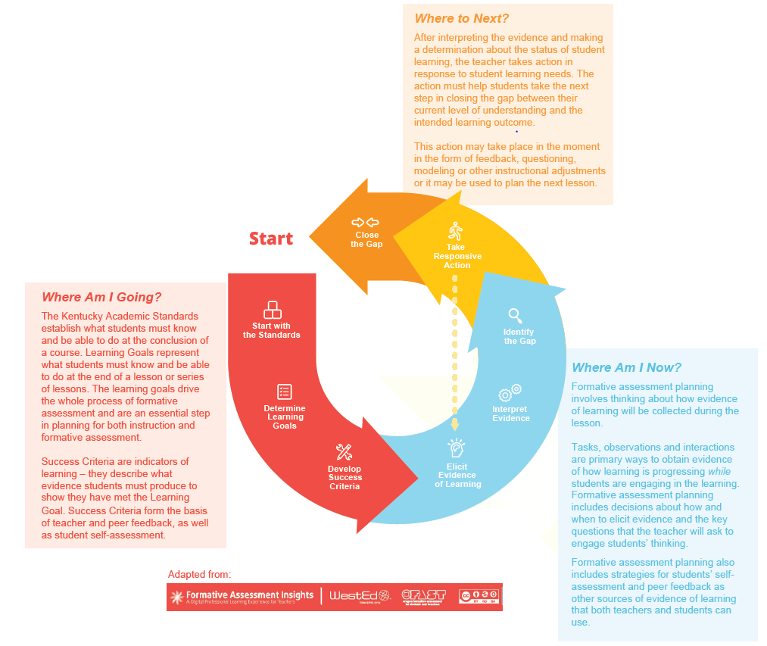
Formative Assessment Cycle

Slide 13
Stage 2: Formative Assessment
For each strategy, the guidance document includes:
Importance of the strategy
Tips and insights for implementing the strategy
Considerations

Slide 14
Stage 2: Formative Assessment
Coming up next:
Video 2: Closer Look at Strategies 1& 2
Clarifying and sharing learning goals and success criteria
Eliciting evidence of student understanding
Questions:
Please send questions to standards@education.ky.gov

