Slide 1
Preparing for Academic Re-entry
Stage 2: Formative Assessment

Slide 2
Academic Re-entry Stage 2
Purpose of Stage 2 is to:
Define formative assessment and explain the benefits for students and teachers
Describe four key strategies that support the formative assessment process
Identify instructional approaches for taking responsive action to address the needs of all learners

Slide 3
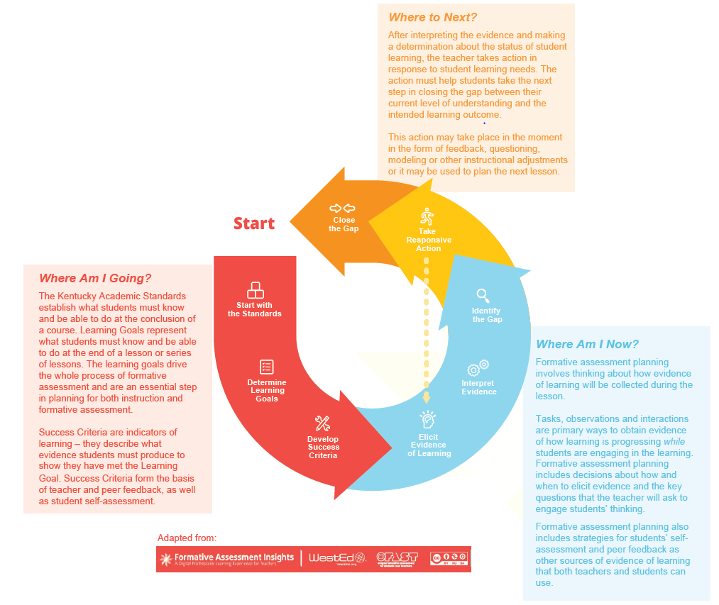
Formative Assessment Cycle

Slide 4
Stage 2: Formative Assessment
Four key strategies:
Clarifying and sharing learning goals and success criteria
Eliciting evidence of student understanding
Providing feedback that moves learning forward
Using peer- and self-assessment to develop student ownership

Slide 5
Identify the Gap

Slide 6
Stage 2: Formative Assessment
Strategy 3: Providing feedback that moves learning forward
Provides students with information they need to understand where they are in their learning and what to do next
Increases student motivation
Students feel they have more control over their own learning when they understand what to do and why they are doing it

Slide 7
Stage 2: Formative Assessment
Strategy 3: Providing feedback that moves learning forward
Teachers should provide feedback that:
Relates student work to the learning goals and success criteria
Students can use to take next steps
Supports students in managing their own learning

Slide 8
Stage 2: Formative Assessment
Strategy 3 considerations:
How will you ensure that your feedback is linked to the learning goal and success criteria?
How will you provide feedback in a timely manner that allows students to take action and apply the feedback?
Text annotations: Notes or comments added digitally to written assignments
Audio or video file: Could be provided to individual students or to small groups of students requiring the same type of feedback
Rubrics: Online scoring guides aligned to the success criteria to evaluate students’ work

Slide 9
Stage 2: Formative Assessment
Strategy 3 considerations:
How will you intentionally build in time for students to respond to and apply feedback to their learning?
How will you structure opportunities to have uninterrupted time with individuals or groups of individuals to provide feedback?
In the virtual setting, how will you structure time and opportunity to meet with individuals or small groups to provide feedback?

Slide 10
Stage 2: Formative Assessment
Strategy 4: Using peer- and self-assessment to develop student ownership
Helps students monitor, direct and regulate their own actions as they progress toward the learning goals
Peer assessment helps students to gain increased clarity on the learning goals and success criteria
Self-assessment allows the students to apply their understanding in the learning goals and success criteria to their own work
Requires a classroom culture characterized by supportive, collaborative relationships to develop trust

Slide 11
Stage 2: Formative Assessment
Strategy 4: Using peer- and self-assessment to develop student ownership
Ideas for supporting peer feedback
Model providing feedback
Use feedback prompts and protocols
Analyze strong and weak feedback

Slide 12
Stage 2: Formative Assessment
Strategy 4: Using peer-and self-assessment to develop student ownership
Self-assessment insights:
Teachers need to explicitly teach and model self-assessment
Students need to apply all three questions from the feedback loop to their own work
Where am I going?
Where am I now?
Where to next?
Key practice in helping students become independent and self-regulated learners

Slide 13
Stage 2: Formative Assessment
Strategy 4 considerations:
How will you build a classroom community, in both face-to-face and virtual settings, that supports peer- and-self assessment? What classroom norms, routines and procedures are needed to build trust and a supportive environment?
How will you provide opportunities for peer assessment?
Ideas for virtual setting:
Collaborative documents such as Google Docs or OneDrive
Group discussion using videoconferencing or a forum with screen-sharing capabilities

Slide 14
Stage 2: Formative Assessment
Strategy 4 considerations:
How will you build in opportunities for students to self-assess and reflect on the learning goals and success criteria?
Possible ideas for virtual setting:
Format the success criteria into a tool students can use as they do their lesson or assignment. Possible examples include a simple bulleted list, a checklist or a rubric.
Include one or more self-assessment loops in the assignment directions where students review their work using the tool and make adjustments to their work.
Include a “mid-point reflection” in a document-based lesson or assignment or include one or more pause points in a video or slide-based lesson or assignment.

Slide 15
Take Responsive Action

Slide 16
Stage 2: Formative Assessment
Taking responsive action
After interpreting the evidence and determining the status of student learning, teachers need to take some action in response to students’ immediate learning needs. Based on the evidence the teacher may:
Take action in the moment
Use the information in planning the next lesson
Determine that student learning is on track and continue with the lesson as planned

Slide 17
Stage 2: Formative Assessment
Possible instructional adjustments include:
Modeling
Prompting
Questioning
Giving Feedback
Telling
Explaining
Directing

Slide 18
Take Responsive Action

Slide 19
Questions? Please send questions to standards@education.ky.gov

