Slide 1
March Leadership Meetings
Creating Instructional Coherence

Slide 2
KDE Facilitators
Micki Ray
Chief Academic Officer, Office of Teaching and Learning
Chrystal Rowland
Director, Division of Program Standards
Fox DeMoisey & Misty Higgins
Professional Learning Coordinators
Jan Sellers
MTSS Coordinator
Thomas Clouse
Education Academic Program Manager

Slide 3
Accessing Materials & Housekeeping
All materials are available in the Google folder shared via email and will be posted in the chat for quick access
Have a printed copy of the participant handout to use throughout the session
Microphones and Camera

Slide 4
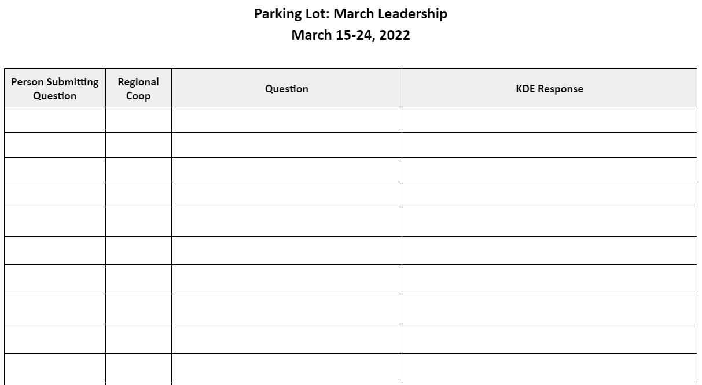
Questions
Post questions in the chat
Post questions in the Google doc “Parking Lot” located in the Google folder
Ask questions during whole group share-outs

Slide 5
The Need for Instructional Coherence
Research shows that schools that are able to demonstrate increased instructional coherence show marked improvements in student performance.
Efforts towards instructional improvement require the intentional coordination of supports, strategies, and initiatives across the system.
*Newman, et al., 2001; Oxley, 2008; Fullan & Quinn, 2016; Cobb, et al., 2018

Slide 6
The Need for Instructional Coherence
Newman, Smith, Allensworth and Bryk (2001) define instructional coherence as:
“A set of interrelated programs for students and staff guided by a common framework for curriculum, instruction, assessment and learning climate and pursued over a sustained period.”

Slide 7
The Need for Instructional Coherence
Three Key Conditions:
Common Instructional Framework
Guides curriculum, teaching, assessment and learning climate
Combines specific expectations for student learning with specific strategies and resources to guide teaching and assessment
Supportive Staff Working Conditions
Expectation that all leaders and teachers implement the framework
Professional learning focused on supporting implementation of the common framework
Allocation of Resources
Advances the school/district’s common framework
Helps avoid fragmented improvement efforts

Slide 8
The Need for Instructional Coherence
Research shows that strengthening instructional coherence results in:
Increased teacher effectiveness both in content knowledge and pedagogy
Increased student engagement and learning leading to overall improvement in student outcomes
*Newman, et al., 2001; Oxley, 2008; Fullan & Quinn, 2016; Cobb, et al., 2018

Slide 9
Today’s Agenda
Learning Goal: We are learning about resources to help create instructional clarity and coherence at the local level.
Section 1: MTSS Implementation Guide
Section 2: Curriculum Development Process
Section 3: Evidence-Based Instructional Practices
Standards Timeline Update

Slide 10
Form Teams
Determine # 1, 2, 3, & 4 using alphabetical order of your first name

Slide 11
Form Teams
Sam | Melissa
Angie | David
# 1 - Angie
# 2 - David
# 3 - Melissa
# 4 - Sam

Slide 12
Round Robin
Determine # 1, 2, 3, & 4 using alphabetical order of your first name
Record your number on participant handout
Single RoundRobin
Name
Role/Location
What is one success you have experienced this school year?

Slide 13
Today’s Agenda
Learning Goal: We are learning about resources to help create instructional clarity and coherence at the local level.
Section 1: MTSS Implementation Guide
Section 2: Curriculum Development Process
Section 3: Evidence-Based Instructional Practices
Standards Timeline Update

Slide 14
Today’s Purpose
Learning Goal: We are learning about resources to help create instructional clarity and coherence at the local level.
Success Criteria:
Examine key implementation features of collaborative problem-solving teams that support alignment and coherence within an integrated MTSS.
Access resources to support implementation, improvement and sustainability of an integrated MTSS.

Slide 15
The Need for Instructional Coherence
Efforts towards instructional improvement require the intentional coordination of supports, strategies, and initiatives across the system.
*Newman, et al., 2001; Oxley, 2008; Fullan & Quinn, 2016; Cobb, et al., 2018

Slide 16
Creating Coherence Through KyMTSS
Promotes coherence and alignment across multiple systems and initiatives so our efforts are not happening in isolation.
Creates a structure for the delivery of high quality instruction, intervention and supports.

Slide 17
Kentucky’s Definition of MTSS
A multi-level prevention system to support student achievement and social-emotional behavioral competencies through an integration of differentiated core instruction, assessment and intervention.

Slide 18
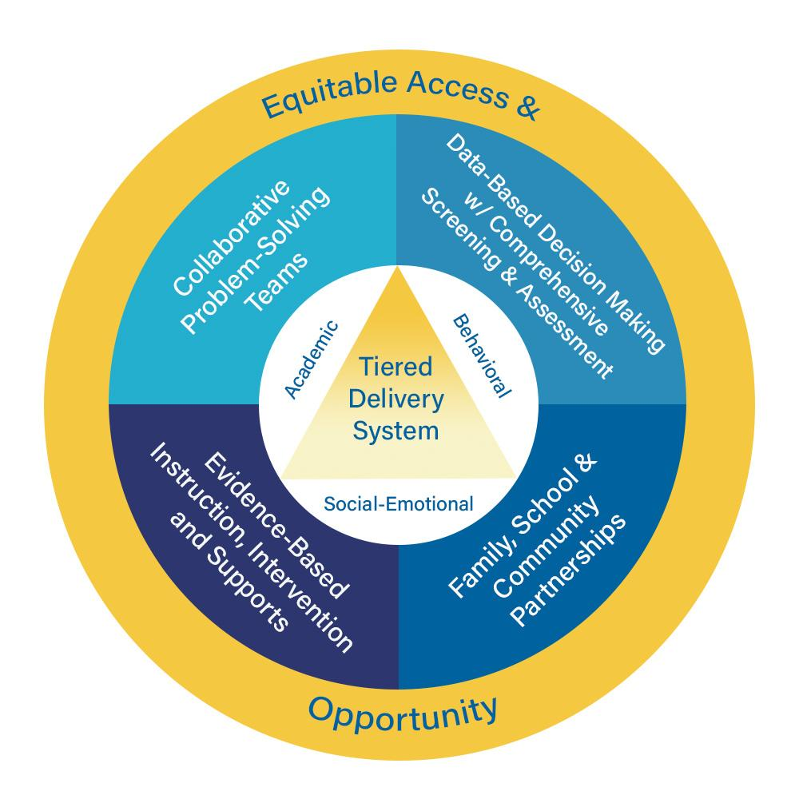
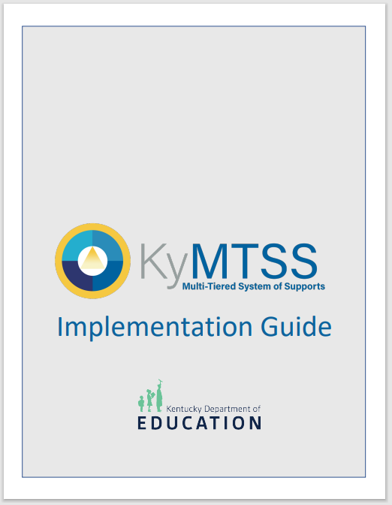
Creating Coherence Through KyMTSS

Slide 19
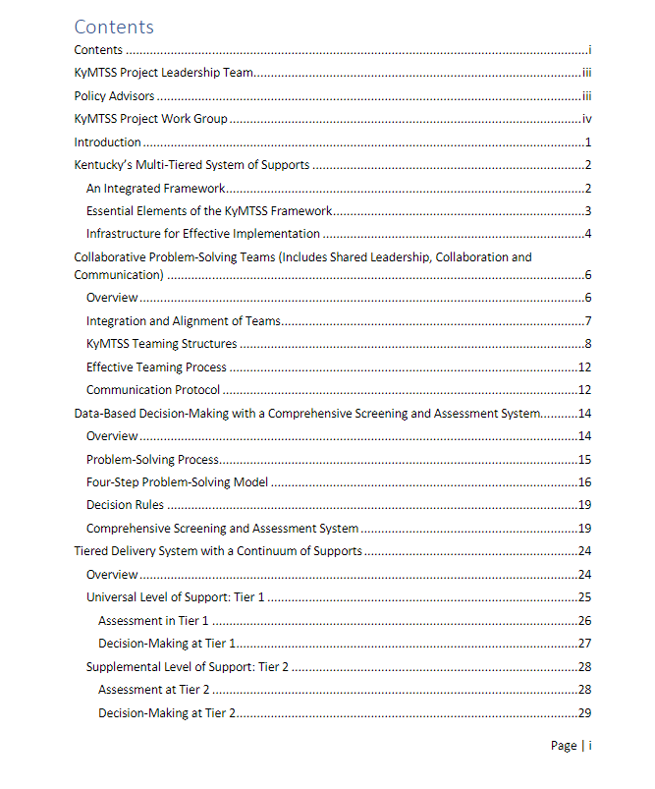
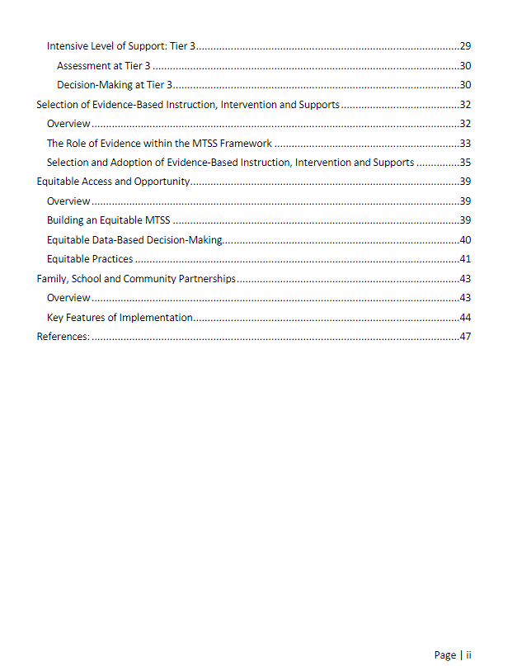
KyMTSS Implementation Guide

Slide 20
Today’s Purpose
Learning Goal: We are learning about resources to help create instructional clarity and coherence at the local level.
Success Criteria:
Examine key implementation features of collaborative problem-solving teams that support alignment and coherence within an integrated MTSS.
Access resources to support implementation, improvement and sustainability of an integrated MTSS.

Slide 21
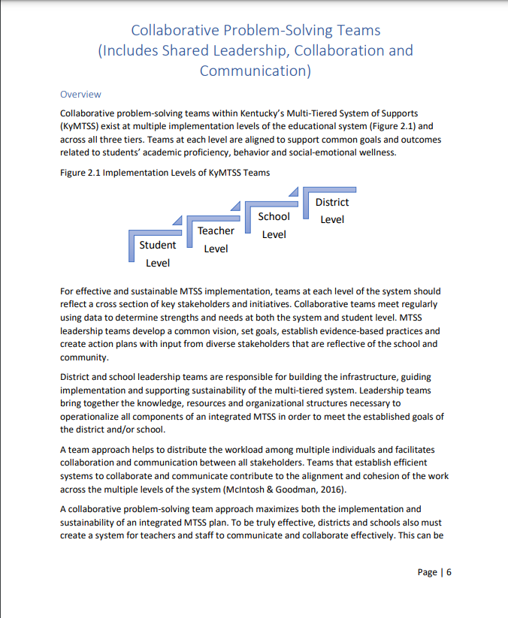
Collaborative Problem-Solving Teams
KyMTSS Implementation Guide
Contents:
Overview
Integration and Alignment of Teams
Common Teaming Structures
Effective Teaming Strategies
Communication Protocol

Slide 22
Collaborative Problem-Solving Teams
Includes shared leadership, collaboration and communication.
Teams exist at multiple implementation levels and tiers.
Teams are aligned to support common goals and outcomes.
Membership is representative of stakeholders and initiatives.

Slide 23
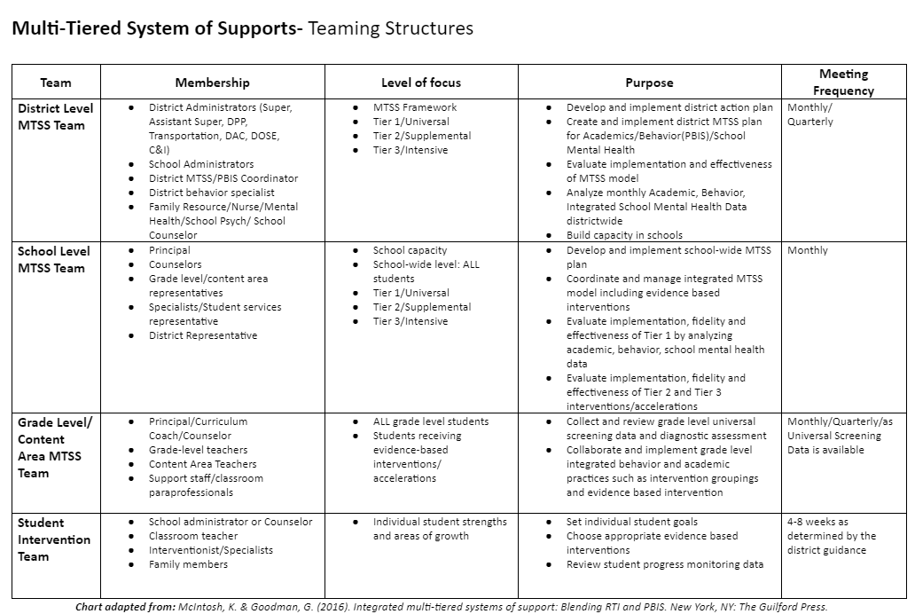
Teaming Structures

Slide 24
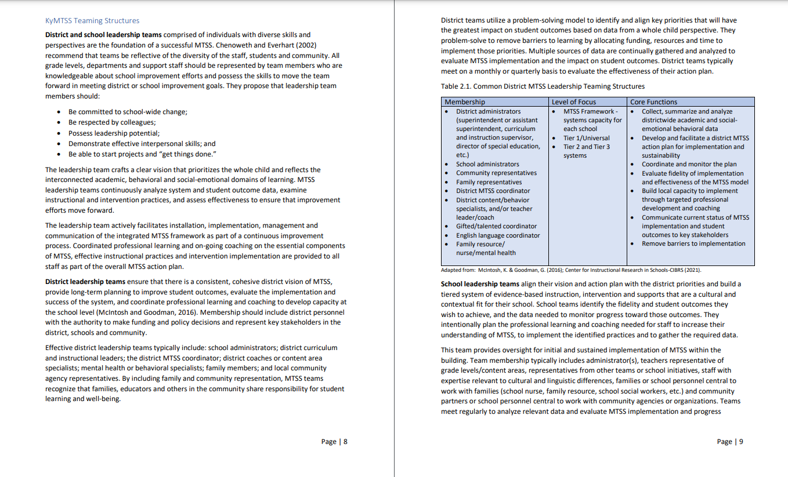
Collaborative Problem-Solving Teams
Success Criteria: Examine key implementation features of collaborative problem-solving teams that support alignment and coherence within an integrated MTSS.
Independent read: Pp. 8-10
District Leadership team
School Leadership team

Slide 25
Collaborative Problem-Solving Teams
As you read about district and school leadership teams:
Examine key implementation features of effective MTSS leadership teams.
Compare these features to your existing teaming structures.
What is in place?
What might need to be expanded or added?

Slide 26
What is one implementation feature your school/district currently has in place and one possible refinement or addition you would like to make?

Slide 27
Collaborative Problem-Solving Teams: Breakout Rooms
1st - Timed Round Robin (3 minutes)
Each person will have 45 seconds to share:
One implementation feature that is currently in place.
One possible refinement/addition.
2nd - Team Discussion (4-5 minutes)
Add ideas, ask clarifying questions and discuss possible next steps you might take

Slide 28
Collaborative Problem-Solving Teams: Whole Group Share Out
What thoughts, ideas and/or questions do you have regarding the makeup, level of focus or core functions of the MTSS leadership teams?

Slide 29
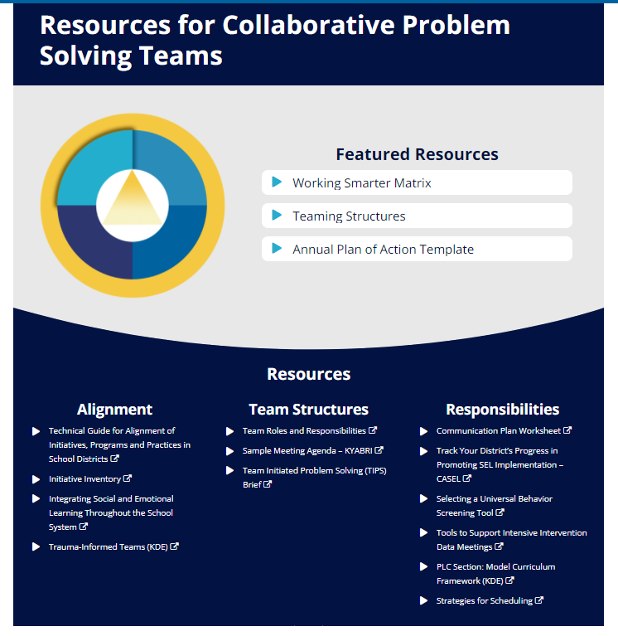
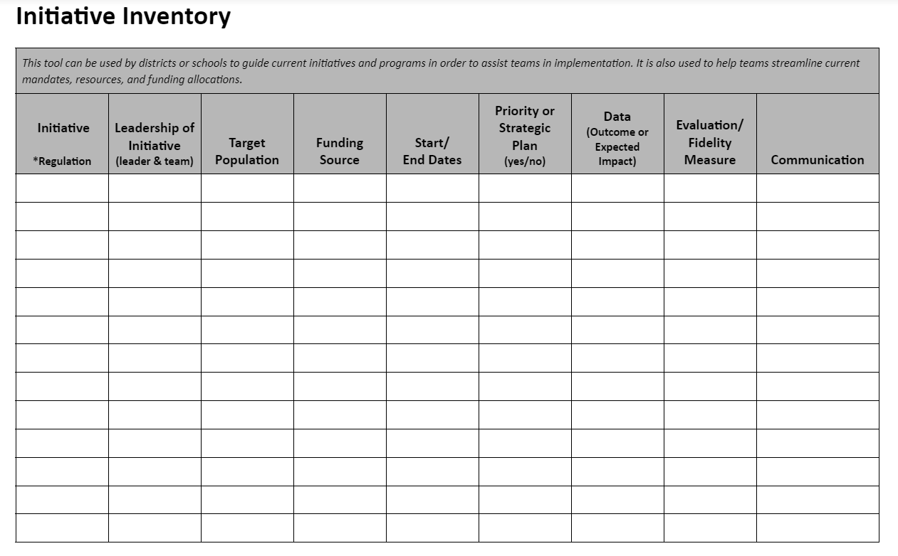
Resources for Collaborative Problem Solving Teams

Slide 30
Today’s Purpose
Learning Goal: We are learning about resources to help create instructional clarity and coherence at the local level.
Success Criteria:
Examine key implementation features of collaborative problem-solving teams that support alignment and coherence within an integrated MTSS.
Access resources to support implementation, improvement and sustainability of an integrated MTSS.

Slide 31
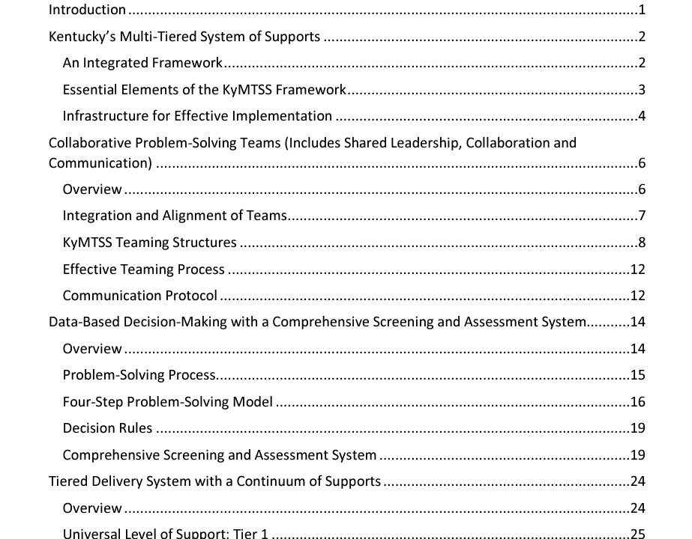
Exploration: KyMTSS Implementation Guide

Slide 32
Explore Resources: Independent
Success criterion: Access resources to support implementation, improvement and sustainability of an integrated MTSS.
As you explore:
What do you notice?
What questions do you have that need further exploration?

Slide 33
Explore Resources: BreakOut Rooms
Team Discussion (5 minutes):
Share something that resonated with you from the section you explored.
What is something you would like to explore further?

Slide 34
Explore Resources: Whole Group Share Out
What thoughts, ideas and/or questions do you have around the resources to support implementation, improvement and sustainability of an integrated MTSS?

Slide 35
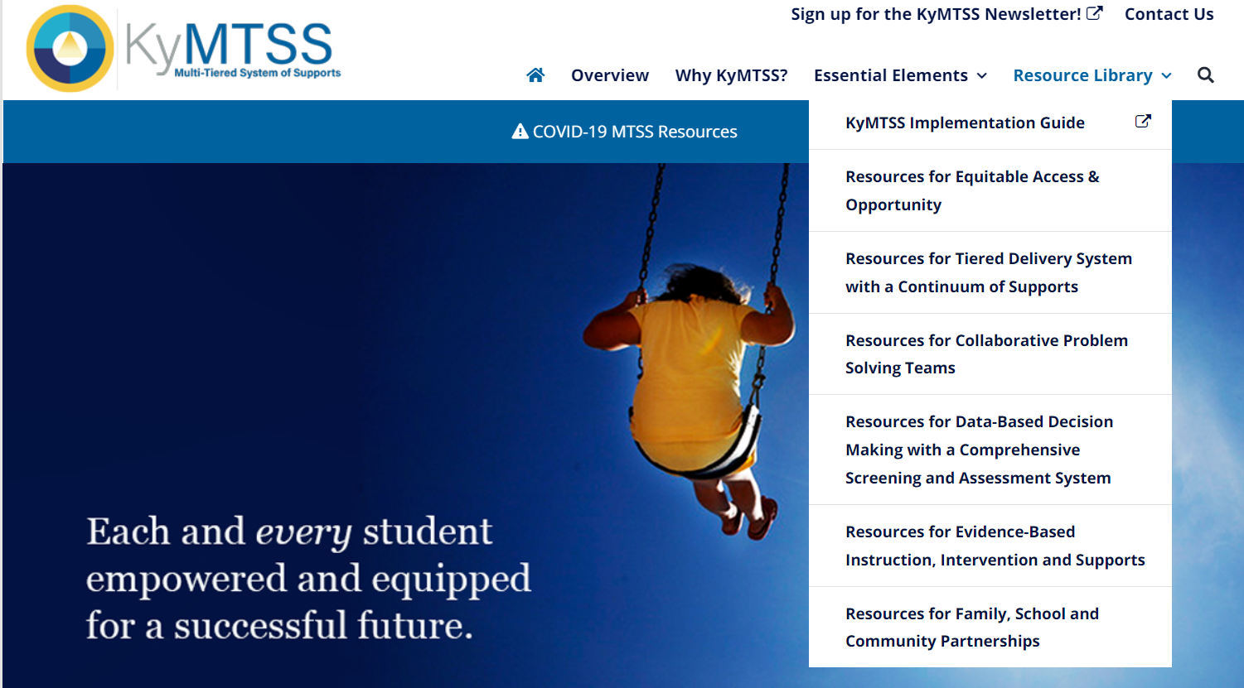
KyMTSS.org

Slide 36
Section 1 Reflection
Based on your learning around key implementation features of an integrated MTSS:
What is most important for you to remember?
What resources might you want to further explore?
What might be some possible next steps for using this learning to help strengthen instructional coherence back in your school/district ?

Slide 37
Today’s Agenda
Learning Goal: We are learning about resources to help create instructional clarity and coherence at the local level.
Section 1: KyMTSS Implementation Guide
Section 2: Curriculum Development Process
Section 3: Evidence-Based Instructional Practices
Standards Timeline Update

Slide 38
Today’s Purpose
Learning Goal: We are learning about resources to help create instructional clarity and coherence at the local level.
Success Criteria:
Examine the process for evaluating and selecting High-Quality Instructional Resources (HQIRs) within the Curriculum Development Process.
Access resources to support local implementation of the Curriculum Development Process.

Slide 39
Creating Curricular Coherence
One component of instructional coherence critical to improving student outcomes is curricular coherence.
Focuses on alignment of standards, curriculum, instructional resources, assessment, and instructional practices within and across grade levels

Slide 40
Three Lenses for Creating an Articulated Program Philosophy
FOCUS:
Articulated Philosophy
LENS 1:
Alignment to Kentucky Academic Standards
LENS 3:
Needs of Our Community
LENS 2:
Alignment to Current Research

Slide 41
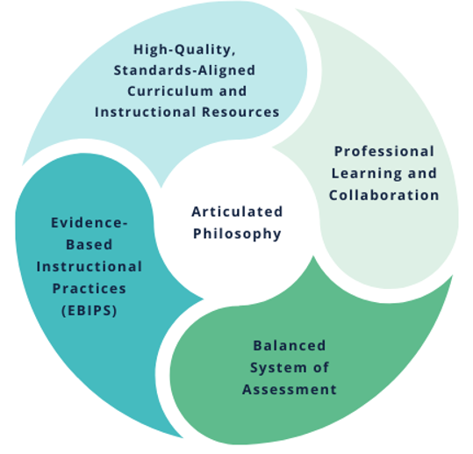
Curricular Coherence
Key Components of Curricular Coherence

Slide 42
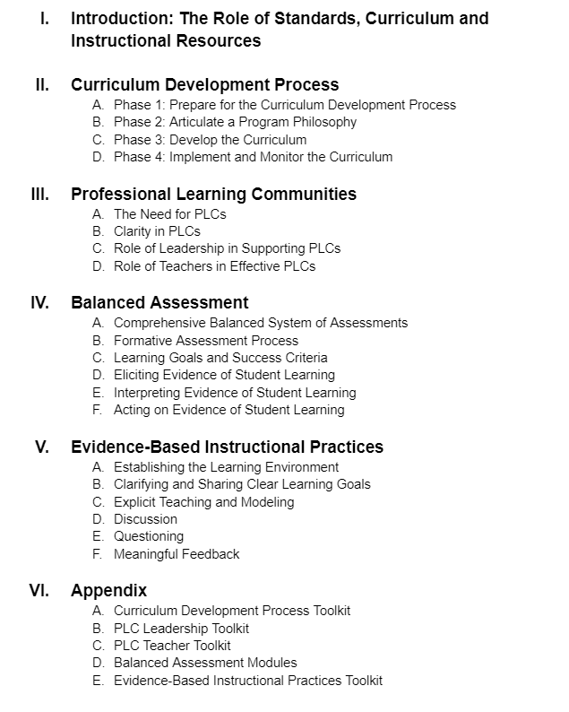
Model Curriculum Framework
Model Curriculum Framework

Slide 43
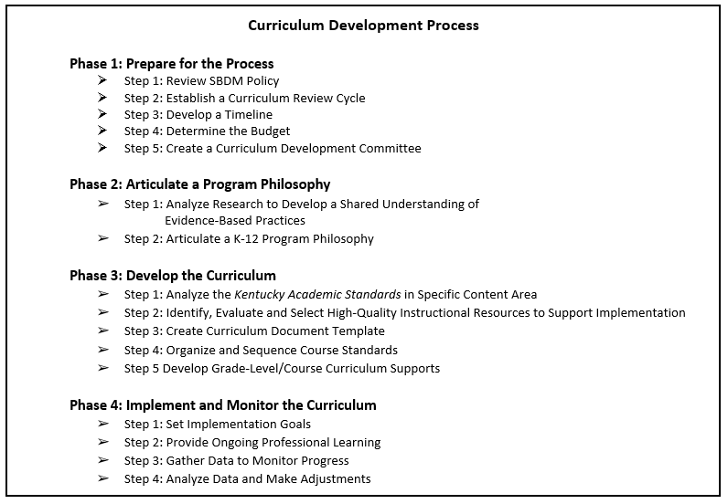
Curriculum Development Process

Slide 44
Today’s Purpose
Learning Goal: We are learning about resources to help create instructional clarity and coherence at the local level.
Success Criteria:
Examine the process for evaluating and selecting High-Quality Instructional Resources (HQIRs) within the Curriculum Development Process.
Access resources to support local implementation of the Curriculum Development Process.

Slide 45
CDP Revisions
Success criterion: Examine the process for evaluating and selecting High-Quality Instructional Resources (HQIRs).
As you read Phase 3, Step 2, focus on the following information:
Elements that are already a part of your local selection process
Elements that might need to be refined or added to your local selection process

Slide 46
What is one element you are doing well and one element you would like to refine/add to your local selection process?

Slide 47
CDP Revisions: Breakout Rooms
1st - Timed RoundRobin (3 min.)
Each person will have 45 seconds to share:
One element you are doing well
One possible refinement/addition
2nd - Team Discussion (4-5 min.)
Add ideas, ask clarifying questions and discuss possible next steps you might take

Slide 48
CDP Revisions: Whole Group Share Out
Success criterion: Examine the process for evaluating and selecting High-Quality Instructional Resources (HQIRs).
What thoughts, ideas and/or questions do you have regarding the process for evaluating and selecting HQIRs?

Slide 49
Today’s Purpose
Learning Goal: We are learning about resources to help create instructional clarity and coherence at the local level.
Success Criteria:
Describe the process for evaluating and selecting High-Quality Instructional Resources (HQIRs).
Access resources to support local implementation of the Curriculum Development Process.

Slide 50
Appendix A

Slide 51
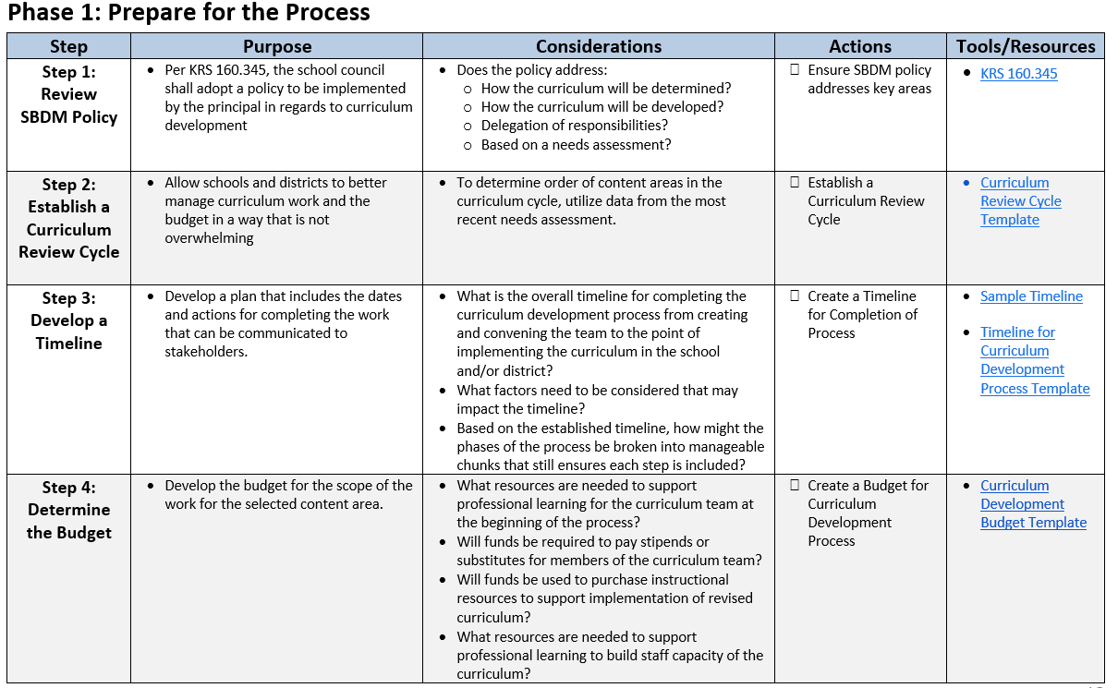
Phase 1: Prepare for the Process

Slide 52
Curriculum Development Process

Slide 53
CDP Toolkit Jigsaw
Success criterion: Access resources to support local implementation of the Curriculum Development Process.
As you explore, focus on the following information:
Which resources are most beneficial?
What resources may still be needed?
Person # 1 - Phase 2, Step 2
Person # 2- Phase 3, Step 2
Person # 3 - Phase 4, Steps 1 & 2
Person # 4- Phase 4, Steps 3 & 4

Slide 54
CDP Toolkit Jigsaw: Breakout Room
Team Discussion (5 min.)
Which resources are most beneficial and why?
What resources may still be needed?

Slide 55
Explore Resources: Whole Group
Share Out
As you explored the new resources:
Which tools and resources may be most beneficial to supporting the work of each phase?
What tools and/or resources may still be needed to support the work of each phase?

Slide 56
Reading & Writing Consumer Guide
(Releasing July 2022)
Section 1: Introduction
Section 2: Characteristics of High-Quality R/W Resources
KDE’s General Characteristics
KDE’s Markers of High-Quality Reading and Writing Instructional Resources
Equity Lenses with specific “look-fors” in Reading and Writing
Section 3: Identifying, Evaluating and Selecting High-Quality R/W Instructional Resources

Slide 57
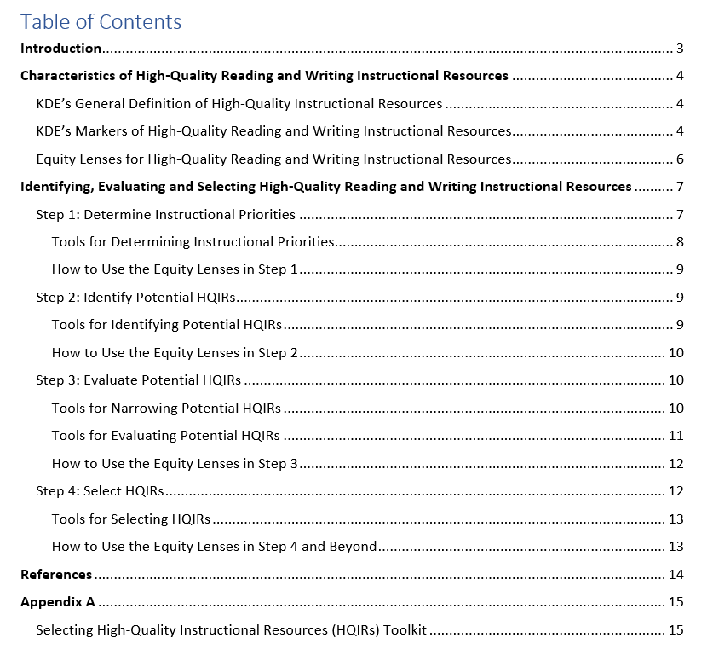
Identifying, Evaluating and Selecting High-Quality Reading and Writing Instructional Resources

Slide 58
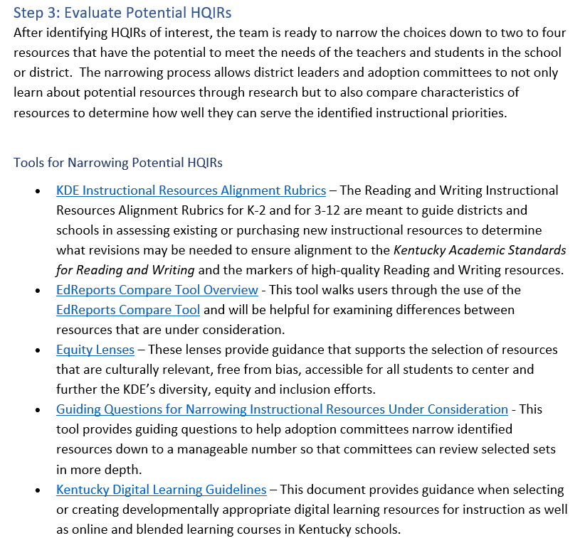
Tools for Narrowing Potential HQIRs

Slide 59
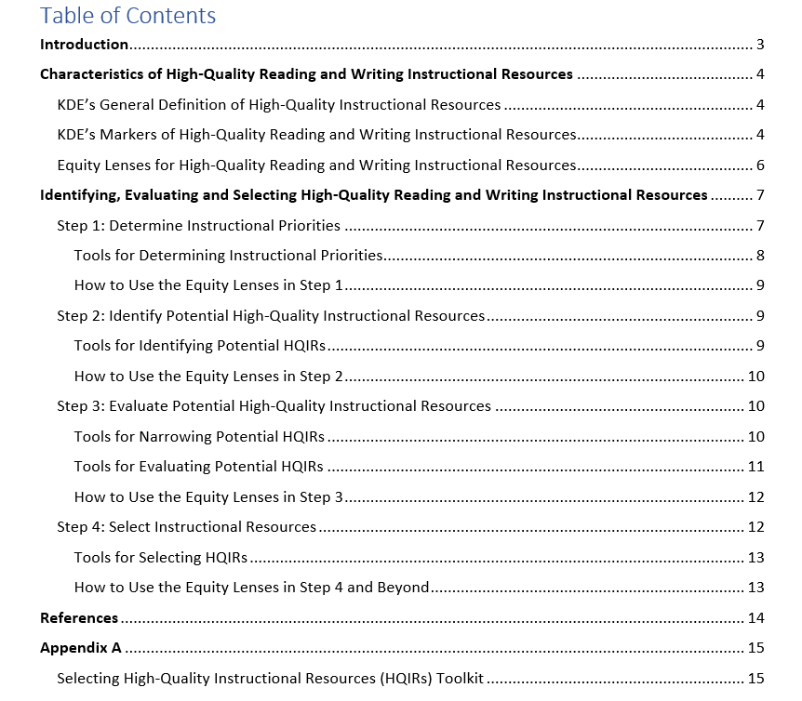
Appendix A

Slide 60
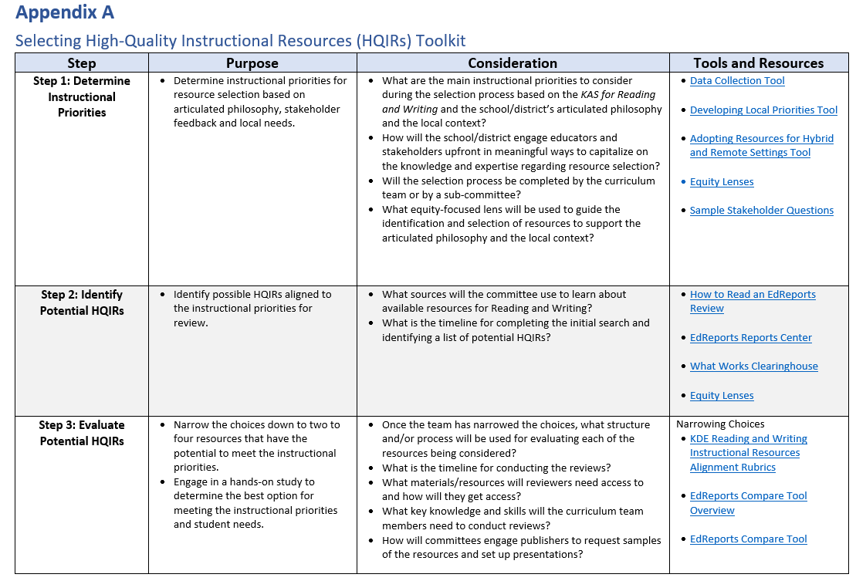
Appendix A

Slide 61
Pilot Goals
Year 1 (Jan - June 2022)
Develop an understanding of the local Curriculum Development Process (CDP)
Utilize the CDP to create a local high-quality, standards-aligned Reading and Writing curriculum supported by High-Quality Instructional Resources (HQIRs)
Year 2 (July 2022-June 2023)
Implement the local curriculum and HQIRs in pilot schools
Provide ongoing professional learning to support implementation
Post-Pilot
Scale the work in Reading and Writing to non-pilot schools and to other content areas

Slide 62
Pilot Participants
Anchorage Independent
Barbourville Independent
Carroll County
Caverna Independent
Estill County
Garrard County
Graves County
Livingston County
Perry County
Robertson County
Walton-Verona Independent
Williamstown Independent

Slide 63
Section 2 Reflection
Based on your learning about the Curriculum Development Process and the selection of instructional resources:
What is most important for you to remember?
What resources might you want to further explore?
What might be some possible next steps for using this learning to help strengthen instructional coherence back in your school/district?

Slide 64
Today’s Agenda
Learning Goal: We are learning about resources to help create instructional clarity and coherence at the local level.
Section 1: MTSS Implementation Guide
Section 2: Curriculum Development Process
Section 3: Evidence-Based Instructional Practices
Standards Timeline Update

Slide 65
Evidence-Based Instructional Practices
Model Curriculum Framework
Examining this figure (graphic) again, infer what it could show about how EBIPs relate to the MCF? What might their fit or contribution be?

Slide 66
The Need for Instructional Coherence
Research shows that strengthening instructional coherence results in:
Increased teacher effectiveness both in content knowledge and pedagogy
Increased student engagement and learning leading to overall improvement in student outcomes
*Newman, et al., 2001; Oxley, 2008; Fullan & Quinn, 2016; Cobb, et al., 2018

Slide 67
Today’s Purpose
Learning Goal: We are learning about resources to help create instructional clarity and coherence at the local level.
Success Criteria:
Explain the importance of utilizing Evidence-Based Instructional Practices (EBIPs) in supporting high-quality, standards-aligned instruction for all students.
Access resources to support implementation of EBIPs at the local level.

Slide 68
Evidenced-Based Instructional Practices (EBIPs)
Success Criterion: Explain the importance of utilizing Evidence-Based Instructional Practices (EBIPs) in supporting high-quality, standards-aligned instruction for all students.
As you read the General Introduction, annotate anything that helps:
Define Evidence-based Instructional Practices
Establish the importance of utilizing EBIPs
Six minutes. Thinking can be held on p. 4 of the participant handout.

Slide 69
Determine the three most important ideas/concepts you highlighted for explaining the importance of utilizing EBIPs.

Slide 70
EBIPs: Breakout Rooms
1st - Continuous RoundRobin
Take turns sharing without stopping until time is called (2 min.)
One idea per turn. Begin with how you might now define EBIPs, and then move to one of the three most important reasons utilizing EBIPs important.
Person three opens.
2nd - Team Discussion
Add ideas, ask questions and discuss additional take-aways from the reading (3-4 min.)
New thinking can be held on p. 4 the participant handout.

Slide 71
EBIPs: Whole Group Share Out
Success criterion: Explain the importance of utilizing Evidence-Based Instructional Practices (EBIPs) in supporting high-quality, standards-aligned instruction for all students.
What overarching thoughts, ideas and/or questions do you have regarding EBIPs and their importance as a part of student instruction?

Slide 72
Key Points from General Introduction
Three important factors to bear in mind:
The practices only have impact when what’s known is applied, the learning circumstances match the practice, and the practice is done with fidelity.
Successful implementation requires intentional planning aligned to the current stage of learning (surface, deep, transfer/GRR).
Data analysis must be used to determine a strategy’s impact.

Slide 73
Today’s Purpose
Learning Goal: We are learning about resources to help create instructional clarity and coherence at the local level.
Success Criteria:
Explain the importance of utilizing Evidence-Based Instructional Practices (EBIPs) in supporting high-quality, standards-aligned instruction for all students.
Access resources to support implementation of EBIPs at the local level.

Slide 74
Evidence-Based Instructional Practices
Establishing the Learning Environment
Clarifying and Sharing Clear Learning Goals
Explicit Teaching and Modeling
Questioning
Discussion
Meaningful Feedback
What about EBIPs embedded in HQIRS?

Slide 75
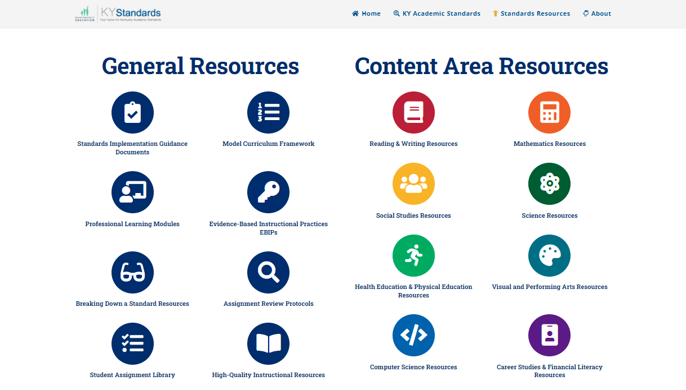
Standards Resources

Slide 76
EBIP 1: Establishing the Learning Environment

Slide 77
Explore Resources: Independent
Success criterion: Access resources to support implementation of EBIPs at the local level.
As you access resources for Evidence-Based Instructional Practices (5 min.), please focus on:
How could specific elements of these practices and resources complement instructional strengths already present at the local level?
What might these practice(s) and resource(s) reveal about instructional needs at the local level?
Thinking can be held on p. 4 of the participant handout.

Slide 78
Explore Resources: Breakout Rooms
Success criterion: Access resources to support implementation of EBIPs at the local level.
As you discuss resources for Evidence-Based Instructional Practices, please focus on:
How could specific elements of these practices and resources complement instructional strengths already present at the local level?
What might these practice(s) and resource(s) reveal about instructional needs at the local level?
Three minutes for discussion. New thinking can be held on p. 4 the participant handout.

Slide 79
Explore Resources: Whole Group Share Out
Success criterion: Access resources to support implementation of EBIPs at the local level.
How might these resources support a shift in instruction at the local level from potentially ‘knowing about ’ some of the evidence-based practices to effectively ‘implementing’ them?

Slide 80
Section 3 Reflection
Based on your learning about Evidence-Based Instructional Practices and their role in a cohesive curriculum:
What is most important for you to remember?
What resources might you want to further explore?
What might be some possible next steps for using this learning to help strengthen instructional coherence back in your school/district?
There is space on p. 5 of the participant handout to hold your thinking. (2 min.)

Slide 81
Final Reflection
Learning Goal: We are learning about resources to help create instructional clarity and coherence at the local level:
How might you characterize the potential impacts of what you have learned today on your readiness to help create greater instructional clarity and coherence in your local context?
There is space on p. 5 of the participant handout to compose and/or to hold thinking as others share.
Introduction: Instructional Coherence
Section 1: KyMTSS Implementation Guide
Section 2: Curriculum Development Process
Section 3: EBIPs

Slide 82
Today’s Agenda
Learning Goal: We are learning about resources to help create instructional clarity and coherence at the local level.
Section 1: Curriculum Development Process
Section 2: Evidence-Based Instructional Practices
Section 3: MTSS Implementation Guide
Standards Timeline Update

Slide 83
Kentucky Academic Standards (KAS) Review Timeline Update
KAS for Science and KAS for the Visual and Performing Arts

Slide 84
Review of the KAS
KRS 158.6453 calls for the Kentucky Department of Education (KDE) to implement a process for reviewing all academic standards and aligned assessments beginning in the 2017-2018 school year. The schedule calls for one or two content areas to be reviewed each year and every six years after that on a rotating basis.

Slide 85
KAS for Science
Application for Advisory Panel (AP) and Review Committee (RC) - October/November 2020
Public Comment Survey on current KAS for Science - January 2021
Initial Vision Setting - April 2021
Committee Meetings to respond to public feedback - June 2021-Present

Slide 86
KAS for Visual and Performing Arts
Public Comment Feedback Survey - Dec, 2021
Application for Advisory Panel (AP) and Review Committee (RC): February 10 -March 16
Selection of AP and RC members - April
First vision setting meeting - June

Slide 87
EILA Certificate

Slide 88
Questions
Chrystal Rowland
chrystal.rowland@education.ky.gov
Fox DeMoisey
fox.demoisey@education.ky.gov
Misty Higgins
misty.higgins@education.ky.gov
Jan Sellers
jan.sellers@education.ky.gov

