Slide 2
Assignment Review Protocols:
Exploring Assignment Review Protocols: Reading & Writing and Mathematics
Webcast
September 19, 2019
Notes:
Jackie
GoSoapbox KAS
Welcome to our 2nd installment of our 7 part series. If you missed the first webcast, you can find it archived at kystandrds.org under resources.

Slide 3
Essential Questions:
What resources are available to Kentucky educators for implementing the KY Academic Standards (KAS)?
How might schools and districts utilize these tools in their implementation plans?
Notes:
Jackie:
Resources have been our focus as we begin this series. We want to raise awareness of resources available as well as delve into some of these resources in depth. Today we will be looking at the R/W and Math assignment review protocols.
and to offer your some questions for reflection as you think or your district’s implementation plan.

Slide 4
KAS 3 Year Implementation Plan Snapshot
Year 1 - Systems/Structures to Support Standards Implementation
2019-2020
Year 2 - Balanced Assessment
2020-2021
Year 3 - Instructional Best Practice
2021-2022
Notes:
Misty
This week we started a book study (talk about how that fits into supporting standards implementation) and upcoming virtual workshop to offer practice.

Slide 5
Kystandards.org
Notes:
Misty
Connect to the last webcast about resources and the website. We want your feedback about the website as well as what other resources you need.

Slide 6
Standards Resources
Notes:
Misty
General resources which takes you to our topic today, “Assignment Review Protocols,” but you will also see another alignment tool - the Instructional Materials Alignment Rubrics. But today our focus is more narrow to just consider teacher assignments.
These tools were developed to help teachers, instructional coaches, or other educators who are involved in curriculum alignment to methodically think through the necessary elements of alignment. While we have alignment tools that can assist with overall curriculum alignment, today’s focus is going to be on the teacher assignment review protocols.
This will have the biggest impact on teachers as the mission with the protocol is to analyze what we’re doing as teachers and ensure we are creating assignments that give students the opportunity to work at grade-level.

Slide 7
Recent Research
Almost 90% of students were doing what was asked of them
71% of the time met the demands of their assignments
More than half made As and Bs
Yet, students only met benchmark on assignments 17% of the time
The Opportunity Myth, Sept. 25, 2018
Notes:
Jackie
Analysis of the student experience. What students are asked to do day-to-day and how they are performing. It’s an assignment on their grade level based on the standards.
The research went on to indicate that the reason students struggle to perform well on a benchmark assignment - based on their grade-level standards - is that they get aren’t getting regular opportunities to practice.

Slide 8
Implications
When students have regular access to
Grade-appropriate assignments
Strong instruction
Deep engagement
Teachers with high expectations
then student achievement improves significantly.
The Opportunity Myth, Sept. 25, 2018
Notes:
Jackie
What they also discovered is when schools are doing certain things well and consistently, students achieve at higher levels. Every student should have access to these 4 resources. When students have access to more of these commitments, it has a significant impact on student achievement. Out of all the research they did, this was one of the most important things they found - that students needed to have the opportunity to practice grade-appropriate, grade-level assignments on a regular basis. (Name all 4) so if I am a teacher with high expectations, I’m preparing and using assignments that are appropriate for my students’ grade level. When these things are in place...when we plan with these 4 things in mind, that’s when we see student achievement improve.

Slide 9
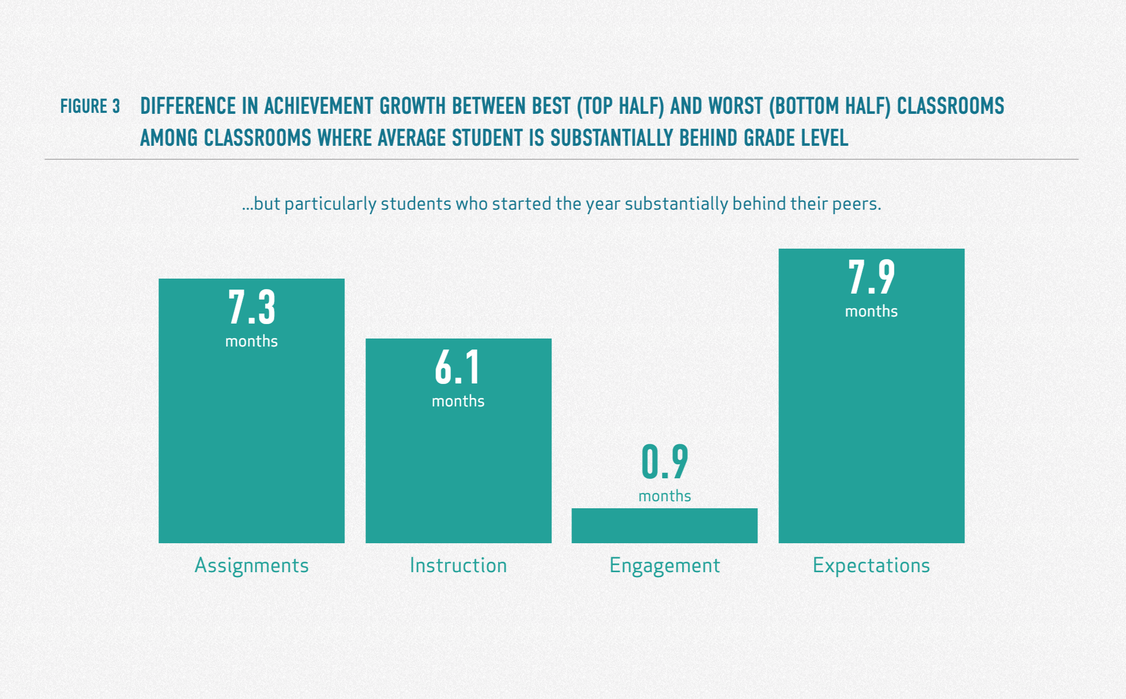
Opportunity Myth
The Opportunity Myth, Sept. 25, 2018
Notes:
Jackie
But when students are significantly behind, you can see the difference these 4 commitments make. Expectations is still leading the way, but grade-level assignments is s close second. It is crucial that we know our assignments are based on grade-level standards. I don’t see expectations straying far from assignments as I have high expectations for students, the assignments I choose or create are going to match those expectations.
So, how do we ensure we are offering these grade-appropriate opportunities? How do we know if our assignments meet this level? That’s first and foremost based on our standards and is our focus for today’s webcast.

Slide 10
Assignment Review Protocols
Notes:
Jackie begins by tying into Op Myth discussion, So how do we ensure this is happening? That’s going to take us to today’s webcast topic.
then Misty goes on into the resource.
We’re going to explore these assignment review protocols. Next Thursday in our Virtual Workshop, we are going to dig into those deeply and practice using them. We will talk more about the workshop at the end of this webcast. On KYStandards.org when we search our standards resources, we’ll find the icon for the Assignment Review Protocols here.

Slide 11
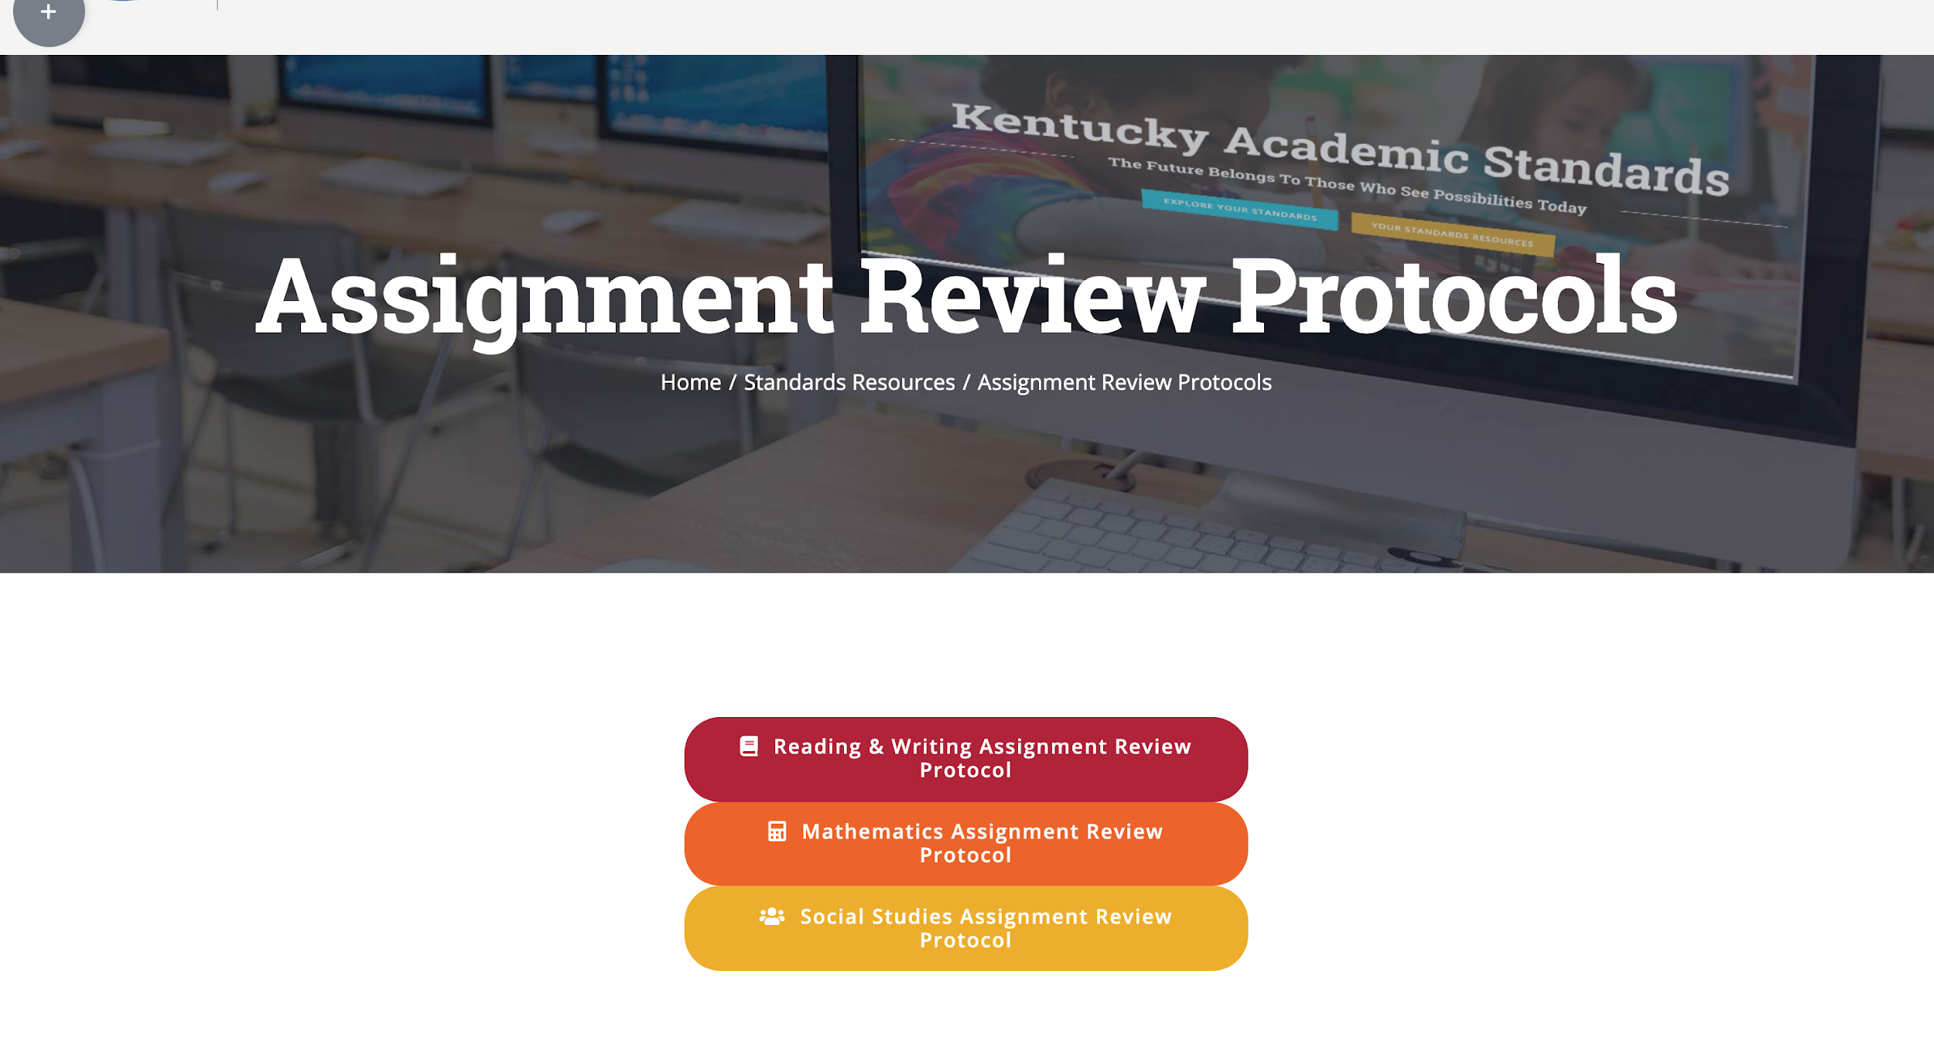
Assignment Review Protocols
Notes:
Misty
Under the Assignment Review Protocols tab are the three protocols that are available at this point. While SS has a review protocol, we aren’t going to talk about that one today or in the virtual workshop. That particular protocol will be a part of the November series whose focus is social studies.

Slide 12
Purpose of the Assignment Review Protocol
Designed to help answer the question
“Does this task give students the opportunity to meaningfully engage in worthwhile grade-level content?”
Notes:
Misty

Slide 13
Areas of Analysis
Reading and Writing and Mathematics focuses on four key areas
Content Standards
Practices
Relevance
Student Work
Notes:
Misty
We always begin with the standards. That is the basis for building assignments and discussing their alignment. You can begin to imagine how a PLC would organize a discussion around the alignment based on the categories of the protocols. The practices. Relevance: how connected the assignment is to authentic, real world context; and some analysis of student work.

Slide 14
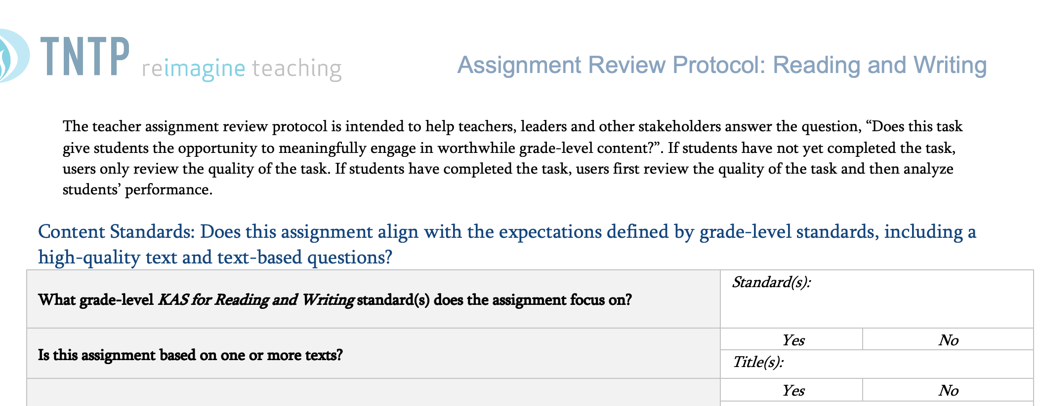
Assignment Review Protocl: R & W
Notes:
Jackie
Reading & Writing example to begin. Notice the focus question is re-emphasizing what we learned from the research about the need for grade-level content and this protocol guides us to answer that question about specific tasks.
Both of these tools begin the analysis with questions about the assignment’s connection and alignment to the standards. We know that it is the standards that keep us grounded to what we’ve learned is essential for student achievement - grade-appropriate assignments. If the standards aren’t the centerpiece of the review discussion, then we’re missing the boat on ensuring assignments stay aligned to the standards. A good example of that would be to begin by thinking of an activity you’d like to do before having a clear idea of WHY you’re doing that assignment. The standards offer the why.
While we are just previewing the tools today, in our first virtual workshop on the 26th we will look more closely at how to answer the questions raised in the protocol.

Slide 15
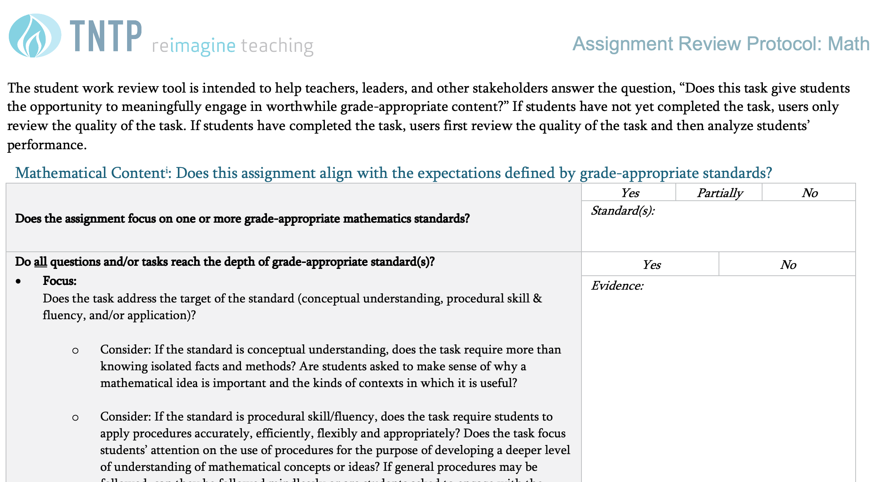
Assignment Review Protocol: Mathematics
Notes:
Jackie

Slide 16
Holistic rating examples
Reading & Writing Protocol
Holistic Rating Examples
Mathematics Protocol
Notes:
Jackie
In all of the review protocols, there is a chance to analyze then pause to determine the strength of that particular area. For instance, after reviewing the pieces of the content standards, the reviewers make a determination based solely on that area. They might decide it is weakly, partially or strongly aligned. This rating will be crucial to make decisions about how instructionally sound this assignment is.
In this case we’re looking at the overall rating for content standards. Notice what it takes to be strongly aligned.

Slide 17
Reading & Writing: Practices Analysis
Notes:
Misty
Again, a way to assist or lead the reviewers of this assignment into intentional and deeper thinking...in this instance about the ILPs.
One important part of this protocol is the help it can offer in considering next steps. The questions can be turned into actions we want to take to improve the assignment.

Slide 18
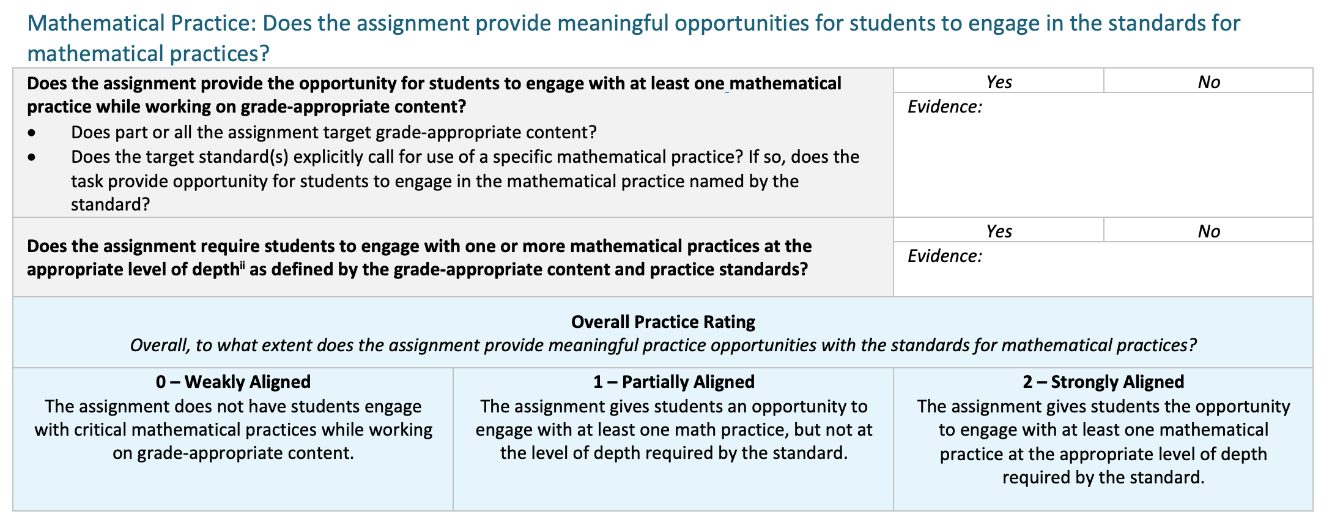
Mathematics:
Practices Analysis

Slide 19
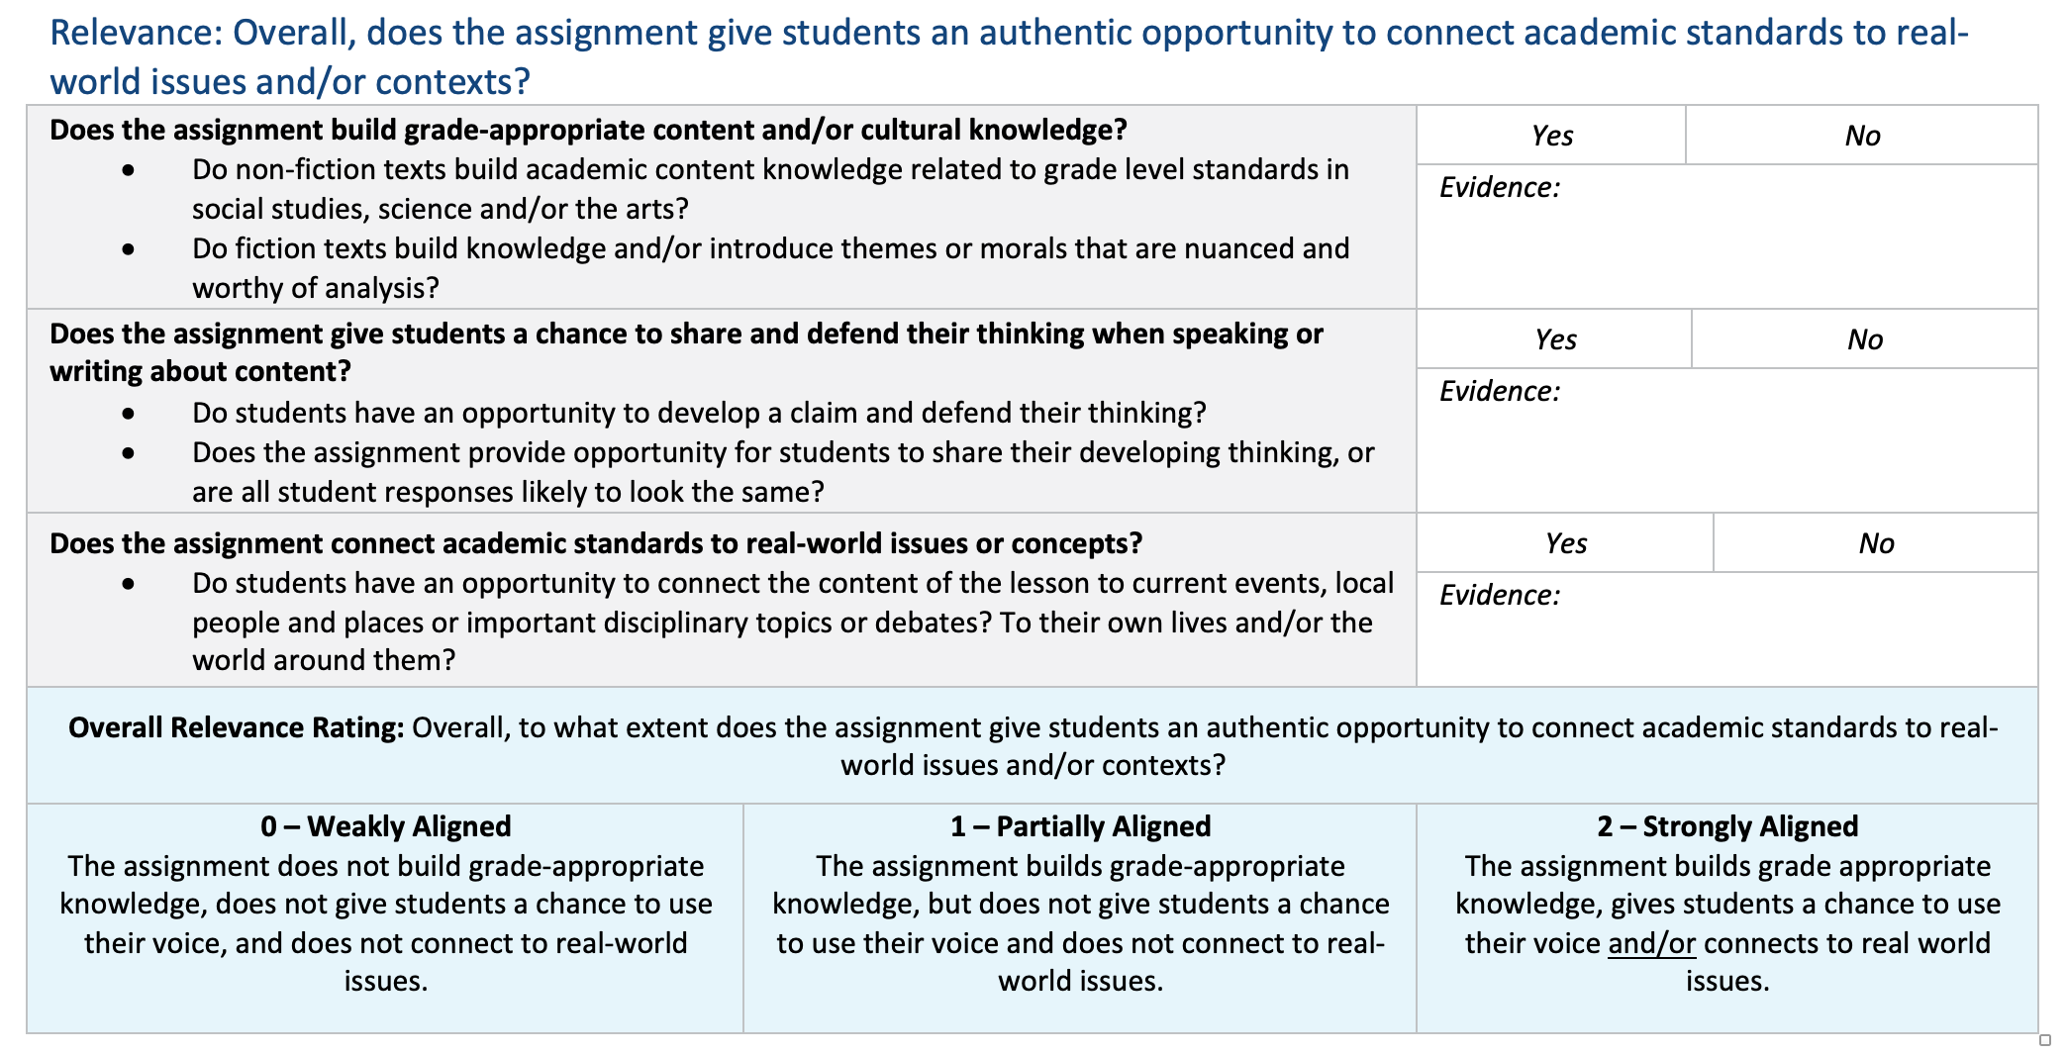
Reading & Writing:
Relevance Analysis
Notes:
Jackie

Slide 20
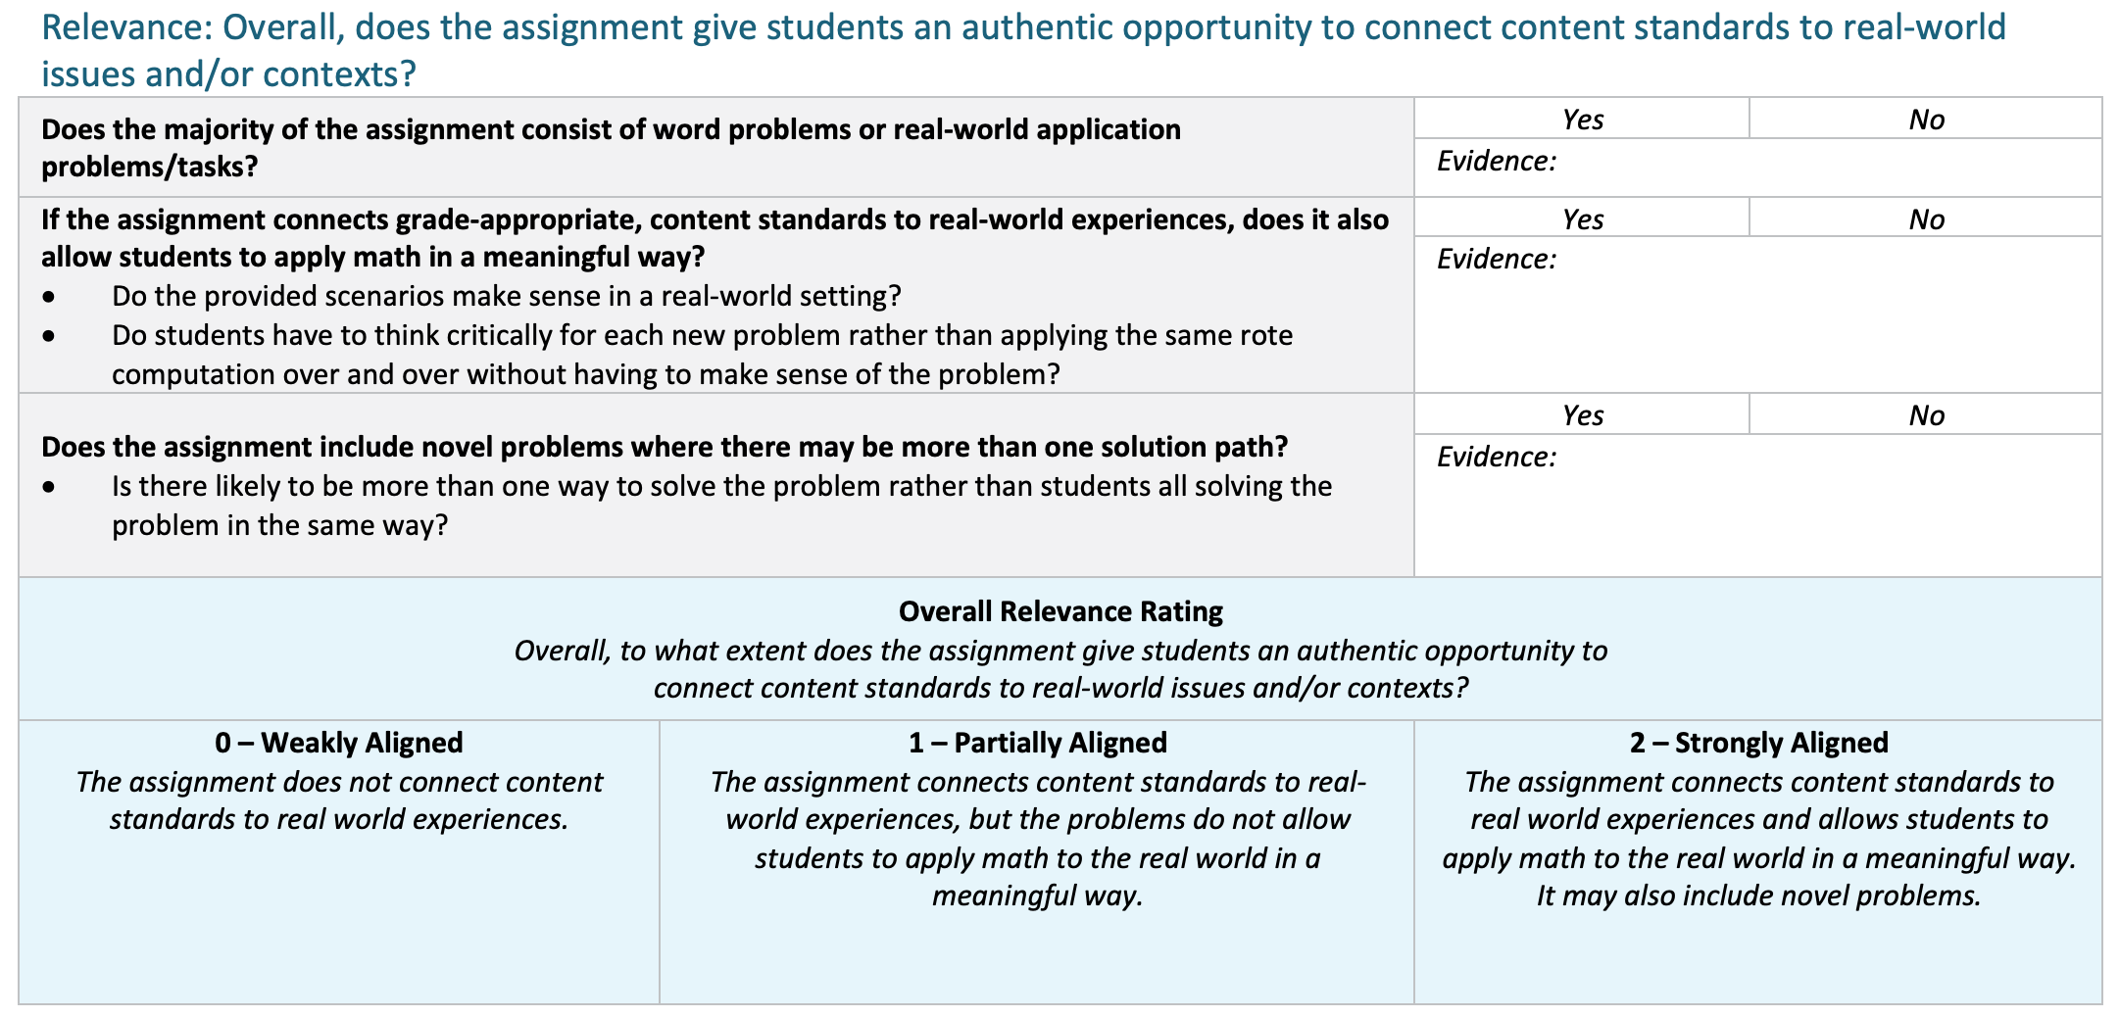
Mathematics:
Relevance Analysis
Notes:
Jackie

Slide 21
Consider Student Performance
The intent of the protocol is to analyze the assignment
Student work gives insight into the effectiveness of the assignment
Notes:
Jackie

Slide 22
Overall Rating
Consider all pieces of analysis (standards, practices, relevance, student work)
Taking all of these into consideration, how does this assignment rate?
Create an overall rating rationale serving as group consensus
Next steps? Can this task/assignment be saved? Should it be tossed? Should it be shared?
Notes:
Jackie

Slide 23
Virtual Workshop
Using Alignment Protocols for Standards Implementation
September 26
4:00 EST & 5:00 EST
Zoom
Notes:
Misty

Slide 24
PL Opportunities
Notes:
Misty
Find info about VW

Slide 25
PL Opportunities List
Notes:
Misty

Slide 26
Virtual Workshop
& 5:00 pm ET
Notes:
Misty

Slide 27
5 Things to Know Before you Go
Subscribe to www.kystandards.org
Webcasts (1st & 3rd Thursday) Virtual Workshops (4th Thursday)
Book Study
9/16/19 - 12/13/19
Clarity for Learning
Virtual Workshop: Using Alignment Tools for Standards Implementation: 9/26/19 4:00 ET & 5:00 ET
Website Feedback: https://www.surveymonkey.com/r/NWTTRCY
Notes:
Jackie

